Slide 1
Software for Embedded Systems
Prof. Saurabh Gandhi (EEE department)

Slide 2
Introduction to Embedded Systems
Administratrivia
What is an embedded system?
How do they differ from general purpose computers?
Embedded vs general purpose software
Examples from automotive, medical, industrial systems
Projects

Slide 3


Administratrivia
Evaluation
Midsemester exam: 20%
Comprehensive exam: 30%
In-class quizzes and attendance: 10%
Projects: 20%
Lab reports: 10%
Lab presentations: 10%
Reference books
Miro Samek — Practical UML Statecharts in C/C++
Douglass et al. — Real-Time Design Patterns
Elecia White — Making Embedded Systems
Jane W. S. Liu — Real-Time Systems
Course page
In-class quizzes!
Code: PS52M5

Slide 4
What is an embedded system?
Examples?
Characteristics?

Slide 5
Embedded systems vs general purpose computers
Hardware requirements?
Resource availability?
Use-case challenges?
Development cycle / tools?

Slide 6
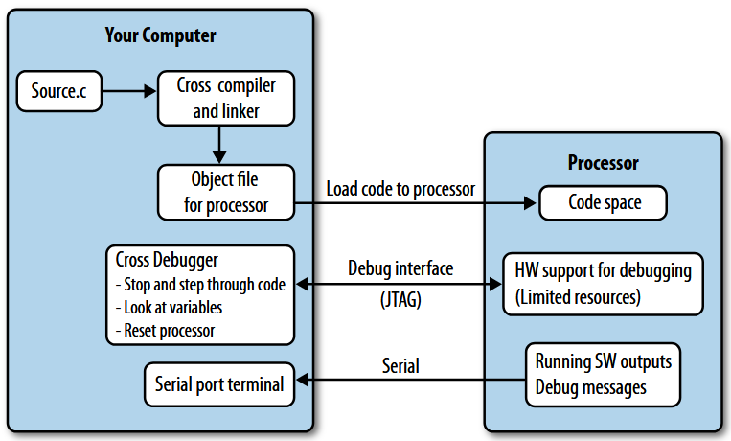
Software development for embedded systems – challenges
Making embedded systems (Fig. 1-1)

Slide 7

Projects
Teams made by instructor (3-4 students with balanced backgrounds)
Projects will be floated in first lab
Work on projects alongside classwork… directly apply what you learn
More details in first lab…
…fill out lab schedule poll (mark as many times as possible)

Slide 8
The role of software in embedded systems
Responsibilities of embedded software
Software is central to embedded systems
Embedded vs general purpose software
Software-hardware interaction
Event-driven nature of embedded systems
Embedded software safety
The need for discipline in developing embedded software

Slide 9
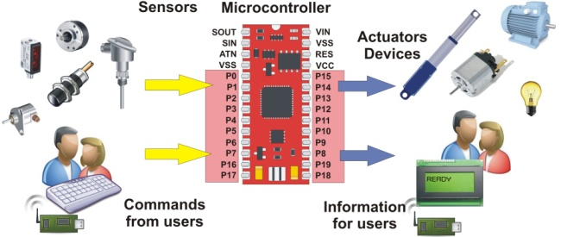
Embedded system responsibilities
Responsibilities:
Interpreting inputs from the physical world
Making control decisions
Driving actuators
Enforcing safety and constraints
Embedded system design directly affects
Safety
Reliability
Power
Timing

Slide 10
Embedded systems moving from hardware- to software-centric
Think about conventional vs contemporary
  Washing machine controller
  Refrigerator controller
  AC controller
  Automobile ECU
Complexity of function
Physical size
Upgradability? Repairability?
What else?

Slide 11
Embedded systems moving from hardware- to software-centric
Custom ASIC (Application Specific ICs) → hardware as a platform
Software as differentiator
  Same engine → software defined fuel injection → cheap vs luxury car
Development cost / time to market (vs unit costs)
Functional complexity (AI, IoT etc.)
Flexibility (changing standards)

Slide 12
Embedded systems moving from hardware- to software-centric
Early embedded systems
  Fixed hardware behavior
  Minimal software, largely for UI
Modern embedded systems
  Generic hardware
  Complex software behavior
  Updates and reconfigurability
Hardware executes, software decides
Responsibilities largely shifted to software!

Slide 13
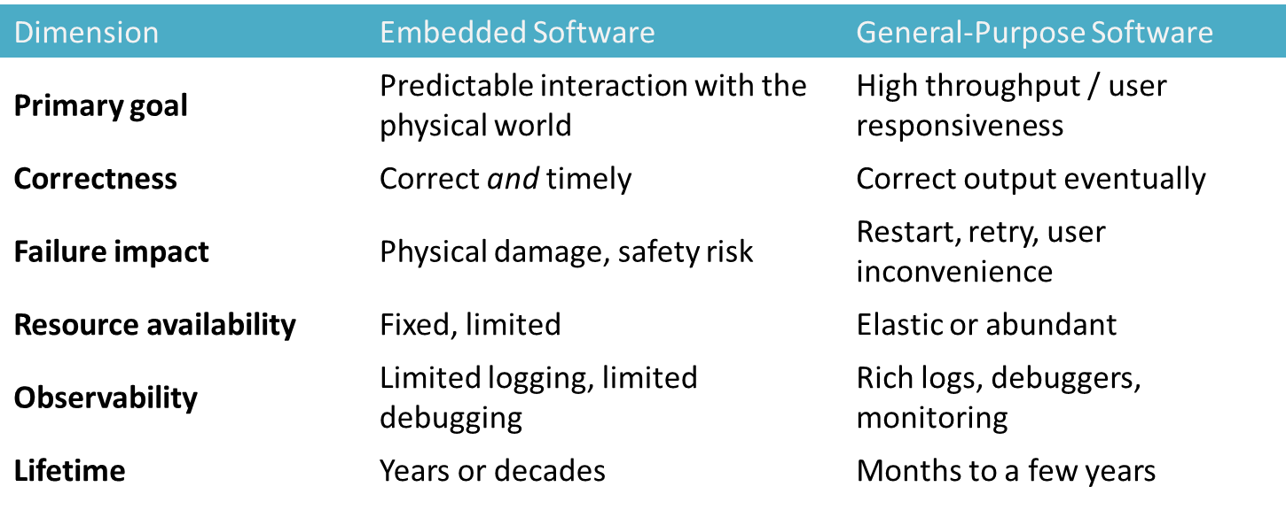
Embedded vs general-purpose software
Embedded software must be predictable, not just correct!

Slide 14
Embedded vs general-purpose software: example
Handling temperature data
General software:
  Read temperature
  Display on screen
  Delay == annoyance
Embedded software:
  Read temperature
  Control heater
  Delay == overheating, accidents etc.

Slide 15
What this means
Much more careful design
Defensive programming
Emphasis on verification
Disciplined coding and testing
Stricter requirements
Modeling
Real-time operating systems
Embedded software is not just software with limited memory!

Slide 16
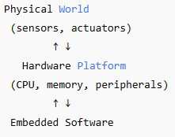
Software – hardware interaction
Embedded software is not hardware-independent!
Needs understanding of the hardware
Asynchronous external events; but software is sequential
Response to asynchronous event needs to be time-bound
Concurrency – many simultaneous event sources and actuator requirements to handle
Embedded software is primarily event-driven

Slide 17
State-dependent behavior in embedded software
Response to the same event can be different depending on the state / system context
State changes must be explicit and controlled
Hidden states can lead to bugs
Example: Button press
  Idle state → start operation
  Running state → stop operation
  Fault state → ignore / raise alarm
Behavioral modeling to cover all possibilities systematically

Slide 18
Emphasis of safety
Cannot afford software crashes (or ensure safety in spite of crashes)
Software running fine does not ensure safety
  For example, an elevator controller software might not crash, but could ignore a sensor and crush a hand!
Identify potential hazardous conditions during design
Must be designed to handle external faults (sensors failing, unexpected inputs etc.)
Prepare the system for the unexpected (safe states)!

Slide 19
Disciplined system design and coding
Ad hoc code → implicit assumptions → late discovery of faults
With discipline: predictable behavior, early detection of errors, verifiable safety
In this course
  Requirements engineering → clarity
  Modeling (UML) → behavioral reasoning
  Architecture → structure and separation
  RTOS & scheduling → timing guarantees
  Verification & testing → confidence

Slide 20
Review questions
Which of the following are characteristics of embedded systems?
What defines correctness in embedded software?
Which statement best explains why embedded software is typically event-driven?
Which distinction most clearly differentiates embedded software from general-purpose software?
An embedded system continues running without crashing, but an actuator keeps operating after a sensor failure, causing physical damage. Which statement is most accurate?

Slide 21
Lifecycle and Evolution Constraints in Embedded Software
Additional constraints specifically faced by embedded systems

Slide 22
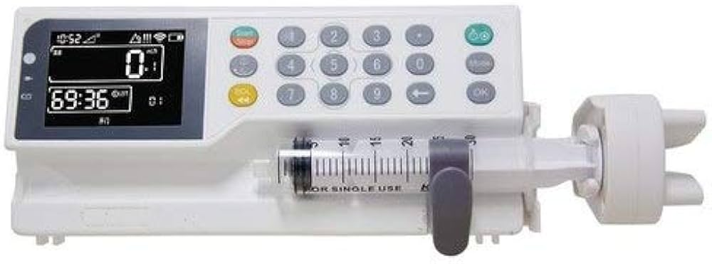
Embedded software lives long
Embedded software often outlives
  The hardware platform
  Suppliers (hardware components)
  Development teams
Typical lifetimes
  Automotive ECUs: 10 – 15 years
  Medical devices: 10 – 20 years
  Industrial controllers: few – several decades
Example: Medtronic — Medical Devices
  Medical device firmware in use for decades
  Post-market surveillance frequently triggers late updates
  Updates require full safety justification / certification
Long-term maintenance is a requirement for embedded systems
Infusion pump

Slide 23
Many things directly affecting the S/W change over these times
What kind of factors change?
  Components reach end-of-life
  Suppliers change
  Hardware revisions to reduce cost
  Regulatory requirements
Changes are inevitable and cannot be planned
But the can be planned for
How to write software that is adaptable to change?

Slide 24
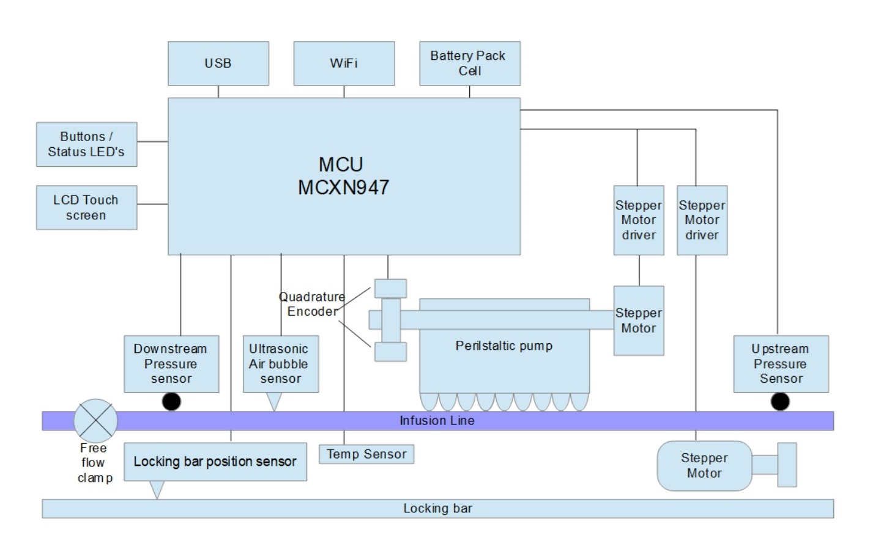
Modularity
Changes in one part should not destabilize others
  components of the system as independent as possible
Isolating change
Infusion pump example
What can change over time?
What are the different functions that can and should remain independent?
Sensor replaced →
  Should control behavior change?
  Control code?

Slide 25
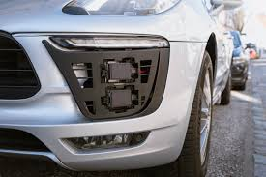
Example – radar sensors from Bosch
Several OEMs (BMW, Audi, Mercedes, VW) use it for:
  Adaptive cruise control (ACC)
  Automatic emergency braking
New sensor generation introduces
  Same function and interface
  But signal behavior was different (noise, SNR etc.)
Behavior degraded
  False positive braking
  Degraded ACC smoothness
OEMs had to retune control logic, revalidate safety via software updates, recalls etc.

Slide 26
Portability
Hardware platforms change, but software must remain equivalent
Infusion pump example: microcontroller itself reached EOL, and new MCU introduced
Why does change of MCU matter so much?
Is it simply about recompiling the code for a different platform?

Slide 27
Example
Programmable Logic Controllers (PLCs): devices used for industrial automation
Observe → Decide → Act → Repeat (1 scan)
Assumes observed variables remain fixed for duration of scan
Siemens – SIMATIC S7 PLC family
  Control executed once per scan, but scan time was never explicitly specified
  New hardware: faster CPUs, but added more complex communication protocols, logging etc.
  Scan times became variable!
  Control became unstable

Slide 28
Portability is
Not just easy of recompiling, BUT
Avoiding undocumented hardware assumptions
Making timing and resource constraints explicit

Slide 29
Configurability: one system, many variants
For example, same car sold in different markets:
  Different features
  Different safety norms
Proper understanding / mapping of configuration required for safe operation

Slide 30
Example: Therac-25 (Radiation Therapy Device)
Software controlled modes of operation: low and high energy radiation, with different dosage times etc., configured in software
Certain configuration settings were rare and not properly validated
Configuration became inconsistent across software modules, causing the timing module to think it is in low energy, and radiation module to think it is in high energy mode
Overdose led to several patient deaths
No hardware failed, no bugs, but poor software

Slide 31
Example: Volkswagen Dieselgate controversy
OEM developed two software configurations – test/diagnostic and normal
Emissions testing during certification was in test mode, within limits
Emissions in normal mode much higher!
Same software → very different behaviors
Infusion pump example: what kind of configurations can you think of?
Notes:
Adult vs pediatric
Different countries might have dosage regulations

Slide 32
Configuration as a safety concern
Feature / configuration flags scattered across code
Difficult to trace unsafe combinations
Explicitly defined and placed rules
Verifiable combinations
Safe as software evolves

Slide 33
Long term maintenance
The ability to diagnose and, crucially, fix issues after deployment
Who maintains embedded software?
  Original developers no longer involved
  Full hardware access might not be available
Infusion pump example: if a bug is discovered after 10 years of operation, can it be handled?
Code without maintainability considerations:
  Fear of making changes – it will break the system!
  Slow fixes
  Increased risk

Slide 34
Example: Mars Pathfinder
‘Priority inversion’ caused the robot to frequently restart after deployment on Mars
Remote logging, debugging and analysis designed into the software
Over-the-air updates
Successfully patched software to recover the robot on Mars

Slide 35
Constraints, not design choices
Modularity
Portability
Configurability
Maintainability
Required for proper lifecycle handling
Next class: defining requirements

Slide 36
Functional responsibilities
Needed to make the system work
Control logic
Data acquisition and processing
State-based behavior
Coordination between subsystems
What are the functional responsibilities of an elevator controller?

Slide 37
Non-functional responsibilities
Needed to make the system work well
Timing correctness
Safety, security and fault handling
Resource usage (CPU, memory, power)
Reliability over long lifetimes
What can be non-functional responsibilities of an elevator controller?

Slide 38
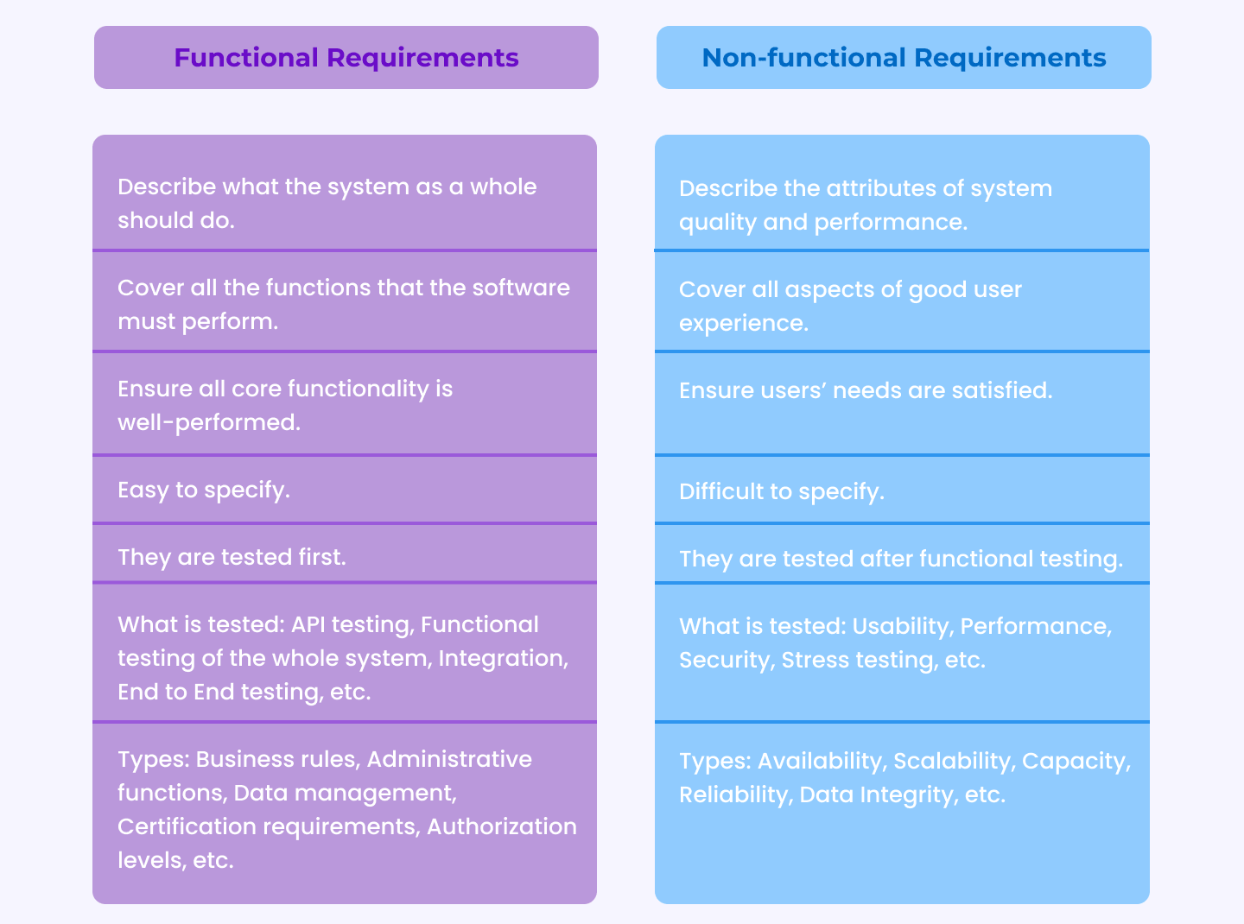
Important to understand and distinguish the two responsibilities

