Slide 1
Software for Embedded Systems
Prof. Saurabh Gandhi (EEE department)

Slide 2
Introduction to Embedded Systems
Administratrivia
What is an embedded system?
How do they differ from general purpose computers?
Embedded vs general purpose software
Examples from automotive, medical, industrial systems
Projects

Slide 3


Administratrivia
Evaluation
Midsemester exam: 20%
Comprehensive exam: 30%
In-class quizzes and attendance: 10%
Projects: 20%
Lab reports: 10%
Lab presentations: 10%
Reference books
Miro Samek — Practical UML Statecharts in C/C++
Douglass et al. — Real-Time Design Patterns
Elecia White — Making Embedded Systems
Jane W. S. Liu — Real-Time Systems
Course page
In-class quizzes!
Code: PS52M5

Slide 4
What is an embedded system?
Examples?
Characteristics?

Slide 5
Embedded systems vs general purpose computers
Hardware requirements?
Resource availability?
Use-case challenges?
Development cycle / tools?

Slide 6
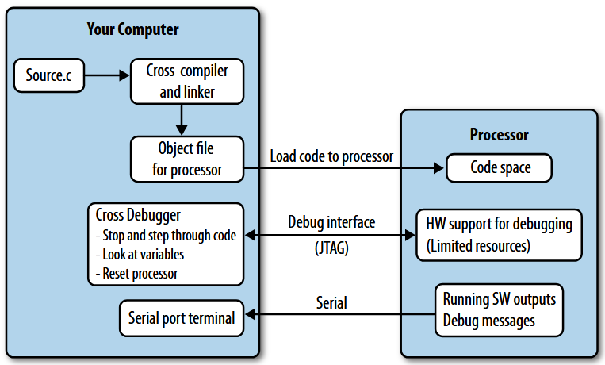
Software development for embedded systems – challenges
Making embedded systems (Fig. 1-1)

Slide 7

Projects
Teams made by instructor (3-4 students with balanced backgrounds)
Projects will be floated in first lab
Work on projects alongside classwork… directly apply what you learn
More details in first lab…
…fill out lab schedule poll (mark as many times as possible)

Slide 8
The role of software in embedded systems
Responsibilities of embedded software
Software is central to embedded systems
Embedded vs general purpose software
Software-hardware interaction
Event-driven nature of embedded systems
Embedded software safety
The need for discipline in developing embedded software

Slide 9
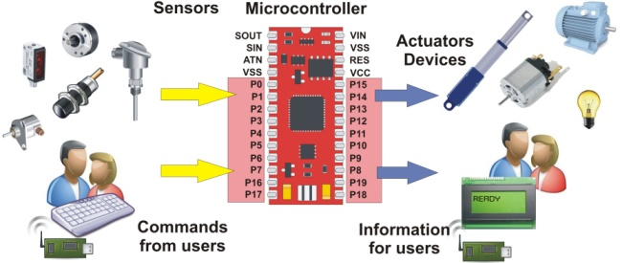
Embedded system responsibilities
Responsibilities:
Interpreting inputs from the physical world
Making control decisions
Driving actuators
Enforcing safety and constraints
Embedded system design directly affects
Safety
Reliability
Power
Timing

Slide 10
Embedded systems moving from hardware- to software-centric
Think about conventional vs contemporary
  Washing machine controller
  Refrigerator controller
  AC controller
  Automobile ECU
Complexity of function
Physical size
Upgradability? Repairability?
What else?

Slide 11
Embedded systems moving from hardware- to software-centric
Custom ASIC (Application Specific ICs) → hardware as a platform
Software as differentiator
  Same engine → software defined fuel injection → cheap vs luxury car
Development cost / time to market (vs unit costs)
Functional complexity (AI, IoT etc.)
Flexibility (changing standards)

Slide 12
Embedded systems moving from hardware- to software-centric
Early embedded systems
  Fixed hardware behavior
  Minimal software, largely for UI
Modern embedded systems
  Generic hardware
  Complex software behavior
  Updates and reconfigurability
Hardware executes, software decides
Responsibilities largely shifted to software!

Slide 13
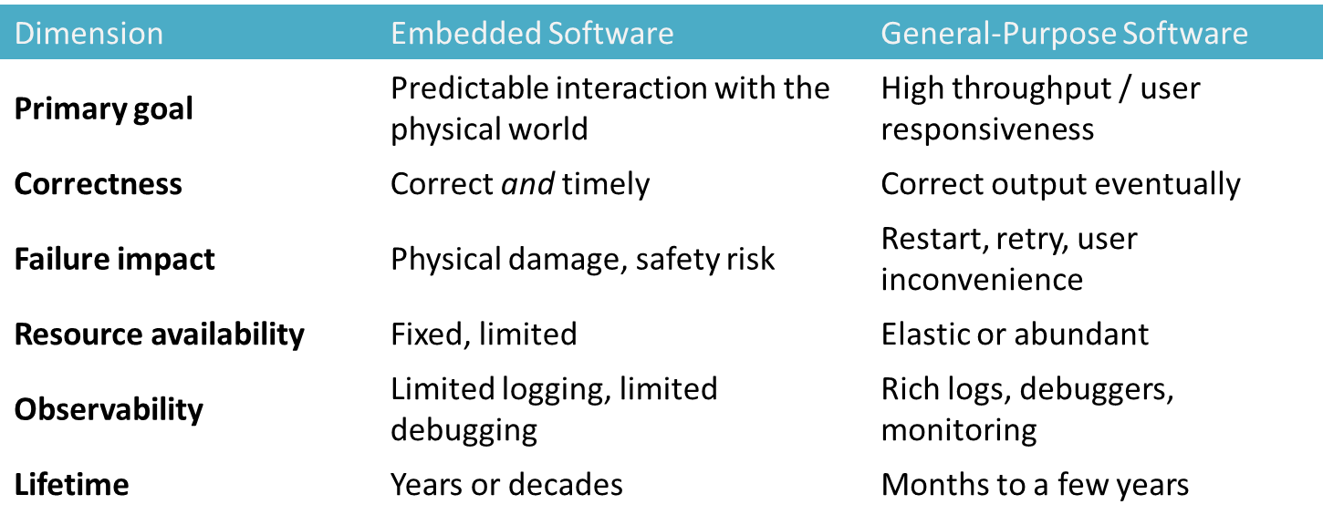
Embedded vs general-purpose software
Embedded software must be predictable, not just correct!

Slide 14
Embedded vs general-purpose software: example
Handling temperature data
General software:
  Read temperature
  Display on screen
  Delay == annoyance
Embedded software:
  Read temperature
  Control heater
  Delay == overheating, accidents etc.

Slide 15
What this means
Much more careful design
Defensive programming
Emphasis on verification
Disciplined coding and testing
Stricter requirements
Modeling
Real-time operating systems
Embedded software is not just software with limited memory!

Slide 16
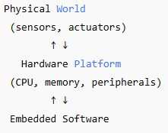
Software – hardware interaction
Embedded software is not hardware-independent!
Needs understanding of the hardware
Asynchronous external events; but software is sequential
Response to asynchronous event needs to be time-bound
Concurrency – many simultaneous event sources and actuator requirements to handle
Embedded software is primarily event-driven

Slide 17
State-dependent behavior in embedded software
Response to the same event can be different depending on the state / system context
State changes must be explicit and controlled
Hidden states can lead to bugs
Example: Button press
  Idle state → start operation
  Running state → stop operation
  Fault state → ignore / raise alarm
Behavioral modeling to cover all possibilities systematically

Slide 18
Emphasis of safety
Cannot afford software crashes (or ensure safety in spite of crashes)
Software running fine does not ensure safety
  For example, an elevator controller software might not crash, but could ignore a sensor and crush a hand!
Identify potential hazardous conditions during design
Must be designed to handle external faults (sensors failing, unexpected inputs etc.)
Prepare the system for the unexpected (safe states)!

Slide 19
Disciplined system design and coding
Ad hoc code → implicit assumptions → late discovery of faults
With discipline: predictable behavior, early detection of errors, verifiable safety
In this course
  Requirements engineering → clarity
  Modeling (UML) → behavioral reasoning
  Architecture → structure and separation
  RTOS & scheduling → timing guarantees
  Verification & testing → confidence

Slide 20
Review questions
Which of the following are characteristics of embedded systems?
What defines correctness in embedded software?
Which statement best explains why embedded software is typically event-driven?
Which distinction most clearly differentiates embedded software from general-purpose software?
An embedded system continues running without crashing, but an actuator keeps operating after a sensor failure, causing physical damage. Which statement is most accurate?

