Slide 1
Software for Embedded Systems
Prof. Saurabh Gandhi (EEE department)

Slide 2
Embedded fundamentals
Microprocessor architecture basics
Memory organization

Slide 3
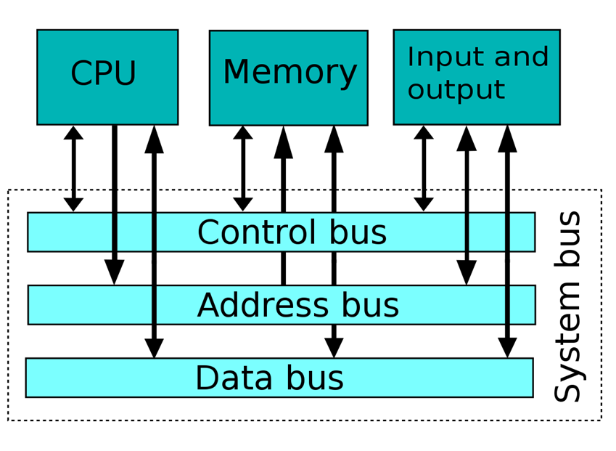
The big picture of an embedded computer

Slide 4
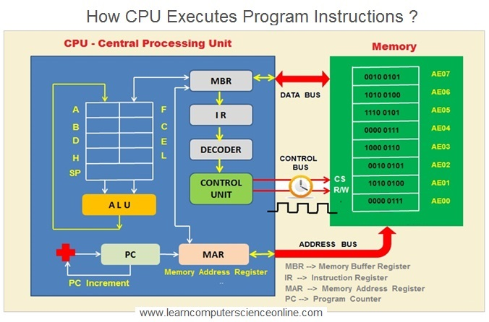
The big picture of a microprocessor

Slide 5
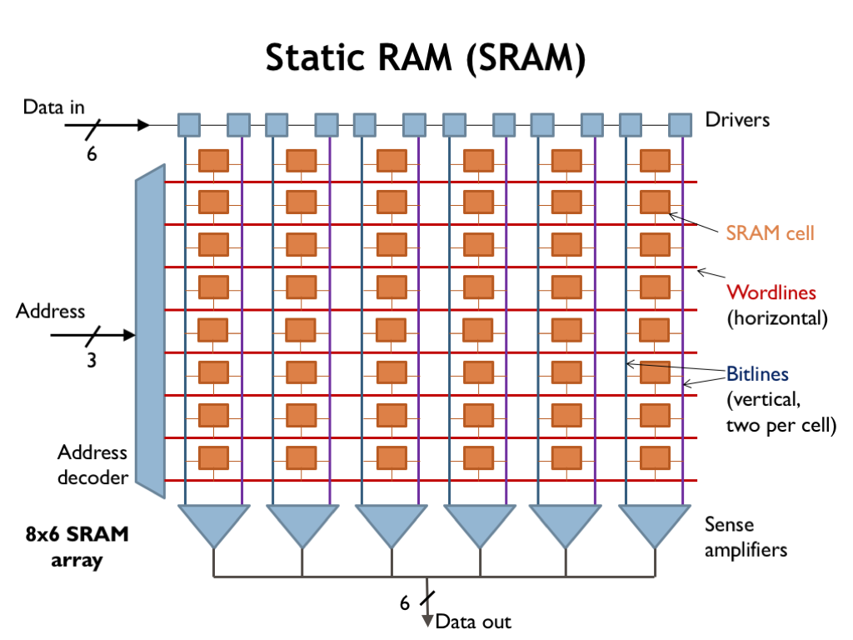
Memory – a simple model

Slide 6
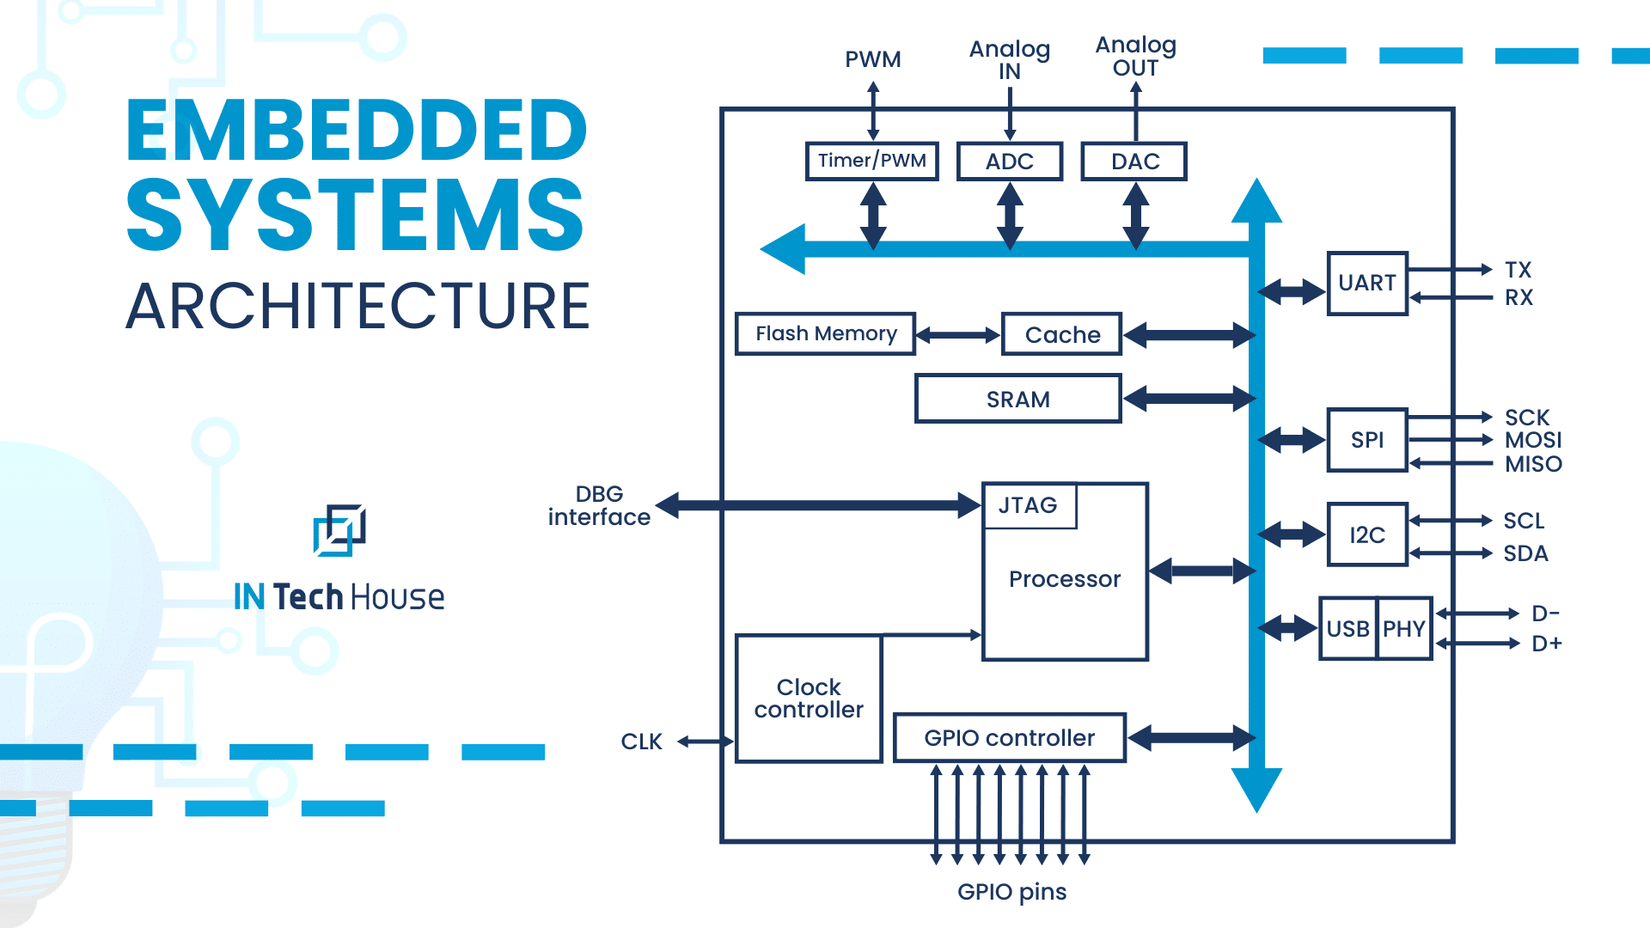
System on chip (SoC) = processor + memory + peripherals

Slide 7
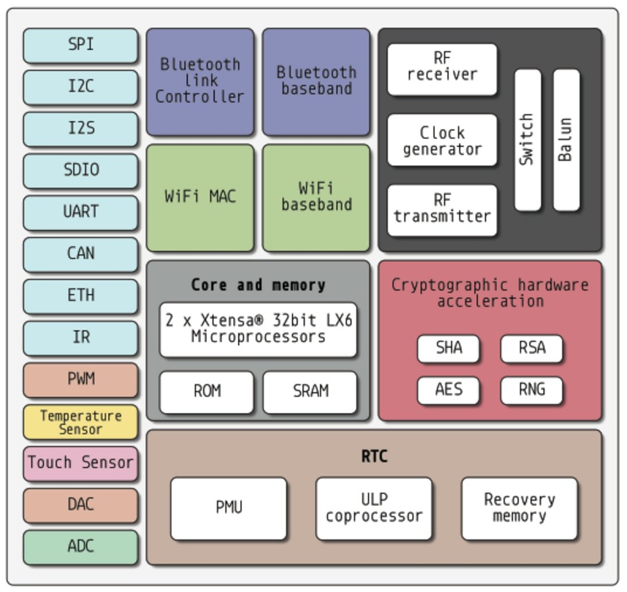
Example: ESP32

Slide 8
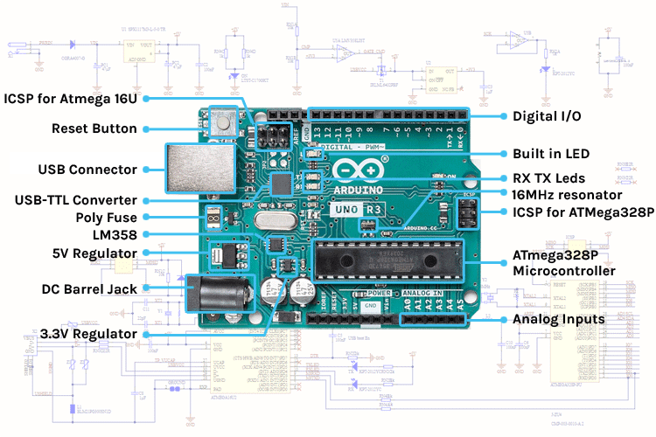
Development boards

Slide 9
Microprocessor architecture
Size of data and address bus (8-bit, 16-bit, 32-bit)
Memory architecture (Harvard, von Neumann)
  Harvard (most common in embedded): separate data and instruction bus – simultaneous fetching of data and instruction
  Von Neumann: Unified memory for code and data
  Modified Harvard: modern ARM Cortex-M processors
Instruction set architecture (ISA): What instructions are available to execute

Slide 10
Embedded ISAs
RISC (reduced instruction set): most common for embedded systems (ARM, RISC-V, xtensa)
Predictable timing of each instruction
Lower power
Simpler design
Easy customization
Clear hardware-software interface

Slide 11
Role of memory in embedded systems
Storage and communication for programs
Communication with sensors and actuators
More constrained than general-purpose computing
  Size, power, reliability
Important for programmers to understand these constraints

Slide 12
Types of memory
Flash / ROM → store program
  Persistent, fast to read but slow to write, fewer write cycles
  good for bulk storage that changes infrequently
EEPROM / NVM → store configuration
  Persistent, slower, larger number of write cycles
  good for storing small chunks of data that change frequently
RAM → hold data, stack, heap
  Volatile, very fast, unlimited write cycles
  hold data required for immediate operation

Slide 13
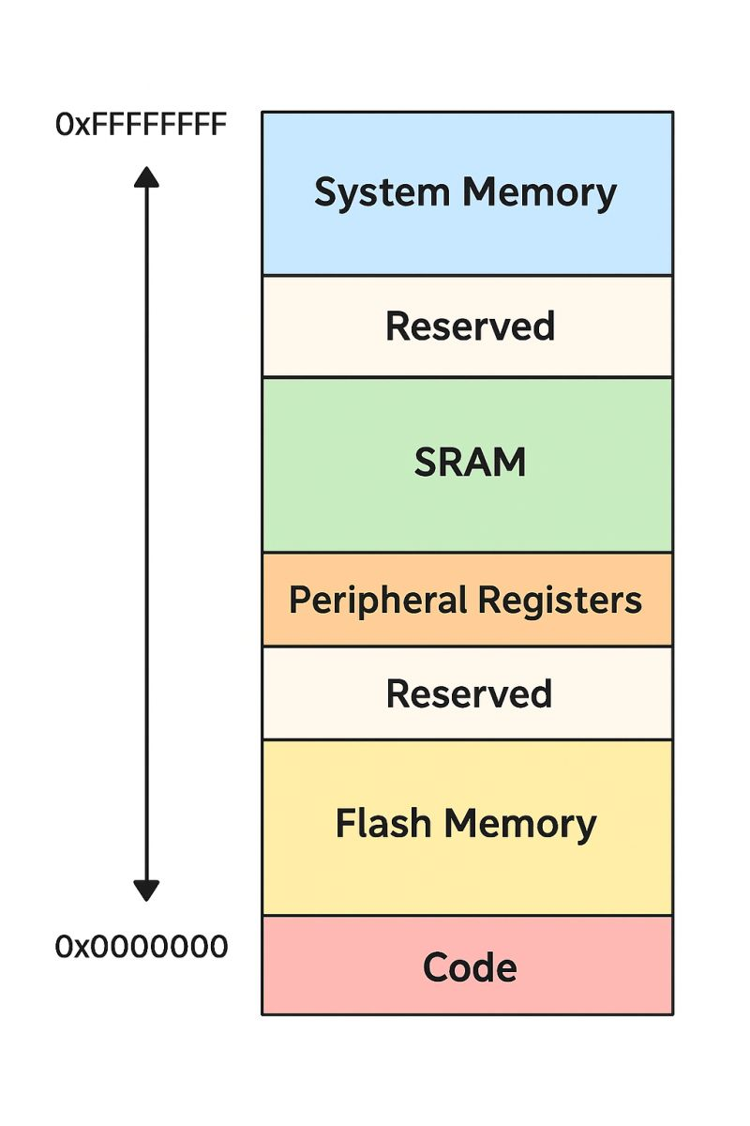
A memory map – what is where in the memory?
Different types of memories might need to be accessed by the processor
Put the all on the same address bus
Memory map: layout that shows the entire address space of a microcontroller

Slide 14
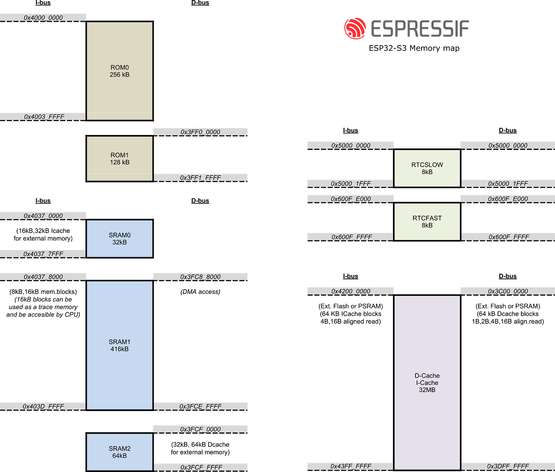
A more complex memory map: ESP32-S3

Slide 15
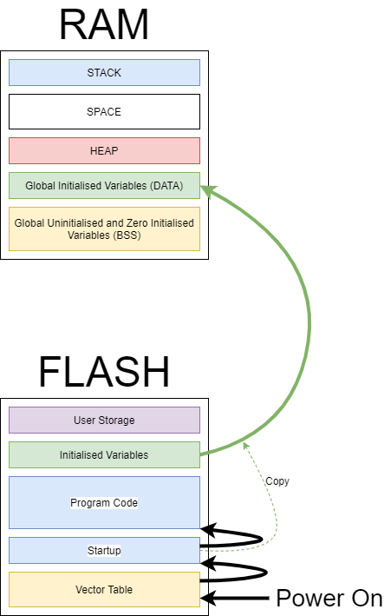
Zooming into the memory space

Slide 16
Vector table
Table of addresses where specific
code lives
Where to execute from when there is a reset?
Exceptions, interrupts etc.
When the event occurs, processor reads the address for that event in the table, then jumps to it for execution

Slide 17
The stack
Function calls
Local variables
Interrupt handling
LIFO (last in first out)
Grows downwards
Common failure: stack overflow

Slide 18
The heap
Dynamic memory allocation
Grows upwards
Risks:
Fragmentation
Unpredictable timing
  Because allocation is dynamic (have to find free blocks, collect garbage etc.)
Collision with stack!
  #1 cause of random embedded software crashes
Avoid heap in safety-critical paths (banned in MISRA-C)

Slide 19
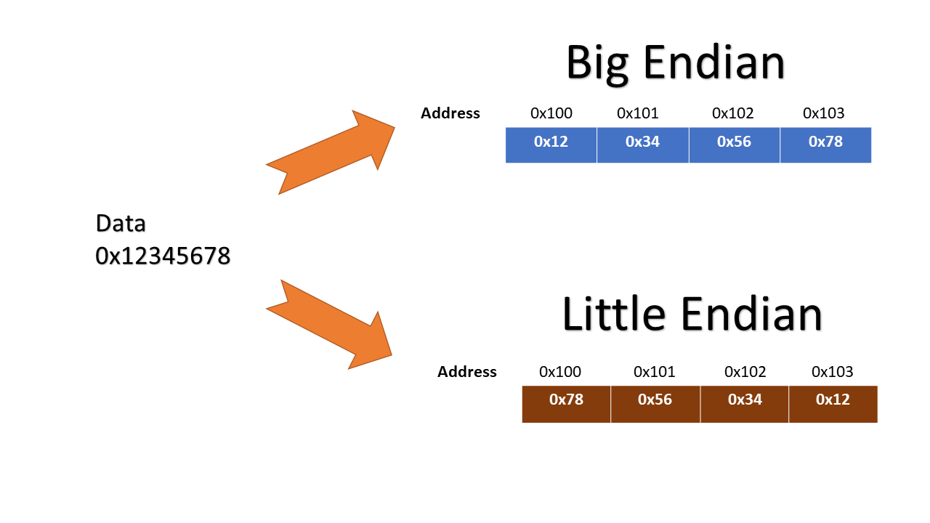
Memory alignment and endianness
Memory is typically byte-addressed
Read from an address returns multiple bytes (1, 2 or 4)
For example, a 32-bit integer must start at an address divisible by 4
Endianness
Matters when communicating
across systems!!

Slide 20
Memory in embedded systems
Non-volatile memory
  EPROM
  EEPROM
  Flash memory
  Disk drives
Volatile memory
  SRAM (static random access memory)
    Fast, deterministic access
    Power hungry
    Used for caches, scratchpads (expensive!)
  DRAM (dynamic random access memory)
    Slower, access time depends on sequence of addresses
    Higher capacity (per unit space, $$)
    Requires periodic refresh
    Used for main memory
Bootloader
  Transfers data from non-volatile to volatile memory at start-up
Types of memory
  Volatile vs non-volatile
  SRAM vs DRAM
Memory architectures
  Harvard vs von Neuman
  Memory-mapped I/O
Memory organization
  Statically allocated
  Stacks
  Heaps (allocation, fragmentation, garbage collection)
Memory hierarchies
Memory protection
  Segmented spaces

