Slide 1
Software for Embedded Systems
Prof. Saurabh Gandhi (EEE department)

Slide 2
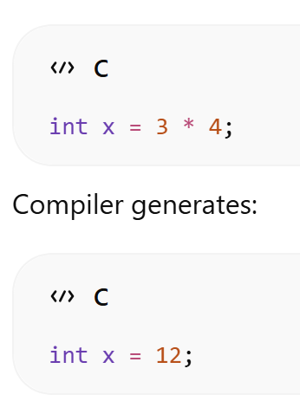
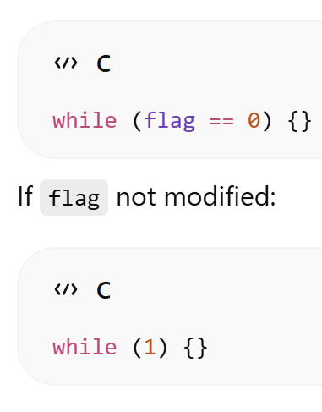
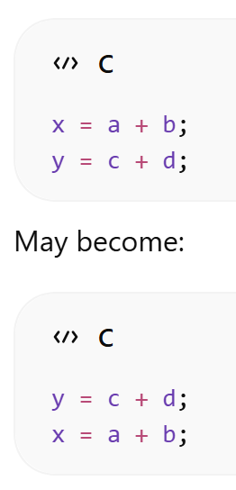
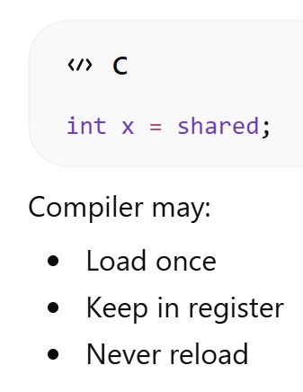
Compiler optimization
Compiler preserves semantics, not step-by-step execution
Compiler assumes
No hidden side effects
Variables do not change unless code says so
But in embedded systems
Hardware changes memory
ISRs modify variables
How do we tell the compiler when to optimize and when to leave code as it is?
Elimination
Reordering
Register caching

Slide 3
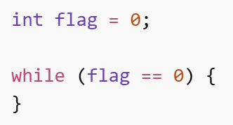
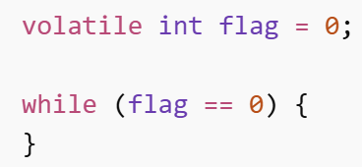

volatile
“This variable can change outside program control”
Compiler guarantees:
Variable is not cached in a register
Does not optimize any variable reads or writes
Where to use `volatile`
Hardware registers (#define UART_STATUS (*(volatile int*)0x4000))
ISR – task communication (volatile int data_ready;)

Slide 4
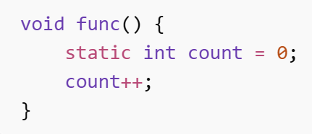
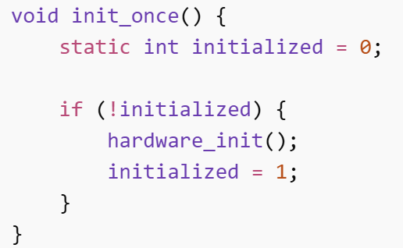
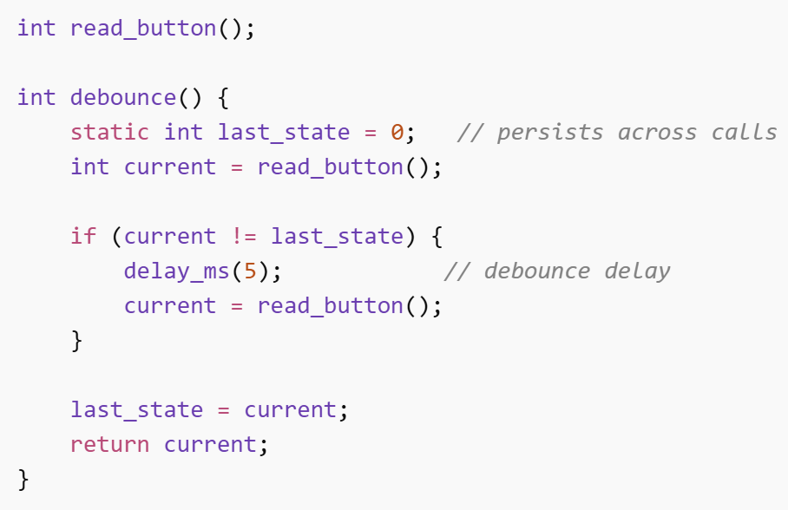
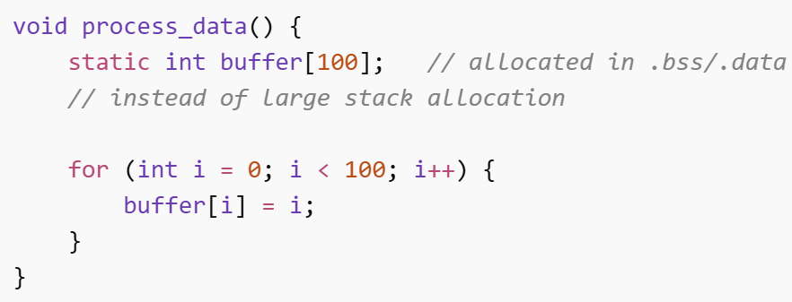
static (local variable)
Initialized once
Retains value across calls
Not stored on stack
Avoids stack usage
Persistent state without exposing a global variable
Predictable memory behavior
Initialization runs only once
No risk of stack overflow

Slide 5

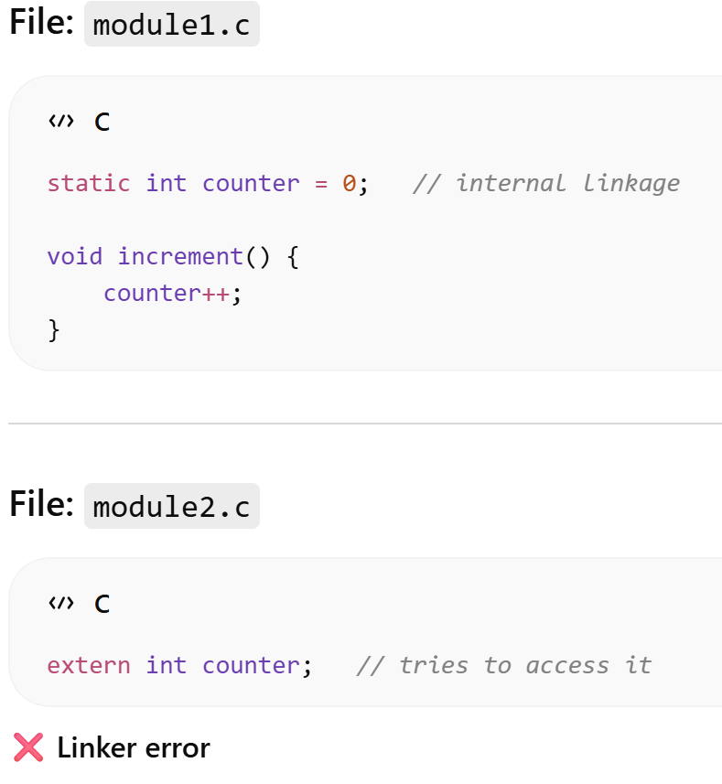
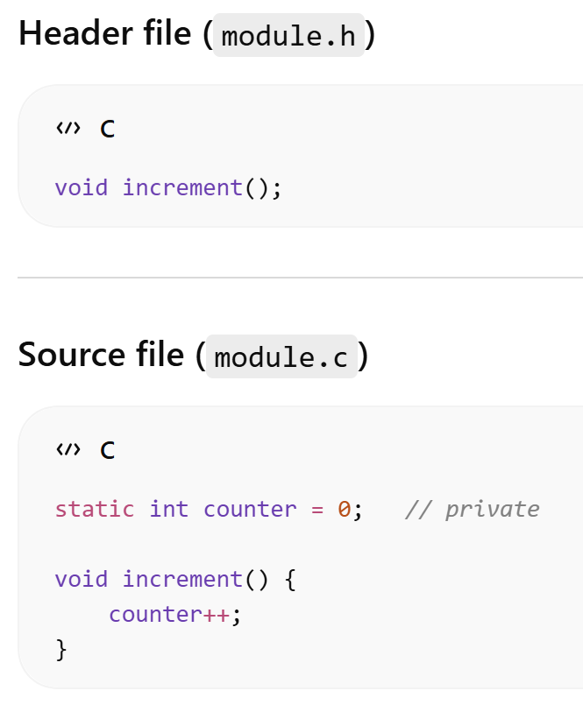
static (file scope)
Visible only in the file where it is defined
Avoids name collision
Provides encapsulation
Prevents accidental cross-module access

Slide 6
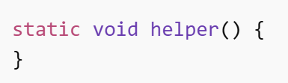
static (functions)
Private helper functions
Clean modular design
Function only used internally and cannot be called from other files

Slide 7
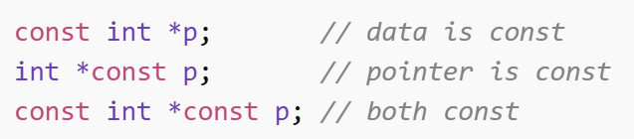


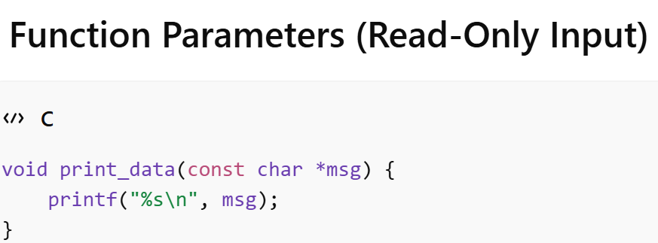

const
Value cannot be modified through this variable
Compiler treats as read-only
Store in flash / ROM instead of RAM; saves RAM space (on some systems / toolchains)
Often placed in .rodata section (flash)
msg points to data that cannot be modified
Prevents accidental modification of caller’s data
Caller can safely reuse data
Constant pointers: fixed mapping to a resource, whose data may change
Hardware registers: data actually cannot change in software

Slide 8

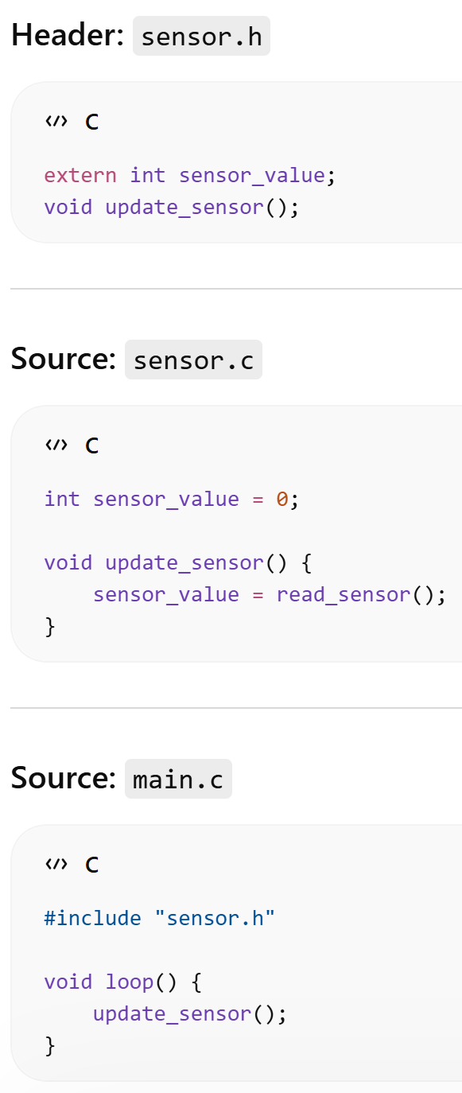
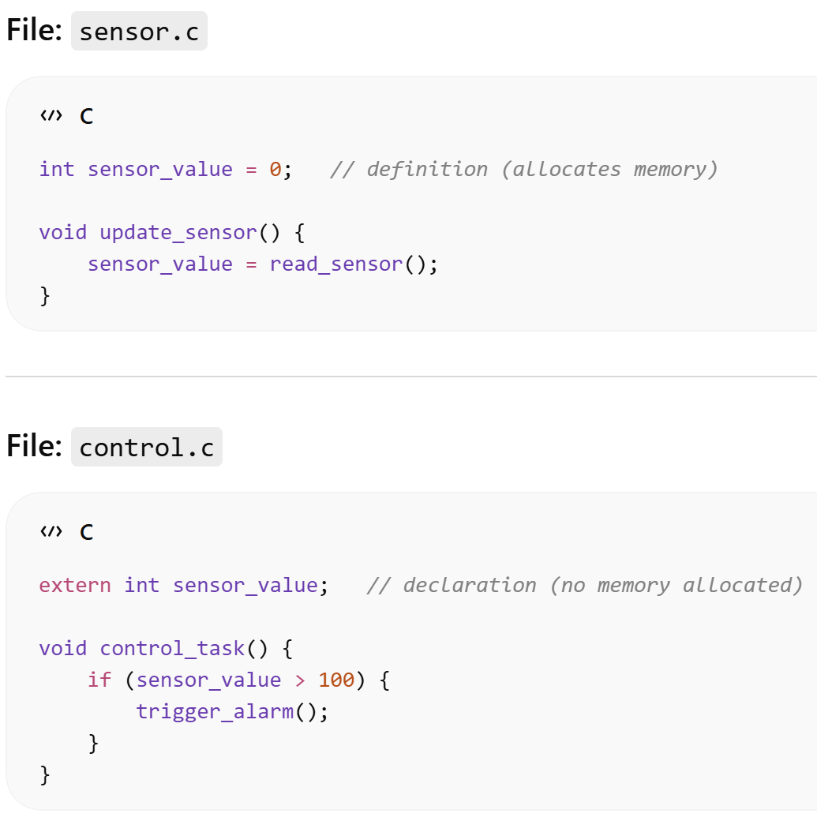
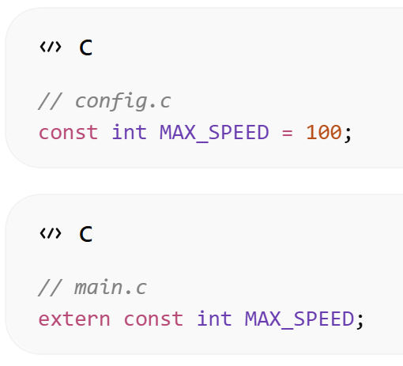
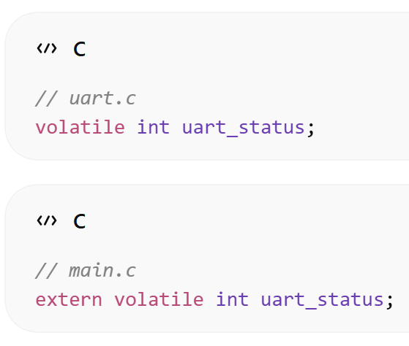
extern
Defined in another file, resolved by linker
Used for cross-module communication

