Slide 1
Software for Embedded Systems
Prof. Saurabh Gandhi (EEE department)

Slide 2
Firmware architecture
How do we structure software so that the behavior we modeled cannot be violated?

Slide 3
What is firmware architecture?
Firmware architecture defines:
Major software components
Their responsibilities
Allowed communication channels between components
Execution context boundaries
It tells us:
Who runs where?
Who may call whom?
Who may block whom?
Who reacts to events?

Slide 4
Architecture is more than layers
Common misconception: architecture means
HAL → drivers → application
HAL: Hardware Abstraction Layer
Layers do not enforce timing constraints
Layers do not prevent blocking
Layers do not encode safety-first design

Slide 5
Architectural building blocks
"Blocks" are the modular, logical, and structural units that make up your system
Isolation: blocks represent independent components
Swap-ability
Testability
A block is anything you can draw a box around in a diagram and define a clear 'Input' and 'Output' for. If you can't draw a box around your code, it's not an architecture; it's a script.

Slide 6
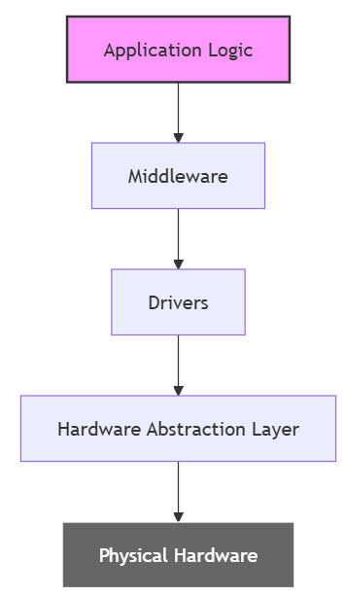
Structural blocks
Define where code lives
Hardware Abstraction Layer (HAL): the block that wraps registers
  Turns LPC_GPIO0->FIOPIN |= (1 << 5) into Led_On()
Drivers: Specialized blocks for external actors
Middleware: Heavy-duty blocks that provide generic services, such as file system handling
Application logic: High level logic

Slide 7
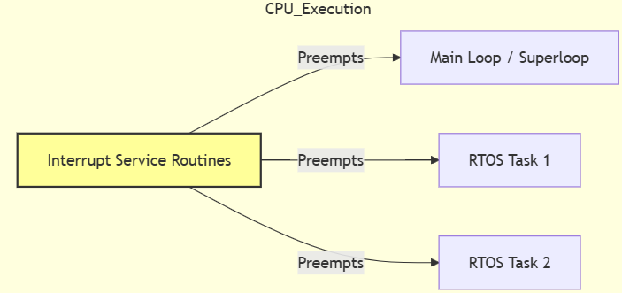
Execution blocks
Define how code runs and how CPU is shared
The main loop (superloop): simplest execution block that runs every task sequentially
Interrupt Service Routines: High priority blocks triggered by hardware events
  Preempt whatever the CPU is doing
RTOS tasks / threads: Independent blocks of execution that have their own priority
  A scheduler decides when the tasks run

Slide 8
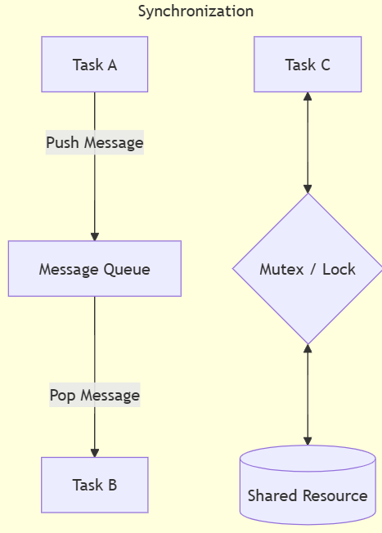
Communication and sync blocks
These blocks allow the other units to talk to each other without causing data corruption
Message queues: A mailbox block (task A drops a message into the queue, task B can pick it up when ready)
Semaphores / mutexes: Lock blocks, ensuring proper resource sharing and usage
Event flags: Simple signal blocks used to wake up sleeping tasks

Slide 9
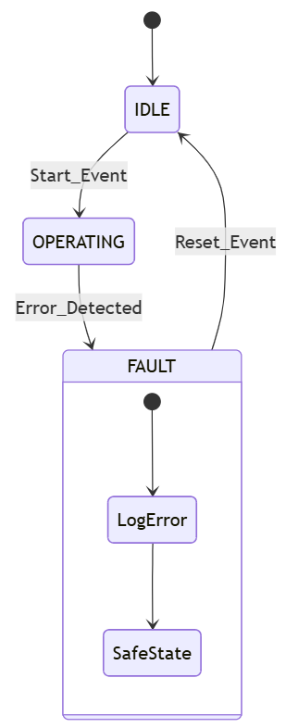
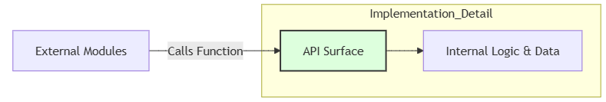
Behavioral and interface blocks
State machines: The core logic block. Tracks the ‘state’ of the system and defines what events are allowed etc.
Fault handlers: The emergency block; code that runs when things go wrong
APIs: The "surface" of a block. It defines the header files and functions that other blocks are allowed to see and call.

Slide 10
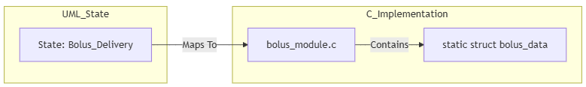
Encapsulation block: states → modules
Each concurrent region in a statechart must map to a separate architectural concern.
Each state owns its own data
Flow control → control module
Safety monitoring → safety module
Logging → logging module

Slide 11
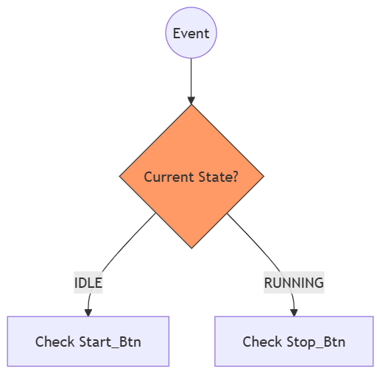
Dispatch block: transitions → executable logic
Decides which state transition logic to run based on the incoming event and current state

Slide 12
ISR bridge: signals → events
Sanitizes raw hardware pulses and turns them into events that the architecture understands

Slide 13
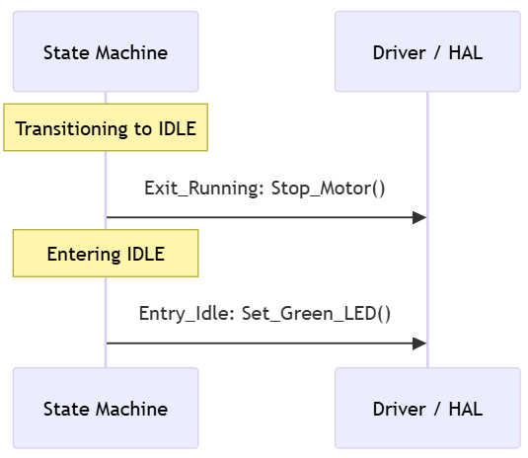
Action hooks: entry/exit/do → hardware commands
Ensures hardware is initialized and cleaned up during state changes

