Slide 1
Software for Embedded Systems
Prof. Saurabh Gandhi (EEE department)

Slide 2
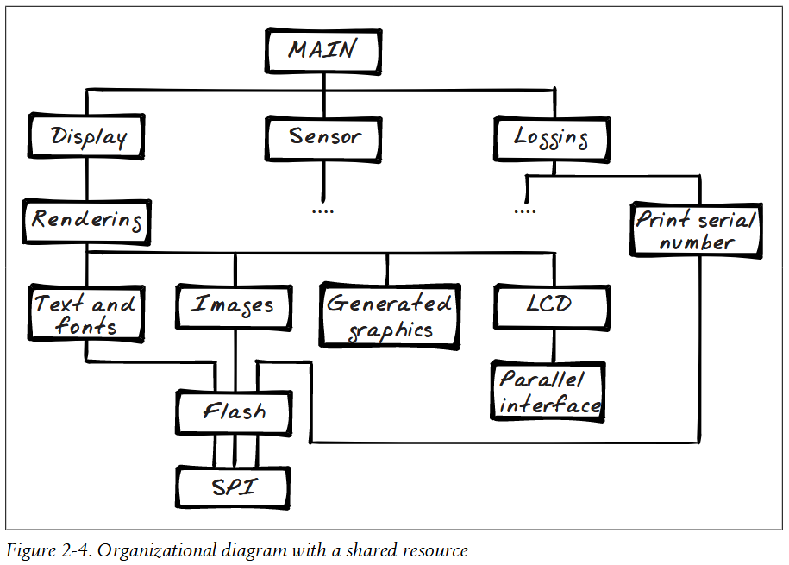
Where we are
Modeling → correct behavior by ensuring we have ‘thought’ of all possibilities
but not yet implemented!
Firmware architecture (so far)
what pieces of code (loosely coupled, modules) do we need
how these pieces control each other
What have we still not decided?
Application layer organization – how is the main logic implemented
When do these pieces of code run?

Slide 3
Organization of the application layer
Application layer is the main (gooey) logic of your system; but within the app layer:
Is there a single controller that decides what to do next?
Are there multiple controllers?
Who receives events from the lower layers?
Who decides the mode or ‘state’?

Slide 4
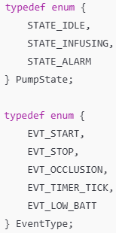
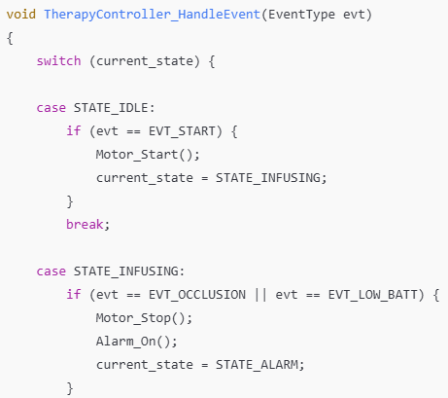
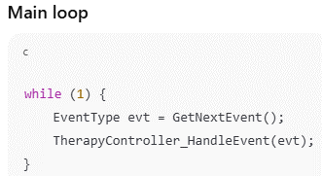
Pattern I: Monolithic controller
One central state machine that handles all state transitions and events

Slide 5
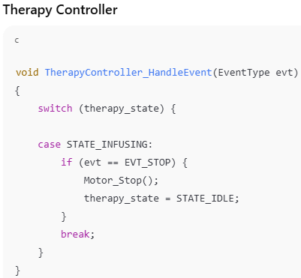
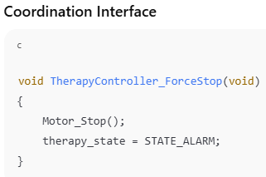
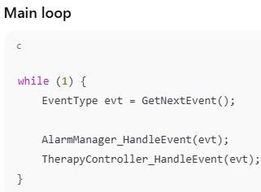
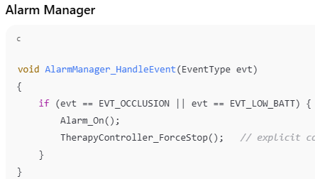
Pattern II: Coordinated controllers
Separate state machines control therapy, alarm and UI
Coordination via defined interfaces

Slide 6
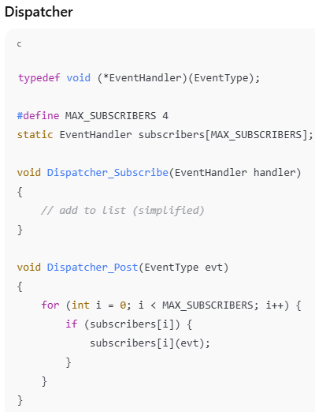
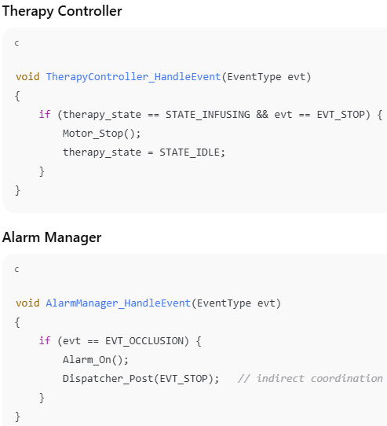
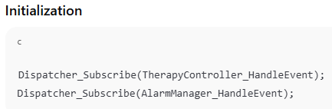
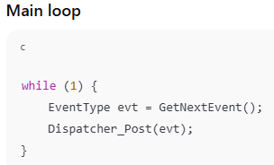
Pattern III: Event dispatcher
One central dispatcher receives events
Separate controllers subscribe to events

Slide 7
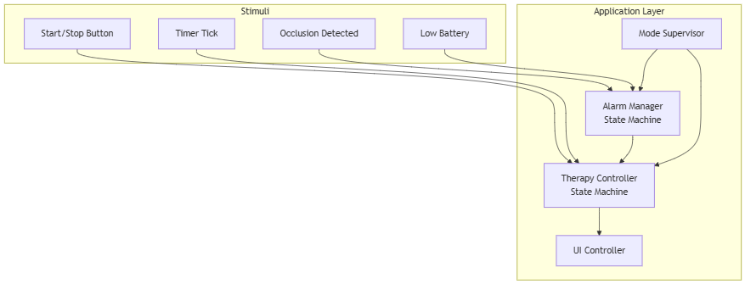
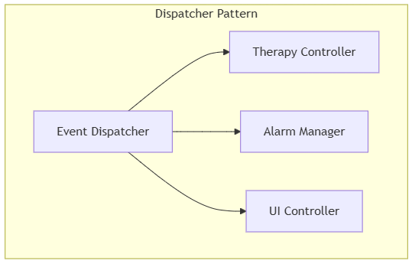
Event ownership at application level
Event | Owned By
Start button | Therapy Controller
Occlusion detected | Alarm Manager (may notify Therapy)
Timer tick | Therapy Controller
Low battery | Alarm Manager

Slide 8
Comparison of application level patterns
Pattern | Strength | Weakness
Monolithic | Simple | Becomes large, mixed concerns
Coordinated Controllers | Clear separation | Ordering & coupling must be managed
Dispatcher | Modular & scalable | Indirect control flow
Property | Coordinated Controllers | Dispatcher
Who knows whom? | Controllers know each other | Controllers know only dispatcher
Direct function calls? | Yes | No
Coupling | Explicit, directional | Indirect, via event bus
Compile-time dependency | Strong | Weaker

Slide 9
Control flow visibility
Coordinated Controllers
Control flow is explicit.
You can trace calls statically.
Easier to reason locally.
Harder to scale globally.
Dispatcher
Control flow is indirect.
Requires mental model of event routing.
Scales better.
Harder to trace.

Slide 10
Ease of adding modules
We want to add logging, safety monitor, UI refresh
Coordinated Controllers
Every new controller may require:
new direct calls
updated dependencies
careful ordering
The dependency graph grows quadratically.
Dispatcher Pattern
New module:
subscribes to events
no other controller modified
The dependency graph remains star-shaped.
That’s the scaling advantage.

Slide 11
Final distinctions
Question | Coordinated | Dispatcher
Who stops infusion? | Alarm calls Therapy directly | Alarm emits STOP event
Who routes events? | Caller | Dispatcher
Where is coupling expressed? | Function calls | Subscription list
Coordinated Controllers
Small system
Safety-critical clarity needed
Explicit authority required
Dispatcher
Large system
Many loosely coupled modules
Plugin-style extensibility

Slide 12
Where we are
Modeling → correct behavior by ensuring we have ‘thought’ of all possibilities
but not yet implemented!
Firmware architecture (so far)
what pieces of code (loosely coupled, modules) do we need
how these pieces control each other
What have we still not decided?
Application layer organization – how is the main logic implemented
When do these pieces of code run?

Slide 13
Execution model = Rules of Running
An execution model defines how control flows through the system over time.
Where code runs (i.e. in what context)
When code runs?
CPU performs one task at a time.
We create the illusion of multitasking by switching Contexts
A context is the snapshot of the CPU’s soul: its registers, its program counter, and its stack
When we switch tasks, we "freeze" one soul and "thaw" another
Execution modeling is the management of CPU "Contexts" and the cost of switching between them

Slide 14
Models and contexts
Superloop: everyone waits in a long line to run sequentially
Foreground/background: Loop + ISRs
Cooperative and preemptive multitasking
RTOS
Contexts:
Main loop
Interrupt
Task (RTOS)
Deferred work

Slide 15
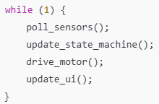
The superloop
Deterministic, simple
Context shared throughout
Hard to scale
Blocking breaks all timing constraints
Improvement: loop + ISR
Still sequential

Slide 16
Multitasking
Illusion of parallel execution
No need to wait for something else to finish
Cooperative: tasks yield voluntarily to the next task
Preemptive: Scheduler starts and stops tasks
Idea of priority

Slide 17
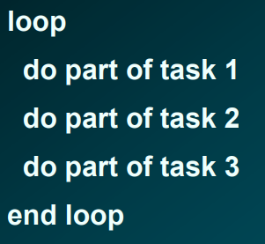
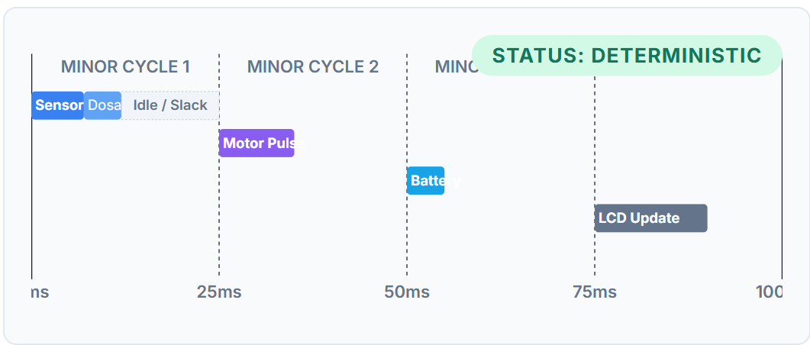
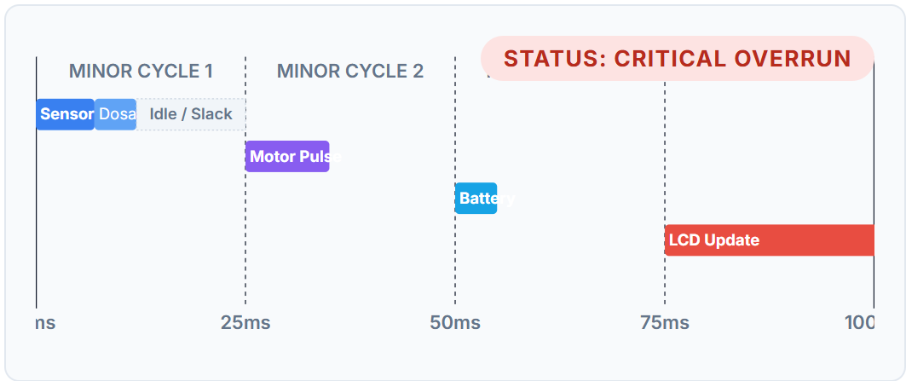
The cyclic executive model
Advantages
Simple implementation
How would you implement?
Low overhead
Very predictable
Disadvantages
Cannot handle sporadic events
Everything must operate in lockstep
Code is scheduled manually
Solution: Cyclic executive with interrupts

Slide 18
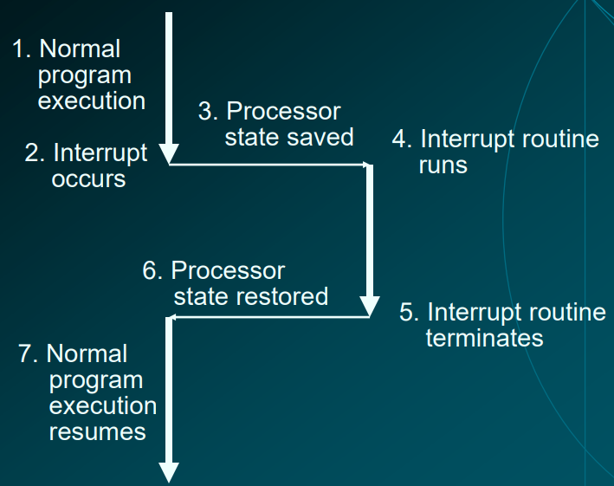
What do you do inside an interrupt service routine?

Slide 19
Typical ISR
Copy peripheral data into a buffer
Indicate to other code that data has arrived
How?
Events
Start or stop a process
Change priority
Acknowledge the interrupt
Tell the hardware that generated it that it has been handled
ISRs run fast!
Placed in RAM instead of flash
Leave longer reaction task outside the ISR

Slide 20
CE + Interrupts
Extremely easy to implement
Very cheap also! No extra overhead code
But
Main loop running in lockstep
Programmer must handle scheduling
Scheduling is static (cannot dynamically change order of tasks)
Latency of event handling still long
Interrupts introduce jitter in task timing

Slide 21
Cooperative multitasking
Processes relinquish control to other processes
More control on when a process stops and goes to another
Better coordination between processes
Priority can be implemented by changing task order
Simple scheduler that maintains priority queues
Programmer has to ensure a single process does not hog all CPU time
Bugs in a single task jeopardize all others

Slide 22
Operating systems
Function and scheduling are usually orthogonal
Let programmer handle function
Operating system will handle the scheduling

Slide 23
Operating systems for conventional vs embedded systems
Conventional:
Multiple threads or processes
File system
Virtual memory and paging
I/O and interrupt handling
Resource allocation
Command interface for executing programs
Embedded:
Lightweight threads
i/o and interrupt handling
Real time guarantees

Slide 24
Embedded operating systems
Lightweight threads
Basic locks
Fast context switches
Input / output
API for talking to devices
Buffering
Interrupt handling
Translate interrupts to events handled by user code
Trigger new tasks to run
Real time guarantees
Guarantee that a task is called at a certain rate
Guarantee interrupt handling time
Priority or deadline driven scheduling

Slide 25
Types of real time constraints
Hard – miss deadline, total failure of system. Minor or major disaster (people may die?)
Firm – result no longer useful after deadline missed
Soft – results gradually less useful as deadline passes.

Slide 26
What factors make real-time hard?
Interrupts (timing disrupted by external event responses)
Unpredictability of CPU execution
Branch prediction, caches, power modes and clock frequency changes, memory management (page fault)
Dynamic memory allocation and garbage collection
Unpredictable hardware (e.g. network access)
Operating systems (scheduler, context switching)
So why do we use RTOSs?

Slide 27
Real time operating systems
Low latency of OS calls
Fast context switching
Main goal: meeting task deadlines
Goal is not fairness (unlike conventional OSes)
If you have five homework assignments, and one is due in an hour, you will work on that one!

Slide 28
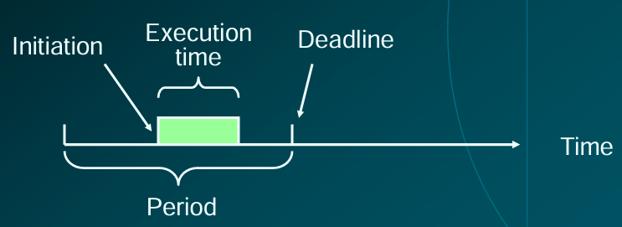
RTOS Task Model
Each task a triplet: (execution time, period, deadline)
Execution time: how long the task takes to run
Period: how often the task must run
Deadline: relative to each period, when must task complete?
Usually: deadline = period
Can be initiated anytime during the period

Slide 29
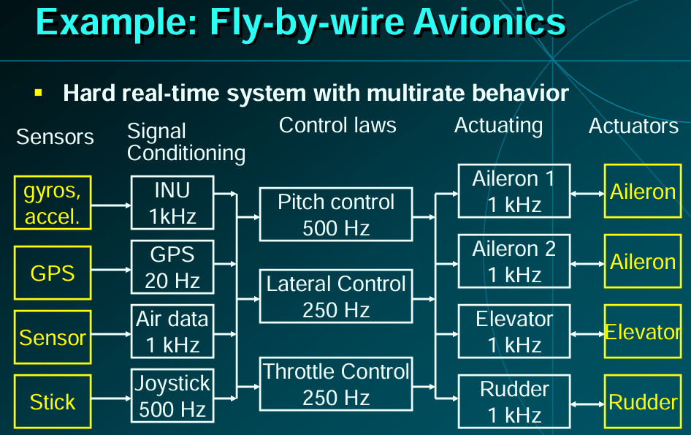
Periods can be very different for different tasks

Slide 30


Can we have period (T) different from deadline(D)?
D < T (constrained deadline)
Control loops based on sensor data (T = 10 ms, D = 5 ms)
Control must be applied early in each cycle
Remaining time for actuation delay, communication etc.
In general
Output must be produced early
Downstream stages require time before next period starts
T < D (arbitrary deadline)
Logging / diagnostics (T = 50 ms, D = 100 ms)
Logging is not urgent
Batching improves efficiency
In general, when buffering is allowed

Slide 31
Scheduling
Given a set of tasks, {(5, 10, 10), (2, 20, 8), (4, 10, 20)} how should they be scheduled to ensure deadlines are never violated?

Slide 32
Fixed priority preemptive scheduling (FPPS)
Each task has a fixed priority
Always run the highest priority runnable process
Continue running till process ends or higher priority process appears
τ1 | 0 | 1 | 0 | 0 | 0 | 1 | 0 | 0 | 0 | 1 | 0 | 0 | 0 | 1 | 0 | 0 | 0 | 1 | 0 | 0 | 0 | 1 | 0 | 0 | 0 | 1 | 0 | 0 | 0 | 1 | 0 | 0 | 0 | 1 | 0 | 0 | 0 | 1 | 0 | 0 | 0 | 1 | 0 | 0 | 0 | 1 | 0 | 0 | 0
τ2 | 0 | 0 | 2 | 2 | 0 | 0 | 0 | 2 | 2 | n0 | 0 | 0 | 2 | 2 | 0 | 0 | 0 | 2 | 2 | 0 | 0 | 0 | 2 | 2 | 0 | 0 | 0 | 2 | 2 | 0 | 0 | 0 | 2 | 2 | 0 | 0 | 0 | 2 | 2 | 0 | 0 | 0 | 2 | 2 | 0 | 0 | 0 | 2 | 2
τ3 | 0 | 0 | 0 | 3 | 3 | 3 | 3 | 0 | 0 | 0 | 0 | 0 | 0 | 0 | 0 | 0 | 0 | 0 | 0 | 0 | 0 | 0 | 0 | 0 | 3 | 3 | 3 | 3 | 0 | 0 | 0 | 0 | 0 | 0 | 0 | 0 | 0 | 0 | 0 | 0 | 0 | 0 | 0 | 0 | 3 | 3 | 3 | 3 | 0
CPU
0 | 1 | 2 | 2 | 3 | 1 | 3 | 2 | 2 | 1 | 3 | 3 | 2 | 1 | 2 | 0 | 0 | 1 | 2 | 2 | 0 | 1 | 2 | 2 | 3 | 1 | 3 | 2 | 2 | 1 | 3 | 3 | 2 | 1 | 2 | 0 | 0 | 1 | 2 | 2 | 0 | 1 | 2 | 2 | 3 | 1 | 3 | 2 | 2

Slide 33
FPPS
What happens if you have multiple processes at the same priority?
Prohibit: each process has unique priority
Time-slice processes at the same priority
Extra context switching
No starvation within a priority level, everyone gets their turn
Processes at the same priority cannot preempt each other
Less context switching, so more efficient

Slide 34
Task sets do not always have a feasible schedule
Consider the task model:
P1 = (10, 20, 20)
P2 = (5, 9, 9)
Write down the appropriate priority levels that ensure these two tasks always finish in time
Is there any way these two tasks can be scheduled to meet all deadlines?
Not schedulable if tasks require more than 100% CPPU utilization!

Slide 35
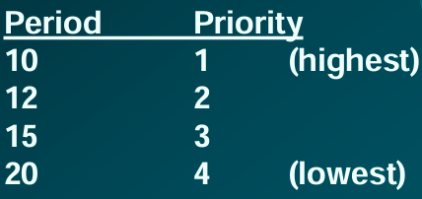
Rate Monotonic Scheduling (RMS)
Processes with shorter period given higher priority
Key result (Liu & Layland, 1973 JACM): RMS is optimal “If there is fixed priority schedule that meets all deadlines, then RMS will produce a feasible schedule”

Slide 36
RMS example
For the tasks shown: p1 = (10, 20, 20); p2 = (15, 30, 30)
Is a schedule impossible?
Is RMS able to give the schedule?
Is any fixed priority able to give a schedule?
Does CPU utilization, U <= 1 guarantee feasible fixed priority schedule?
τ1 | 1 | 1 | 1 | 1 | 1 | 1 | 1 | 1 | 1 | 1 | 0 | 0 | 0 | 0 | 0 | 0 | 0 | 0 | 0 | 0 | 1 | 1 | 1 | 1 | 1 | 1 | 1 | 1 | 1 | 1 | 0 | 0 | 0 | 0 | 0 | 0 | 0 | 0 | 0 | 0 | 1 | 1 | 1 | 1 | 1 | 1 | 1 | 1 | 1 | 1
τ2 | 2 | 2 | 2 | 2 | 2 | 2 | 2 | 2 | 2 | 2 | 2 | 2 | 2 | 2 | 2 | 0 | 0 | 0 | 0 | 0 | 0 | 0 | 0 | 0 | 0 | 0 | 0 | 0 | 0 | 0 | 2 | 2 | 2 | 2 | 2 | 2 | 2 | 2 | 2 | 2 | 2 | 2 | 2 | 2 | 2 | 0 | 0 | 0 | 0 | 0
 | 1 | 1 | 1 | 1 | 1 | 1 | 1 | 1 | 1 | 1 | 2 | 2 | 2 | 2 | 2 | 2 | 2 | 2 | 2 | 2 | 1 | 1 | 1 | 1 | 1 | 1 | 1 | 1 | 1 | 1 | 2 | 2 | 2 | 2 | 2 | 2 | 2 | 2 | 2 | 2 | 1 | 1 | 1 | 1 | 1 | 1 | 1 | 1 | 1 | 1
CPU

Slide 37
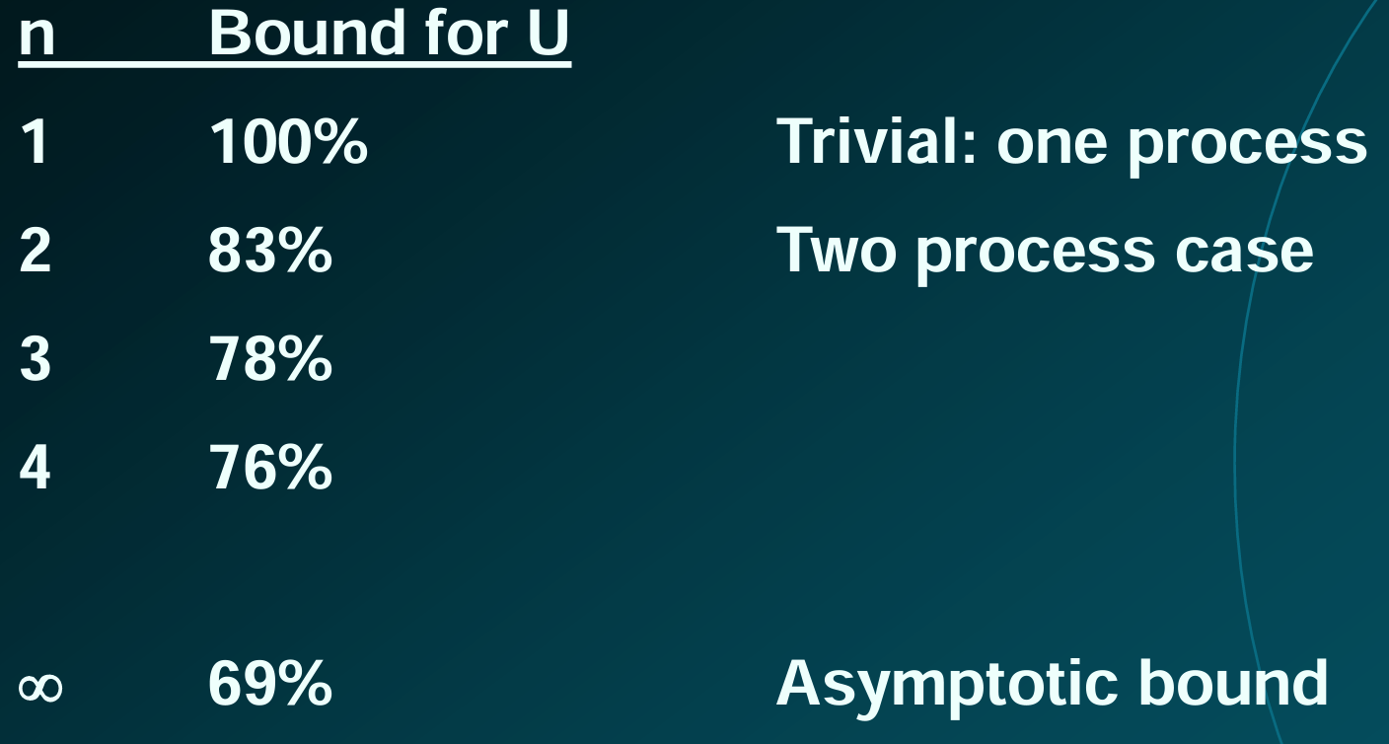
When is there an RMS schedule?
U > 1: no schedule possible
RMS schedule always exists if U < n (2^{1/n} – 1)
If U < 69%, RMS will always give a schedule
If U > 69%, RMS may still give a valid schedule, but it is not guaranteed to work for all task models
RMS is optimal when T = D. When D < T: deadline monotonic

Slide 38
RMS example
For the tasks shown: p1 = (10, 20, 20); p2 = (15, 30, 30)
No RMS schedule
For what model will a schedule exist?
p2 = (10, 30, 30) gives U = 83% (within limit for n = 2)
τ1 | 1 | 1 | 1 | 1 | 1 | 1 | 1 | 1 | 1 | 1 | 0 | 0 | 0 | 0 | 0 | 0 | 0 | 0 | 0 | 0 | 1 | 1 | 1 | 1 | 1 | 1 | 1 | 1 | 1 | 1 | 0 | 0 | 0 | 0 | 0 | 0 | 0 | 0 | 0 | 0
τ2 | 2 | 2 | 2 | 2 | 2 | 2 | 2 | 2 | 2 | 2 | 0 | 0 | 0 | 0 | 0 | 0 | 0 | 0 | 0 | 0 | 2 | 2 | 2 | 2 | 2 | 2 | 2 | 2 | 2 | 2 | 0 | 0 | 0 | 0 | 0 | 0 | 0 | 0 | 0 | 0
 | 1 | 1 | 1 | 1 | 1 | 1 | 1 | 1 | 1 | 1 | 2 | 2 | 2 | 2 | 2 | 2 | 2 | 2 | 2 | 2 | 1 | 1 | 1 | 1 | 1 | 1 | 1 | 1 | 1 | 1 | 2 | 2 | 2 | 2 | 2 | 2 | 2 | 2 | 2 | 2
CPU

Slide 39
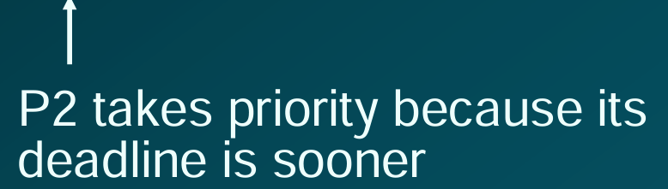
Can we do better with dynamic priorities?
Earliest deadline first
Process with the earliest next deadline given highest priority
p1 = (10, 20, 20); p2 = (15, 30, 30) (U = 100%)
τ1 | 1 | 1 | 1 | 1 | 1 | 1 | 1 | 1 | 1 | 1 | 0 | 0 | 0 | 0 | 0 | 0 | 0 | 0 | 0 | 0 | 1 | 1 | 1 | 1 | 1 | 1 | 1 | 1 | 1 | 1 | 0 | 0 | 0 | 0 | 0 | 0 | 0 | 0 | 0 | 0 | 1 | 1 | 1 | 1 | 1 | 1 | 1 | 1 | 1 | 1 | 0 | 0 | 0 | 0 | 0 | 0 | 0 | 0 | 0 | 0
Τ2 | 2 | 2 | 2 | 2 | 2 | 2 | 2 | 2 | 2 | 2 | 2 | 2 | 2 | 2 | 2 | 0 | 0 | 0 | 0 | 0 | 0 | 0 | 0 | 0 | 0 | 0 | 0 | 0 | 0 | 0 | 2 | 2 | 2 | 2 | 2 | 2 | 2 | 2 | 2 | 2 | 2 | 2 | 2 | 2 | 2 | 0 | 0 | 0 | 0 | 0 | 0 | 0 | 0 | 0 | 0 | 0 | 0 | 0 | 0 | 0
 | 1 | 1 | 1 | 1 | 1 | 1 | 1 | 1 | 1 | 1 | 2 | 2 | 2 | 2 | 2 | 2 | 2 | 2 | 2 | 2 | 2 | 2 | 2 | 2 | 2 | 1 | 1 | 1 | 1 | 1 | 1 | 1 | 1 | 1 | 1 | 2 | 2 | 2 | 2 | 2 | 2 | 2 | 2 | 2 | 2 | 2 | 2 | 2 | 2 | 2 | 1 | 1 | 1 | 1 | 1 | 1 | 1 | 1 | 1 | 1
CPU

Slide 40
Earliest deadline first
EDF is optimal
If a dynamic priority schedule exists, EDF will produce a feasible schedule
EDF is efficient
A dynamic priority schedule exists if and only if utilization is no greater than 100%
i.e. EDF is most efficient at getting every bit of CPU availability utilized

Slide 41
Which is better – RMS or EDF?
Scheduling overhead:
RMS: simple lookup of priorities: o(1)
EDF: sort tasks based on deadline every time: o(n)
Analysis:
RMS, with fixed priorities, is easier to analyze and debug for a system; more predictable
Overload behavior (if more U than supported):
RMS: Low priority tasks suffer, high priority are always safe
EDF: All tasks are knocked off deadline

Slide 42
Priority inversion

