Slide 1
Software for Embedded Systems
Prof. Saurabh Gandhi (EEE department)

Slide 2
Lifecycle and Evolution Constraints in Embedded Software
Additional constraints specifically faced by embedded systems

Slide 3
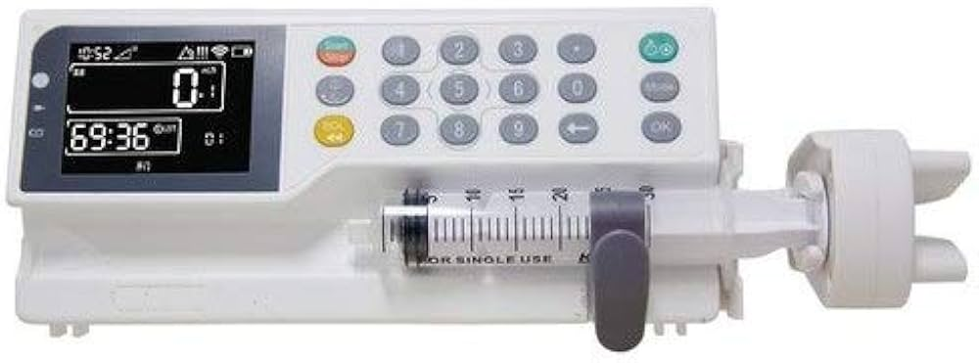
Embedded software lives long
Embedded software often outlives
  The hardware platform
  Suppliers (hardware components)
  Development teams
Typical lifetimes
  Automotive ECUs: 10 – 15 years
  Medical devices: 10 – 20 years
  Industrial controllers: few – several decades
Example: Medtronic — Medical Devices
  Medical device firmware in use for decades
  Post-market surveillance frequently triggers late updates
  Updates require full safety justification / certification
Long-term maintenance is a requirement for embedded systems
Infusion pump

Slide 4
Many things directly affecting the S/W change over these times
What kind of factors change?
  Components reach end-of-life
  Suppliers change
  Hardware revisions to reduce cost
  Regulatory requirements
Changes are inevitable and cannot be planned
But the can be planned for
How to write software that is adaptable to change?

Slide 5
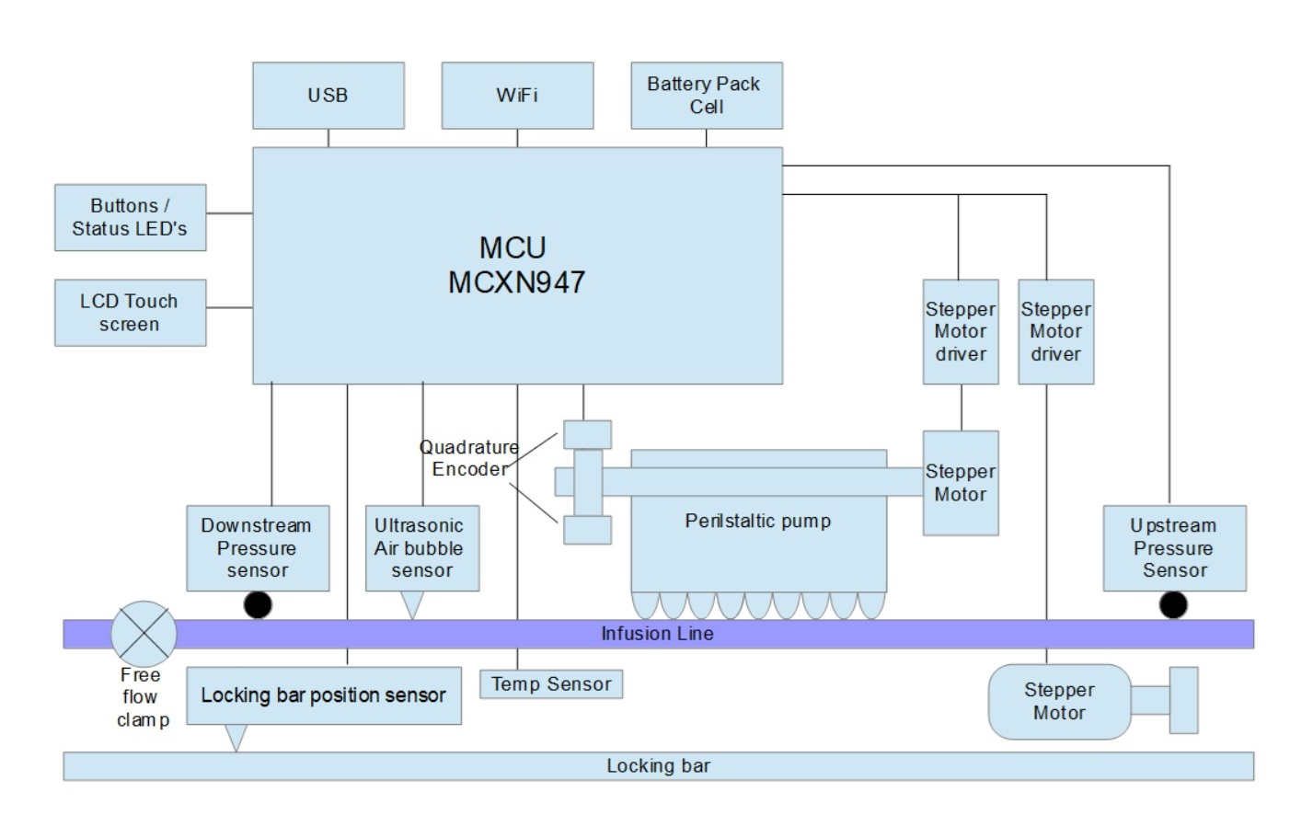
Modularity
Changes in one part should not destabilize others
  components of the system as independent as possible
Isolating change
Infusion pump example
What can change over time?
What are the different functions that can and should remain independent?
Sensor replaced →
  Should control behavior change?
  Control code?

Slide 6
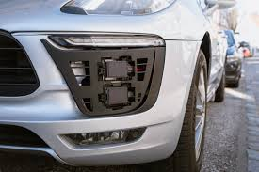
Example – radar sensors from Bosch
Several OEMs (BMW, Audi, Mercedes, VW) use it for:
  Adaptive cruise control (ACC)
  Automatic emergency braking
New sensor generation introduces
  Same function and interface
  But signal behavior was different (noise, SNR etc.)
Behavior degraded
  False positive braking
  Degraded ACC smoothness
OEMs had to retune control logic, revalidate safety via software updates, recalls etc.

Slide 7
Portability
Hardware platforms change, but software must remain equivalent
Infusion pump example: microcontroller itself reached EOL, and new MCU introduced
Why does change of MCU matter so much?
Is it simply about recompiling the code for a different platform?

Slide 8
Example
Programmable Logic Controllers (PLCs): devices used for industrial automation
Observe → Decide → Act → Repeat (1 scan)
Assumes observed variables remain fixed for duration of scan
Siemens – SIMATIC S7 PLC family
  Control executed once per scan, but scan time was never explicitly specified
  New hardware: faster CPUs, but added more complex communication protocols, logging etc.
  Scan times became variable!
  Control became unstable

Slide 9
Portability is
Not just easy of recompiling, BUT
Avoiding undocumented hardware assumptions
Making timing and resource constraints explicit

Slide 10
Configurability: one system, many variants
For example, same car sold in different markets:
  Different features
  Different safety norms
Proper understanding / mapping of configuration required for safe operation

Slide 11
Example: Therac-25 (Radiation Therapy Device)
Software controlled modes of operation: low and high energy radiation, with different dosage times etc., configured in software
Certain configuration settings were rare and not properly validated
Configuration became inconsistent across software modules, causing the timing module to think it is in low energy, and radiation module to think it is in high energy mode
Overdose led to several patient deaths
No hardware failed, no bugs, but poor software

Slide 12
Example: Volkswagen Dieselgate controversy
OEM developed two software configurations – test/diagnostic and normal
Emissions testing during certification was in test mode, within limits
Emissions in normal mode much higher!
Same software → very different behaviors
Infusion pump example: what kind of configurations can you think of?
Notes:
Adult vs pediatric
Different countries might have dosage regulations

Slide 13
Configuration as a safety concern
Feature / configuration flags scattered across code
Difficult to trace unsafe combinations
Explicitly defined and placed rules
Verifiable combinations
Safe as software evolves

Slide 14
Long term maintenance
The ability to diagnose and, crucially, fix issues after deployment
Who maintains embedded software?
  Original developers no longer involved
  Full hardware access might not be available
Infusion pump example: if a bug is discovered after 10 years of operation, can it be handled?
Code without maintainability considerations:
  Fear of making changes – it will break the system!
  Slow fixes
  Increased risk

Slide 15
Example: Mars Pathfinder
‘Priority inversion’ caused the robot to frequently restart after deployment on Mars
Remote logging, debugging and analysis designed into the software
Over-the-air updates
Successfully patched software to recover the robot on Mars

Slide 16
Constraints, not design choices
Modularity
Portability
Configurability
Maintainability
Required for proper lifecycle handling
Next class: defining requirements

Slide 17
Requirements Engineering
Getting things right more critical for embedded systems than others
Cost of requirement errors grows exponentially if discovered during deployment

Slide 18
Why requirements engineering exists
Embedded systems often fail, not because of coding errors, but because of hidden:
Assumptions
Ambiguities
Constraints
Give examples based on last lecture.

Slide 19
The RE process
Elicitation: Discovering what the system must do.
Analysis: Checking for consistency and feasibility.
Specification: Documenting the requirements formally.
Validation: Ensuring the requirements meet the stakeholder's true needs.

Slide 20
What is a requirement?
Example (infusion pump):
“The pump should deliver fluid safely”
Is this a requirement?
Is this a good requirement?
“The system shall stop the pump motor within 20 ms of detecting an over-temperature condition.”
Which of the two ‘requirements’ above is better?

Slide 21
What is a requirement?
An obligation on the system that must hold under specified conditions
Not a list of features, a design decision, or an implementation detail

Slide 22
What category are these?
The system has alarm feature when sensor fails
The system shall detect over-temperature within 50 ms
The system shall use SPI to communicate with sensors
The system shall store data in a circular buffer
System supports multiple operating modes
The system shall use an RTOS
The system shall support replacement of temperature sensors without modification to control logic.
The system shall use an ADC to read the temperature sensor
The system shall use a hardware abstraction layer

Slide 23
Sources of requirements
Infusion pump
Doctors → dosage accuracy
Nurses → alarms and response time
Hardware → sensor limits
Regulations → safety limits
Lifecycle → maintainability, configurability
Beyond the User: Identifying non-human stakeholders is important!
Iterative process – you will have to go back and forth

Slide 24
Functional requirements
Needed to make the system work
Control logic
Data acquisition and processing
State-based behavior
Coordination between subsystems
What are the functional requirements for the infusion pump?
“The system shall deliver fluid at the programmed rate.”

Slide 25
Non-functional responsibilities
Needed to make the system work well
Timing correctness
Resource usage (CPU, memory, power)
Configurability
RAMS: Reliability, Availability, Maintainability, Safety
In embedded systems, NFRs often "outweigh" functional ones

Slide 26
NFRs for the infusion pump
The system shall enter a safe state upon sensor failure.
The system shall operate within available RAM without dynamic memory allocation during operation
The system shall detect over-temperature within 50 ms
The system shall prevent unsafe combinations of operating modes.

Slide 27
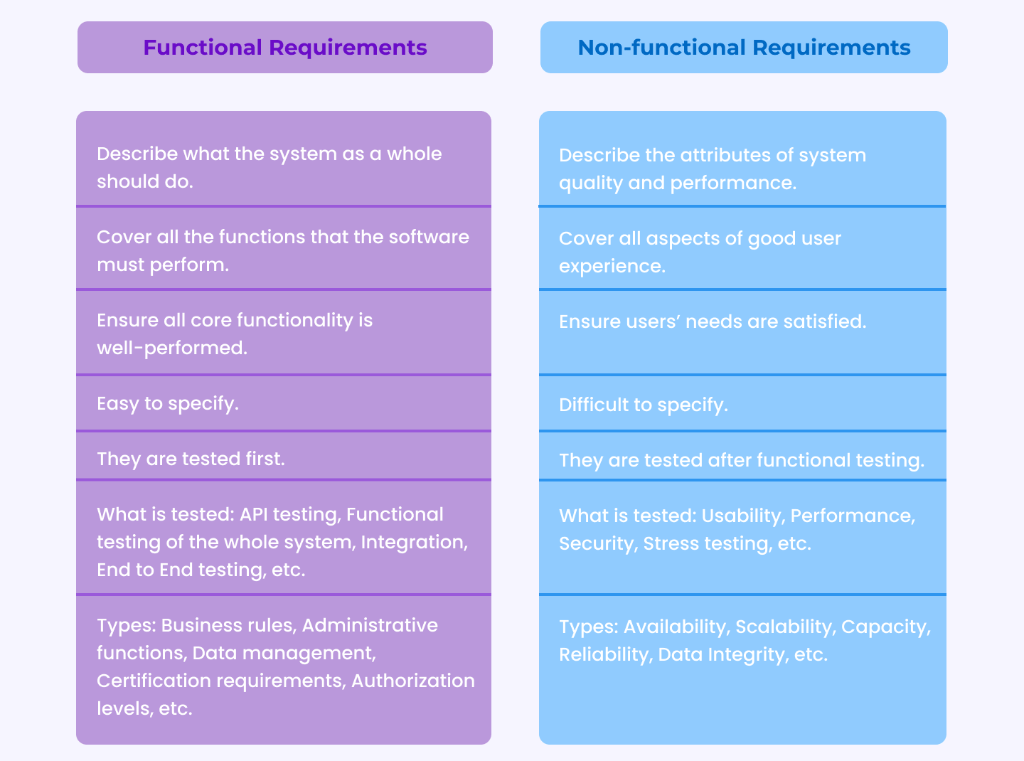
Important to understand and distinguish the two

Slide 28
Characteristics of a good requirement
Unambiguous
Testable
Necessary
Feasible
Traceable
Good or bad? (why?):
“system should respond quickly”
“system must be robust”

Slide 29
Requirements analysis
Things to consider before writing requirements:
Are there conflicts?
Are there any hidden assumptions?
Are there any missing constraints?
Validation: are we building the right system?
  Do the requirements reflect user intent?
  Do they cover failure cases?
  Can we verify the requirements later?
Verification: are we building the system right?
  Does the implementation satisfy all requirements?

Slide 30
Traceability
In long projects, requirements are written early, design decisions made later, code modified even later…
Not easy to track why something exists, and what will break if we change it
Traceability: ability to answer:
  Why does this exist?
  What requirement does it satisfy?
  What must be rechecked of it changes?
Traceability preserves intent over time

Slide 31
Summary
Requirements capture obligations
Validation ensures we chose the right obligations
Verification ensures obligations are met
Traceability connects intent to implementation over time
How to ensure our design process incorporates these steps from the very beginning? V-model!

Slide 32
The software development lifecycle
What is an SDLC?
What makes embedded SDLC special?

Slide 33
What is a Software Development Life Cycle (SDLC)?
Software is not built in a vacuum, but follows certain process models
Choice of process determines when mistakes are found or how change is handled
SDLC: A structured process used by teams to design, develop, test and maintain high-quality software
For example, a simple model:
Requirements → Design → Code → Test → Deploy → Maintain

Slide 34
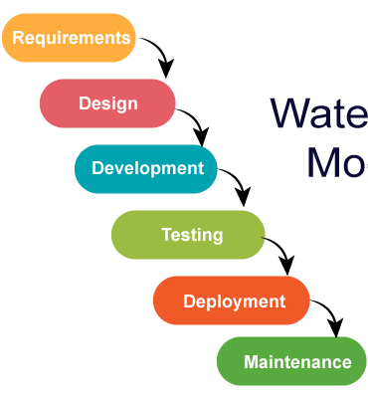
Classic SDLC:
The waterfall model
Linear / sequential
Each phase completed before next
Clear milestones
What are the problems with this model?
  Testing occurs late (if a fundamental requirement is wrong, you find it out at the very end!)
  Expensive to rework
  Link between intent (requirements) and evidence (testing) is weak
  Rigidity: Changing anything requires rework of entire chain

Slide 35
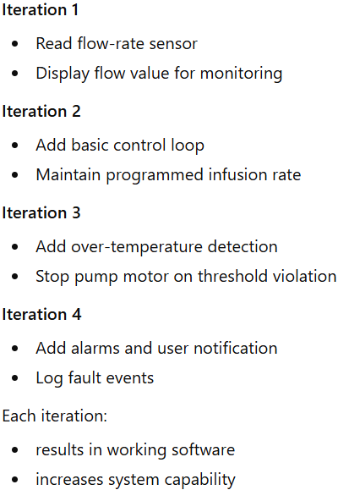
Iterative / Incremental models
Development occurs in short "Sprints“; each sprint delivers a "Minimum Viable Product" (MVP)
Advantages:
Highly adaptable to changing needs
Early visible progress
Easier debugging
Stakeholders can see functionality early (requirements verification can start early)
Continuous feedback and refinement

Slide 36
Problems with the iterative approach
Maintaining safety becomes challenging – things change in unpredictable ways
Verification planning comes late, so validation is also deferred
Hardware bottleneck:
  Embedded hardware and software are often co-designed
  Manufacturing hardware iteratively takes time
  And costs much more than making software changes

Slide 37
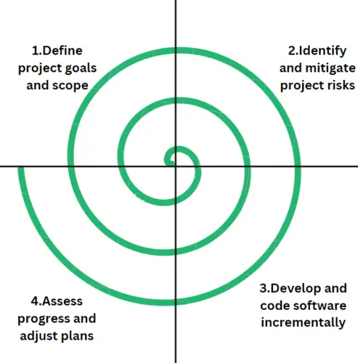
The spiral model
Iterative, but focusing on risk analysis
Build → assess risks → reduce the most critical risks → repeat
Safety-first iterative approach
Tells us what to worry about and fix first
Big picture is lacking
Not systematic enough to ensure nothing important is missing
Early spiral
  Risk: Incorrect infusion rate
  Action: Prototype control loop, validate accuracy
Next spiral
  Risk: Over-temperature causing patient harm
  Action: Add temperature monitoring and safe shutdown logic
Next spiral
  Risk: Sensor failure undetected
  Action: Add fault detection and alarm behavior
Each spiral:
  focuses on the most dangerous failure modes first
  may revisit requirements and design

Slide 38
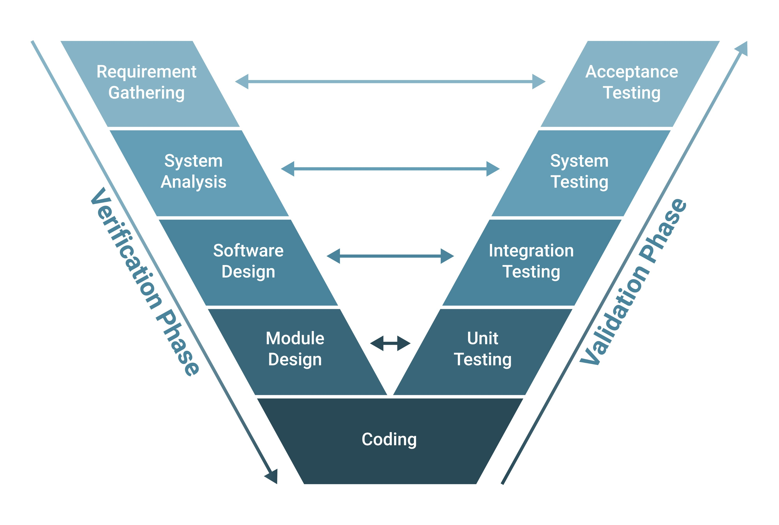
The V-Model (V = Verification!)
Refinement of the waterfall model (waterfall bent upwards)
Testing and design/development are made parallel
Left side is
decomposition
Right side is integration
Each development stage has
corresponding testing stage
Left: Verify; right: validate

Slide 39
Levels of testing in embedded systems
Unit Testing: Individual C/C++ modules (often in isolation via mocks).
Integration Testing: Interaction between modules and Hardware-Software Interface (HSI).
System Testing: Testing the full "Black Box" against functional requirements.
Acceptance Testing: Operational testing in the final environment (e.g., in the car or the industrial plant).

Slide 40
Traceability is the backbone of the V-Model
Change Management: If a customer changes a sensor requirement, which test cases need to be re-run?
Traceability: each requirement is designed for, implemented and verified
Regulatory Compliance: Standards like ISO 26262 (Automotive) and DO-178C (Aerospace) mandate 100% traceability.

Slide 41
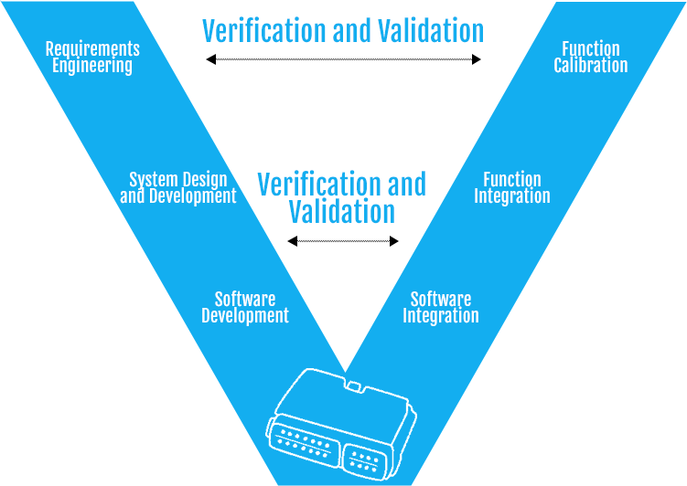
Infusion pump example
Requirement: The system
shall stop the pump
motor within 20 ms of
detecting an over-temp
Define
What constitutes over-temp?
What it means to ‘stop pump’
Identify systems involved:
Temperature sensing, control logic,
motor actuation
Behavior definition:
normal and over-temperature state
Transition:
event: temp>thresh → action: motor stop
Code elements:
temp monitor, motor control, timing
Patient safety
Prevent tissue damage
Lifecycle and safety constraints
System verification:
Inject over-temperature condition
Measure motor stop time and document
Integration verification:
verify sensor→ control → actuator path
sensor reading reaches control, control decision reaches motor module, no data is dropped, overwritten, delayed, no duplicate events
Example bugs caught: sensor event detected, but not handled by control logic
Wrong unit conversion in the chain
Unit verification:
Correct temperature read, motor stops when commanded

Slide 42
Verification planning
How each requirement will be verified?
  At what level?
  What will count as evidence?
Verification methods:
  Inspection, analysis, testing, documentation
Software Verification and Validation Plan (SVVP): A document that defines the "Who, What, When, and How" of testing.
Key Content (based on IEEE 1012):
  Verification Tasks (e.g., Code Reviews, Unit Testing)
  Pass/Fail Criteria
  Hardware/Software tools needed (Debuggers, Oscilloscopes)

Slide 43
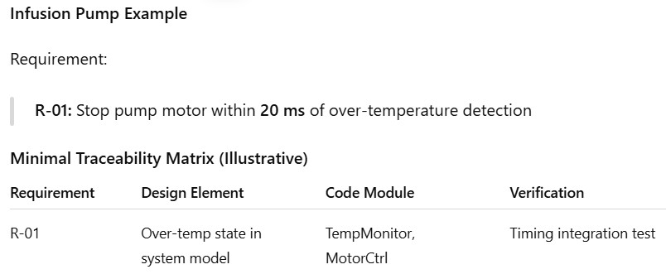
Requirements Traceability Matrix
A traceability matrix is a structured way to show how each requirement is designed, implemented, and verified across the V-model.
Requirements ←→ Acceptance / System Tests
Design ←→ Integration Tests
Implementation ←→ Unit Tests
RTM records these links

