Slide 1
Software for Embedded Systems
Prof. Saurabh Gandhi (EEE department)

Slide 2
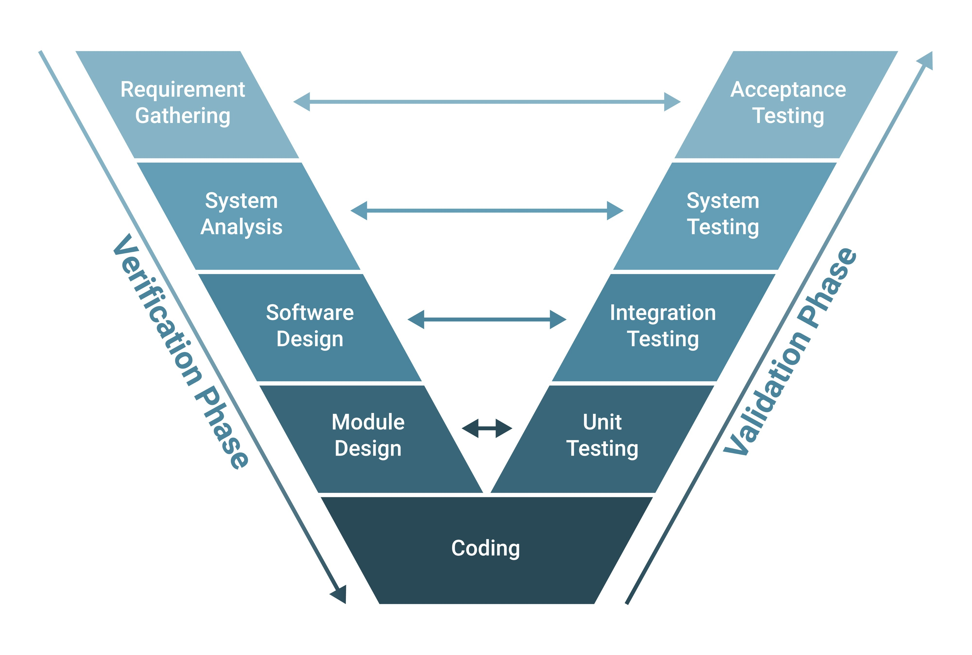

Where we are

Slide 3
What UML has given us
Functional completeness of system
Correct behavioral flow (no missing states or transitions)
Explicit safety states
Valid and ordered interactions between components
Provided we are able to implement the system that we modeled!

Slide 4
What UML does not decide
The actual implementation
Relationship with the hardware
Where each piece of code lives
What part of code performs what action
How hardware resources are shared
UML models are deliberately hardware agnostic (so we can focus on behavior first) → What should happen?
But now, we need to think about implementation → How to make it happen?

Slide 5
Firmware architecture
How do we structure software so that the behavior we modeled cannot be violated?

Slide 6
What is firmware architecture?
Firmware architecture defines:
Major software components
Their responsibilities
Allowed communication channels between components
Execution context boundaries
It tells us:
Who runs where?
Who may call whom?
Who may block whom?
Who reacts to events?

Slide 7
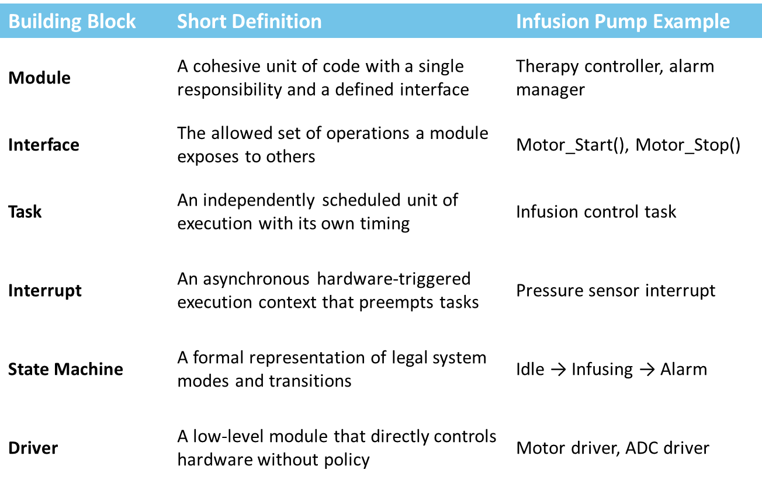
The building blocks of a software
Notes:
A module is about responsibility, not files
An interface is about permission, not convenience
A task owns time
An interrupt owns urgency
A state machine owns legality
A driver owns hardware access

Slide 8
Modules Are Units of Responsibility
A module has
One responsibility
A public interface
Hidden state
Example:
Motor module
  handles motor operations
  exposes start() and stop() on its interface
  hides states of internal registers required for function

Slide 9
Owners of time and urgency
Tasks:
Own execution flow
Run independently
Interrupts:
Preempt tasks
Detect emergencies
Example:
Therapy task controls infusion
Pressure interrupt detects occlusion

Slide 10
Who decides vs who executes?
State machine decides what (action) is allowed
Driver executes the action
Example:
State machine enters ‘alarm’ state
Motor driver stops motor

Slide 11
Architecture: How do we arrange these blocks?
So that behavior is realized?
Which module decides? Executes?
Who can override whom?
A critical concern: shared resources
Where do we start building our actual software?

Slide 12
Back to diagrams!
Creating system diagrams
Why make more diagrams?
Identify shared resources
Find difficult code components
How to balance complexity, flexibility, ease of implementation?
Delegate development tasks within teams
Reduce interdependencies between modules
Protect modules from each other
Identify interfaces
Define precise tests

Slide 13
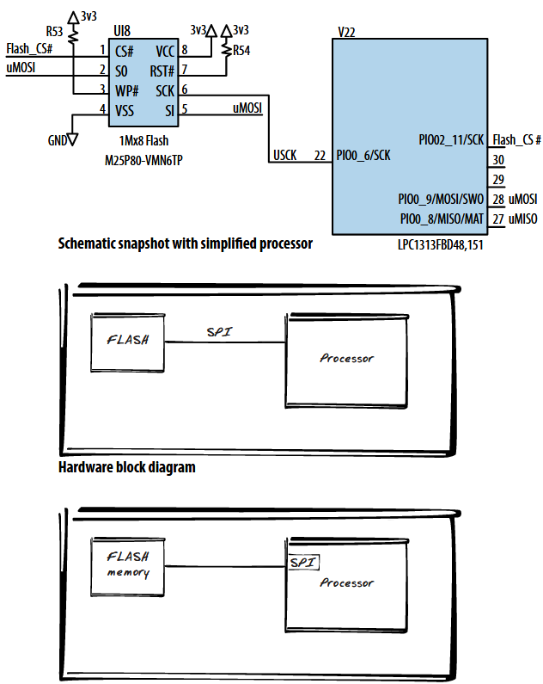
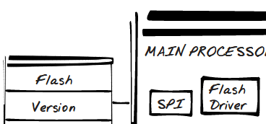
View 1: block diagrams
What exists in the system?
Start with the physical objects in your system – the microcontroller and peripherals
How do you talk to these?
  Communication goes inside the processor box (part of software)
How do you control the peripheral?
  Add another box, a driver
What are you using the peripheral for?
…

Slide 14
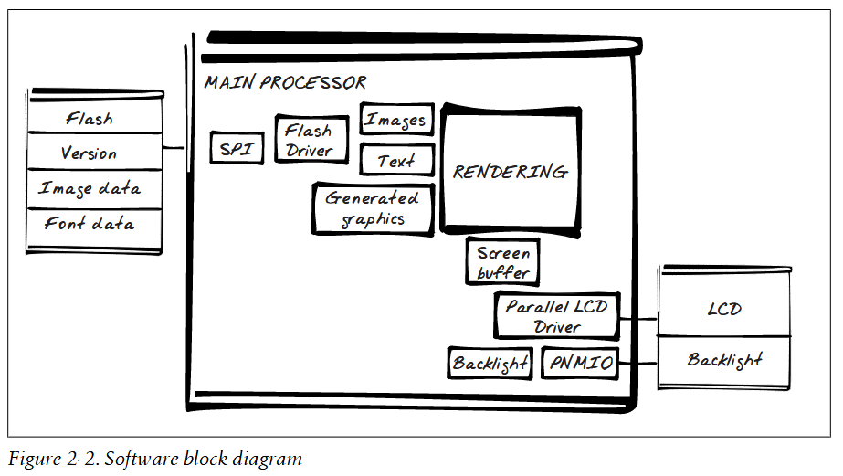
View 1: block diagrams
What exists in the system?

Slide 15
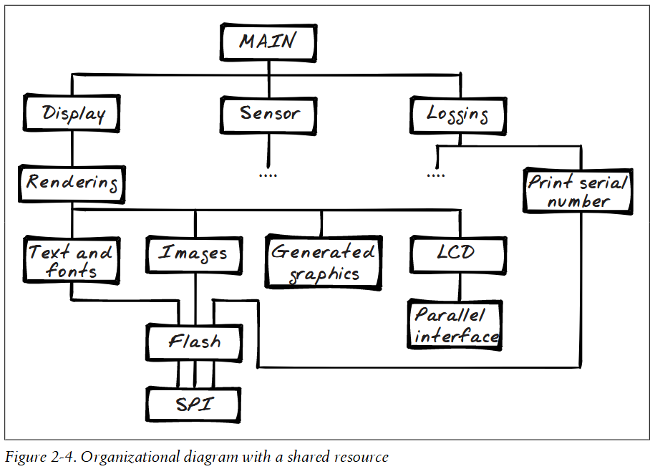
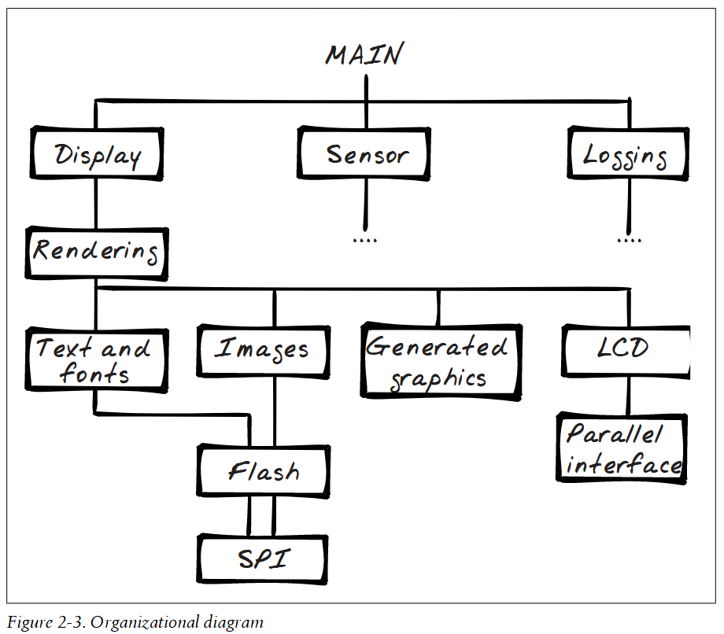
View 2: Hierarchy of Control
Who controls whom?
Sharing resources
Be careful!!!

Slide 16
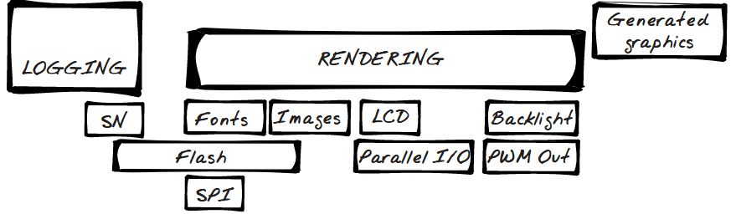
View 3: the layered view
Size and relationship between objects
Start at the bottom with peripherals (not shown)
Move up while adding blocks as layers
  Size proportional to complexity

Slide 17
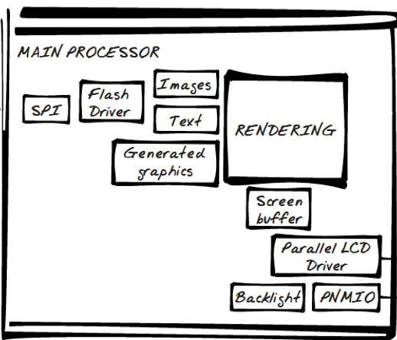
Using system diagrams:
Simplifying the system
Difficult code components – boxes that are very different across views!
Resource sharing: what peripherals can we keep independent?
Can any boxes be combined?
  In hierarchy: objects used by only one other object
  In layers: objects in a layer that are always used together (shared connections above and below)
What boxes need splitting?
  Several modules that touch the same
  lower module: can we break it up?
  For example: logging can use flash only
  at the start to read serial no, and never again!

Slide 18
Using system diagrams:
Delegation of tasks
How would you split tasks within the team?
  Assign entire blocks / groups of blocks
  Assign hierarchy branches
Reduce interdependencies
  How interdependent are the tasks of different team members?
  Too much interdependency → complex, buggy, fragile software
Identify interfaces
  Scope for delegation → scope for splitting + interface
Protection
  Think of your module can be protected from mistakes by other modules
  Will adding a box to your group reduce data sharing?
Testing
  Define inputs, outputs and function of each module
  Define tests to confirm this behavior

Slide 19
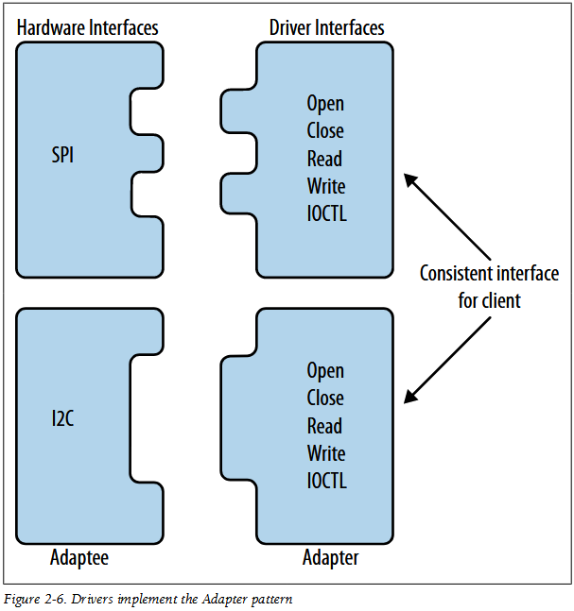
Encapsulating modules and building interfaces
Making interfaces between modules that do not depend specifically on what is inside the modules
POSIX / Unix driver standard
  open() and close(): initialize and clean up
  open() is often replaced by init()
  read() and write(): move data
  ioctl(): handle device-specific features
Convert ungainly hardware interfaces into consistent software APIs for higher level clients

Slide 20
Driver interface example
spi.open()
spi_open()
SpiOpen(WITH_LOCK)
spi.ioctl_change_frequency(THIRTY_MHz)
SpiIoctl(kChangeFrequency, THIRTY_MHz)
These are a few representative coding styles. BUT they are very important (save time debugging by following a consistent style). See Google’s suggestions.

Slide 21
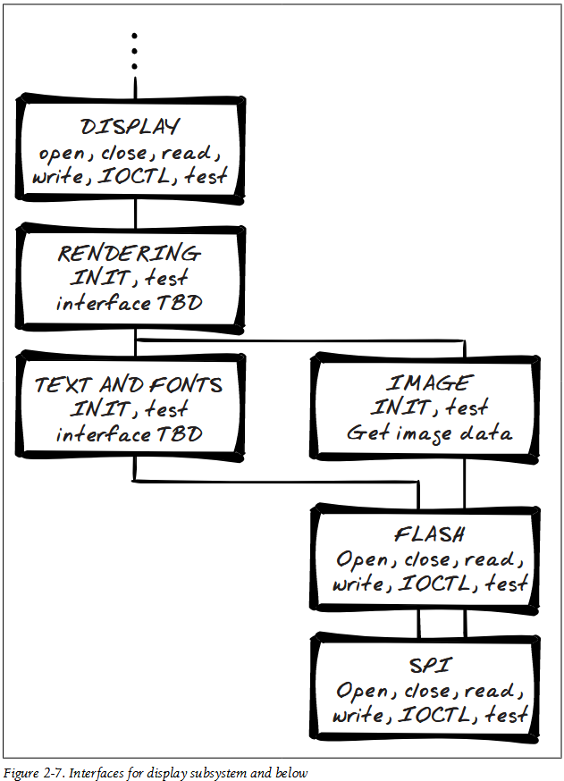
Drivers can (and should) be stackable
Each interface offered by a lower layer contains:
init() or open(), close(), read(), write()
Or equivalently, get_image_data() etc.
test()
What should a good init() be like / do?
Initialize all modules below it in the hierarchy
OK to be called multiple times
Resets system to a known state in case of partial failure

Slide 22
The Model-View-Controller (MVC) pattern
Purpose: isolate the algorithm (the gooey center of the application) from the UI for independent development and testing
View: interface to the user (or other hardware), including input from sensors or output to actuators
Model: domain-specific data and logic
Controller: glue between Model and View
  Handles how to get the inputs to the model for processing and outputs from the model for display / communication
Why?
Replace views with virtual / file-based inputs and outputs
Test the core (model) under a variety of conditions
Portability – application core is independent of externals

Slide 23


MVC in your projects
View is the UART (interface to the user)
Controller: a small module that you will write to supply UART inputs to the core logic and extract logic outputs over UART to your PC

Slide 24
Organizing your code

Slide 25
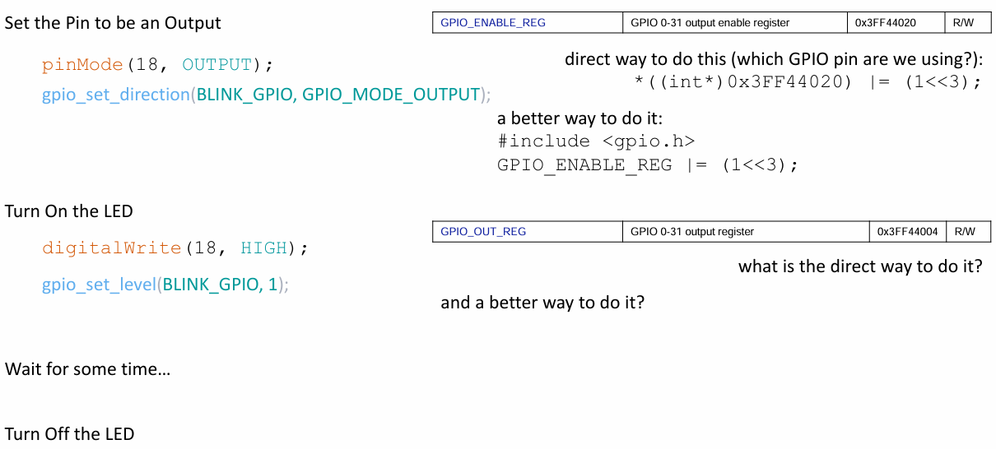
The many ways to blink an LED
Read – Modify – Write cycle
Must be atomic, i.e. complete as a single unit
Otherwise: unintended consequences!

Slide 26
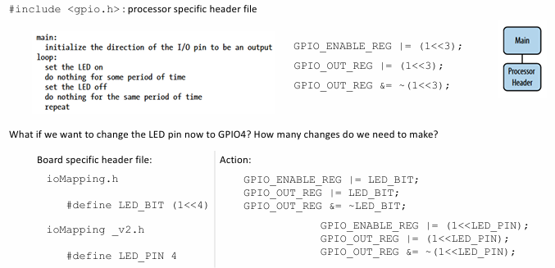
The many ways to blink an LED! Separating hardware from action

Slide 27
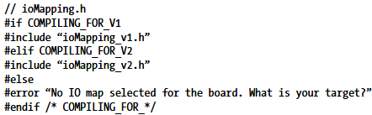
The many ways to blink an LED! Separating hardware from action
Board-specific header files and version reuse

Slide 28
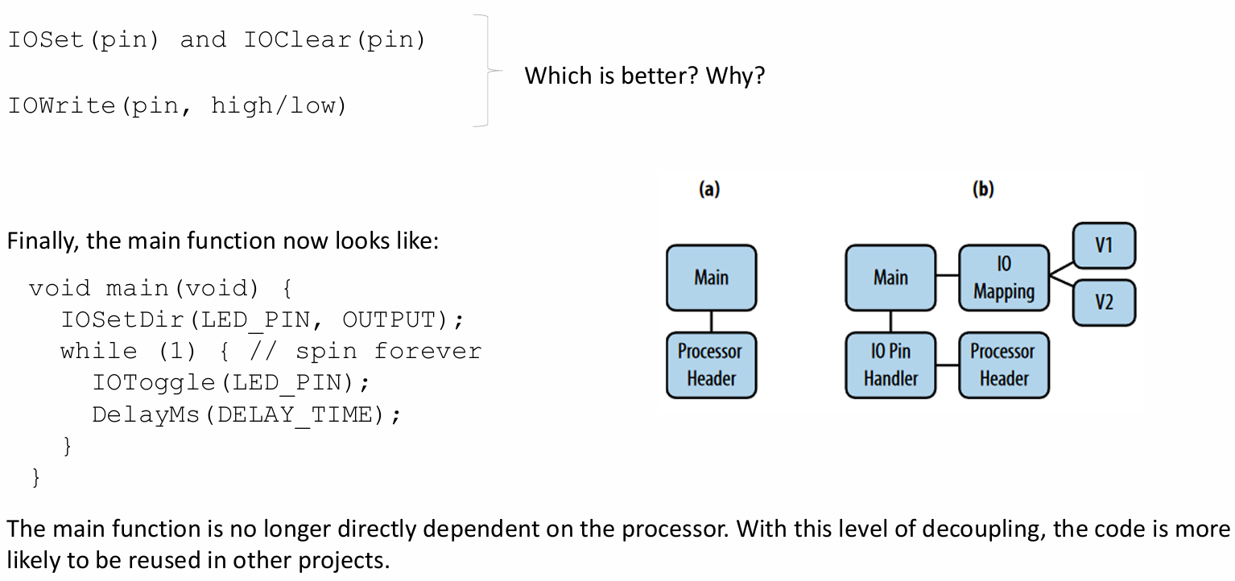
The many ways to blink an LED
I/O handling code
IOWrite: does everything in one function, so less code space
More parameters → more stack

Slide 29
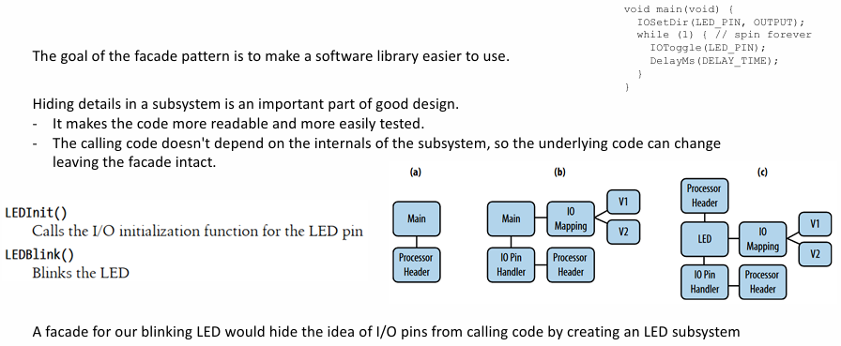
The many ways to blink an LED
Simplifying the main interface (façade)

Slide 30
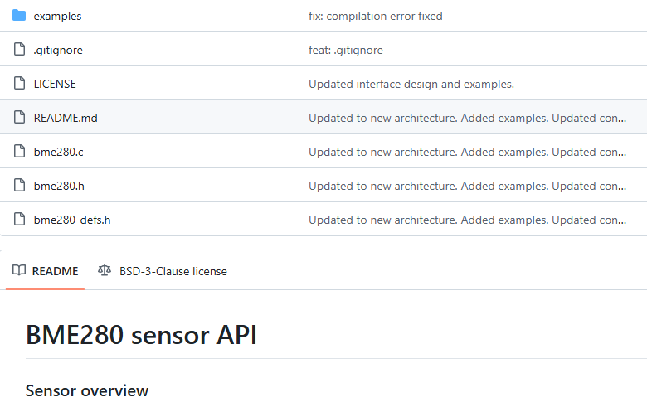
Integrating 3rd party libraries
Example: BME280 sensor from Bosch

Slide 31
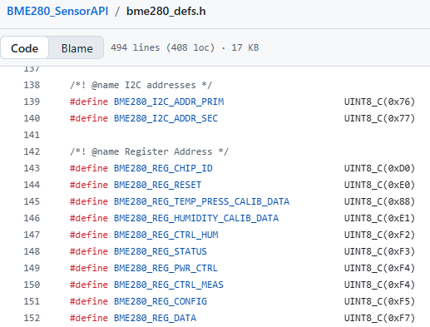
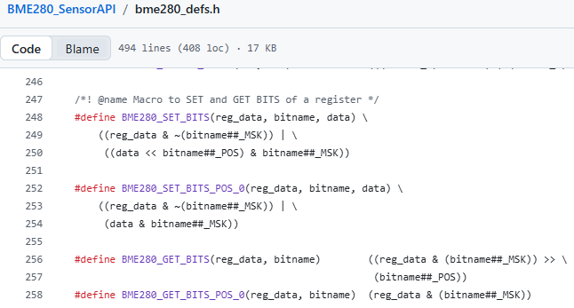
BME280 sensor API: bme280_defs.h
Utility functions / macros
Register definitions

Slide 32
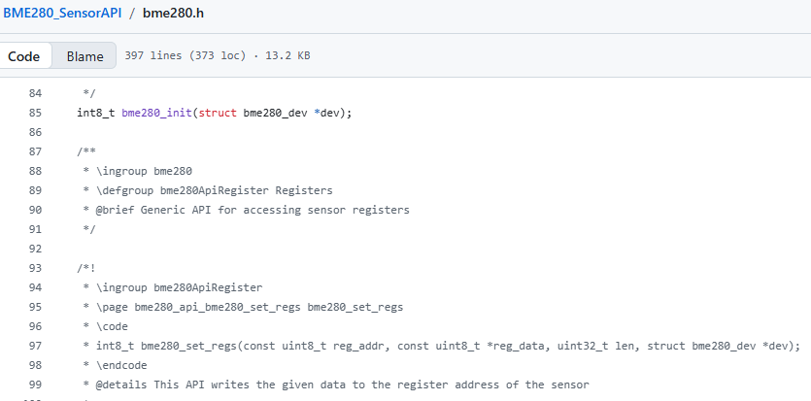
BME280 sensor API: bme280.h / bme280.c
How do you talk to the device?
Suppose we want to use I2C, supported by the peripheral device
I2C is processor specific (project specific)
Application code is project specific
Sandwiched in between is the project agnostic third party library
How do we cleanly integrate it?
Useful functions to manipulate the sensor
bme280_get_sensor_settings
bme280_set_sensor_mode
bme280_soft_reset
bme280_get_sensor_data

Slide 33
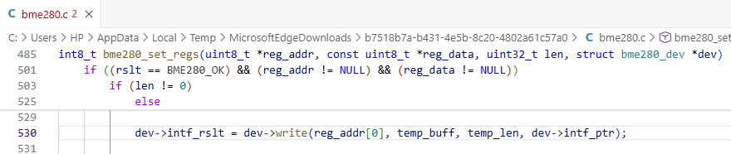
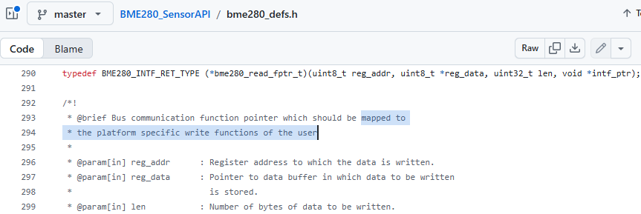
Integrating third party libraries: the glue for sandwich
1. bme library internally defines a set_regs() function to set register values
2. set_regs uses a user-defined dev.write (or dev->write) function

Slide 34
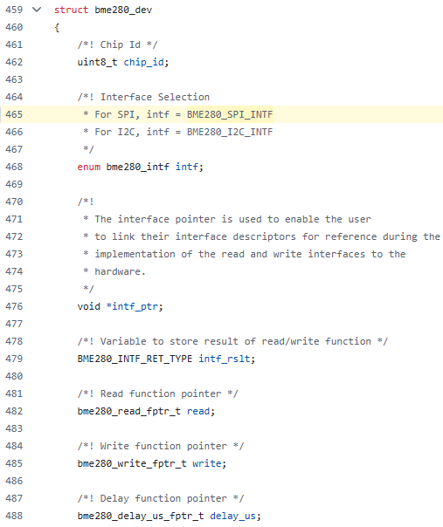
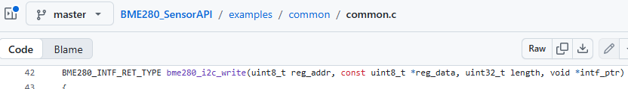


Integrating third party libraries: the glue for sandwich
3. Library will provide a struct / class through which this write function pointer is used by the library
4. Your code (sensor init module): define the i2c write function; then initialize the bme device with pointer to your function

Slide 35
Where we are
Modeling → correct behavior by ensuring we have ‘thought’ of all possibilities
but not yet implemented!
Firmware architecture (so far)
  what pieces of code (loosely coupled, modules) do we need
  how these pieces control each other
What have we still not decided?
Application layer organization – how is the main logic implemented
When do these pieces of code run?

Slide 36
Organization of the application layer
Application layer is the main (gooey) logic of your system; but within the app layer:
Is there a single controller that decides what to do next?
Are there multiple controllers?
Who receives events from the lower layers?
Who decides the mode or ‘state’?

Slide 37
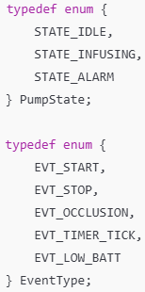
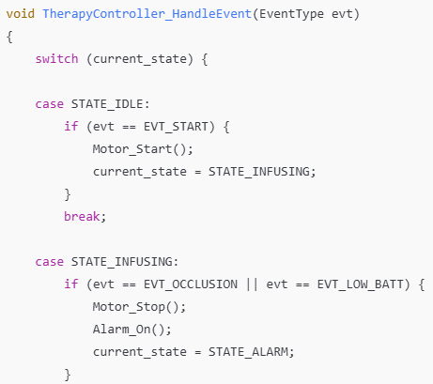
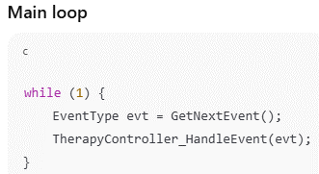
Pattern I: Monolithic controller
One central state machine that handles all state transitions and events

Slide 38
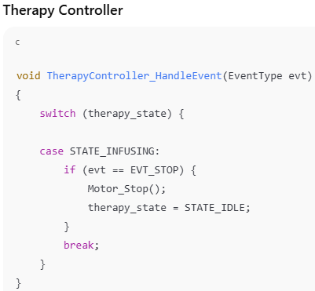
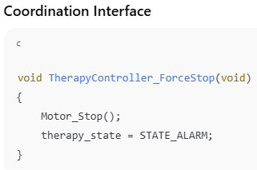
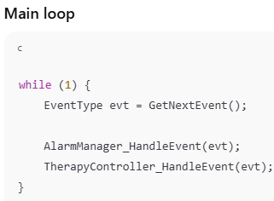
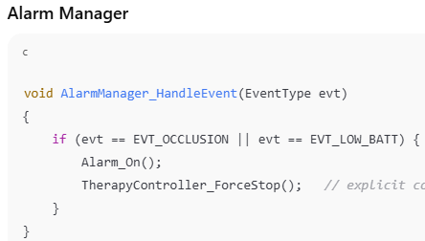
Pattern II: Coordinated controllers
Separate state machines control therapy, alarm and UI
Coordination via defined interfaces

Slide 39
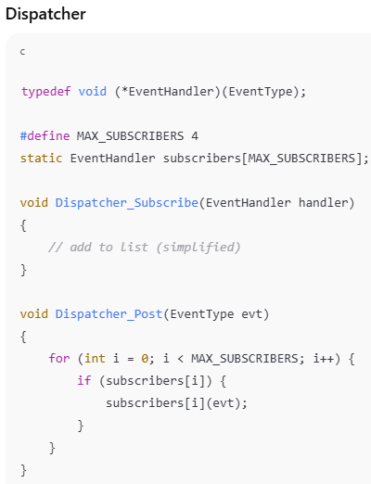
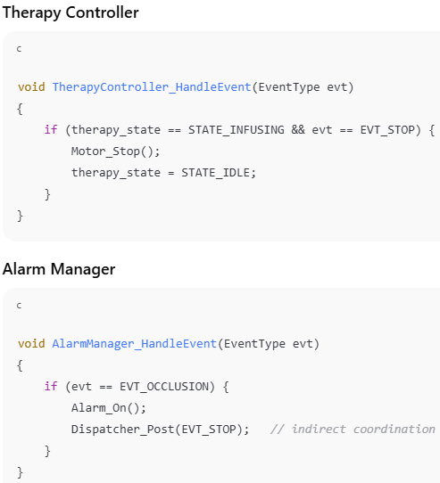
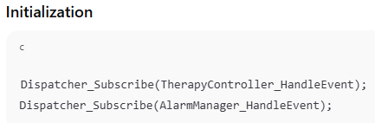
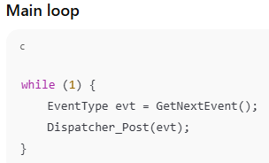
Pattern III: Event dispatcher
One central dispatcher receives events
Separate controllers subscribe to events

Slide 40
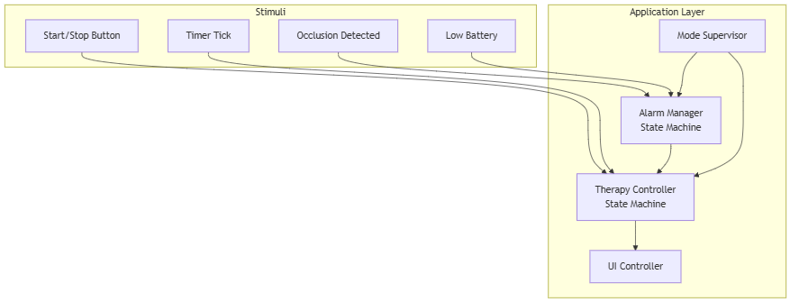
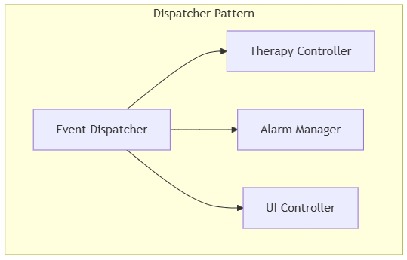
Event ownership at application level
Event | Owned By
Start button | Therapy Controller
Occlusion detected | Alarm Manager (may notify Therapy)
Timer tick | Therapy Controller
Low battery | Alarm Manager

Slide 41
Comparison of application level patterns
Pattern | Strength | Weakness
Monolithic | Simple | Becomes large, mixed concerns
Coordinated Controllers | Clear separation | Ordering & coupling must be managed
Dispatcher | Modular & scalable | Indirect control flow
Property | Coordinated Controllers | Dispatcher
Who knows whom? | Controllers know each other | Controllers know only dispatcher
Direct function calls? | Yes | No
Coupling | Explicit, directional | Indirect, via event bus
Compile-time dependency | Strong | Weaker

Slide 42
Control flow visibility
Coordinated Controllers
Control flow is explicit.
You can trace calls statically.
Easier to reason locally.
Harder to scale globally.
Dispatcher
Control flow is indirect.
Requires mental model of event routing.
Scales better.
Harder to trace.

Slide 43
Ease of adding modules
We want to add logging, safety monitor, UI refresh
Coordinated Controllers
Every new controller may require:
  new direct calls
  updated dependencies
  careful ordering
The dependency graph grows quadratically.
Dispatcher Pattern
New module:
  subscribes to events
  no other controller modified
The dependency graph remains star-shaped.
That’s the scaling advantage.

Slide 44
Final distinctions
Question | Coordinated | Dispatcher
Who stops infusion? | Alarm calls Therapy directly | Alarm emits STOP event
Who routes events? | Caller | Dispatcher
Where is coupling expressed? | Function calls | Subscription list
Coordinated Controllers
Small system
Safety-critical clarity needed
Explicit authority required
Dispatcher
Large system
Many loosely coupled modules
Plugin-style extensibility

Slide 45
Where we are
Modeling → correct behavior by ensuring we have ‘thought’ of all possibilities
but not yet implemented!
Firmware architecture (so far)
  what pieces of code (loosely coupled, modules) do we need
  how these pieces control each other
What have we still not decided?
Application layer organization – how is the main logic implemented
When do these pieces of code run?

Slide 46
Execution model = Rules of Running
An execution model defines how control flows through the system over time.
Where code runs (i.e. in what context)
When code runs?
CPU performs one task at a time.
We create the illusion of multitasking by switching Contexts
A context is the snapshot of the CPU’s soul: its registers, its program counter, and its stack
When we switch tasks, we "freeze" one soul and "thaw" another
Execution modeling is the management of CPU "Contexts" and the cost of switching between them

Slide 47
Models and contexts
Superloop: everyone waits in a long line to run sequentially
Foreground/background: Loop + ISRs
Cooperative and preemptive multitasking
RTOS
Contexts:
Main loop
Interrupt
Task (RTOS)
Deferred work

Slide 48
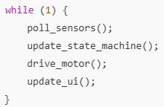
The superloop
Deterministic, simple
Context shared throughout
Hard to scale
Blocking breaks all timing constraints
Improvement: loop + ISR
Still sequential

Slide 49
Multitasking
Illusion of parallel execution
Cooperative: tasks yield voluntarily to the next task
Preemptive: Scheduler starts and stops tasks
Idea of priority

