Slide 1
Digital Design
Prof. GSS Chalapathi,
Prof. Saurabh Gandhi,
Prof. Ramesh Sambangi

Slide 2
Review questions
The table shown below is called a…
The characteristic equation for a J-K flip-flop is…
The table shown below is called a…
The flip-flop shown below will trigger on…

Slide 3
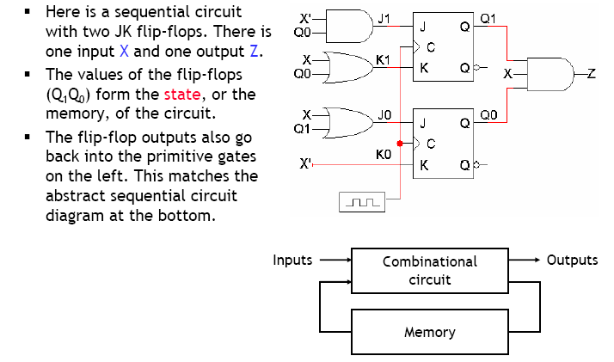
Analyzing sequential circuits

Slide 4
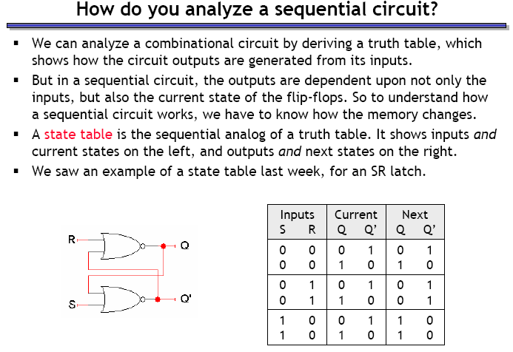
How do we begin analyzing the circuit?

Slide 5
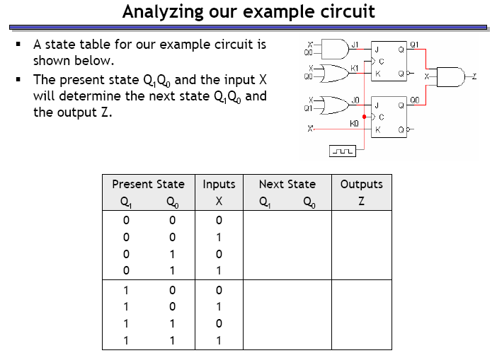
Analyzing our example circuit

Slide 6
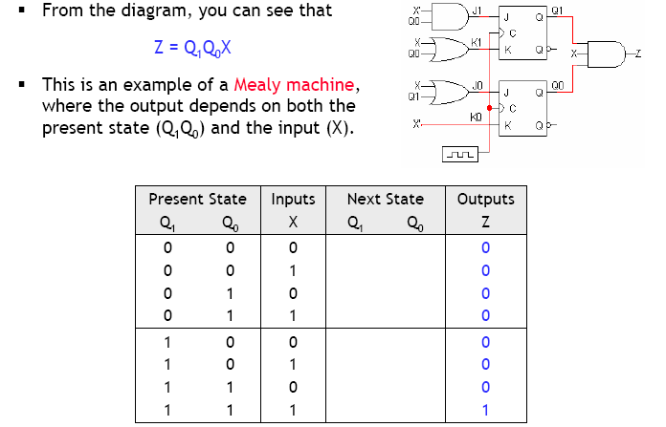
Finding the outputs

Slide 7
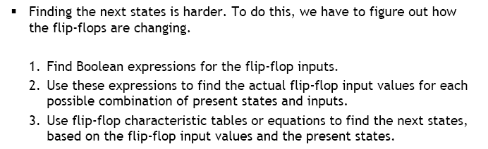
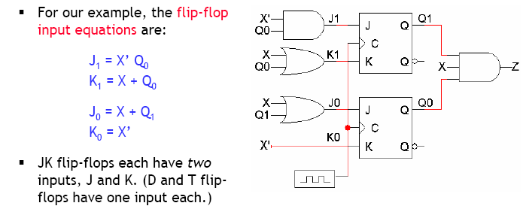
Finding next states

Slide 8
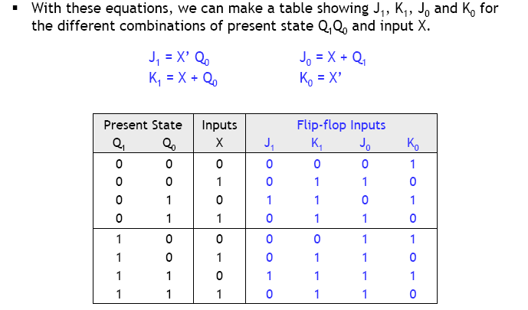
Flip flop input values

Slide 9
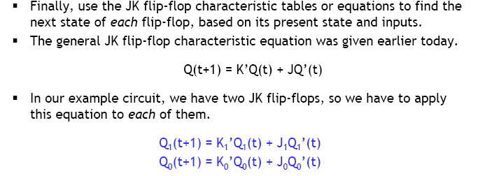
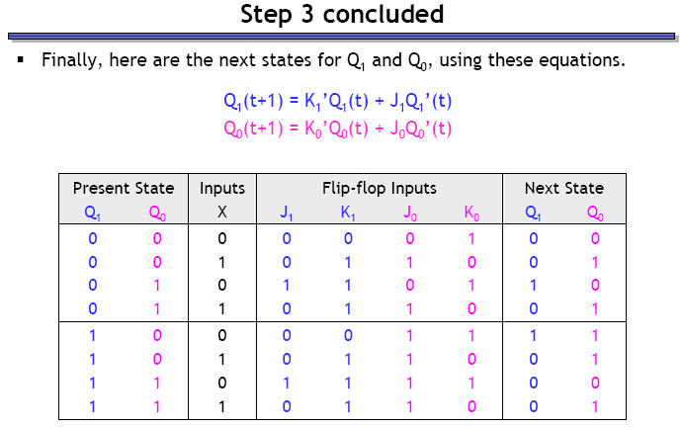
Finding the next states

Slide 10
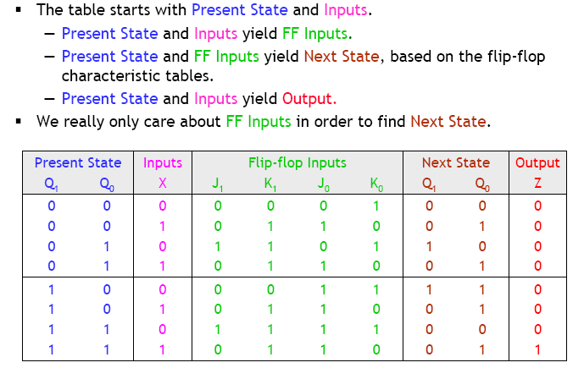
State table

Slide 11
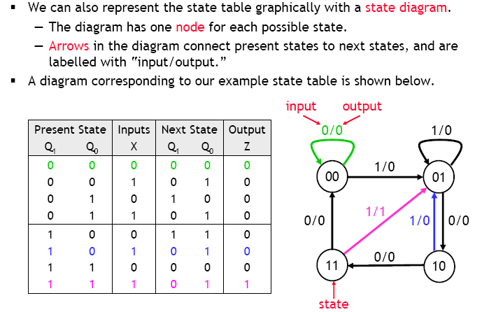
State diagrams

Slide 12
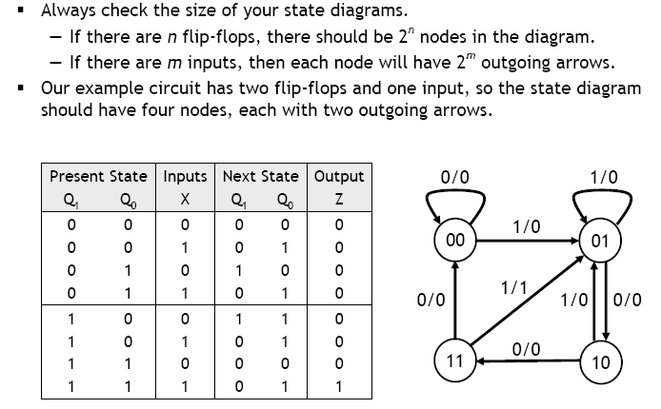
Size of the state diagram

Slide 13
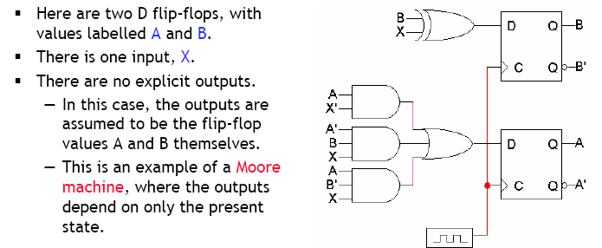
Example

Slide 14
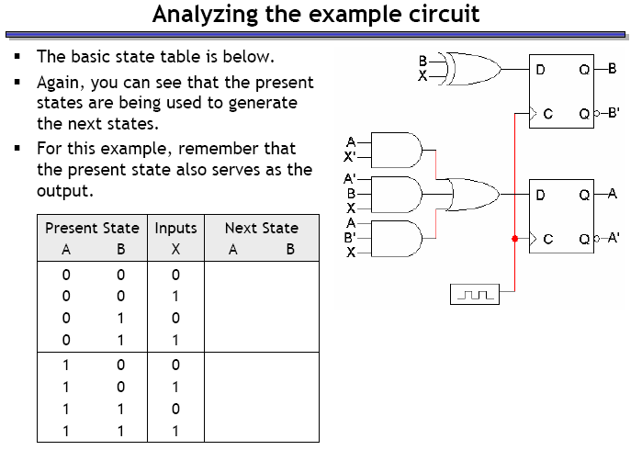
Example – circuit analysis

Slide 15
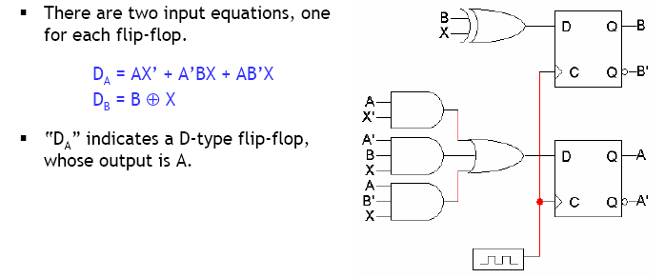
Step 1: Flip flop input equations

Slide 16
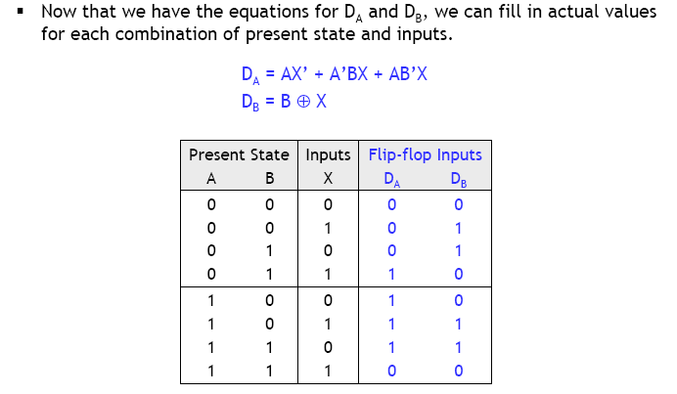
Step 2: Flip flop input values

Slide 17
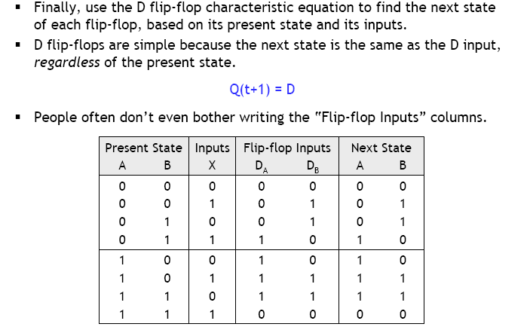
Step 3: finding next states

Slide 18
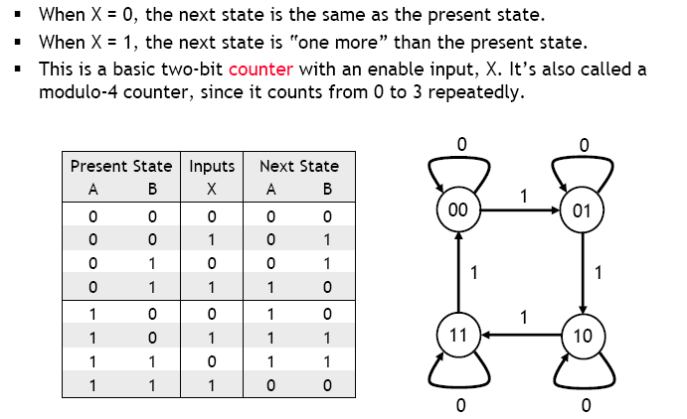
What does this circuit do?

Slide 19
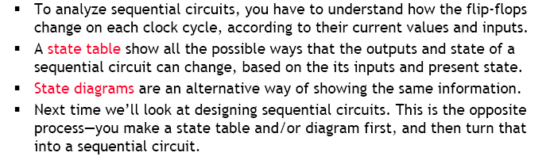
Summary

