Slide 1
Digital Design
Prof. GSS Chalapathi,
Prof. Saurabh Gandhi,
Prof. Ramesh Sambangi

Slide 2
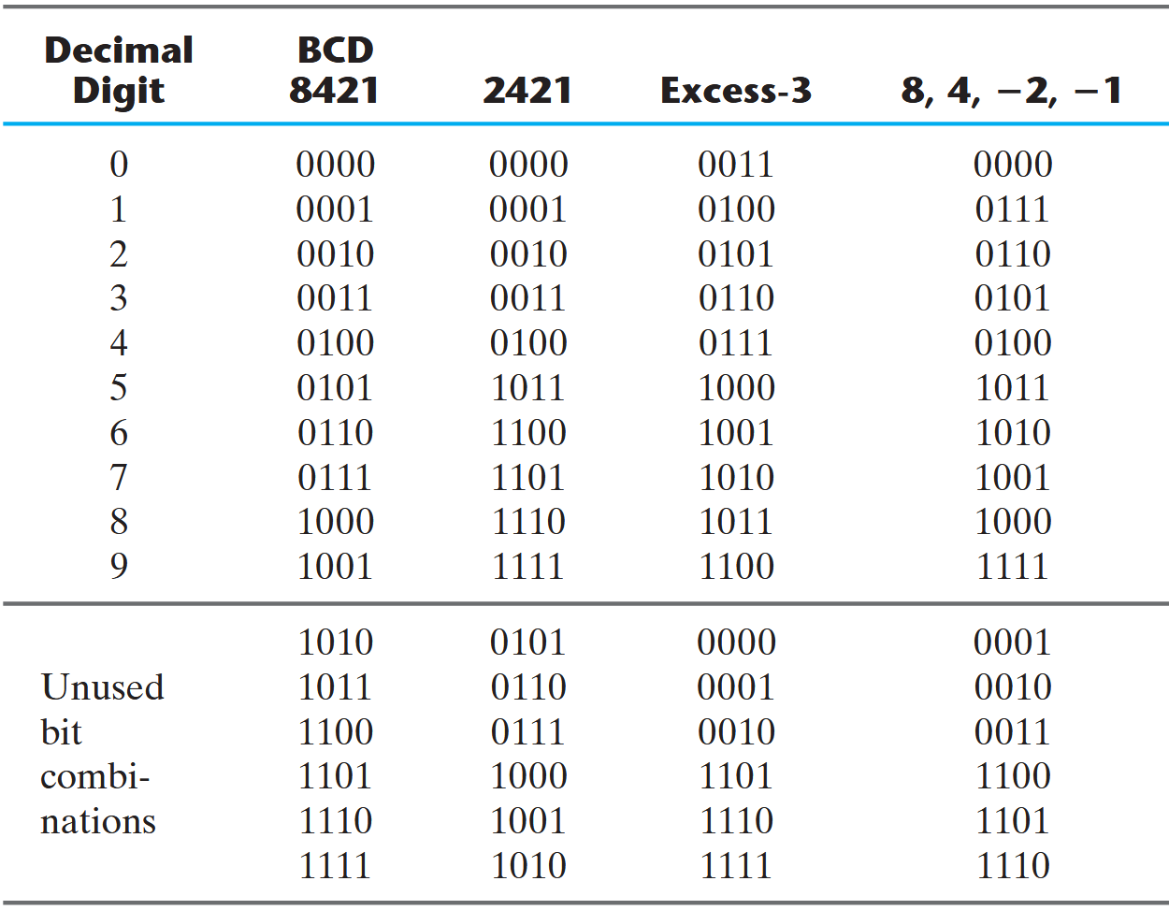
Review questions
Select the correct statements about binary representations
Different interpretations of the same binary string
Theorems and postulates of Boolean Algebra

Slide 3
Working in Binary
Representing information in binary
Operations on binary numbers, Boolean Algebra
Obtaining binary expressions and making circuits
K-maps for simplifying expressions
K-maps in special cases

Slide 4
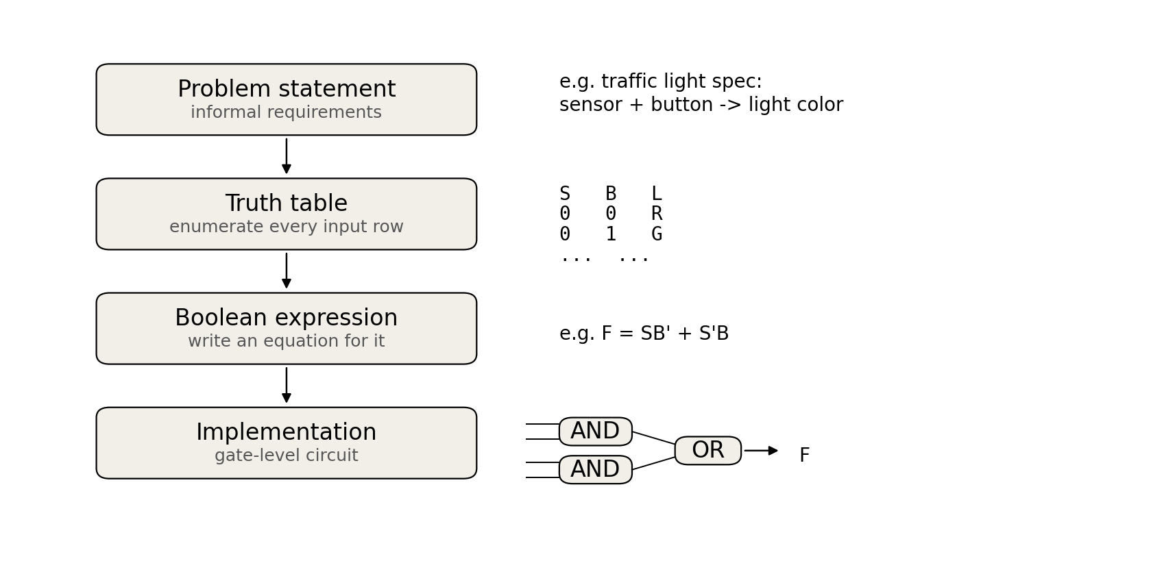

The grand scheme of designing combinational circuits

Slide 5
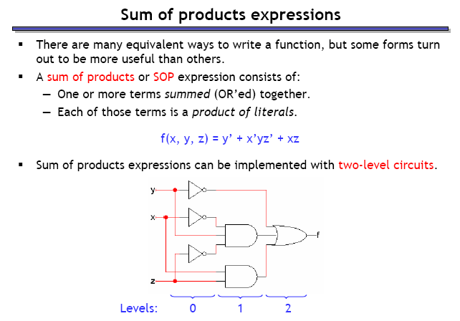
From expressions to circuits

Slide 6
The grand scheme of designing combinational circuits

Slide 7
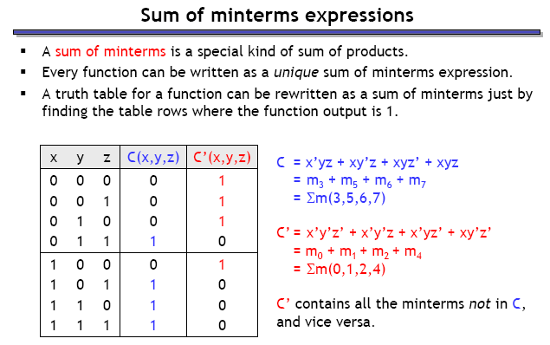
From truth tables to expressions
Here is a truth table. Can you write down the Boolean expression for C(x, y, z)?
A general way to write an expression for every possible truth table, just by looking at it…
…minterms!

Slide 8
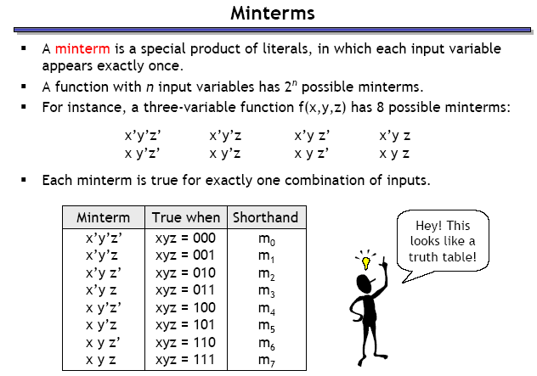
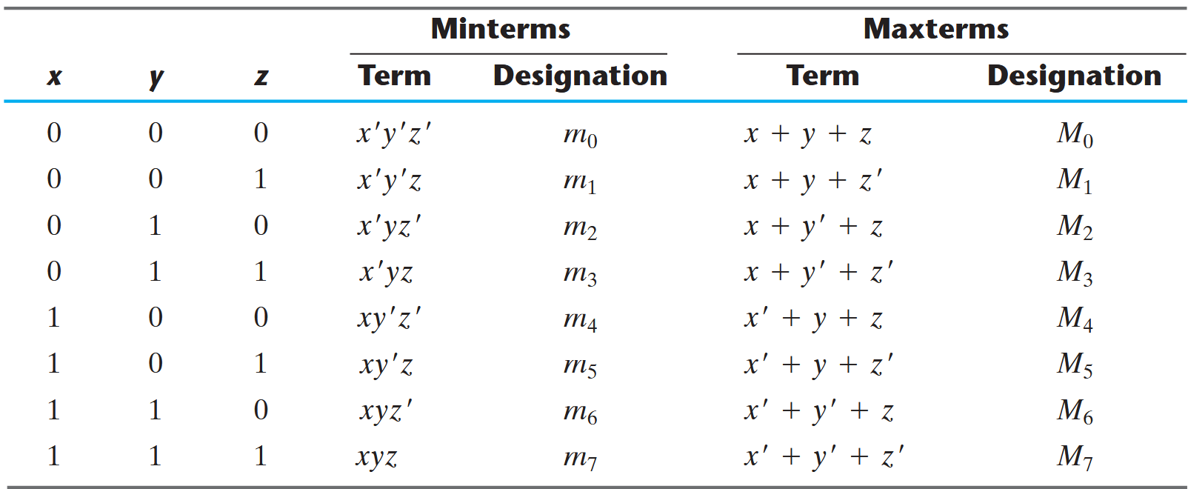
minterms

Slide 9
Sum of minterms

Slide 10
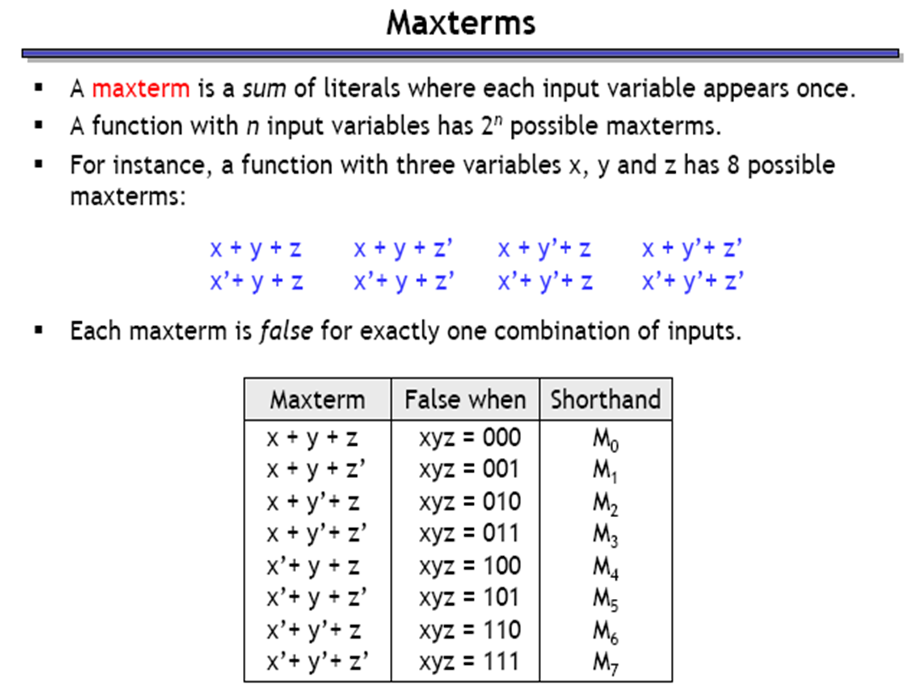
maxterms – the dual version of minterms

Slide 11
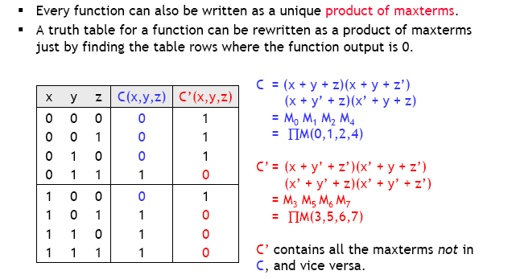
Product of maxterms
Can you guess the POMax from a SOMin expression?

Slide 12
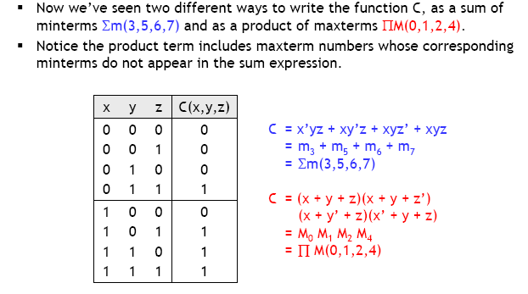
Relationship between minterms and maxterms

Slide 13
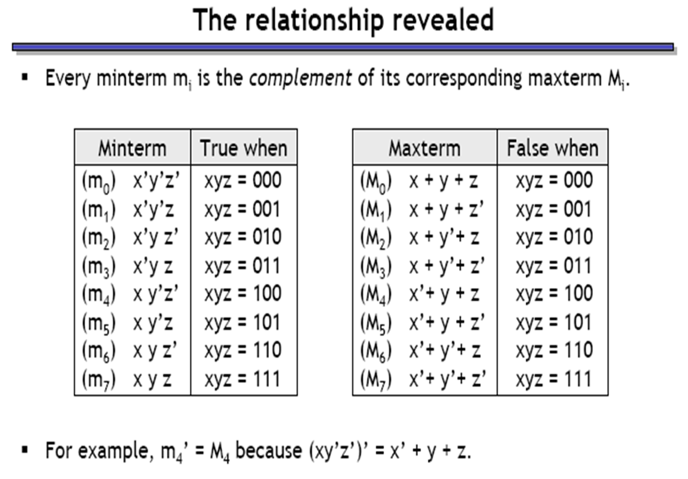
Relationship between minterms and maxterms

Slide 14
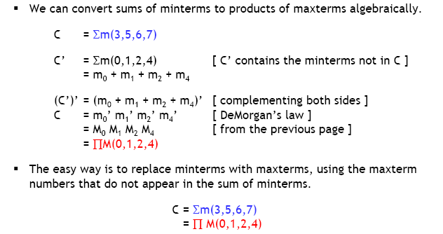
Converting between minterms and maxterms

Slide 15
The grand scheme of designing combinational circuits
DONE WITH COMBINATIONAL?!

