Slide 1
Digital Design
Prof. GSS Chalapathi,
Prof. Saurabh Gandhi,
Prof. Ramesh Sambangi

Slide 2
Review questions
In SOP expressions, k-maps enable a reduction in ________
Which of the following rules apply when grouping terms in a k-map?

Slide 3
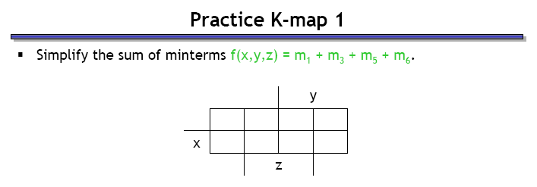
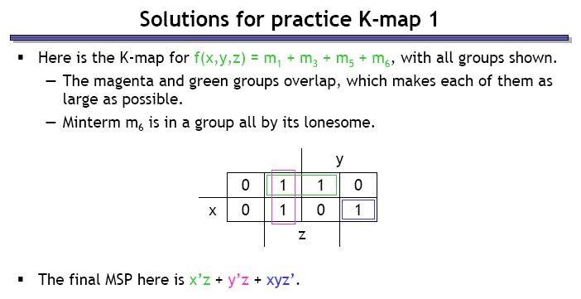
A simple k-map example

Slide 4
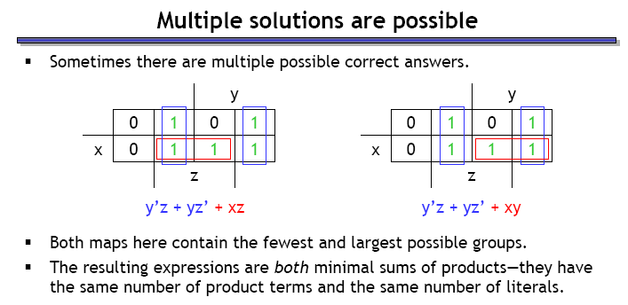
Another simple k-map example
Which of the following two groupings is correct / better?
A B
The best solution need not be unique!

Slide 5
Working in Binary
Representing information in binary
Operations on binary numbers, Boolean Algebra
Obtaining binary expressions and making circuits
K-maps for simplifying expressions – applications
Advanced K-maps

Slide 6
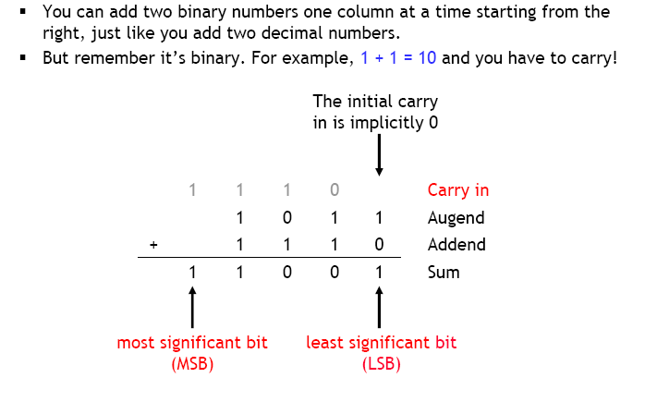
Binary addition – terminology

Slide 7
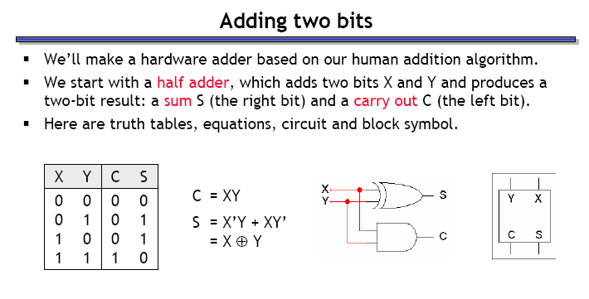
Adding two bits: half adder

Slide 8
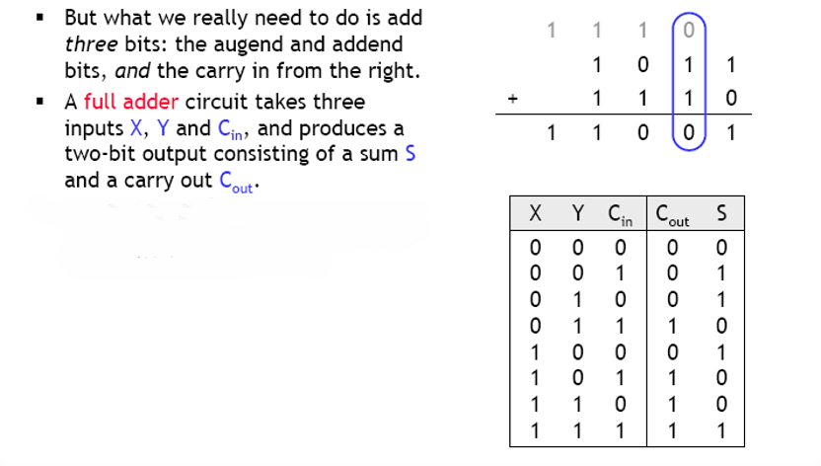
Adding three bits: full adder

Slide 9
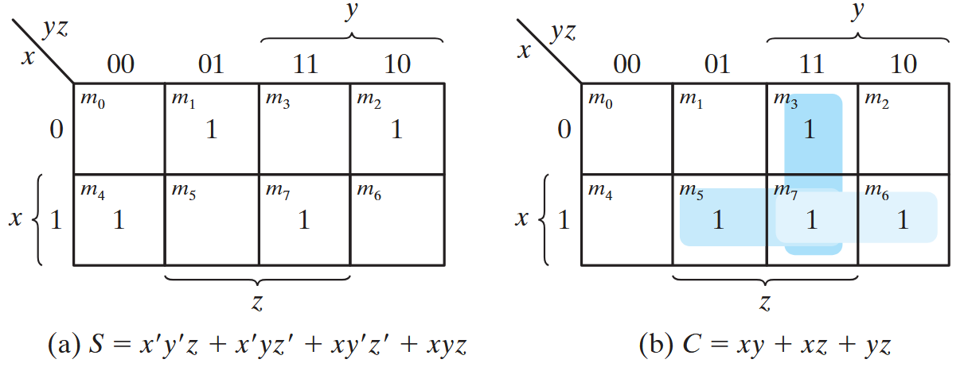
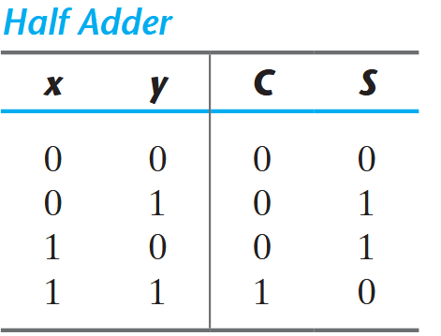
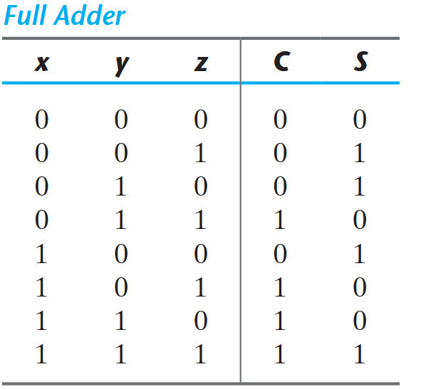
Using K-maps to build a binary full adder
K-map for S
K-map for C

Slide 10
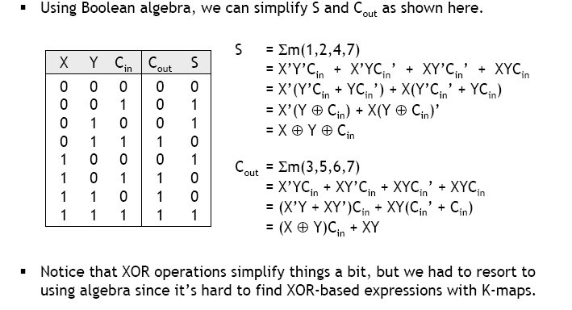
Full adder equations

Slide 11
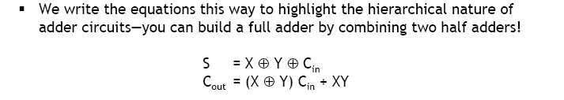
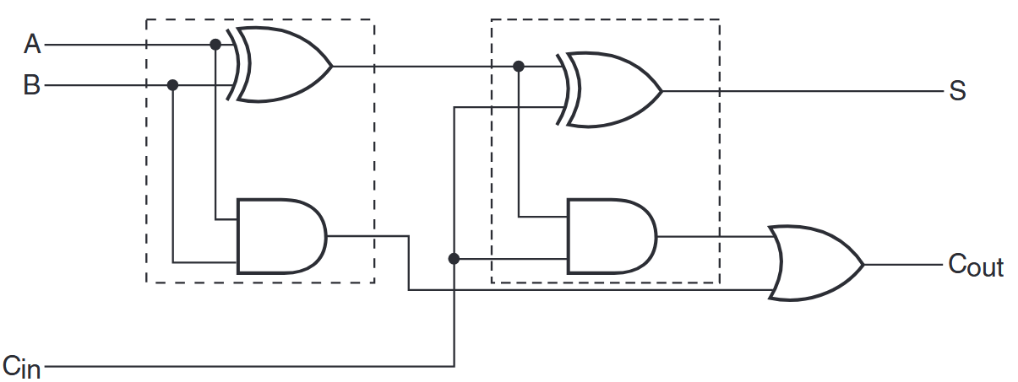
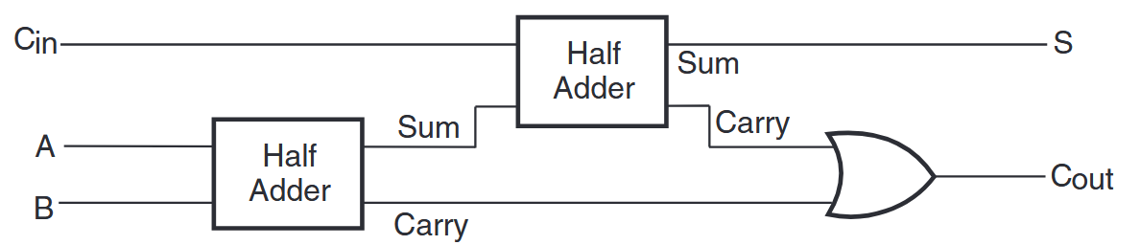
Full adder circuit

Slide 12
4-bit adders
Now we want to build a circuit that will add two 4-bit numbers:
a₃a₂a₁a₀
+ b₃b₂b₁b₀
With a 1-bit carry in, c_{i}.
It outputs a 4-bit sum, s₃s₂s₁s₀, and a carry out, c_{o}.
How many inputs does the circuit have?
How many lines in the truth table?
Is there an easier way?
Remember how we used two half-adders to build a full adder?

Slide 13
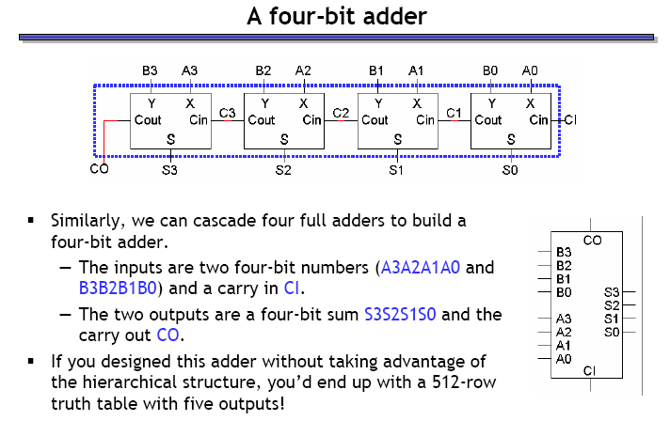
A four-bit adder

Slide 14
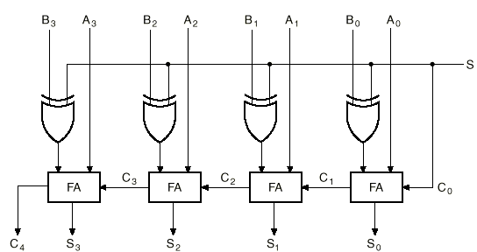
What does this circuit do?
When S = 0:
Inputs are A and B
Result is A + B
When S = 1:
Inputs become A and B’
C₀ = 1, so 1 is added to A + B’
Result is A - B
XOR gate acts as a programmable inverter!
Is the subtraction result correct as is?
When A > B?
When B > A?

Slide 15
Binary subtraction
Remember the complement method for subtraction?
The subtraction A-B can be performed by taking the 2’s complement of B and adding to A.
The 2's complement of B can be obtained by complementing B and adding one to the result.
A-B = A + 2C(B) = A + 1C(B) + 1 = A + B’ + 1

Slide 16
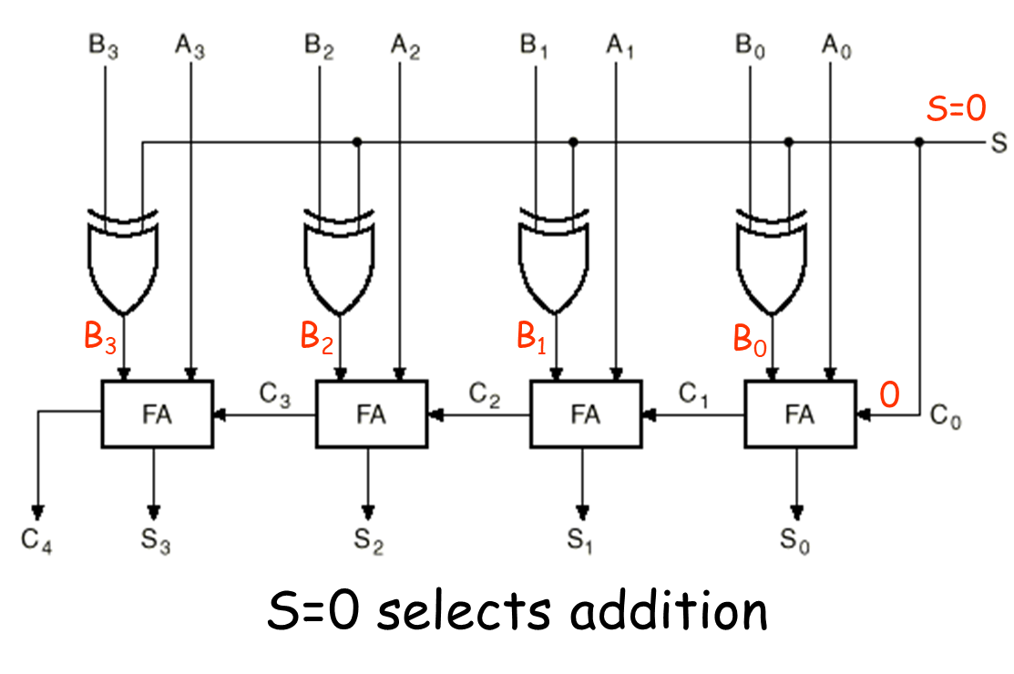
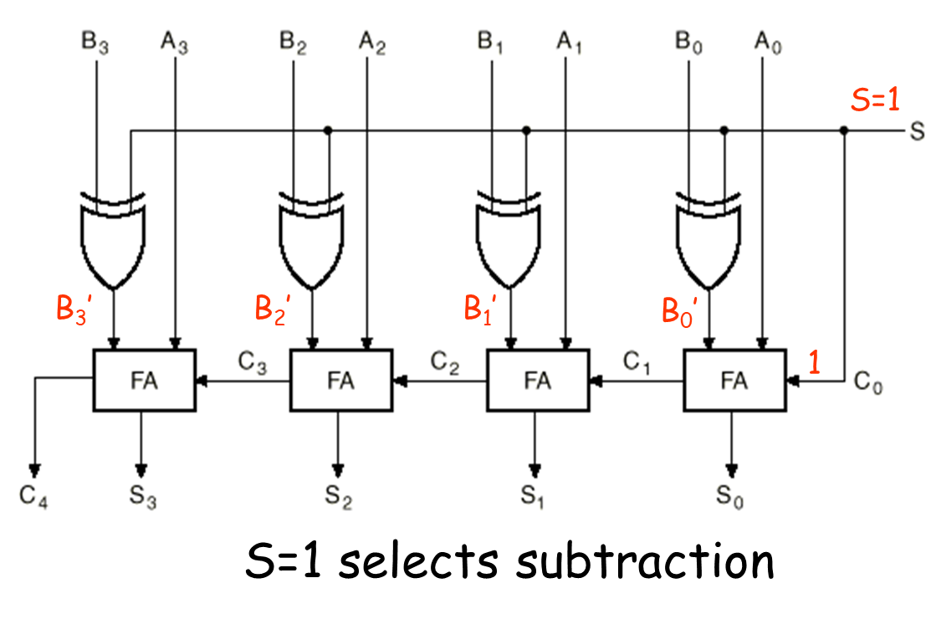
Addition and subtraction modes

Slide 17
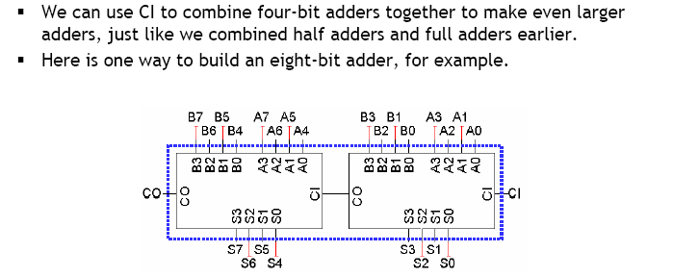
Extending the 4-bit adder: ripple carry adders
How long does the addition take?

