Slide 1
Digital Design
Prof. GSS Chalapathi,
Prof. Saurabh Gandhi,
Prof. Ramesh Sambangi

Slide 2
Logistics

Slide 3
Evaluation components ( / 300 )
Component | Duration | Total Marks | Nature of component | Date and Time
Midsemester exam | 90 mins | 75 | CB/OB | See tentative schedule here.
Comprehensive exam | 180 mins | 105 | CB/OB
Quizzes (best 2 / 3) | 45 mins each | 30 | CB
Lab exam$ | 2 hr + 1.5 hr | 50 | OB
Class participation% | N/A | 20 + 5 | OB | All classes
Lab performance# | N/A | 15 | OB | All labs
#1.5 marks each, best 10 out of 12 (for attendance and completion as defined for each lab)
%based on the engagement score described below
$ [IPC lab] Converting a circuit to Verilog (15 marks), writing an appropriate test bench (15 marks) + [Digital lab] Clean and functional physical implementation of circuits on breadboards (20 marks)
Weightages subject to reasonable minor adjustments if needed.

Slide 4

Class participation https://student-ces.vercel.app/
Step 1: Log in with your BITS email
Step 2: Join the course using this code: SXPGYZ
Step 3: Open the ‘Live session’ tab
Step 4: Answer the questions that show up on your screen!
(provide location permission)
What section are you attending today? L1 / L2 / L3
Select all that apply
Where will you find course related announcements and material?
Step 5: Bookmark / install the pwa

Slide 5
Class participation (20 + 5 marks)
BITSapp (BITS Interactive Teaching System): 20 marks total
All lectures will count. NO MAKE-UPs, since there are so many lectures.
Marks based on # questions attempted + # days attended, both
Primarily based on attempting only, though SOME answers will also be checked for correctness to detect random answering
If you are found to answer while not in class – straight ZERO / 20
Location permission is used to detect this!
No location == not counted, so ensure you provide location permission
Participating sincerely and genuinely will DEFINITELY help you in exams (ask your seniors who took Comp Arch last semester)
Other minor participation components: 5 marks (to be announced later)

Slide 6
Lab performance and exam
1.5 marks per lab, best 10 / 12 (NO MAKE-UPs for any reason)
Requirements:
Implement the circuits for all runs in Logisim evolution before the lab
Show the simulations to the lab instructors and answer any questions they ask on it (0.5 marks)
Implement the circuit in a neat manner (0.5 marks)
Demonstrate correct working (0.5 marks)
Lab 4 onwards: Verilog part needs to be completed and submitted (how? Later)
Will greatly benefit in the lab exam by completing these regularly
Lab exam
[IPC lab] Verilog circuit implementation and testing (30 marks)
[Digital lab] Implementing and debugging circuits neatly (20 marks)

Slide 7
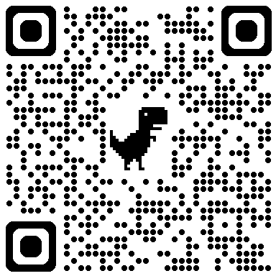
Course material and announcements
Google classroom
classroom.google.com
Joining code: bwosvprd
Join now.

Slide 8
Finding information + contacting IC
Schedule (lectures, labs, tutorials): https://tinyurl.com/f215-schedule
FAQs (evaluation scheme related and others): https://tinyurl.com/f215-faqs
Contacting IC
E-mails will NOT BE answered or acted upon
Fill out the form at https://tinyurl.com/f215-contact instead

Slide 9
Open book part of compre / midsem
Open book part of compre and midsem will allow
ONLY HADNWRITTEN NOTES IN A NOTEBOOK
No loose sheets
No printouts (of digital notes) or copies
General recommendation: take proper notes in the class, slides will not be sufficient study material

Slide 10
Why study Digital Design?
Industry relevance:
Basis for chip design, FPGA development, ASIC/SoC development and validation, hardware systems, embedded system design
Automotive, consumer electronics, aerospace, IoT
Understanding computer hardware will help design better software: performance optimization, hardware acceleration, cloud infrastructure, security
Foundation for better AI: Google’s TPU, Apple’s Neural Engine, NVIDIA’s DL cores, building domain-specific AI enabled hardware
Research opportunities:
Computer architecture, VLSI design, neuromorphic computing (e.g., IBM TrueNorth, Intel Loihi), security
Hardware-aware ML, real time AI, bio-inspired computing, quantum computing, fault tolerant systems

Slide 11
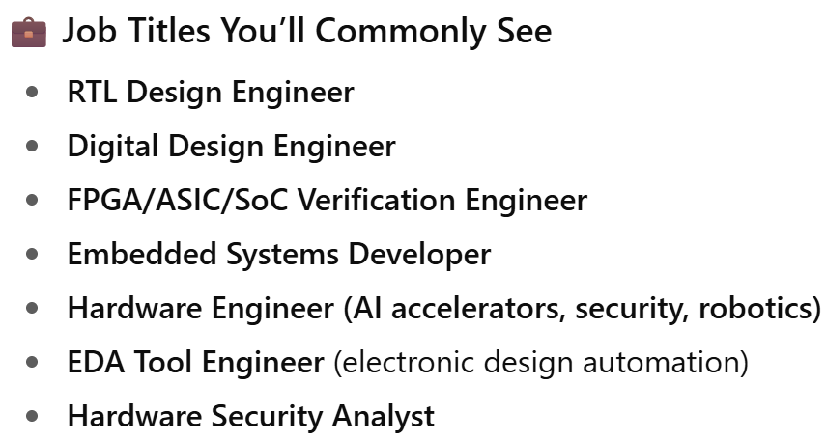
(since we are all using it) GPT says…
Overall Market Demand Summary
Sector | Digital Design Demand | Notes
Semiconductors & Chip Design | 🔥 Very High | Core skill for VLSI, ASIC, FPGA, SoC. Growth fueled by AI, 5G, custom silicon.
Embedded Systems & IoT | 🔥 High | Used in consumer electronics, automotive, defense, and medical devices.
AI/ML Hardware (Edge & Cloud) | 🔥 High | Digital design is needed for accelerators like GPUs, TPUs, NPUs.
FPGA-based Systems | 🔥 High | Especially in telecom, finance, defense, and AI prototyping.
Automotive (ADAS, EV) | 🔥 High | Key to hardware in electric vehicles, autonomous driving, etc.
Cloud Infrastructure | ⚡ Moderate to High | Digital hardware design is essential for optimizing data center hardware.
Startups in Deep Tech | ⚡ Moderate to High | Especially in AI hardware, robotics, edge computing.
Top Hiring Companies:
Chip Makers: Intel, AMD, Nvidia, Qualcomm, ARM, Broadcom, Apple, Samsung.
AI Hardware: Google (TPU), Amazon (Inferentia), Tesla, Cerebras, Graphcore.
Startups: SiFive (RISC-V), Tenstorrent, Mythic, Edge Impulse, etc.
Defense/Avionics: Boeing, Lockheed Martin, DRDO (India), HAL.
Automotive: Tesla, Bosch, NXP, Renesas, Mobileye.
Most of these have core design roles in India now!
Several Indian startups getting into this field as well!

Slide 12
What the heck is ‘digital’ about our age?
Signals
Continuous
Discrete
Systems
Analog
Digital

Slide 13
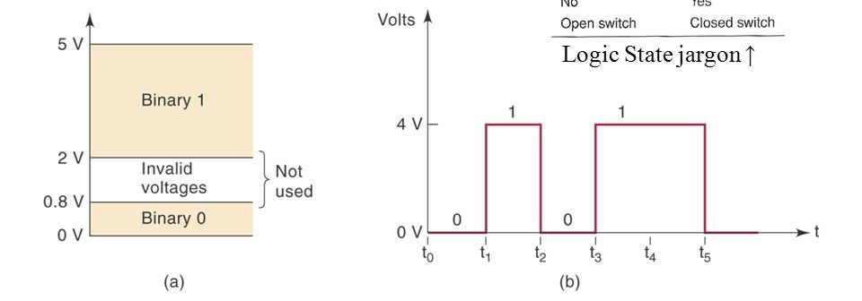
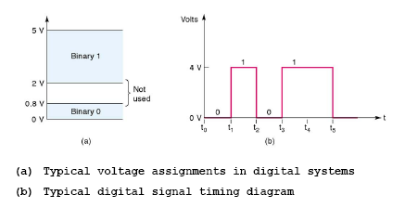
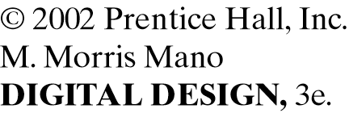
A typical binary digital system

Slide 14
Advantages of digital systems
Reproducibility of results
Ease of design
Programmability
Speed
Cost
Integrated Circuits

Slide 15
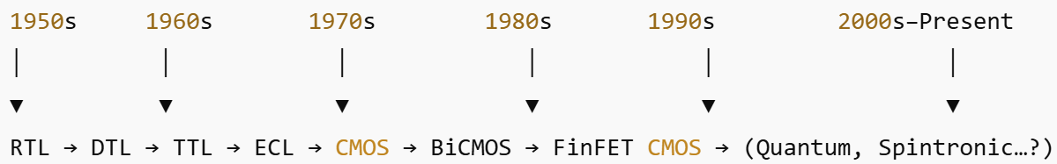
What are integrated circuits?
Linear
Digital
Levels of integration
SSI
MSI
LSI
VLSI
IC logic families
RTL, DTL
TTL
ECL
NMOS, PMOS
CMOS

Slide 16
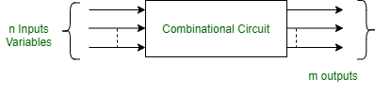
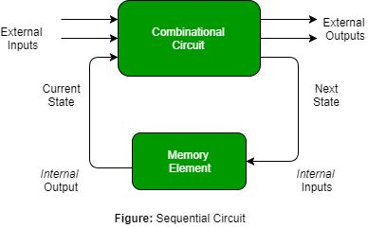
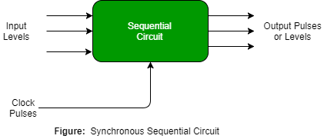
Broad categories of digital circuits
Combinational
Sequential

Slide 17
In this course
Binary representations and binary arithmetic
Combinational circuit design
Sequential circuit design
Digital logic families, ICs and their characteristics
Basics of HDL

