Slide 1
Digital Design
Prof. GSS Chalapathi,
Prof. Saurabh Gandhi,
Prof. Ramesh Sambangi

Slide 2
Review questions
To implement an expression in the SOP form, the three different levels comprise of what gates? Arrange them in the correct order.
A POS form can be written with ________
How many minterms can you make with 4 variables?
A Boolean function of 5 variables written as sum of minterms will have
Converting between minterms and maxterms

Slide 3
Working in Binary
Representing information in binary
Operations on binary numbers, Boolean Algebra
Obtaining binary expressions and making circuits
K-maps for simplifying expressions
K-maps in special cases

Slide 4
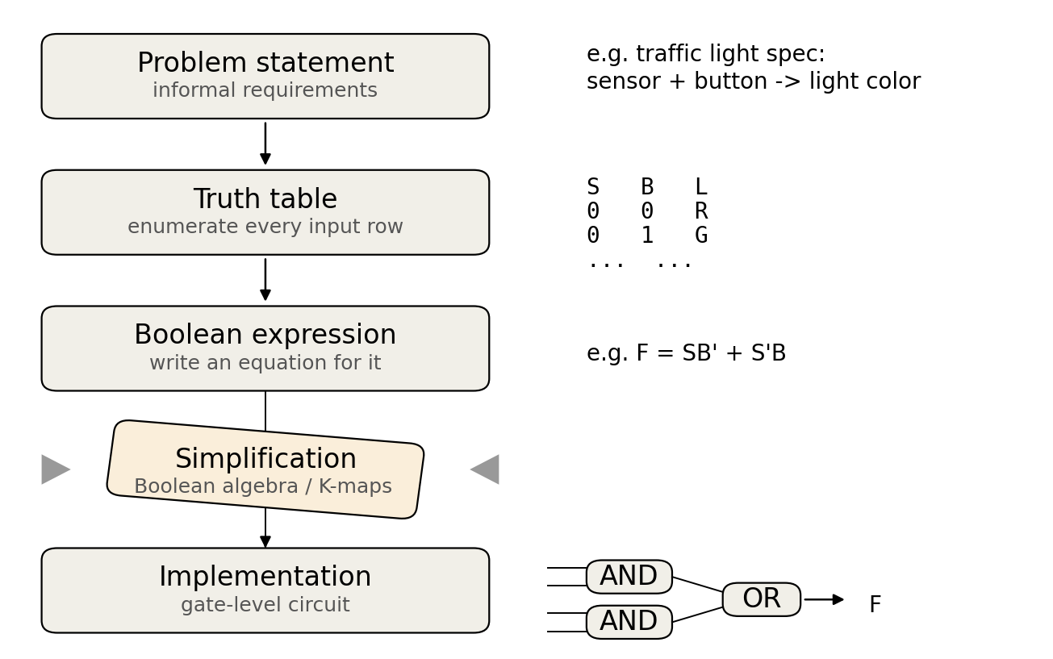
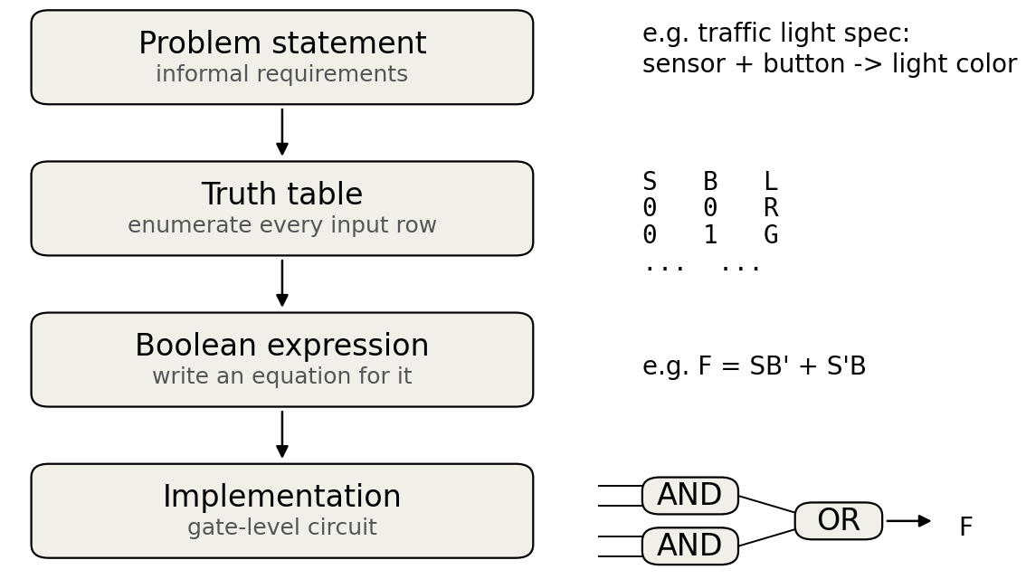
The grand scheme of designing combinational circuits
DONE WITH COMBINATIONAL?!

Slide 5
Karnaugh Maps
Graphical Device used to Simplify Boolean expressions
Useful for up to six variables
Reduce expressions to a minimal sum of products (MSP) form
Minimum number of product terms
Each product has a minimal number of literals
Circuit-wise leads to minimal two-level implementation

Slide 6
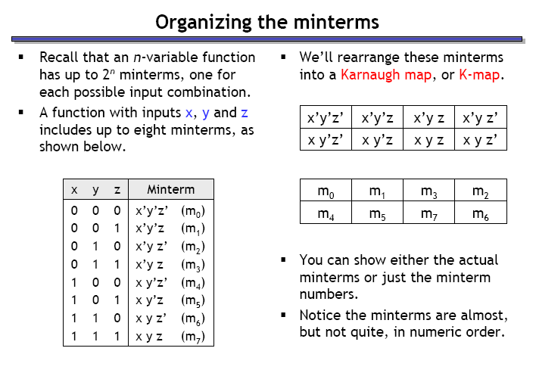
Building K-maps
Row of a Truth Table corresponds to a square in K-map
Adjacent squares differ in only one variable
Combine squares with 1’s
y z = 0 0 0 1 1 1 1 0
x = 0
x = 1

Slide 7
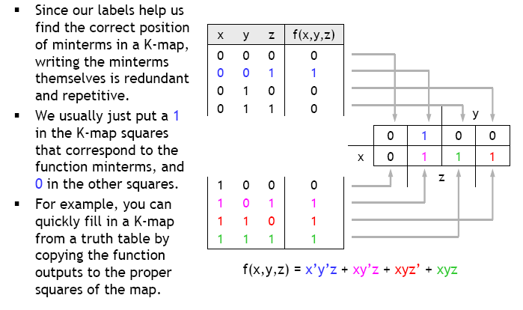
Filling in the k-map

Slide 8
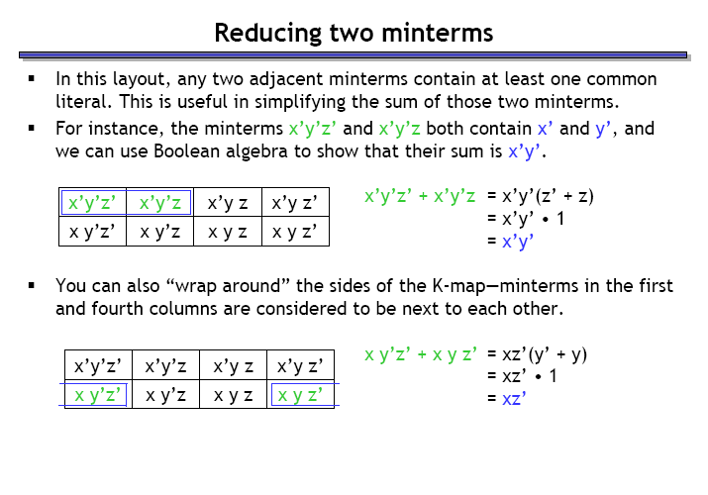
Reducing two minterms in k-maps
What will you get by adding m0 and m4?

Slide 9
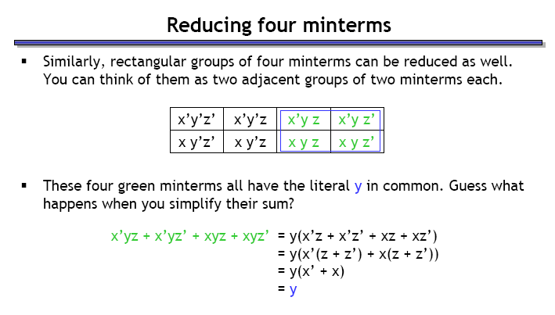
Reducing four minterms in k-maps

Slide 10
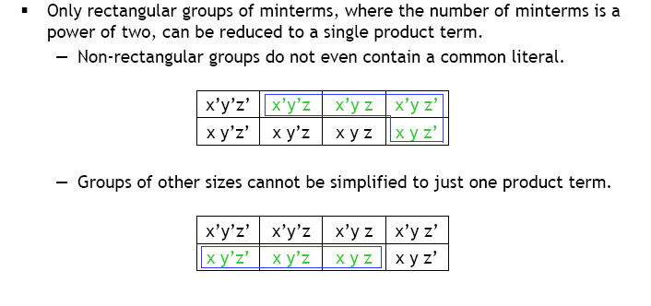
Reducible groups

Slide 11
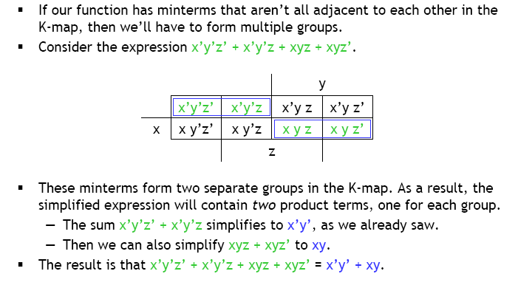
Reducing multiple groups

Slide 12
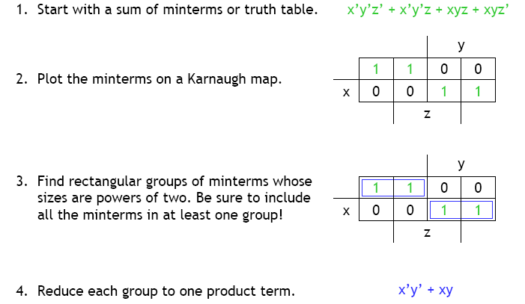
Summary: simplification using k-maps

Slide 13
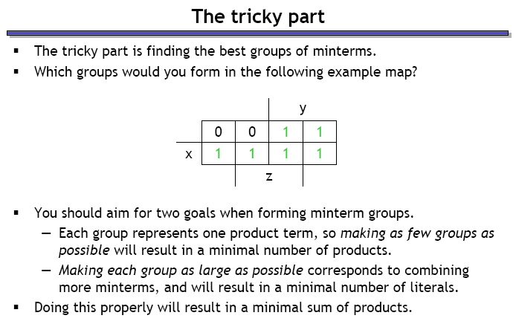
How to decide the best group of minterms?

Slide 14
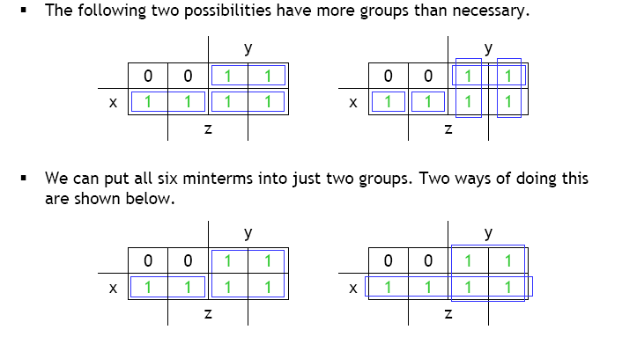
Minimizing groups

Slide 15
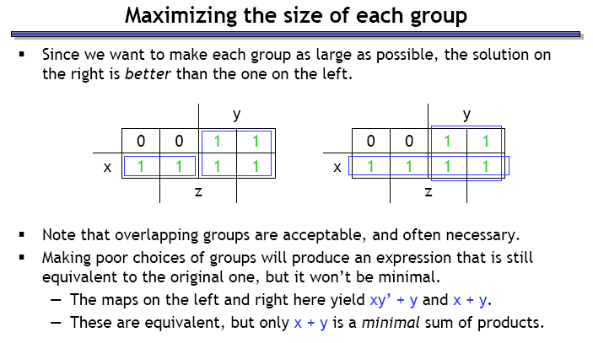
Maximizing group size

