Slide 1
Dataflow & Behavioral Modeling
Prof. GSS Chalapathi,
Prof. Saurabh Gandhi,
Prof. Ramesh Sambangi

Slide 2
Data Types in Verilog HDL
Nets:
Nets represents a physical connection
Does not store a value
Driven continuously by a source
Declared using keyword wire.
Registers:
Can hold a value until it is assigned again
Declared using keyword reg.
Used for signals assigned inside initial or always blocks
reg does not necessarily mean a hardware register
integer → signed 32-bit integer, commonly used in testbenches
time → stores simulation time
real → floating-point value, mainly for simulation

Slide 3
Data types contd..
integer → signed 32-bit integer, commonly used in testbenches
Ex: integer count;
initial begin
count = 10;
end
time → stores simulation time
time t;
initial begin
#10 t = $time;
$display("Time = %t", t);
end
real → floating-point value, mainly for simulation
real voltage;
initial begin
voltage = 1.25;
end

Slide 4
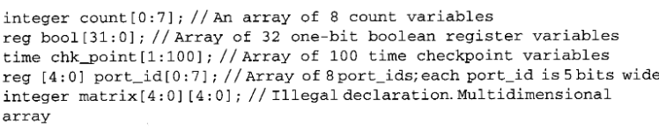
Data types contd..
Vectors: A vector represents multiple bits as a single signal.
wire [3:0] A;
Arrays: An array is a collection of elements.
reg [7:0] data [0:3];
Memory: A memory can be represented as an array of vectors. useful for representing RAM, ROM, register files, lookup tables, instruction memory, and data memory.
reg [7:0] memory [0:15];

Slide 5
Data types contd..
Parameters: A parameter represents a constant that can be used to make a design configurable.
parameter WIDTH = 8;
wire [WIDTH-1:0] A;
localparam: is also a constant, but it cannot normally be overridden during module
localparam IDLE = 2'b00;
localparam RUN = 2'b01;
localparam DONE = 2'b10;

Slide 6
Data types contd..
String: Verilog does not have a separate string data type in traditional Verilog. A string can be stored in a register/vector.
reg [11*5-1:0] var_name;
initial begin
var_name = "BITS PILANI";
end

Slide 7
System Tasks
System tasks are built-in Verilog commands provided by the simulator.
Task | Function | Example
$display | Display once | $display("A=%b",A);
$write | Display without newline | $write("A=%b",A);
$monitor | Continuously monitor changes | $monitor("A=%b",A);
$time | Current simulation time | $time
$stop | Suspend simulation | $stop;
$finish | End simulation | $finish;

Slide 8
$display statement
Used to print values and messages during simulation.
Prints only when the statement is executed.
reg a, b;
reg [3:0] sum;
initial begin
a = 1;
#10 b = 0;
sum = 4'b1010;
$display("a = %b, b = %b, sum = %b", a, b, sum);
end
output:
a = 1, b = 0, sum = 1010

Slide 9
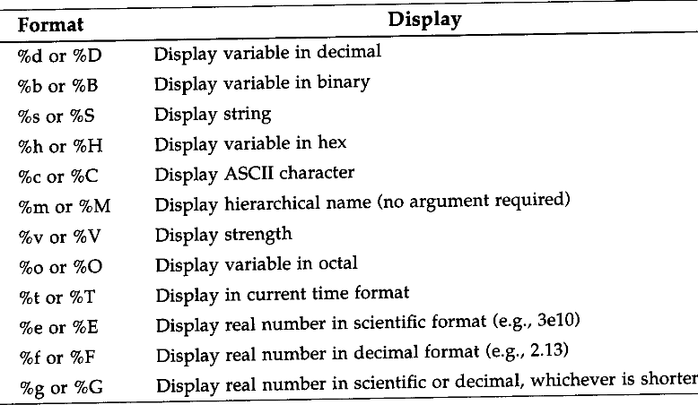
String format

Slide 10
$monitor
keeps watching signals and prints whenever their values change.
Ex:
reg a, b;
initial begin
$monitor("Time=%0t : a=%b b=%b", $time, a, b);
a = 0;
b = 0;
#10 a = 1;
#10 b = 1;
End
Output: Time=0 : a=0 b=0
Time=10 : a=1 b=0
Time=20 : a=1 b=1

Slide 11
$stop & $finish
When the simulator encounters $stop:
The simulation is paused.
The simulator enters a debug/interactive mode.
You can inspect signal values, waveforms, and variables.
The simulation can generally be resumed from that point.
When the simulator encounters $finish:
The current simulation is terminated.
The simulator exits the simulation run.
No further Verilog statements are executed.
It is commonly used at the end of a testbench after all test cases are completed.

Slide 12
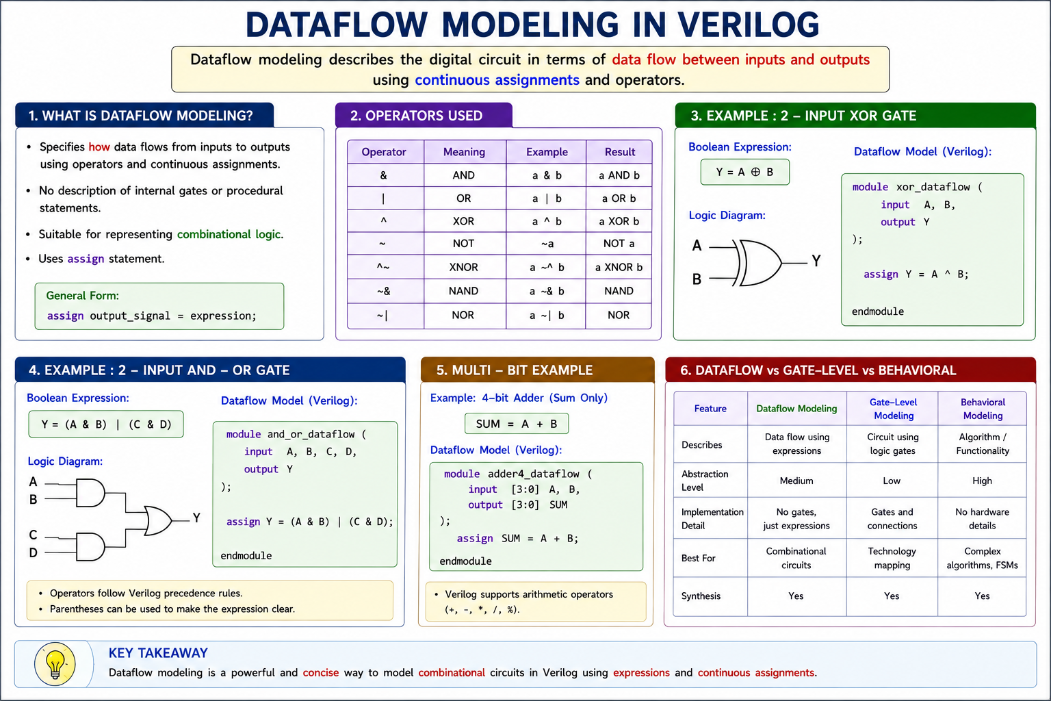

Slide 13
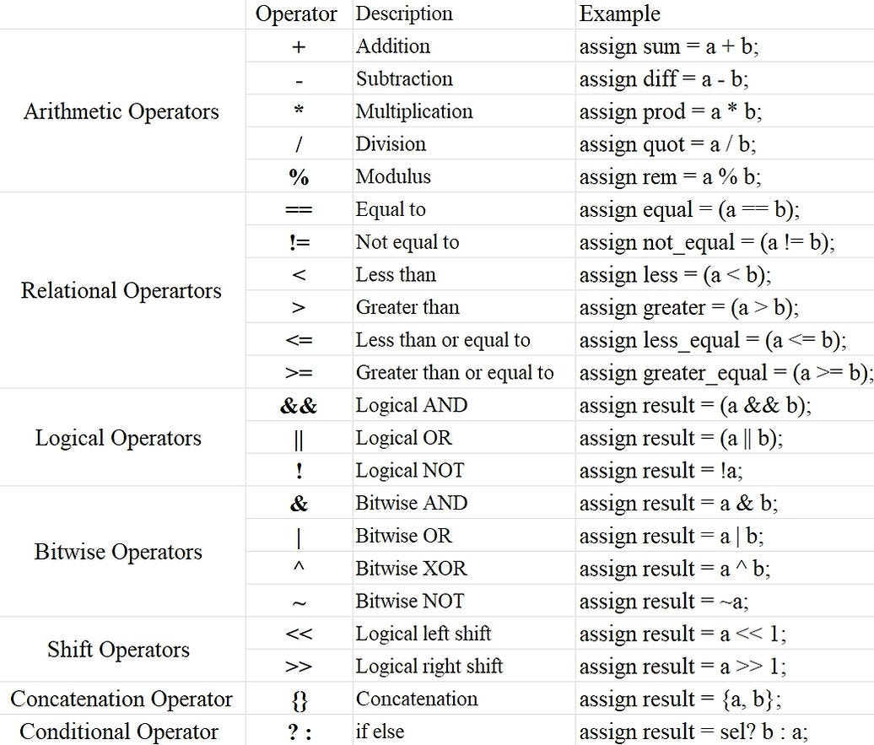
Operator types

Slide 14
Operator Precedence
Operator precedence determines which operator is evaluated first when an expression contains multiple operators.
Parentheses have the highest priority. The expression inside parentheses is evaluated first.
Operator | Symbols | Precedence
Unary | + - ! ~ | Highest
Multiply/Divide/Modulus | * / % | ↓
Add / Subtract | + - | ↓
Shift | << >> | ↓
Relational | < <= > >= | ↓
Equality | == != === !== | ↓
Reduction | &, ~& ^ ^~ |, ~| | ↓
Logical | && || | ↓
Conditional | ? : | Lowest precedence

Slide 15
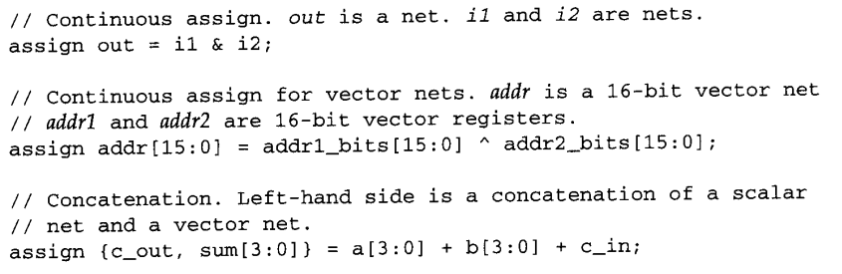
Dataflow modelling rules
The output of a continuous assignment should be a net, typically wire.
The operands on the right-hand side can be registers or nets or function calls. Registers or nets can be scalars or vectors.

Slide 16
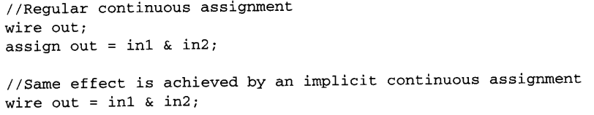
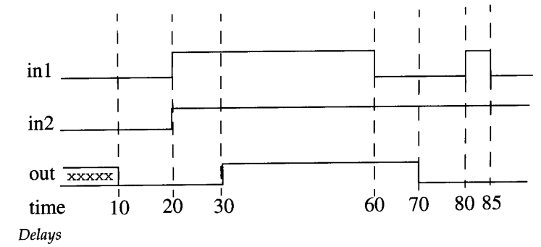
Dataflow modelling contd..
Implicit Continuous Assignment
Delays:
wire out;
assign #10 out = in1 & in2; // continuous assign delay
Implicit continuous assignment delay
wire #10 out = inl & in2;

Slide 17
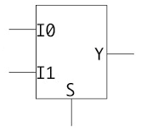
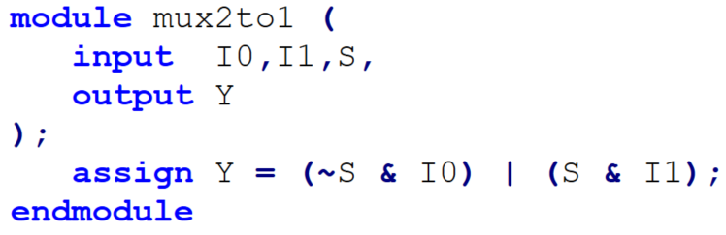

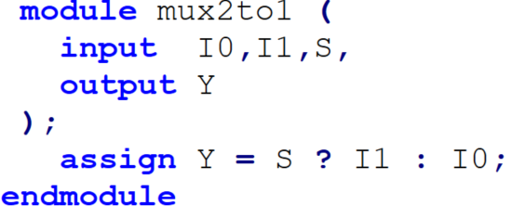
Multiplexer example
Using regular boolean expression
Using conditional operator

Slide 18
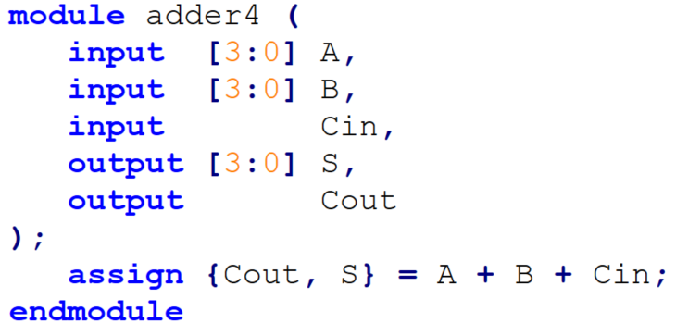
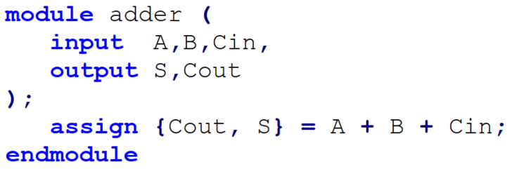
Adder example
RTL code specifies WHAT operation is required; synthesis determines HOW the operation is implemented in hardware.
The synthesis tool decides the actual hardware implementation based on the target technology, constraints, and synthesis settings.

Slide 19
Behavioral Modeling
Why do we need behavioral modeling?
Higher level of abstraction – focus on functionality rather than hardware structure.
Less code – complex circuits can be described with a few statements.
Easy to modify – changes in functionality are easier to implement.
Suitable for complex digital systems – counters, controllers, processors, etc.
Synthesizable behavioral code can be converted into hardware by synthesis tools.

Slide 20
Procedural Statements
Behavioral modeling mainly uses procedural blocks: always and initial
Other behavioral statements appear only inside these statements.
Each always and initial statements represent separate activity flow in verilog.
always and initial blocks cannot be nested.
Procedural block | Purpose
initial | Executes once at the beginning of simulation
always | Executes repeatedly whenever its sensitivity condition is satisfied

Slide 21
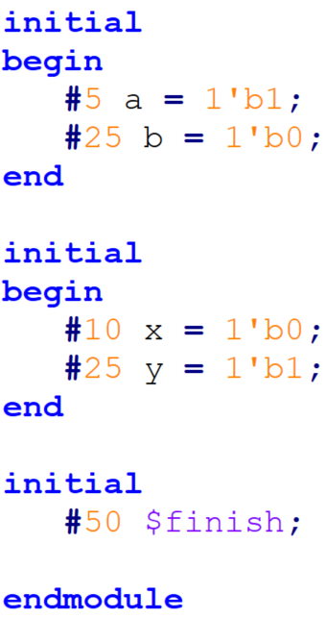
initial statement
initial block starts at time 0, executes exactly once during a simulation.
if multiple initial blocks present each block execute parallely at 0.
Useful for initialization
monitoring
time statement executed
0 m = 1'b0;
5 a = 1'b1;
10 x = 1'b0;
30 b = 1'b0;
35 y = 1'b1;
50 $finish;

Slide 22
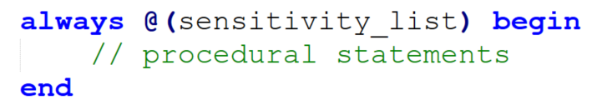
always statement
The always block is a procedural block used to describe circuit behavior.
The block is executed repeatedly during simulation.
Execution is controlled by a sensitivity list. The sensitivity list specifies which signal changes can trigger the always block.
Commonly used for describing combinational and sequential circuits.
An always block does not mean that the statements execute continuously. It repeatedly waits for an event and then executes.

Slide 23
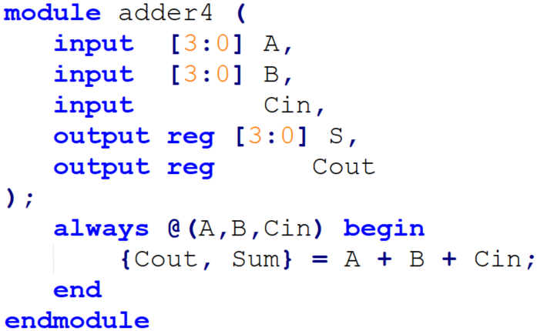
Adder example

Slide 24
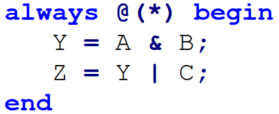
Procedural Assignments
Procedural assignments update the values of reg, integer, real, or time variables.
The value assigned to the variable remain unchanged until another procedural update.
Two types: blocking and nonblocking assignments
Blocking Assignments: A blocking assignment is a procedural assignment is completed before execution proceeds to the next statement. operator used ‘=’
Nonblocking:
used to schedule an update of a variable. operator used ‘<=’

Slide 25
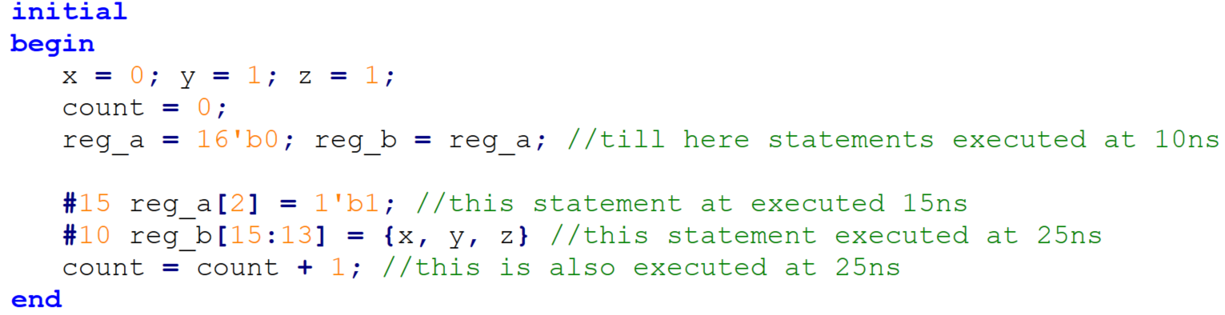
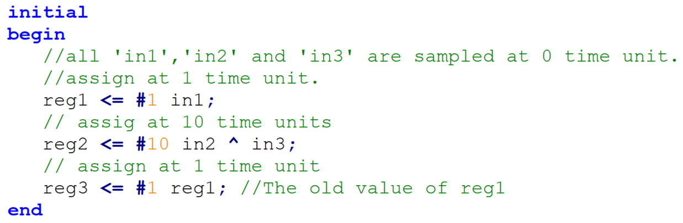
Examples
Blocking
Nonblocking

Slide 26
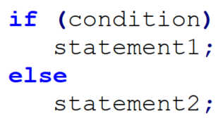
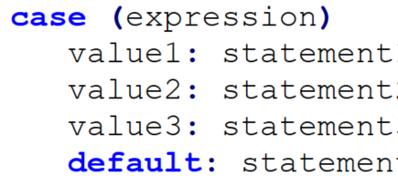
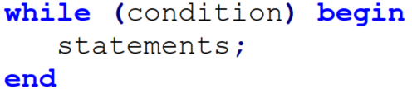
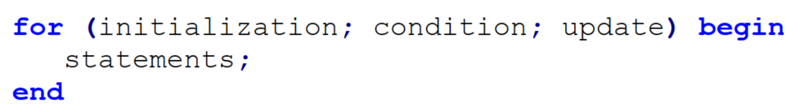
Other statements
Conditional statements
Multiway branching: case statement
loops: for and while

Slide 27
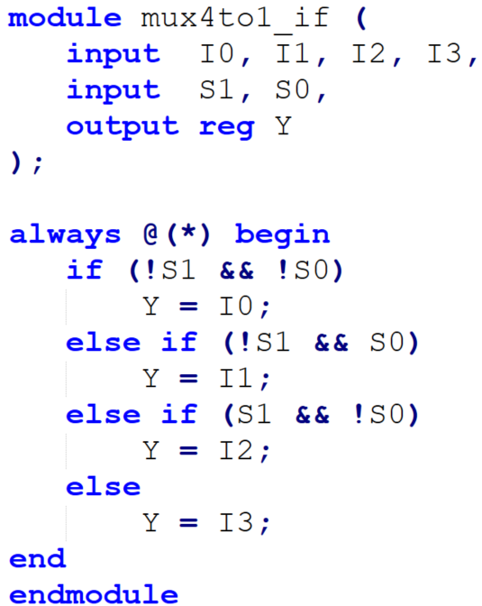
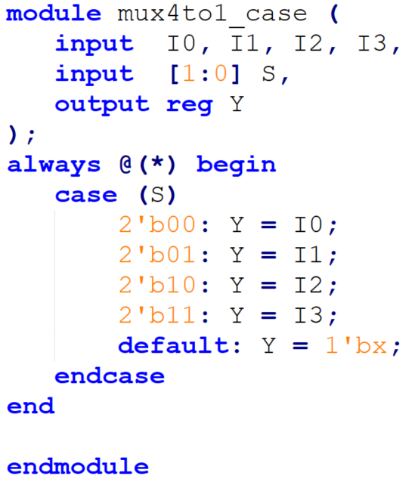
Example

Slide 28
