Slide 1
Digital Design
Prof. GSS Chalapathi,
Prof. Saurabh Gandhi,
Prof. Ramesh Sambangi

Slide 2
Review questions
What happens to Q when SR = 00?
What should SR be for Q to be set?

Slide 3
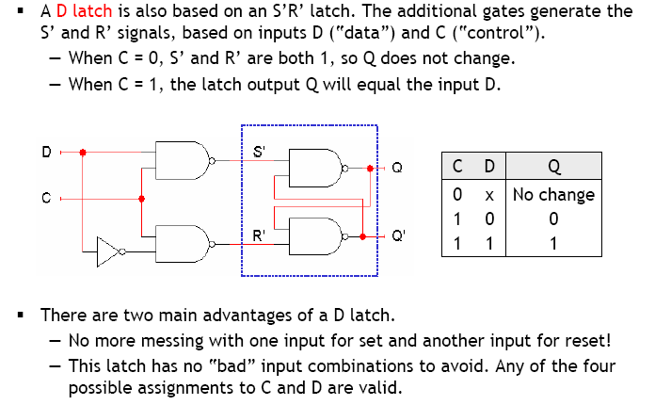
The D latch (D = Data)

Slide 4
Flip-flops
Latches are transparent i.e. any change on inputs is immediately reflected in the output
When control signal is high, data continuously flows from input to output
Terminology: Latches are ‘level sensitive’
Synchronization across multiple memory units might become difficult and unpredictable
Solution: ‘edge sensitive’ memory units, called flip-flops, that respond only at specific times

Slide 5
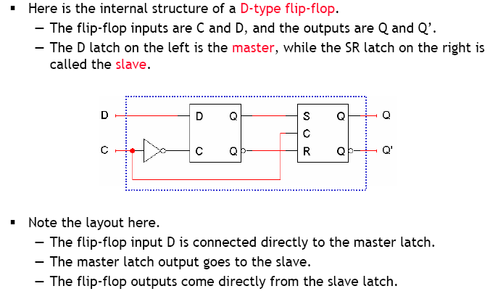
D flip-flop (D = Data or Delay…)

Slide 6
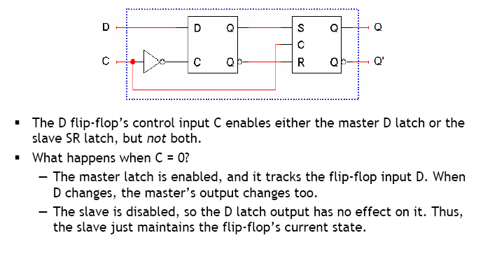
Working of D the flip-flop: C = 0

Slide 7
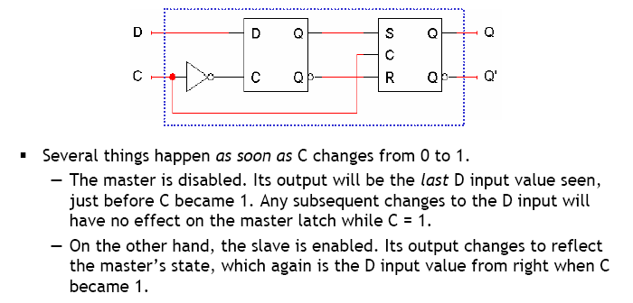
Working of D the flip-flop: C = 1

Slide 8
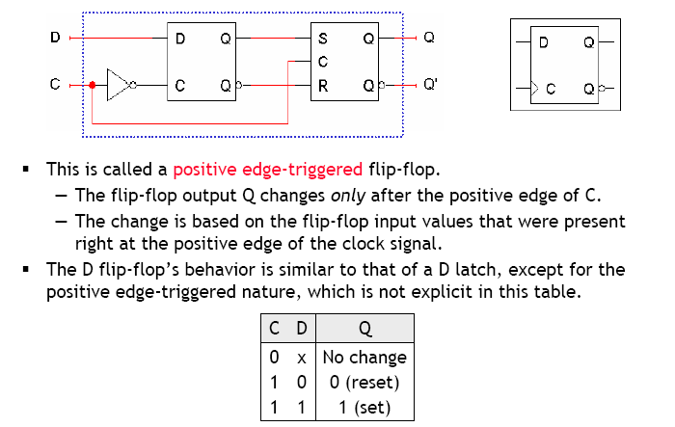
Positive edge triggering

Slide 9
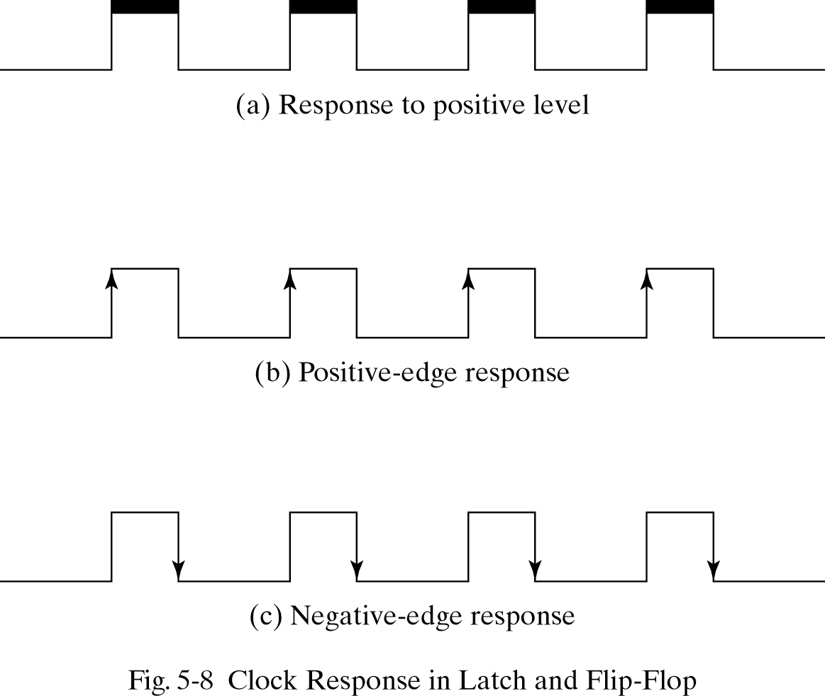
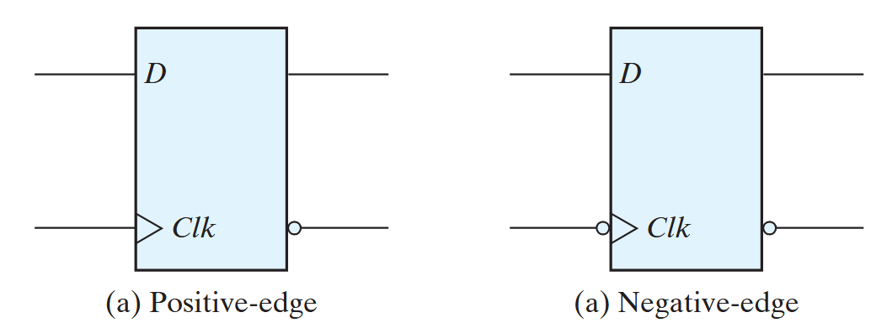
Level vs edge triggering summary

Slide 10
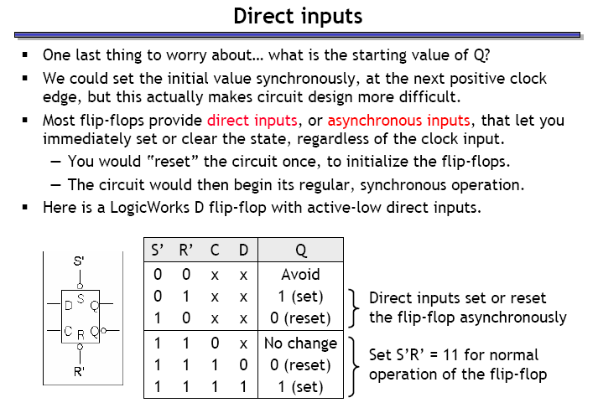
Flip-flops with direct inputs

Slide 11
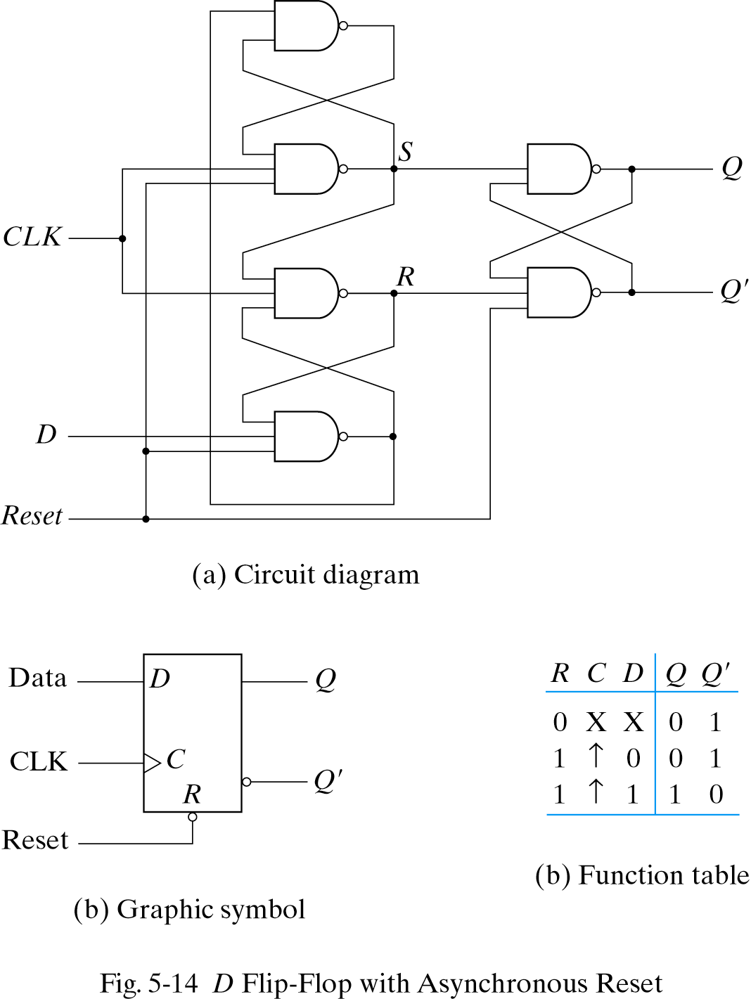
D flip-flop with asynchronous reset

Slide 12
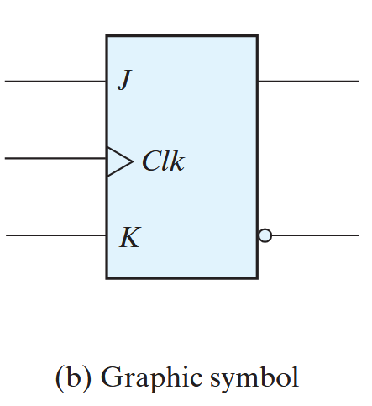
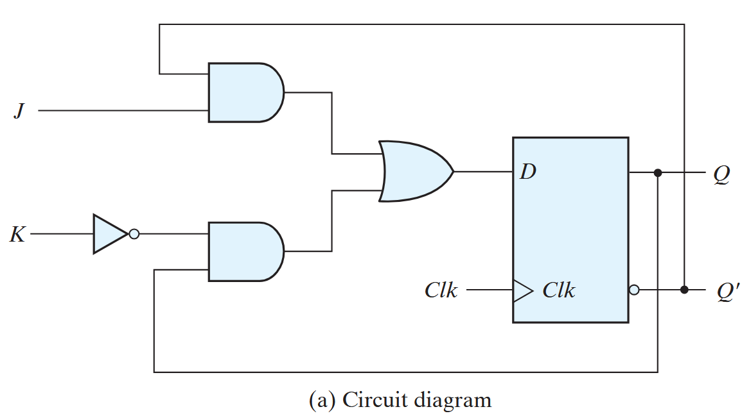

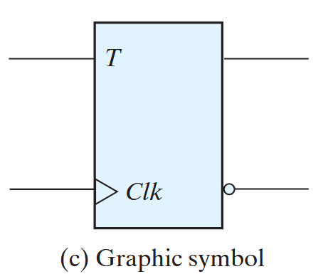
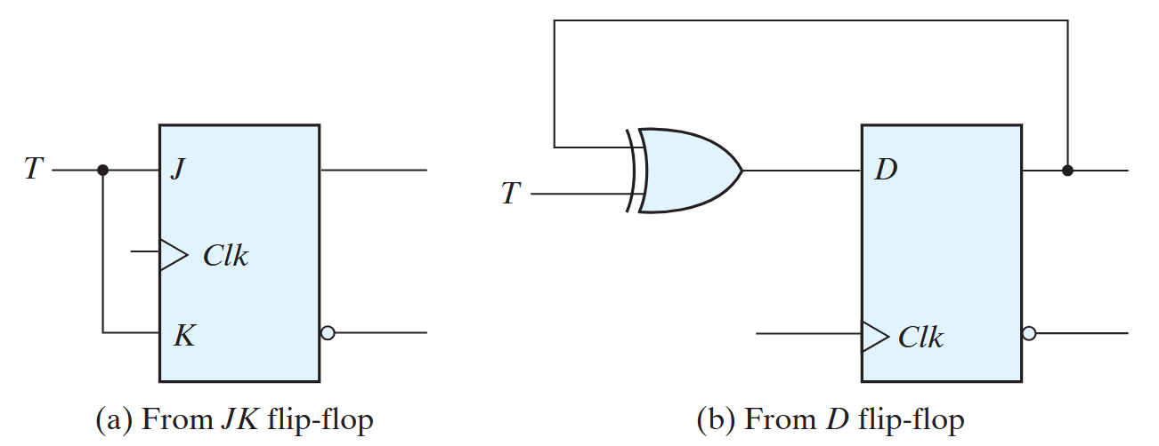
Other types of flip-flops
There are three operations that can be performed with a flip-flop:
  Set it to 1
  Reset it to 0
  Complement its output
D flip-flop can set or reset the output, no toggle
JK flip-flop has two inputs and performs all three operations
  The J input sets the flip-flop to 1
  The K input resets it to 0
  When both inputs are enabled, the output is complemented
T (toggle) flip-flop

Slide 13
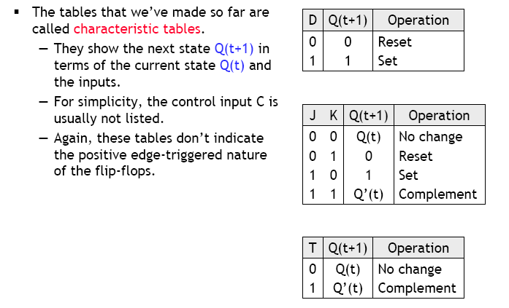
Characteristic tables

Slide 14
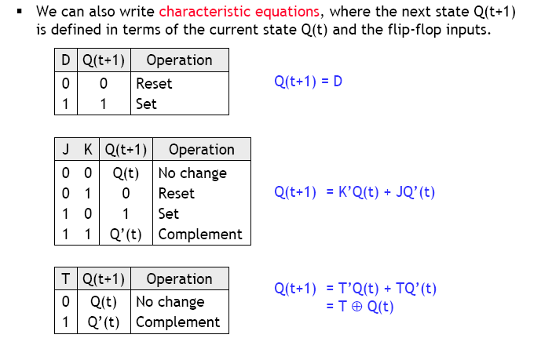
Characteristic equations

Slide 15
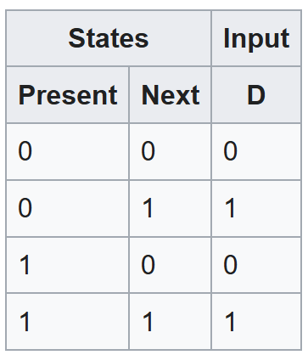
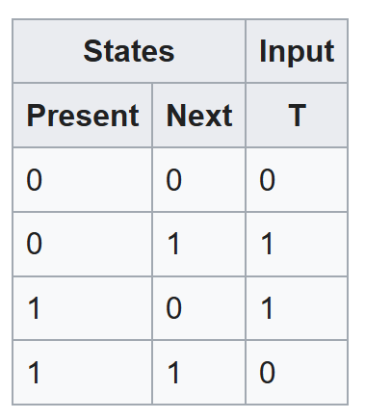
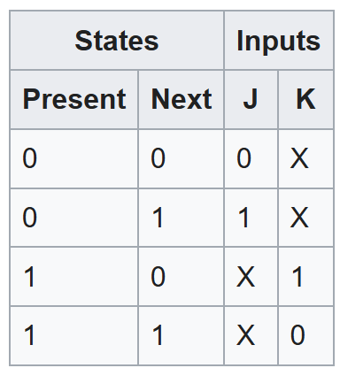
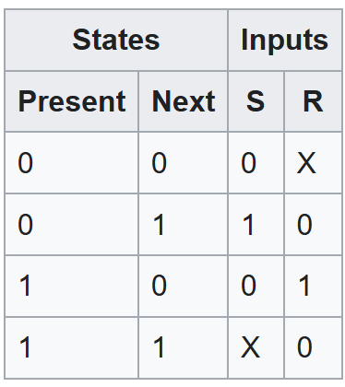
Excitation tables
Shows the minimum inputs that are necessary to generate a particular next state (in other words, to "excite" it to the next state) when the current state is known
Rearrange the data so that the current state and next state are next to each other on the left-hand side
Inputs needed to make that state change happen are shown on the right side of the table

Slide 16
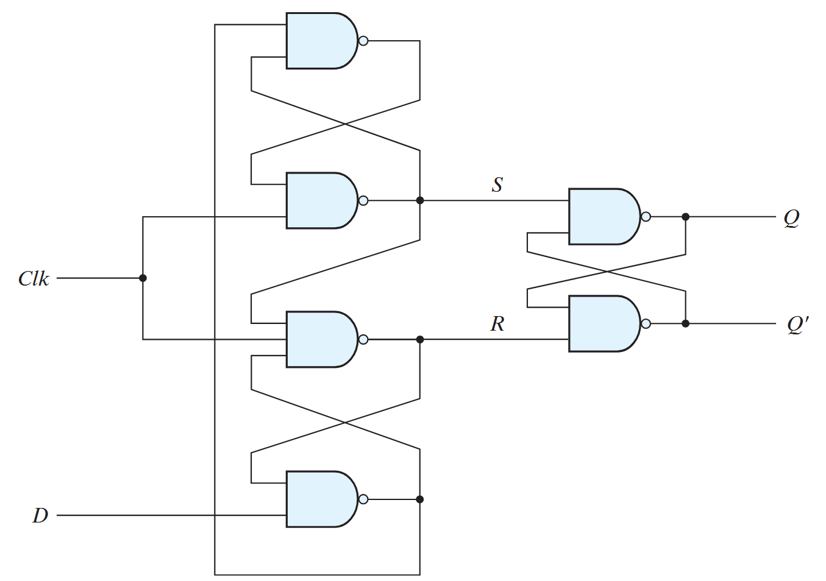
Another design of the D flip-flop

Slide 17
Working of the 3-latch design
Case I:
D = 0, CLK = 0
D = 0 => B = 1
CLK = 0 => R = 1, S = 1
B = 1, S = 1 => A = 0
ASRB = 0111
SR = 11 => No change in Q
A
B

Slide 18
Working of the 3-latch design
In case I (i.e., ASRB=0111) make CLK=1
D = 0 => B = 1
B = 1, S = 1 => A = 0
A = 0 => S = 1
S = 1, B = 1, CLK = 1 => R = 0
SR = 10 => RESET
ASRB = 0101
Only R has changed here after one gate delay.
What happens if D changes now:
If D changes after R has stabilized there will be no effect on output.
This is Hold Time.
A
B

Slide 19
Working of the 3-latch design
A
Case II:
D = 1, CLK = 0
CLK = 0 => R = 1, S = 1
D = 1, R = 1 => B = 0
B = 0, S = 1 => A = 1
ASRB = 1110
SR = 11 => No change
B

Slide 20
Working of the 3-latch design
A
In case II make CLK = 1
ASRB = 1110
R = 1, D = 1 => B = 0
B = 0, => A = 1
A = 1, CLK = 1 => S = 0 => R = 1
SR = 01 => SET
ASRB = 1010
B

Slide 21
Working of the 3-latch design
From D = 1, CLK = 0 what if we suddenly changed to D = 0, CLK = 1?
ASRB = 1110
D = 0 => B = 1
CLK = 1, A = 1 => S = 0
S = 0, B = 1 => A = 1
S = 0, B = 1, CLK = 1 => R = 1
SR = 01 => SET
ASRB = 1011
Wrong result
Correct sequence will be:
Go from case II to case I, i.e., let ASRB change from 1110 to 0111. Here A takes two gate delays to change. This is Setup time.
Now go from case I to D = 0, CLK = 1.
A
B

