Slide 1
BITS Pilani Digital Design
Prof. GSS Chalapathi, Prof. Saurabh Gandhi (EEE department)

Slide 2
Review questions
Solution provided by k-maps is …
Equations for Sum and Carry of a full adder

Slide 3
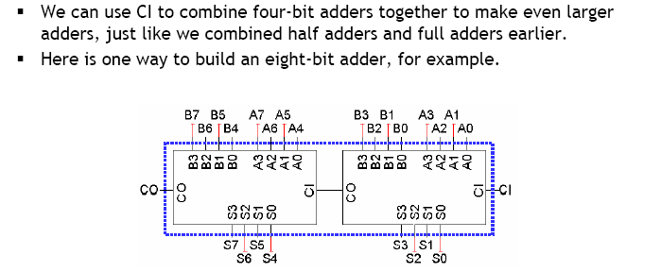
Extending the 4-bit adder: ripple carry adders
How long does the addition take?

Slide 4
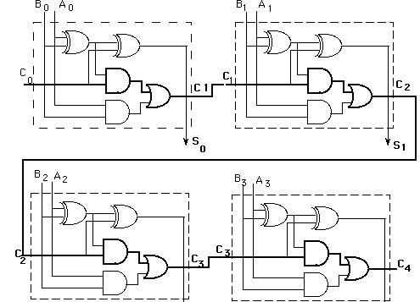
Ripple carry delays
S₃
S₄
How much time does a 4-bit adder take to perform addition?
How many gates does the input signal have to flow through in a single FA?
In a 4-bit adder (count along the longest path)?
For an n-bit adder, how many gates does the signal have to flow through?
2n + 1 (for a 64-bit adder, 129 gates!)
Assuming ~1 ns propagation delay per gate, how many 64-bit additions can you perform per second?
How many do modern processors carry out?

Slide 5
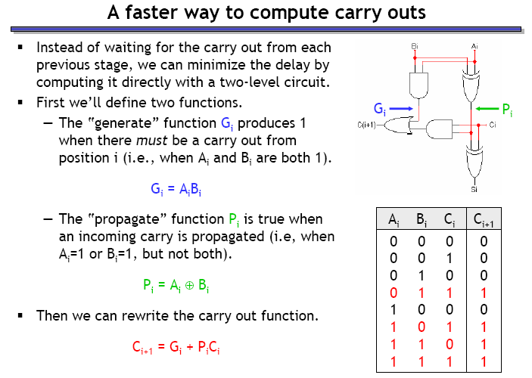
Can we have faster adders?

Slide 6
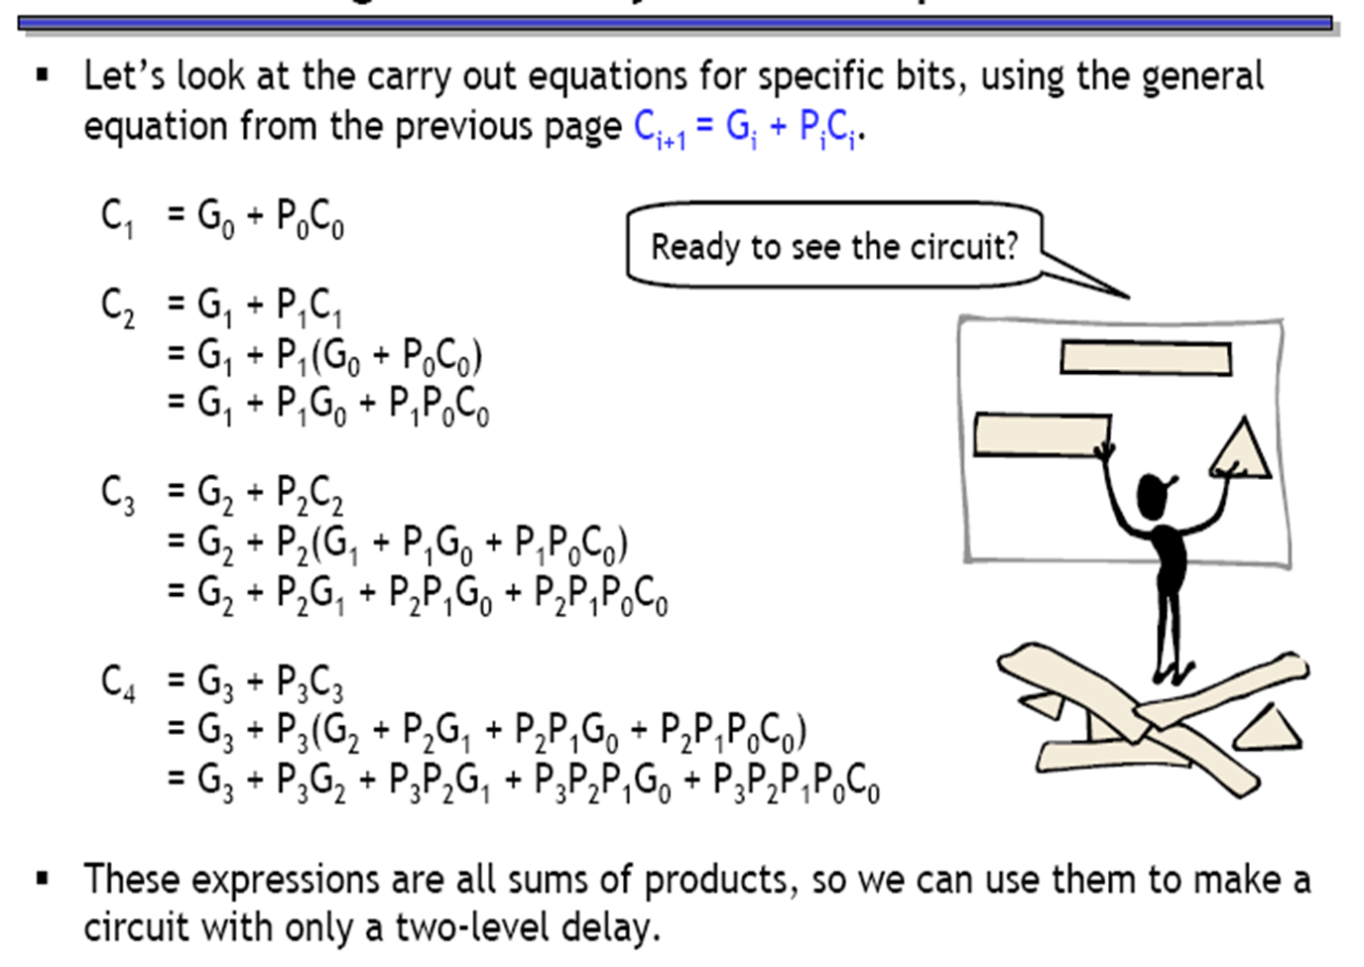
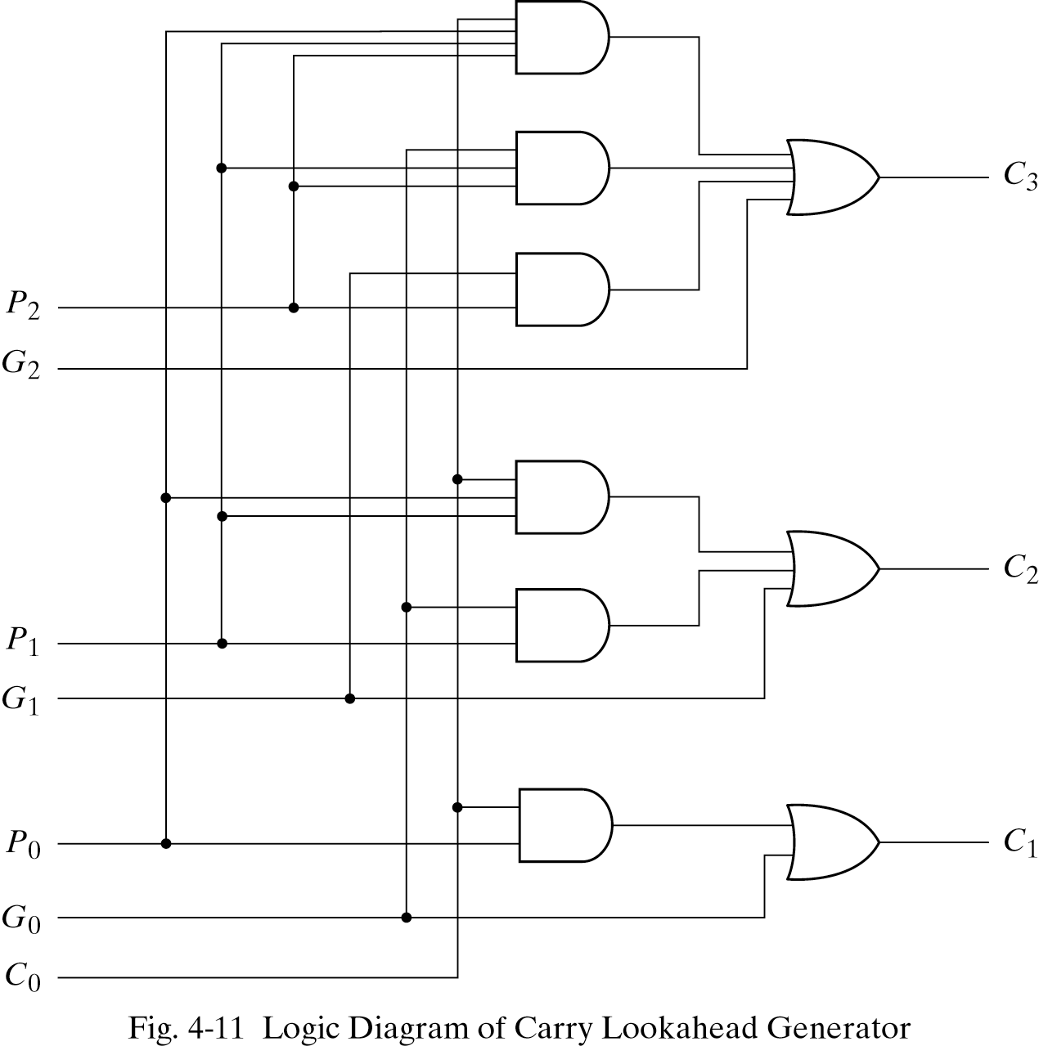
Can we have faster adders?

Slide 7
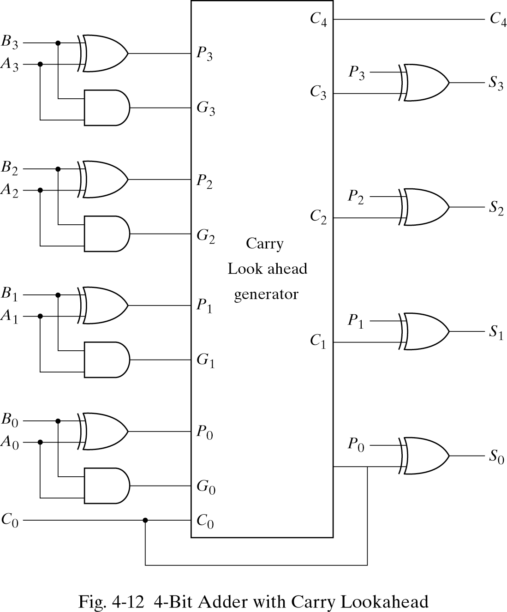
4-bit adder with carry lookahead

Slide 8
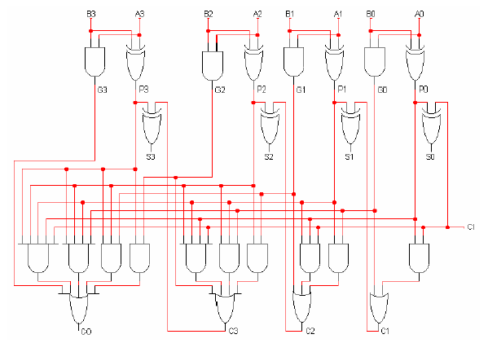
A faster 4-bit adder
How many 64-bit additions can this circuit perform per second?

Slide 9
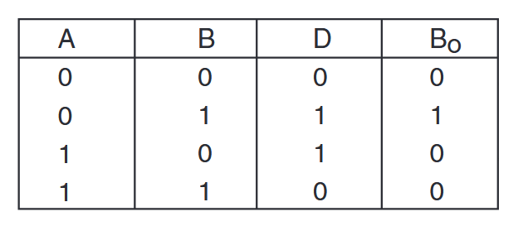
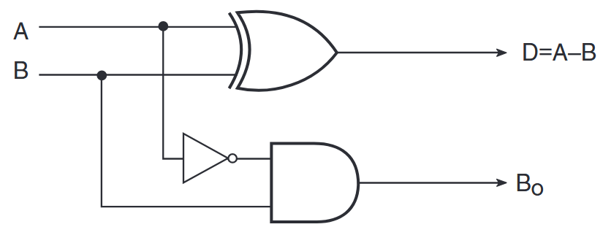
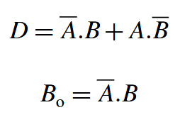
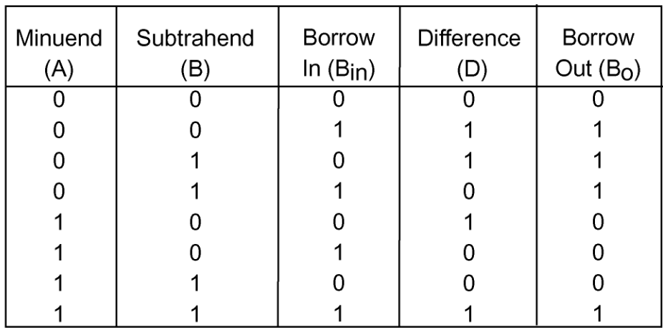


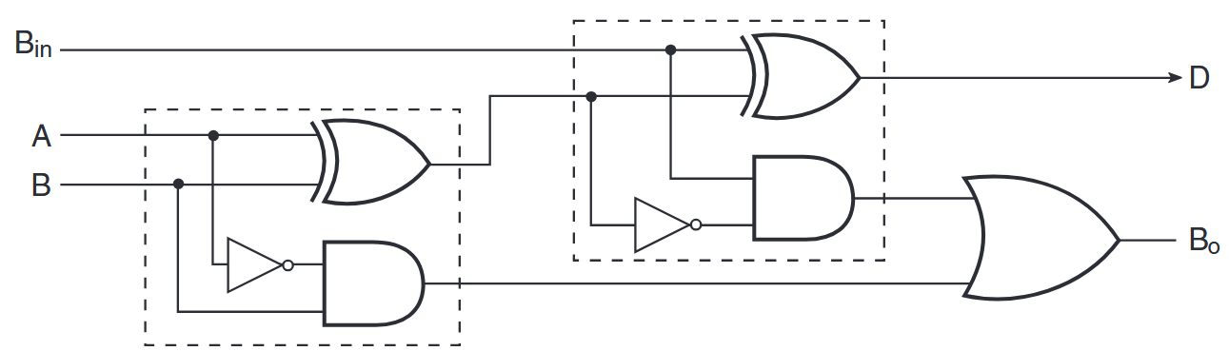
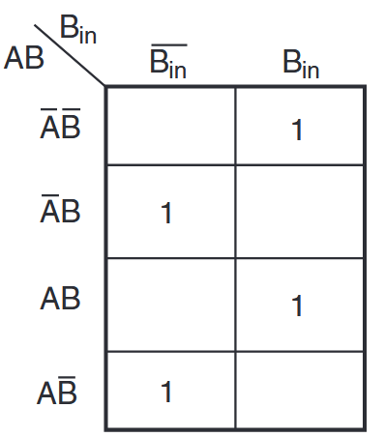
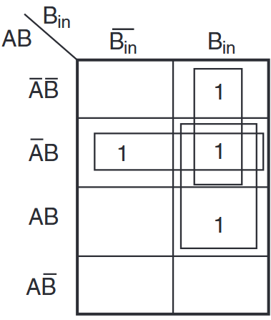
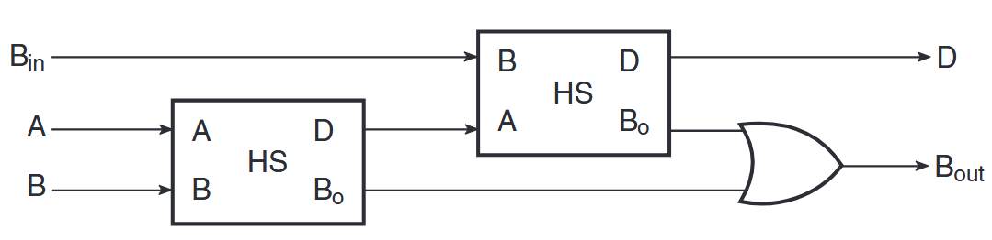
Building an exclusive subtractor
Half subtractor
sum → difference
carry → borrow
Full subtractor

