Slide 1
BITS Pilani
Digital Design
Prof. GSS Chalapathi, Prof. Saurabh Gandhi (EEE department)

Slide 2
Registers
Flip-flops store only one bit
We surely need larger units of storage, for example 32 bit integers or floating point numbers
A register is an extension of a flip flop that can store multiple bits
Registers are commonly used as temporary storage in a processors
  Faster and more convenient than main memory
  More registers can help speed up complex calculations

Slide 3
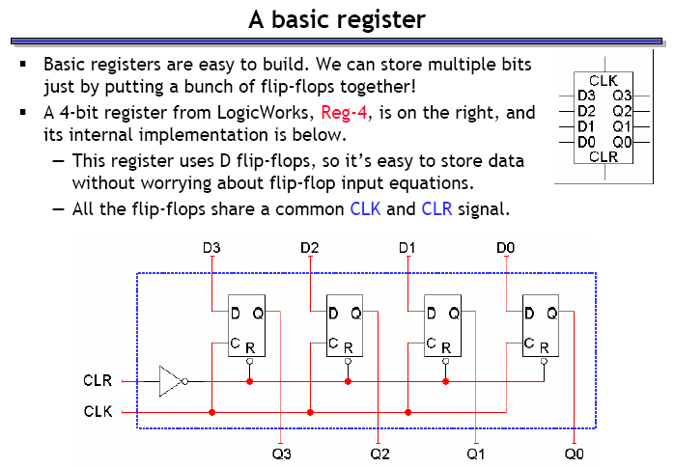
A basic register
Basic registers are easy to build – just put a bunch of flip flops together!

Slide 4
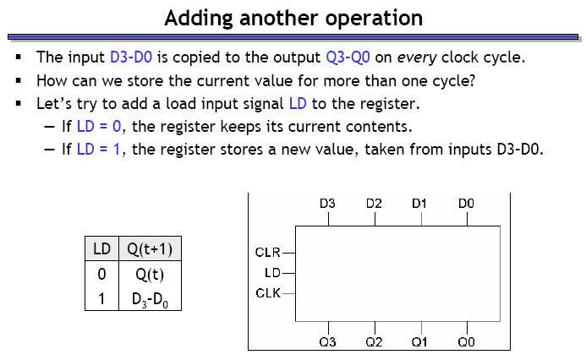
Register with LOAD

Slide 5
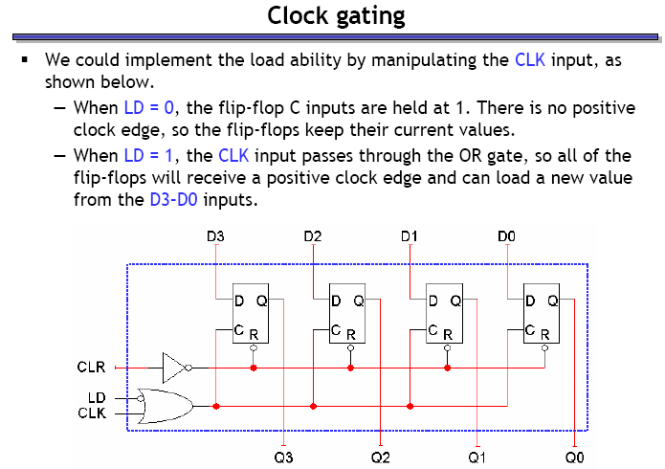
LOAD with ‘clock gating’

Slide 6
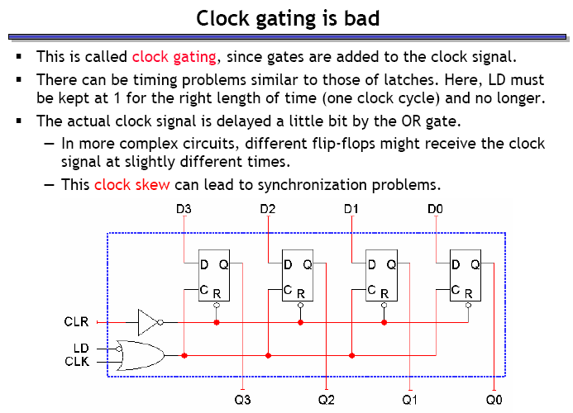
The problems with clock gating

Slide 7
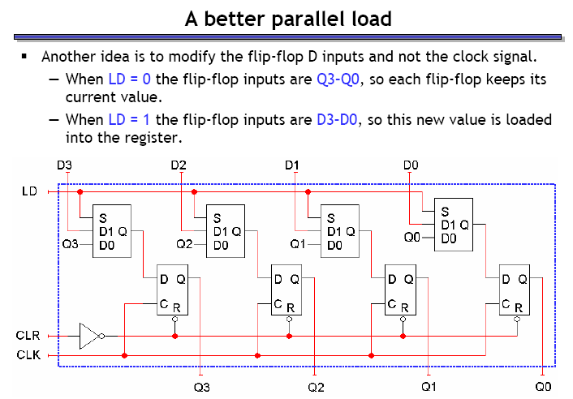
A better implementation of LOAD

Slide 8
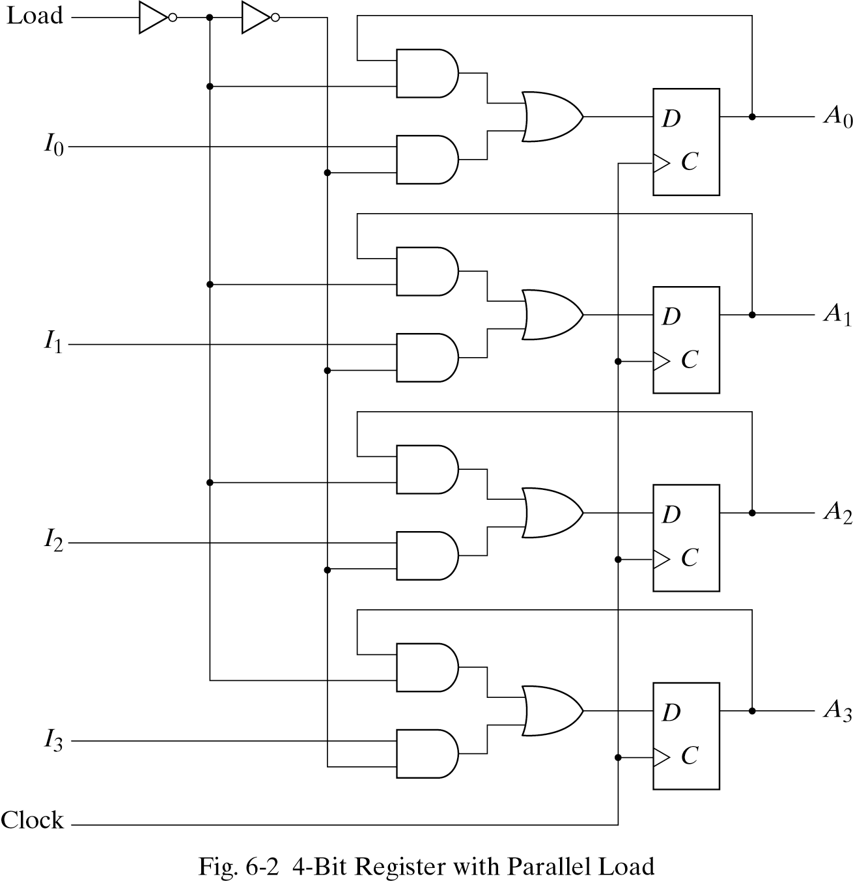
Parallel load without Muxes

Slide 9
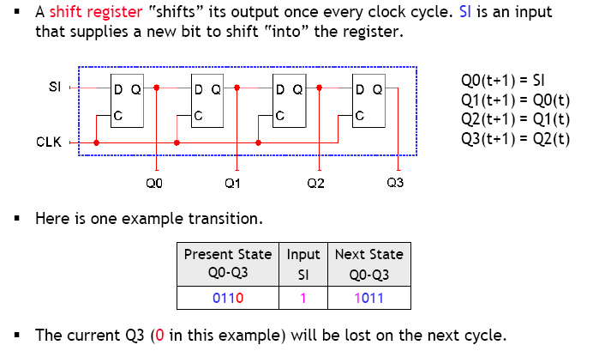
Shift registers

Slide 10
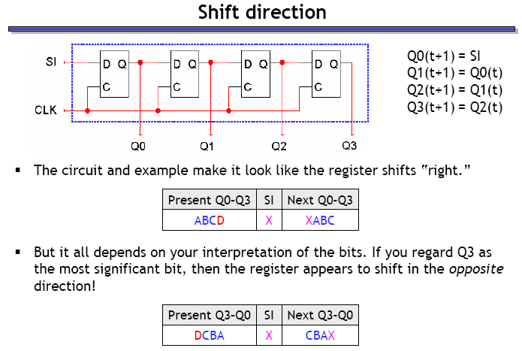
Shift direction

Slide 11
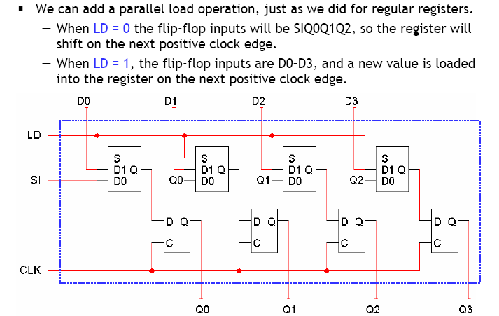
Shift registers with parallel load

Slide 12
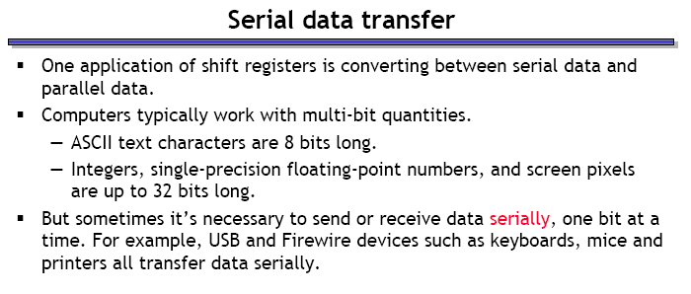
The use of shift registers

Slide 13
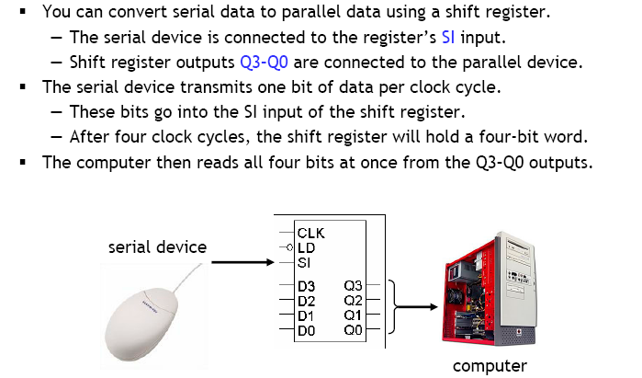
Receiving serial data

Slide 14
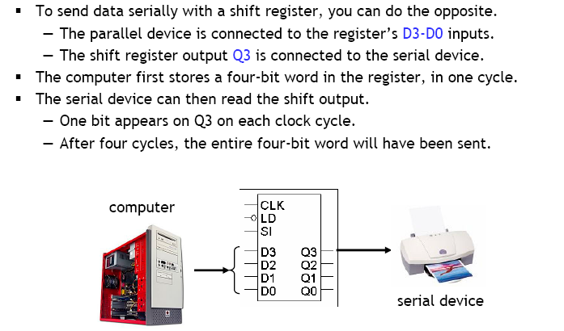
Sending serial data

Slide 15
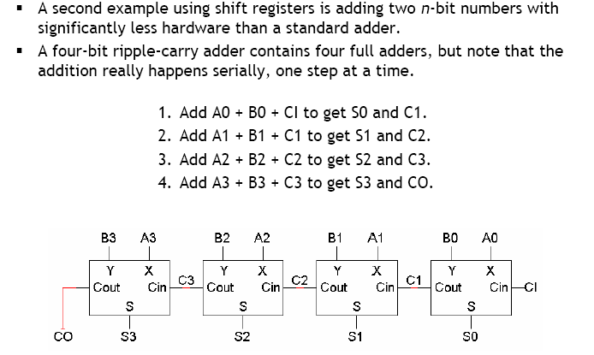
Serial addition

Slide 16
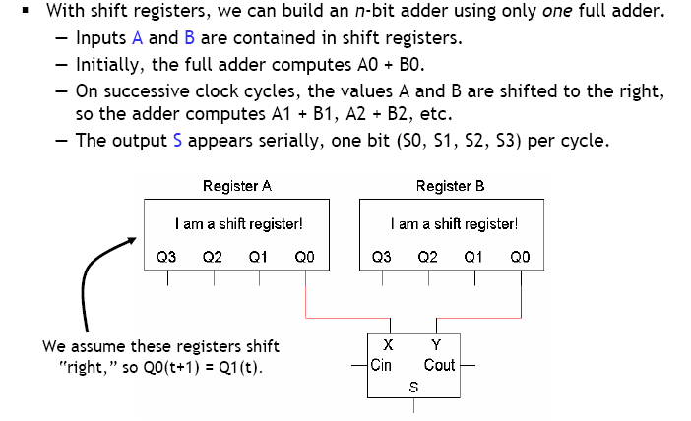
Serial addition – implementation

Slide 17
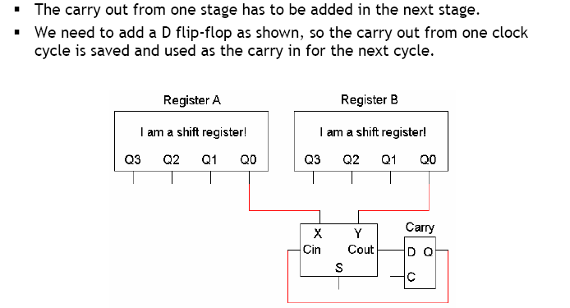
How to deal with the carry?

Slide 18
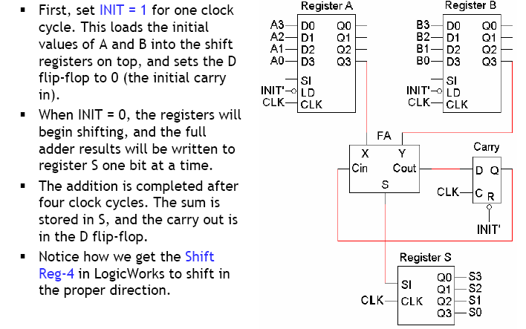
Putting together the serial adder

Slide 19
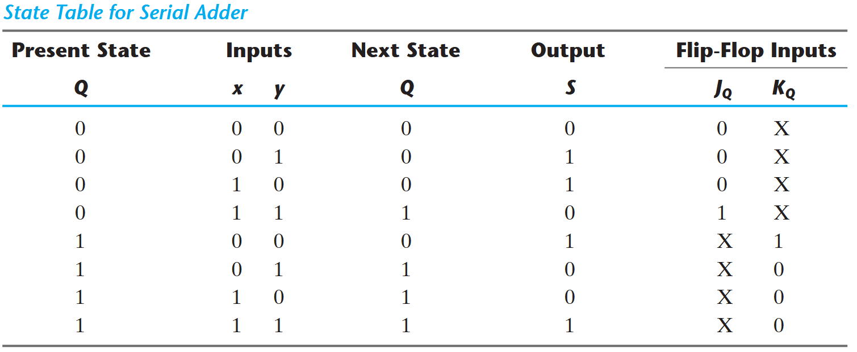
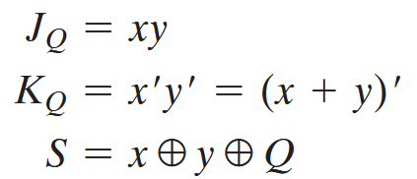
Designing a serial adder from scratch

Slide 20
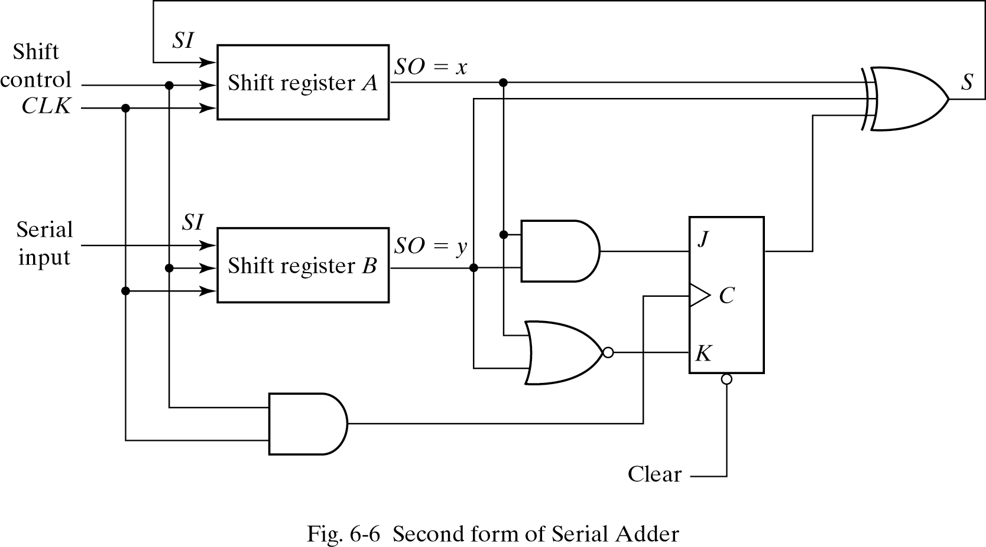
Serial adder from scratch implemented with shift registers

Slide 21
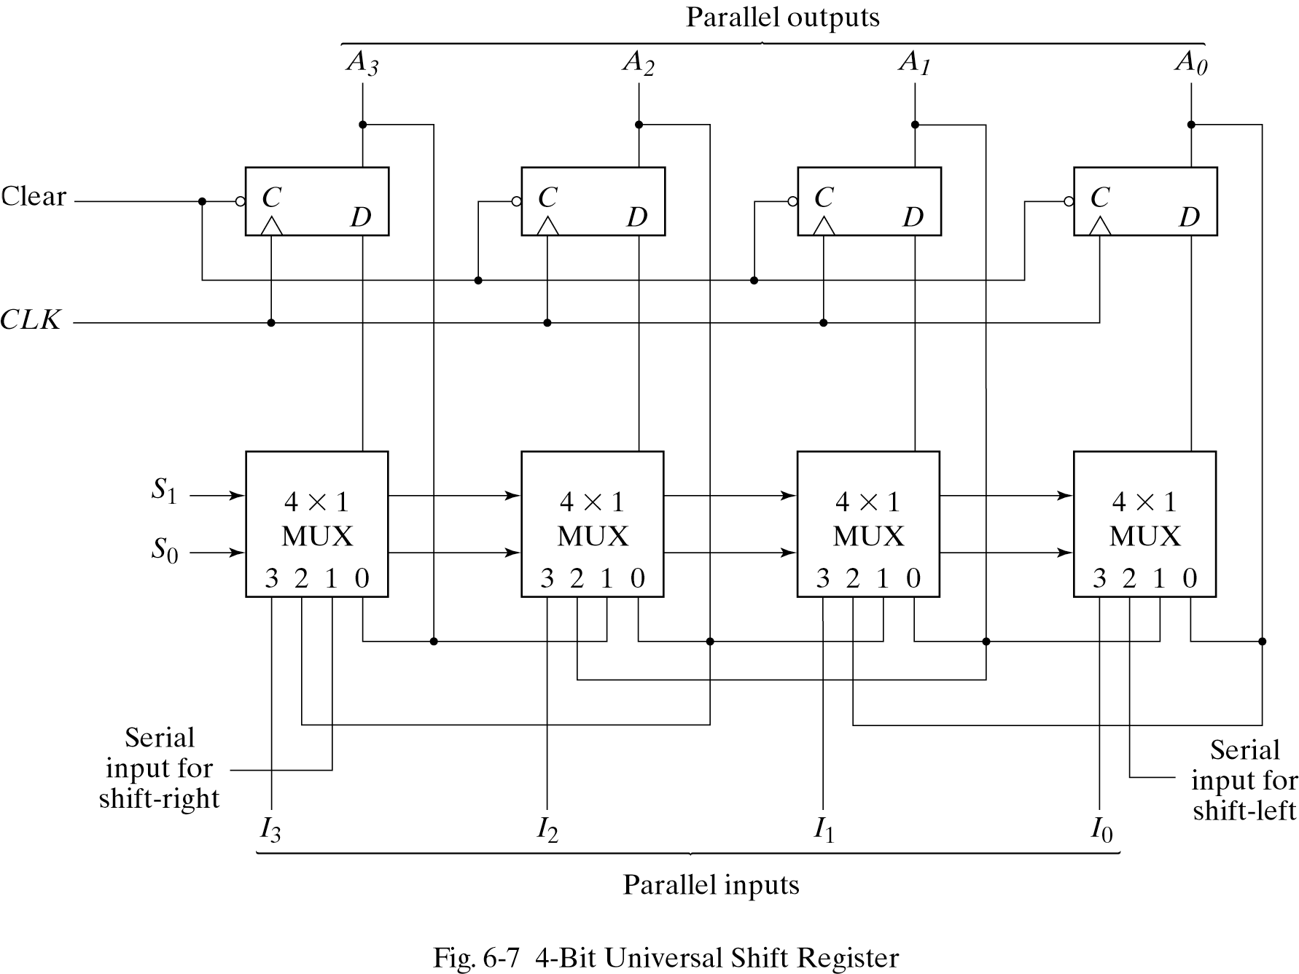
Universal shift register

