Slide 1
Digital Design
Prof. GSS Chalapathi,
Prof. Saurabh Gandhi,
Prof. Ramesh Sambangi

Slide 2
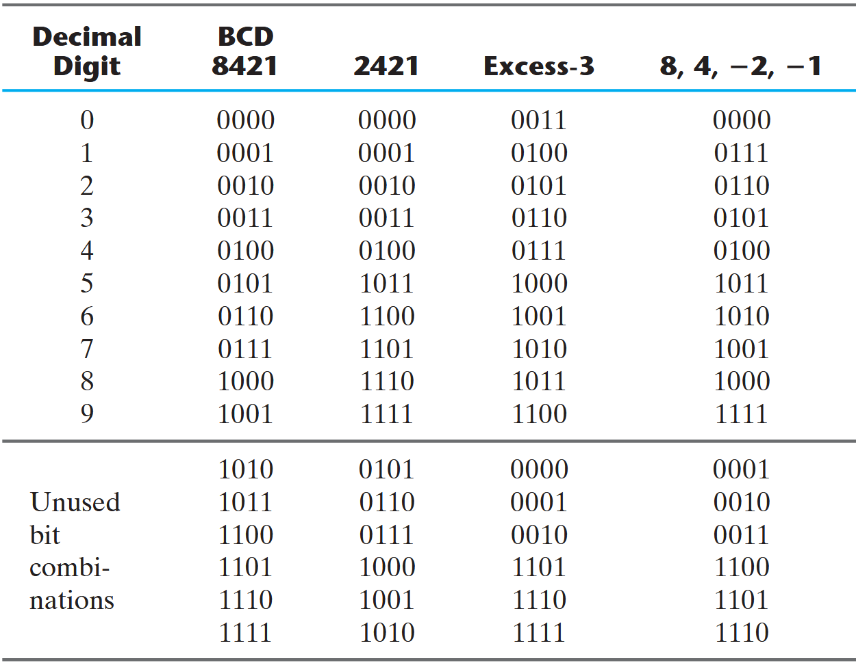
Review questions
What is 1’s complement of 10010101?
What is 2’s complement of 10010101?
Select the correct statements about binary representations
Different interpretations of the same binary string

Slide 3
Working in Binary
Representing information in binary
Operations on binary numbers, Boolean Algebra
Obtaining and simplifying binary expressions
K-maps for simplifying expressions
K-maps in special cases

Slide 4
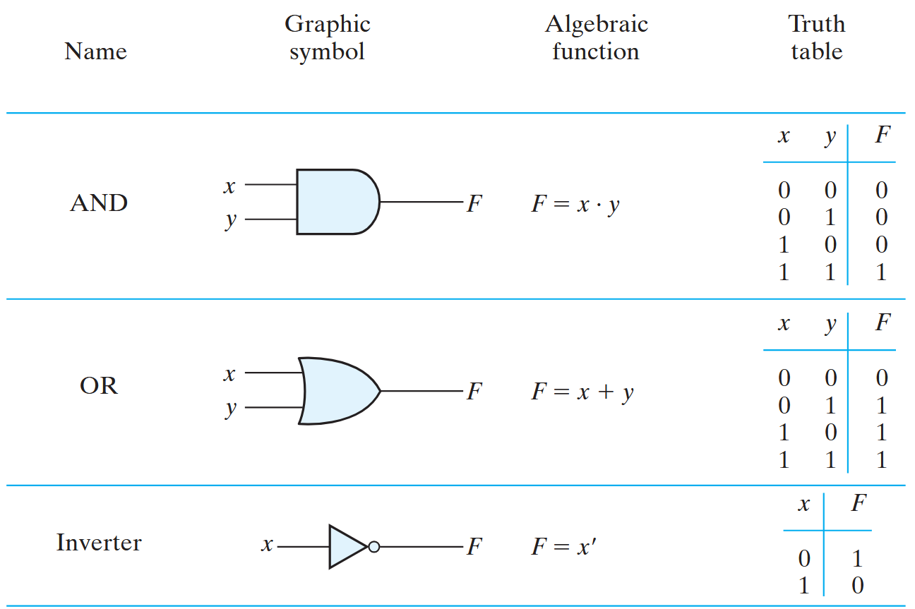
Operations with binary numbers

Slide 5
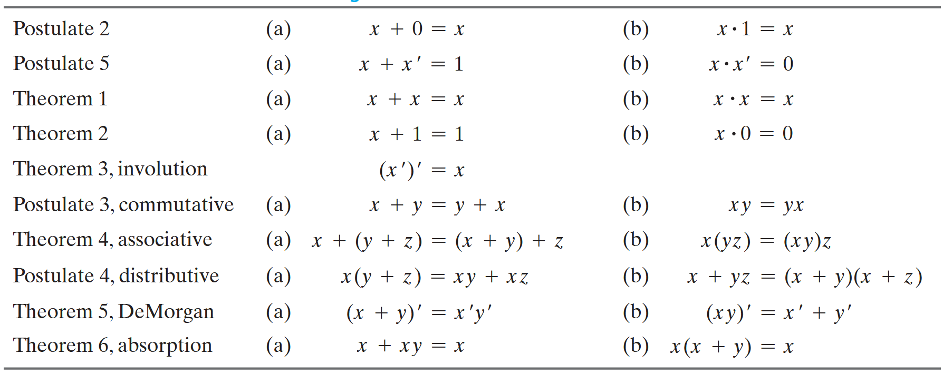
Boolean algebra: postulates and theorems
Principle of duality: Interchanging operators and the identity elements result in a valid expression!

Slide 6
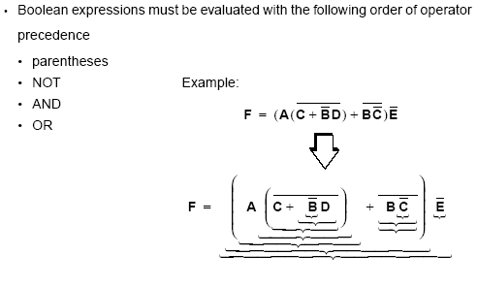
Operator precedence in Boolean expressions

Slide 7
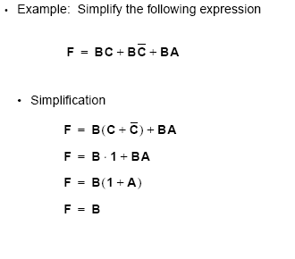
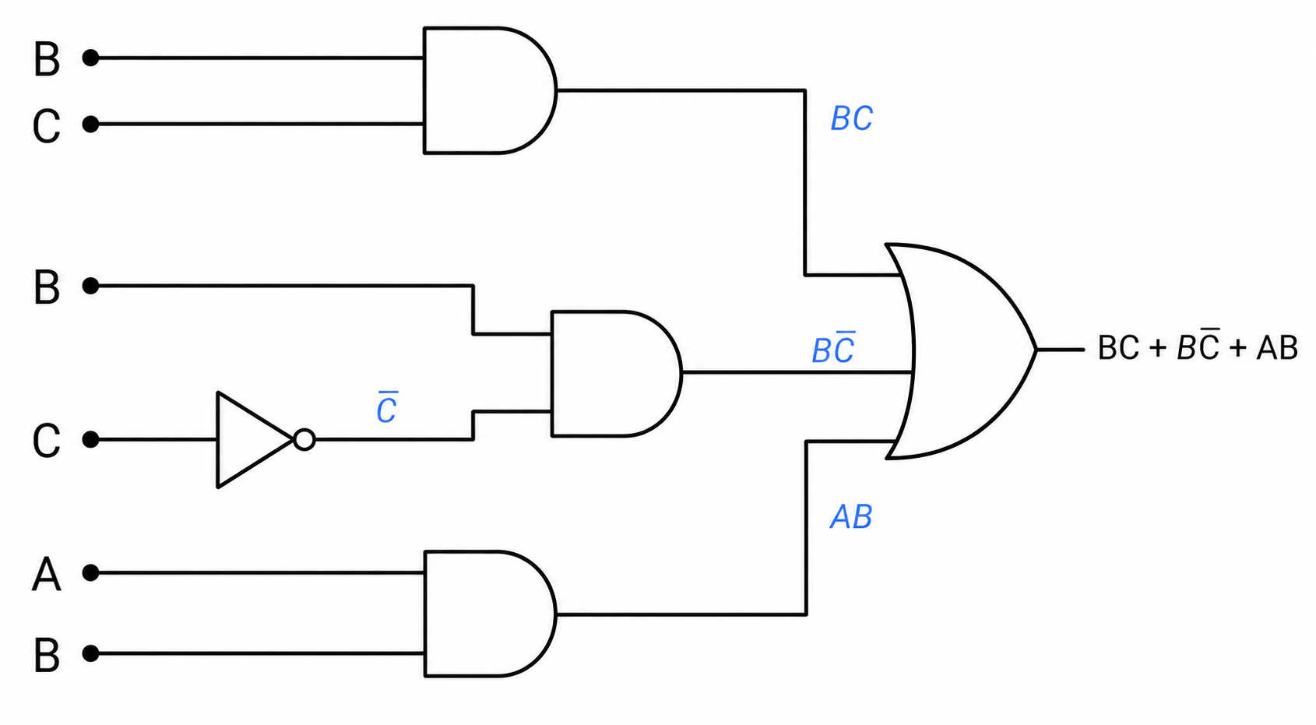
Examples of Boolean functions
How will you implement this using gates?
What is the truth table of this function?
A | B | C | F
0 | 0 | 0 | 0
0 | 0 | 1 | 0
0 | 1 | 0 | 1
0 | 1 | 1 | 1
1 | 0 | 0 | 0
1 | 0 | 1 | 0
1 | 1 | 0 | 1
1 | 1 | 1 | 1
What do you notice about the function?

Slide 8
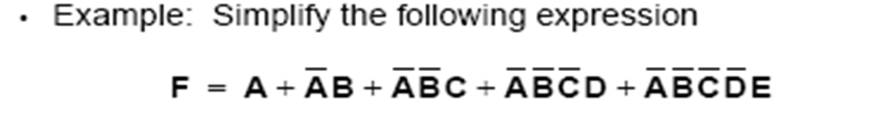
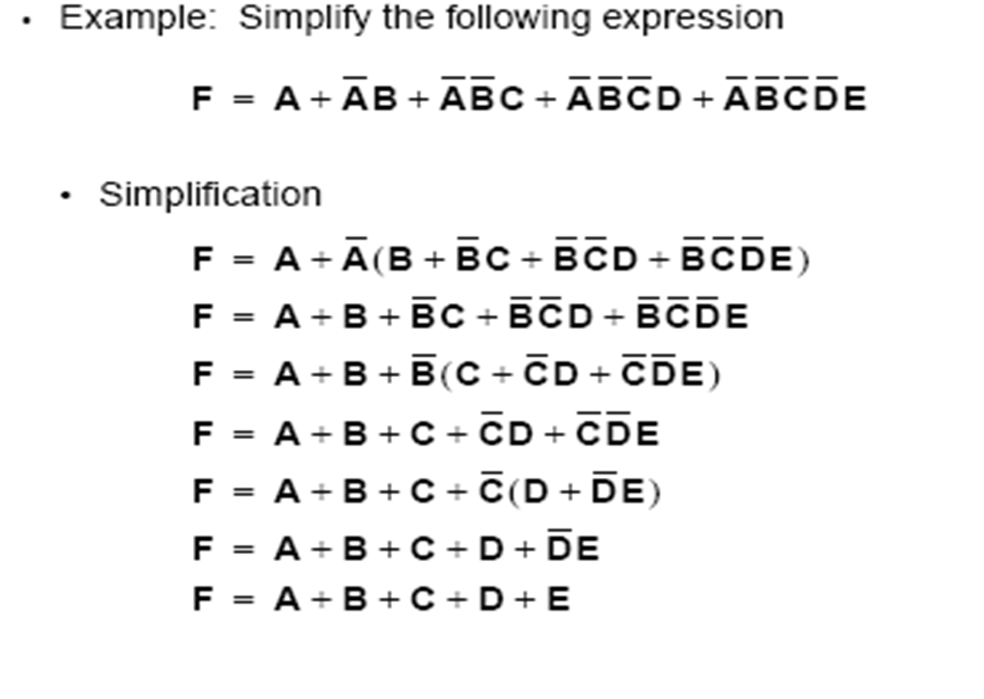
Examples of Boolean functions

Slide 9
Complement of functions
F’ is a function that takes the value 0 whenever F takes 1 and vice versa
How do you get the complement of a function?
Use de Morgan’s laws
Alternately:
Take the dual
Complement each literal
Example:
F = X’YZ’ + X’Y’Z
Dual of F is
Complementing each literal gives (X+Y’+Z)(X+Y+Z’) = F’
Verify with truth tables!
(X’+Y+Z’)(X’+Y’+Z)

