Slide 1
Day 2 · The Cluster
September 18, 2026
Alex Storer, Jeff Ott, Natalya Rapstine
Data, Analytics, and Research Computing – GSB Research Hub

Slide 2
Agenda
Part 1
What is inside any computer
Running a script
Research computing resources
Profiling
Why profiling matters
Slurm
Part 2
Parallelization
Job arrays
GPUs
Where to get help

Slide 3
Part 1 · Where your code runs
9:00–9:20 · concepts only

Slide 4
What is inside any computer?

Slide 5
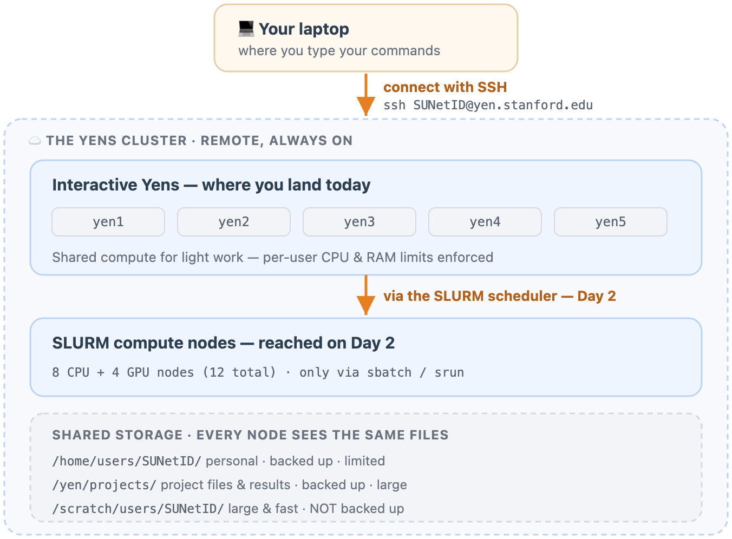
Your laptop, a Yen, the cloud
Same parts everywhere. What changes is how much, and who else wants it.
You write code on your laptop. It runs on a machine somewhere else.

Slide 6
Same parts, different amounts
 | Your laptop | One Yen node | The cloud
CPU cores | a handful | up to 256 on yen1 | as many as you rent
RAM | single-digit GB | 250 GB – 3 TB | as much as you rent
Storage | your own disk | shared, ~1 PB | rented volumes
Who else is on it | nobody | everyone | nobody
Close the lid | work stops | keeps running | keeps running

Slide 7
CPU and cores
The CPU is the processor chip. It does the work.
A core is one independent worker inside it.
Each core runs instructions on its own. That independence is the whole reason parallel work is possible at all.
One core can only do one thing at a time. Eight cores can do eight — but only if your work comes apart into eight pieces.

Slide 8
RAM, storage, and I/O
RAM — the desk.
Holds the data the CPU is actively using. Fast, and limited. Run out and the job dies.
Storage — the filing cabinet.
Where your files live when nothing is running. Large, and slow to reach.
I/O — walking between them.
Moving data from storage into RAM, and writing results back. Almost always the slowest thing your script does.

Slide 9
Running a script

Slide 10
What running a script actually means
Four things happen, in this order, every time.
1 · Load from disk
Python reads your script and your data files from storage.
2 · Into RAM
The data lands in memory, where the CPU can reach it.
3 · The CPU works
Cores execute your steps against what is in RAM.
4 · Save to disk
Results are written back, so they survive the run.

Slide 11
How your data moves
Watch the first leg.
Getting data from disk into RAM is the slow one. Once it is close to the processor, the work itself is quick.

Slide 12
Disk is about a million times farther away than RAM.
THE TAKEAWAY
The CPU reaches RAM in nanoseconds; a disk read takes milliseconds. If your data does not fit in RAM all at once, the script keeps going back to disk mid-computation — and that, far more often than a slow CPU, is what makes a job crawl.

Slide 13
Research computing resources

Slide 14
You have a running script. What does it need?
Three resources account for almost every decision you will make.
Compute time — how long it runs.
Cores — how many workers it uses at once.
RAM — how much memory it holds while running.
There are others — disk space, network, GPU memory — but these three are the ones you will declare, argue about, and get wrong.

Slide 15
How much of each does your script use?
That is the question. And you cannot answer it by reading the code.
Not from the algorithm, not from the file size, not from how long it took on your laptop last Tuesday.
You have to measure it while it runs.

Slide 16
Profiling

Slide 17
Measuring those three things is profiling
Profiling is measuring what your code actually consumes as it runs — instead of guessing.
Memory profiling
Measuring how much RAM the job holds.
CPU profiling
Measuring how many cores it uses, and for how long.
Profiling
Usually just means all three at once. That is what we will do.
It works whether you wrote the script or inherited it. In the work block you will profile one you have never seen.

Slide 18
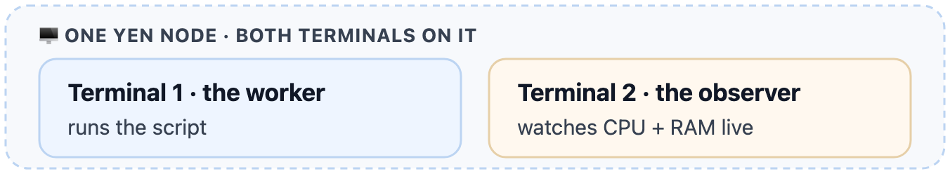
Two terminals, one node
One runs the script. The other watches it.
Both tools only see the machine they are on.
So the second terminal has to be on the same Yen as the first.

Slide 19
Why profiling matters

Slide 20
Because resources are finite — and shared
Your laptop
All yours. Nobody else is competing for it. Also: small, and it sleeps.
The cloud
All yours too — for rent. You pay by the hour whether you use it or not.
The Yens
"Free" to you, and **shared** with everyone else doing research at the GSB. Which makes being a good citizen an actual technical skill, not a nicety.

Slide 21
What being a good citizen means in practice
It means you know what your code needs before you ask for it.
Is this a 2-hour job or a 2-week job?
Does it want 10 cores or 200?
Can the problem be broken into parts and run in parallel to finish sooner?
Are you actually using what you asked for — or holding it idle?
Every one of those is a measurement, not an opinion.

Slide 22
Getting it wrong costs, in both directions
Ask for too much
You wait longer in the queue, because a big request is harder to schedule. And once it starts you hold cores and memory you never touch — which nobody else can use.
Ask for too little
The job hits the ceiling you declared and gets killed partway through. You queued, you waited, and you have nothing to show.
Measure first, and you ask for roughly what you use.

Slide 23
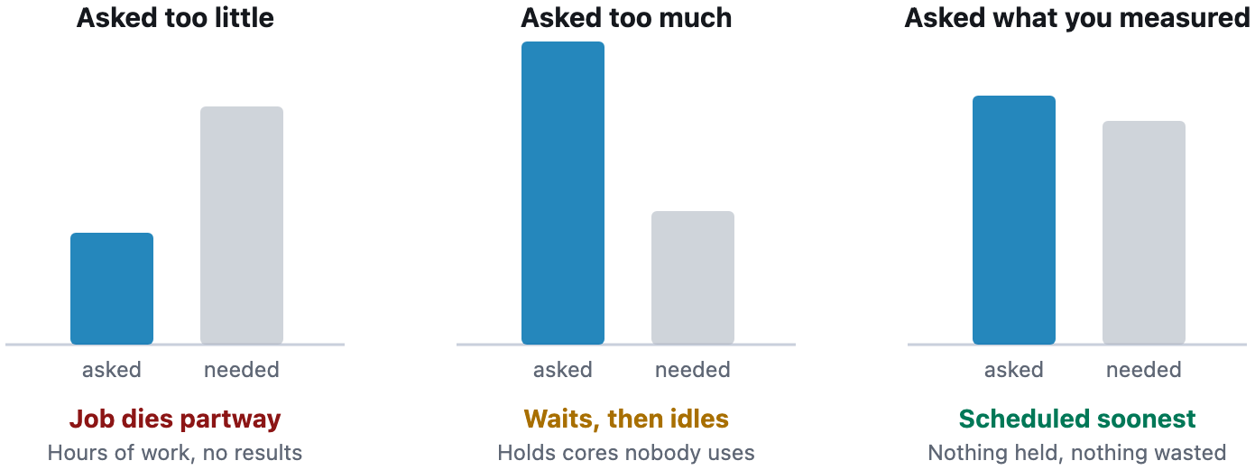
Three ways to size a request
Only the third one is doing your research a favour.

Slide 24
Two situations
The same inherited script, two different mornings.

Slide 25
Situation 1 — the script you inherited
Your PI hands you a script from a PhD student who graduated. "Run this, then extend the analysis."
1 · Copy it to the Yens
2 · Profile it on an interactive Yen
3 · It measures 10 GB of RAM, 25 cores, 5 hours
4 · You run it right there on the interactive Yen — and sit watching the output for five hours, hoping your connection does not drop
Step 4 is the problem. Nothing about it is wrong except everything.

Slide 26
Situation 2 — same script, worse morning
Same script, same instruction.
1 · Copy it to the Yens
2 · Profile it on an interactive Yen — and partway through it gets **killed** for exceeding the per-user memory limit
3 · You scale the input down to 10% of the data and profile again. This time it runs: 10 GB of RAM, 1 core, 1 hour
But that is a tenth of the data.
So what do you actually ask for?

Slide 27
The correct way, both times
Stop running it on the interactive Yen. Submit it to yen-slurm.
Situation 1 — you measured the real thing
Ask for 10 GB, 25 cores, 5 hours.
Situation 2 — you measured a tenth, so scale the estimate
Ask for 100 GB, 1 core, 10 hours.
Then close your laptop and walk away.
Work on another part of the project. Have lunch. Take a nap. The job does not need you in the room.

Slide 28
It is subtler than multiplying by ten
Not all code scales linearly.
Ten times the data is not always ten times the memory, and almost never ten times the time. Sometimes it is worse than linear.
And the estimate is not the only lever.
Maybe the right move is to rewrite the script to use more cores and less RAM. Maybe it is to break the work into independent pieces and run them at the same time.
That second idea is Part 2.

Slide 29
Slurm

Slide 30
What Slurm gives you
A queue, and then a machine that is yours.
More resources than interactive.
The limits that killed the job in Situation 2 are interactive limits. Batch nodes are bigger.
And they are yours while the job runs.
Dedicated cores and memory — nobody else competing, nobody else's job slowing yours.
The price: you have to say what you need up front.
Which is why the whole morning has been about measuring it.

Slide 31
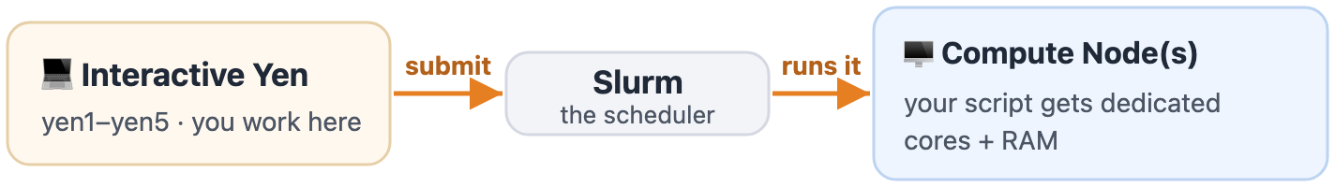
Where a job goes
You submit from a shared interactive Yen. Slurm finds you a compute node.
You are not asking for a computer.
You are asking for a slice of cores, for a span of time.

Slide 32
The lifecycle of a job
PD means queued and waiting for a node. R means running.
When it finishes, what it printed is waiting for you in logs/.

Slide 33
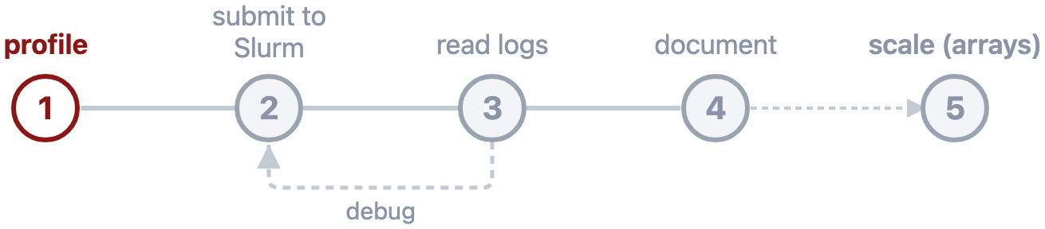
Where this morning fits
Part 1 is steps 1 to 3. Part 2 is 4 and 5 — and it runs on the numbers you write down this morning.

Slide 34
Lab Time.
Part 1 · 9:20–10:30 · work at your own pace

Slide 35
Your Goals — Part 1
Profile a script you have never seen
Write the resources down — time, cores, RAM
Submit a Slurm job
Read its log
Find the lab materials at: darc.stanford.edu/class
New to the terminal?
Getting through the profiling exercises is a good morning. Ask early — that is what we are here for.
Done already?
Check whether anyone at your table is stuck before you start the bonus material.

Slide 36
Checkpoint — Part 1
Everyone should have reached
Profiled the mystery script (two terminals)
Profiled the batch script on 10 filings
Resource Profile written into the README ← protect this one
Peeked at the queue: told R from PD
Written and submitted a Slurm job
Debugged a failed job from its .err ← matters most
/day2/profiling/ · /day2/slurm-scheduler/ · /day2/slurm-job/
Extra, if you are ahead
Watch a job on its node while it runs
An interactive job with srun
fix_me_2 and fix_me_3
Fix the broken one-file script
Chain two jobs with a dependency
The dev partition · vectorization · core counts
All bonus. None of it is the floor.
Not done the Resource Profile? Do that before anything on the right — Part 2 runs on those numbers.

Slide 37
Part 2 · Doing many things at once
10:30–10:50 · concepts only

Slide 38
The script you just ran
You already have a hundred separate jobs.
No filing needs any other filing to be finished first. Running them one after another was a decision in your code — not something the problem asked for.
The rest of this is about undoing that decision.

Slide 39
Parallelization
What it is, when it helps, and when it does nothing.

Slide 40
What it is, and is not
Running many copies of the same work at the same time.
It is not making one run faster.
Work that will not come apart still gets plenty from the cluster — a node to itself, far more memory, nobody competing for your cores, and the freedom to walk away. It just will not get this.
The test is independence.
Could you hand each piece to a different person, and never let them talk?

Slide 41
One burner, four sandwiches
The steps of one sandwich are a chain.
Grilling cannot start before assembly. More cooks change nothing.

Slide 42
Four burners, four sandwiches
The sandwiches are independent.
Four burners finish at t = 4 what one burner finishes at t = 16.

Slide 43
Your extraction job is four burners
Inside one filing, a chain. Across filings, nothing.
Inside a single filing the steps are strictly ordered: read it, send it to the API, validate the reply, write the result. Four cores on one filing leaves three idle.
Across filings there is no ordering at all. Filing 2 does not care whether filing 1 is done.
So the unit you parallelize is the filing, not the step.

Slide 44
The part that will not split sets the floor.
THE CEILING
However many workers you add, you can only ever shrink the part that does split. Asking for more cores past that point buys you nothing but a longer wait in the queue.

Slide 45
Three from your own research
Which of these come apart? Discussion — no keyboards.
1 · Sum every value in an array. Now sum an expensive function of every value.
Both split. Only one is worth it — adding numbers is so cheap that handing pieces out and collecting them back costs more than the work.
2 · Check a key is unique before you merge on it.
Splits, but not cleanly. Each worker checks its chunk — but a duplicate can sit across a boundary, so one step still has to see all of it.
3 · A hundred pages scraped, each appending a row to the same CSV.
The scraping is independent. The writing is not. A hundred writers interleave, and you get corrupted rows.

Slide 46
Independent compute is easy. Shared state is where it breaks.
THE PATTERN UNDER ALL THREE
Write to separate places. Combine afterwards.
That one habit is the difference between an array that works and one that quietly corrupts its own output.

Slide 47
Shapes of parallelism
More cores, more jobs, or both.

Slide 48
Where you started: one job, one core
This morning's loop. Eight filings, one after another.
The baseline everything else is measured against.

Slide 49
One job, many cores
The job splits the work across cores itself.
Faster — and capped at one machine, since a job cannot use cores on a node it was not given.

Slide 50
Many jobs, one core each
An array. Slurm hands out many small jobs instead of one big one.
Scales past a single machine, and one failure costs one task instead of the run.

Slide 51
Many jobs, many cores
Both at once. Most throughput, biggest request.
And the longest wait before anything starts.

Slide 52
What each shape actually costs
Eight filings, five seconds each | One core per job | Many cores per job
One job | 40s — a loop, no speedup | 20s — capped at one machine
Many jobs | 20s — an array, scales out | 10s — most throughput

Slide 53
Job arrays

Slide 54
What an array is
One script, submitted once, run many times over.
Every task runs the identical script. Exactly one thing differs between them: a number saying which task this is.
Which means nothing decides which filing each task takes.
Slurm hands you a number. Turning that number into a filing is your code's job.

Slide 55
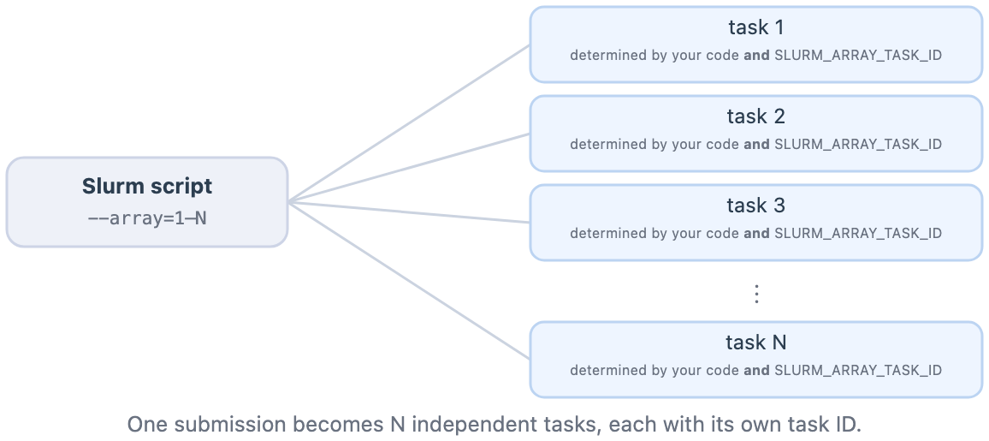
One script in, many tasks out
You submit once.
Slurm runs the same script many times, handing each copy a different task ID.

Slide 56
Two things that will bite you
You choose where the numbering starts. Then you live with it.
Start at zero and the task number is already a list position. Start at one and every lookup needs a − 1. Forget, and nothing complains — you silently skip the first one and run off the end.
An array is not unlimited.
On the normal partition task numbers run to 511, and the ceiling differs by partition. More tasks than that has to be split across several arrays.

Slide 57
Make your tasks safe to run again
If the output for this task already exists, skip it.
Four lines of code. It turns a rerun from "pay for all hundred again" into "finish the six that failed".
At a hundred tasks, some will fail. That stops being an exception and becomes the normal case — so the ability to just resubmit the whole array is what saves you.

Slide 58
Estimate, request, run, check.
THE HABIT THAT OUTLASTS TODAY
Write the estimate down before you submit anything. Turn it into a request. Run it. Then compare what it really used against what you guessed.
There is nothing to learn from step four if you skipped step one.

Slide 59
GPUs
Preview only. The bonus page has the rest.

Slide 60
Fourteen GPUs, in three tiers
GPU | Memory on the card
A30 | 24 GB
A40 | 48 GB
H200 | 141 GB
Fourteen in total, against hundreds of CPU cores per node. The scarcest thing on the cluster.

Slide 61
A model that does not fit in GPU memory does not run slowly. It does not run.
WHAT DECIDES WHAT YOU CAN RUN
Most limits make things slower. This one is a cliff: the weights fit on the card, or the job will not start. VRAM decides which models you can load at all.

Slide 62
Would a GPU have helped this morning?
You already measured the answer.
No — and not by a little.
A GPU makes arithmetic fast. Your job barely does any: it asks for a filing, waits, and writes the answer down. Your two clocks said so.
Where they do earn their keep:
Training or fine-tuning a model · large matrix operations · running an LLM's weights yourself instead of calling someone else's API.

Slide 63
Where to get help

Slide 64
After today
RCpedia — rcpedia.stanford.edu
The written documentation for the Yens. Storage, Slurm, software, quotas.
Slack — #gsb-yen-users
Where Yen users and the DARC team answer questions about the cluster, Slurm, storage and software. Also where maintenance windows and new hardware get announced.
Email — gsb_darcresearch@stanford.edu
For anything you would rather not post in a channel, or that needs a direct answer. Typically one business day.
The course site stays up.

Slide 65
When you are stuck
"My Slurm job keeps failing"
#gsb-yen-users — someone has seen it. Include your error output.
"My code works on my laptop but not the Yens"
#gsb-yen-users — again, paste the error.
"Is this dataset ok to send to an LLM?"
Email DARC, or ask your IRB coordinator.
"I want to run something much bigger"
Email DARC — we can advise on allocations.

Slide 66
Lab Time.
Part 2 · 10:50–11:50 · hands on keyboards

Slide 67
Your Goals — Part 2
Submit a job array — and watch it fan out
Make your tasks safe to run again
The capstone: estimate first, then check against what it used
Find the lab materials at: darc.stanford.edu/class
Start from the array script already in the repo.
slurm/hello_array.slurm exists so everyone sees fan-out work with their own eyes. Writing both array files from scratch is bonus, not the floor.
By 11:50 the estimate matters more than the run.

Slide 68
Checkpoint — Part 2
Everyone should have reached
An array running from slurm/hello_array.slurm
Tasks made rerun-safe (idempotent)
Capstone: estimate written down first
Capstone: submitted, then compared against sacct
/day2/job-arrays/ · /day2/capstone/
Extra, if you are ahead
Write both array files from scratch
Merge the results into one CSV
Distill a Slurm skill for Claude — /day2/slurm-with-claude/
GPUs — /day2/gpus/
Run all 992 filings
All bonus. Nobody is behind for skipping these.
Experts: don't just leave. The bonus pages are where the Yen-specific tooling lives — quotas, permissions, user limits.

