Slide 1
Traveller Online

Slide 2
Who are we?

Slide 3
What did we do?

Slide 4


What did we use?
Java
Hibernate API
Spring framework and Lombok
MySQL
Argon framework
Postman
MVC
Git
Intelij

Slide 5
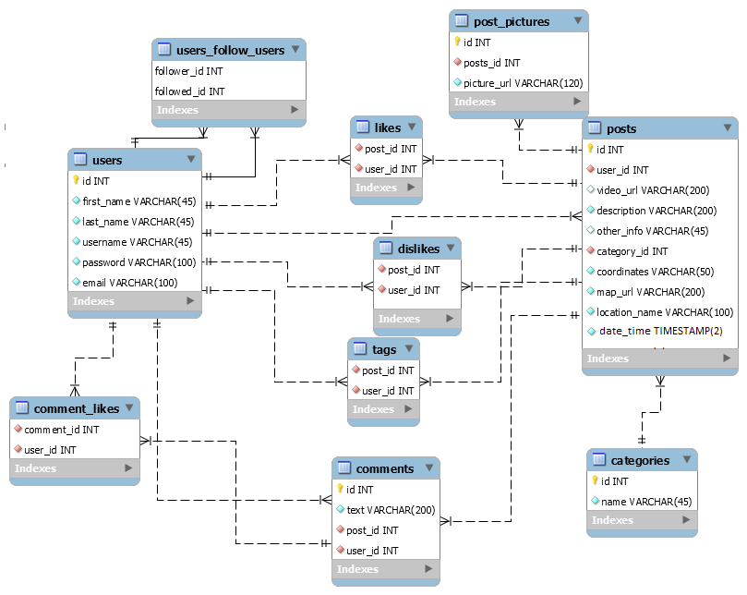
ER DIAGRAM

Slide 6
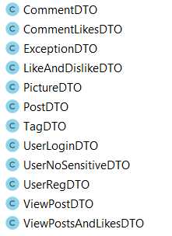
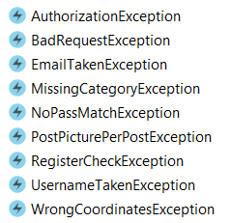

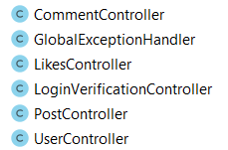
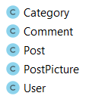
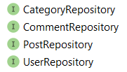
Class Diagrams
DAOs &
Repositories
DTOs
Exceptions
Controllers
POJOs

Slide 7
Let’s get started!

Slide 8
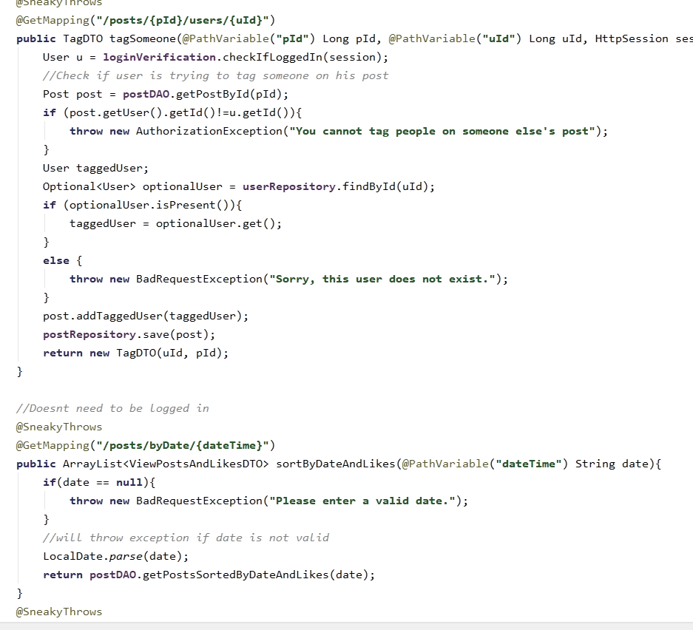
Any questions?

