Slide 1
Recursion and iteration
algorithm examples

Slide 2
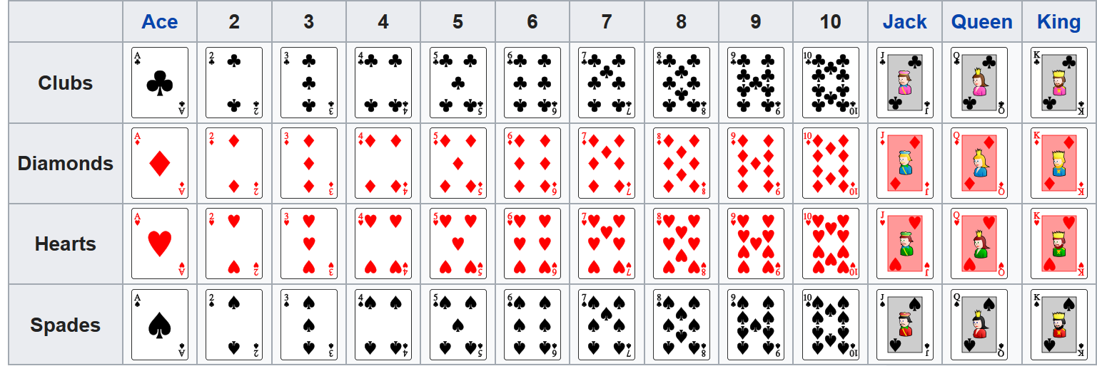
Standard 52-card deck
en.wikipedia.org/wiki/Standard_52-card_deck

Slide 3
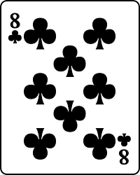
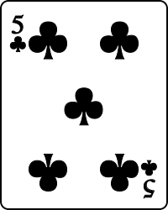
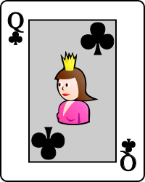

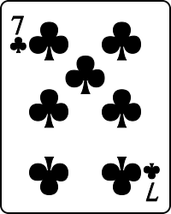
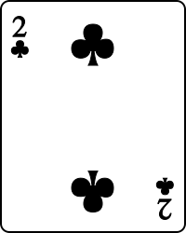
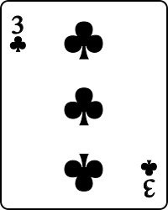
Selection sort
min
selection_sort.py
def selection_sort(L): unsorted = L[:] result = [] while unsorted: e = min(unsorted) unsorted.remove(e) result.append(e) return result
unsorted
sorted
result
min and .remove scan the remaining unsorted list for each element moved to result
order |L|² comparisons
Notes:
L[:] makes copy to ensure L remains unchanged
L = [3, 2, 1, 5, 7]
sorted(L)
L.sort() # side effect

Slide 4
Sorting a pile of cards (Merge sort)
left
split
right
If one card in pile, i.e. pile is sorted
Otherwise
Split pile into two piles, left and right, of approximately same size
Sort left and right recursively (independently)
Merge left and right (which are sorted)
recurse
recurse
merge

Slide 5
merge_sort.py
def merge_sort(L): n = len(L) if n <= 1: return L[:] mid = n // 2 left, right = L[:mid], L[mid:] return merge(merge_sort(left), merge_sort(right)) def merge(A, B): n = len(A) + len(B) C = n * [None] a, b = 0, 0 for c in range(n): if a < len(A) and (b == len(B) or A[a] < B[b]): C[c] = A[a] a = a + 1 else: C[c] = B[b] b = b + 1 return C
mid
split
6 | 5 | 9 | 2 | 4 | 8 | 1 | 7
6 | 5 | 9 | 2 |  | 4 | 8 | 1 | 7
recurse
2 | 5 | 6 | 9 |  | 1 | 4 | 7 | 8
merge
1 | 2 | 4 | 5 | 6 | 7 | 8 | 9
a
0 | 1 | 2 | 3
2 | 5 | 6 | 9
A
input
b
0 | 1 | 2 | 3
1 | 4 | 7 | 8
B
c
n-1
0 | 1 | 2 | 3 | 4 | 5 | 6 | 7
1 | 2 | 4 | 5 | 6
output
C
Notes:
Could also have used C.append on an initial empty C, and while a + b < n

Slide 6
Question – Depth of recursion for 52 elements
1
2
3
4
5
6
7
8
9
10
Don’t know
Max recursive subproblem size
52 → 26 → 13 → 7 → 4 → 2 → 1
Depth 4 for 8 elements
6 | 5 | 9 | 2 | 4 | 8 | 1 | 7
6 | 5 | 9 | 2 |  | 4 | 8 | 1 | 7
6 | 5 |  | 9 | 2 |  | 4 | 8 |  | 1 | 7
6 |  | 5 |  | 9 |  | 2 |  | 4 |  | 8 |  | 1 |  | 7

Slide 7
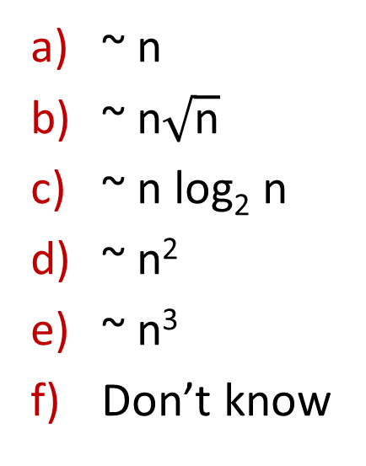
Question – Order of comparisons by Merge sort ?
merge_sort.py
def merge_sort(L): n = len(L) if n <= 1: return L[:] else: mid = n // 2 left, right = L[:mid], L[mid:] return merge(merge_sort(left), merge_sort(right)) def merge(A, B): n = len(A) + len(B) C = n * [None] a, b = 0, 0 for c in range(n): if a < len(A) and (b == len(B) or A[a] < B[b]): C[c] = A[a] a = a + 1 else: C[c] = B[b] b = b + 1 return C
~ n
~ n$\sqrt{\text{n}}$
~ n log₂ n
~ n²
~ n³
Don’t know

Slide 8
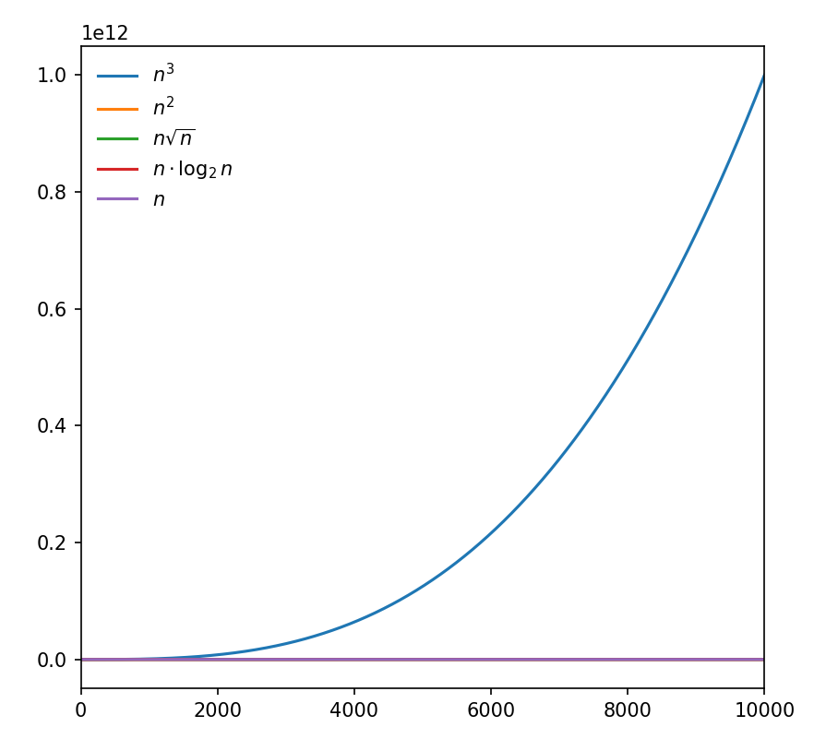
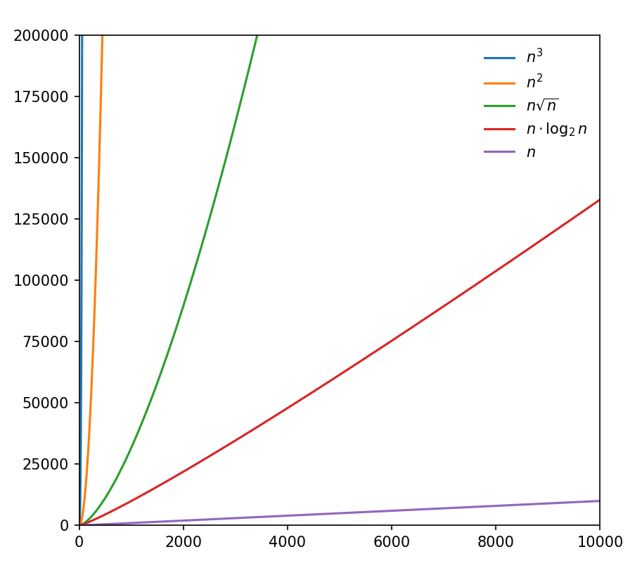
Growth of some functions

Slide 9

Merge sort without recursion
Start with piles of size one
Repeatedly merge two smallest piles
merge_sort.py
def merge_sort_iterative(L): Q = [[x] for x in L] while len(Q) > 1: Q.insert(0, merge(Q.pop(), Q.pop())) return Q[0]
merge_sort.py
def merge_sort_iterative(L): Q = [[x] for x in L] while len(Q) > 1: Q.insert(0, merge(Q.pop(), Q.pop())) return Q[0] from collections import deque def merge_sort_deque(L): Q = deque([[x] for x in L]) while len(Q) > 1: Q.appendleft(merge(Q.pop(), Q.pop())) return Q[0]
insert at front of list inefficient
merge_sort_iterative([7,1,9,3,-2,5])
Values of Q in while-loop
[[7], [1], [9], [3], [-2], [5]]
[[-2, 5], [7], [1], [9], [3]]
[[3, 9], [-2, 5], [7], [1]]
[[1, 7], [3, 9], [-2, 5]]
[[-2, 3, 5, 9], [1, 7]]
[[-2, 1, 3, 5, 7, 9]]
Note: Lists in Q appear in non-increasing length order, where longest ≤ 2∙ shortest
deques are a generalization of lists with efficient updates at both ends

Slide 10
Question – Number of iterations of while-loop ?
merge_sort_iterative([7, 1, 9, 3, -2, 5])
1
2
3
4
5
6
7
Don’t know
merge_sort.py
def merge_sort_iterative(L): Q = [[x] for x in L] while len(Q) > 1: Q.insert(0, merge(Q.pop(), Q.pop())) return Q[0]

Slide 11
Quicksort (randomized)
quicksort.py
import random def quicksort(L): if len(L) <= 1: return L[:] idx = random.randrange(len(L)) pivot = L[idx] other = L[:idx] + L[idx + 1:] small = [e for e in other if e < pivot] large = [e for e in other if e >= pivot] return quicksort(small) + [pivot] + quicksort(large)
random idx
pivot
0 | 1 | 2 | 3 | 4 | 5 | 6 | 7
6 | 9 | 5 | 2 | 4 | 8 | 1 | 7
partition
small
large
2 | 4 | 1 | 5 | 6 | 9 | 8 | 7
recurse
1 | 2 | 4 | 5 | 6 | 7 | 8 | 9
combine
1 | 2 | 4 | 5 | 6 | 7 | 8 | 9
order |L|∙log₂ |L| comparisons, expected

Slide 12
Sorting comparison (single run)
tuned merge-sort (Tim-sort)
implementation in C
|L| | Selection sort | Merge sort Recursive | Merge sort Iterative | Merge sort Deque | Quicksort | sorted (Python builtin)
2¹⁰ 2¹¹ 2¹² 2¹³ 2¹⁴ 2¹⁵ 2¹⁶ 2¹⁷ 2¹⁸ 2¹⁹ 2²⁰ 2²¹ 2²² | 0.006 0.02 0.09 0.37 1.50 6.19 25.67 104.20 | 0.002 0.004 0.008 0.02 0.04 0.08 0.18 0.38 0.81 1.69 3.65 7.85 16.69 | 0.003 0.006 0.01 0.04 0.10 0.26 0.81 2.96 10.78 41.71 167.31 | 0.002 0.000 0.008 0.03 0.06 0.13 0.26 0.61 1.29 2.58 5.15 9.68 19.09 | 0.002 0.003 0.007 0.02 0.03 0.07 0.14 0.29 0.62 1.48 3.30 7.53 17.6 | 0.00004 0.0001 0.0003 0.0007 0.002 0.003 0.008 0.02 0.04 0.09 0.20 0.45 1.00
x 4
x 4
x 2
x 2
x 2
x 2
Notes:
Sorting random floats in [0, 1]
Average time of sufficiently many runs to make time >= 1.0 second, since windows timing resolution 0.016 second

Slide 13
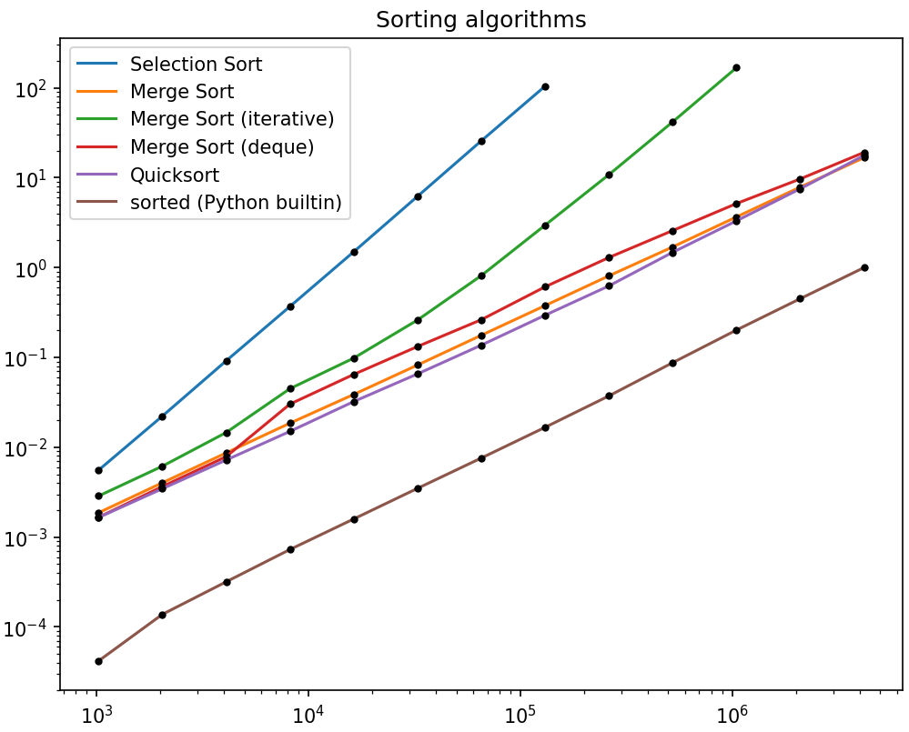
Sorting comparison

Slide 14
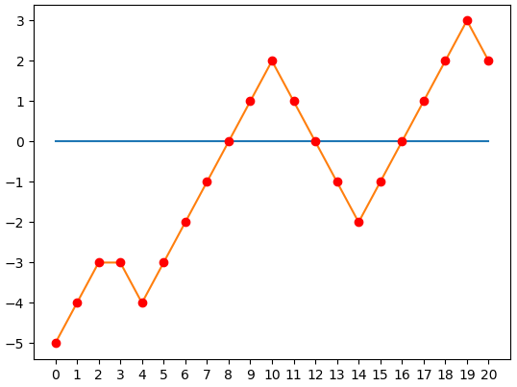
Find zero
Given a list L of integers starting with a negative and ending with a positive integer, and where |L[i+1] - L[i]| ≤ 1, find the position of a zero in L.
L = [-5, -4, -3, -3, -4, -3, -2, -1, 0, 1, 2, 1, 0, -1, -2, -1, 0 , 1, 2, 3, 2]

Slide 15
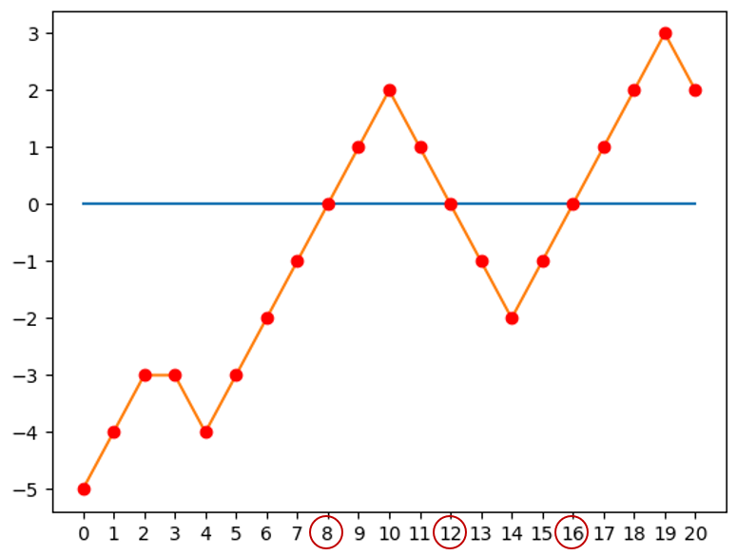
find_zero.py
def find_zero_loop(L): i = 0 while L[i] != 0: i += 1 return i def find_zero_enumerate(L): for i, e in enumerate(L): if e == 0: return i def find_zero_index(L): return L.index(0) | def find_zero_binary_search(L): low = 0 high = len(L) - 1 while True: # L[low] < 0 < L[high] mid = (low + high) // 2 if L[mid] == 0: return mid elif L[mid] < 0: low = mid else: high = mid def find_zero_recursive(L): def search(low, high): mid = (low + high) // 2 if L[mid] == 0: return mid elif L[mid] < 0: return search(mid, high) else: return search(low, mid) return search(0, len(L) - 1)

Slide 16
find_zero.py
def find_zero_loop(L): i = 0 while L[i] != 0: i += 1 return i def find_zero_enumerate(L): for i, e in enumerate(L): if e == 0: return i def find_zero_index(L): return L.index(0) | def find_zero_binary_search(L): low = 0 high = len(L) - 1 while True: # L[low] < 0 < L[high] mid = (low + high) // 2 if L[mid] == 0: return mid elif L[mid] < 0: low = mid else: high = mid def find_zero_recursive(L): def search(low, high): mid = (low + high) // 2 if L[mid] == 0: return mid elif L[mid] < 0: return search(mid, high) else: return search(low, mid) return search(0, len(L) - 1)
Function (|L| = 10⁶) | Time, sec
find_zero_loop find_zero_enumerate find_zero_index find_zero_binary_search find_zero_recursive | 0.13 0.10 0.015 0.000015 0.000088

Slide 17
Greatest Common Divisor (GCD)
Notation x↑y denotes y is divisible by x, e.g. 3↑12 i.e. y = a∙x for some integer a
Definition gcd(m, n) = max { x | x↑m and x↑n }
Fact if x↑y and x↑z then x↑(y + z) and x↑(y - z)
Observation m if m = n
gcd(m, n) = gcd(m, n – m) if m < n
gcd(m – n, n) if m > n
gcd(90, 24)
m | n
90 | 24
66 | 24
42 | 24
18 | 24
18 | 6
12 | 6
6 | 6
(recursive definition)

Slide 18
Greatest Common Divisor (GCD)
gcd_slow.py
def gcd(m, n): while m != n: if n > m: n = n - m else m = m - n return m
gcd_slow_recursive.py
def gcd(m, n): if m == n: return m elif m > n: return gcd(m - n, n) else: return gcd(m, n - m)
gcd.py
def gcd(m, n): while n != 0: m, n = n, m % n return m
gcd_recursive.py
def gcd(m, n): if n == 0: return m else: return gcd(n, m % n)
gcd_recursive_one_line.py
def gcd(m, n): return m if n == 0 else gcd(n, m % n)
Notes:
In a recursive call to gcd_recursive the sum x+y is at most 2/3 of the previous call => logarithmic number of calls.
Fibonacci numbers are inputs causing deep recursion

Slide 19
Permutations
Generate a list L of all permutations of a tuple
An implementation of permutations exists in the itertools module
Python shell
permutations(('a', 'b', 'c')) [('a', 'b', 'c'), ('b', 'a', 'c'), ('b', 'c', 'a'), ('a', 'c', 'b'), ('c', 'a', 'b'), ('c', 'b', 'a')]
permutations.py
def permutations(L): if len(L) == 0: return [L[:]] # empty tuple (ensures same type as L) else: P = permutations(L[1:]) return [p[:i] + L[:1] + p[i:] for p in P for i in range(len(L))]
Notes:
The usage of L[:] and L[:1] makes the implementation polymorph – and works for strings, tuples and lists

Slide 20
Maze solver
maze input
11 19 #######A########### #.......#.....#...# #.###.###...#.#.#.# #...#.....#.#...#.# #.#.###.#.#.#.###.# #.#.....#...#.#...# #.###########.#.#.# #.#.#.....#...#.#.# #.#.#####.#####.#.# #.........#.....#.# ###############B###
Input
First line #rows and #columns
Following #rows lines contain strings containing #column characters
There are exactly one 'A' and one 'B'
'.' are free cells and '#' are blocked cells
Output
Print whether there is a path from 'A' to 'B' or not
Notes:
Exercise is to print the path

Slide 21
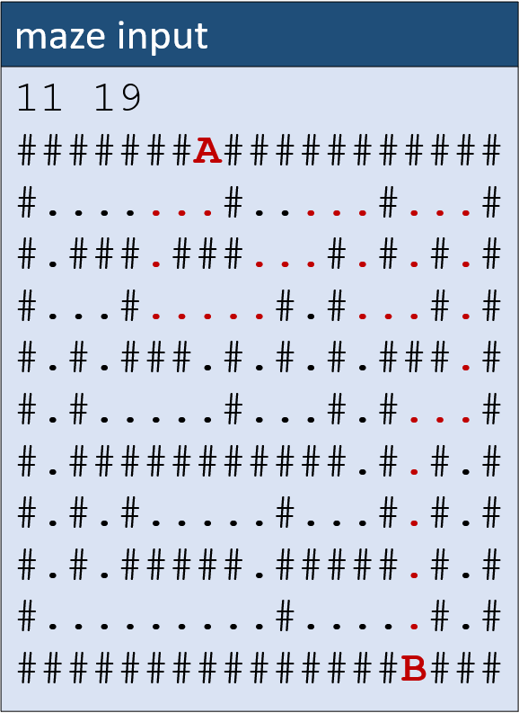
Maze solver (recursive)
maze_solver.py
def explore(i, j): global solution, visited if (0 <= i < n and 0 <= j < m and maze[i][j] != '#' and not visited[i][j]): visited[i][j] = True if maze[i][j] == 'B': solution = True explore(i - 1, j) explore(i + 1, j) explore(i, j - 1) explore(i, j + 1) | def find(symbol): for i, row in enumerate(maze): j = row.find(symbol) if j >= 0: return (i, j) n, m = [int(x) for x in input().split()] maze = [input() for i in range(n)] solution = False visited = [m * [False] for i in range(n)] explore(*find('A')) if solution: print('path from A to B exists') else: print('no path')
Notes:
find returns -1 if not

Slide 22
Maze solver (iterative)
maze_solver_iterative.py
def explore(i, j): global solution, visited Q = [(i, j)] # cells to visit while Q: i, j = Q.pop() if (0 <= i < n and 0 <= j < m and maze[i][j] != '#' and not visited[i][j]): visited[i][j] = True if maze[i][j] == 'B': solution = True Q.append((i - 1, j)) Q.append((i + 1, j)) Q.append((i, j - 1)) Q.append((i, j + 1)) | def find(symbol): for i, row in enumerate(maze): j = row.find(symbol) if j >= 0: return (i, j) n, m = [int(x) for x in input().split()] maze = [input() for i in range(n)] solution = False visited = [m*[False] for i in range(n)] explore(*find('A')) if solution: print("path from A to B exists") else: print("no path")
Notes:
Only "explore" changed
Could add "break" when solution found
Visited could be a set of cells found

