Slide 1
Dictionaries and Sets
dict
set
frozenset
set/dict comprehensions

Slide 2
Dictionaries (type dict)
key | value
'a' | 7
'foo' | '42nd'
5 | 29
'5' | 44
5.5 | False
False | True
(3, 4) | 'abc'
{key₁: value₁, ..., key_{k}: value_{k} }
Stores a mutable set of (key, value) pairs, denoted items, with distinct keys, i.e. maps keys to values
Constructing empty dictionary: dict() or {}
dict[key] lookup for key in dictionary, and returns associated value. Key must be present, otherwise a KeyError is raised
dict[key] = value assigns value to key, overriding exising value if present
distinct keys, i.e. not ”==”
https://docs.python.org/3/tutorial/datastructures.html#dictionaries
Notes:
key must be hashable (see later slide)

Slide 3

Dictionaries (type dict)
Python shell
d = {'a': 42, 'b': 57} d {'a': 42, 'b': 57} d.keys() dict_keys(['a', 'b']) list(d.keys()) ['a', 'b'] d.items() dict_items([('a', 42), ('b', 57)]) list(d.items()) [('a', 42), ('b', 57)] | for key in d: print(key) a b for key, val in d.items(): print('Key', key, 'has value', val) Key a has value 42 Key b has value 57 {5: 'a', 5.0: 'b'} {5: 'b'}
Python shell
surname = dict(zip(['Donald', 'Mickey', 'Scrooge'], ['Duck', 'Mouse', 'McDuck'])) surname['Mickey'] 'Mouse'
Notes:
5 vs 5.0, the key in the dictionary is the first inserted
items and keys are views into the dictionary (current view of the underlying dictionary)
You cannot index into a dict_keys object, you need to convert to a list first then.
d = {'a':1, 'b':2}
k = d.keys()
d['c'] = 3
k
>>> dict_keys(['a', 'b', 'c'])

Slide 4
Dictionaries (type dict)
Python shell
gradings = [('A', 7), ('B', 4), ('A', 12), ('C', 10), ('A', 7)] grades = {} # empty dictionary for student, grade in gradings: if student not in grades: # is key in dictionary grades[student] = [] grades[student].append(grade) grades {'A': [7, 12, 7], 'B': [4], 'C': [10]} print(grades['A']) [7, 12, 7] print(grades['E']) # can only lookup keys in dictionary KeyError: 'E' print(grades.get('E')) # .get returns None if key not in dictionary None print(grades.get('E', [])) # change default return value [] print(grades.get('A', [])) [7, 12, 7]

Slide 5
Dictionary initialization
Python shell
d1 = {'A': 7, 'B': 42} d2 = dict([('A', 7), ('B', 42)]) # list of (key, value) pairs d3 = dict(A=7, B=42) # keyword arguments to constructor d1 == d2 == d3 True
Note: keyword initialization only works if keys are strings which are valid keyword arguments to a function – but saves writing a lot of quotes
Python shell
d1 = dict(A=1, B=2) d2 = dict(B=3, C=4) d1 | d2 # merge dictionaries {'A': 1, 'B': 3, 'C': 4} # rightmost value for 'B' wins {**d1, **d2, 'D': 5} # ** inserts dictionary content {'A': 1, 'B': 3, 'C': 4, 'D': 5} # rightmost value for 'B' wins d1 |= d2 # same as d1.update(d2) d1 {'A': 1, 'B': 3, 'C': 4}
| and |=
new in Python 3.9 PEP 584
Notes:
Keyword arguments first covered in later lecture, but must be valid variable name

Slide 6
Dictionary operation | Description
len(d) | Items in dictionary
d[key] | Lookup key
d[key] = value | Update value of key
del d[key] | Delete an existing key
key in d | Key membership
key not in d | Key non-membership
clear() | Remove all items
copy() | Shallow copy
get(key), get(key, default) | d[key] if key in dictionary, otherwise None or default
items() | View of the dictionaries items
keys() | View of the dictionaries keys
values() | View of the dictionaries values
pop(key) | Remove key and return previous value
popitem() | Remove and return an arbitrary item
update() | Update key/value pairs from another dictionary
https://docs.python.org/3/library/stdtypes.html#mapping-types-dict

Slide 7
Tuples as dictionary keys
A tuple can be used as a dictionary key, and parenthesis can be omitted
Python shell -
d = {('a', 1): 7, ('b', 2): 42} d[('b', 2)] 42 d['b', 2] # same as above, parenthesis omitted 42 T = [[None, None], [42, None]] # 2D table as lists-of-lists T[1][0] 42 T[1, 0] # wrong, T is a list (of lists) TypeError: list indices must be integers or slices, not tuple T = {(1, 0): 42} # 2D table as dictionary T[1, 0] # dictionary lookup with tuple (1, 0) as key 42 T[1][0] # wrong, T has only one key = the tuple (1, 0) KeyError: 1

Slide 8
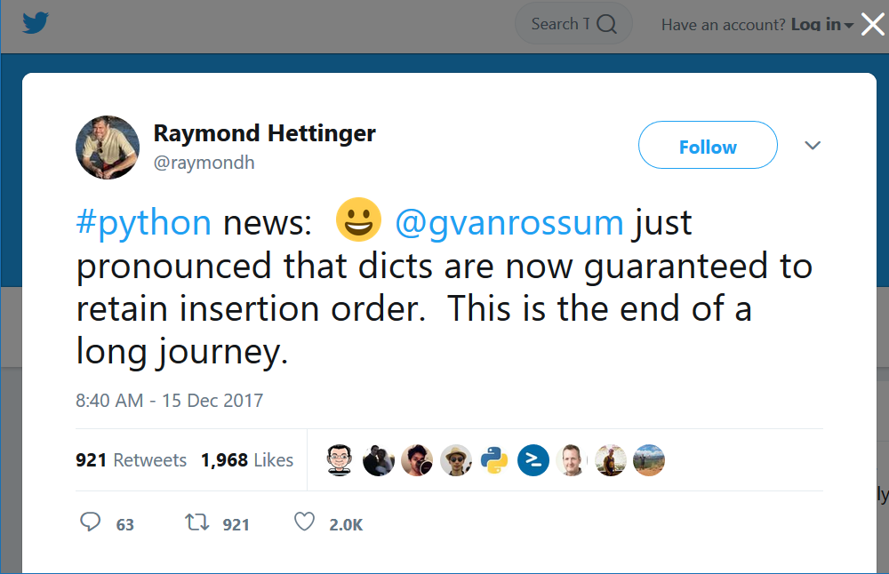
Order returned by list(d.keys()) ?
The Python Standard Library Mapping Types — dict
“Dictionaries preserve insertion order. Note that updating a key does not affect the order. Keys added after deletion are inserted at the end.” (since Python 3.7)
docs.python.org/3/library/stdtypes.html
Python shell
d = {'d': 1, 'c': 2, 'b': 3, 'a': 4} d['x'] = 5 # new key at end d['c'] = 6 # overwrite value del d['b'] # remove key 'b' d['b'] = 7 # reinsert key 'b' at end d {'d': 1, 'c': 6, 'a': 4, 'x': 5, 'b': 7}
Raymond Hettinger @ Twitter
See also Raymond’s talk @ PyCon 2017
Modern Python Dictionaries A confluence of a dozen great ideas
Notes:
18/2-18: PRE 3.7 documenting does still state that the order is arbitrary
13/2-20 ”Keys and values are iterated over in insertion order.”

Slide 9
Dictionary comprehension
Similarly to creating a list using list comprehension, one can create a set of key-value pairs:
{key : value for variable in list}
Python shell
names = ['Mickey', 'Donald', 'Scrooge'] list(enumerate(names, start=1)) [(1, 'Mickey'), (2, 'Donald'), (3, 'Scrooge')] dict(enumerate(names, start=1)) # construct dict from pairs {1: 'Mickey', 2: 'Donald', 3: 'Scrooge'} {name: idx for idx, name in enumerate(names, start=1)} {'Mickey': 1, 'Donald': 2, 'Scrooge': 3}
Notes:
Could also have used dict(map(reversed, D.items()))

Slide 10
Sets (set and frozenset)
Operation | Description
S | T | Set union
S & T | Set intersection
S – T | Set difference
S ^ T | Symmetric difference
set() | Empty set ( {} = empty dictionary )
set(L) | Create set from sequence
x in S | Membership
x not in S | Non-membership
S.isdisjoint(T) | Disjoint sets
S <= T | Subset
S < T | Proper subset
S >= T | Superset
S > T | Proper superset
len(S) | Size of S
S.add(x) | Add x to S (not frozenset)
{value₁, ..., value_{k} }
Values of type set represent mutable sets, where ”==” elements only appear once
Do not support: indexing, slicing
frozenset is an immutable version of set
Python shell
S = {2, 5, 'a', 'c'} T = {3, 4, 5, 'c'} S | T {2, 3, 4, 5, 'a', 'c'} S & T {5, 'c'} | S ^ T {2, 3, 4, 'a'} S - T {2, 'a'} {4, 5, 5.0, 5.1} {4, 5, 5.1}
https://docs.python.org/3/tutorial/datastructures.html#sets
https://docs.python.org/3/library/stdtypes.html#set-types-set-frozenset
Notes:
If one of the arguments to |, & , - or ^ is a frozentset and the other set, the result is type the first
To have a set of sets, the sets inserted must be frozenset since they need to be immutable
frozenset([1,2]) | set([3,4])
frozenset({1, 2, 3, 4})
set([3,4]) | frozenset([1,2])
{1, 2, 3, 4}
timeit.timeit('-1 in L', setup='L = list(range(10_000_000))', number = 100)
4.7
timeit.timeit('-1 in L', setup='L = set(range(10_000_000))', number = 100)
5.2e-06

Slide 11
Question – What value has the expression ?
sorted( { 5, 5.5, 5.0, '5' } )
{'5', 5, 5.0, 5.5}
{5, 5.5}
['5', 5.0, 5.5]
['5', 5, 5.5]
TypeError
Don’t know
Notes:
Cannot compare string and floats
{ 5, 5.5, 5.0, '5’ } = {'5', 5, 5.5} # since 5 == 5.0 and 5 is inserted before 5.0

Slide 12
Sets of (frozen) sets
Sets are mutable, i.e. cannot be used as dictionary keys or elements in sets
Frozen sets can
Python shell
S = {{'a'}, {'a', 'b'}, {'a', 'c'}} TypeError: unhashable type: 'set' S = {frozenset({'a'}), frozenset({'a', 'b'}), frozenset({'a', 'c'})} frozenset({'a', 'b'}) in S True {'a', 'b'} in S # automatically converts unhashable set to frozenset True {'a', 'b'} == frozenset(['a', 'b']) # frozenset from list True D = {frozenset({'a', 'b'}): 42} # dictionary frozenset({'a', 'b'}) in D True {'a', 'b'} in D # dictionaries are not that friendly as sets TypeError: unhashable type: 'set'
Notes:
To have a set of sets, the sets inserted must be frozenset since they need to be immutable
https://docs.python.org/3/library/stdtypes.html
“Note, the elem argument to the __contains__(), remove(), and discard() methods may be a set. To support searching for an equivalent frozenset, a temporary one is created from elem.”

Slide 13
Set comprehension
Similarly to creating a list using list comprehension, one can create a set of values (also using nested for- and if-statements):
{value for variable in list}
A value occurring multiple times as value will only be included once
primes_set.py
n = 101 not_primes = {m for f in range(2, n) for m in range(2 * f, n, f)} primes = set(range(2, n)) - not_primes
Python shell
L = ['a', 'b', 'c'] {(x,(y,z)) for x in L for y in L for z in L if x != y and y != z and z != x} {('a',('b','c')),('a',('c','b')),('b',('a','c')),...,('c',('b','a'))} L = {'a', 'b', 'c'} {(x,(y,z)) for x in L for y in L - {x} for z in L - {x, y}} {('c',('b','a')),('c',('a','b')),('a',('c','b')),...,('b',('a','c'))}
Notes:
x != y and y != z and z != x can be shortened to x != y != z != x
{…} removes dublicates for m
Note: cannot compute L – {x} if L is a list

Slide 14
Hash, equality, and immutability
Keys for dictionaries and sets must be hashable, i.e. have a __hash__() method returning an integer that does not change over their lifetime and an __eq__() method to check for equality with “==”
'abc'.__hash__() could e.g. return 624337162
(624337162).__hash__() would also return 624337162
All built-in immutable types are hashable. In particular tuples of immutable values are hashable. I.e. nested tuples like ((('a'),'b'),('c',('d','e'))) representing trees can be used as dictionary keys or stored in a set
Notes:
Frozenset is also hashable
Each new Python execution selects a new hash function

Slide 15
Sketch of internal set implementation
0
1
2
3
hash('abc') % size
size - 1
elements with same hash value (hopefully few) search linearly using ==
 | 'abc' | 624337162
Raymond Hettinger, Modern Python Dictionaries - A confluence of a dozen great ideas
Notes:
Since Python 3.3: The seed for hashing Strings is changed for each new run of the Python interpreter
hash(-1) == hash(-2) == -2 ☺

Slide 16
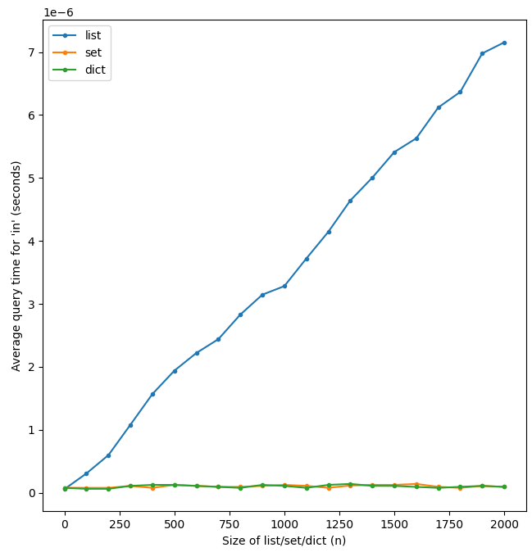
Membership queries in
in.py
from random import shuffle, choices from time import time import matplotlib.pyplot as plt time_L = [] time_S = [] time_D = [] ns = [1, *range(100, 2001, 100)] for n in ns: print(f'{n = }') L = list(range(n)) shuffle(L) S = set(L) D = {value: 42 for value in L} queries = choices(L, k=1_000_000) for X, times in [(L, time_L), (S, time_S), (D, time_D)]: count = 0 start = time() for q in queries: if q in X: count +=1 end = time() times.append((end - start) / len(queries)) plt.plot(ns, time_L, '.-', label='list') plt.plot(ns, time_S, '.-', label='set') plt.plot(ns, time_D, '.-', label='dict') plt.xlabel('Size of list/set/dict (n)') plt.ylabel("Average query time for 'in' (seconds)") plt.legend() plt.show()
Lists
linear time in
≈ 3∙10⁻⁹ ∙ n
Sets and dictionaries constant time in
≈ 1∙10⁻⁷ sec
Avoid using in repeatedly on long lists

Slide 17
Module collections (container datatypes)
Python builtin containers for data: list, tuple, dict, and set.
The module collections provides further alternatives (but these are not part of the language like the builtin containers)
deque double ended queue
namedtuple tuples allowing access to fields by name
Counter special dictionary to count occurrences of elements
...
https://docs.python.org/3/library/collections.html

Slide 18
deque – double ended queues
Extends lists with efficient updates at the front
Inserting at the front of a standard Python list takes linear time in the size of the list – very slow for long lists
Python shell
L = list() L.append(1) L.append(2) L.insert(0, 0) # insert at the front L.insert(0, -1) # slow for long lists L.insert(0, -2) L [-2, -1, 0, 1, 2] | from collections import deque d = deque() # create empty deque d.append(1) d.append(2) d.appendleft(0) # efficient d.appendleft(-1) d.appendleft(-2) d deque([-2, -1, 0, 1, 2]) for e in d: print(e, end=', ') -2, -1, 0, 1, 2,

Slide 19
namedtuple – tuples with field names
Since Python 3.7 dataclass better choice
Compromise between tuple and dict, can increase code readability
Python shell
person = ('Donald Duck', 1934, '3 feet') # as tuple person[1] # not clear what is accessed 1934 person = {'name': 'Donald Duck', 'appeared': 1934, 'height': '3 feet'} # as dict person['appeared'] # more clear what is accessed, but ['...'] overhead 1934 from collections import namedtuple Person = namedtuple('Person', ['name', 'appeared', 'height']) # create new type person = Person('Donald Duck', 1934, '3 feet') # as namedtuple person Person(name='Donald Duck', appeared=1934, height='3 feet') person.appeared # short and clear 1934 person[1] # still possible 1934
Notes:
Perfomance is at the same level at tuples; no space overhead
Guarantees that you never create too many fields
immutable and hashable
Since: Python 3.7 also data classes (will be covered in lecture on decorators, since it is a class decorator)
namedtuple a little bit like a ”struct” in other languages (e.g. C), except that a namedtuple is immutable
Javascript allows person.name on a dictionary, if the key is a valid attribute name

Slide 20
Counter – dictionaries for counting
Python shell
from collections import Counter fq = Counter('abracadabra') # create new counter from a sequence fq Counter({'a': 5, 'b': 2, 'r': 2, 'c': 1, 'd': 1}) # frequencies of the letters fq['a'] 5 fq.most_common(3) [('a', 5), ('b', 2), ('r', 2)] fq['x'] += 5 # increase count of 'x', also valid if 'x' not in Counter yet Counter('aaabbbcc') - Counter('aabdd') # counters can be subtracted Counter({'b': 2, 'c': 2, 'a': 1}) Counter([1, 2, 1, 3, 4, 5]) + Counter([3, 3, 3]) # counters can be added Counter({3: 4, 1: 2, 2: 1, 4: 1, 5: 1}) T = 'AfD adsf dsa f dsaf daf dsaf DSA fda f SA dsa f dsa fdsa f dsAf sAf f dsaf' Counter(T.lower().split()).most_common(3) [('f', 5), ('dsa', 4), ('dsaf', 4)]

Slide 21
Handin 3 & 4 – Triplet distance (Dobson, 1975)
((('A','F'),'B'),('D',('C','E'))) (((('D','A'),'B'),'F'),('C','E'))
(a) (b)
/\ /\
/ \ / \
/ \ / \
/ \ / \
/ \ / \
/ \ / \
/\ /\ /\ /\
/ \ / \ / \ / \
/ \ / \ / \ 'C' 'E'
/\ 'B' 'D' /\ / \
/ \ / \ /\ 'F'
'A' 'F' 'C' 'E' / \
/ \
/\ 'B'
/ \
'D' 'A'
How similar are the trees ?
arxiv.org/abs/1706.10284

Slide 22

Handin 3 & 4 – Triplet distance (Dobson, 1975)
Consider all $\left(\begin{matrix}n \\ 3\end{matrix}\right)$ subsets of size three, and count how many do not have identical substructure (topology) in the two trees.
(a) (b)
anchor * /\
/ \ / \
/ \ / \
/ \ / \
/ \ / \
/ \ / \
/\ /\ anchor * /\
/ \ / \ / \ / \
/ \ / \ / \ 'C' 'E'
/\ 'B' 'D' /\ / \
/ \ / \ /\ 'F'
'A' 'F' 'C' 'E' / \
/ \
/\ 'B'
/ \
'D' 'A'
/\
/ \
/ \
'D' /\
/ \
'A' 'F'
('D',('A','F'))
/\
/ \
/ \
'F' /\
/ \
'A' 'D'
('F',('A','D'))
{ 'A','D', 'F'}
canonical ordering
arxiv.org/abs/1706.10284
Notes:
arxiv.org/abs/1706.10284
Cache Oblivious Algorithms for Computing the Triplet Distance Between Trees
Gerth Stølting Brodal, Konstantinos Mampentzidis
(large scale trees)

