Slide 1
Python basics
Comments
”;”
Variable names
int, float, str
type conversion
assignment (=)
print(), help(), type()

Slide 2
Python comments
A ‘#’ indicates the beginning of a comment. From ‘#’ until of end of line is ignored by Python.
x = 42 # and here goes the comment
Comments useful to describe what a piece of code is supposed to do, what kind of input is expected, what is the output, side effects...
Comments are aimed at people (including yourself) reading the code

Slide 3
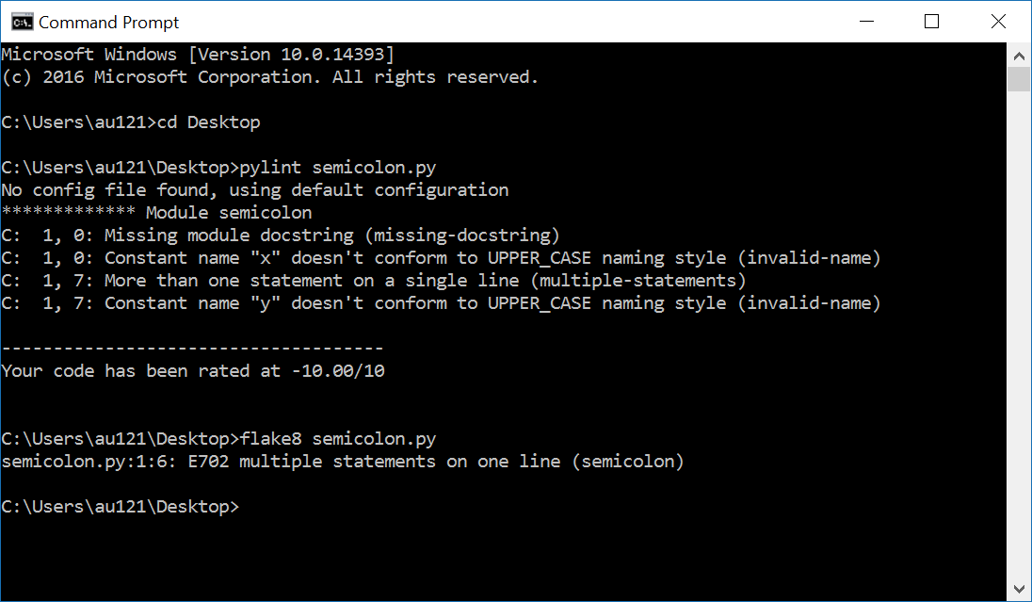
The “;” in Python
Normally statements follow in consecutive lines with identical indentation
x = 1
y = 1
but Python also allows multiple statements on one line, separated by “;”
x = 1; y = 1
General Python PEP 8 guideline: avoid using “;”
Other languages like C, C++ and Java require “;” to end/separate statements
neither pylint or flake8 like “;”
Notes:
PEP8: ”Compound statements (multiple statements on the same line) are generally discouraged.”
”x = 1 y = 2” on a single line without ”;” generates ”SyntaxError: invalid syntax”

Slide 4
Variable names
Variable name = sequence of letters ‘a’-’z’, ‘A’-’Z’, digits ‘0’-’9’, and underscore ‘_’
v, volume, height_of_box, WidthOfBox, x0, _v12_34B, _
a name cannot start with a digit
names are case sensitive (AB, Ab, aB and ab are different variables)
Variable names are references to objects in memory
Use meaningful variables names
Python 3 reserved keywords:
(snake_case) (CamelCase)
and as assert break | class continue def del | elif else except finally | for from global if | import in is lambda | nonlocal not or pass | raise return try while | with yield | None False True
Notes:
0x10 is hexadecimal
0b1111 is binary
PEP8 anbefaler fx at klassenavne er CamelCase
Note last three keywords starts with capital – these are constants

Slide 5

Question – Not a valid Pyton variable name?
Python reserved keyword
print
for
_100
x
_
python_for_ever
Don’t know
Python shell
print = 7 print(42) Traceback (most recent call last): File "<stdin>", line 1, in <module> TypeError: 'int' object is not callable
print is a valid variable name, with default value a builtin function to print output to a shell – assigning a new value to print is very likely a bad idea (like many others sum, int, str, ...)
Notes:
print(42)
print = 42
print(42) – fails
import builtins
builtins.print(42)

Slide 6
Integer literals
.... -4, -3, -2, -1, 0, 1, 2, 3, 4 ....
Python integers can have an arbitrary number of digits (only limited by machine memory)
Can be preceded by a plus (+) or minus (-)
For readability underscores (_) can be added between digits,
2_147_483_647
(for more, see PEP 515 - Underscores in Numeric Literals)
Notes:
Since Python 3.11, can only print integers with at most 4300 digits (default value).
sys.set_int_max_str_digits(0) allows an arbitrary number of digits to be printed

Slide 7
Question – What statement will not fail?
x = _42
_10 = -1_1
x = 1__0
x = +1_0_
Don’t know

Slide 8
Float literals
Python shell
0.1 + 0.2 + 0.3 0.6000000000000001 (0.1 + 0.2) + 0.3 0.6000000000000001 0.1 + (0.2 + 0.3) 0.6 type(0.1) <class 'float'> 1e200 * 1e300 inf 0.1+(0.2+0.3) == (0.1+0.2)+0.3 False x = 0.1 + 0.2 y = 0.3 x == y False print(f'{x:.30f}') # 30 decimals 0.300000000000000044408920985006 print(f'{y:.30f}') # 30 decimals 0.299999999999999988897769753748 import sys sys.float_info.min 2.2250738585072014e-308 sys.float_info.max 1.7976931348623157e+308
Decimal numbers are represented using float – contain “.” or “e”
Examples
3.1415
-.00134
124e3 = 124∙10³
-2.345e2 = -234.5
12.3e-4 = 0.00123
Floats are often only approximations, e.g. 0.1 is not 1/10
Extreme values (CPython)
max = 1.7976931348623157e+308
min = 2.2250738585072014e-308
NB: Use module fractions for exact fractions/rational numbers.
Associativity rule does not apply to floats
Notes:
first usage of a comparison, and result is a Boolean
import sys
sys.float_info
forward reference to string formatting in “operations.pptx” / next lecture
import fractions
fractions.Fraction(10, 5)

Slide 9
Question – What addition order is ”best”?
1e10 + 1e-10 + -5e-12 + -1e10
1e10 + -1e10 + 1e-10 + -5e-12
1e-10 + 1e10 + -1e10 + -5e-12
-5e-12 + -1e10 + 1e10 + 1e-10
Any order is equally good
Don’t know
1e10 = 10000000000
-1e10 = -10000000000
1e-10 = 0.0000000001
-5e-12 = -0.000000000005
Python shell
1e10 + 1e-10 + -5e-12 + -1e10 0.0 1e10 + -1e10 + 1e-10 + -5e-12 9.500000000000001e-11 1e-10 + 1e10 + -1e10 + -5e-12 -5e-12 -5e-12 + -1e10 + 1e10 + 1e-10 1e-10
a) - d) give four different outputs

Slide 10
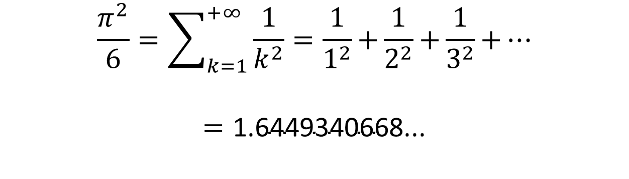
Approximating π = 3.14159265359...
pi_approximation_riemann.py
apx = 0.0 k = 0.0 while True: k = k + 1.0 apx = apx + 1.0 / (k * k) print(k, apx)
Output
... 94906261.0 1.6449340578345741 94906262.0 1.6449340578345744 94906263.0 1.6449340578345746 94906264.0 1.6449340578345748 94906265.0 1.644934057834575 94906266.0 1.644934057834575 94906267.0 1.644934057834575 94906268.0 1.644934057834575 94906269.0 1.644934057834575 94906270.0 1.644934057834575 ...
$$\frac{π^{2}}{6}=\sum_{k=1}^{+∞}{\frac{1}{k^{2}}=\frac{1}{1^{2}}\text{+}\frac{1}{2^{2}}\text{+}\frac{1}{3^{2}}\text{+}⋯}$$
$$=\text{1.6449340668...}$$
Riemann zeta function ζ(2)
This is not a course in numeric computations – but now you are warned....

Slide 11
Python float ≡ IEEE-754 double precision*
A binary number is a number in base 2 with digits/bits from {0,1}
10110₂ = 1∙2⁴ + 0∙2³ + 1∙2² + 1∙2¹ + 0∙2⁰ = 16 + 4 + 2 = 22₁₀
IEEE-754 64-bit double
sign s 1 bit | exponent e 11 bits | coefficient c 52 bits
s = 0
c
+1 | 0011101101011100111010101010101010101010101011101100 | 1001010101100.0100011110010101111001110101010111110101100110101
e – 1023 bits
2⁻⁶
Python shell
1e200 * 1e200 inf -1e200 * 1e200 -inf 1e-200 * 1e-200 0.0 -1e-200 * 1e-200 -0.0 1e200 * 1e200 * 0.0 nan
Float value | Case
(-1)^{s} ∙ (1 + c ∙ 2^{–52}) ∙ 2e ^{– 1023} | 0 < e < 2047
(-1)^{s} ∙ c ∙ 2^{–1074} | e = 0, c ≠ 0
+0 and -0 | e = 0, c = 0
+∞ and -∞ | e = 2047, c = 0
NaN (“not a number”) | s = 0, e = 2047, c ≠ 0
(*most often, but there is no guarantee given in the Python language specification that floats are represented using IEEE-754)
Notes:
THESE DETAILS SHOULD NOT BE CONSIDERED CURRICULUM !!! (not Part of Python language definition anyway!)
s determines sign for 0 and ∞
note -0.0 == +0.0 == 0.0
import math
math.copysign(1, -0.0) == -1
sys.float_info.min = 1/2**1022 = 2.2250738585072014e-308 is the smallest value with 52 bit precision
But the smallest value is 1 / 2**1074 = 4.9406564584e-324 (but only one bit precision)

Slide 12
String literals (type str)
Sequence of characters enclosed by single (') or double (") quotes
"a 'quoted' word" "Hello World" 'abc' 'a "quoted" word' '_"_\'_"_'
Escape characters
\n newline
\t tab
\\ backslash
\' single quote
\" double quote
A backslash (\) a the end of line, will continue line/string on next line
Use triple single or double quotes (''' or """) for enclosing strings spanning more lines
(in particular for Python Dosctrings, see PEP 257)
string-test.py
print("abc") print('de\'f') print("'ghi'") print("'jk\nl'\"") print("mn\ o") print("p\\q\tr")
Output
$ python string-test.py abc de'f 'ghi' 'jk l'" mno p\q r

Slide 13
Question – What does the following print ? print("\\\"\\n\n'")
\\\"\\n\n'
\"\nn'
\"\n '
"nn'
\" '
Don’t know
Notes:
print(42)
print = 42
print(42) – fails
import builtins
builtins.print(42)

Slide 14
Long string literals
long-string-literals.py
s1 = 'abc' "def" # two string literals print(s1) s2 = '"' "'" '"' # avoid escaping quotes print(s2) s3 = 'this is a really, really, really, \ really, really, long string' print(s3) s4 = ('this is a really, really, ' 'really, really, really, ' 'long string') print(s4) very_very_long_variable_name = ( 'this is a really, really, ' # line 1 'really, really, really, ' # line 2 "long string" # line 3 ) print(very_very_long_variable_name)
Python shell
abcdef "'" this is a really, really, really, really, really, long string this is a really, really, really, really, really, long string this is a really, really, really, really, really, long string
Long string literals often need to be split over multiple lines
In Python two (or more) string literals following each other will be treated as a single string literal (they can use different quotes)
Putting parenthesis around multiple literals allows line breaks
Advantages:
avoids the backslash at the end of line
can use indentation to increase readability
allows comments between literals
Notes:
the very_very_long_variable_name version is stable wrt indentation when query-replacing variable names
print('"'"'"'"'"'"'"') - even makes sense...

Slide 15
Raw string literals
By prefixing a string literal with an r, the string literal will be considered a raw string and backslashes become literal characters
Useful in cases where you actually need backslashes in your strings, e.g. when working with Python’s regular expression module re
Python shell
print('\let\epsilon\varepsilon') # \v = vertical tab \let\epsilon arepsilon print('\\let\\epsilon\\varepsilon') # many backslashs \let\epsilon\varepsilon print(r'\let\epsilon\varepsilon') # more readable \let\epsilon\varepsilon

Slide 16
print(...)
Python shell
print() print(7) 7 print(2, 'Hello') 2 Hello print(3, 'a', 4) 3 a 4 print(3, 'a', 4, sep=':') 3:a:4 print(5); print(6) 5 6 print(5, end=', '); print(6) 5, 6
print can print zero, one, or more values
default behavior
print a space between values
print a line break after printing all values
default behavior can be changed by keyword arguments “sep“ and “end“

Slide 17
print(...) and help(...)
Python shell
help(print) Help on built-in function print in module builtins: print(...) print(value, ..., sep=' ', end='\n', file=sys.stdout, flush=False) Prints the values to a stream, or to sys.stdout by default. Optional keyword arguments: file: a file-like object (stream); defaults to the current sys.stdout. sep: string inserted between values, default a space. end: string appended after the last value, default a newline. flush: whether to forcibly flush the stream.
Notes:
Help text is the __doc__ attribute, e.g. print.__doc__
IDLE, VSCode, etc use this information as help desk while typing

Slide 18
Assignments
variable = expression
x = 42
Multiple assignments – right hand side evaluated before assignment
x, y, z = 2, 5, 7
Useful for swapping
x, y = y, x
Assigning multiple variables same value in left-to-right
x = y = z = 7
Warning
i = 1
i = v[i] = 3 # v[3] is assigned value 3
In languages like C and C++ instead v[1] is assigned 3

Slide 19
Python is dynamically typed, type(...)
The current type of a value can be inspected using the type() function (that returns a type object)
In Python the values contained in a variable over time can be of different type
In languages like C, C++ and Java variables are declared with a given type, e.g.
int x = 42;
and the different values stored in this variable must remain of this type
Python shell
x = 1 type(x) <class 'int'> x = 'Hello' type(x) <class 'str'> type(42) <class 'int'> type(type(42)) <class 'type'>
x new type

Slide 20
Type conversion
Python shell
float(42) 42.0 int(7.8) 7 x = 7 print("x = " + x) Traceback (most recent call last): File "<stdin>", line 1, in <module> TypeError: must be str, not int print("x = " + str(x)) x = 7 print("x = " + str(float(x))) x = 7.0 int("7.3") Traceback (most recent call last): File "<stdin>", line 1, in <module> ValueError: invalid literal for int() with base 10: '7.3' int(float("7.3")) 7
string concatenation
Convert a value to another type:
new-type(value)
Sometimes done automatically:
1.0+7=1.0+float(7)=8.0
Notes:
In Javascript and Java: ”X” + 1 computes to ”X1”, ie does the conversion to string automatically

Slide 21
Questions – str(float(int(float("7.5")))) ?
7
7.0
7.5
"7"
"7.0"
"7.5"
Don’t know

