Slide 1
Operations
None, bool
basic operations
strings
+= and friends

Slide 2
NoneType
The type None has only one value: None
Used when context requires a value, but none is really available
Example: All functions must return a value. The function print has the side-effect of printing something to the standard output, but returns None
Example: Initialize a variable with no value, e.g. list entries mylist = [None, None, None]
Python shell
x = print(42) 42 print(x) None

Slide 3
Type bool
Named after mathematician George Boole (1815-1864)
The type bool only has two values: True and False
Logic truth tables:
x or y | True | False
True | True | True
False | True | False
x and y | True | False
True | True | False
False | False | False
x | not x
True | False
False | True

Slide 4
Scalar vs Non-scalar Types
Scalar types (atomic/indivisible): int, float, bool, None
Non-scalar: Examples strings and lists
"string"[3] = "i"
[2, 5, 6, 7][2] = 6

Slide 5
Questions – What is [7,3,5][[1,2,3][1]] ?
1
2
3
5
7
Don’t know

Slide 6

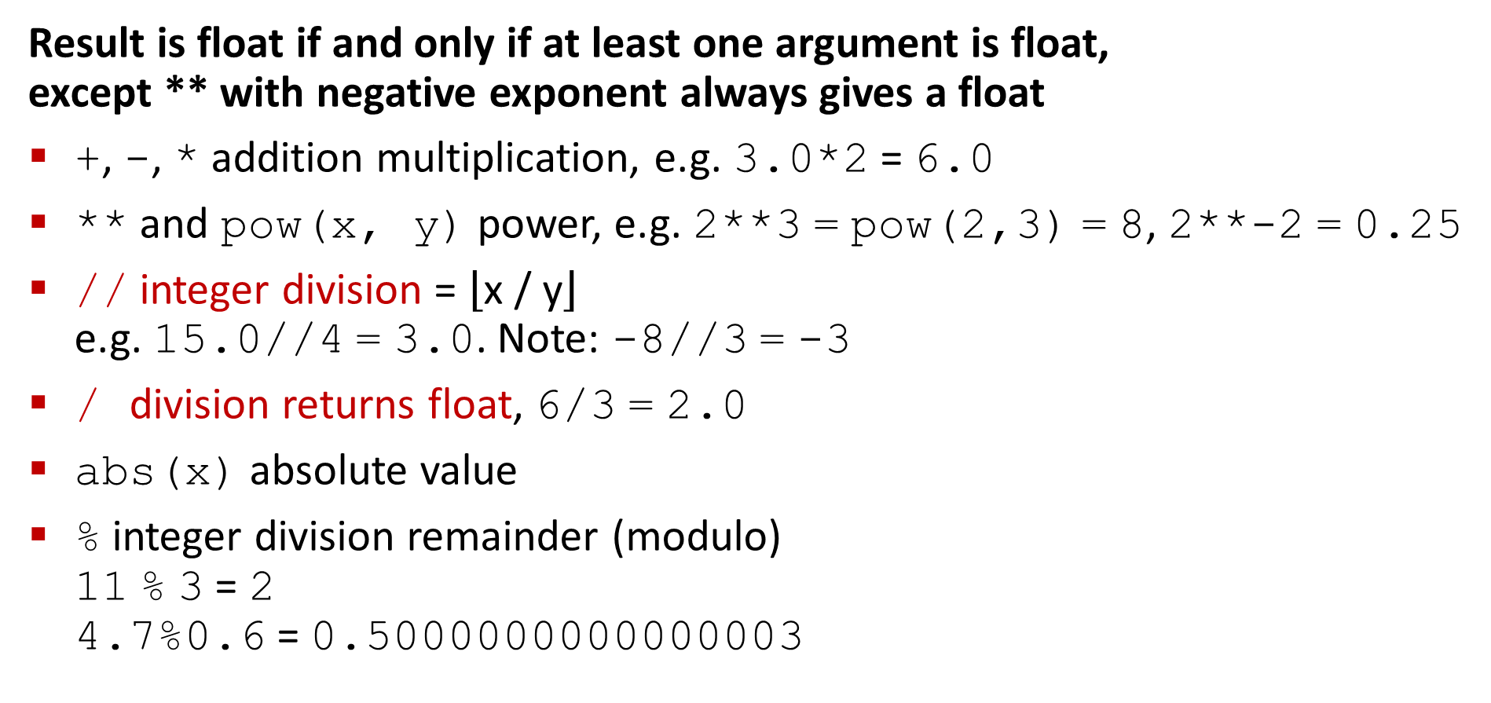
Operations on int and float
Result is float if and only if at least one argument is float, except ** with negative exponent always gives a float
+, -, * addition multiplication, e.g. 3.0*2 = 6.0
** and pow(x, y) power, e.g. 2**3 = pow(2,3) = 8, 2**-2 = 0.25
// integer division = $\left\lfloor \text{x} \text{/} \text{y}\right\rfloor$ e.g. 15.0//4 = 3.0. Note: -8//3 = -3
/ division returns float, 6/3 = 2.0
abs(x) absolute value
% integer division remainder (modulo) 11 % 3 = 2 4.7%0.6 = 0.5000000000000003
Python shell
0.4 // 0.1 4.0 0.4 / 0.1 4.0 0.3 // 0.1 2.0 0.3 / 0.1 2.9999999999999996 10**1000 / 2 OverflowError: integer division result too large for a float
Notes:
Note (Python 3.6): Inconsistent error reporting
1e300 * 1e300 -> inf
1e300 ** 2 -> OverflowError

Slide 7
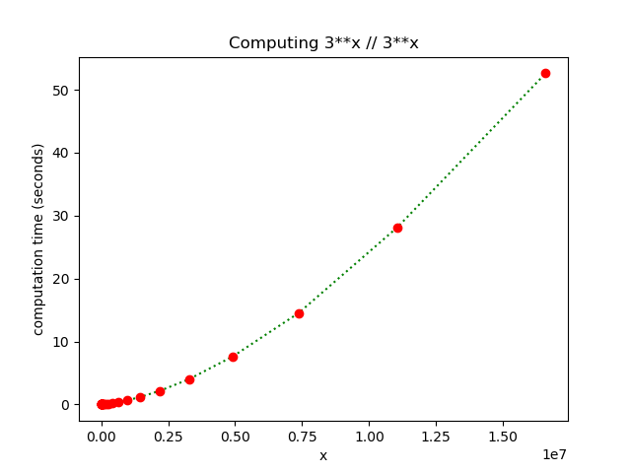
Running time for 3 ** x // 3 ** x
Working with larger integers takes slightly more than linear time in the number of digits
Notes:
NOTE: Converting long integer (internally represented in binary) to decimal for printing takes QUADRATIC time
>>> timeit.timeit('(3**1000000)', number=1)
0.35205646000031265
>>> timeit.timeit('str(3**1000000)', number=1)
15.860024185000384

Slide 8
integer-division-timing.py
from time import time import matplotlib.pyplot as plt bits, compute_time = [], [] for i in range(42): x = 3 ** i // 2 ** i start = time() result = 3 ** x // 3 ** x # the computation we time end = time() t = end - start print('i =', i, 'x =', x, 'Result =', result, 'time(sec) =', t) bits.append(x) compute_time.append(t) plt.title('Computing 3**x // 3**x') plt.xlabel('x') plt.ylabel('computation time (seconds)') plt.plot(bits, compute_time, 'g:') plt.plot(bits, compute_time, 'ro') plt.show()

Slide 9
module math
Many standard mathematical functions are available in the Python module “math”, e.g.
sqrt, sin, cos, tan, asin, acos, atan, log(natural), log10, exp, ceil, floor, ...
To use all the functions from the math module use import math Functions are now available as e.g. math.sqrt(10) and math.ceil(7.2)
To import selected functions you instead write from math import sqrt, ceil
The library also contains some constants, e.g. math.pi = 3.141592... and math.e = 2.718281...
Note: x ** 0.5 significantly faster than sqrt(x)
Python shell
(0.1 + 0.2) * 10 3.0000000000000004 math.ceil((0.1 + 0.2) * 10) 4
docs.python.org/3/library/math.html module statistics contains basic functions like mean and variance, see docs.python.org/3/library/statistics.html
Notes:
timeit.timeit returns sec. for running the code 1.000.000 times
most functions are just wrappers to the corresponding C99 functions

Slide 10
Python shell
import math math.sqrt(8) 2.8284271247461903 from math import pi, sqrt pi 3.141592653589793 sqrt(5) 2.23606797749979 from math import sqrt as kvadratrod kvadratrod(3) 1.7320508075688772 import timeit timeit.timeit('1e10**0.5') 0.021124736888936863 timeit.timeit('sqrt(1e10)', 'from math import sqrt') 0.1366314052865789 timeit.timeit('math.sqrt(1e10)', 'import math') 0.1946660841634582
docs.python.org/3.12/library/timeit.html

Slide 11
Rounding up integer fractions
Python shell
from math import ceil from timeit import timeit 13 / 3 4.333333333333333 13 // 3 4 -13 // 3 -5 -(-13 // 3) 5 ceil(13 / 3) 5 -(-22222222222222222223 // 2) 11111111111111111112 ceil(22222222222222222223 / 2) 11111111111111110656 timeit('ceil(13 / 3)', 'from math import ceil') 0.2774667127609973 timeit('-(-13 // 3)') # negation trick is fast 0.05231945830200857
Python: ⸢x/y⸣ = -(-x//y)
The intermediate result x/y in
math.ceil(x/y)
is a float with limited precision
Alternative computation:
⸢x/y⸣ = (x+(y-1)) // y
-(-13/3)
Python | Java | C
-(-13//3) = 5 | -(-13/3) = 4 | -(-13/3) = 4
Notes:
-3//2 vs –(3//2) (the first equals (-3)//2 = -2, whereas –(3//2) = -(1) )=-1)

Slide 12
floats : Overflow, inf, -inf, nan
Python shell
1e250 ** 2 OverflowError: (34, 'Result too large') 1e250 * 1e250 inf -1e250 * 1e250 -inf import math math.inf inf type(math.inf) <class 'float'> math.inf / math.inf nan type(math.nan) <class 'float'> math.nan == math.nan False float('inf') - float('inf') nan
There exists special float values inf, -inf, nan representing “+infinity”, “-infinity” and “not a number”
Can be created using e.g. float('inf') or imported from the math module
Some overflow operations generate an OverflowError, other return inf and allow calculations to continue !
Read the IEEE 754 standard if you want to know more details...

Slide 13
Operations on bool
The operations and, or, and not behave as expected when the arguments are False/True.
The three operators also accept other types, where the following values are considered false:
False, None, 0, 0.0, "", []
(see The Python Standard Library > Built-in Types > True Value Testing for more false values)
Short-circuit evaluation: The rightmost argument of and and or is only evaluated if the result cannot be determined from the leftmost argument alone. The result is either the leftmost or rightmost argument (see truth tables), i.e. the result is not necessarily False/True. True or 7/0 is completely valid since 7/0 will never be evaluated (which otherwise would throw a ZeroDivisionError exception)
x | x or y
false | y
otherwise | x
x | x and y
false | x
otherwise | y
x | not x
false | True
otherwise | False
Notes:
More meaningful example, assume L is a list:
if len(L) > 0 and L[0] != 0: L[0] -= 1
=>
If L and L[0]: L[0] -= 1
----
Testing:
def value(x):
print(‘value is', x)
return x
value(2) and value(5)
value(2) or value(5)

Slide 14
Questions – What is "abc" and 42 ?
False
True
"abc"
42
TypeError
Don’t know

Slide 15
Comparison operators (e.g. int, float, str)
Python shell
3 == 7 False 3 == 3.0 True "-1" != -1 True "abc" == "ab" + "c" True 2 <= 5 True -5 > 5 False 1 == 1.0 True 1 == 1.0000000000000001 True 1 == 1.000000000000001 False
== test if two objects are equal, returns bool
not to be confused with the assignment operator (=)
!= not equal
>
>=
<
<=
Notes:
Nice thing about Python “if x=3:” will give a syntax error, opposed to other languages... like C, C++ << java???>>

Slide 16
Chained comparisons
A recurring condition is often
x < y and y < z
If y is a more complex expression, we would like to avoid computing y twice, i.e. we often would write tmp = complex expression x < tmp and tmp < z
In Python this can be written as a chained comparisons (which is shorthand for the above)
x < y < z
Note: Chained comparisons do not exist in C, C++, Java, ...

Slide 17
Questions – What is 1 < 0 < 6/0 ?
True
False
0
1
6
ZeroDivisionError
Don’t know

Slide 18
Binary numbers and operations
Binary number = integer written in base 2: 101010₂ = 42₁₀ = 2¹ + 2³ +2⁵
Python constant prefix 0b: 0b101010 → 42
bin(x) converts integer to string: bin(49) → "0b110001"
int(x, 2) converts binary string value to integer: int("0b110001", 2) → 49
Bitwise operations
| Bitwise OR
& Bitwise AND
~ Bitwise NOT (~ x equals to –x - 1)
^ Bitwise XOR
Example: bin(0b1010 | 0b1100) → "0b1110"
Hexadecimal = base 16, Python prefix 0x: 0x30 → 48, 0xA0 → 160, 0xFF → 255
<< and >> integer bit shifting left and right, e.g. 12 >> 2 → 3, and 1 << 4 → 16

Slide 19
Operations on strings
Python shell
len("abcde") 5 "abcde"[2] 'c' x, y = 2, 3 "x = %s, y = %s" % (x, y) 'x = 2, y = 3' "x = {}, y = {}".format(x, y) 'x = 2, y = 3' "x = {1}, y = {0}".format(y, x) 'x = 2, y = 3' f'x + y = {x + y}' 'x + y = 5' f'{x + y = }' # >= Python 3.8 'x + y = 5' f'{x} / {y} = {x / y:.3}' '2 / 3 = 0.667' "abc" + "def" 'abcdef' 3 * "x--" 'x--x--x--' 0 * "abc" ''
len(str) returns length of str
str[index] returns index+1’th symbol in str
str₁ + str₂ returns concatenation of two strings
int * str concatenates str with itself int times
Formatting: % operator or .format() function or formatted string literals (f-strings) with prefix letter f and Python expressions in {}
(see pyformat.info for an introduction)
old Python 2 way
since Python 3.0
since Python 3.6
From “What’s New In Python 3.0”, 2009: A new system for built-in string formatting operations replaces the % string formatting operator. (However, the % operator is still supported; it will be deprecated in Python 3.1 and removed from the language at some later time.) Read PEP 3101 for the full scoop.
% formatting (inherited from C’s sprint() function) was supposed to be on the way out - but is still going strong in Python 3.13
Notes:
decimaler = 5
f'et tal {1/3 = :.{decimaler}}’
.format useful when same value has to be inserted multiple times: '{1} {1} {0}'.format('abc', 42)

Slide 20
Python does not automatic convert to string
A str can not be concatenated with an int
The int must first be converted to a str using str(int value)
In some languages, like Java and Javascript, the conversion to string happens automatically (just a language design choice)
works in Java and Javascript
Python shell
'abc' + 42 TypeError: can only concatenate str (not "int") to str 'abc' + str(42) 'abc42'
Notes:
Javascript example: Open Google Chrome + F12 + Console: ‘abc’ + 42
document.body.style.background = 'lightblue’ // background color
document.body.style.color // text color
javascript:{
/* Bookmarklet to recolor all text on a page to your favorite color. */
favorite_color = "red";
function recolor(doc) {
for (const e of doc.querySelectorAll("*")) {
e.style.setProperty("color", "white", "important");
e.style.setProperty("background", "black", "important");
if (e.shadowRoot) recolor(e.shadowRoot);
if (e.nodeName == "IFRAME") recolor(e.contentWindow.document);
};
};
recolor(window.document);
}

Slide 21
... more string functions
str[-i] returns the symbol i positions from the right, the rightmost str[-1]
str[from:to] substring starting at index from and ending at index to-1
str[from:-to] substring starting at from and last at index len(str)- to -1
str[from:to:step] only take every step’th symbol in str[from:to]
from or/and to can be omitted and defaults to the beginning/end of string
chr(x) returns a string of length 1 containing the x’th Unicode character
ord(str) for a string of length 1, returns the Unicode number of the symbol
str.lower() returns string in lower case
str.split() split string into list of words, e.g.
"we love python".split() = ['we', 'love', 'python']
docs.python.org/3/library/string.html
Notes:
for i in range(256): print(i, "'" + chr(i) + "'")

Slide 22
Python shell
s = 'this is a string' s.capitalize() 'This is a string' s.title() 'This Is A String' s.upper() 'THIS IS A STRING' s.title().swapcase() 'tHIS iS a sTRING s.removeprefix('this is ') 'a string' s.removesuffix(' string') 'this is a' s.replace('is', 'IS') 'thIS IS a string' s.ljust(30) 'this is a string ' s.center(30) ' this is a string ' s.rjust(30, '.') '..............this is a string' s.count('i') 3 '12345'.zfill(8) '00012345'
https://docs.python.org/3/library/stdtypes.html#text-sequence-type-str

Slide 23
Questions – What is s[2:42:3]?
0 | 1 | 2 | 3 | 4 | 5 | 6 | 7 | 8 | 9 | 10 | 11 | 12 | 13 | 14 | 15 | 16 | 17 | 18 | 19 | 20 | 21 | 22 | 23 | 24 | 25 | 26 | 27 | 28 | 29 | 30 | 31 | 32 | 33 | 34 | 35 | 36 | 37 | 38 | 39 | 40 | 41 | 42 | 43 | 44
s = 'abwwdexy___lwtopavghevt_xypxxyattx_hxwoadnxxx'
'wwdexy___lwtopavghevt_xypxxyattx_hxwoadn'
'we_love_python'
'we_love_java'
Don’t know

Slide 24
Strings are immutable
Strings are non-scalar, i.e. for s = "abcdef", s[3] will return "d"
Strings are immutable and cannot be changed once created. I.e. the following natural update is not possible (but is e.g. allowed in C)
s[3] = "x"
To replace the "d" with "x" in s, instead create the new string
s = s[:3] + "x" + s[4:]

Slide 25
Operators Precedence rules & Associativity
Precedence (low to high)
or
and
not x
in not in is is not == < <= != > >=
|
^
&
<< >>
+ -
* @ / // %
+x -x ~x
**
Example: * has higher precedence than +
2 + 3 * 4 ≡ 2 + (3 * 4) → 14 and (2 + 3) * 4 → 20
All operators in same group are evaluated left-to-right
2 + 3 - 4 - 5 ≡ ((2 + 3) - 4) - 5 → -4
except for **, that is evaluated right-to-left
2**2**3 ≡ 2**(2**3) → 256
Rule: Use parenthesis whenever in doubt of precedence!
docs.python.org/3/reference/expressions.html
Notes:
is, is not ...
in, not in ...
@ matrix multiplication (for numpy)
https://docs.python.org/3/reference/expressions.html#summary

Slide 26
Long expressions
Long expressions can be broken over several lines by putting parenthesis around it
The PEP8 guidelines recommend to limit all lines to a maximum of 79 characters
Python shell
(1 + 2 + 3) 6
https://www.python.org/dev/peps/pep-0008/#maximum-line-length

Slide 27
+= and friends
Recurring statement is
x = x + value
In Python (and many other languages) this can be written as
x += value
This also applies to other operators like
+= -= *= /= //= **=
|= &= ^= <<= >>=
Python shell
x = 5 x *= 3 x 15 a = 'abc' a *= 3 a 'abcabcabc'

Slide 28
:= assignment expressions (the “Walrus Operator”)
New in Python 3.8
Syntax
name := expression
Evaluates to the value of expression, with the side effect of assigning result to name
Useful for naming intermediate results/repeating subexpressions for later reusage
See PEP 572 for further details and restrictions of usage
In some languages, e.g. Java, C and C++, “=“ also plays the role of “:=“, implying “if (x=y)” and “if (x==y)” mean quite different things (common typo)
Python shell
(x := 2 * 3) + 2 * x 18 print(1 + (x := 2 * 3), 2 + x) 7 8 x := 7 SyntaxError (x := 7) # valid, but not recommended while line := input(): print(line.upper()) abc ABC
Notes:
Why did := first come with Python 3.8 (Fall 2019)?
Because many people think it is not necessary and can be counterproductive for producing readable code

