Slide 1
Object oriented programming
classes, objects
self
construction
encapsulation

Slide 2
Object Oriented Programming
Programming paradigm, other paradigms are e.g.
functional programming where the focus is on functions, lambda’s and higher order functions, and
imperative programming focusing on sequences of statements changing the state of the program
Core concepts are objects, methods and classes,
allowing one to construct abstract data types, i.e. user defined types
objects have states
methods manipulate objects, defining the interface of the object to the rest of the program
OO supported by many programming languages, including Python
Notes:
Example of a builtin class is "list"

Slide 3

Object Oriented Programming - History (selected programming languages)
Mid 1960’s Simula 67
(Ole-Johan Dahl and Kristen Nygaard, Norsk Regnesentral Oslo)
Introduced classes, objects, virtual procedures
1970’s Smalltalk (Alan Kay, Dan Ingalls, Adele Goldberg, Xerox PARC)
Object-oriented programming, fully dynamic system (opposed to the static nature of Simula 67 )
1985 Eiffel (Bertrand Meyer, Eiffel Software)
Focus on software quality, capturing the full software cycle
1985 C++ (Bjarne Stroustrup [MSc Aarhus 1975], AT&T Bell Labs)
1995 Java (James Gosling, Sun)
2000 C# (Anders Hejlsberg (studied at DTU) et al., Microsoft)
Python (Guido van Rossum)
Multi-paradigm programming language, fully dynamic system
Note: Java, C++, Python, C# are among Top 5 on TIOBE March 2024 index of popular languages (only non OO language among Top 5 was C)
Byte Magazine, August 1981
Notes:
Byte magazine 1981 broad Object Oriented Programming to a wider audience

Slide 4
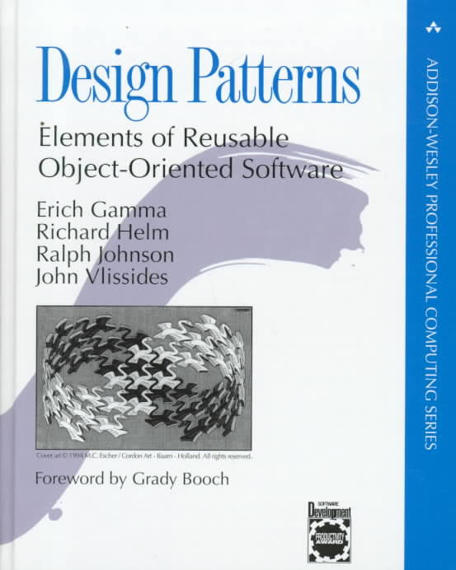

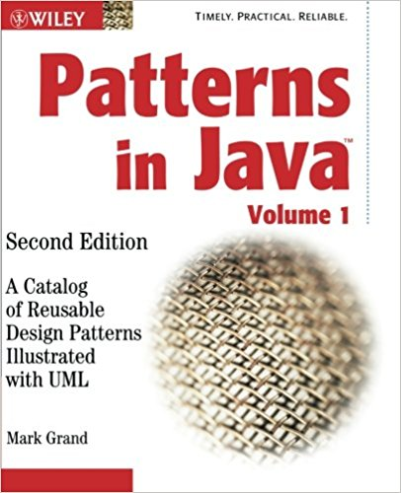
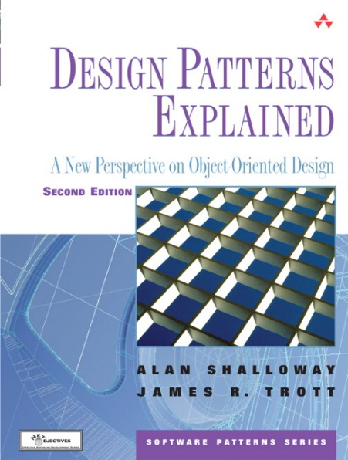
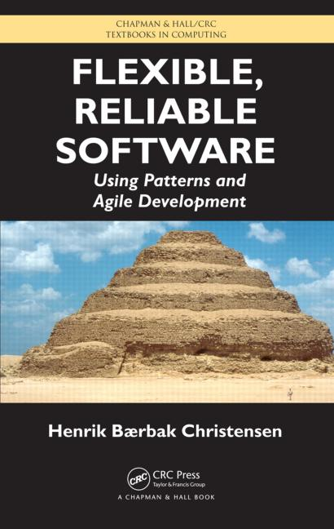
Design Patterns (not part of this course) reoccuring patterns in software design
Java cookbook 2003
Java textbook 2004
Java textbook 2010
The Classic book 1994
(C++ cookbook)
A very alternative book 2004
(Java, very visual)
...and many more books on the topic of Design Patterns, also with Python
Notes:
Book 1994 identified a set of common “patterns” used in Object Oriented programming
Henrik Bærbak Christensen inspired by Shwalloway & Trott

Slide 5
Some known classes, objects, and methods
Type / class | Objects | Methods (examples)
int | 0 -7 42 1234567 | .__add__(x), .__eq__(x), .__str__()
str | "" 'abc' '12_ a' | .isdigit(), .lower(), .__len__()
list | [] [1,2,3] ['a', 'b', 'c'] | .append(x), .clear(), .__mul__(x)
dict | {'foo' : 42, 'bar' : 5} | .keys(), .get(), .__getitem__(x)
NoneType | None | .__str__()
Python shell
5 + 7 # + calls .__add__(7) 12 (5).__add__(7) # eq. to 5 + 7 12 (7).__eq__(7) # eq. to 7 == 7 True 'aBCd'.lower() 'abcd' 'abcde'.__len__() # .__len__() called by len(...) 5 ['x', 'y'].__mul__(2) ['x', 'y', 'x', 'y'] {'foo' : 42}.__getitem__('foo') # eq. to {'foo' : 42}['foo'] 42 None.__str__() # used by str(...) 'None' 'abc'.__str__(), 'abc'.__repr__() ('abc', "'abc'")
Example:
The function str(obj) calls the methods obj.__str__() or obj.__repr__(), if obj.__str__ does not exist.
print calls str.
Notes:
str() is really the constructor for the class
__getitem__(x) eq. to [x]
repr('abc') = "'abc'“ whereas str(‘abc’) = ‘abc’; IDLE shell prints repr by default, usually a valid Python expression to be evaluated by eval()

Slide 6
Classes and Objects
objects
(instances)
class
(type)
student_DD
name = 'Donald Duck' id = '107'
data attributes
class Student
set_name(name) set_id(student_id) get_name() get_id()
student_MM
name = 'Mickey Mouse' id = '243'
class methods
student_SM
name = 'Scrooge McDuck' id = '777'
creating instances of class Student using constructor Student()
docs.python.org/3/tutorial/classes.html
Notes:
argument named student_id, since ”id” is a buildt in function

Slide 7
Using the Student class
student.py
student_DD = Student() student_MM = Student() student_SM = Student() student_DD.set_name('Donald Duck') student_DD.set_id('107') student_MM.set_name('Mickey Mouse') student_MM.set_id('243') student_SM.set_name('Scrooge McDuck') student_SM.set_id('777') students = [student_DD, student_MM, student_SM] for student in students: print(student.get_name(), 'has id', student.get_id())
Python shell
Donald Duck has id 107 Mickey Mouse has id 243 Scrooge McDuck has id 777
Call constructor for class Student. Each call returns a new Student object.
Call class methods to set data attributes
Call class methods to read data attributes

Slide 8
class Student
name of class
docstring containing documentation for class
class definitions start with the keyword class
student.py
class Student: '''Documentation of class''' def set_name(self, name): self.name = name def set_id(self, student_id): self.id = student_id def get_name(self): return self.name def get_id(self): return self.id
the first argument to all class methods is a reference to the object called upon, and by convention the first argument should be named self .
often called mutator methods, since they change the state of an object
use self. to access an attribute of an object or class method (attribute reference)
often called accessor methods, since they only read the state of an object
Note In other OO programming languages the explicit reference to self is not required (in Java and C++ self is the keyword this)
class method definitions start with keyword def (like normal function definitions)

Slide 9

When are object attributes initialized ?
Python shell
x = Student() x.set_name("Gladstone Gander") x.get_name() 'Gladstone Gander' x.get_id() AttributeError: 'Student' object has no attribute 'id'
Default behaviour of a class is that instances are created with no attributes defined, but has access to the attributes / methods of the class
In the previous class Student both the name and id attributes were first created when set by set_name and set_id, respectively
Notes:
'Gladstone Gander‘ = Fætter højben

Slide 10
Class construction and __init__
When an object is created using class_name()it’s initializer metod __init__ is called.
To initialize objects to contain default values, (re)define this function.
student.py
class Student: def __init__(self): self.name = None self.id = None ... previous method definitions ...

Slide 11
Question – What is printed ?
Python shell
class C: def __init__(self): self.v = 0 def f(self): self.v = self.v + 1 return self.v x = C() print(x.f() + x.f())
1
2
3
4
5
Don’t know

Slide 12
__init__ with arguments
When creating objects using class_name(args) the initializer method is called as __init__(args)
To initialize objects to contain default values, (re)define this function to do the appropriate initialization
student.py
class Student: def __init__(self, name=None, student_id=None): self.name = name self.id = student_id ... previous method definitions ...
Python shell
p = Student('Pluto') print(p.get_name()) Pluto print(p.get_id()) None

Slide 13
Are accessor and mutator methods necessary ?
No - but good programming style
pair.py
class Pair: """ invariant: the_sum = a + b """ def __init__(self, a, b): self.a = a self.b = b self.the_sum = self.a + self.b def set_a(self, a): self.a = a self.the_sum = self.a + self.b def set_b(self, b): self.b = b self.the_sum = self.a + self.b def sum(self): return self.the_sum
Python shell
p = Pair(3, 5) p.sum() 8 p.set_a(4) p.sum() 9 p.a # access object attribute 4 p.b = 0 # update object attribute p.sum() 9 # the_sum not updated
constructor
mutator
accessor

Slide 14
Converting objects to str
To be able to convert an object to a string using str(object), define the method __str__
__str__ is e.g. used by print
Student_constructor.py
class Student: def __str__(self): return f"Student('{self.name}', '{self.id}')" ... previous method definitions ...
Python shell
print(student_DD) # without __str__ <__main__.Student object at 0x03AB6B90> print(student_DD) # with __str__ Student('Donald Duck', '107')

Slide 15
Defining order on instances of a class (sorting)
To define an order on objects, define the “<“ operator by defining __lt__
When ”<” is defined a list L of students can be sorted using sorted(L) and L.sort()
student.py
class Student: def __lt__(self, other): return self.id < other.id ... previous method definitions ...
Python shell
student_DD < student_MM True [x.id for x in students] ['243', '107', '777'] [x.id for x in sorted(students)] ['107', '243', '777']

Slide 16
Nothing is private in Python
private_attributes.py
class My_Class: def set_xy(self, x, y): self._x = x self._y = y def get_sum(self): return self._x + self._y obj = My_Class() obj.set_xy(3, 5) print('Sum =', obj.get_sum()) print('_x =', obj._x)
Python shell
Sum = 8 _x = 3
Python does not support hiding information inside objects
Recommendation is to start attributes with underscore, if these should be used only locally inside a class, i.e. be considered ”private”
PEP8: “Use one leading underscore only for non-public methods and instance variables“

Slide 17
C++ private, public
private_attributes.cpp
#include <iostream> using namespace std; class My_Class { private: int x, y; public: void set_xy(int a, int b) { x = a; y = b }; int get_sum() { return x + y; }; }; main() { My_Class obj; obj.set_xy(3, 5); cout << "Sum = " << obj.get_sum() << endl; cout << "x = " << obj.x << endl; }
C++ vs Python
argument types
return types
void = NoneType
private / public access specifier
types of data attributes
data attributes must be defined in class
object creation
no self in class methods
4
5
6
4
8
1
1
2
3
8
2
7
invalid reference
Notes:
data attributes must be declared and have a default value, so that they are always defined

Slide 18
Java private, public
private_attributes.java
class My_Class { private int x, y; public void set_xy(int a, int b) { x = a; y = b; } public int get_sum() { return x + y; }; }; class private_attributes { public static void main(String args[]){ My_Class obj = new My_Class(); obj.set_xy(3, 5); System.out.println("Sum = " + obj.get_sum()); System.out.println("x = " + obj.x); } }
5
4
6
Java vs Python
argument types
return types
void = NoneType
private / public access specifier
types of data attributes
data attributes must be defined in class
object creation
no self in class methods
2
3
8
1
1
4
2
8
4
7
invalid reference

Slide 19
Name mangling (partial privacy)
Python handles references to class attributes inside a class definition with at least two leading underscores and at most one trailing underscore in a special way: __attribute is textually replaced by _classname__attribute
Note that [Guttag, p. 200] states ”that attribute is not visible outside the class” – which only is partially correct (see example)
name_mangeling.py
class MySecretBox: def __init__(self, secret): self.__secret = secret
Python shell
x = MySecretBox(42) print(x.__secret) AttributeError: 'MySecretBox' object has no attribute '__secret' print(x._MySecretBox__secret) 42
Notes:
obj.__dict__ returns the dictionary’s available attributes
obj.__class__ returns the class of the object

Slide 20
Class attributes
class
object
class Student
next_id = 3 set_name(name) set_id(student_id) get_name() get_id()
student_DD
name = 'Donald Duck' id = '2'
data attributes
class attributes
obj.attribute first searches the objects attributes to find a match, if no match, continuous to search the attributes of the class
Assignments to obj.attribute are always to the objects attribute (possibly creating the attribute)
Class attributes can be accesed directly as class.attribute (or obj.__class__.attribute)
Notes:
argument named student_id, since ”id” is a buildt in function

Slide 21
Class data attribute
student_auto_id.py
class Student: next_id = 1 # class attribute def __init__(self, name): self.name = name self.id = str(Student.next_id) Student.next_id += 1 def get_name(self): return self.name def get_id(self): return self.id students = [Student('Scrooge McDuck'), Student('Donald Duck'), Student('Mickey Mouse')] for student in students: print(student.get_name(), "has student id", student.get_id())
Python shell
Scrooge McDuck has student id 1 Donald Duck has student id 2 Mickey Mouse has student id 3
1
next_id is a class attribute
Accessed using Student.next_id
The lookup can be replaced with self.next_id, since only the class has this attribute, looking up in the object will be propagated to a lookup in the class attributes
In the update it is crucial that we update the class attribute, since otherwise the incremented value will be assigned as an object attribute
(What will the result be?)
2
1
2
Notes:
(2) self.next_id += 1 will imply all objects to get ID = 1 and next_id = 2

Slide 22
Question – What does obj.get() return ?
Python shell
class MyClass: x = 2 def get(self): self.x = self.x + 1 return MyClass.x + self.x obj = MyClass() print(obj.get()) ?
4
5
6
UnboundLocalError
Don’t know
class MyClass
x = 2 get()
obj
x = 3

Slide 23
Class data attribute example (in Python)
class_attributes.py
class My_Class: x = 1 # class attribute def inc(self): My_Class.x = self.x + 1 obj1 = My_Class() obj2 = My_Class() obj1.inc() obj2.inc() print(obj1.x, obj2.x)
Python shell
3 3
obj1
class My_Class
x = 1 inc()
obj2
Note that My_Class.x and self.x refer to the same class attribute (since self.x has never been assigned a value)

Slide 24
__dict__, __name__ and __class__
Python shell
MM = Student('Mickey Mouse') MM.__dict__ # objects attributes {'name': 'Mickey Mouse', 'id': '1'} MM.__class__ # objects class (reference to object of type class) <class '__main__.Student'> Student.__name__ # class name (string) 'Student' Student.__dict__ # class attributes mappingproxy({ '__module__': '__main__’, # module where class defined 'next_id': 2, # class data attriute '__init__': <function Student.__init__ at 0x000002831344CD30>, # class method 'get_name': <function Student.get_name at 0x000002831344CE50>, # class method 'get_id': <function Student.get_id at 0x000002831344CEE0>, # class method '__dict__': <attribute '__dict__' of 'Student' objects>, # attributes of class '__weakref__': <attribute '__weakref__' of 'Student' objects>, # (for garbage collecting) '__doc__': None # docstring })

Slide 25
Java static
static_attributes.java
class My_Class { public static int x = 1; public void inc() { x += 1; }; } class static_attributes { public static void main(String args[]){ My_Class obj1 = new My_Class(); My_Class obj2 = new My_Class(); obj1.inc(); obj2.inc(); System.out.println(obj1.x); System.out.println(obj2.x); } }
Java output
3 3
In Java class attributes, i.e. attribute values shared by all instances, are labeled static
Python allows both class and instance attributes with the same name – in Java at most one of them can exist
obj1
class My_Class
x = 1 inc()
obj2

Slide 26
C++ static
static_attributes.cpp
#include <iostream> using namespace std; class My_Class { public: static int x; // "= 1" is not allowed void inc() { x += 1; }; }; int My_Class::x = 1; // class initialization int main(){ My_Class obj1; My_Class obj2; obj1.inc(); obj2.inc(); cout << obj1.x << endl; cout << obj2.x << endl; }
C++ output
3 3
In C++ class attributes, i.e. attribute values shared by all instances, are labeled static
ISO C++ forbids in-class initialization of non-const static member
Python allows both class and instance attributes with the same name – in C++ at most one of them can exist
obj1
class My_Class
x = 1 inc()
obj2
Notes:
ISO message is verbatim error message from computer

Slide 27
Constants
A simple usage of class data attributes is to store a set of constants (but there is nothing preventing anyone to chance these values)
Python shell
class Color: RED = "ff0000" GREEN = "00ff00" BLUE = "0000ff" Color.RED 'ff0000'

Slide 28
PEP8 Style Guide for Python Code (some quotes)
Class names should normally use the CapWords convention.
Always use self for the first argument to instance methods.
Use one leading underscore only for non-public methods and instance variables.
For simple public data attributes, it is best to expose just the attribute name, without complicated accessor/mutator methods.
Always decide whether a class's methods and instance variables (collectively "attributes") should be public or non-public. If in doubt, choose non-public; it's easier to make it public later than to make a public attribute non-public.
www.python.org/dev/peps/pep-0008/

Slide 29
Some methods many classes have
Method | Description
__eq__(self, other) | Used to test if two elements are equal Two elements where __eq__ is true must have equal __hash__
__str__(self) | Used by str and print
__repr__(self) | Used by repr, e.g. for printing to the IDE shell (usually something that is a valid Python expression for eval())
__len__(self) | Length (integer) of object, e.g. lists, strings, tuples, sets, dictionaries
__doc__ | The docstring of the class
__hash__(self) | Returns hash value (integer) of object Dictionary keys and set values must have a __hash__ method
__lt__(self, other) | Comparison (less than, <) used by sorted and sort()
__init__(self,...) | Class initializer
Overloading operators: www.python-course.eu/python3_magic_methods.php
Notes:
Default hash(object) = memory address // 16

