Slide 1
Introduction to Programming with Scientific Applications
Missing handins, deadline 17 May 2024
Final project, deadline 31 May 2024
Course evaluation
Exam, 15 June 2024
AOB

Slide 2
Exam
5 hours, written exam, with aids, including PC and internet
Communication with others about the exam is not permitted during the exam
WISEflow Device Monitor must be enabled
AI assistants like ChatGPT and GitHub Copilot are not allowed
Reexam in August
Grade is an overall assessment of the implementation project and the exam
The result of the final exam must meet the minimum requirements for acceptance to be able to pass the course
The final exam contributes 80% to the final grade
wiseflow.au.dk
Download .zip + add missing code + upload .zip
Questions? – post them on Brightspace
Notes:
Et eksperiment

Slide 3
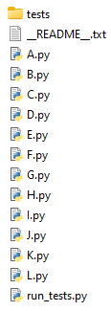


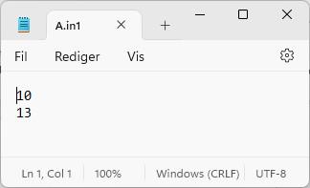
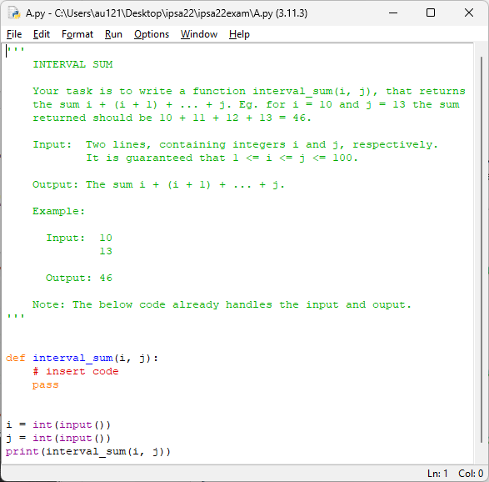
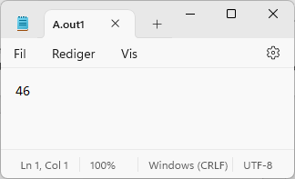
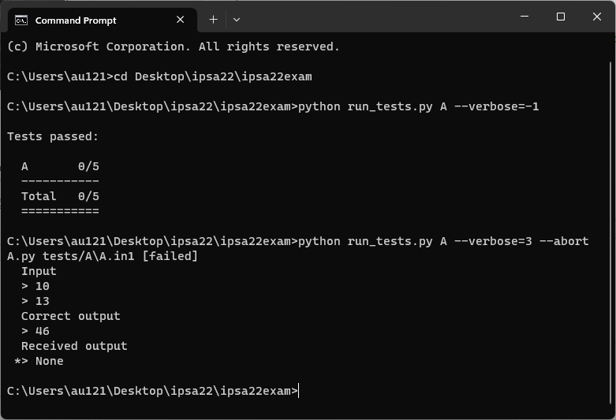
Content of .zip file
test input
Exam questions
test output
run_tests.py arguments
A B C … exercises to evaluate default are all
--abort stop on first error
--verbose=value amount of output
* = line with wrong output

Slide 4

Evaluation of code
Don’t expect partial scores for this solution
Each problem will be assigned a weight
There will be problems of varying difficulty
Code will be evaluated on known test cases and unknown test cases
In general, automatic scoring, in some exceptional cases manual
Googling / stack overflow / Python documentation etc. is allowed, but put a comment if you copied code from internet to avoid plagiarism

Slide 5
AOB ?

