Slide 1

Relational data
SQLite
pandas

Slide 2
Two tables
Table: country
name | population | area | capital
'Denmark' | 5748769 | 42931 | 'Copenhagen'
'Germany' | 82800000 | 357168 | 'Berlin'
'USA' | 325719178 | 9833520 | 'Washington, D.C.'
'Iceland' | 334252 | 102775 | 'Reykjavik'
Table: city
name | country | population | established
'Copenhagen' | 'Denmark' | 775033 | 800
'Aarhus' | 'Denmark' | 273077 | 750
'Berlin' | 'Germany' | 3711930 | 1237
'Munich' | 'Germany' | 1464301 | 1158
'Reykjavik' | 'Iceland' | 126100 | 874
'Washington D.C.' | 'USA' | 693972 | 1790
'New Orleans' | 'USA' | 343829 | 1718
'San Francisco' | 'USA' | 884363 | 1776

Slide 3
SQL pronounced ˌɛsˌkjuːˈɛl or ˈsiːkwəl
Table: country
name | population | area | capital
'Denmark' | 5748769 | 42931 | 'Copenhagen'
'Germany' | 82800000 | 357168 | 'Berlin'
'USA' | 325719178 | 9833520 | 'Washington, D.C.'
'Iceland' | 334252 | 102775 | 'Reykjavik'
SQL = Structured Query Language
Database = collection of tables stored persistently on disk
ANSI and ISO standards since 1986 and 1987, respectively; origin early 70s
Widespread used SQL databases (can handle many tables/rows/users): Oracle, MySQL, Microsoft SQL Server, PostgreSQL and IBM DB2
SQLite is a very lightweight version storing a database in a single file, without a separate database server; first release in 2000
SQLite is included in both iOS and Android mobil phones and operating systemes like Mac OS, Windows, and Fedora Linux
programs
Database
SQL
The Course “Databases” gives a more in-depth introduction to SQL (MySQL)
Notes:
Multiple programs on multiple machines can connect to a database
seqel = the original name for SQL

Slide 4
Examples : SQL statements
Table: country
name | population | area | capital
'Denmark' | 5748769 | 42931 | 'Copenhagen'
'Germany' | 82800000 | 357168 | 'Berlin'
'USA' | 325719178 | 9833520 | 'Washington, D.C.'
'Iceland' | 334252 | 102775 | 'Reykjavik'
CREATE TABLE country (name, population, area, capital)
INSERT INTO country VALUES ('Denmark', 5748769, 42931, 'Copenhagen')
UPDATE country SET population=5748770 WHERE name='Denmark'
SELECT name, capital FROM country WHERE population >= 1000000
> [('Denmark', 'Copenhagen'), ('Germany', 'Berlin'), ('USA', 'Washington, D.C.')]
SELECT * FROM country WHERE capital = 'Berlin' > [('Germany', 82800000, 357168, 'Berlin')]
SELECT country.name, city.name, city.established FROM city, country WHERE city.name=country.capital AND city.population < 700000 > [('Iceland', 'Reykjavik', 874), ('USA', 'Washington, D.C.', 1790)]
DELETE FROM country WHERE name = 'Germany'
DROP TABLE country
www.w3schools.com/sql/
Notes:
"WHERE clause" used to filter records

Slide 5
SQLite
sqlite-example.py
import sqlite3 connection = sqlite3.connect('example.sqlite') # creates file if necessary c = connection.cursor() c.executescript('''DROP TABLE IF EXISTS country; -- multiple SQL statements DROP TABLE IF EXISTS city''') countries = [('Denmark', 5748769, 42931, 'Copenhagen'), ('Germany', 82800000, 357168, 'Berlin'), ('USA', 325719178, 9833520, 'Washington, D.C.'), ('Iceland', 334252, 102775, 'Reykjavik')] cities = [('Copenhagen', 'Denmark', 775033, 800), ('Aarhus', 'Denmark', 273077, 750), ('Berlin', 'Germany', 3711930, 1237), ('Munich', 'Germany', 1464301, 1158), ('Reykjavik', 'Iceland', 126100, 874), ('Washington, D.C.', 'USA', 693972, 1790), ('New Orleans', 'USA', 343829, 1718), ('San Francisco', 'USA', 884363, 1776)] c.execute('CREATE TABLE country (name, population, area, capital)') c.execute('CREATE TABLE city (name, country, population, established)') c.executemany('INSERT INTO country VALUES (?,?,?,?)', countries) c.executemany('INSERT INTO city VALUES (?,?,?,?)', cities) connection.commit() # save data to database before closing connection.close()
docs.python.org /3/library/sqlite3.html
Notes:
SQLlite is +200.000 lines of C code
To get a list of tables:
SELECT name FROM sqlite_master WHERE type='table‘
a cursor has an execute method to execute SQL code

Slide 6
SQLite query examples
try to avoid using the asterisk (*) as a good habit
www.sqlitetutorial.net/sqlite-select
sqlite-example.py
for row in c.execute('SELECT * FROM country'): # * = all columns, execute returns iterator print(row) # row is by default a Python tuple for row in c.execute('''SELECT * FROM city, country -- all pairs of rows from city × country WHERE city.name = country.capital AND city.population < 700000'''): print(row) print(*c.execute('''SELECT country.name, COUNT(city.name) AS cities, 100 * SUM(city.population) / country.population FROM city JOIN country ON city.country = country.name -- SQL join 2 tables WHERE city.population > 500000 -- only consider big cities GROUP BY city.country -- output has one row per group of rows ORDER BY cities DESC, SUM(city.population) DESC''')) # ordering of output
Python shell
('Denmark', 5748769, 42931, 'Copenhagen') ('Germany', 82800000, 357168, 'Berlin') ('USA', 325719178, 9833520, 'Washington, D.C.') ('Iceland', 334252, 102775, 'Reykjavik') ('Reykjavik', 'Iceland', 126100, 874, 'Iceland', 334252, 102775, 'Reykjavik') ('Washington, D.C.', 'USA', 693972, 1790, 'USA', 325719178, 9833520, 'Washington, D.C.') ('Germany', 2, 6) ('USA', 2, 0) ('Denmark', 1, 13)
Notes:
* = all columns
ORDER BY comma separately list of criteria, DESC can be appended force decreasing order (optional)
SELECT returns an iterator
2nd and 3rd examples are both examples of JOIN (SQLite supports different kinds of SQL)
* is good for testing, but returns ALL columns. What happens if somebody adds new columns to the database? Does your code handle this?
Iceland missing, because no big cities (last example computes percentage of population living in a big city > ½ million)

Slide 7

SQL injection
Right way
c.execute('INSERT INTO users VALUES (?)', (user,))
unsafe-example.py
import sqlite3 connection = sqlite3.connect('users.sqlite') c = connection.cursor() c.execute('CREATE TABLE users (name)') while True: user = input('New user: ') c.executescript(f'INSERT INTO users VALUES ("{user}")') connection.commit() print(list(c.execute('SELECT * FROM users')))
Insecure NEVER use f-string with user input
can execute a string containing several SQL statements
Python shell
New user: gerth [('gerth',)] New user: guido [('gerth',), ('guido',)] New user: evil"); DROP TABLE users; -- sqlite3.OperationalError: no such table: users
INSERT INTO users VALUES ("evil"); DROP TABLE users; --")
Notes:
In SQL ‘--’ starts a comment until end of line
Run, insert some names, interrupt: Comment out CREATE TABLE on 2nd & return => data saved on disk between runs

Slide 8

xkcd.com/327/

Slide 9

Pandas
Comprehensive Python library for data manipulation and analysis, in particular tables and time series
Pandas data frames = tables
Supports interaction with SQL, CSV, JSON, ...
Integrates with Jupyter, numpy, matplotlib, ...
pandas.pydata.org

Slide 10
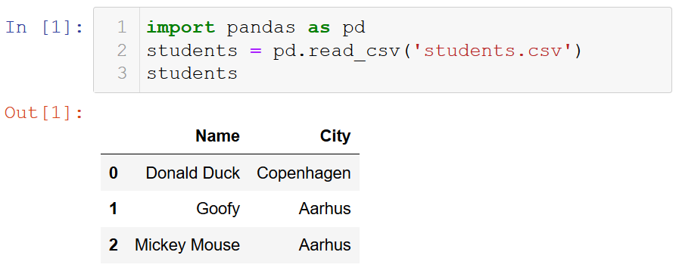
Pandas integration with Jupyter
Tables (Pandas data frames) are rendered nicely in Jupyter
students.csv
Name,City "Donald Duck","Copenhagen" "Goofy","Aarhus" "Mickey Mouse","Aarhus”
Notes:
type(students) = <class 'pandas.core.frame.DataFrame'>

Slide 11
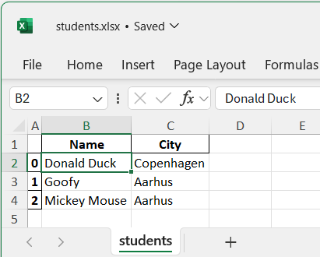
Reading tables (data frames)
Pandas provides functions for reading and writting pandas.DataFrames as files in different data formats, e.g. SQLite, csv and EXCEL files
pandas-example.py
import pandas as pd import sqlite3 connection = sqlite3.connect('example.sqlite') countries = pd.read_sql_query('SELECT * FROM country', connection) cities = pd.read_sql_query('SELECT * FROM city', connection) students = pd.read_csv('students.csv') students.to_sql('students', connection, if_exists='replace') students.to_excel('students.xlsx', sheet_name='students') print(students)
Python shell
Name City 0 Donald Duck Copenhagen 1 Goofy Aarhus 2 Mickey Mouse Aarhus
Notes:
countries, cities, students all <class 'pandas.core.frame.DataFrame'>
(pd.DataFrame is pd.core.frame.DataFrame) == True
Also to_excel & read_excel methods

Slide 12
Selecting columns and rows
Table: country
name | population | area | capital
'Denmark' | 5748769 | 42931 | 'Copenhagen'
'Germany' | 82800000 | 357168 | 'Berlin'
'USA' | 325719178 | 9833520 | 'Washington, D.C.'
'Iceland' | 334252 | 102775 | 'Reykjavik'
Python shell
countries['name'] # select column countries.name # same as above countries[['name', 'capital']] # select multiple columns, note double-[] countries.head(2) # first 2 rows countries[1:3] # slicing rows, rows 1 and 2 countries[::2] # slicing rows, rows 0 and 2 countries.at[1, 'area'] # indexing cell by (row label, column name) cities[(cities['name'] == 'Berlin') | (cities['name'] == 'Munich')] # select rows name country population established 2 Berlin Germany 3711930 1237 # note original row labels 3 Munich Germany 1464301 1158 pd.DataFrame([[1, 2], [3, 4], [5, 6]], columns=['x', 'y']) # create DF from list pd.DataFrame(np.random.random((3, 2)), columns=['x', 'y']) # from numpy
pandas.pydata.org/pandas-docs/stable/user_guide/indexing.html
Notes:
read table using SQL query
many ways to index into DataFrame’s very flexible – but at the same time overwhelming....

Slide 13
Row labels
Python shell
df = pd.DataFrame(np.arange(1, 13).reshape(3, 4), index=['q', 'w', 'e'], # row labels columns=['c', 'a', 'd', 'e']) # column names df c a d e q 1 2 3 4 # row labels can be strings w 5 6 7 8 e 9 10 11 12 df.loc['w':'e', ['e', 'a']] # slice of labeled rows e a w 8 6 e 12 10 df.loc['w'] # single row (a one-dimensional pd.Series) c 5 a 6 d 7 e 8 Name: w, dtype: int32 df.iloc[:2,:2] # use iloc to work with integer indexes c a q 1 2 w 5 6
Notes:
Creating a dataframe from numpy array without index/columns, creates labels 0,1,2,… both for rows and columns; then df[1] = column 1, df.loc[1] = row 1
Note loc slice by labeled rows is inclusive in last row name
Column names can be selected in arbitrary order

Slide 14
Merging tables and creating a new column
pandas-example.py
M = pd.merge(countries, cities, left_on='capital', right_on='name') # both data frames had a 'name' and 'population' column M1 = M.rename(columns={ 'population_x': 'country_population', 'population_y': 'capital_population' }) M2 = M1.drop(columns=['name_x', 'name_y']) M2['%pop in capital'] = M2.capital_population / M2.country_population # add column M2.sort_values('%pop in capital', ascending=False, inplace=True) print(M2[['country', '%pop in capital']])
Python shell
country %pop in capital 3 Iceland 0.377260 # note row labels are permuted 0 Denmark 0.134817 1 Germany 0.044830 2 USA 0.002131
Notes:
sort_values : 'inplace' changes existing data frame without creating new

Slide 15
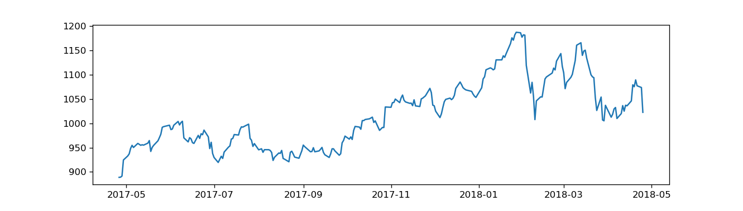
Googlefinance > Pandas > Matplotlib
googlefinance-example.py
from googlefinance.client import get_price_data # pip install googlefinance.client param = { 'q': 'GOOGL', # Stock symbol (ex: 'AAPL', 'MSFT', 'FB') 'i': '86400', # Interval size in seconds ('86400' = 1 day intervals) 'x': 'NASD', # Stock exchange symbol on which stock is traded (ex: 'NASD') 'p': '1Y' # Period (Ex: '1Y' = 1 year) } df = get_price_data(param) # get price data (return pandas dataframe) import matplotlib.pyplot as plt plt.plot(df['Close']) plt.show()
pypi.org/project/googlefinance.client
Notes:
From Pandas Datareader webpage 26/4-2019
As of v0.6.0 Google finance is still functioning for historical price data, although there are frequent reports of failures. Failure is frequently encountered when bulk downloading historical price data.

Slide 16
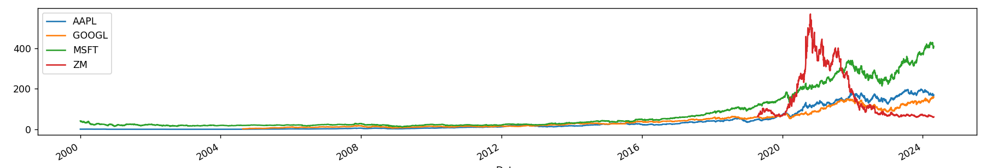
Pandas datareader and Matplotlib
pandas_datareader provides access to many data sources
dataframes have a .plot method (using matplotlib.pyplot)
pip install pandas-datareader and pip install setuptools
pandas-datareader.py
import matplotlib.pyplot as plt import pandas_datareader #df = pandas_datareader.data.DataReader(['AAPL', 'GOOGL', 'MSFT', 'ZM'], 'stooq') # ignores start=... df = pandas_datareader.stooq.StooqDailyReader(['AAPL', 'GOOGL', 'MSFT', 'ZM'], start='2000-01-01').read() df['Close'].plot() plt.legend() plt.show()
pandas-datareader.readthedocs.io
pandas-datareader.readthedocs.io/en/latest/readers/stooq.html
Notes:
Depends on "distutils" module.
In Python 3.12 module "distutils" was removed, instead use "setuptools" module, that fills in for distutils.
Datareader objects have a .plot method to plot using pyplot

Slide 17
Hierarchical / Multi-level indexing (MultiIndex)
Python shell
df.tail(2) Attributes Close ... Volume Symbols AAPL GOOGL MSFT ... GOOGL MSFT ZM Date ... 2020-04-29 287.73 1342.18 177.43 ... 5417888.0 51286559.0 22033320.0 2020-04-30 293.80 1346.70 179.21 ... 2788644.0 53627543.0 16648922.0 df['Close'].tail(2) Symbols AAPL GOOGL MSFT ZM Date 2020-04-29 287.73 1342.18 177.43 146.48 2020-04-30 293.80 1346.70 179.21 135.17 df['Close']['GOOGL'].tail(2) Date 2020-04-29 1342.18 2020-04-30 1346.70 Name: GOOGL, dtype: float64 df.loc[:, pd.IndexSlice[:,'GOOGL']].tail(2) Attributes Close High Low Open Volume Symbols GOOGL GOOGL GOOGL GOOGL GOOGL Date 2020-04-29 1342.18 1360.15 1326.73 1345.00 5417888.0 2020-04-30 1346.70 1350.00 1321.50 1331.36 2788644.0
Both rows and columns can have multi-level indexing
Python shell
df.columns MultiIndex([( 'Close', 'AAPL'), ( 'Close', 'GOOGL'), ( 'Close', 'MSFT'), ( 'Close', 'ZM'), ( 'High', 'AAPL'), ( 'High', 'GOOGL'), ( 'High', 'MSFT'), ( 'High', 'ZM'), ( 'Low', 'AAPL'), ( 'Low', 'GOOGL'), ( 'Low', 'MSFT'), ( 'Low', 'ZM'), ( 'Open', 'AAPL'), ( 'Open', 'GOOGL'), ( 'Open', 'MSFT'), ( 'Open', 'ZM'), ('Volume', 'AAPL'), ('Volume', 'GOOGL'), ('Volume', 'MSFT'), ('Volume', 'ZM')], names=['Attributes', 'Symbols'])
pandas.pydata.org/pandas-docs/stable/user_guide/advanced.html

