Slide 1
Linear programming
Example Numpy: PageRank
scipy.optimize.linprog
Example linear programming: Maximum flow

Slide 2
PageRank

Slide 3
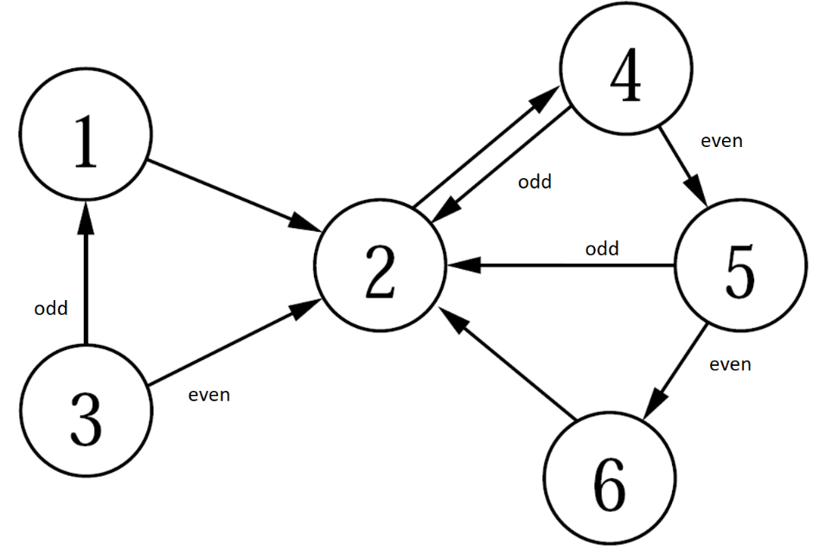

PageRank - A NumPy / Jupyter / matplotlib example
Google's original search engine ranked webpages using PageRank
View the internet as a graph where nodes correspond to webpages and directed edges to links from one webpage to another webpage
Google’s PageRank algorithm was described in (infolab.stanford.edu/pub/papers/google.pdf, 1998)

Slide 4


Five different ways to compute PageRank probabilities
Simulate random process manually by rolling dices
Simulate random process in Python
Computing probabilities using matrix multiplication
Repeated matrix squaring
Eigenvector for λ = 1

Slide 5

Random surfer model (simplified)
The PageRank of a node (web page) is the fraction of the time one visits a node by performing an infinite random traversal of the graph starting at node 1, and in each step
with probability 1/6 jumps to a random page (probability 1/6 for each node)
with probability 5/6 follows an outgoing edge to an adjacent node (selected uniformly)
The above can be simulated by using a dice: Roll a dice. If it shows 6, jump to a random page by rolling the dice again to figure out which node to jump to. If the dice shows 1-5, follow an outgoing edge - if two outgoing edges roll the dice again and go to the lower number neighbor if it is odd.
Notes:
Python: random.randint(1, 6)
tiny.cc/pagerank

Slide 6


Slide 7
Adjacency matrix and degree vector
pagerank.ipynb
import numpy as np # Adjacency matrix of the directed graph in the figure # (note that the rows/colums are 0-indexed, whereas in the figure the nodes are 1-indexed) G = np.array([[0, 1, 0, 0, 0, 0], [0, 0, 0, 1, 0, 0], [1, 1, 0, 0, 0, 0], [0, 1, 0, 0, 1, 0], [0, 1, 0, 0, 0, 1], [0, 1, 0, 0, 0, 0]]) n = G.shape[0] # number of rows in G degree = np.sum(G, axis=1, keepdims=True) # column vector with row sums = out-degrees # The below code handles sinks, i.e. nodes with outdegree zero (no effect on the graph above) G = G + (degree == 0) # add edges from sinks to all nodes (uses broadcasting) degree = np.sum(G, axis=1, keepdims=True)

Slide 8
Simulate random walk (random surfer model)
pagerank.ipynb
from random import randint, choice STEPS = 1000000 # adjacency_list[i] is a list of all j where (i, j) is an edge of the graph. adjacency_list = [[j for j, e in enumerate(row) if e] for row in G] count = np.zeros(n) # histogram over number of node visits state = 0 # start at node with index 0 for _ in range(STEPS): count[state] += 1 # increment count for state if randint(1, 6) == 6: # original paper uses 15% instead of 1/6 state = randint(0, 5) else: state = choice(adjacency_list[state]) print(adjacency_list, count / STEPS, sep='\n')
Python shell
[[1], [3], [0, 1], [1, 4], [1, 5], [1]] [0.039365 0.353211 0.02751 0.322593 0.1623 0.095021]

Slide 9
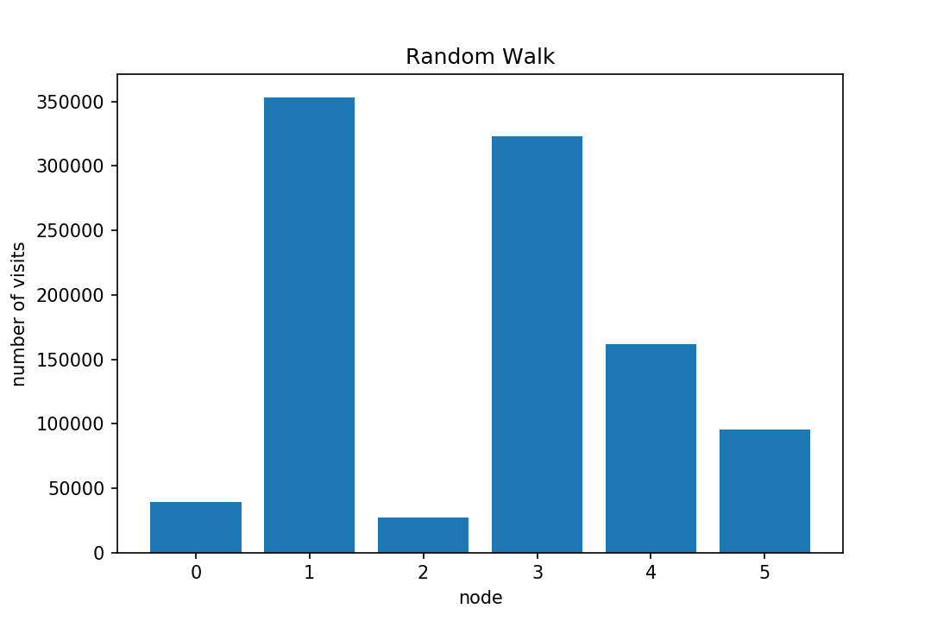
Simulate random walk (random surfer model)
pagerank.ipynb
import matplotlib.pyplot as plt plt.bar(range(6), count) plt.title('Random Walk') plt.xlabel('node') plt.ylabel('number of visits') plt.show()

Slide 10
Transition matrix A
pagerank.ipynb
A = G / degree # Normalize row sums to one. Note that 'degree' # is an n x 1 matrix, whereas G is an n x n matrix. # The elementwise division is repeated for each column of G print(A)
Python shell
[[0. 1. 0. 0. 0. 0. ] [0. 0. 0. 1. 0. 0. ] [0.5 0.5 0. 0. 0. 0. ] [0. 0.5 0. 0. 0.5 0. ] [0. 0.5 0. 0. 0. 0.5] [0. 1. 0. 0. 0. 0. ]]
Notes:
division = done by broadcasting

Slide 11
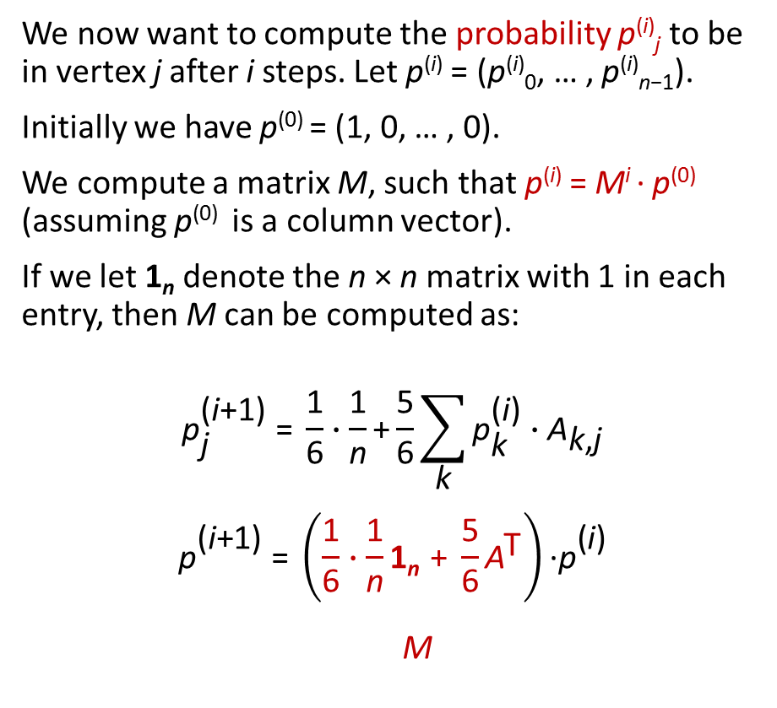
Repeated matrix multiplication
pagerank.ipynb
ITERATIONS = 20 p_0 = np.zeros((n, 1)) p_0[0, 0] = 1.0 M = 1 / (6 * n) + 5 / 6 * A.T p = p_0 prob = p # 'prob' will contain each # computed 'p' as a new column for _ in range(ITERATIONS): p = M @ p prob = np.append(prob, p, axis=1) print(p)
Python shell
[[0.03935185] [0.35326184] [0.02777778] [0.32230071] [0.16198059] [0.09532722]]
We now want to compute the probability p^{(i)}_{j} to be in vertex j after i steps. Let p^{(i)} = (p^{(i)}₀, … , p^{(i)}_{n−1}).
Initially we have p⁽⁰⁾ = (1, 0, … , 0).
We compute a matrix M, such that p^{(i)} = M^{i} ∙ p⁽⁰⁾ (assuming p⁽⁰⁾ is a column vector).
If we let 1_{n} denote the n × n matrix with 1 in each entry, then M can be computed as:
$${\text{p}}_{\text{j}}^{\text{(}\text{i}\text{+1}\text{)}} \text{=} \frac{\text{1}}{\text{6}}∙\frac{\text{1}}{\text{n}}\text{+}\frac{\text{5}}{\text{6}}\sum_{\text{k}}{{\text{p}}_{\text{k}}^{\text{(}\text{i}\text{)}}∙{\text{A}}_{\text{k}\text{,}\text{j}}}$$
$${\text{p}}_{}^{\text{(}\text{i}\text{+1)}} \text{=} {\left(\frac{\text{1}}{\text{6}}∙\frac{\text{1}}{\text{n}}\text{1}\text{n} \text{+} \frac{\text{5}}{\text{6}}{\text{A}}^{\text{T}}\right)\text{∙}\text{p}}_{}^{\text{(}\text{i}\text{)}}$$
$$\text{M}$$
Notes:
p = column vector
A = np.arange(4).reshape(2, 2)
np.append(A, A) # result is 1-vector
np.append(A, A, axis=0) # added as roows
np.append(A, A, axis=1) # added as columns

Slide 12
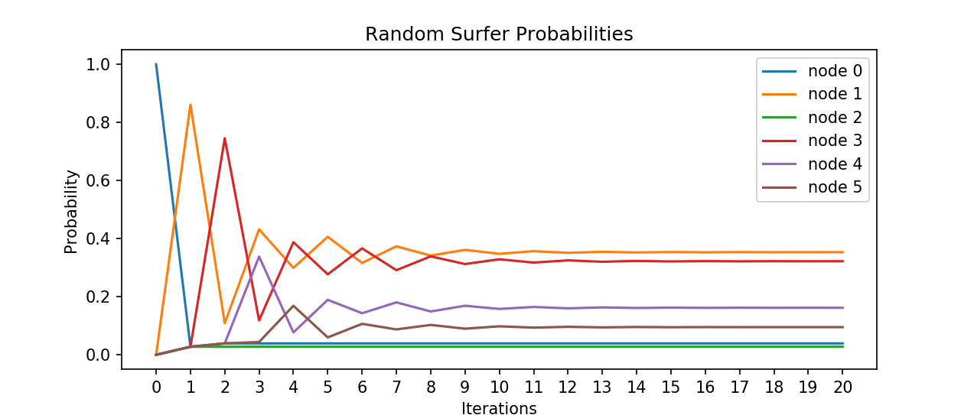
Rate of convergence
pagerank.ipynb
x = range(ITERATIONS + 1) for node in range(n): plt.plot(x, prob[node], label=f'node {node}') plt.xticks(x) plt.title('Random Surfer Probabilities') plt.xlabel('Iterations') plt.ylabel('Probability') plt.legend() plt.show()

Slide 13
Repeated squaring
log₂ k
M⋅(⋯(M⋅(M⋅p⁽⁰⁾))⋯) = M^{k}⋅p⁽⁰⁾ = M^{2log2 k}⋅p⁽⁰⁾ = (⋯((M²)²)²⋯)²⋅p⁽⁰⁾
k multiplications, k power of 2
pagerank.ipynb
from math import log2 MP = M for _ in range(1 + int(log2(ITERATIONS))): MP = MP @ MP p = MP @ p_0 print(p)
Python shell
[[0.03935185] [0.35332637] [0.02777778] [0.32221711] [0.16203446] [0.09529243]]

Slide 14
PageRank : Computing eigenvector for λ = 1
We want to find a vector p, with |p| = 1, where Mp = p, i.e. an eigenvector p for the eigenvalue λ = 1
pagerank.ipynb
eigenvalues, eigenvectors = np.linalg.eig(M) idx = eigenvalues.argmax() # find the largest eigenvalue (= 1) p = np.real(eigenvectors[:, idx]) # .real returns the real part of complex numbers p /= p.sum() # normalize p to have sum 1 print(p)
Python shell
[0.03935185 0.3533267 0.02777778 0.32221669 0.16203473 0.09529225]

Slide 15
PageRank : Note on practicality
In practice an explicit matrix for billions of nodes is infeasible, since the number of entries would be order of 10¹⁸
Instead use sparse matrices (in Python modul scipy.sparse) and stay with repeated multiplication

Slide 16
Linear programming

Slide 17
scipy.optimize.linprog
scipy.optimize.linprog can solve linear programs of the following form, where one wants to find an n x 1 vector x satisfying:
dimension
Minimize: c^{T} ∙ x c : n x 1
Subject to: A_{ub} ∙ x ≤ b_{ub} A_{ub} : m x n b_{ub} : m x 1 A_{eq} ∙ x = b_{eq} A_{eq} : k x n b_{eq} : k x 1
Some other open-source optimization libraries PuLP and Pyomo
For industrial strength linear solvers, use solvers like Cplex or Gurobi (mixed-integer linear programs)
Notes:
PuLP and Pyomo are used in other courses on the Data Science education.
Cplex and Gurobi are used throughout many course on the Math-Econics education.
Gurobi has free academic licenses.

Slide 18
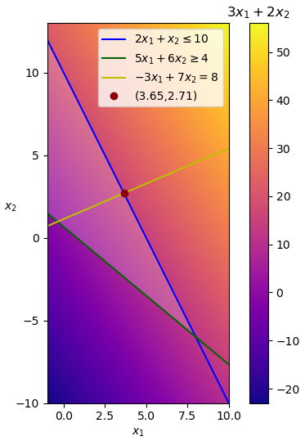

Linear programming example
Maximize
3∙x₁ + 2∙x₂
Subject to
2∙x₁ + 1∙x₂ ≤ 10
5∙x₁ + 6∙x₂ ≥ 4
-3∙x₁ + 7∙x₂ = 8
linear_programming.py
import numpy as np from scipy.optimize import linprog c = np.array([3, 2]) A_ub = np.array([[ 2, 1], [-5, -6]]) # multiplied by -1 b_ub = np.array([10, -4]) A_eq = np.array([[-3, 7]]) b_eq = np.array([8]) res = linprog(-c, # maximize = minimize the negated A_ub=A_ub, b_ub=b_ub, A_eq=A_eq, b_eq=b_eq) print(res) # res.x is the optimal vector
Python shell
fun: -16.35294117647059 message: 'Optimization terminated successfully.‘ nit: 3 slack: array([ 0. , 30.47058824]) status: 0 success: True x: array([3.64705882, 2.70588235])
Minimize
- (3∙x₁ + 2∙x₂)
Subject to
2∙x₁ + 1∙x₂ ≤ 10
-5∙x₁ + -6∙x₂ ≤ -4
-3∙x₁ + 7∙x₂ = 8
Notes:
Keyword argument "bound" defines the ranges for the variables.
Default bound is (0, None), ie variables must be non-negative

Slide 19
Maxmium flow

Slide 20
Solving maximum flow using linear programming
Maximize
x₇ + x₈
Subject to
x₀ ≤ 4
x₁ ≤ 3
x₂ ≤ 1
x₃ ≤ 1
x₄ ≤ 3
x₅ ≤ 1
x₆ ≤ 3
x₇ ≤ 1
x₈ ≤ 5
x₁ = x₄ + x₅
x₀ = x₂ + x₃
x₃ + x₅ + x₆ = x₈
x₂ + x₄ = x₆ + x₇
B
= 1
D
flow value
x₅
1
x₈
= 4
3
x₄
= 2
5
x₁
A
= 3
3
F
x₆
3
= 2
1
capacity constraints
x₀
1
= 2
x₃
source
= 1
sink
x₇
4
C
1
E
= 1
x₂
= 1
flow conservation
We will use the scipy.optimize.linprog function to solve the maximum flow problem on the above directed graph. We want to send as much flow from node A to node F. Edges are numbered 0..8 and each edge has a maximum capacity.
Note: solution not unique

Slide 21
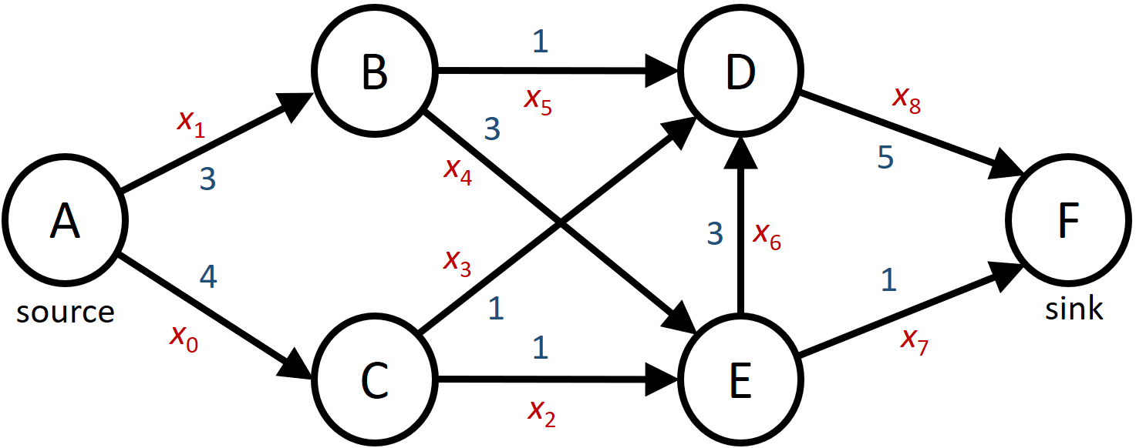

Solving maximum flow using linear programming
Minimize
- x₇ - x₈
Subject to
x₀ ≤ 4
x₁ ≤ 3
x₂ ≤ 1
x₃ ≤ 1
x₄ ≤ 3
x₅ ≤ 1
x₆ ≤ 3
x₇ ≤ 1
x₈ ≤ 5
0 = - x₁ + x₄ + x₅
0 = - x₀ + x₂ + x₃
0 = - x₃ - x₅ - x₆ + x₈
0 = - x₂ - x₄ + x₆ + x₇
x is a vector describing the flow along each edge
c is a vector to add the flow along the edges (7 and 8) to the sink (F), i.e. a function computing the flow value
A_{ub} and b_{ub} is a set of capacity constraints, for each edge flow ≤ capacity
A_{eq} and b_{eq} is a set of flow conservation constraints, for each non-source and non-sink node (B, C, D, E), requiring that the flow into equals the flow out of a node
flow value
c^{T}∙x
A_{ub}∙x ≤ b_{ub}
capacity constraints
I∙x ≤ capacity
A_{eq}∙x = b_{eq} = 0
flow conservation

Slide 22

maximum-flow.py
import numpy as np from scipy.optimize import linprog # 0 1 2 3 4 5 6 7 8 conservation = np.array([[ 0,-1, 0, 0, 1, 1, 0, 0, 0], # B [-1, 0, 1, 1, 0, 0, 0, 0, 0], # C [ 0, 0, 0,-1, 0,-1,-1, 0, 1], # D [ 0, 0,-1, 0,-1, 0, 1, 1, 0]]) # E # 0 1 2 3 4 5 6 7 8 sinks = np.array([0, 0, 0, 0, 0, 0, 0, 1, 1]) # 0 1 2 3 4 5 6 7 8 capacity = np.array([4, 3, 1, 1, 3, 1, 3, 1, 5]) res = linprog(-sinks, A_eq=conservation, b_eq=np.zeros(conservation.shape[0]), A_ub=np.eye(capacity.size), b_ub=capacity) print(res)
Python shell
fun: -5.0 message: 'Optimization terminated successfully.' nit: 9 slack: array([2., 0., 0., 0., 1., 0., 1., 0., 1.]) status: 0 success: True x: array([2., 3., 1., 1., 2., 1., 2., 1., 4.])
the solution found varies with the scipy version

Slide 23
Mixed Integer Linear programming

Slide 24
Mixed integer linear programming (MILP)
Combines arithmetic with logic
python -m pip install gurobipy
Gurobi, state the of art commercial MILP solver, free acdemic license
Notes:
Gurobi
1) Create account at gurobi.com
2) Get free academic license, https://portal.gurobi.com/iam/licenses/request/?type=academic
3) Download Gurobi (Gurobi-12.0.2-win64.msi)
4) grbgetkey …
5) pip install gurobipy

