Slide 1
Introduction to Programming with Scientific Applications
Missing handins – deadline: ASAP, but latest May 31st
Final project – deadline: May 31st
June 1st the exam office is informed who passed the mandatory course assignments
Course evaluation
Exam
AOB

Slide 2
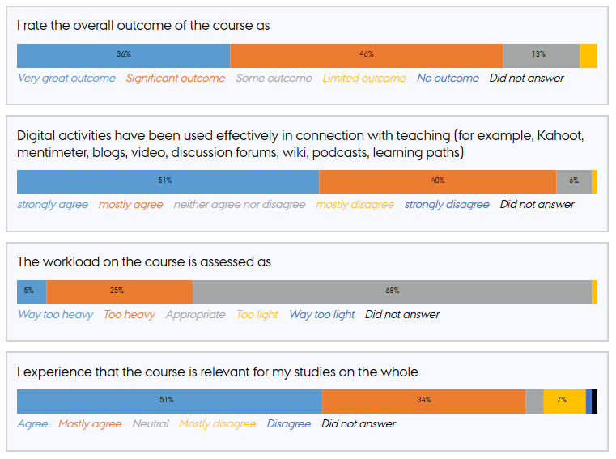
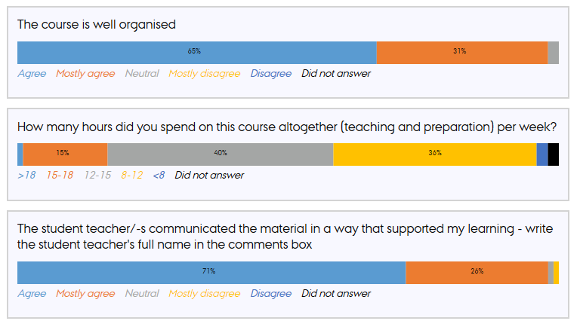
Course evaluation
”Not that relevant for my math studies... but will be super relevant when entering the real world”
Videos sometimes delayed

Slide 3
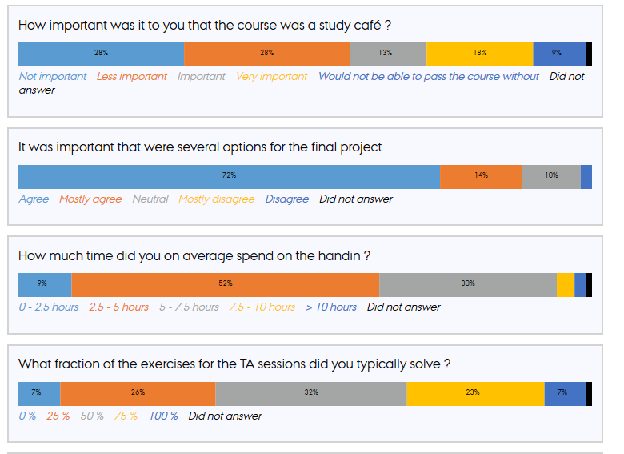
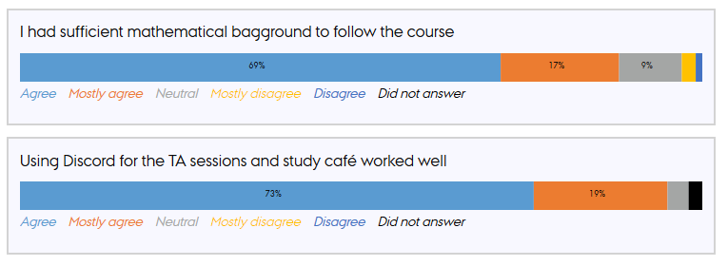
Your background

Slide 4
Digital activities
Would have used the study café more, if it had been on discord from the beginning

Slide 5
Workload
Handin took often a lot of time
Exercises hard to understand
Recursion start was tough
To many evaluation components (handins, project, exam)
Notes:
Brugt meget tid
Afleveringsopgaver – Tidskrævende
Mange har brugt MEGET TID på afleveringerne – har man kunnet få hjælp?
Dårligt formulerede opgaver

Slide 6
TAs - did an excellent job

Slide 7
Exam – 26 June 2020
6 hours, written exam, with aids, including PC and internet
Communication with others about the exam is not permitted during the exam
Reexam in August (format likely the same, but no formal decision)
Grade is an overall assessment of the implementation project and the exam
The result of the final exam must meet the minimum requirements for acceptance to be able to pass the course
The final exam will contribute roughly 3/4 to the final grade – but the final grade is an overall assessment
eksamen.au.dk
Download .zip + add missing code + upload .zip
Questions? – post them on Blackboard
Notes:
Et eksperiment

Slide 8
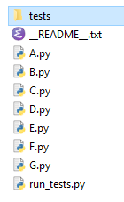

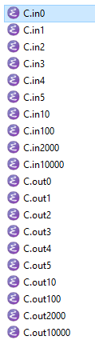
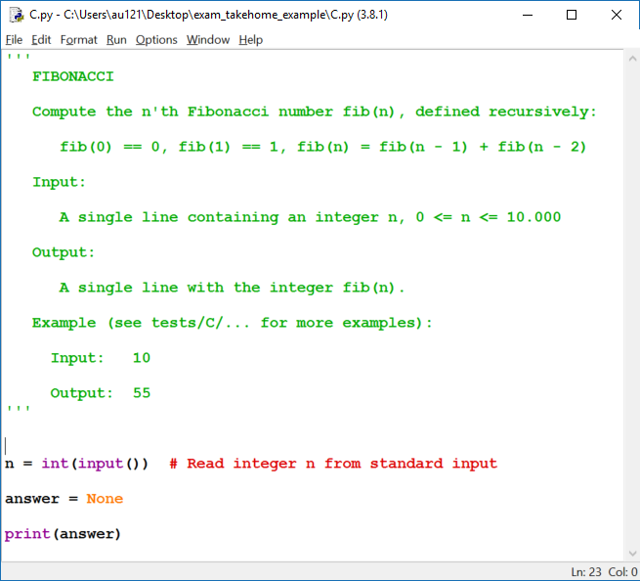
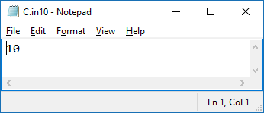
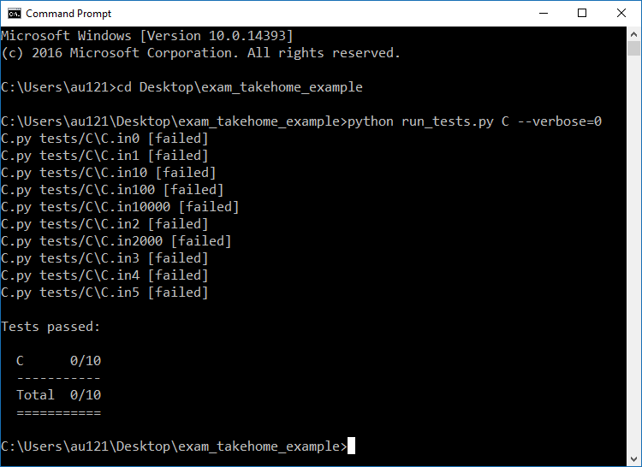
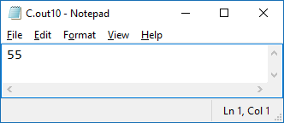
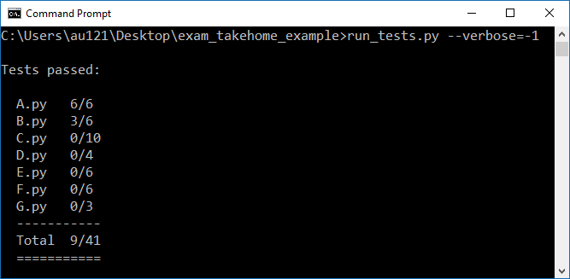
Content of .zip file
Exam questions
test input
test output

Slide 9
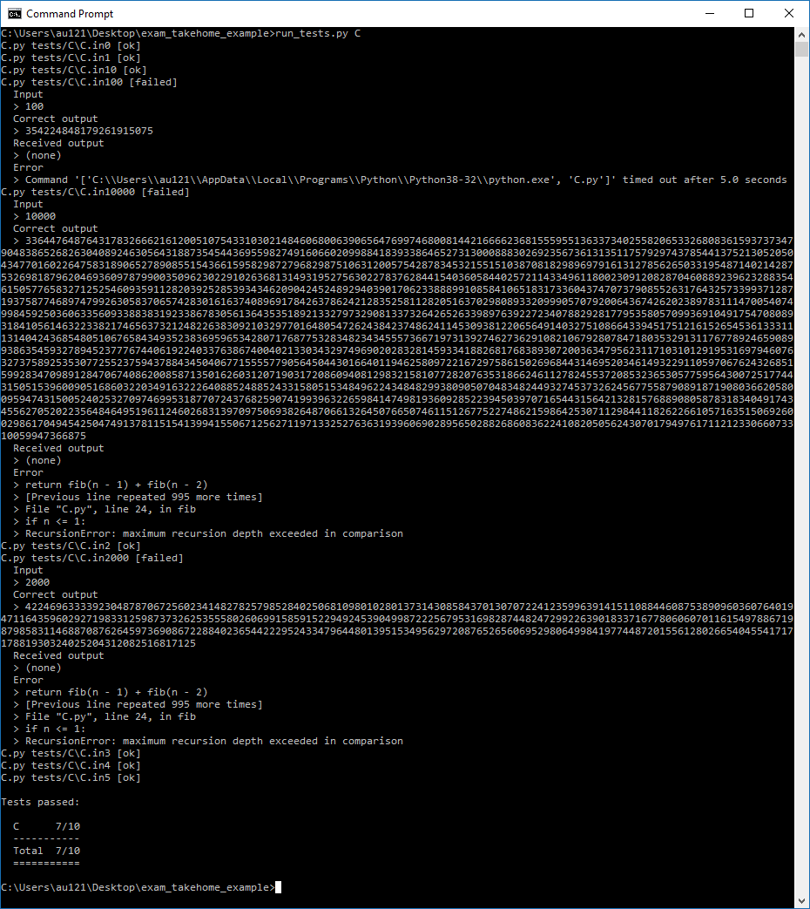
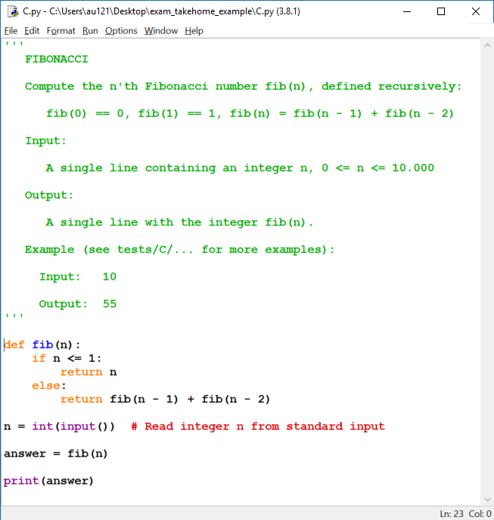
Partial solution that only works for small input

Slide 10

Evaluation of code
Don’t expect partial scores for this solution
Each problem will be assigned a weight
There will be problems of varying difficulty
import to be able to differentiate throughout
Code will be evaluated on known test cases and unknown test cases
In general automatic scoring in some exceptional cases manual
Googling / stack overflow / Python documentation etc. is allowed, but put a comment if you copied code from internet to avoid plagiarism

Slide 11
AOB ?

