Slide 1
Working with text
file formats
CSV, JSON, XML, Excel
regular expressions
module re, finditer

Slide 2
Some file formats
File extension | Content
.html | HyperText Markup Language
.mp3 | Audio File
.png .jpeg .jpg | Image files
.svg | Scalable Vector Graphics file
.json | JavaScript Object Notation
.csv | Comma separated values
.xml | eXtensible Markup Language
.xlmx | Micosoft Excel 2010/2007 Workbook
File extension | Description
.exe | Windows executable file
.app | Max OS X Application
.py | Python program
.pyc | Python compiled file
.java | Java program
.cpp | C++ program
.c | C program
.txt | Raw text file
Notes:
Python has support for many different file types
.csv is a .xml file format

Slide 3


PIL – the Python Imaging Library
pip install Pillow
For many file types there exist Python packages handling such files, e.g. for images Pillow supports 40+ different file formats
For more advanced computer vision tasks you should consider OpenCV
rotate_image.py
from PIL import Image img = Image.open('Python-Logo.png') img_out = img.rotate(45, expand=True) img_out.save('Python-rotated.png')
Python-Logo.png
Python-rotated.png
python-pillow.org
Notes:
Pillow is a new branch of the old “PIL” module
The original Python Image Library was called PIL, but stopped being developed in 2009. https://www.pythonware.com/products/pil/
Pillow is a fork of PIL that is updated regularly ("Pillow is released quarterly on January 2nd, April 1st, July 1st and October 15th.")

Slide 4
CSV files - Comma Separated Values
Simple 2D tables are stored as rows in a file, with values separated by comma
Strings stored are quoted if necessary
Values read are strings
The deliminator (default comma) can be changed by keyword argument delimiter. Other typical deliminators are tabs '\t', and semicolon ';'
csv-example.py
import csv FILE = 'csv-data.csv' data = [[1, 2, 3], ['a', '"b"'], [1.0, ['x',"y"], 'd']] with open(FILE, 'w', newline='') as outfile: csv_out = csv.writer(outfile) for row in data: csv_out.writerow(row) with open(FILE, 'r', newline='') as infile: for row in csv.reader(infile): print(row)
Python shell
['1', '2', '3'] ['a', '"b"'] ['1.0', "['x', 'y']", 'd']
csv-data.csv
1,2,3 a,"""b""" 1.0,"['x', 'y']",d
docs.python.org/3/library/csv.html
Notes:
CSV files can have a nonuniform number of columns in the rows
Recall with-as closes the file automatically
Numpy and Pandas support reading tables directly, so no nead to use the CSV module

Slide 5
CSV files - Tab Separated Values
csv-tab-separated.py
import csv FILE = 'tab-separated.csv' with open(FILE) as infile: for row in csv.reader(infile, delimiter='\t'): print(row)
Python shell
['1', '2', '3'] ['4', '5', '6'] ['7', '8', '9']
tab-separated.csv
1 2 3 4 5 6 7 8 9
Notes:
Sometimes “.csv” files that are tab-separated are called “.tsv” files
It is common that fiels using “;” as separator are also called “.csv” files (confusing!)

Slide 6
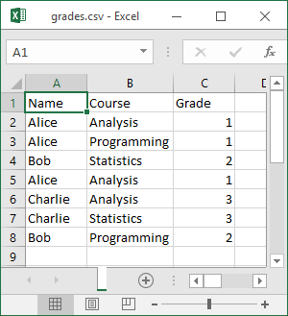
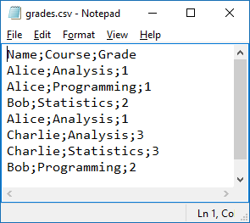
Reading an Excel generated CSV file
average.py
import csv with open('grades.csv') as file: data = csv.reader(file, delimiter=';') # data = iterator over the rows header = next(data) # ['Name', 'Course', 'Grade'] count = {} total = {} for row in data: # iterate over data rows course = row[header.index('Course')] grade = int(row[header.index('Grade')]) count[course] = count.get(course, 0) + 1 total[course] = total.get(course, 0) + grade print('Average grades:') width = max(map(len, count)) # maximum course name length for course in count: print(f'{course:>{width}s} : {total[course] / count[course]:.2f}')
Python shell
Average grades: Analysis : 1.67 Programming : 1.50 Statistics : 2.50
Saving a file in Excel as CSV (Comma delimited) (*.csv)
Sometimes use ‘;’ as default separator, determined by Windows Regional settings
Notes:
Fun fact: Saving “comma” separated in Excel uses semi-colon ☺
grade : remember to convert to int
Use ”.get” to allow undefined entries and get a default value (could also have used a "defaultdict")
Excel > File > Options > Advanced

Slide 7
CSV files - Quoting
csv-quoting.py
import csv import sys data = [[1, 1.0, '1.0'], ['abc', '"', '\t"', ',']] quoting_options = [(csv.QUOTE_MINIMAL, 'QUOTE_MINIMAL'), (csv.QUOTE_ALL, 'QUOTE_ALL'), (csv.QUOTE_NONNUMERIC, 'QUOTE_NONNUMERIC'), (csv.QUOTE_NONE, 'QUOTE_NONE')] for quoting, name in quoting_options: print(name) csv_out = csv.writer(sys.stdout, quoting=quoting, escapechar='\\') for row in data: csv_out.writerow(row)
Python shell
QUOTE_MINIMAL # cannot distinguish 1.0 and "1.0" 1,1.0,1.0 abc,""""," ""","," QUOTE_ALL # cannot distinguish 1.0 and "1.0" "1","1.0","1.0" "abc",""""," ""","," QUOTE_NONNUMERIC 1,1.0,"1.0" "abc",""""," ""","," QUOTE_NONE # cannot distinguish 1.0 and "1.0" 1,1.0,1.0 abc,\", \",\,
The amount of quoting is controlled with keyword argument quoting
csv.QUOTE_MINIMALetc. can be used to select the quoting level
Depending on choice of quoting, numeric values and strings cannot be distinguished in CSV file (csv.reader will read all as strings anyway)
Notes:
Since the columns in csv files have a given type by the application using the csv file, it might not be a problem not to be able to differentiate between numbers and strings containing numbers
csv.QUOTE_... are just integers

Slide 8
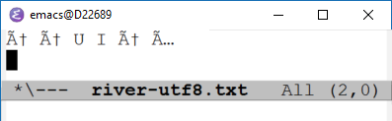
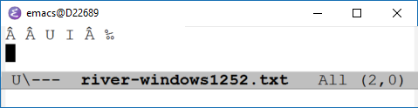
File encodings...
river-utf8.py (size 17 bytes, encoding UTF-8)
Æ Æ U I Æ Å
river-windows1252.py (size 13 bytes, encoding Windows-1252)
Æ Æ U I Æ Å
Text files can be encoded using many different encodings (UTF-8, UTF-16, UTF-32, Windows-1252, ANSI, ASCII, ISO-8859-1, ...)
Different encodings can result in different file sizes, in particular when containing non-ASCII symbols
Programs often try to predict the encoding of text files (often with success, but not always)
Opening files assuming wrong encoding can give strange results....
Opening UTF-8 encoded file but trying to decode using Windows-1252
Opening Windows-1252 encoded file but trying to decode using UTF-8
en.wikipedia.org/wiki/Character_encoding
Notes:
Notepad on Windows can e.g. tell you a file encoding when you select ”Save as”
Online tools can also do it
Python packages also exist
Longer string ”Æ Æ U Å Æ Ø I Æ Å, Æ Æ!”
EMACS:
Ctrl-h v buffer-file-coding-system (describe current buffers encoding)
M-x set-buffer-file-coding-system (before saving)
M-x revert-buffer-with-coding-system (on already open buffer, but with wrong encoding)

Slide 9
encoding.py
for filename in ['river-utf8.txt', 'river-windows1252.txt']: print(filename) f = open(filename, 'rb') # open input in binary mode, default = text mode = 't' line = f.readline() # type(line) = bytes = immutable list of integers in 0..255 print(line) # byte literals look like strings, prefixed 'b' print(list(line)) # print bytes as list of integers f = open(filename, 'r', encoding='utf-8') # try to open file as UTF-8 line = f.readline() # fails if input line is not utf-8 print(line)
Python shell
river-utf8.txt b'\xc3\x86 \xc3\x86 U I \xc3\x86 \xc3\x85\r\n' # \x = hexadecimal value follows [195, 134, 32, 195, 134, 32, 85, 32, 73, 32, 195, 134, 32, 195, 133, 13, 10] Æ Æ U I Æ Å river-windows1252.txt b'\xc6 \xc6 U I \xc6 \xc5\r\n' [198, 32, 198, 32, 85, 32, 73, 32, 198, 32, 197, 13, 10] UnicodeDecodeError: 'utf-8' codec can't decode byte 0xc6 in position 0: invalid continuation byte 'Æ Æ U I Æ Å'.encode('utf8') # convert string to (an immutable array of) bytes b'\xc3\x86 \xc3\x86 U I \xc3\x86 \xc3\x85' 'Æ Æ U I Æ Å'.encode('utf8').decode('Windows-1252') # decode bytes to string 'Ã† Ã† U I Ã† Ã…'
river-utf8.py
Æ Æ U I Æ Å
Notes:
list('abc') vs list(b'abc'), to create byte array bytes([97, 98, 99])
”Æ” requires two bytes in utf-8 but only one in wi,ndows1252
>>> 'Æ' < 'Å'
False
>>> 'Æ' > 'Å'
True
>>>

Slide 10
Reading CSV files with specific encoding
read_shopping.py
import csv with open('shopping.csv', encoding='Windows-1252') as file: for article, amount in csv.reader(file): print('Buy', amount, article)
Python shell
Buy 2 æbler Buy 4 pærer Buy 3 jordbær Buy 10 gulerødder
shopping.csv
æbler,2 pærer,4 jordbær,3 gulerødder,10
CSV file saved with Windows-1252 encoding

Slide 11
JSON
“JSON (JavaScript Object Notation) is a lightweight data-interchange format. It is easy for humans to read and write. It is easy for machines to parse and generate. It is based on a subset of the JavaScript Programming Language, Standard ECMA-262 3rd Edition - December 1999. JSON is an ideal data-interchange language.”
www.json.org
Human readable file format
Easy way to save a Python expression to a file
Does not support all Python types, e.g. sets are not supported, and tuples are saved (and later loaded) as lists

Slide 12
JSON example
json-data.json
[ [ null, true ], [ 42.7, [ 42 ] ], [ 3, 2, 4 ], [ 5, 6, 7 ], { "a": "apple", "b": "banana", "c": "coconut" } ]
json-example.py
import json FILE = 'json-data.json' data = ((None, True), (42.7, (42,)), [3, 2, 4], (5, 6, 7), {'b':'banana', 'a':'apple', 'c': 'coconut'}) with open(FILE, 'w') as outfile: json.dump(data, outfile, indent=2, sort_keys=True) with open(FILE) as infile: indata = json.load(infile) print(indata)
Python shell
[[None, True], [42.7, [42]], [3, 2, 4], [5, 6, 7], {'a': 'apple', 'b': 'banana', 'c': 'coconut'}]
Notes:
import sys
import json
json.dump({'a':42, 42:'a'}, sys.stdout, indent=1, sort_keys=True)
(In Javascript None is called “null”, and “true” and “false” are not capitalized, no line breaks in strings)

Slide 13
XML - eXtensible Markup Language
cities.xml
<?xml version="1.0"?> <world> <country name="Denmark"> <city name="Aarhus" pop="264716"/> <city name="Copenhagen" pop="1295686"/> </country> <country name="USA"> <city name="New York" pop="8622698"/> <city name="San Francisco" pop="884363"/> </country> </world>
XML is a widespread used data format to store hierarchical data with tags and attributes
world
docs.python.org/3/library/xml.html
country
{name: 'Denmark'}
country
{name: 'USA'}
city
{name: 'Aarhus', pop: '264716'}
city
{name: 'Copenhagen', pop: '1295686'}
city
{name: 'New York', pop: '8622698'}
city
{name: 'San Francisco', pop: '884363'}
Notes:
Example: street maps exported from https://www.openstreetmap.org are XML files (have extension ".osm")

Slide 14
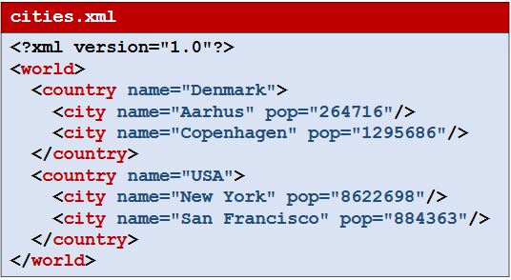
xml-example.py
import xml.etree.ElementTree as ET FILE = 'cities.xml' tree = ET.parse(FILE) # parse XML file to internal representation root = tree.getroot() # get root element for country in root: for city in country: print(city.attrib['name'], # get value of attribute for an element 'in', country.attrib['name'], 'has a population of', city.attrib['pop']) print(root.tag, root[0][1].attrib) # the tag & indexing the children of an element print([city.attrib['name'] for city in root.iter('city')]) # .iter finds elements
Python shell
Aarhus in Denmark has a population of 264716 Copenhagen in Denmark has a population of 1295686 New York in USA has a population of 8622698 San Francisco in USA has a population of 884363 world {'name': 'Copenhagen', 'pop': '1295686'} ['Aarhus', 'Copenhagen', 'New York', 'San Francisco']
Notes:
.iter takes tag type

Slide 15
XML tags with text
city-descriptions.xml
<?xml version="1.0"?> <world> <country name="Denmark"> <city name="Aarhus" pop="264716">The capital of Jutland</city> <city name="Copenhagen" pop="1295686">The capital of Denmark</city> </country> <country name="USA"> <city name="New York" pop="8622698">Known as Big Apple</city> <city name="San Francisco" pop="884363">Home of the Golden Gate Bridge</city> </country> </world>
xml-descriptions.py
import xml.etree.ElementTree as ET FILE = 'city-descriptions.xml' tree = ET.parse(FILE) root = tree.getroot() for city in root.iter('city'): print(city.get('name'), '-', city.text)
Python shell
Aarhus - The capital of Jutland Copenhagen - The capital of Denmark New York - Known as Big Apple San Francisco - Home of the Golden Gate Bridge
Notes:
above ”.get()” is used instead of ”attrib[]”.
.attrib is a dictionary (type dict)
.get returns default value (None) if attribute does not exist

Slide 16
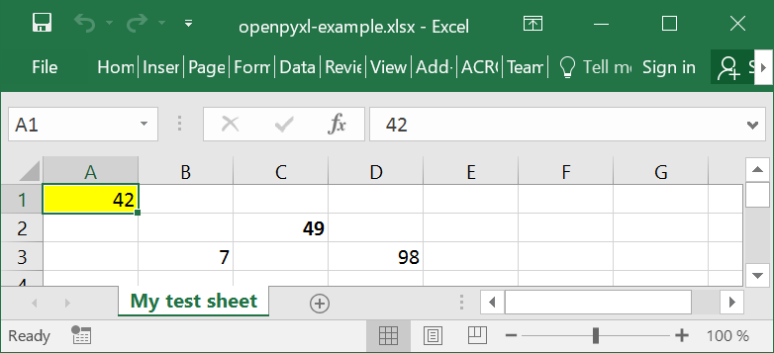
Openpyxl - Microsoft Excel 2010 manipulation
openpyxl-example.py
from openpyxl import Workbook from openpyxl.styles import Font, PatternFill wb = Workbook() # create workbook ws = wb.active # active worksheet ws['A1'] = 42 ws['B3'] = 7 ws['C2'] = ws['A1'].value + ws['B3'].value ws['D3'] = '=A1+B3+C2' ws.title = 'My test sheet' ws['A1'].fill = PatternFill('solid', fgColor='ffff00') ws['C2'].font = Font(bold=True) wb.save('openpyxl-example.xlsx')
openpyxl.readthedocs.io/en/stable/tutorial.html
Notes:
An .xlsx file is really a zip file containing a folder with a lot of xml files
EXCEL files allow formatting opposed to a simple .csv file
Example: openpyxl-example/xl/worksheets/sheet1.xml

Slide 17
String searching using find
Search for first occurence of substring in str[start, end]
str.find(substring[, start[, end]])
Returns -1 if no occurence found.
.index similar as .find, except raises ValueError exception if substring not found
string-search.py
text = 'this is a string - a list of characters' pattern = 'is' idx = text.find(pattern) while idx >= 0: print(idx, end=' ') idx = text.find(pattern, idx + 1)
Python shell
2 5 22
docs.python.org/3/library/stdtypes.html#textseq

Slide 18
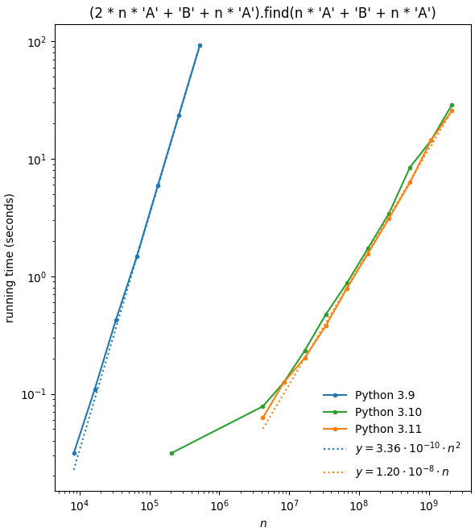
Is str.find fast?
Typically linear
Until Python 3.9 in some cases quadractic
"A^{2n}BA^{n}".find("A^{n}BA^{n}")
docs.python.org/3/whatsnew/3.10.html ”Substring search functions such as str1 in str2 and str2.find(str1) now sometimes use Crochemore & Perrin’s “Two-Way” string searching algorithm to avoid quadratic behavior on long strings.”
Notes:
Python 3.10.8 vs 3.9.7 timings: 3.9 had quadratic time on ”bad example”
Python 3.9 was released in 2020, but already back in 1977 (Knuth-Morris-Pratt) it was known how to support find in worst-case linear time – but the Python developers had prioritized typical performance over worst-case performance.
Timings below 10⁻¹ seconds noisy
https://docs.python.org/3/whatsnew/3.10.html
Substring search functions such as str1 in str2 and str2.find(str1) now sometimes use Crochemore & Perrin’s “Two-Way” string searching algorithm to avoid quadratic behavior on long strings.

Slide 19
Regular expression – A powerful language to describe sets of strings
Examples
abc denotes a string of letters
ab*c any string starting with a, followed by an arbitrary number of bs and terminated by c, i.e. {ac, abc, abbc, abbbc, abbbbc, ...}
ab+c equivalent to abb*c, i.e. there must be at least one b
a\wc any three letter string, starting with a and ending with c, where second character is any character in [a-zA-Z0-9_]
a[xyz]c any three letter string, starting with a and ending with c, where second character is either x, y or z
a[^xyz]c any three letter string, starting with a and ending with c, where second character is none of x, y or z
^xyz match at start of string (prefix)
xyz$ match at end of string (suffix)
...
See docs.python.org/3/library/re.html for more
Notes:
Example: find substring that is part of word (i.e. letters before and after)
Regular expressions e.g. also supported by overleaf

Slide 20
String searching using regular expressions
re.search(pattern, text)
find the first occurence of pattern in text – returns None or a match object
re.findall(pattern, text)
returns a list of non-overlapping occurence of pattern in text – returns a list of substrings
re.finditer(pattern, text)
iterator returning a match object for each non-overlapping occurence of pattern in text
Python shell
import re text = 'this is a string - a list of characters' re.findall(r'i\w*', text) # prefix with 'r' for raw string literal ['is', 'is', 'ing', 'ist'] for m in re.finditer(r'a[^at]*t', text): # m is a match object print(f'text[{m.start()}, {m.end()}] = {m.group()}') text[8, 12] = a st text[19, 25] = a list text[33, 36] = act
docs.python.org/3/library/re.html
Notes:
raw string literals do not need to escape \ to get a \
> '\s\n', r'\s\n'
('\\s\n', '\\s\\n’)

Slide 21
Substitution and splitting using regular expressions
re.sub(pattern, replacement, text)
replace any occurence of the pattern in text by replacement
re.split(pattern, text)
split text at all occurences of patern
Python shell
text = 'this is a string - a list of characters' re.sub(r'\w*i\w*', 'X', text) # replace all words containing i by 'X' 'X X a X - a X of characters' re.sub(r'\w*i\w*', lambda m: m.group()[::-1], text) # reverse words containing i 'siht si a gnirts - a tsil of characters' re.split(r'[^\w]+a[^\w]+', text) # split around word 'a' ['this is', 'string', 'list of characters']
docs.python.org/3/library/re.html
Notes:
Regular expression substitution is useful when str.replace is to restricted
'abcd'.replace('bc', 'BC')
re.sub can take a callable as the replace argument

Slide 22
Regular expression substitution: \b \w \1 \2 ...
Assume we want to replace ”a” with ”an” in front of words starting with the vowels a, e, i, o and u.
Python shell
txt = 'A elephant, a zebra and a ape' # two places to correct re.sub('a', 'an', txt) # same as txt.replace('a', 'an') 'A elephannt, an zebran annd an anpe' # replaces all letters 'a' with 'an' re.sub(r'\ba\b', 'an', txt) # raw string + \b boundary of word 'A elephant, an zebra and an ape' # all lower 'a' replaced re.sub(r'\b[aA]\b', 'an', txt) 'an elephant, an zebra and an ape' # both 'a' and 'A' replaced by 'an' re.sub(r'\b([aA])\b', r'\1n', txt) # use () and \1 to reinsert match 'An elephant, an zebra and an ape' # kept 'a' and 'A' re.sub(r'\b([aA])\s+[aeiou]', r'\1n', txt) # \s+ = one or more whitespace 'Anlephant, a zebra and anpe' # missing original whitespace + vowel re.sub(r'\b([aA])(\s+[aeiou])', r'\1n\2', txt) # reinsert both () using \1 \2 'An elephant, a zebra and an ape'
Notes:
Many text editing systems allow the usage of regular expressions to some extend: overleaf, emacs, microsoft word (although with own nonstandard syntax), google docs

Slide 23
Fun with strings: Lindenmayer systems (L-systems)
L_system.py
S = 'A' # axiom rules = {'A': 'AB', 'B': 'A'} for i in range(8): S = ''.join(rules.get(c, c) for c in S) print(S)
Python shell
AB ABA ABAAB ABAABABA ABAABABAABAAB ABAABABAABAABABAABABA ABAABABAABAABABAABABAABAABABAABAAB
Axiom A
(1) AB
(2) ABA
(3) ABAAB
(4) ABAABABA
Rules
A → AB
B → A
First four iterations of parallel rewriting
“L-systems were introduced and developed in 1968 by Aristid Lindenmayer, a Hungarian theoretical biologist and botanist at the University of Utrecht. Lindenmayer used L-systems to describe the behaviour of plant cells and to model the growth processes of plant development.”
- Wikipedia
en.wikipedia.org/wiki/L-system

Slide 24
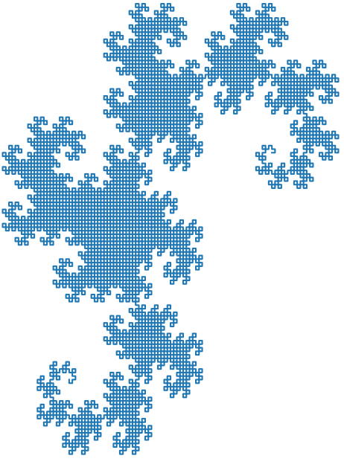
Heighway Dragon
dragon.py
import matplotlib.pyplot as plt from math import sin, cos, radians axiom = 'FX' rules = {'X': 'X+YF+', 'Y': '-FX-Y'} def apply_rules(axiom, rules, repeat): for _ in range(repeat): axiom = ''.join(rules.get(symbol, symbol) for symbol in axiom) return axiom def walk(commands, position=(0, 0), angle=0, turn=90): path = [position] for move in commands: if move == 'F': position = (position[0] + cos(radians(angle)), position[1] + sin(radians(angle))) path.append(position) elif move == '-': angle -= turn elif move == '+': angle += turn return path path = walk(apply_rules(axiom, rules, 13)) plt.plot(*zip(*path), '-') plt.title('Heighway dragon') plt.show()
Interprete the symbols of the resulting string as a walk where 'F' = draw line forward, and '+' and '-' are turn left and right 90° (X and Y are skipped)
FX+YF++-FX-YF++-FX+YF+--FX-YF++-FX+YF++-FX-YF+--FX+YF+--FX-YF++-FX+YF++-FX-YF++-FX+YF+--FX-YF+--FX+YF++-FX-YF+--FX+YF+--FX-YF++-FX+YF++-FX-YF++-FX+YF+--FX-YF++-FX+YF++-FX-YF+--FX+YF+--FX-YF+--FX+YF++-FX-YF++-FX+YF+--FX-YF+--FX+YF++-FX-YF+--FX+YF+--FX-YF++-FX+YF++-FX-YF++-FX+YF+--FX-YF++-FX+YF++-FX-Y

Slide 25
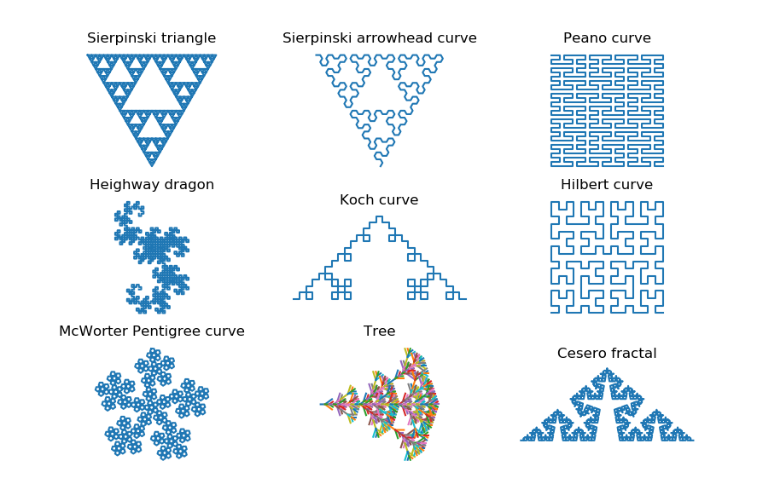
More space filling curves...
Axiom F-G-G F → F-G+F+G-F G→ GG Forward F and G Turns 120° | Axiom A A → B-A-B B → A+B+A Forward A and B Turns 60° | Axiom L L → LFRFL-F-RFLFR+F+LFRFL R→ RFLFR+F+LFRFL-F-RFLFR
Axiom FX X → X+YF+ Y → -FX-Y | Axiom F F → F+F-F-F+F | Axiom L L → +RF-LFL-FR+ R → -LF+RFR+FL-
Axiom F-F-F-F-F F → F-F-F++F+F-F Turns 72° | Axiom F F → F[+FF][-FF]F[-F][+F]F Turns 36° [ and ] return to start point when done | Axiom F F → F+F--F+F Turns 80°
Notes:
For “Tree” each “[“ starts a new path with a new color...

Slide 26
More space filling curves... (source code)
space-filling-L_systems.py
import matplotlib.pyplot as plt from math import sin, cos, radians def walk(commands, pos=(0, 0), forward=frozenset('F'), angle=0, turn=90): paths = [[pos]] stack = [] for move in commands: if move in forward: pos = (pos[0]+cos(radians(angle)), pos[1]+sin(radians(angle))) paths[-1].append(pos) elif move == '-': angle -= turn elif move == '+': angle += turn elif move == '[': stack.append((pos, angle)) elif move == ']': pos, angle = stack.pop() paths.append([pos]) return paths | def apply_rules(axiom, rules, repeat=1): for _ in range(repeat): axiom = ''.join(rules.get(symbol, symbol) for symbol in axiom) return axiom curves = [ # Lindenmayer systems (L-systems) ('Sierpinski triangle', 'F-G-G', {'F': 'F-G+F+G-F', 'G': 'GG'}, 5, {'turn': 120, 'forward': {'F','G'}}), ('Sierpinski arrowhead curve', 'A', {'A': 'B-A-B', 'B': 'A+B+A'}, 5, {'turn': 60, 'forward': {'A','B'}}), ('Peano curve', 'L', {'L': 'LFRFL-F-RFLFR+F+LFRFL', 'R': 'RFLFR+F+LFRFL-F-RFLFR'}, 3, {}), ('Heighway dragon','FX', {'X': 'X+YF+', 'Y': '-FX-Y'}, 10, {}), ('Koch curve', 'F', {'F': 'F+F-F-F+F'}, 3, {}), ('Hilbert curve', 'L', {'L': '+RF-LFL-FR+', 'R': '-LF+RFR+FL-'}, 4, {}), ('McWorter Pentigree curve', 'F-F-F-F-F', {'F': 'F-F-F++F+F-F'}, 3, {'turn': 72}), ('Tree', 'F', {'F': 'F[+FF][-FF]F[-F][+F]F'}, 3, {'turn': 36}), ('Cesero fractal', 'F', {'F': 'F+F--F+F'}, 5, {'turn': 80}) ] for idx, (title, axiom, rules, repeat, walk_arg) in enumerate(curves, start=1): paths = walk(apply_rules(axiom, rules, repeat), **walk_arg) ax = plt.subplot(3, 3, idx, aspect='equal') ax.set_title(title) for path in paths: plt.plot(*zip(*path), '-') plt.axis('off') plt.show()

