Slide 1
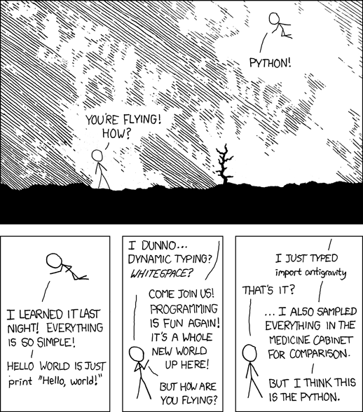
Modules and packages
import – from – as
__name__, '__main__'
heapq
docs.python.org/3/tutorial/modules.html
xkcd.com/353
Notes:
'import antigravity' open this xkcd webpage

Slide 2
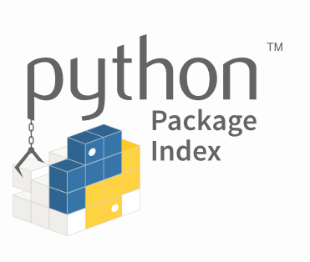
Python modules and packages
A Python module is a module_name.py file containing Python code
A Python package is a collection of modules
Why do you need modules ?
A way to structure code into smaller logical units
Encapsulation of functionality
Reuse of code in different programs
Your can write your own modules and packages or use any of the +600.000 existing packages from pypi.org
The Python Standard Library consists of the modules listed on docs.python.org/3/library
Notes:
earlier ways to structure code:
functions
classes

Slide 3
Defining and importing a module
mymodule.py
'''This is a 'print something' module.''' from random import choice print('Running my module') def print_something(n): W = ['Eat', 'Sleep', 'Rave', 'Repeat'] print(' '.join(choice(W) for _ in range(n))) def the_name(): print(f'__name__ = "{__name__}"')
using_mymodule.py
import mymodule mymodule.the_name() mymodule.print_something(5) from mymodule import print_something print_something(5)
Python shell
Running my module __name__ = "mymodule" Eat Sleep Sleep Sleep Rave Eat Sleep Rave Repeat Sleep
A module is only run once when imported several times

Slide 4
Some modules mentioned in the course
Module (example functions) | Description
math (pi sqrt ceil log sin) | basic math
random (random randint) | random number generator
numpy (array shape) | multi-dimensional data
pandas | data tables
SQLlite | SQL database
scipy scipy.optimize (minimize linprog) scipy.spatial (ConvexHull) | mathematical optimization
matplotlib matplotlib.pyplot (plot show style) matplotlib.backends.backend_pdf (PdfPages) mpl_toolkits.mplot3d (Axes3D) | plotting data print plots to PDF 3D plot tools
doctest (testmod) unittest (assertEqual assertTrue) | testing using doc strings unit testing
time (time) datetime (date.today) | current time, coversion of time values
timeit (timeit) | time execution of simple code
heapq | use a list as a heap
Module (example functions) | Description
functools (cache lru_cache total_ordering) | higher order functions and decorators
itertools (islice permutations) | Iterator tools
collections (Counter deque) | datat structures for collections
builtins | module containing the Python builtins
os (path) | operating system interface
sys (argv path) | system specific functions
Tkinter PyQt | graphic user interface
xml | xml files (eXtensible Markup Language)
json | JSON (JavaScript Object Notation) files
csv | comma separated files
openpyxl | EXCEL files
re | regular expression, string searching
string (split join lower ascii_letters digits) | string functions

Slide 5

Ways of importing modules
import.py
# Import a module name in the current namespace # All definitions in the module are available as <module>.<name> import math print(math.sqrt(2)) # Import only one or more specific definitions into current namespace from math import sqrt, log, ceil print(ceil(log(sqrt(100), 2))) # Import specific modules/definitions from a module into current namespace under new names from math import sqrt as kvadratrod, \ log as logaritme # long import line broken onto multiple lines import matplotlib.pyplot as plt print(logaritme(kvadratrod(100))) # Import all definitions form a module in current namespace # Deprecated, since unclear what happens to the namespace from math import * print(pi) # where did 'pi' come from?
Python shell
1.4142135623730951 4 2.302585092994046 3.141592653589793
m.py
m/__init__.py
m/__main__.py
Notes:
'from <module> import ....' will automatically load the full module, if it has not already been loaded

Slide 6
__all__ vs import *
A module can control what is imported by import * by defining __all__
all.py
__all__ = ['f'] def f(): print('this is f') def g(): print('this is g')
Python shell
import all all.f() this is f all.g() this is g from all import * f() this is f g() NameError: name 'g' is not defined
Python shell
min <built-in function min> sum <built-in function sum> import numpy numpy.min <function min at 0x0000024E5DAC71F0> numpy.sum <function sum at 0x0000024E5DAC5D70> from numpy import * min <function min at 0x0000024E5DAC71F0> sum <function sum at 0x0000024E5DAC5D70> numpy.__all__ [..., 'min', ..., 'sum', ...] # len(numpy.__all__) == 500
Notes:
numpy defines __all__
matplotlib also but matplotlib.pyplot not

Slide 7
Performance of different ways of importing
sqrt_performance.py
from time import time import math start = time() x = sum(math.sqrt(x) for x in range(10000000)) end = time() print('math.sqrt', end - start) from math import sqrt start = time() x = sum(sqrt(x) for x in range(10000000)) end = time() print('from math import sqrt', end - start) def test(sqrt=math.sqrt): # abuse of keyword argument start = time() x = sum(sqrt(x) for x in range(10000000)) end = time() print('bind sqrt to keyword argument', end - start) test()
Python shell
math.sqrt 4.05187726020813 from math import sqrt 3.5011463165283203 bind sqrt to keyword argument 3.261594772338867
from math import sqrt
appears to be faster than
math.sqrt
Notes:
math.sqrt slowest
Could also use a local variable instead of a keyword argument. Performance about the same.

Slide 8
Listing definitions in a module: dir(module)
Python shell
import math import matplotlib.pyplot as plt dir(math) ['__doc__', '__loader__', '__name__', '__package__', '__spec__', 'acos', 'acosh', 'asin', 'asinh', 'atan', 'atan2', 'atanh', 'ceil', 'copysign', 'cos', 'cosh', 'degrees', 'e', 'erf', 'erfc', 'exp', 'expm1', 'fabs', 'factorial', 'floor', 'fmod', 'frexp', 'fsum', 'gamma', 'gcd', 'hypot', 'inf', 'isclose', 'isfinite', 'isinf', 'isnan', 'ldexp', 'lgamma', 'log', 'log10', 'log1p', 'log2', 'modf', 'nan', 'pi', 'pow', 'radians', 'sin', 'sinh', 'sqrt', 'tan', 'tanh', 'tau', 'trunc'] help(math) Help on built-in module math: NAME math DESCRIPTION ...
https://docs.python.org/3/library/functions.html#dir
Notes:
Warning: dir is not necessarily the full list – it is just trying to generate a meaningfull list; technically it
calls the __dir__ method
set(numpy.__dir__()) - set(numpy.__all__)

Slide 9
__name__
double.py
'''Module double.''' def f(x): ''' Some doc test code: >>> f(21) 42 >>> f(7) 14 ''' return 2 * x print(f'{__name__ = }') if __name__ == '__main__': import doctest doctest.testmod(verbose=True)
Python shell
__name__ = __main__ ... 2 passed and 0 failed. Test passed.
using_double.py
import double print(f'{__name__ = }') print(double.f(5))
Python shell
__name__ = 'double' __name__ = '__main__' 10
The variable __name__ contains the name of the module, or '__main__' if the file is run as the main file by the interpreter
Can e.g. be used to test a module if the module is run independently

Slide 10
module importlib
a_constant.py
the_constant = 7
Python shell
import a_constant # import module a_constant.the_constant 7 from a_constant import the_constant the_constant 7 # Update 7 to 42 in a_constant.py a_constant.the_constant # new value not reflected 7 import a_constant # void, module already loaded a_constant.the_constant 7 # unchanged import importlib importlib.reload(a_constant) <module 'a_constant' from 'C:\\...\\a_constant.py'> a_constant.the_constant 42 the_constant 7 # imported attributes are not updated by reload from a_constant import the_constant # force update the_constant 42 # the new value
Implements the import statement (Python internal implementation details)
importlib.reload(module)
Reloads a previously imported module. Relevant if you have edited the code for the module and want to load the new version in the Python interpreter, without restarting the full program from scratch.

Slide 11
Packages
A package is a collection of modules (and subpackages) in a folder = package name
Only folders having an __init__.py file are considered packages
The __init__.py can be empty, or contain code that will be loaded when the package is imported, e.g. importing specific modules
mypackage/__init__.py
mypackage/a.py
print('Loading mypackage.a') def f(): print('mypackage.a.f')
using_mypackage.py
import mypackage.a mypackage.a.f()
Python shell
Loading mypackage.a mypackage.a.f

Slide 12
A package with a subpackage
mypackage/__init__.py
print('loading mypackage')
mypackage/a.py
print('Loading mypackage.a') def f(): print('mypackage.a.f')
mypackage/mysubpackage/__init__.py
print('loading mypackage.mysubpackage') import mypackage.mysubpackage.b
mypackage/mysubpackage/b.py
print('Loading mypackage.mysubpackage.b') def g(): print('mypackage.mysubpackage.b.g')
using_mysubpackage.py
import mypackage.a mypackage.a.f() import mypackage.mysubpackage mypackage.mysubpackage.b.g() from mypackage.mysubpackage.b import g g()
Python shell
loading mypackage Loading mypackage.a mypackage.a.f loading mypackage.mysubpackage Loading mypackage.mysubpackage.b mypackage.mysubpackage.b.g mypackage.mysubpackage.b.g

Slide 13
__pycache__ folder
When Python loads a module the first time it is compiled to some intermediate code, and stored as a .pyc file in the __pycache__ folder.
If a .pyc file exists for a module, and the .pyc file is newer than the .py file, then import loads .pyc – saving time to load the module (but does not make the program itself faster)
It is safe to delete the __pycache__ folder – but it will be created again next time a module is loaded

Slide 14
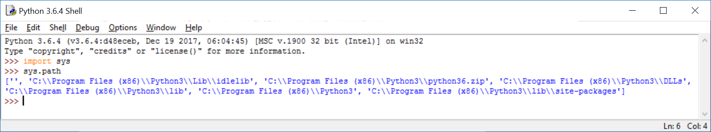
Path to modules
Python searches the following folders for a module in the following order:
The directory containing the input script / current directory
Environment variable PYTHONPATH
Installation defaults
The function path in the modul sys returns a list of the paths

Slide 15
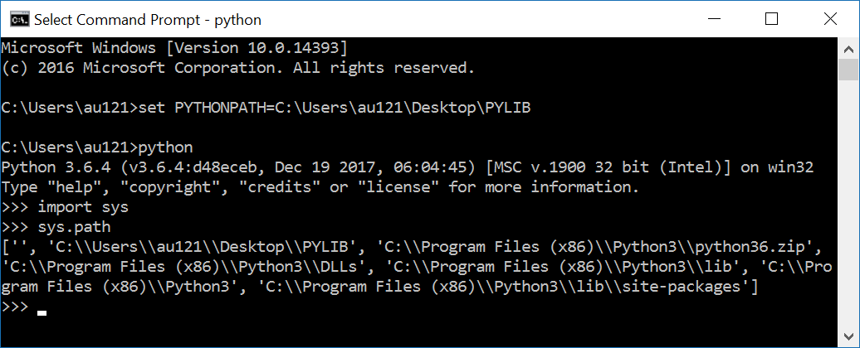
Setting PYTHONPATH from windows shell
set PYTHONPATH=paths separated by semicolon (only valid until shell is closed)
Notes:
Why double-\ (since Python string)

Slide 16
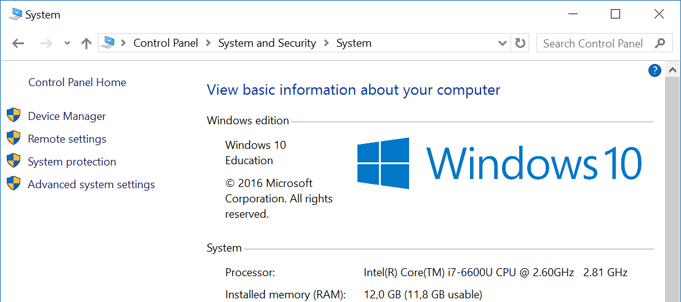
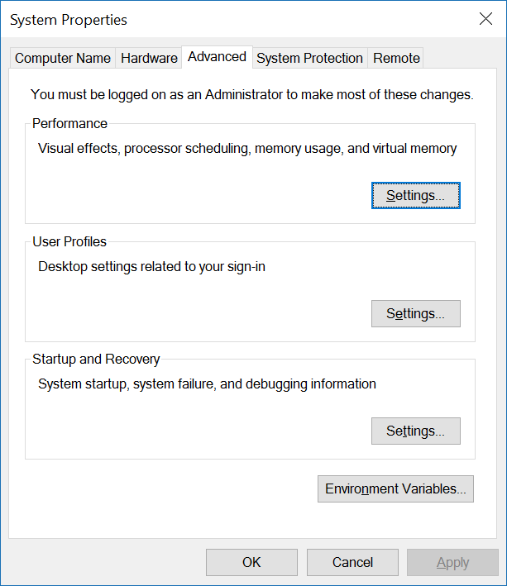
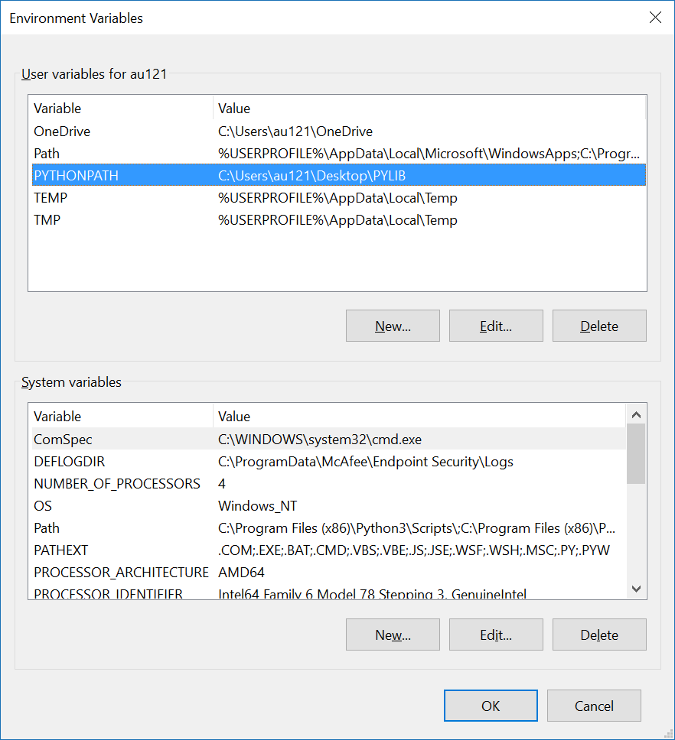
Setting PYTHONPATH from control panel
Control panel > System > Advanced system settings > Environment Variables > User variables > Edit or New PYTHONPATH
Notes:
Open "control panel" and search for "environment variables"

Slide 17
Python shell
import this The Zen of Python, by Tim Peters Beautiful is better than ugly. Explicit is better than implicit. Simple is better than complex. Complex is better than complicated. Flat is better than nested. Sparse is better than dense. Readability counts. Special cases aren't special enough to break the rules. Although practicality beats purity. Errors should never pass silently. Unless explicitly silenced. In the face of ambiguity, refuse the temptation to guess. There should be one-- and preferably only one --obvious way to do it. Although that way may not be obvious at first unless you're Dutch. Now is better than never. Although never is often better than *right* now. If the implementation is hard to explain, it's a bad idea. If the implementation is easy to explain, it may be a good idea. Namespaces are one honking great idea -- let's do more of those!
www.python.org/dev/peps/pep-0020/

Slide 18
module heapq (Priority Queue)
heap.py
import heapq from random import random H = [] # a heap is just a list for _ in range(10): heapq.heappush(H, random()) while True: x = heapq.heappop(H) print(x) heapq.heappush(H, x + random())
Python shell
0.20569933892764458 0.27057819339616174 0.31115615362876237 0.4841062272152259 0.5054280956005357 0.509387117524076 0.598647195480462 0.7035150735555027 0.7073929685826221 0.7091224012815325 0.714213496127318 0.727868481291271 0.8051275413759873 0.8279523767282903 0.8626022363202895 0.9376631236263869 0.9378490058037452 1.0444967889759456
Implements a binary heap (Williams 1964).
Stores a set of elements in a standard list, where arbitrary elements can be inserted efficiently and the smallest element can be extracted efficiently
heapq.heappush
heapq.heappop
docs.python.org/3/library/heapq.html
J. W. J. Williams. Algorithm 232: Heapsort. Communications of the ACM (1964)
Notes:
Used by scheduling exercise
queue.PriorityQueue is an alternative priority queue that supports concurrent processes

Slide 19
Valid heap
Python shell
from random import randint L = [randint(1, 20) for _ in range(10)] L # just random numbers [18, 1, 15, 17, 4, 14, 11, 3, 4, 9] import heapq heapq.heapify(L) # make L a valid heap L [1, 3, 11, 4, 4, 14, 15, 17, 18, 9] print(heapq.heappop(L)) 1 L [3, 4, 11, 4, 9, 14, 15, 17, 18] heapq.heappush(L, 7) L [3, 4, 11, 4, 7, 14, 15, 17, 18, 9]
A valid heap satisfies for all i:
L[i] ≤ L[2∙i +1] and L[i] ≤ L[2∙i + 2]
heapify(L) rearranges the elements in a list to make the list a valid heap
J. W. J. Williams. Algorithm 232: Heapsort. Communications of the ACM (1964)

Slide 20
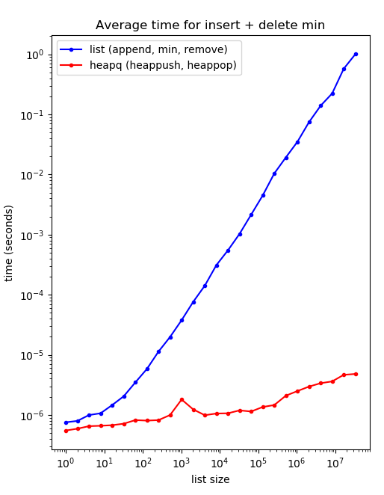
Why heapq ?
min and remove on a list take linear time (runs through the whole list)
heapq supports heappush and heappop in logarithmic time
For lists of length 30.000.000 the performance gain is a factor 200.000
J. W. J. Williams. Algorithm 232: Heapsort. Communications of the ACM (1964)

Slide 21
heap_performance.py (generating plot on previous slide)
import heapq from random import random import matplotlib.pyplot as plt from time import time import gc # garbage collection size = [] time_heap = [] time_list = [] for i in range(26): n = 2 ** i size.append(n) L = [random() for _ in range(n)] R = max(1, 2 ** 23 // n) gc.collect() start = time() for _ in range(R): L.append(random()) x = min(L) L.remove(x) end = time() time_list.append((end - start) / R) | L = None # avoid MemoryError L = [random() for _ in range(n)] heapq.heapify(L) # make L a legal heap gc.collect() start = time() for _ in range(100000): heapq.heappush(L, random()) x = heapq.heappop(L) end = time() time_heap.append((end - start) / 100000) plt.title('Average time for insert + delete min') plt.xlabel('list size') plt.ylabel('time (seconds)') plt.plot(size, time_list, 'b.-', label='list (append, min, remove)') plt.plot(size, time_heap, 'r.-', label='heapq (heappush, heappop)') plt.xscale('log') plt.yscale('log') plt.legend() plt.show()
A
B
B
Avoid out of memory error for largest experiment, by allowing old L to be garbage collected
Reduce noise in experiments by forcing Python garbage collection before measurement
A
B

