Slide 1
Dynamic programming
memoization
decorator memoized / functools.cache
systematic subproblem computation

Slide 2
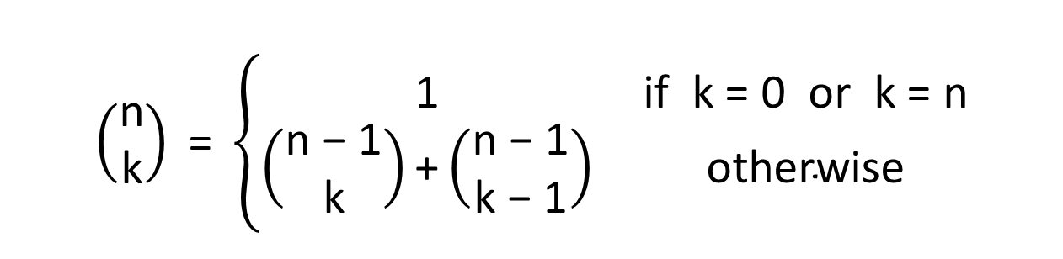
Binomial coefficient
--(7, 5)
|--(6, 5)
| |--(5, 5)
| --(5, 4)
| |--(4, 4)
| --(4, 3)
| |--(3, 3)
| --(3, 2)
| |--(2, 2)
| --(2, 1)
| |--(1, 1)
| --(1, 0)
--(6, 4)
|--(5, 4)
| |--(4, 4)
| --(4, 3)
| |--(3, 3)
| --(3, 2)
| |--(2, 2)
| --(2, 1)
| |--(1, 1)
| --(1, 0)
--(5, 3)
|--(4, 3)
| |--(3, 3)
| --(3, 2)
| |--(2, 2)
| --(2, 1)
| |--(1, 1)
| --(1, 0)
--(4, 2)
|--(3, 2)
| |--(2, 2)
| --(2, 1)
| |--(1, 1)
| --(1, 0)
--(3, 1)
|--(2, 1)
| |--(1, 1)
| --(1, 0)
--(2, 0)
identical computations
$$\left(\begin{matrix}\text{n} \\ \text{k}\end{matrix}\right) \text{= }\left\{\begin{matrix}\text{1} & \text{if} \text{k}\text{ = 0 }\text{or} \text{k}\text{ = }\text{n} \\ \left(\begin{matrix}\text{n}\text{ − 1} \\ \text{k}\end{matrix}\right)\text{+}\left(\begin{matrix}\text{n}\text{ − 1} \\ \text{k}\text{ − 1}\end{matrix}\right) & \text{otherwise}\end{matrix}\right.$$
binomial_recursive.py
def binomial(n, k): if k == 0 or k == n: return 1 return binomial(n - 1, k) + binomial(n - 1, k - 1)
recursion tree for binomial(7,5)
Notes:
Have earlier seen binomial computated by a recursion function, when we introduced recursion
earlier seen this computation is slow (because all leaves of the recursion only returns 1)
Biniomial coefficient = example of recursive computation, where the recursion is on smaller subproblems, and the number of different arguments is limited
Try binomial(100, 50) VERY SLOW!

Slide 3
Dynamic Programming ≡ Remember solutions already found (memoization)
Technique sometimes applicable when running time otherwise becomes exponential
Only applicable if stuff to be remembered is manageable

Slide 4
Binomial Coefficient Dynamic programming using a dictionary
recursion tree for binomial(7,5)
--(7, 5)
|--(6, 5)
| |--(5, 5)
| --(5, 4)
| |--(4, 4)
| --(4, 3)
| |--(3, 3)
| --(3, 2)
| |--(2, 2)
| --(2, 1)
| |--(1, 1)
| --(1, 0)
--(6, 4)
|--(5, 4)
--(5, 3)
|--(4, 3)
--(4, 2)
|--(3, 2)
--(3, 1)
|--(2, 1)
--(2, 0)
binomial_dictionary.py
answers = {} # answers[(n, k)] = binomial(n, k) def binomial(n, k): if (n, k) not in answers: if k == 0 or k == n: answer = 1 else: answer = binomial(n - 1, k) + binomial(n - 1, k - 1) answers[(n, k)] = answer return answers[(n, k)]
Python shell
binomial(6, 3) 20 answers {(3, 3): 1, (2, 2): 1, (1, 1): 1, (1, 0): 1, (2, 1): 2, (3, 2): 3, (4, 3): 4, (2, 0): 1, (3, 1): 3, (4, 2): 6, (5, 3): 10, (3, 0): 1, (4, 1): 4, (5, 2): 10, (6, 3): 20}
Use a dictionary answers to store already computed values
reuse value stored in dictionary answers

Slide 5
Question – What is the order of the size of the dictionary answers after calling binomial(n, k) ?
binomial_dictionary.py
answers = {} # answers[(n, k)] = binomial(n, k) def binomial(n, k): if (n, k) not in answers: if k == 0 or k == n: answer = 1 else: answer = binomial(n - 1, k) + binomial(n - 1, k - 1) answers[(n, k)] = answer return answers[(n, k)]
max(n, k)
n + k
n * k
n^{k}
k^{n}
Don’t know

Slide 6
Binomial Coefficient Dynamic programming using decorator
Use a decorator (@memoize) that implements the functionality of remembering the results of previous function calls
binomial_decorator.py
def memoize(f): # answers[args] = f(*args) answers = {} def wrapper(*args): if args not in answers: answers[args] = f(*args) return answers[args] return wrapper | @memoize def binomial(n, k): if k == 0 or k == n: return 1 else: return binomial(n - 1, k) + binomial(n - 1, k - 1)
www.python-course.eu/python3_memoization.php
Notes:
requires args to be immutable & hashable, since they should be used as keys into a dictionary

Slide 7
binomial_decorator_trace.py | Python shell (without @memoize) | Python shell (with @memoize)
def trace(f): # decorator to trace recursive calls indent = 0 def wrapper(*args): nonlocal indent spaces = '| ' * indent arg_str = ', '.join(map(repr, args)) print(spaces + f'{f.__name__}({arg_str})') indent += 1 result = f(*args) indent -= 1 print(spaces + f'> {result}') return result return wrapper def memoize(f): answers = {} def wrapper(*args): if args not in answers: answers[args] = f(*args) return answers[args] wrapper.__name__ = f.__name__ + '_memoize' return wrapper @trace @memoize def binomial(n, k): if k == 0 or k == n: return 1 return binomial(n - 1, k) + binomial(n-1, k-1) print(binomial(5, 2)) | binomial(5, 2) | binomial(4, 2) | | binomial(3, 2) | | | binomial(2, 2) | | | > 1 | | | binomial(2, 1) | | | | binomial(1, 1) | | | | > 1 | | | | binomial(1, 0) | | | | > 1 | | | > 2 | | > 3 | | binomial(3, 1) | | | binomial(2, 1) | | | | binomial(1, 1) | | | | > 1 | | | | binomial(1, 0) | | | | > 1 | | | > 2 | | | binomial(2, 0) | | | > 1 | | > 3 | > 6 | binomial(4, 1) | | binomial(3, 1) | | | binomial(2, 1) | | | | binomial(1, 1) | | | | > 1 | | | | binomial(1, 0) | | | | > 1 | | | > 2 | | | binomial(2, 0) | | | > 1 | | > 3 | | binomial(3, 0) | | > 1 | > 4 > 10 10 | binomial_memoize(5, 2) | binomial_memoize(4, 2) | | binomial_memoize(3, 2) | | | binomial_memoize(2, 2) | | | > 1 | | | binomial_memoize(2, 1) | | | | binomial_memoize(1, 1) | | | | > 1 | | | | binomial_memoize(1, 0) | | | | > 1 | | | > 2 | | > 3 | | binomial_memoize(3, 1) | | | binomial_memoize(2, 1) | | | > 2 | | | binomial_memoize(2, 0) | | | > 1 | | > 3 | > 6 | binomial_memoize(4, 1) | | binomial_memoize(3, 1) | | > 3 | | binomial_memoize(3, 0) | | > 1 | > 4 > 10 10
without assigning wrapper.__name__ the name shown would be wrapper
saved recursive calls when using memoization
Notes:
If @trace and @memoize are swapped then the function name printed in the last column is “binomial” instead of “binomial_memoize”

Slide 8

Dynamic programming using cache decorator
bionomial_cache.py
from functools import cache @cache def binomial(n, k): if k == 0 or k == n: return 1 else: return binomial(n - 1, k) + binomial(n - 1, k - 1)
The decorators @cache (since Python 3.9) and @lru_cache(maxsize=None) in the standard library functools supports the same as the decorator @memoize
By default @lru_cache at most remembers (caches) 128 previous function calls, always evicting Least Recently Used entries from its dictionary
functools.cache can have problems when using sys.setrecursionlimit (e.g. with Python 3.13 on Windows)
docs.python.org/3/library/functools.html#functools.cache
Notes:
The functools decorators also inhere in the docstrings (.__doc__), such that help and doctest also work.
Technical issue with functools.cache and increasing the recursionlimit: https://github.com/python/cpython/issues/112215

Slide 9
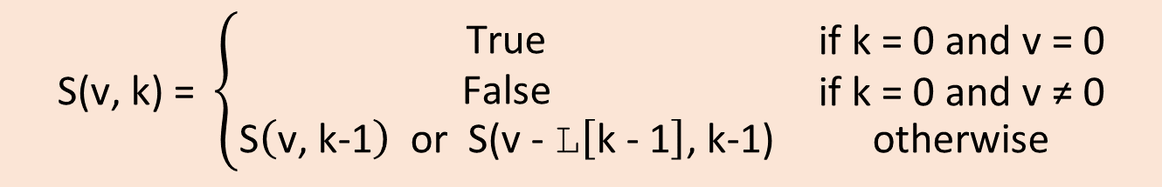
Subset sum using dynamic programming
In the subset sum problem (Exercise 13.4) we are given a number x and a list of numbers L, and want to determine if a subset of L has sum x
L = [3, 7, 2, 11, 13, 4, 8] x = 22 = 7 + 11 + 4
Let S(v, k) denote if it is possible to achieve value v with a subset of L[:k], i.e. S(v, k) = True if and only if a subset of the first k values in L has sum v
S(v, k) can be computed from the recurrence
$$\text{S}\text{(}\text{v}\text{, }\text{k}\text{) = }\left\{\begin{matrix}\begin{aligned}\text{T}\text{rue} \\ \text{False}\end{aligned} & \begin{aligned}\text{if} \text{k}\text{ = 0 }\text{and} \text{v}\text{ = 0} \\ \text{if} \text{k}\text{ = 0 }\text{and} \text{v}\text{ ≠ 0}\end{aligned} \\ \text{S}\left(\text{v}\text{, }\text{k}\text{−1}\right) \text{or} \text{S}\text{(}\text{v}\text{ − }\text{L}\left[\text{k}\text{ − 1}\right]\text{, }\text{k}\text{−1)} & \text{otherwise}\end{matrix}\right.$$
Notes:
Exercise 13.4 asks you to return the subset equal to x, and to use an exception to stop the recursion

Slide 10
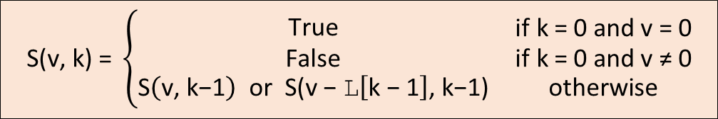
Subset sum using dynamic programming
subset_sum_dp.py
def subset_sum(x, L): @memoize def solve(value, k): if k == 0: return value == 0 return solve(value, k - 1) or solve(value - L[k - 1], k - 1) return solve(x, len(L))
Python shell
subset_sum(11, [2, 3, 8, 11, -1]) True subset_sum(6, [2, 3, 8, 11, -1]) False
$$\text{S}\text{(}\text{v}\text{, }\text{k}\text{) = }\left\{\begin{matrix}\begin{aligned}\text{T}\text{rue} \\ \text{False}\end{aligned} & \begin{aligned}\text{if} \text{k}\text{ = 0 }\text{and} \text{v}\text{ = 0} \\ \text{if} \text{k}\text{ = 0 }\text{and} \text{v}\text{ ≠ 0}\end{aligned} \\ \text{S}\left(\text{v}\text{, }\text{k}\text{−1}\right) \text{or} \text{S}\text{(}\text{v}\text{ − }\text{L}\left[\text{k}\text{ − 1}\right]\text{, }\text{k}\text{−1)} & \text{otherwise}\end{matrix}\right.$$

Slide 11
Question – What is a bound on the size order of the memoization table if all values are possitive integers?
subset_sum_dp.py
def subset_sum(x, L): @memoize def solve(value, k): if k == 0: return value == 0 return solve(value, k-1) or solve(value - L[k-1], k-1) return solve(x, len(L))
Python shell
subset_sum(11, [2, 3, 8, 11, -1]) True subset_sum(6, [2, 3, 8, 11, -1]) False
len(L)
sum(L)
x
2^{len(L)}
len(L)
len(L)*sum(L)
Don’t know
Notes:
Algorithm likely only useful when len(L)*sum(L) is small

Slide 12
Subset sum using dynamic programming
subset_sum_dp.py
def subset_sum_solution(x, L): @memoize def solve(value, k): if k == 0: if value == 0: return [] else: return None solution = solve(value, k - 1) if solution != None: return solution solution = solve(value - L[k - 1], k - 1) if solution != None: return solution + [L[k - 1]] return None return solve(x, len(L))
Python shell
subset_sum_solution(11, [2, 3, 8, 11, -1]) [3, 8] subset_sum_solution(6, [2, 3, 8, 11, -1]) None
Notes:
Essentially the memoization should keep track of all subproblems with no solution

Slide 13
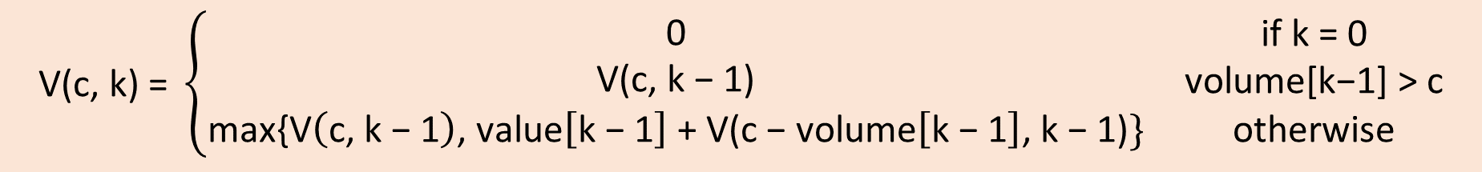
Knapsack problem
 | Volume | Value
0 | 3 | 6
1 | 3 | 7
2 | 2 | 8
3 | 5 | 9
Given a knapsack with volume capacity C, and set of objects with different volumes and value
Objective: Find a subset of the objects that fits in the knapsack (sum of volume ≤ capacity) and has maximal value
Example: If C = 5 and the volume and weights are given by the table, then the maximal value 15 can be achieved by the 2nd and 3rd object
Let V(c, k) denote the maximum value achievable by a subset of the first k objects within capacity c
$$\text{V}\text{(}\text{c}\text{, }\text{k}\text{) = }\left\{\begin{matrix}\begin{aligned}\text{0} \\ \text{V}\text{(}\text{c}\text{, }\text{k}\text{ − 1)}\end{aligned} & \begin{aligned}\text{if} \text{k}\text{ = 0} \\ \text{volume}\text{[}\text{k}\text{−1] > }\text{c}\end{aligned} \\ \text{max}\text{\{}\text{V}\left(\text{c}\text{, }\text{k}\text{ − 1}\right)\text{, }\text{value}\left[\text{k}\text{ − 1}\right] \text{+ }\text{V}\text{(}\text{c}\text{ − }\text{volume}\left[\text{k}\text{ − 1}\right]\text{, }\text{k}\text{ − 1)}\} & \text{otherwise}\end{matrix}\right.$$

Slide 14
Knapsack – maximum value
knapsack.py
def knapsack_value(volume, value, capacity): @memoize def solve(c, k): # solve with capacity c and objects 0..k-1 if k == 0: # no objects to put in knapsack return 0 v = solve(c, k - 1) # try without object k-1 if volume[k - 1] <= c: # try also with object k-1 if space v = max(v, value[k - 1] + solve(c - volume[k - 1], k - 1)) return v return solve(capacity, len(volume))
Python shell
volumes = [3, 3, 2, 5] values = [6, 7, 8, 9] knapsack_value(volumes, values, 5) 15

Slide 15
Knapsack – maximum value and objects
knapsack.py
def knapsack(volume, value, capacity): @memoize def solve(c, k): # solve with capacity c and objects 0..k-1 if k == 0: # no objects to put in knapsack return 0, [] v, solution = solve(c, k - 1) # try without object k-1 if volume[k - 1] <= c: # try also with object k-1 if space v2, sol2 = solve(c - volume[k - 1], k - 1) v2 = v2 + value[k - 1] if v2 > v: v = v2 solution = sol2 + [k - 1] return v, solution return solve(capacity, len(volume))
Python shell
volumes = [3, 3, 2, 5] values = [6, 7, 8, 9] knapsack(volumes, values, 5) (15, [1, 2])

Slide 16
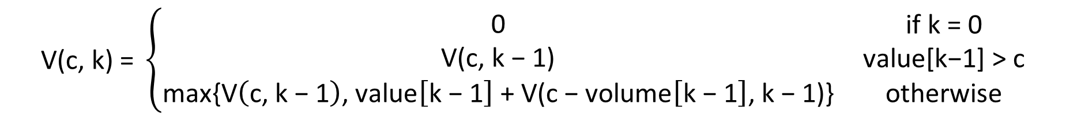
Knapsack - Table
$$\text{V}\text{(}\text{c}\text{, }\text{k}\text{) = }\left\{\begin{matrix}\begin{aligned}\text{0} \\ \text{V}\text{(}\text{c}\text{, }\text{k}\text{ − 1)}\end{aligned} & \begin{aligned}\text{if} \text{k}\text{ = 0} \\ \text{value}\text{[}\text{k}\text{−1] > }\text{c}\end{aligned} \\ \text{max}\text{\{}\text{V}\left(\text{c}\text{, }\text{k}\text{ − 1}\right)\text{, }\text{value}\left[\text{k}\text{ − 1}\right] \text{+ }\text{V}\text{(}\text{c}\text{ − }\text{volume}\left[\text{k}\text{ − 1}\right]\text{, }\text{k}\text{ − 1)\}} & \text{otherwise}\end{matrix}\right.$$
volume[k-1]
capacity
0
c
0
include object k-1
skip object k-1
k-1
systematic fill out table
only need to remember two rows
k
V(c, k)
len(volume)
final answer

Slide 17
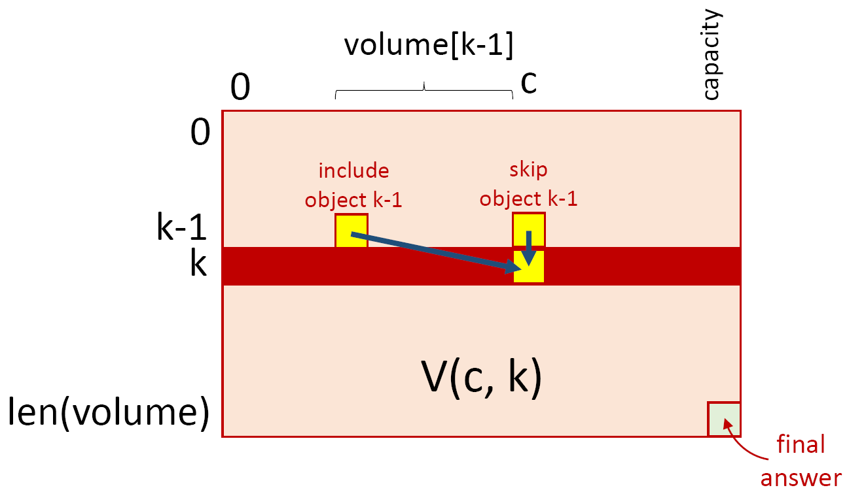
Knapsack – Systematic table fill out
knapsack_systematic.py
def knapsack(volume, value, capacity): solutions = [(0, [])] * (capacity + 1) for obj in range(len(volume)): for c in reversed(range(volume[obj], capacity + 1)): prev_v, prev_solution = solutions[c - volume[obj]] v = value[obj] + prev_v if solutions[c][0] < v: solutions[c] = v, prev_solution + [obj] return solutions[capacity]
Python shell
volumes = [3, 3, 2, 5] values = [6, 7, 8, 9] knapsack(volumes, values, 5) (15, [1, 2])
1
base case k = 0
consider each object
solutions[c:] current row
solutions[:c] previous row
compute next row right-to-left
solutions[:volume[obj]]
unchanged from previous row
1
2
2
4
5
3
3
4
5
Notes:
(4) Compute right-to-left since we are overwritting previous row with new values

Slide 18
Summary
Dynamic programming is a general approach for recursive problems where one tries to avoid recomputing the same expresions repeatedly
Solution 1: Memoization
add dictionary to function to remember previous results
decorate with a @memoize decorator
Solution 2: Systematic table fill out
can need to compute more values than when using memoization
can discard results not needed any longer (reduced memory usage)

Slide 19
Coding competitions and online judges
If you like to practice your coding skills, there are many online “judges” with numerous exercises and where you can upload and test your solutions.
Project Euler
Kattis
CodeForces
Topcoder
See cs.au.dk/~gerth/code/

Slide 20

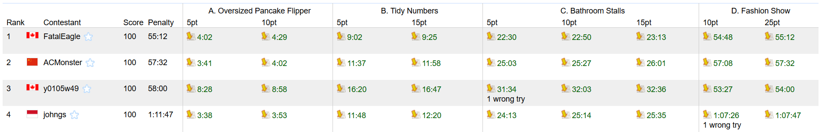
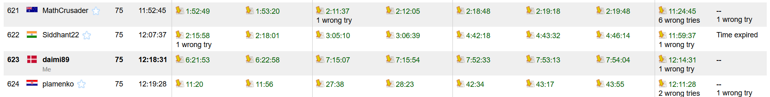
Google Code Jam codingcompetitions.withgoogle.com/codejam
Coding competition
Qualification round 2022 (April 2, 01:00 – April 3, 04:00)
In 2021 there was 37.000 participants for the qualification round
Scoreboard 2017

Slide 21
Google Code Jam - Qualification Round 2017 Problem A: Oversized Pancake Flipper (description)
N pancakes each with exactly one happy chocolate side
K-flipper that can flip K consecutive pancakes
Problem: Find minimim number of flips to make all pancakes happy, if possible
4-flipper
Before
Flipped
After

