Slide 1
Lists
List syntax
List operations
copy.deepcopy
range
while-else
for
for-break-continue-else

Slide 2

List operations
L[-index] == L[len(L)-index]
Negative indexing from the right is Python specific, and is e.g. not supported in Java, C, C++
List syntax [value₀, value₁, ..., value_{k-1}]
List indexing L[index], L[-index]
List slices L[from:to], L[from:to:step] or L[slice(from,to,step)]
Creating a copy of a list L[:] or L.copy()
List concatenation (creates new list) X + Y
List repetition (repeated concatenation with itself) 42 * L
Length of list len(L)
Check if element is in list e in L (returns True or False)
Check if element is not in list e not in L (same as not e in L)
Index of first occurrence of element in list L.index(e)
Number of occurrences of element in list L.count(e)
sum(L) min(L) max(L)
= creates new list
docs.python.org/3/library/stdtypes.html#sequence-types-list-tuple-range

Slide 3
sum(…)
Python 3.12 change
Python shell
1 - 1/3 - 1 + 1/3 # mathematically should be zero 5.551115123125783e-17 # but floats are imprecise L = [1, -1/3, -1, 1/3] L [1, -0.3333333333333333, -1, 0.3333333333333333] # mix of int and float sum(L) 5.551115123125783e-17 sum([1.0, -1/3, -1.0, 1/3]) # all floats 5.551115123125783e-17 # Python 3.11 sum([1.0, -1/3, -1.0, 1/3]) 0.0 # Python 3.12 uses "Neumaier summation" to improve accuracy for floats sum([1, -1/3, -1, 1/3]) 5.551115123125783e-17 # Python 3.12 looses accuracy when mixing int and float import math math.fsum([1, -1/3, -1, 1/3]) # math.fsum more accurate float sums 0.0
Notes:
Python 3.12 & 3.13 get confused when the first element in the list is an integer

Slide 4
List modifiers (lists are mutable)
Extend list with elements (X is modified) X.extend(Y)
Append an element to a list (L is modified) L.append(42)
Replace sublist by another list (length can differ) X[i:j] = Y
Delete elements from list del L[i:j:k]
Remove & return element at position L.pop(i)
Remove first occurrence of element L.remove(e)
Reverse list L.reverse()
L *= 42
L.insert(i, x) same as L[i:i] = [x]
Python shell
x = [1, 2, 3, 4, 5] x[2:4] = [10, 11, 12] x [1, 2, 10, 11, 12, 5] x = [1, 2, 11, 5, 8] x[1:4:2] = ['a', 'b'] [1, 'a', 11, 'b', 8]
docs.python.org/3/library/stdtypes.html#sequence-types-list-tuple-range
Notes:
L.pop() = L.pop(-1), i.e. removes the last element from the list

Slide 5
Questions – What is x ?
x = [1,2,3,4,5,6,7,8,9,10]
x[2:8:3] = ['a', 'b']
[1,2,'a','b',5,6,7,8,9,10]
[1,'a',3,4,5,6,7,'b',9,10]
[1,2,3,4,5,6,7,'a','b']
[1,2,'a',4,5,'b',7,8,9,10]
ValueError
Don’t know

Slide 6
Questions – What is y ?
y = [1,2,3,4,5,6,7,8,9,10,11,12,13,14,15,16,17,18,19]
y = y[3:15:3][1:4:2]
[3,6,9,12,15]
[7,13]
[1,9]
[4,7,10,13,2,4]
TypeError
Don’t know

Slide 7

Nested lists (multi-dimensional lists)
Lists can contain lists as elements, that can contain lists as elements, that ...
Can e.g. be used to store multi-dimensional data (list lengths can be non-uniform)
Note: For dealing with matrices the NumPy module is a better choice
multidimensional-lists.py
list1d = [1, 3, 5, 2] list2d = [[1, 2, 3, 4], [5, 6, 7, 9], [0, 8, 2, 3]] list3d = [[[5,6], [4,2], [1,7], [2,4]], [[1,2], [6,3], [2,5], [7,5]], [[3,8], [1,5], [4,3], [2,4]]] print(list1d[2]) print(list2d[1][2]) print(list3d[2][0][1])
Python shell
5 7 8

Slide 8
aliasing
Memory
a | 13 | a[0]
 | 27 | a[1]
 | 7 | a[2]
 | 42 | a[3]
a = [13, 27, 7, 42]
b = a
a[2] = 12
b
12-

Slide 9
y = x vs y = x[:]
Memory
a | 13 | a[0]
 | 27 | a[1]
 | 7 | a[2]
 | 42 | a[3]
Memory
a | 13 | a[0]
 | 27 | a[1]
 | 7 | a[2]
 | 42 | a[3]
 | 13 | b[0]
 | 27 | b[1]
 | 7 | b[2]
 | 42 | b[3]
a = [13, 27, 7, 42]
b = a
a[2] = 12
a = [13, 27, 7, 42]
b = a[:]
a[2] = 12
b
12-
12-
b
Notes:
Slicing creates a new list

Slide 10
x[:] vs nested structures
Memory
a |  | a[0]
 |  | a[1]
 | 3
 | 5
 | 7
 | 11
c |  | c[0]
 |  | c[1]
b
a = [[3,5],[7,11]]
b = a
c = a[:]
a[0][1] = 4 c[1] = b[0]
4-
-
-
-

Slide 11
Question – what is c ?
Memory
a |  | a[0]
 |  | a[1]
 | 3
 | 5
 | 7
 | 11
c |  | c[0]
 |  | c[1]
[[3,5],[7,11]]
[[3,5],[3,5]]
[[3,4],[3,5]]
[[3,4],[3,4]]
Don’t know
b
a = [[3,5],[7,11]]
b = a
c = a[:]
a[0][1] = 4 c[1] = b[0]
4-
-
-
-
Try pythontutor.com
Notes:
Pythontutor.com only uses Python 3.6

Slide 12
copy.deepcopy
Memory
a |  | a[0]
 | 7 | a[1]
 | 3
 | 5
 |  | b[0]
 | 7 | b[1]
 | 3
 | 5
To make a copy of all parts of a composite value use the function deepcopy from module copy
4-
Python shell
from copy import deepcopy a = [[3, 5], 7] b = deepcopy(a) a[0][0] = 4 a [[4,5],7] b [[3,5],7]
b

Slide 13
Initializing a 2-dimensional list
Python shell
x = [1] * 3 x [1, 1, 1] y = [[1] * 3] * 4 y [[1, 1, 1], [1, 1, 1], [1, 1, 1], [1, 1, 1]] y[0][0] = 0 y [[0, 1, 1], [0, 1, 1], [0, 1, 1], [0, 1, 1]]
Python shell
y = [] for _ in range(4): y.append([1] * 3) y[0][0] = 0 y [[0, 1, 1], [1, 1, 1], [1, 1, 1], [1, 1, 1]]

Slide 14
range(from, to, step)
In Python 2, range generates the explicit list, i.e. always use memory proportional to the length; xrange in Python 2 corresponds to range in Python 3; Python 3 is more memory friendly
range(from, to, else) represents the sequence of numbers starting with from, with increments of step, and smaller/greater than to if step positive/negative
range(5) : 0, 1, 2, 3, 4 (default from = 0, step = 1) range(3, 8) : 3, 4, 5, 6, 7 (default step = 1) range(-2, 7, 3) : -2, 1, 4 (from and to can be any integer) range(2, -5, -2) : 2, 0, -2, -4 (decreasing sequence if step negative)
Ranges are immutable, can be indexed like a list, sliced, and compared (i.e. generate the same numbers)
list(range(...)) generates the explicit list of numbers
Python shell
range(1, 10000000, 3)[2] 7 range(1, 10000000, 3)[100:120:4] range(301, 361, 12) range(1, 10000000, 3)[100:120:4][2:3] range(325, 337, 12) list(range(5, 14, 3)) [5, 8, 11]

Slide 15
Question – What is range(3,20,4)[2:4][1] ?
3
7
11
15
19
Don’t know

Slide 16
for - loop
Python shell
for x in [1, 'abc', [2, 3], 5.0]: print(x) 1 abc [2, 3] 5.0 for x in 'abc': print(x) a b c for x in range(5, 15, 3): print(x) 5 8 11 14
For every element in a sequence execute a block of code: for var in sequence:
block
Sequences can e.g. be lists, strings, ranges
break and continue can be used like in a while-loop to break out of the for-loop or continue with the next element in the sequence

Slide 17
Question – What is printed ?
Python shell
for i in range(1, 4): for j in range(i, 4): print(i, j, sep=':', end=' ')
1:1 1:2 1:3 2:1 2:2 2:3 3:1 3:2 3:3
1:1 1:2 1:3 2:2 2:3 3:3
1:1 2:1 3:1 1:2 2:2 3:2 1:3 2:3 3:3
1:1 2:1 3:1 2:2 3:2 3:3
Don’t know
Notes:
NOTE i in 2nd for-loop

Slide 18
Question – break, what is printed ?
Python shell
for i in range(1, 4): for j in range(1, 4): print(i, j, sep=':', end=' ') if j >= i: break
nothing
1:1
1:1 2:1 2:2 3:1 3:2 3:3
1:1 2:2 3:3
Don’t know
In nested for- and while-loops, break only breaks the innermost loop
Notes:
NOTE i in 2nd for-loop

Slide 19
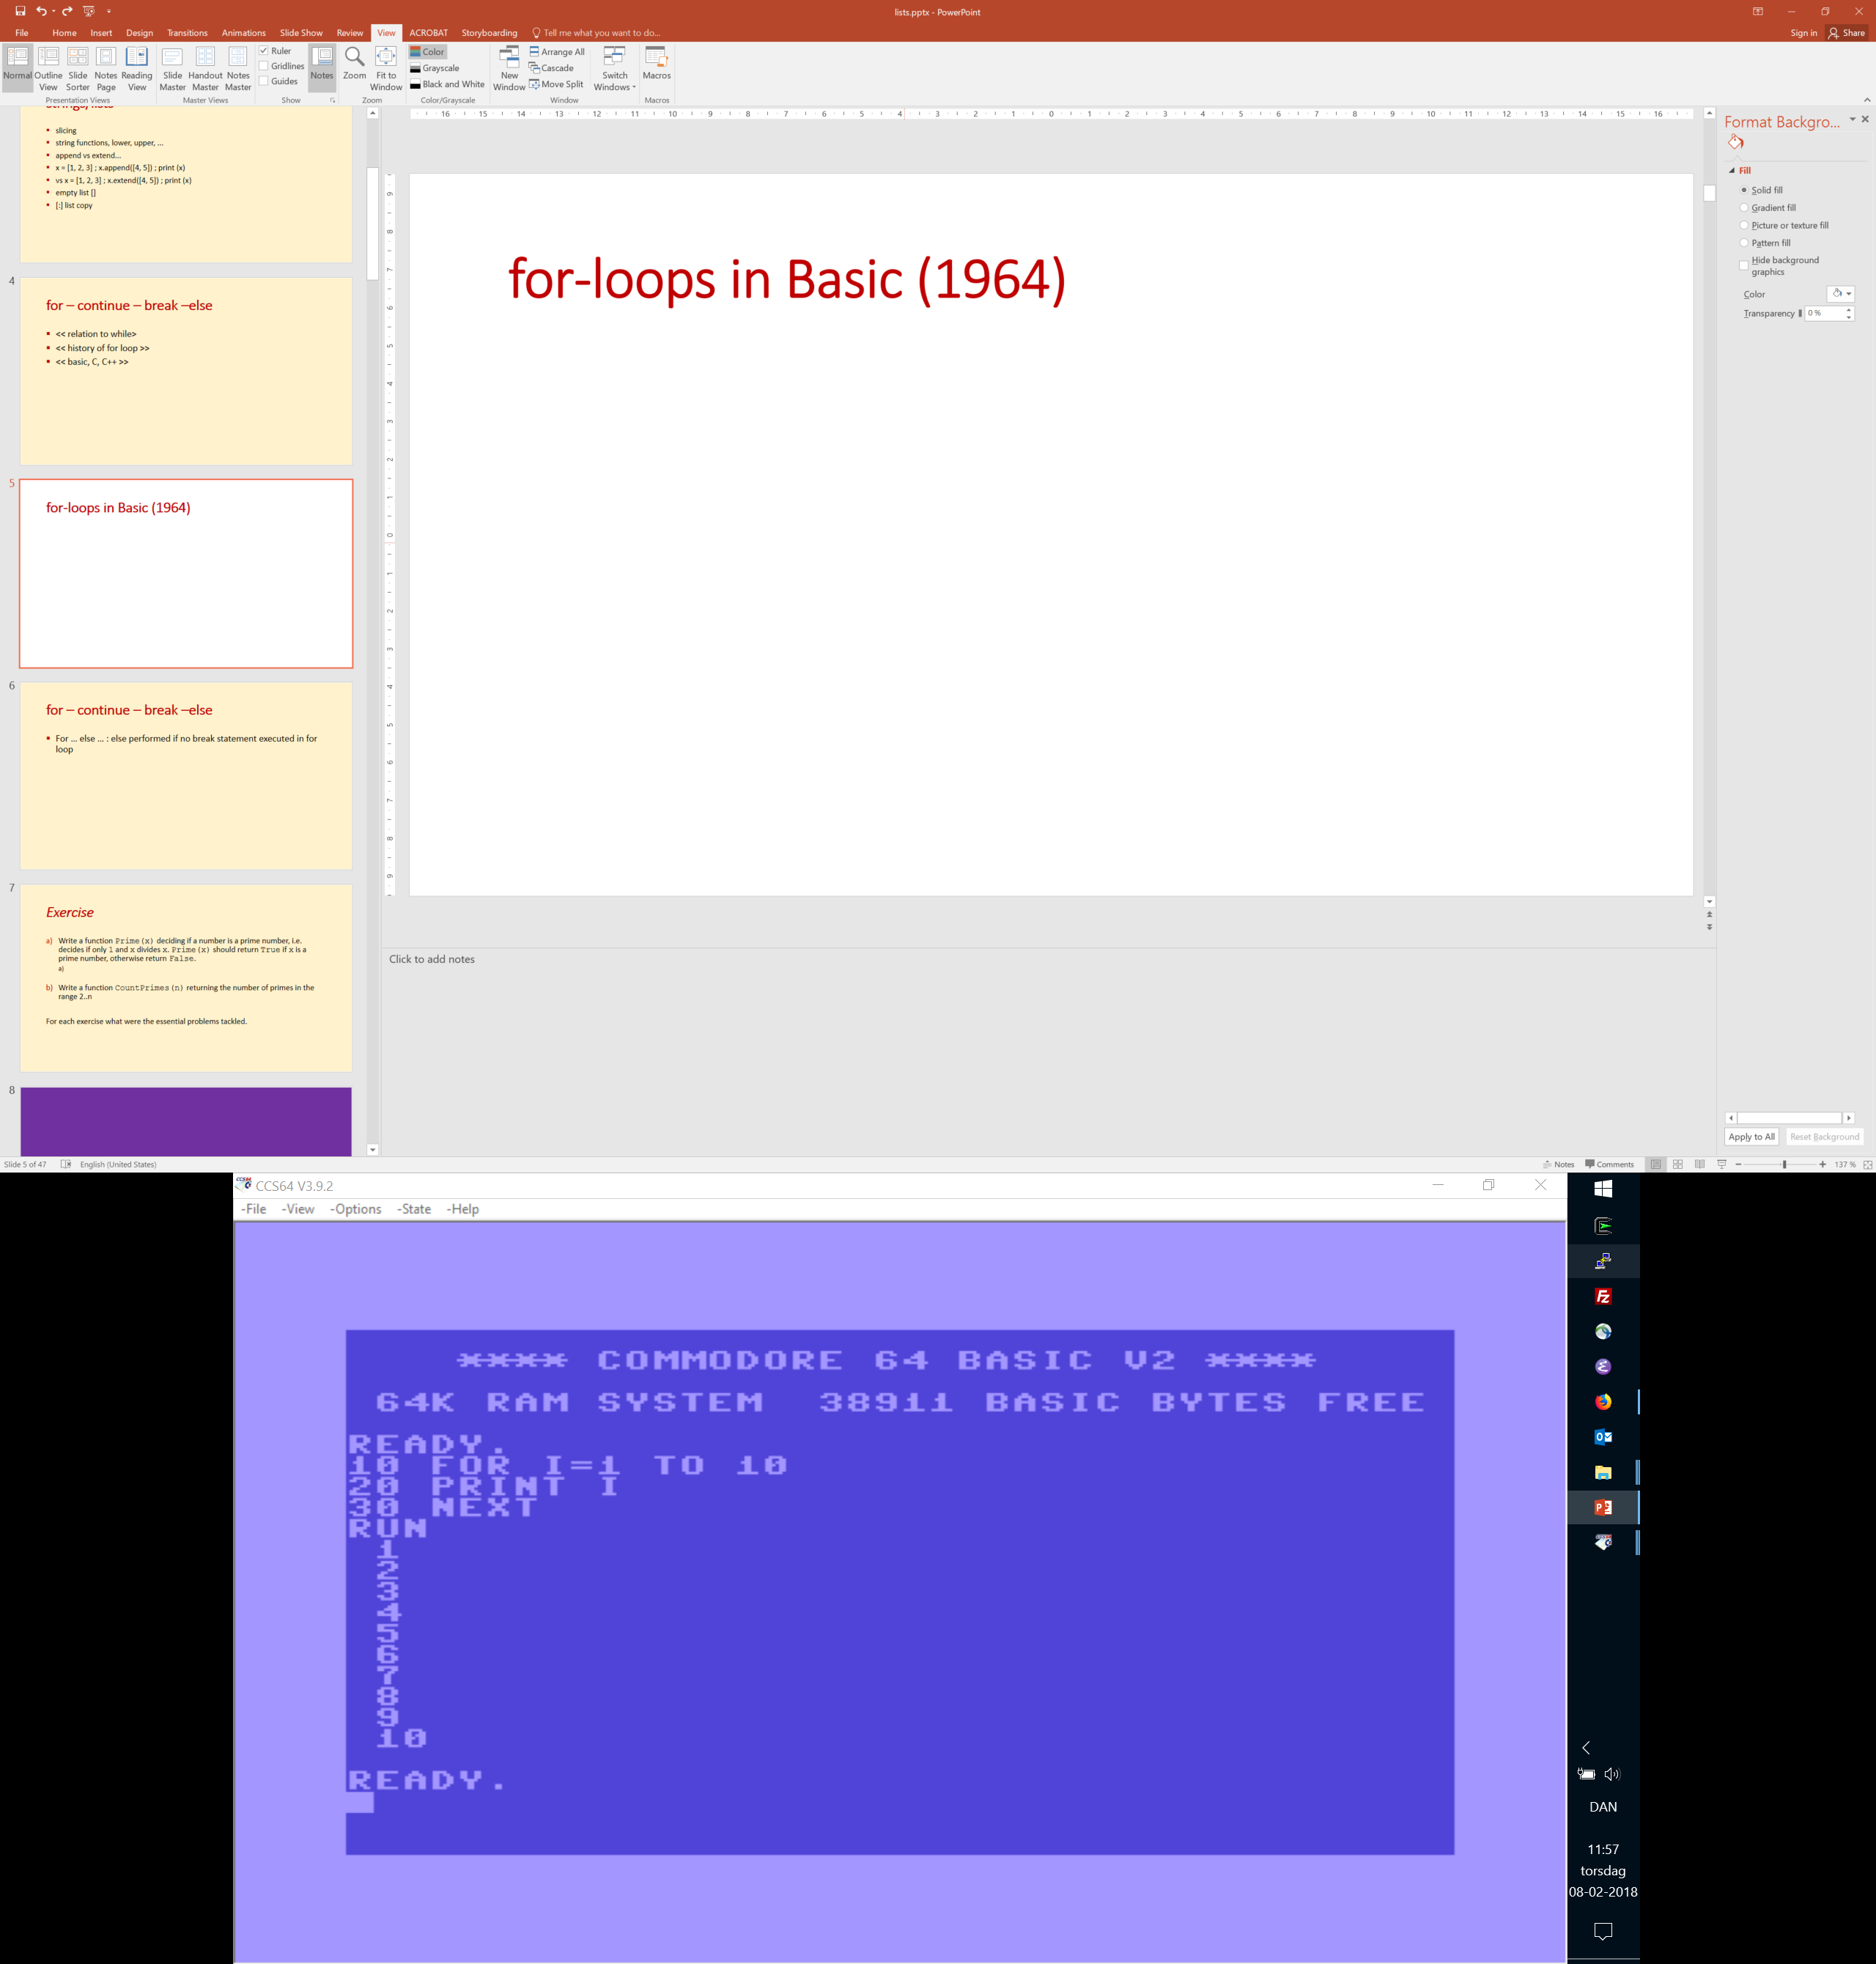
Notes:
Note BASIC includes the last index in the range for the for-loop
Needs keyword NEXT to indicate where the FOR loop ends
https://vice.pokefinder.org/ run x64.exe
Alt-D toggle full screen
LIST : show program
RUN : run program
Alt-F12 : Hardware reset

Slide 20
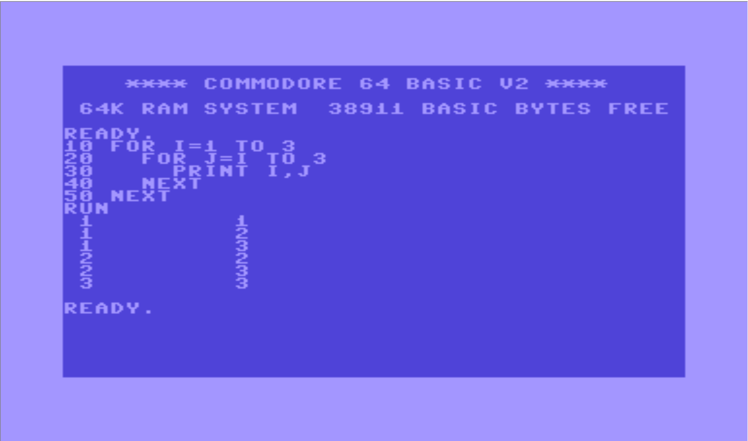

Slide 21
Palindromic substrings
palindrom.py
s = 'abracadrabratrallalla' for i in range(len(s)): for j in range(i + 2, len(s) + 1): t = s[i:j] if t == t[::-1]: print(t)
Python shell
aca alla allalla ll llall lal alla ll
Find all palindromic substrings of length ≥ 2, i.e. substrings spelled identically forward and backwards:
abracadrabratrallalla i j i j
Algorithm: Test all possible substrings (brute force/exhaustive search)
Note: the slice t[::-1] is t reversed
Notes:
example of tested loops
Handin: make a more efficient algorithm

Slide 22
Sieve of Eratosthenes
eratosthenes.py
n = 100 prime = [True] * (n + 1) for i in range(2, n): for j in range(2 * i, n + 1, i): prime[j] = False for i in range(2, n + 1): if prime[i]: print(i, end=' ')
Python shell
2 3 5 7 11 13 17 19 23 29 31 37 41 43 47 53 59 61 67 71 73 79 83 89 97
Find all prime numbers ≤ n
Algorithm:
2 3 4 5 6 7 8 9 10 11 12 13 14 ...
2 3 4 5 6 7 8 9 10 11 12 13 14 ... 2 3 4 5 6 7 8 9 10 11 12 13 14 ...
2 3 4 5 6 7 8 9 10 11 12 13 14 ...
2 3 4 5 6 7 8 9 10 11 12 13 14 ...
2 3 4 5 6 7 8 9 10 11 12 13 14 ...
en.wikipedia.org/wiki/Sieve_of_Eratosthenes
Notes:
Mulige optimeringer:
Spring j over hvis prime[j] == False
for i in range(2, sqrt(n))
for j in range(i * i, n + 1, i)
Run code

Slide 23
while-else and for-else loops
Both for- and while-loops can have an optional “else”:
for var in sequence:
block else:
block
while condition:
block else:
block
The “else” block is only executed if no break is performed in the loop
The “else” construction for loops is specific to Python, and does not exist in e.g. C, C++ and Java

Slide 24
Linear search
linear-search-for.py
found = False for i in range(len(L)): if L[i] == x: print(x, 'at position', i, 'in', L) found = True break if not found: print(x, 'not in', L)
linear-search-while.py
L = [7, 3, 6, 4, 12, 'a', 8, 13] x = 4 i = 0 while i < len(L): if L[i] == x: print(x, 'at position', i, 'in', L) break i = i + 1 if i >= len(L): print(x, 'not in', L)
linear-search-for-else.py
for i in range(len(L)): if L[i] == x: print(x, 'at position', i, 'in', L) break else: print(x, 'not in', L)
linear-search-while-else.py
i = 0 while i < len(L): if L[i] == x: print(x, 'at position', i, 'in', L) break i = i + 1 else: print(x, 'not in', L)
linear-search-builtin.py
if x in L: print(x, 'at position', L.index(x), 'in', L) else: print(x, 'not in', L)
Notes:
L.index(x) can only be called if x in L, otherwise an exception is raised

Slide 25
Some performance considerations

Slide 26
String concatenation
Python shell
s = 'A' + 'B' + 'C' s 'ABC' 'x'.join(['A', 'B', 'C']) 'AxBxC' s = '' s += 'A' s += 'B' s += 'C' s 'ABC' L = [] L.append('A') L.append('B') L.append('C') L ['A', 'B', 'C'] s = ''.join(L) s 'ABC'
To concatenate two (or few) strings use
str₁ + str₂ var += str
To concatenate several/many strings use
''.join([str₁, str₂, str₃, ... , str_{n}])
Concatenating several strings by repeated use of + generates explicitly the longer-and-longer intermediate results; using join avoids this slowdown
Notes:
Recall strings are immutable

Slide 27
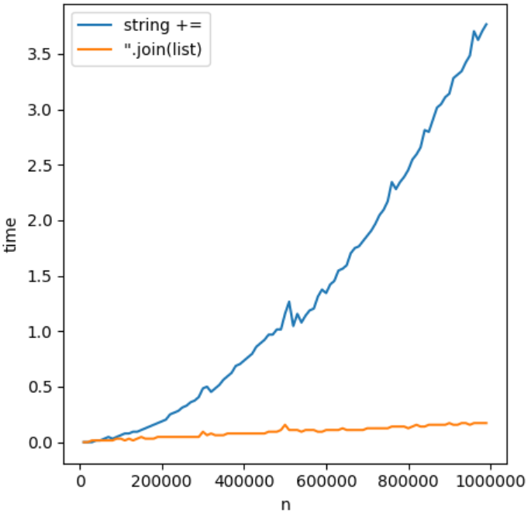
string-concatenation.py
from time import time from matplotlib import pyplot as plt ns = range(10_000, 1_000_000, 10_000) time_string = [] time_list = [] for n in ns: start = time() s = '' for _ in range(n): s += 'abcdefgh' # slow end = time() time_string.append(end - start) start = time() substrings = [] for _ in range(n): substrings.append('abcdefgh'); s = ''.join(substrings); end = time() time_list.append(end - start) plt.plot(ns, time_string, label='string +=') plt.plot(ns, time_list, label="''.join(list)") plt.xlabel('n') plt.ylabel('time') plt.legend() plt.show()
≈ 4∙10⁻¹² ∙ n²
≈ 2∙10⁻⁷ ∙ n
Notes:
time.time() returns the number of seconds since January 1, 1970, 00:00:00 (UTC)

Slide 28
The internal implementation of Python lists
Accessing and updating list positions take the same time independently of position
Creating new / deleting entries in a list depends on position, Python optimizes towards updates at the end
Try to organize your usage of lists to insert / delete elements at the end L.append(element) and L.pop()
Python lists internally have space for adding ≈ 12.5 % additional entries at the end; when the reserved extra space is exhausted the list is moved to a new chunk of memory with ≈ 12.5 % extra space
0
i
len(L) - 1
memory
 | L | L reserve
move right
L[i:i] = [42] will move all trailing cells one position to right
next cell to be used by L.append
github.com/python/cpython/blob/master/Objects/listobject.c
Notes:
In source code search for “>> 3”

Slide 29
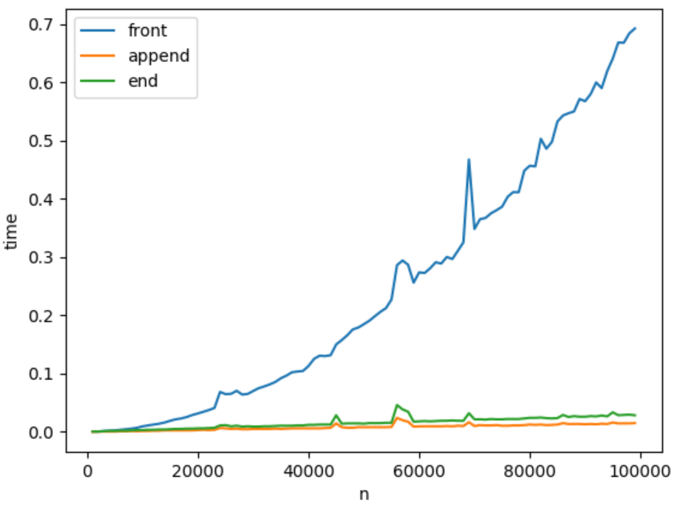
List insertions at front vs end
list-insertions.py
from time import time from matplotlib import pyplot as plt ns = range(1000, 100_000, 1000) time_end = [] time_append = [] time_front = [] for n in ns: start = time() L = [] for i in range(n): L[i:i] = [i] # insert after list end = time() time_end.append(end - start) start = time() L = [] for i in range(n): L.append(i) # append to list end = time() time_append.append(end - start) start = time() L = [] for i in range(n): L[0:0] = [i] # insert at front end = time() time_front.append(end - start) plt.plot(ns, time_front, label='front') plt.plot(ns, time_append, label='append') plt.plot(ns, time_end, label='end') plt.xlabel('n') plt.ylabel('time') plt.legend() plt.show()
≈ 7∙10⁻¹⁰ ∙ n²
≈ 3∙10⁻⁷ ∙ n
≈ 2∙10⁻⁷ ∙ n

Slide 30
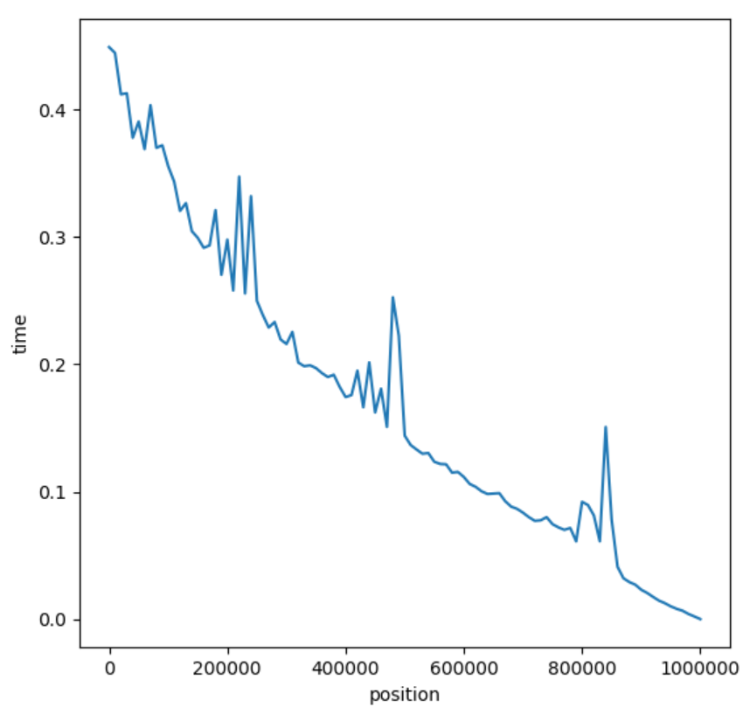
Updates (insertions + deletions) in the middle of a list
list-updates.py
from time import time from matplotlib import pyplot as plt ns = range(0, 1_000_001, 10_000) time_pos = [] L = list(range(1_000_000)) # L = [0, ..., 999_999] for i in ns: start = time() for _ in range(1000): L[i:i] = [42] # insert element before L[i] del L[i] # remove L[i] from L end = time() time_pos.append(end - start) plt.plot(ns, time_pos) plt.xlabel('position') plt.ylabel('time') plt.show()
updates at front of list
updates at end of list
Notes:
data from single run => lot of noise

