Slide 1
Documentation, testing and debugging
docstring
defensive programming
assert
test driven developement
assertions
testing
unittest
debugger
coverage
static type checking (mypy, pyright)

Slide 2
On average, a developer creates 70 bugs per 1000 lines of code
15 bugs per 1,000 lines of code find their way to the customers
Fixing a bug takes 30 times longer than writing a line of code
75% of a developer’s time is spent on debugging
coralogix.com
Notes:
Some numbers on frequency on errors (2015)
- Let us try to avoid introducing bugs at the first place

Slide 3

Ensuring good quality code ?
Design phase
Development
(hopefully)
correct program
Usage
Idea
Coding
User runs program
success
Fix bug
Testing
success
Goal
Develop programs that work correctly
Tools and techniques
fail
Find bug
runs forever / crash / incorrect output / explosion / ...
Notes:
Idea can be very clear or less well-developed

Slide 4
What is good code ?
Readability
well-structured
documentation
comments
follow some standard structure (easy to recognize, follow PEP8 Style Guide)
Correctness
outputs the correct answer on valid input
eventually stops with an answer on valid input (should not go in infinite loop)
Reusable...

Slide 5
Why ?
Documentation
specification of functionality
docstring
for users of the code
modules
methods
classes
comments
for readers of the code
Testing
Correct implementation ?
Try to predict behavior on unknown input ?
Performance guarantees ?
Debugging
Where is the #!¤$ bug ?
”Program testing can be used to show the presence of bugs, but never to show their absence” ̶ Edsger W. Dijkstra
Notes:
docstring is also for writer of code

Slide 6
Built-in exceptions (class hierarchy)
BaseException +-- SystemExit +-- KeyboardInterrupt +-- GeneratorExit +-- Exception +-- StopIteration +-- StopAsyncIteration +-- ArithmeticError | +-- FloatingPointError | +-- OverflowError | +-- ZeroDivisionError +-- AssertionError +-- AttributeError +-- BufferError +-- EOFError +-- ImportError | +-- ModuleNotFoundError +-- LookupError | +-- IndexError | +-- KeyError +-- MemoryError +-- NameError | +-- UnboundLocalError +-- TypeError +-- ValueError | +-- UnicodeError | +-- UnicodeDecodeError | +-- UnicodeEncodeError | +-- UnicodeTranslateError | | +-- OSError | +-- BlockingIOError | +-- ChildProcessError | +-- ConnectionError | | +-- BrokenPipeError | | +-- ConnectionAbortedError | | +-- ConnectionRefusedError | | +-- ConnectionResetError | +-- FileExistsError | +-- FileNotFoundError | +-- InterruptedError | +-- IsADirectoryError | +-- NotADirectoryError | +-- PermissionError | +-- ProcessLookupError | +-- TimeoutError +-- ReferenceError +-- RuntimeError | +-- NotImplementedError | +-- RecursionError +-- SyntaxError | +-- IndentationError | +-- TabError +-- SystemError +-- Warning +-- DeprecationWarning +-- PendingDeprecationWarning +-- RuntimeWarning +-- SyntaxWarning +-- UserWarning +-- FutureWarning +-- ImportWarning +-- UnicodeWarning +-- BytesWarning +-- ResourceWarning
docs.python.org/3/library/exceptions.html
Notes:
Emphasized (red) exception types are those likely already seen during the course until now
Blue are those we consider today

Slide 7
Testing for unexpected behaviour ?
infinite-recursion1.py
def f(depth): f(depth + 1) # infinite recursion f(0)
Python shell
RecursionError: maximum recursion depth exceeded
infinite-recursion3.py
import sys def f(depth): if depth > 100: print('runaway recursion???') sys.exit() # system function f(depth + 1) f(0)
Python shell
runaway recursion???
raises SystemExit
infinite-recursion2.py
def f(depth): if depth > 100: print('runaway recursion???') raise SystemExit # raise built-in exception f(depth + 1) f(0)
Python shell
runaway recursion???
let the program eventually fail
check and raise exceptions
check and call sys.exit
Notes:
Try to add code for spotting fishy behaviour

Slide 8
Catching unexpected behaviour – assert
infinite-recursion4.py
def f(depth): assert depth <= 100 # raise exception if False f(depth + 1) f(0)
Python shell
File "...\infinite-recursion4.py", line 2, in f assert depth <= 100 AssertionError
keyword assert checks if boolean expression is true, if not, raises exception AssertionError
optional second parameter passed to the constructor of the exception
try to fail fast to discover errors early – making debugging easier
infinite-recursion5.py
def f(depth): assert depth <= 100, 'runaway recursion???' f(depth + 1) f(0)
Python shell
File "...\infinite-recursion5.py", line 2, in f assert depth <= 100, "runaway recursion???" AssertionError: runaway recursion???
infinite-recursion6.py
def f(depth): if not depth <= 100: raise AssertionError('runaway recursion???') f(depth + 1) f(0)
Python shell
File "...\infinite-recursion6.py", line 3, in f raise AssertionError("runaway recursion???") AssertionError: runaway recursion???
Notes:
“fail fast” link to article explaining the usage of assertions
The str argument to assert can e.g. contain information about unexpected values of variables

Slide 9
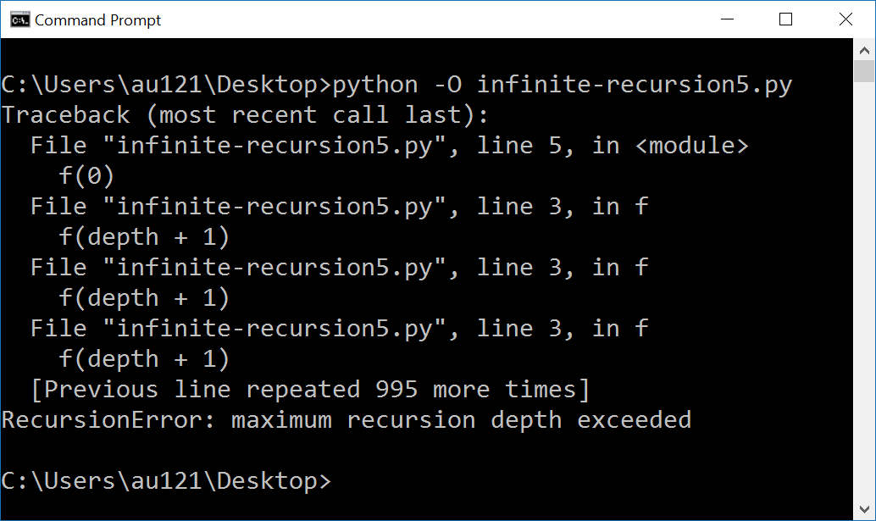
Disabling assert statements
assert statements are good to help check correctness of program – but can slow down program
invoking Python with option –O disables all assertions (by setting __debug__ to False)
docs.python.org/3/reference/simple_stmts.html#assert
Notes:
Cannot set __debug__ within the code:
__debug__ = False
^^^^^^^^^
SyntaxError: cannot assign to __debug__

Slide 10
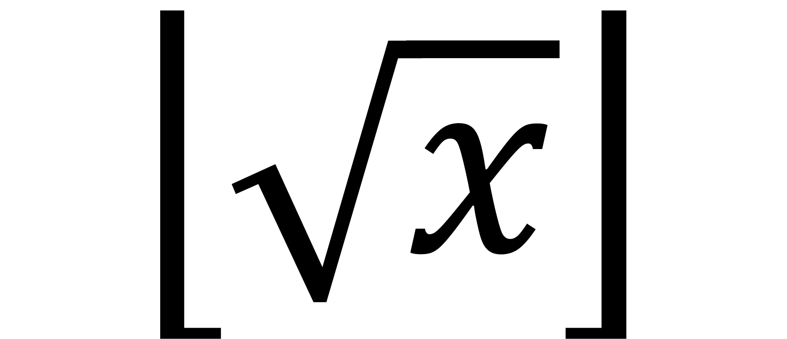
Example
$$\left\lfloor \sqrt{x}\right\rfloor$$

Slide 11
First try... (seriously, the bugs were not on purpose)
intsqrt_buggy.py
def int_sqrt(x): low = 0 high = x while low < high - 1: mid = (low + high) / 2 if mid ** 2 <= x: low = mid else: high = mid return low
Python shell
int_sqrt(10) 3.125 # 3.125 ** 2 = 9.765625 int_sqrt(-10) 0 # what should the answer be ?

Slide 12
Let us add a specification...
intsqrt.py
def int_sqrt(x): '''Compute the integer square root of an integer x. Requires x >= 0 is an integer. Returns the integer floor(sqrt(x)).''' ...
Python shell
help(int_sqrt) Help on function int_sqrt in module __main__: int_sqrt(x) Compute the integer square root of an integer x. Requires x >= 0 is an integer. Returns the integer floor(sqrt(x)).
all methods, classes, and modules can have a docstring (ideally have) as a specification
for methods: summarize purpose in first line, followed by input requirements and ouput guarantees
the docstring is assigned to the object’s __doc__ attribute
docstring
input requirements
output guarantees
PEP 257 -- Docstring Conventions
www.python.org/dev/peps/pep-0257/
Notes:
Writing the doc string forces you to think about what the funktion should do and edge cases

Slide 13
Let us check input requirements...
intsqrt.py
def int_sqrt(x): '''Compute the integer square root of an integer x. Requires x >= 0 is an integer. Returns the integer floor(sqrt(x)).''' assert isinstance(x, int) assert 0 <= x ...
Python shell
int_sqrt(-10) File "...\int_sqrt.py", line 7, in int_sqrt assert 0 <= x AssertionError
doing explicit checks for valid input arguments is part of defensive programming and helps spotting errors early (instead of continuing using likely wrong values... resulting in a final meaningless error)
check input requirements
Notes:
Testing for the input type is not necessary in typed languages like C, C++, Java where the method only can be called with arguments of the correct type

Slide 14
Let us check if output correct...
intsqrt.py
def int_sqrt(x): '''Compute the integer square root of an integer x. Requires x >= 0 is an integer. Returns the integer floor(sqrt(x)).''' assert isinstance(x, int) assert 0 <= x ... assert isinstance(result, int) assert result ** 2 <= x < (result + 1) ** 2 return result
Python shell
int_sqrt(10) File "...\int_sqrt.py", line 20, in int_sqrt assert isinstance(result, int) AssertionError
output check identifies the error
mid = (low + high) / 2
should have been
mid = (low + high) // 2
The output check helps us to ensure that function specifications are satisfied in applications
check output

Slide 15
Let us test some input values...
intsqrt.py
def int_sqrt(x): ... assert int_sqrt(0) == 0 assert int_sqrt(1) == 1 assert int_sqrt(2) == 1 assert int_sqrt(3) == 1 assert int_sqrt(4) == 2 assert int_sqrt(5) == 2 assert int_sqrt(200) == 14
Python shell
Traceback (most recent call last): File "...\int_sqrt.py", line 28, in <module> assert int_sqrt(1) == 1 File "...\int_sqrt.py", line 21, in int_sqrt assert result ** 2 <= x < (result + 1) ** 2 AssertionError
test identifies wrong output for x = 1

Slide 16
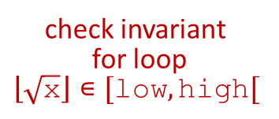
Let us check progress of algorithm...
intsqrt.py
... low, high = 0, x while low < high - 1: # low <= floor(sqrt(x)) < high assert low ** 2 <= x < high ** 2 mid = (low + high) // 2 if mid ** 2 <= x: low = mid else: high = mid result = low ...
Python shell
Traceback (most recent call last): File "...\int_sqrt.py", line 28, in <module> assert int_sqrt(1) == 1 File "...\int_sqrt.py", line 21, in int_sqrt assert result ** 2 <= x < (result + 1) ** 2 AssertionError
test identifies wrong output for x = 1
but invariant apparently correct ???
problem
low == result == 0 high == 1
implies loop never entered
output check identifies the error
high = x
should have been
high = x + 1
check invariant for loop $$\left\lfloor \sqrt{\text{x}}\right\rfloor ∊[\text{low}, \text{high}[$$

Slide 17
Final program
intsqrt.py
def int_sqrt(x): '''Compute the integer square root of an integer x. Requires x >= 0 is an integer. Returns the integer floor(sqrt(x)).''' assert isinstance(x, int) assert 0 <= x low, high = 0, x + 1 while low < high - 1: # low <= floor(sqrt(x)) < high assert low ** 2 <= x < high ** 2 mid = (low + high) // 2 if mid ** 2 <= x: low = mid else: high = mid result = low assert isinstance(result, int) assert result ** 2 <= x < (result + 1) ** 2 return result assert int_sqrt(0) == 0 assert int_sqrt(1) == 1 assert int_sqrt(2) == 1 assert int_sqrt(3) == 1 assert int_sqrt(4) == 2 assert int_sqrt(5) == 2 assert int_sqrt(200) == 14
We have used assertions to:
Test if input arguments / usage is valid (defensive programming)
Test if computed result is correct
Test if an internal invariant in the computation is satisfied
Perform a final test for a set of test cases (should be run whenever we change anything in the implementation)

Slide 18
Which checks would you add to the below code?
binary-search.py
def binary_search(x, L): '''Binary search for x in sorted list L. Assumes x is an integer, and L a non-decreasing list of integers. Returns index i, -1 <= i < len(L), where L[i] <= x < L[i+1], assuming L[-1] = -infty and L[len(L)] = +infty.''' low, high = -1, len(L) while low + 1 < high: mid = (low + high) // 2 if x < L[mid]: high = mid else: low = mid result = low return result

Slide 19
binary-search-assertions.py
def binary_search(x, L): '''Binary search for x in sorted list L. Assumes x is an integer, and L a non-decreasing list of integers. Returns index i, -1 <= i < len(L), where L[i] <= x < L[i+1], assuming L[-1] = -infty and L[len(L)] = +infty.''' assert isinstance(x, int) assert isinstance(L, list) assert all([isinstance(e, int) for e in L]) assert all([L[i] <= L[i + 1] for i in range(len(L) - 1)]) low, high = -1, len(L) while low + 1 < high: # L[low] <= x < L[high] assert (low == -1 or L[low] <= x) and (high == len(L) or x < L[high]) mid = (low + high) // 2 assert isinstance(L[mid], int) assert (low == -1 or L[low] <= L[mid]) and (high == len(L) or L[mid] <= L[high]) if x < L[mid]: high = mid else: low = mid result = low assert (isinstance(result, int) and -1 <= result < len(L) and ((result == -1 and (len(L) == 0 or x < L[0])) or (result == len(L) - 1 and x >= L[-1]) or (0 <= result < len(L) - 1 and L[result] <= x < L[result + 1]))) return result assert binary_search(42, []) == -1 assert binary_search(42, [7]) == 0 assert binary_search(7, [42]) == -1 assert binary_search(7, [42, 42, 42]) == -1 assert binary_search(42, [7, 7, 7]) == 2 assert binary_search(42, [7, 7, 7, 56, 81]) == 2 assert binary_search(8, [1, 3, 5, 7, 9]) == 3
1
Verifying if L is a sorted list of integers can slow down the program significantly
Alternative is to only verify if the part of L visited is a sorted subsequence
input
2
1
inefficient
loop
input
2
output
test cases

Slide 20
Test driven development / Stress tests / Random testing
Test driven development Write the tests before functionality – only write code needed by tests
The challenge – what tests to do? Can you manually find all relevant cases? In particular all edge cases?
Automate the testing?
Write method that can verify the output (possibly slower than the method)
Systematically try all possible inputs (if range is small)
Try a large random subset of inputs (if many possible inputs)
intsqrt_automatic_testing.py
import random def int_sqrt(x): return 42 # Dummy code – write test code first def test_int_sqrt(x): print('.', end='', flush=True) # Show progress assert x >= 0 # Verify input answer = int_sqrt(x) # Verify output assert answer ** 2 <= x < (answer + 1) ** 2 # Test small inputs for x in range(0, 100): test_int_sqrt(x) # Test increasing sized inputs for d in range(3, 30): for _ in range(100): # Repeat for each size test_int_sqrt(random.randint(1, 10 ** d))
Notes:
Very constructive way to only write necessary code – only write code that makes you pass a test
Might consider to use random.seed(0), to ensure the same sequence of random numbers, so that you can repeat the failed test
[random.randint(1,100) for _ in range(25)]

Slide 21
Testing – how ?
Run set of test cases
test all cases in input/output specification (black box testing)
test all special cases (black box testing)
set of tests should force all lines of code to be tested (glass box testing)
Visual test
Automatic testing
Systematically / randomly generate input instances
Create function to validate if output is correct (hopefully easier than finding the solution)
Formal verification
Use computer programs to do formal proofs of correctness, like using Coq
Notes:
glass box = you need to know how the code is structured to force different parts to be executed
Integer square root was simple to verify, just consider the squares

Slide 22
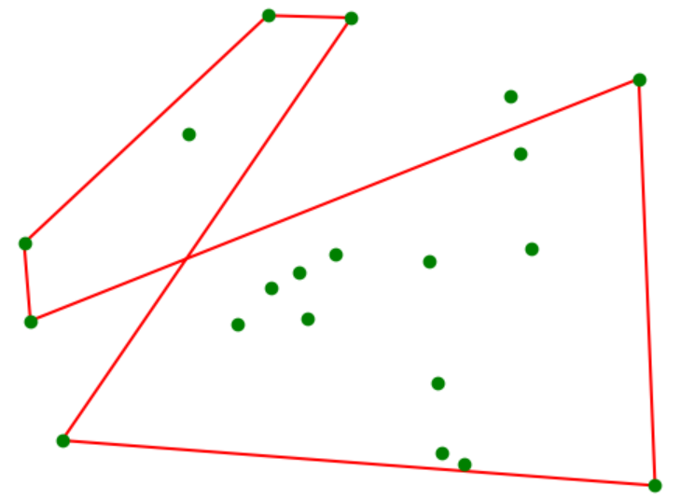
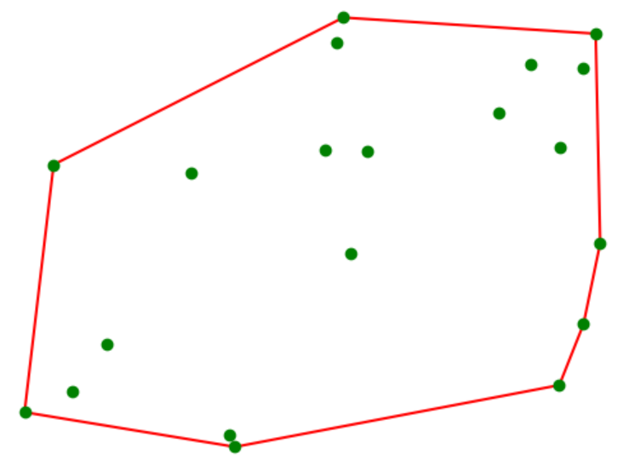
Visual testing – Convex hull computation
Correct
Bug ! (not convex)

Slide 23
doctest
binary-search-doctest.py | Python shell
def binary_search(x, L): '''Binary search for x in sorted list L. Examples: >>> binary_search(42, []) -1 >>> binary_search(42, [7]) 0 >>> binary_search(42, [7,7,7,56,81]) 2 >>> binary_search(8, [1,3,5,7,9]) 3 ''' low, high = -1, len(L) while low + 1 < high: mid = (low + high) // 2 if x < L[mid]: high = mid else: low = mid return low import doctest doctest.testmod(verbose=True) | Trying: binary_search(42, []) Expecting: -1 ok Trying: binary_search(42, [7]) Expecting: 0 ok Trying: binary_search(42, [7,7,7,56,81]) Expecting: 2 ok Trying: binary_search(8, [1,3,5,7,9]) Expecting: 3 ok 1 items had no tests: __main__ 1 items passed all tests: 4 tests in __main__.binary_search 4 tests in 2 items. 4 passed and 0 failed. Test passed.
Python module
Test instances (pairs of input and corresponding output) are written in the doc strings, formatted as in an interactive Python session
docs.python.org/3/library/doctest.html
Notes:
doctest comes with Python as standard library
Useful fo simple tests

Slide 24
pytest
binary-search-pytest.py
import pytest def binary_search(x, L): '''Binary search for x in sorted list L.''' low, high = -1, len(L) while low + 1 < high: mid = (low + high) // 2 if x < L[mid]: high = mid else: low = mid return low def test_binary_search(): assert binary_search(42, []) == -1 assert binary_search(42, [7]) == 0 assert binary_search(42, [7,7,7,56,81]) == 2 assert binary_search(8, [1,3,5,7,9]) == 3 def test_types(): with pytest.raises(TypeError): _ = binary_search(5, ['a', 'b', 'c'])
Shell
pytest binary-search-pytest.py ============= test session starts ============= platform win32 -- Python 3.11.2, pytest-7.2.1, pluggy-1.0.0 plugins: anyio-3.6.2 collected 2 items binary-search-pytest.py .. [100%] ============== 2 passed in 0.05s ==============
Run all tests stored in functions prefixed by test_ or test_ prefixed test methods inside Test prefixed test classes
pip install pytest
Run the pytest program from a shell
pytest.org
Notes:
class name starts with Test (without underscore, since camel-case naming of class names)
The shell should be an OS shell, not a Python shell

Slide 25
unittest
binary-search-unittest.py
def binary_search(x, L): '''Binary search for x in sorted list L.''' low, high = -1, len(L) while low + 1 < high: mid = (low + high) // 2 if x < L[mid]: high = mid else: low = mid return low import unittest class TestBinarySearch(unittest.TestCase): def test_search(self): self.assertEqual(binary_search(42, []), -1) self.assertEqual(binary_search(42, [7]), 0) self.assertEqual(binary_search(42, [7,7,7,56,81]), 2) self.assertEqual(binary_search(8, [1,3,5,7,9]), 3) def test_types(self): self.assertRaises(TypeError, binary_search, 5, ['a', 'b', 'c']) unittest.main(verbosity=2)
Python shell
test_search (__main__.TestBinarySearch) ... ok test_types (__main__.TestBinarySearch) ... ok ---------------------------------------------------------------------- Ran 2 tests in 0.051s OK
Python module
A comprehensive object-oriented test framework, inspired by the corresponding JUnit test framework for Java
docs.python.org/3/library/unittest.html
Notes:
default verbosity level is 1; level 2 increases the amount of output generated during the testing phase

Slide 26
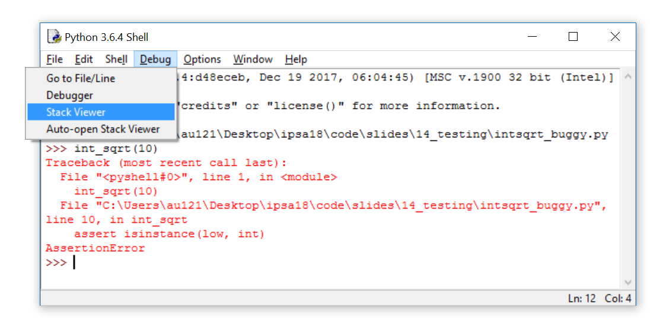
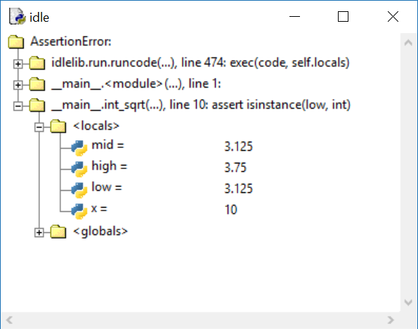
Debugger (IDLE)
When an exception has stopped the program, you can examine the state of the variables using Debug > Stack Viewer in the Python shell

Slide 27
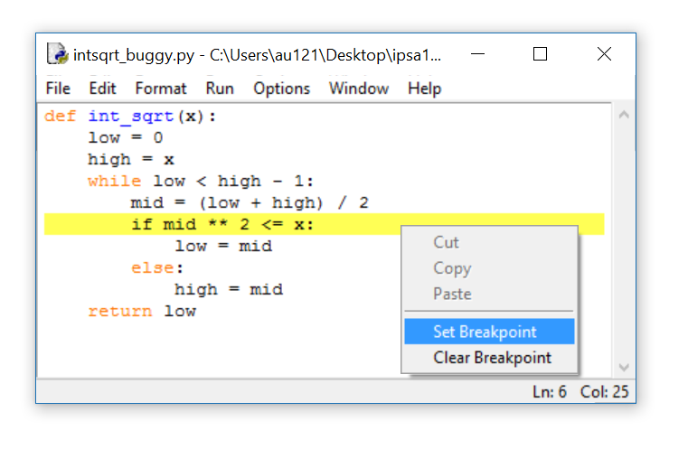
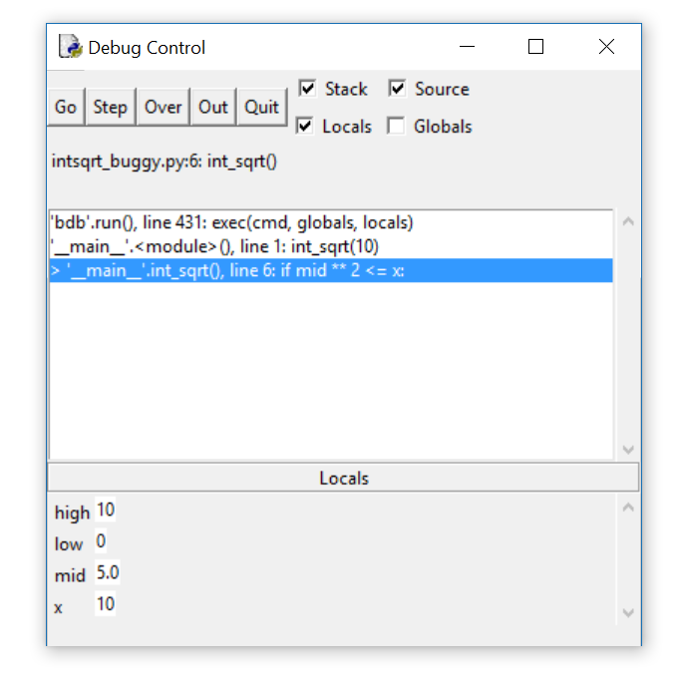
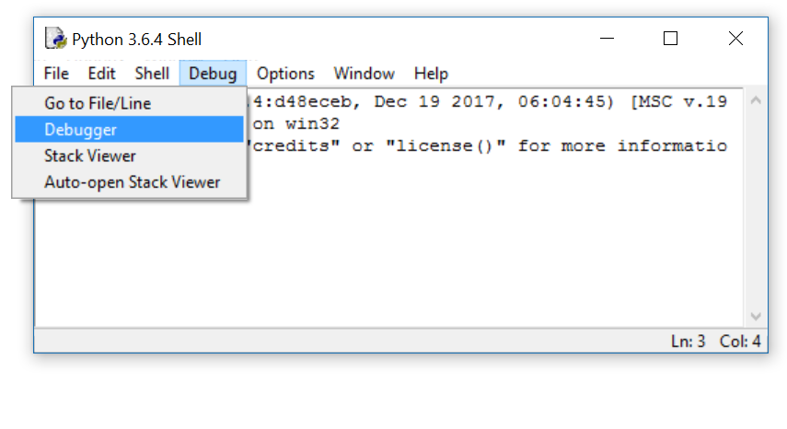
Stepping through a program (IDLE debugger)
Debug > Debugger in the Python shell opens Debug Control window
Right click on a code line in editor to set a “breakpoint” in your code
Debug Control: Go → run until next breakpoint is encountered; Step → execute one line of code; Over → run function call without details; Out → finish current function call; Quit → Stop program;
Notes:
To use debugger, open debugger, and then run code (F5)

Slide 28
Coverage
goldbach.py
1 def odd(x): 2 return x % 2 == 1 3 def sum_of_three_primes(n): 4 assert odd(n) and n > 5 5 primes = (set(range(2, n + 1)) – 6 set(x for f in range(2, n + 1) 7 for x in range(2 * f, n + 1, f))) 8 for x in primes: 9 for y in primes: 10 for z in primes: 11 if n == x + y + z: 12 print(n, 'is the sum of three primes', x, y, z) 13 return 14 print(n, 'is not the sum of three primes') 15 for n in range(7, 1000, 2): 16 sum_of_three_primes(n)
Shell
coverage run –-branch goldbach.py 7 is the sum of three primes 2 2 3 9 is the sum of three primes 2 2 5 ... 999 is the sum of three primes 3 5 991 coverage report -m goldbach.py Name Stmts Miss Branch BrPart Cover Missing --------------------------------------------------------- goldbach.py 14 1 12 1 92% 14 --------------------------------------------------------- TOTAL 14 1 12 1 92%
Ensure that your tests cover the whole code and all possible branches are taken
The module coverage can monitor running your code and report which lines and branches were not executed
pip install coverage
Note 100% coverage does not guarantee that there are no errors… just fewer
pypi.org/project/coverage
en.wikipedia.org/wiki/Goldbach’s_weak_conjecture
Notes:
code coverage does not ensure all branches are taken (an ”if:” might not have an ”else:” part)
Goldbach’s weak conjecture states that line 14 will never be executed, recently proved
Sometimes you need significant insights into the problem, why some code can never be executed…

Slide 29
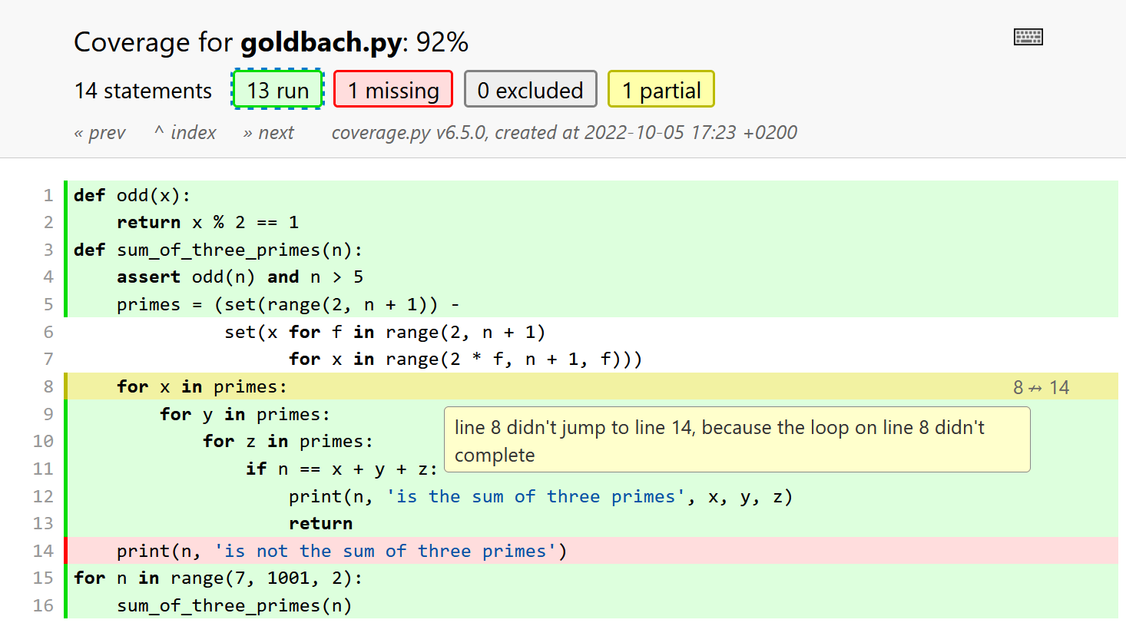
coverage html
Notes:
“coverage html” generates a nice html overview of the code that was executed

Slide 30
Concluding remarks
Simple debugging: add print statements
Test driven development → Strategy for code development, where tests are written before the code
Defensive programming → add tests (assertions) to check if input/arguments are valid according to specification
When designing tests, ensure coverage (the set of test cases should make sure all code lines get executed)
Python testing frameworks: doctest, unittest, pytest, ...

Slide 31
Mypy – a static type checker for Python
Experimental
Static type checking tries to analyze a program for potential type errors without executing the program
Installing:
pip install mypy
Running Python will cause an error during execution, whereas using mypy the error will be found without executing the program
Standard (and required) in statically typed languages like Java, C, C++
mypy-simple.py
print('start') print(42 + 'abc') # error print('end')
Shell
python mypy-simple.py start TypeError: unsupported operand type(s) for +: 'int' and 'str' mypy mypy-simple.py mypy-simple.py:2: error: Unsupported operand types for + ("int" and "str") [operator]
mypy-lang.org PEP 484 - Type Hints
Notes:
Guido van Rossum (@ Google 2005-12 -> Dropbox 2013-19 -> Microsoft, 2020-) is a core developer for mypy
Static type checking Python is used by Google, Facebook, Microsoft (according to Guido)

Slide 32
mypy does not spot all errors…
mypy-add.py
def add(x, y): return x + y # bug: x int and y string print(add(42, 'abc'))
Shell
python add.py TypeError: unsupported operand type(s) for +: 'int' and 'str' mypy add.py Success: no issues found in 1 source file
Notes:
Guido van Rossum (@ Google 2005-12 -> Dropbox 2013-19 -> Microsoft, 2020-) is a core developer for mypy
Static type checking Python is used by Google, Facebook, Microsoft (according to Guido)

Slide 33
Type hints (PEP 484)
mypy-basic-types.py
x : int # type hint x = 42 x = 'abc' # type error y : int = 42 # type hint y = 'abc' # type error z = 42 z = 'abc' # type changed from int to str print(x, y, z)
Shell
python mypy-basic-types.py abc abc abc mypy mypy-basic-types.py mypy-basic-types.py:3: error: Incompatible types in assignment (expression has type "str", variable has type "int") mypy-basic-types.py:5: error: ... mypy-basic-types.py:7: error: ...
Python allows type hints in programs
Type hints are ignored at run-time by Python, but useful for static type analysis (e.g. mypy)
Syntax
variable : type
variable : type = value
Notes:
global variable __annotations__ contains the annotations of global variables
dataclasses (@dataclass decorator) use type hints

Slide 34
Type hints – functions
def name(variable : type, ...) -> return type:
For functions and methods function.__annotations__ is a dictionary with the annotation
The types become part of the documentation
mypy-function.py | Shell
def f(x: int, units: str) -> str: return str(x) + ' ' + units def g(x, units: str) -> str: return str(x) + ' ' + units print(f(3, 'cm')) print(f('one', 'meter')) print(g(3, 'cm')) print(g('one', 'meter')) print(f.__annotations__) | python mypy-function.py 3 cm one meter 3 cm one meter {'x': <class 'int'>, 'units': <class 'str'>, 'return': <class 'str'>} mypy mypy-function.py mypy-function.py:8: error: Argument 1 to "f" has incompatible type "str"; expected "int"
Notes:
x in g has no type
Global variable annotations are in __annotations__
from typing import Literal
Specific values can be tested using ”Literal” from ”typing”
def f(cmd: Literal['add', 'sub']):
if cmd in {'add', 'sub'}:
pass
else:
raise NotImplementedError f('add')
f('sub')
f('addd')

Slide 35
More type hints in Python 3.9 ...see PEP 484 for even more...
mypy-typing.py
from typing import Mapping, Set, List, Tuple, Union, Optional S : Set = {} # error {} dictionary S2 : Set[int] = {1, 2, 'abc'} # error 'abc' is not int D : Mapping[int, int] = {1: 42, 'a': 1} # error 'a' is not int T : Tuple[int, str] = (42, 7) # error 7 is not str L : List[Union[int, str]] = [42, 'a', None] # error list can only contain int and str L2 : List[Optional[str]] = ['abc', None, 42] # error list can only contain str og None
Shell
mypy mypy-typing.py mypy-typing.py:3: error: Incompatible types in assignment (expression has type "Dict[<nothing>, <nothing>]", variable has type "Set[Any]") mypy-typing.py:4: error: Argument 3 to <set> has incompatible type "str"; expected "int" mypy-typing.py:5: error: Dict entry 1 has incompatible type "str": "int"; expected "int": "int" mypy-typing.py:6: error: Incompatible types in assignment (expression has type "Tuple[int, int]", variable has type "Tuple[int, str]") mypy-typing.py:7: error: List item 2 has incompatible type "None"; expected "Union[int, str]" mypy-typing.py:8: error: List item 2 has incompatible type "int"; expected "Optional[str]"
PEP 484 - Type Hints

Slide 36
… the same in Python 3.10
mypy-typing-new.py
# deprecated: from typing import Mapping, Set, List, Tuple, Union, Optional S : set = {} # error {} dictionary S2 : set[int] = {1, 2, 'abc'} # error 'abc' is not int D : dict[int, int] = {1: 42, 'a': 1} # error 'a' is not int T : tuple[int, str] = (42, 7) # error 7 is not str L : list[int | str] = [42, 'a', None] # error list can only contain int and str L2 : list[str | None] = ['abc', None, 42] # error list can only contain str og None
Shell
mypy mypy-typing-new.py mypy-typing-new.py:3: error: Incompatible types in assignment (expression has type "Dict[<nothing>, <nothing>]", variable has type "Set[Any]") mypy-typing-new.py:4: error: Argument 3 to <set> has incompatible type "str"; expected "int" mypy-typing-new.py:5: error: Dict entry 1 has incompatible type "str": "int"; expected "int": "int" mypy-typing-new.py:6: error: Incompatible types in assignment (expression has type "Tuple[int, int]", variable has type "Tuple[int, str]") mypy-typing-new.py:7: error: List item 2 has incompatible type "None"; expected "Union[int, str]" mypy-typing-new.py:8: error: List item 2 has incompatible type "int"; expected "Optional[str]"
PEP 585 - Type Hinting Generics In Standard Collections (Python 3.9) PEP 604 – Allow writing union types as X | Y (Python 3.10)
Notes:
Do not need to import typing from simple annotations (generic does), can use builtin type
The deprecated functionality will be removed from the typing module in the first Python version released 5 years after the release of Python 3.9.0. (i.e. in 2025)
Type union (python 3.10)

Slide 37
Specific values
mypy-literal.py
from typing import Literal def calc(cmd: Literal['add', 'sub'], x: int, y: int) -> int: match cmd: case 'add': return x + y case 'sub': return x - y case _: raise ValueError(f"Unknown command '{cmd}'") print(f"{calc('add', 5, 8) = }") print(f"{calc('sub', 5, 8) = }") print(f"{calc('mul', 5, 8) = }") # error
Shell
python.exe mypy-literal.py calc('add', 5, 8) = 13 calc('sub', 5, 8) = -3 ValueError: Unknown command 'mul' mypy.exe .\mypy-literal.py mypy-literal.py:11: error: Argument 1 to "calc" has incompatible type "Literal['mul']"; expected "Literal['add', 'sub']" [arg-type] Found 1 error in 1 file (checked 1 source file)
PEP 586 - Literal Types (since Python 3.8)
Notes:
Do not need to import typing from simple annotations (generic does), can use builtin type
The deprecated functionality will be removed from the typing module in the first Python version released 5 years after the release of Python 3.9.0. (i.e. in 2025)
Type union (python 3.10)

Slide 38
Type hints for methods with multiple signatures
printing1.py
class MyClass: def print(self, value: int | str) -> None: if isinstance(value, int): print('An integer', value) elif isinstance(value, str): print('A string', value)
printing2.py
from typing import overload class MyClass: # type definition of usages @overload def print(self, value: int) -> None: ... @overload def print(self, value: str) -> None: ... # actual implementation def print(self, value): if isinstance(value, int): print('An integer', value) elif isinstance(value, str): print('A string', value)
The right solution is useful for functions/methods with more complex overloaded type signatures
... is the Python Ellipsis object
@overload is a Python decorator
docs.python.org/3/library/typing.html

Slide 39
Type hints for class inheritance
abstract.py
from typing import override, final class A(): @final # prevent subclasses to override f (since Python 3.8) def f(self): print('f') self.g() def g(self): raise NotImplementedError class B(A): @override # check if parent class contains g (since Python 3.12) def g(self): print('g')
Use pyright (pip install pyright) to check the above, a static type checking tool from Microsoft
mypy does not check it (mypy 1.8.0)
Notes:
VSCode plugin Pylance uses pyright

