Slide 1
Python basics
Comments
”;”
Variable names
int, float, str
type conversion
assignment (=)
print(), help(), type()

Slide 2
Python comments
A ‘#’ indicates the beginning of a comment. From ‘#’ until of end of line is ignored by Python.
x = 42 # and here goes the comment
Comments useful to describe what a piece of code is supposed to do, what kind of input is expected, what is the output, side effects...
Comments are aimed at people (including yourself) reading the code

Slide 3
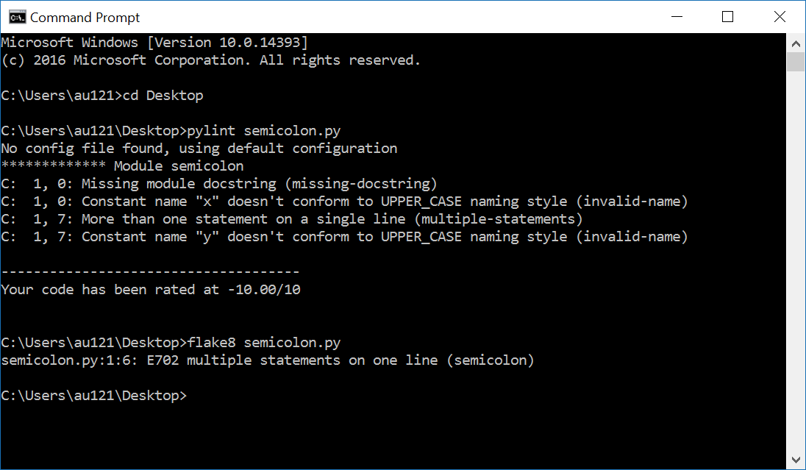
The “;” in Python
Normally statements follow in consecutive lines with identical indentation
x = 1
y = 1
but Python also allows multiple statements on one line, separated by “;”
x = 1; y = 1
General Python PEP 8 guideline: avoid using “;”
Other languages like C, C++ and Java require “;” to end/separate statements
neither pylint or flake8 like “;”
Notes:
PEP8: ”Compound statements (multiple statements on the same line) are generally discouraged.”
”x = 1 y = 2” on a single line without ”;” generates ”SyntaxError: invalid syntax”

Slide 4
Variable names
Variable name = sequence of letters ‘a’-’z’, ‘A’-’Z’, digits ‘0’-’9’, and underscore ‘_’
v, volume, height_of_box, WidthOfBox, x0, _v12_34B, _
a name cannot start with a digit
names are case sensitive (AB, Ab, aB and ab are different variables)
Variable names are references to objects in memory
Use meaningful variables names
Python 3 reserved keywords:
(snake_case) (CamelCase)
and as assert break | class continue def del | elif else except finally | for from global if | import in is lambda | nonlocal not or pass | raise return try while | with yield | None False True
Notes:
0x10 is hexadecimal
0b1111 is binary
PEP8 anbefaler fx at klassenavne er CamelCase
Note last three keywords starts with capital – these are constants

Slide 5

Question – Not a valid Pyton variable name?
Python reserved keyword
print
for
_100
x
_
python_for_ever
Don’t know
Python shell
print = 7 print(42) Traceback (most recent call last): File "<stdin>", line 1, in <module> TypeError: 'int' object is not callable
print is a valid variable name, with default value a builtin function to print output to a shell – assigning a new value to print is very likely a bad idea (like many others sum, int, str, ...)
Notes:
print(42)
print = 42
print(42) – fails
import builtins
builtins.print(42)

Slide 6
Integer literals
.... -4, -3, -2, -1, 0, 1, 2, 3, 4 ....
Python integers can have an arbitrary number of digits (only limited by machine memory)
Can be preceded by a plus (+) or minus (-)
Leading zeros are not allowed (e.g., 7 cannot be written as 007)
For readability underscores (_) can be added between digits,
2_147_483_647
(for more, see PEP 515 - Underscores in Numeric Literals)
Notes:
Since Python 3.11, can only print integers with at most 4300 digits (default value).
sys.set_int_max_str_digits(0) allows an arbitrary number of digits to be printed

Slide 7
Question – What statement will not fail?
x = _42
_10 = -1_1
x = 1__0
x = +1_0_
Don’t know

Slide 8
Float literals
Python shell
0.1 + 0.2 + 0.3 0.6000000000000001 (0.1 + 0.2) + 0.3 0.6000000000000001 0.1 + (0.2 + 0.3) 0.6 type(0.1) <class 'float'> 1e200 * 1e300 inf 0.1+(0.2+0.3) == (0.1+0.2)+0.3 False x = 0.1 + 0.2 y = 0.3 x == y False print(f'{x:.30f}') # 30 decimals 0.300000000000000044408920985006 print(f'{y:.30f}') # 30 decimals 0.299999999999999988897769753748 import sys sys.float_info.min 2.2250738585072014e-308 sys.float_info.max 1.7976931348623157e+308
Decimal numbers are represented using float – contain “.” or “e”
Examples
3.1415
-.00134
124e3 = 124∙10³
-2.345e2 = -234.5
12.3e-4 = 0.00123
Floats are often only approximations, e.g. 0.1 is not 1/10
Extreme values (CPython)
max = 1.7976931348623157e+308
min = 2.2250738585072014e-308
NB: Use module fractions for exact fractions/rational numbers.
Associativity rule does not apply to floats
Notes:
first usage of a comparison, and result is a Boolean
import sys
sys.float_info
forward reference to string formatting in “operations.pptx” / next lecture
import fractions
fractions.Fraction(10, 5)

Slide 9
Question – What addition order is ”best”?
1e10 + 1e-10 + -5e-12 + -1e10
1e10 + -1e10 + 1e-10 + -5e-12
1e-10 + 1e10 + -1e10 + -5e-12
-5e-12 + -1e10 + 1e10 + 1e-10
Any order is equally good
Don’t know
1e10 = 10000000000
-1e10 = -10000000000
1e-10 = 0.0000000001
-5e-12 = -0.000000000005
Python shell
1e10 + 1e-10 + -5e-12 + -1e10 0.0 1e10 + -1e10 + 1e-10 + -5e-12 9.500000000000001e-11 1e-10 + 1e10 + -1e10 + -5e-12 -5e-12 -5e-12 + -1e10 + 1e10 + 1e-10 1e-10
a) - d) give four different outputs

Slide 10
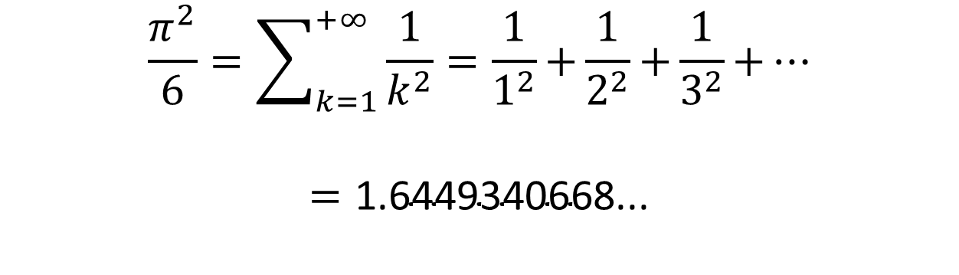
Approximating π = 3.14159265359...
pi_approximation_riemann.py
apx = 0.0 k = 0.0 while True: k = k + 1.0 apx = apx + 1.0 / (k * k) print(k, apx)
Output
... 94906261.0 1.6449340578345741 94906262.0 1.6449340578345744 94906263.0 1.6449340578345746 94906264.0 1.6449340578345748 94906265.0 1.644934057834575 94906266.0 1.644934057834575 94906267.0 1.644934057834575 94906268.0 1.644934057834575 94906269.0 1.644934057834575 94906270.0 1.644934057834575 ...
$$\frac{π^{2}}{6}=\sum_{k=1}^{+∞}{\frac{1}{k^{2}}=\frac{1}{1^{2}}\text{+}\frac{1}{2^{2}}\text{+}\frac{1}{3^{2}}\text{+}⋯}$$
$$=\text{1.6449340668...}$$
Riemann zeta function ζ(2)
This is not a course in numeric computations – but now you are warned....

Slide 11
Python float ≡ IEEE-754 double precision*
A binary number is a number in base 2 with digits/bits from {0,1}
10110₂ = 1∙2⁴ + 0∙2³ + 1∙2² + 1∙2¹ + 0∙2⁰ = 16 + 4 + 2 = 22₁₀
IEEE-754 64-bit double
sign s 1 bit | exponent e 11 bits | coefficient c 52 bits
s = 0
c
+1 | 0011101101011100111010101010101010101010101011101100 | 1001010101100.0100011110010101111001110101010111110101100110101
e – 1023 bits
2⁻⁶
Python shell
1e200 * 1e200 inf -1e200 * 1e200 -inf 1e-200 * 1e-200 0.0 -1e-200 * 1e-200 -0.0 1e200 * 1e200 * 0.0 nan
Float value | Case
(-1)^{s} ∙ (1 + c ∙ 2^{–52}) ∙ 2e ^{– 1023} | 0 < e < 2047
(-1)^{s} ∙ c ∙ 2^{–1074} | e = 0, c ≠ 0
+0 and -0 | e = 0, c = 0
+∞ and -∞ | e = 2047, c = 0
NaN (“not a number”) | s = 0, e = 2047, c ≠ 0
(*most often, but there is no guarantee given in the Python language specification that floats are represented using IEEE-754)
Notes:
THESE DETAILS SHOULD NOT BE CONSIDERED CURRICULUM !!! (not Part of Python language definition anyway!)
s determines sign for 0 and ∞
note -0.0 == +0.0 == 0.0
import math
math.copysign(1, -0.0) == -1
sys.float_info.min = 1/2**1022 = 2.2250738585072014e-308 is the smallest value with 52 bit precision
But the smallest value is 1 / 2**1074 = 4.9406564584e-324 (but only one bit precision)

Slide 12

String literals (type str)
string-test.py
print("abc") print('de\'f') print("'ghi'") print("'jk\nl'\"") print("mn\ o") print("p\\q\tr") print("\N{SNOWMAN}")
Output
$ python string-test.py abc de'f 'ghi' 'jk l'" mno p\q r
Sequence of characters enclosed by single (') or double (") quotes
"a 'quoted' word" "Hello World" 'abc' 'a "quoted" word' '_"_\'_"_'
Escape characters
\n newline
\t tab
\\ backslash
\' single quote
\" double quote
\N{unicode name}
A backslash (\) at the end of line, will continue line/string on next line
Use triple single or double quotes (''' or """) for enclosing strings spanning more lines
(in particular for Python Dosctrings, see PEP 257)

Slide 13
Question – What does the following print ? print("\\\"\\n\n'")
\\\"\\n\n'
\"\nn'
\"\n '
"nn'
\" '
Don’t know
Notes:
print(42)
print = 42
print(42) – fails
import builtins
builtins.print(42)

Slide 14
Long string literals
long-string-literals.py
s1 = 'abc' "def" # two string literals print(s1) s2 = '"' "'" '"' # avoid escaping quotes print(s2) s3 = 'this is a really, really, really, \ really, really, long string' print(s3) s4 = ('this is a really, really, ' 'really, really, really, ' 'long string') print(s4) very_very_long_variable_name = ( 'this is a really, really, ' # line 1 'really, really, really, ' # line 2 "long string" # line 3 ) print(very_very_long_variable_name)
Python shell
abcdef "'" this is a really, really, really, really, really, long string this is a really, really, really, really, really, long string this is a really, really, really, really, really, long string
Long string literals often need to be split over multiple lines
In Python two (or more) string literals following each other will be treated as a single string literal (they can use different quotes)
Putting parenthesis around multiple literals allows line breaks
Advantages:
avoids the backslash at the end of line
can use indentation to increase readability
allows comments between literals
Notes:
the very_very_long_variable_name version is stable wrt indentation when query-replacing variable names
print('"'"'"'"'"'"'"') - even makes sense...

Slide 15
Raw string literals
By prefixing a string literal with an r, the string literal will be considered a raw string and backslashes become literal characters
Useful in cases where you actually need backslashes in your strings, e.g. when working with Python’s regular expression module re
Strange exception: A raw string cannot end with an odd number of backslashes
Python shell
print('\let\epsilon\varepsilon') # \v = vertical tab \let\epsilon arepsilon print('\\let\\epsilon\\varepsilon') # many backslashs \let\epsilon\varepsilon print(r'\let\epsilon\varepsilon') # more readable \let\epsilon\varepsilon

Slide 16
print(...)
Python shell
print() print(7) 7 print(2, 'Hello') 2 Hello print(3, 'a', 4) 3 a 4 print(3, 'a', 4, sep=':') 3:a:4 print(5); print(6) 5 6 print(5, end=', '); print(6) 5, 6
print can print zero, one, or more values
default behavior
print a space between values
print a line break after printing all values
default behavior can be changed by keyword arguments “sep“ and “end“

Slide 17
print(...) and help(...)
Python shell
help(print) Help on built-in function print in module builtins: print(...) print(value, ..., sep=' ', end='\n', file=sys.stdout, flush=False) Prints the values to a stream, or to sys.stdout by default. Optional keyword arguments: file: a file-like object (stream); defaults to the current sys.stdout. sep: string inserted between values, default a space. end: string appended after the last value, default a newline. flush: whether to forcibly flush the stream.
Notes:
Help text is the __doc__ attribute, e.g. print.__doc__
IDLE, VSCode, etc use this information as help desk while typing

Slide 18
Assignments
variable = expression
x = 42
Multiple assignments – right hand side evaluated before assignment
x, y, z = 2, 5, 7
Useful for swapping
x, y = y, x
Assigning multiple variables same value in left-to-right
x = y = z = 7
Warning
i = 1
i = v[i] = 3 # v[3] is assigned value 3
In languages like C and C++ instead v[1] is assigned 3

Slide 19
Python is dynamically typed, type(...)
The current type of a value can be inspected using the type() function (that returns a type object)
In Python the values contained in a variable over time can be of different type
In languages like C, C++ and Java variables are declared with a given type, e.g.
int x = 42;
and the different values stored in this variable must remain of this type
Python shell
x = 1 type(x) <class 'int'> x = 'Hello' type(x) <class 'str'> type(42) <class 'int'> type(type(42)) <class 'type'>
x new type

Slide 20
Type conversion
Python shell
float(42) 42.0 int(7.8) 7 x = 7 print("x = " + x) Traceback (most recent call last): File "<stdin>", line 1, in <module> TypeError: must be str, not int print("x = " + str(x)) x = 7 print("x = " + str(float(x))) x = 7.0 int("7.3") Traceback (most recent call last): File "<stdin>", line 1, in <module> ValueError: invalid literal for int() with base 10: '7.3' int(float("7.3")) 7
string concatenation
Convert a value to another type:
new-type(value)
Sometimes done automatically:
1.0+7=1.0+float(7)=8.0
Notes:
In Javascript and Java: ”X” + 1 computes to ”X1”, ie does the conversion to string automatically

Slide 21
Questions – str(float(int(float("7.5")))) ?
7
7.0
7.5
"7"
"7.0"
"7.5"
Don’t know

