Slide 1
Graphical user interfaces (GUI)
Tkinter

Slide 2
primitive_calculator.py
accumulator = 0 while True: print('Accumulator:', accumulator) print('Select:') print(' 1: clear') print(' 2: add') print(' 3: subtract') print(' 4: multiply') print(' 5: quit') choice = int(input('Choice: ')) match choice: case 1: accumulator = 0 case 2: accumulator += int(input('add: ')) case 3: accumulator -= int(input('subtract: ')) case 4: accumulator *= int(input('multiply by: ')) case 5: break
Python shell
Accumulator: 0 Select: 1: clear 2: add 3: subtract 4: multiply 5: quit Choice: 2 add: 10 Accumulator: 10 Select: 1: clear 2: add 3: subtract 4: multiply 5: quit Choice: 2 add: 15 Accumulator: 25 Select: ...
Notes:
A text interface from the console

Slide 3
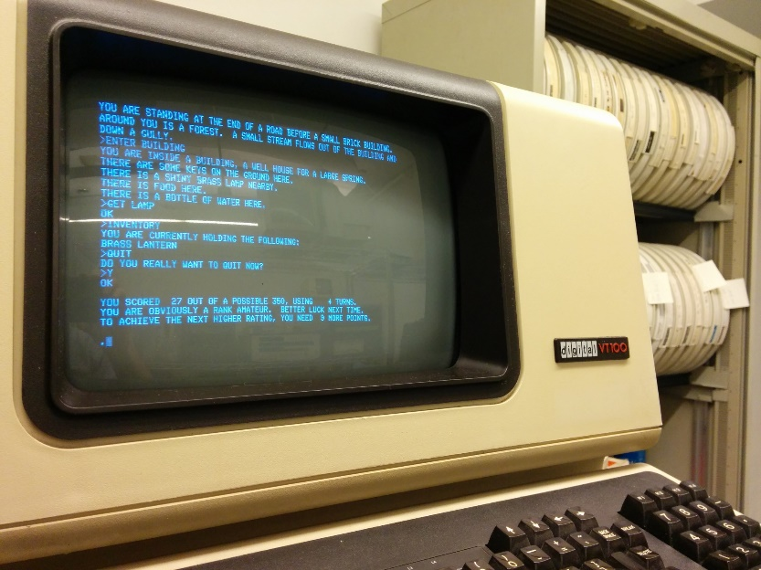
Python GUI’s (Graphical Users Interfaces)
There is a long list of GUI frameworks and toolkits, designer tools
we will only briefly look at Tkinter
GUI are, opposed to a text terminal, easier to use, more intuitive and flexible
Windows, icons, menus, buttons, scrollbars mouse / touch / keyboard interaction etc.
Operating system (e.g. Windows, maxOS, iOS, Linux, Android) provides basic functionality in particular a window manager
Writing GUI applications from scratch can be painful – frameworks try to provide all standard functionality
en.wikipedia.org/wiki/Colossal_Cave_Adventure
wiki.python.org/moin/GuiProgramming

Slide 4
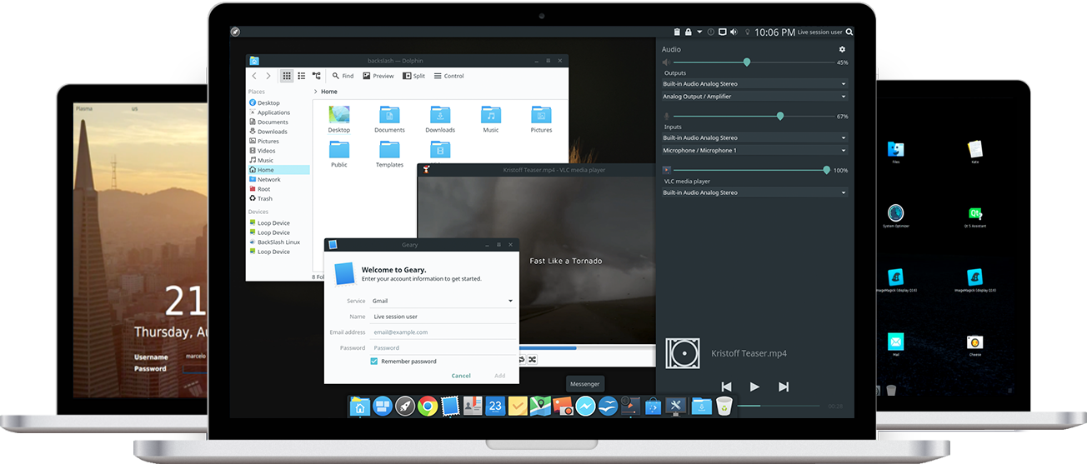
BackSlash Linux GUI www.backslashlinux.com
Notes:
“Our desktop runs on BackSlash Shell which is composted of a number of Open-Source Components and is built using Qt. “

Slide 5
Tkinter
“Tkinter is Python's de-facto standard GUI (Graphical User Interface) package. It is a thin object-oriented layer on top of Tcl/Tk.”
“Tcl is a high-level, general-purpose, interpreted, dynamic programming language.”
“Tk is a free and open-source, cross-platform widget toolkit that provides a library of basic elements of GUI widgets for building a graphical user interface (GUI) in many programming languages.”
“The popular combination of Tcl with the Tk extension is referred to as Tcl/Tk, and enables building a graphical user interface (GUI) natively in Tcl. Tcl/Tk is included in the standard Python installation in the form of Tkinter.”
en.wikipedia.org

Slide 6
Terminology
widgets (e.g. buttons, editable text fields, labels, scrollbars, menus, radio buttons, check buttons, canvas for drawing, frames...)
events (e.g. key press, mouse click, mouse entering/leaving, resizing windows, redraw requests, ...)
listening (application waits for events to be fired)
event handler (a function whose purpose is to handle an event, many triggered by user or OS/Window manager)
geometry managers (how to organize widgets in a window: Tkinter pack, grid, place)
Notes:
place should be avoided (specific position in the parent widget)

Slide 7
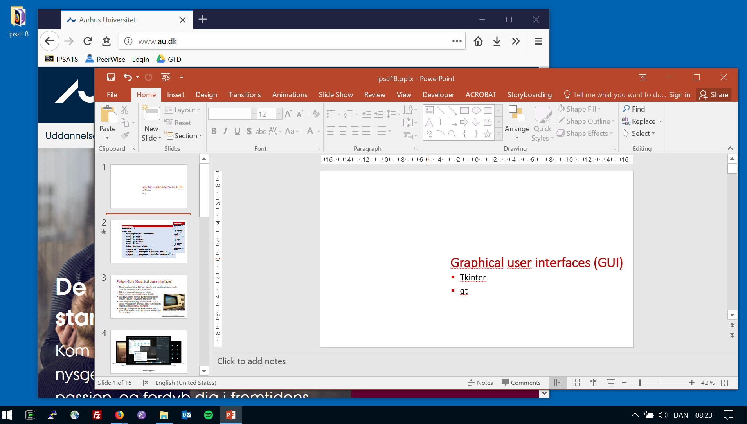
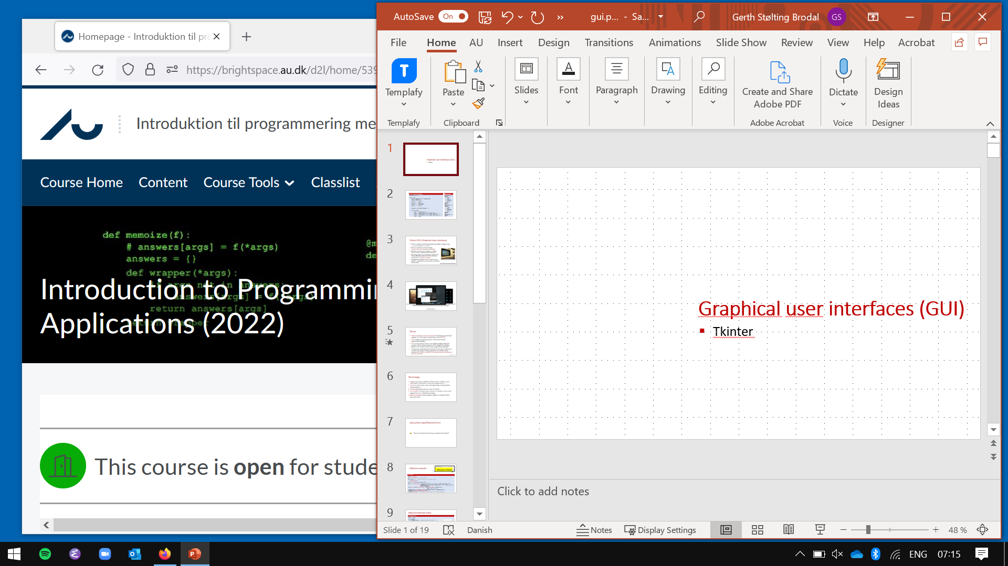

Slide 8

docs.python.org/3/library/tk.html
“tkinter is also famous for having an outdated look and feel”
Comes with Python
Alternatives PySide, PyQt, Kivy, …

Slide 9
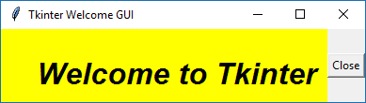
Welcome example
pady
padx
welcome.py
import tkinter root = tkinter.Tk() # root window def do_quit(): # event handler for 'Close' button root.destroy() root.title('Tkinter Welcome GUI') label = tkinter.Label(root, text='Welcome to Tkinter', background='yellow', anchor=tkinter.SE, font=('Helvetica', '24', 'bold italic'), padx=10, pady=10) label.pack(side=tkinter.LEFT, fill=tkinter.BOTH, expand=True) close_button = tkinter.Button(root, text='Close', command=do_quit) close_button.pack(side=tkinter.RIGHT) tkinter.mainloop() # loop until all windows are closed/destroyed
# parent window
Notes:
inversion of control
mainloop # without this, the window will show up but program terminates if run from shell

Slide 10

Welcome example (class)
welcome_class.py
import tkinter class Welcome: def do_quit(self): # event handler for 'Close' self.root.destroy() def __init__(self, window_title): self.root = tkinter.Tk() self.root.title(window_title) self.label = tkinter.Label(self.root, text='Welcome') self.label.pack(side=tkinter.LEFT) self.close_button = tkinter.Button(self.root, text='Close', command=self.do_quit) self.close_button.pack(side=tkinter.RIGHT) Welcome('My Window') tkinter.mainloop()

Slide 11
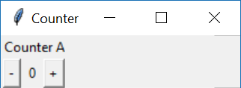
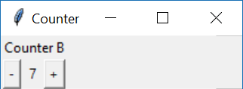
increment.py (part I)
import tkinter class Counter: def do_quit(self): self.root.destroy() def add(self, x): self.counter += x self.count.set(self.counter) def __init__(self, message): self.counter = 0 self.root = tkinter.Toplevel() # new window self.root.title('Counter') self.label = tkinter.Label(self.root, text=message) self.label.grid(row=0, columnspan=3) self.minus_button = tkinter.Button(self.root, text='-', command=lambda: self.add(-1)) self.minus_button.grid(row=1, column=0) self.count = tkinter.IntVar() self.count_label = tkinter.Label(self.root, textvariable=self.count) self.count_label.grid(row=1, column=1) self.plus_button = tkinter.Button(self.root, text='+', command=lambda: self.add(+1)) self.plus_button.grid(row=1, column=2)

Slide 12

increment.py (part II)
class Counter_app: def __init__(self): self.counters = 0 self.root = tkinter.Tk() self.create = tkinter.Button(self.root, text='Create counter', command=self.new_counter) self.create.pack() def new_counter(self): Counter('Counter ' + chr(ord('A') + self.counters)) self.counters += 1 Counter_app() tkinter.mainloop()

Slide 13
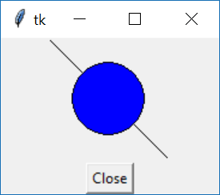
Canvas
canvas.py
import tkinter root = tkinter.Tk() canvas = tkinter.Canvas(root, width=100, height=100) canvas.pack() canvas.create_line(0, 0, 100, 100) canvas.create_oval(20, 20, 80, 80, fill='blue') close = tkinter.Button(root, text='Close', command=root.destroy) close.pack() tkinter.mainloop()
Notes:
(0,0) = upper left

Slide 14
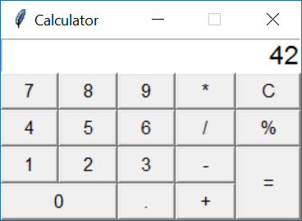

Slide 15
calculator.py (Part I)
import tkinter from tkinter import messagebox class Calculator: def __init__(self, root): self.root = root self.display = tkinter.Entry(self.root, font=('Helvetica', 16), justify=tkinter.RIGHT) self.display.insert(0, '0') self.display.grid(row=0, column=0, columnspan=5) # grid = geometry manager self.button(1, 0, '7') self.button(1, 1, '8') self.button(1, 2, '9') self.button(1, 3, '*') self.button(1, 4, 'C', command=self.clearText) # 'C' button self.button(2, 0, '4') self.button(2, 1, '5') self.button(2, 2, '6') self.button(2, 3, '/') self.button(2, 4, '%') self.button(3, 0, '1') self.button(3, 1, '2') self.button(3, 2, '3') self.button(3, 3, '-') self.button(3, 4, '=', rowspan=2, command=self.calculateExpression) # '=' button self.button(4, 0, '0', columnspan=2) self.button(4, 2, '.') self.button(4, 3, '+')

Slide 16
calculator.py (Part II)
def button(self, row, column, text, command=None, columnspan=1, rowspan=1): if command == None: command = lambda: self.appendToDisplay(text) B = tkinter.Button(self.root, font=('Helvetica', 11), text=text, command=command) B.grid(row=row, column=column, rowspan=rowspan, columnspan=columnspan, sticky='NWNESWSE') def clearText(self): self.replaceText('0') def replaceText(self, text): self.display.delete(0, tkinter.END) self.display.insert(0, text) def appendToDisplay(self, text): if self.display.get() == '0': self.replaceText(text) else: self.display.insert(tkinter.END, text) def calculateExpression(self): expression = self.display.get().replace('%', '/ 100') try: result = eval(expression) # DON'T DO THIS !!! self.replaceText(result) except: messagebox.showwarning('Message', 'Invalid expression') root = tkinter.Tk() root.title('Calculator') root.resizable(0, 0) # disallow resizing and maximizing the window Calculator(root) tkinter.mainloop()
Notes:
Qt more modern framework (written in C++)
Can use QtDesigner to design interfaces
tkinter.messagebox.showinfo requires ”import tkinter.messagebox”, other fails with ”module 'tkinter' has no attribute 'messagebox’” since submodule
.resizeable(False, False) or .resizeable(0, 0) disables resizeable and “fullscreen” button on the window’s topbar.

Slide 17
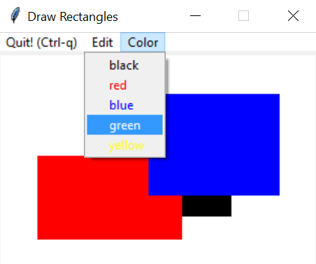
Creating a menu
rectangles.py
class Rectangles: Colors = ['black', 'red', 'blue', 'green', 'yellow'] def create_menu(self): menubar = tkinter.Menu(self.root) menubar.add_command(label='Quit! (Ctrl-q)', command=self.do_quit) editmenu = tkinter.Menu(menubar, tearoff=0) editmenu.add_command(label='Clear', command=self.clear_all) editmenu.add_command(label='Delete last (Ctrl-z)', command=self.delete_last_rectangle) colormenu = tkinter.Menu(menubar, tearoff=0) for color in self.Colors: # list of color names colormenu.add_command(label=color, foreground=color, command=self.get_color_handler(color)) menubar.add_cascade(label='Edit', menu=editmenu) menubar.add_cascade(label='Color', menu=colormenu) self.root.config(menu=menubar) # Show menubar def get_color_handler(self, color): return lambda : self.set_color(color) def set_color(self, color): self.current_color = color ...
Notes:
Use root.config to show menu instead of .pack or .grid

Slide 18
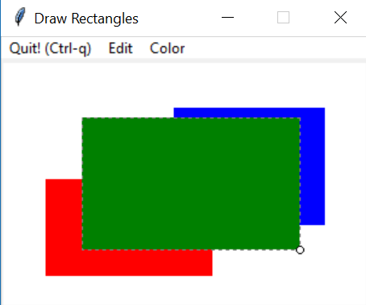
Binding key and mouse events
Whenever a key is pressed, mouse button is pressed/released, mouse is moved, mouse enters/leaves objects etc. events are triggered that can be bound to call a user defined event handler
rectangles.py (continued)
... self.root = tkinter.Tk() self.root.bind('<Control-q>', self.do_quit) self.root.bind('<Control-z>', self.delete_last_rectangle) ... self.canvas = tkinter.Canvas(self.root, width=300, height=200, background='white') self.canvas.bind('<Button-1>', self.create_rectangle_start) self.canvas.bind('<B1-Motion>', self.create_rectangle_mouse_move) self.canvas.bind('<ButtonRelease-1>', self.create_rectangle_end) ...
Notes:
Keys are bound to the root window, whereas mouse clicks are bound to the specific widget(=canvas)

Slide 19
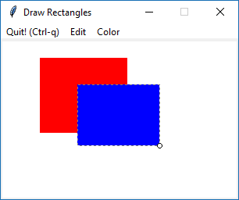
Handling mouse events
rectangles.py (continued)
def create_rectangle_start(self, event): radius = 3 x, y = event.x, event.y self.top_pos = (x, y) self.bottom_pos = (x, y) self.rectangle = self.canvas.create_rectangle(x, y, x, y, # top-left = bottom-right fill=self.current_color, width=1, outline='grey', dash=(3, 5)) self.corner = self.canvas.create_oval(x - radius, y - radius, x + radius, y + radius, fill='white') def create_rectangle_mouse_move(self, event): if self.corner: x, y = event.x, event.y x_, y_ = self.bottom_pos self.bottom_pos = (x, y) self.canvas.coords(self.rectangle, *self.top_pos, *self.bottom_pos) self.canvas.move(self.corner, x - x_, y - y_) def create_rectangle_end(self, event): if self.corner: self.canvas.delete(self.corner) self.corner = None if self.bottom_pos != self.top_pos: self.rectangles.append(self.rectangle) self.canvas.itemconfig(self.rectangle, width=0) else: # empty rectangle, skip self.canvas.delete(self.rectangle) self.rectangle = None

Slide 20
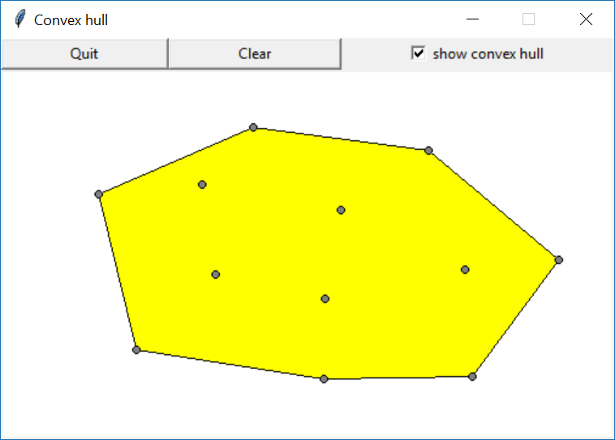
Exercise 25.1 (convex hull GUI)
Notes:
Grid : top-row 2 buttons + tkinter.Checkbutton, button-row canvas with columnspan=3

