Slide 1




Statistical Models for the Analysis of Brain Connectivity Based on fMRI Data
Yoshio Takane
McGill University and University of Victoria
September 19, 2013
This talk is dedicated to Professor Haruo Yanai of St. Luke College of Nursing

Slide 2
Structural Equation Models (SEMs)
Methods for investigating if hypothesized relationships among observed variables are consistent with data
path analysis (sociology)
simultaneous equation models
(econometrics)
Latent variables to simplify the relationships among observed variables (psychometrics)

Slide 4
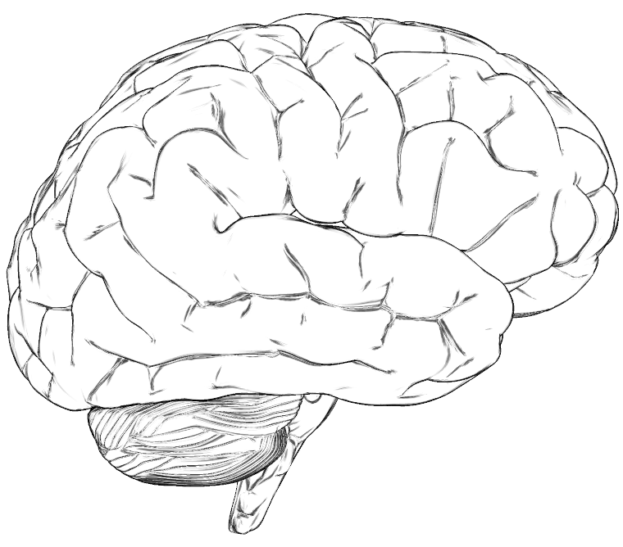
Effective Connectivity
SPC
V5
V1
V1 = Primary Visual Cortex
V5 = Middle Temporal Area
SPC = Superior Parietal Cortex
Attention to Visual Motion Study (Friston et al, 2003)
Notes:
Dynamic GSCA is a useful method to reveal how functionally specialized areas interact and how these interactions depend on changes of experimental context. Here is an example of analyzing effective connectivity. First, a number of specific brain regions are selected based on a hypothesis about their importance in completing a given task. Here, V1, V5, and SPC are selected. The selected brain areas are called regions of interest, in short, ROIs. And then, their directional relationships in response to cognitive tasks are modeled and tested.

Slide 5
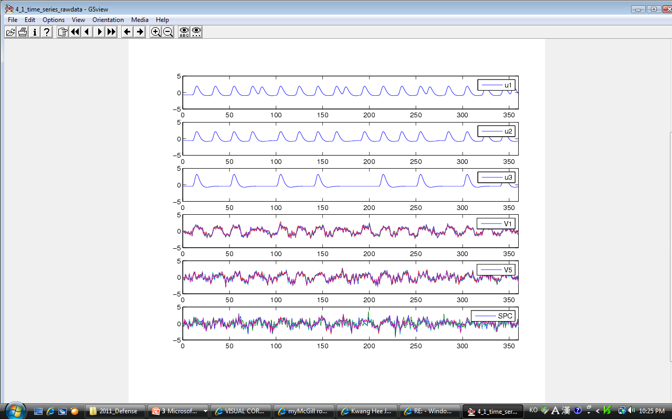
Time Series of Three ROIs
Five BOLD signals for each ROI
ROIs Constructs or latent variables
BOLD signals Observed variables
Notes:
Here are the functional neuroimaging data. Five BOLD signals in each of the three ROIs are presented in the figure. It can be seen that although there is a bit of variability among the voxels, there is also some common variability across voxels within a ROI. This common variability is our main focus of analysis. It is deemed representative of neuronal activities in the ROI, and is to be captured in the form of a latent variable in a SEM framework. Thus, in the Dynamic GSCA model, ROIs correspond to constructs or latent variables, which indicate activity in the brain regions. And the BOLD signals in voxels in the ROIs correspond to indicator or observed variables.

Slide 6
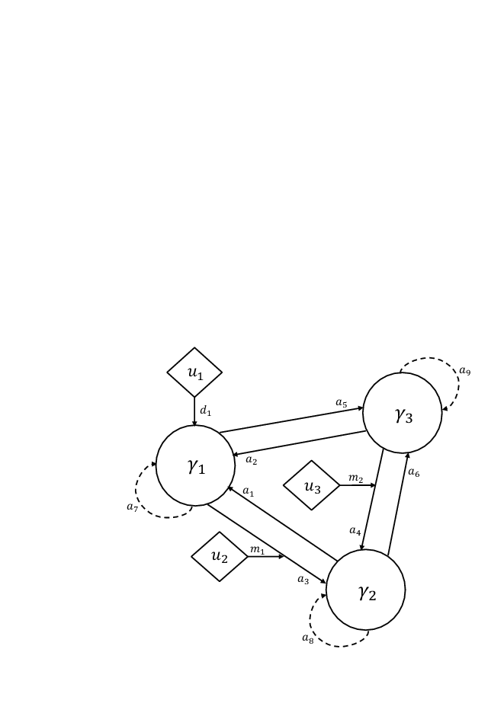
The Attention to Visual Motion Data
u1 = Photic
u2 = Motion
u3 = Attention
Source: Friston et al. (2003)
Notes:
Here is a diagram which includes all the features that I mentioned right before. In the model, there are three ROIs and three stimuli. The hypothesized model includes 6 contemporaneous effects, 3 time lagged effects, 1 direct effect, and 2 modulating effects.

Slide 8
Shift Matrices
Notes:
Here is an example of shift matrices. S0 represents contemporaneous effect between ROIs, while S1 represent time-one lag effects among ROIs.

Slide 9
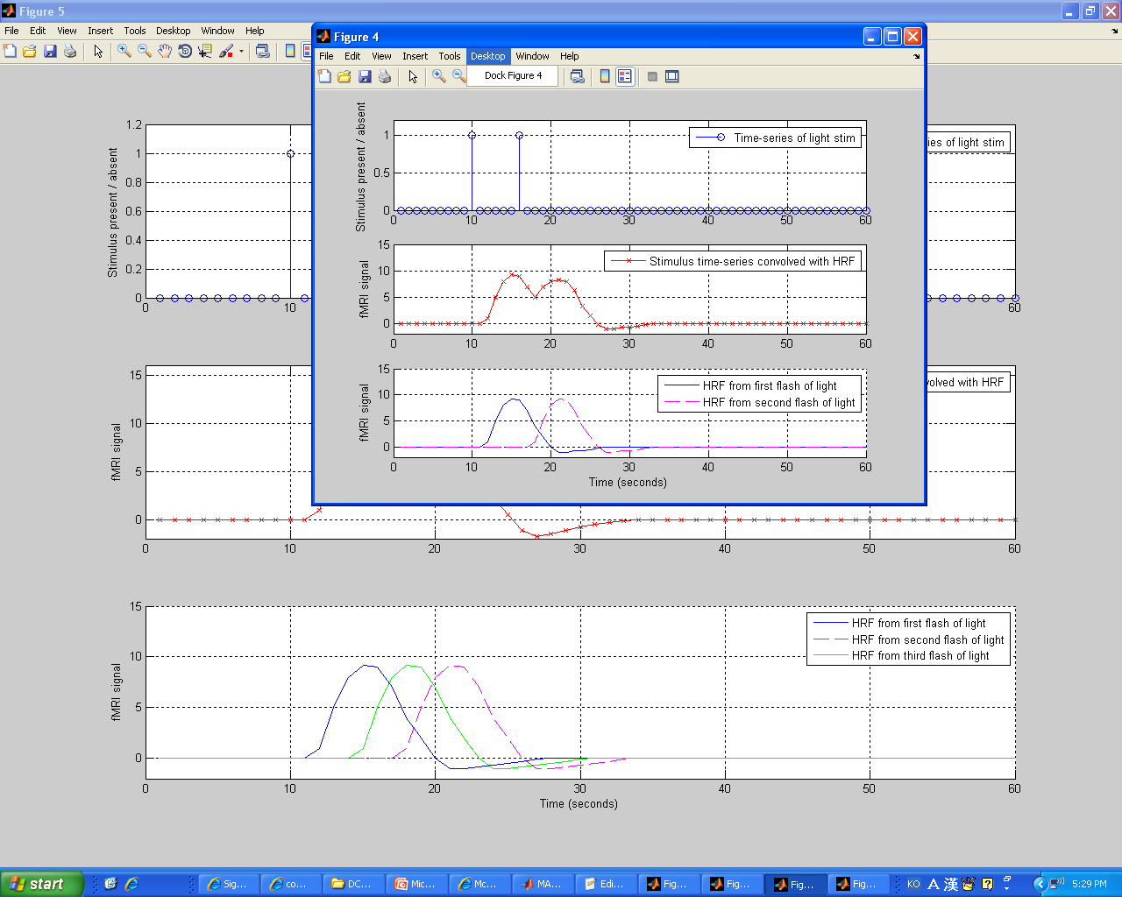
Experimental Stimuli
Notes:
Here is an example of experimental stimuli convolved with hemodynamic response function. Specifically, to model a hemodynamic response function of an experimental stimulus, first, a delta function is generated with zero and one (zero denotes no stimulus, one denotes stimulus), and then the inputs were convolved with a hemodynamic response function (gamma function). Here, I used a SPM routine for the convolution, which is commonly used for this purpose.

Slide 10
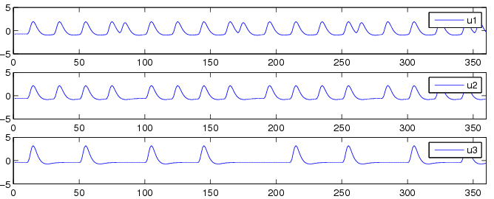
Time Series of Experimental Stimuli
u1 = Photic
u2 = Motion
u3 = Attention
Notes:
As a result, I obtained the following time series of three experimental stimuli.

Slide 11
Model Features
Features in Conventional SEM
Contemporaneous Effects of ROIs on other ROIs
(2) New Features
Time Lagged Effects
Stimulus Effects
a) Direct effects
b) Modulating effects
Notes:
Next, let’s see the model features of Dynamic GSCA. Dynamic GSCA has a feature to capture contemporaneous effects of ROIs on other ROIs as the same as conventional SEM. However, it has new features, that is, time lagged effects and stimulus effects. Here, time lagged effects indicate that earlier states in ROIs exert influence on later states in ROIs. Dynamic GSCA is also able to investigate direct effects of experimental stimuli on a certain ROIs and modulating effects on connections between ROIs. Thus, Dynamic GSCA enables us to examine more specific research questions.

Slide 12
Model Fitting
Estimate model parameters in such a way as to minimize the sum of squared residuals under some side conditions

Slide 13
A Special Bootstrap Method
Assessment of reliability – Bootstrap method
Data are correlated
A modified moving block bootstrap method
Notes:
In addition, I employed a special bootstrap method in dynamic GSCA, called a modified moving block bootstrap method, in order to assess the reliability of parameter estimates. This is because the standard bootstrap method used in the original GSCA does not take into account the time order of observations. Specifically, in Dynamic GSCA, I break down the original BOLD signals into overlapping blocks. Then, I draw blocks of observations with replacement. Finally, I apply Dynamic GSCA to the bootstrapped samples, considering time dependence among consecutive observations.

Slide 14
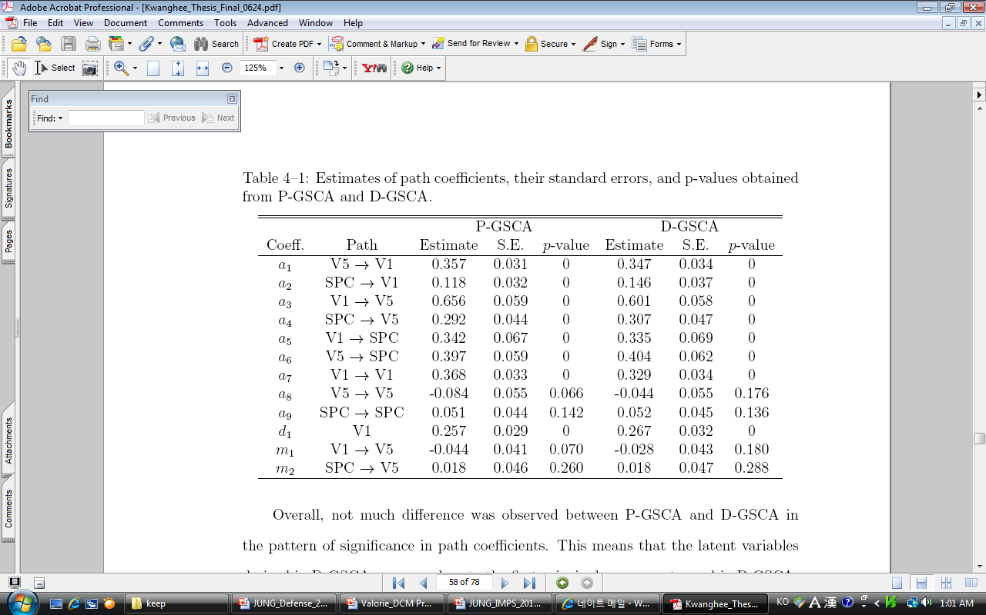
Result 1 : Attention to Visual Motion Data
Estimates, SE, p-values
Notes:
Next, let’s see the result of the attention to visual motion data anaysis. All contemporaneous effects were significant at the alpha level of .05.; only one autoregressive effect turned out be significant; the direct effect of u1 on V1 was signficant. However, neither of the two modulating effects of stimulus inputs were significant.

Slide 15
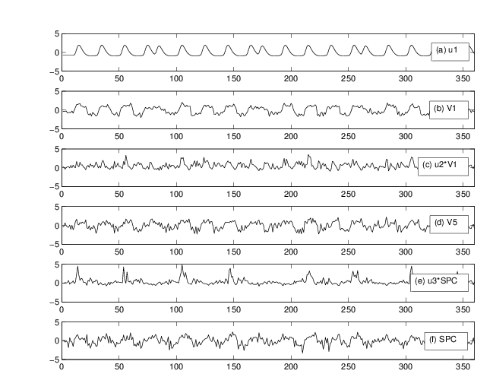
Result 1: Attention to Visual Motion Data
Notes:
In this figure, the time series of u1 and extracted components are presented. As can be seen, the significant direct effect of u1 on V1 is sensible because they covary quite clearly.

Slide 16
Result 2: Memory Task Data
PCUN
DCG
MOG
THA
INS
MTG
HIP
Source: Wang et al. (2010)
Notes:
In the second example, I considered a network hub drawn from a memory study. In the model, there are seven ROIs, which are fully connected by contemporaneous reciprocal relations and by autoregressive paths. Although this kind of complex model is realistic and prevalent in practical brain connectivity studies, it cannot be fitted by any other existing methods because of computational difficulties.

Slide 17
Result 2: Memory Task Data
PCUN
DCG
MOG
THA
INS
MTG
HIP
Notes:
I found the significant paths using Dynamic GSCA without any computational difficulties.
****Slides 19 and 20 might be combined into one. You present 19, and then add X’s to connections that were insignificant.

Slide 18
A Summary so far
Dynamic GSCA can accommodate more complex and elaborate models
Single optimization criterion/ Simple and reliable algorithm
Modified moving block bootstrap method to handle correlated observations
Notes:
To summarize, I observed that Dynamic GSCA was capable of modeling and analyzing the elaborate and complex models without encountering computational difficulties.

Slide 19
Extensions of Dynamic GSCA
Dynamic GSCA with latent interactions
2. Simultaneous analysis of multi-subject data
Multi-sample (multi-group) comparison
Multilevel analysis
Notes:
Furthermore, the Dynamic GSCA model may be extended by in a variety of ways to enhance its capabilities. The possible enhancements include higher order latent variables, simultaneous analysis of multi-sample data, and incorporating interactions among latent variables.

Slide 20
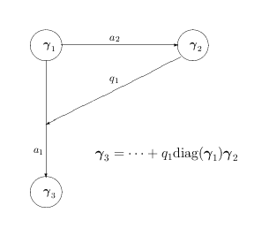
Latent Interaction

Slide 21
Multiple Subjects
A recent article posted at a blog site called NEUROSKEPTIC is questioning the validity of some procedure in SPM (Does it mean “Spurious Positive Mapping” rather than “Statistical Parametric Mapping?”) based on Eklund et al. (2012), who examined nearly 1500 individual resting-state fMRI data sets by SPM, and found significant task unrelated activations in a majority of cases.

Slide 22
A commentary of the article said “It is quite common to find such spontaneous activations in individual data. However, those activations are not synchronized across individuals, so they tend to disappear when multiple-subject data are simultaneously analyzed.”

Slide 23
Second Model
Measurement model:
-- Extracts the most representative variations of ROIs across subjects within groups
-- Multiple-set canonical correlation analysis (instead of PCA-like model as before)
-- Homogeneity across subjects, but not across ROIs
Structural model remains essentially the same as before (but includes latent interactions)

Slide 24
The Bootstrap Method
Sample from subjects
Equivalent to sampling blocks of length equal to T
Calculate mean, sd, and p-values for estimated parameterst and fit indices
We may also bootstrap any contrasts between parameters (e.g., directionality of influence).

Slide 25
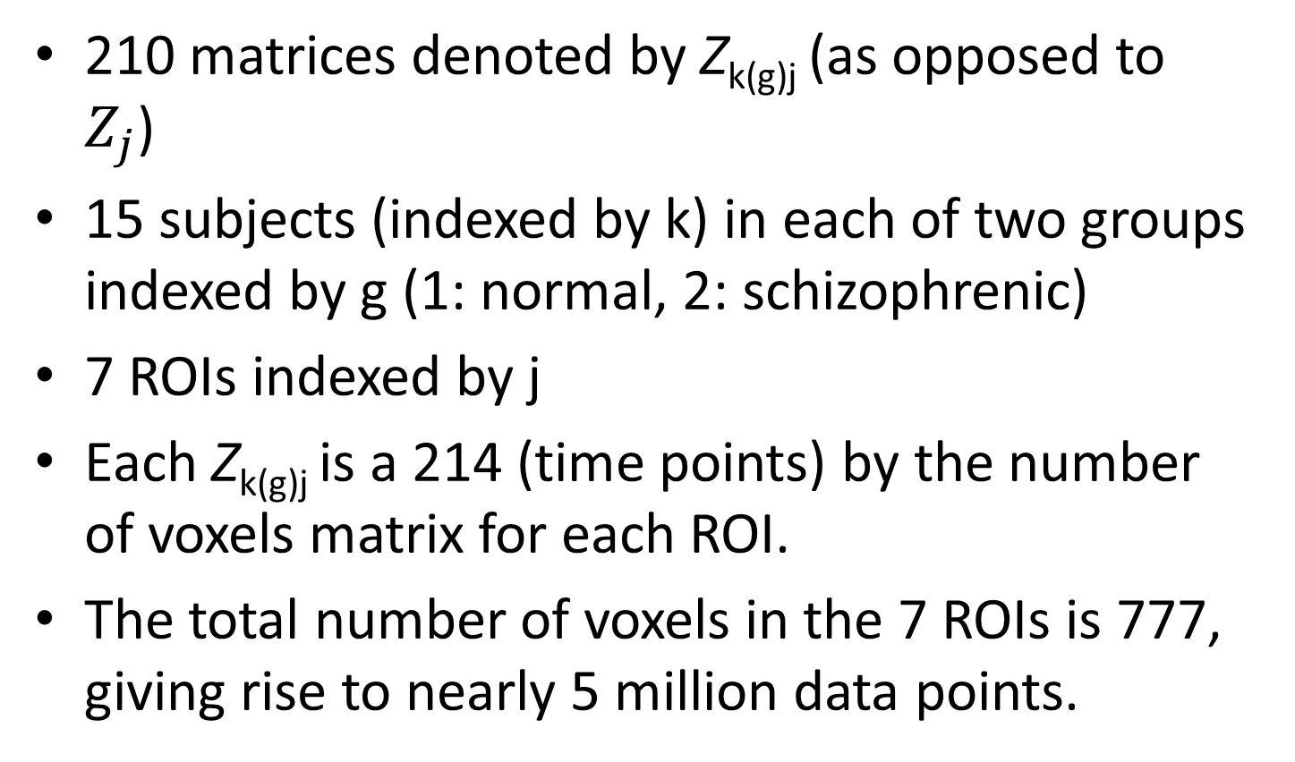
An Example Data Set
210 matrices denoted by Z_{k(g)j} (as opposed to $Z_{j}$)
15 subjects (indexed by k) in each of two groups indexed by g (1: normal, 2: schizophrenic)
7 ROIs indexed by j
Each Z_{k(g)j} is a 214 (time points) by the number of voxels matrix for each ROI.
The total number of voxels in the 7 ROIs is 777, giving rise to nearly 5 million data points.

Slide 26

Equality Constraints
We may constrain $γ_{gj}$ (ROI j’s activations) across groups
We may also constrain other structural parameters equal across groups

Slide 27
Analyses
No stimulus effects; 7 ROIs are bidirectionally connected; Time-lagged effects of order 1
Analysis I: All parameters are assumed equal across groups.
Analysis II: No parameters are assumed equal. (Equivalent to two separate analyses.)

Slide 28
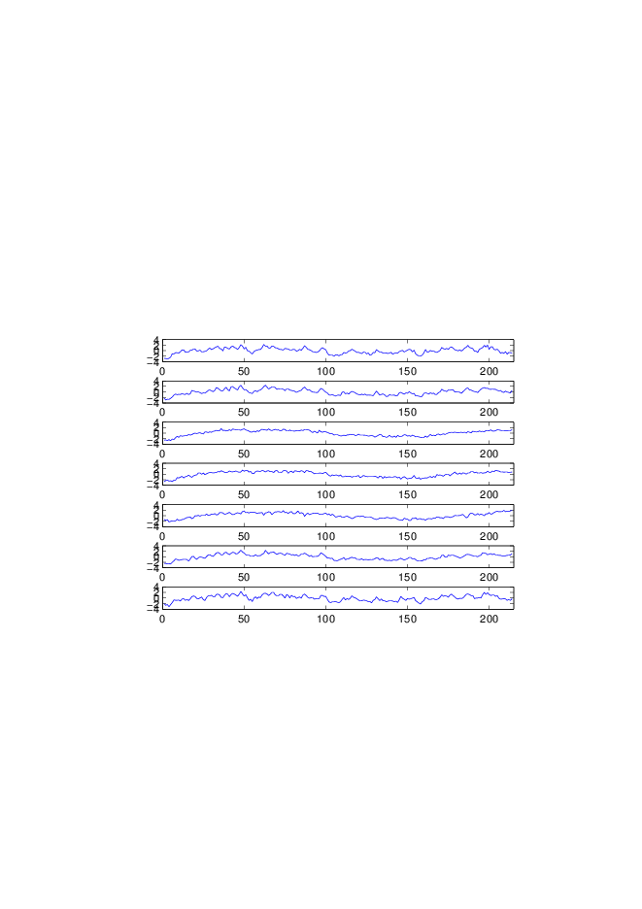
Time Series of ROIs: Assumed Equal Across Groups
IPL-L
PreCG-L
CL-L
CL-R
IPL-R
PreCG-R
SMA

Slide 29
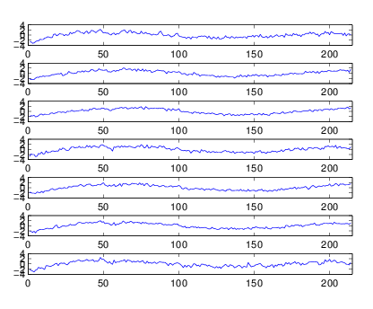
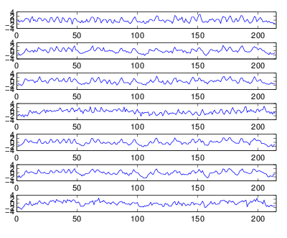
Time Series of ROIs: Separate Groups
Normals
Schizophrenics

Slide 30
The Second Order PCA of SeparateTime Series for ROIs
I
II
Normal 49.2%. 35.7%
1 0.8740 0.3319 IPL-L
2 0.9515 0.0541 PreCG-L
3 0.9431 -0.0444 CL-L
4 0.9360 0.1513 CL-R
5 0.9621 -0.0422 IPL-R
6 0.9547 0.1525 PreCG-R
7 0.8805 0.3406 SMA
schizophrenic
1 -0.1473 0.8472 IPL-L
2 0.1945 0.9284 PreCG-L
3 -0.0357 0.9442 CL-L
4 0.7038 -0.1592 CL-R
5 -0.0068 0.9564 IPL-R
6 0.2163 0.9042 PreCG-R
7 0.4833 0.6976 SMA

Slide 31

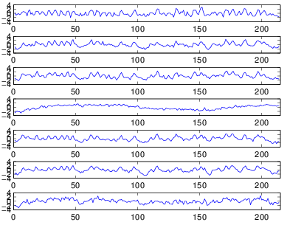
Time Series for ROIs: ROI 4 Equated Across Groups
Normals
Schizophrenics

Slide 32
Future Prospects
User friendly program
More flexible constraints
Groups created by repeated measurements
Time varying regression coefficients in structural models
Nonlinear models(?); Differential equations

Slide 33
Contributions by
Kwanghee Jung (McGill → Univ. of Texas at Houston)
Lixing Zhou (McGill)
Heungsun Hwang (McGill)
Todd Woodward (University of British Columbia)

Slide 34
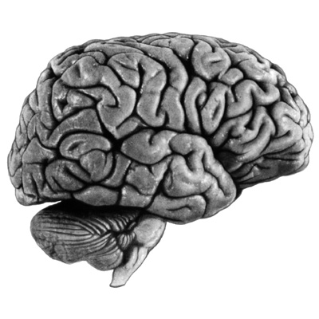
Thank you

Slide 35
Historical 1
Unified SEM (Kim et al., 2007) – autoregressive effects
Extended unified SEM (Gates et al., 2010) – stimulus effects
GSCA (Hwang & Takane, 2004) – PCA-SEM
Dynamic GSCA (Jung et al., 2012)

Slide 36
Historical 2
Regularized GCANO (Takane et al., 2008)
Functional GCANO (Hwang et al., 2012)
GCANO –PCA (Hwang et al., 2013)
Dynamic GCANO – GCANO-SEM

