Slide 1
On Likelihood Ratio Tests for Dimensionality Selection
Yoshio Takane (McGill Univ.)
Peter van der Heijden (Utrecht Univ.)
Michael Browne (Ohio State Univ.)

Slide 2
Models requiring dimensionality selection
MDS
FA/PCA
CANO/DISC/MANOVA
CA
Correlation/association models
LCA
RA
Finite mixture models
Multi-layer neural network (NN) models

Slide 3

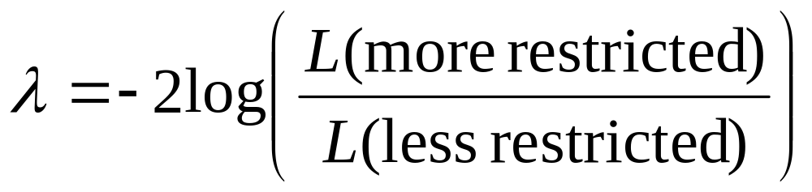
Likelihood ratio (LR) statistic
Ordinary Case
(1) Saturated model
(2) Model A
(3) Model B (true)
((3) nested in (2), and (2) nested in (1))
(2) vs (3) _{a}²
(1) vs (2) _{b}²
(1) vs (3) _{a+b}²

Slide 4
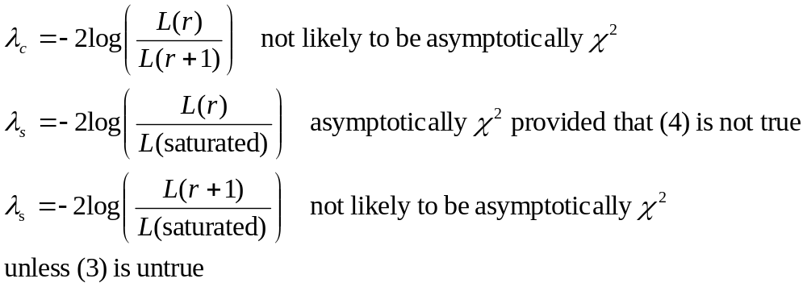
Dimensionality Selection
Saturated
(2) dim. r+1
(3) dim. r (true)
(4) dim. r-1 (not true)

Slide 5
Local Regularity (Shapiro, 1986)
A point θ₀ in the parameter space Ω is said to be locally regular, if rank(J(θ)) = rank(J(θ₀)) for all θ in a neighborhood of θ₀, where
J(θ) = (∂ξ(θ)/∂θ’).
ξ: vector of model values
θ: vector of model parameters
θ₀ must be in the interior of Ω (so that there is a neighborhood of θ₀ in Ω).

Slide 6
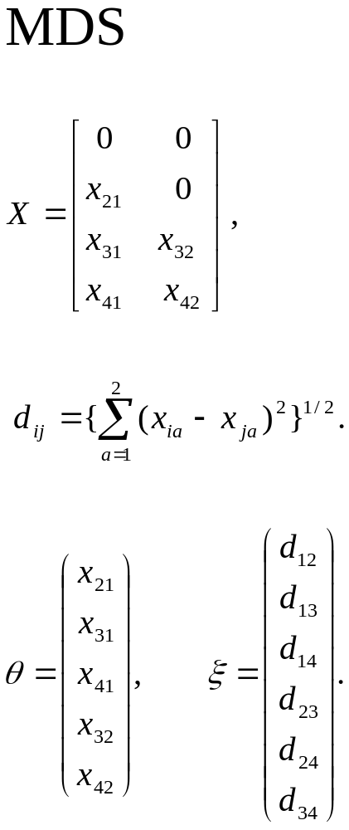

Slide 7
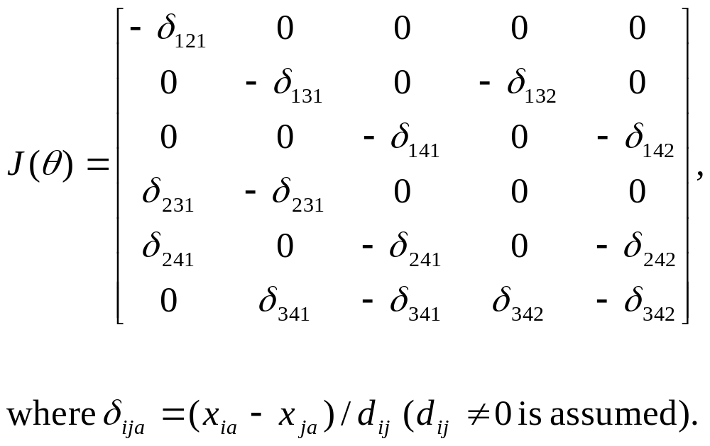

Slide 8
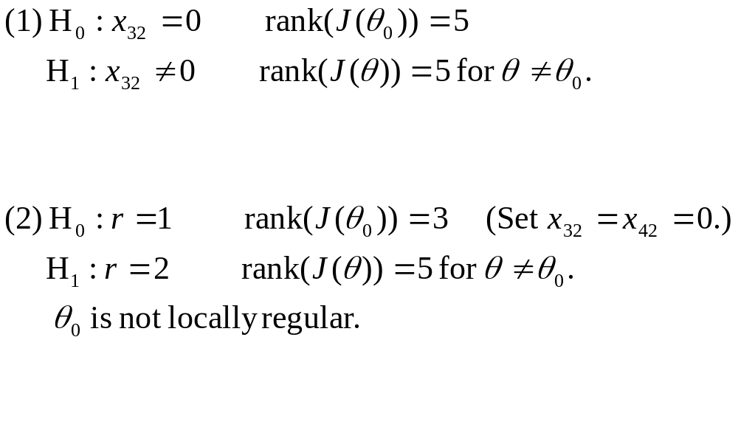

Slide 9
Local regularity is a sufficient condition (along other conditions) for λ to follow an asymptotic chi-square distribution.
Its violation does not imply that λ is never asymptotically chi-square.
Each specific case has to be examined. How bad is chi-square as an approximation?

Slide 10
A Monte Carlo Study
MDS
r = 2
n = 10 (number of stimuli)
N = 4, 20, 500, 2000 (number of replications)
100 samples in each condition
2 and 3-dimensional solutions by ML
λ_{c} (2 vs 3, left panel) and λ_{s} (2 vs saturated, right panel)

Slide 11
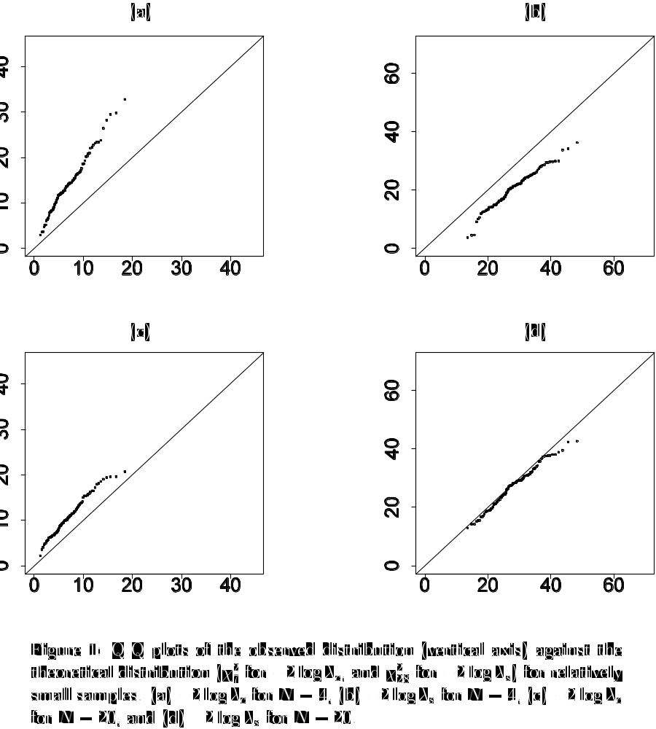

Slide 12
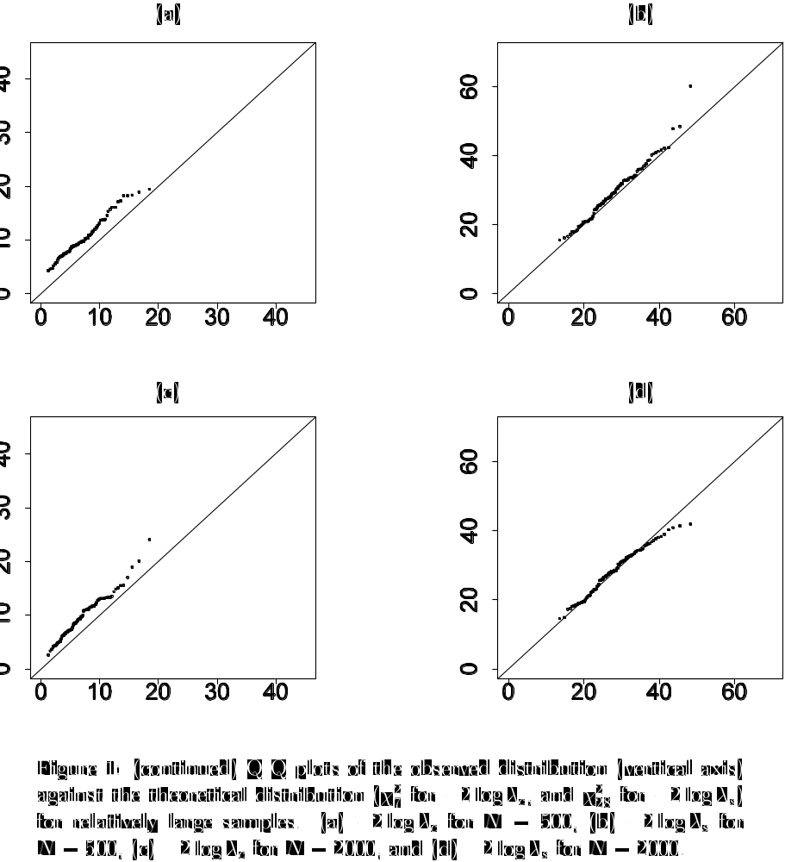

Slide 13
Conclusions
Use λ_{s} whenever possible.
There are models for which no saturated models exist (e.g., RA, Gaussian mixtures, multi-layer NN models).
Permutation tests, parametric Bootstrap
Attempts to find the true distribution of λ_{c} (Adler, 2000; Dacunha-Castelle & Gassiat, 1997; Liu & Shao, 2002, etc.).

Slide 14
Unidentifiability of parameters or boundary points have been typically blamed for the anomaly. The problem is that re-parameterizations can hide these problems. For example, there is no apparent unidentifiability problem in the MDS example we discussed, and the variance with the non-negativity constraint   0 can be re-parameterized as ² with no apparent boundary.

Slide 15
( = 0 is no longer a boundary point.)
But the problem persists. (We cannot get away from the problem by reparameterization.) The local regularity condition still indicates that  = 0 is a problematic point.

Slide 16
There are two cases in which the distribution is known under the violation of the local regularity condition:
Parameters on the boundary → the chi-bar-square distribution (Shapiro, 1985; 1988; Dijkstra, 1992)
The distribution of the greatest characteristic root from a Wishart matrix (Roy’s max eigenvalue criterion)

Slide 17
CANO/DISC/MANOVA
LR tests → Wilks’ Λ → Bartlett’s approximation: When r = 0 (true; independence model), -M ln Λ ~χ²(pq), where M = N - (½)(p + q + 3), Λ = _{i=1}(1 – α_{i}²), α_{i}² is the i^{th} largest eigenvalue of YP_{X}Y with respect to Y’Y, and p and q are the number of variables in X and Y.
-M ln (1 – α₁²) does not follow the asymptotic chi-square.
When r = 1 (true, but r  0), -M _{i=2} ln (1 – α_{i}²) ~ χ²((p-1)(q-1)).

Slide 18
CA
Pearsonian chi-square
When r = 0 (true; independence model), N(_{i=1} α_{i}²) ~ χ²((p-1)(q-1)).
α_{i}²  - ln(1 – α_{i}²).
N α₁² does not follow asymptotic chi-square, (but the distribution of the greatest characteristic root from a Whishart matrix).

