Slide 1




Analysis of Brain Connectivity through fMRI Data: Dynamic GSCA and GCANO
Yoshio Takane
University of Victoria and McGill University
September 3, 2015
Given as the Yanai Lecture at the 43rd Meeting of the Behaviormetric Society of Japan

Slide 2
Dynamic GSCA, G(S)CANO
Dynamic GSCA: Jung, Takane, Hwang & Woodward (2012; Pka), Hwang & Takane (2014; monograph), Jung, Takane, Hwang & Woodward (in press; Pka)
Dynamic GCANO: Zhou, Takane & Hwang (under review; CSDA)

Slide 3
The Behaviormetric Society Annual Meetings: Attendance Record
第4回（1976年、東大） nonmetric common factor analysis
第8回（1980年、慶応） sorting data の数量化法
第10回（1982年、国研） sorting data の確率モデル
第11回（1983年、京大） MAXMC, MAXSC
第13回（1985年、北大） diagonal estimation in DEDICOM
第14回（1986年、東大） IRT & FA, statistical expert system
第16回（1988年、千葉大） two special cases of CPCA
第17回（1989年、岡大） IPDA for ordered categorical data
第19回（1991年，名大） DCDD, 制約付きDEDICOM
第21回（1993年、阪大） oblique projectors
第22回（1994年、筑波大） knowledge reresentation in ANN

Slide 4
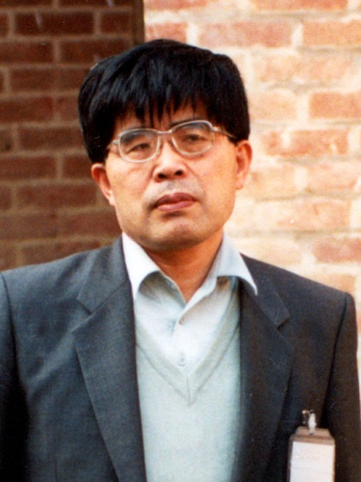
Professor Yanai in 1992 in Dehli (Puntanen, Styan, and Isotalo, 2011, p. 307)

Slide 5
柳井先生
なれ初め. 1967年春. 5月祭.
「柳井先生の御退官に寄せて」 柳井晴夫教授退官記念文集 （2006, March） 26-27．
「情熱の人，柳井先生」 行動計量学会報 （2014, June） 2-3.
「柳井先生と多変量解析」 行動計量学 (2014, July) , 41, 73-82. (The 24th IWMS in Haikou, China, May, 2015 → full paper to be published in Special Matrices.
Downloadable at takane.brinkster.net/Yoshio/
「心理学ライフ海外編 」 心理学ワールド 「2014-2015) 68号, 69号, 70号, 33-35. 新曜社.
（最初の2号、downloadable at 日本心理学会->
心理学ワールド）

Slide 6
Brain connectivity analysis
Specialization/Integration
fMRI data (time series of BOLD signals): indicators of brain activity at voxels
ROIs (regions of interest) : collections of voxels
Bold signals at voxels – manifest variables (MVs)
ROIs – blocks of MVs
Representative variations in ROIs – latent variables
(LVs)
Relationships among ROIs

Slide 7
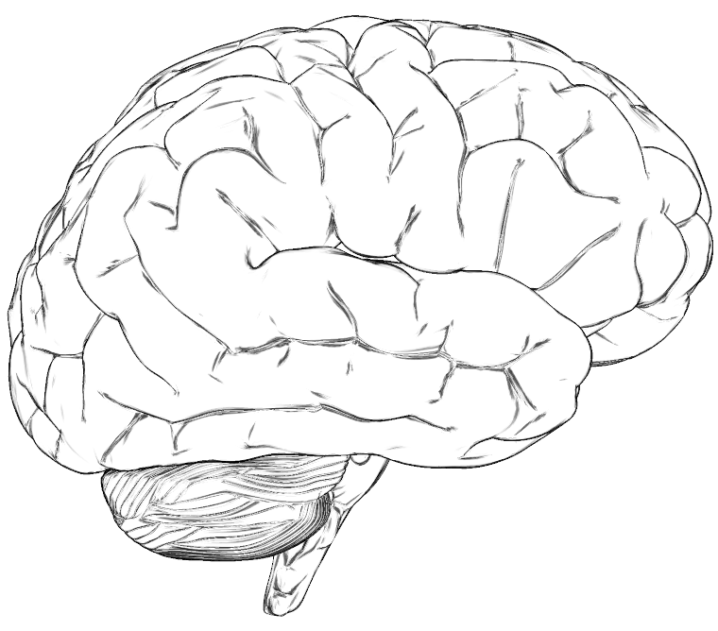
Effective Connectivity
SPC
V5
V1
V1 = Primary Visual Cortex
V5 = Middle Temporal Area
SPC = Superior Parietal Cortex
Attention to Visual Motion Study (Friston et al, 2003)
Notes:
Dynamic GSCA is a useful method to reveal how functionally specialized areas interact and how these interactions depend on changes of experimental context. Here is an example of analyzing effective connectivity. First, a number of specific brain regions are selected based on a hypothesis about their importance in completing a given task. Here, V1, V5, and SPC are selected. The selected brain areas are called regions of interest, in short, ROIs. And then, their directional relationships in response to cognitive tasks are modeled and tested.

Slide 8
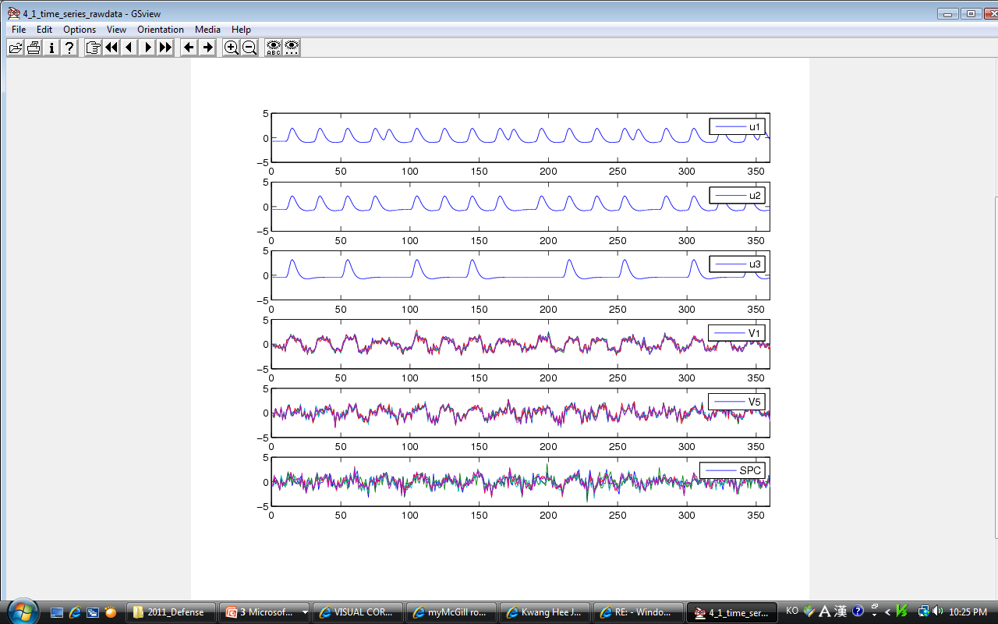
Time Series of Three ROIs
Five BOLD signals for each ROI
ROIs Constructs or latent variables
BOLD signals Observed variables
Notes:
Here are the functional neuroimaging data. Five BOLD signals in each of the three ROIs are presented in the figure. It can be seen that although there is a bit of variability among the voxels, there is also some common variability across voxels within a ROI. This common variability is our main focus of analysis. It is deemed representative of neuronal activities in the ROI, and is to be captured in the form of a latent variable in a SEM framework. Thus, in the Dynamic GSCA model, ROIs correspond to constructs or latent variables, which indicate activity in the brain regions. And the BOLD signals in voxels in the ROIs correspond to indicator or observed variables.

Slide 9
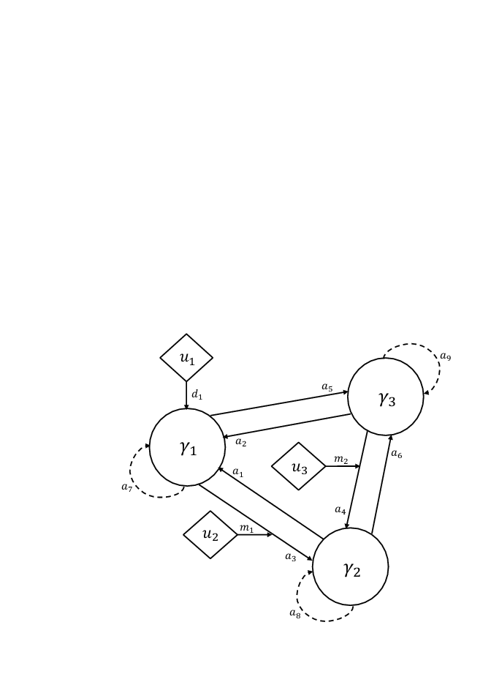
The Attention to Visual Motion Data
u1 = Photic
u2 = Motion
u3 = Attention
Source: Friston et al. (2003)
Notes:
Here is a diagram which includes all the features that I mentioned right before. In the model, there are three ROIs and three stimuli. The hypothesized model includes 6 contemporaneous effects, 3 time lagged effects, 1 direct effect, and 2 modulating effects.

Slide 10
Model Equations

Slide 11
Shift Matrices
Notes:
Here is an example of shift matrices. S0 represents contemporaneous effect between ROIs, while S1 represent time-one lag effects among ROIs.

Slide 12
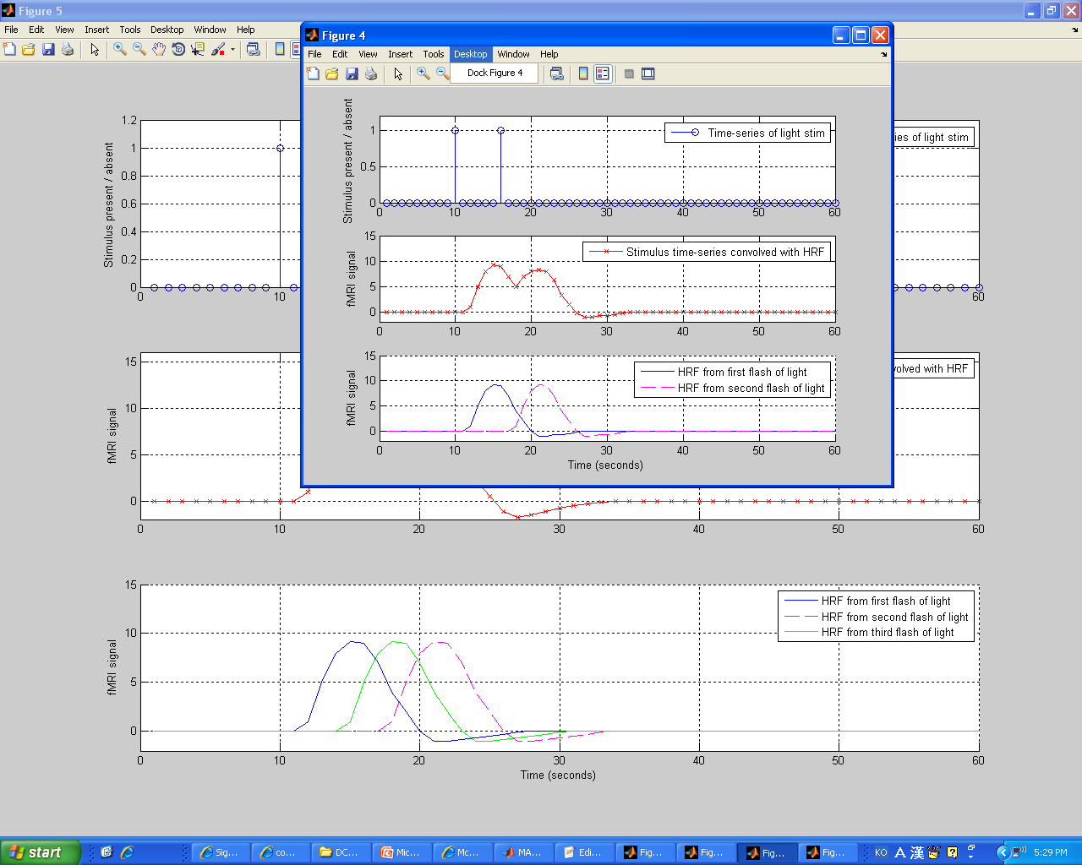
Experimental Stimuli
Notes:
Here is an example of experimental stimuli convolved with hemodynamic response function. Specifically, to model a hemodynamic response function of an experimental stimulus, first, a delta function is generated with zero and one (zero denotes no stimulus, one denotes stimulus), and then the inputs were convolved with a hemodynamic response function (gamma function). Here, I used a SPM routine for the convolution, which is commonly used for this purpose.

Slide 13
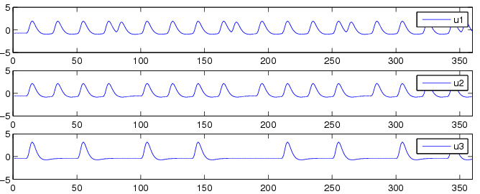
Time Series of Experimental Stimuli
u1 = Photic
u2 = Motion
u3 = Attention
Notes:
As a result, I obtained the following time series of three experimental stimuli.

Slide 14
Model Features
Features in Conventional SEM
Contemporaneous Effects of ROIs on other ROIs
(2) New Features
Time Lagged Effects
Stimulus Effects
a) Direct effects
b) Modulating effects
Notes:
Next, let’s see the model features of Dynamic GSCA. Dynamic GSCA has a feature to capture contemporaneous effects of ROIs on other ROIs as the same as conventional SEM. However, it has new features, that is, time lagged effects and stimulus effects. Here, time lagged effects indicate that earlier states in ROIs exert influence on later states in ROIs. Dynamic GSCA is also able to investigate direct effects of experimental stimuli on a certain ROIs and modulating effects on connections between ROIs. Thus, Dynamic GSCA enables us to examine more specific research questions.

Slide 15
Model Fitting
Estimate model parameters in such a way as to minimize the sum of squared residuals under some side conditions

Slide 16
A Special Bootstrap Method
Assessment of reliability – A Bootstrap method
Data are correlated
A modified moving block bootstrap method
Notes:
In addition, I employed a special bootstrap method in dynamic GSCA, called a modified moving block bootstrap method, in order to assess the reliability of parameter estimates. This is because the standard bootstrap method used in the original GSCA does not take into account the time order of observations. Specifically, in Dynamic GSCA, I break down the original BOLD signals into overlapping blocks. Then, I draw blocks of observations with replacement. Finally, I apply Dynamic GSCA to the bootstrapped samples, considering time dependence among consecutive observations.

Slide 17
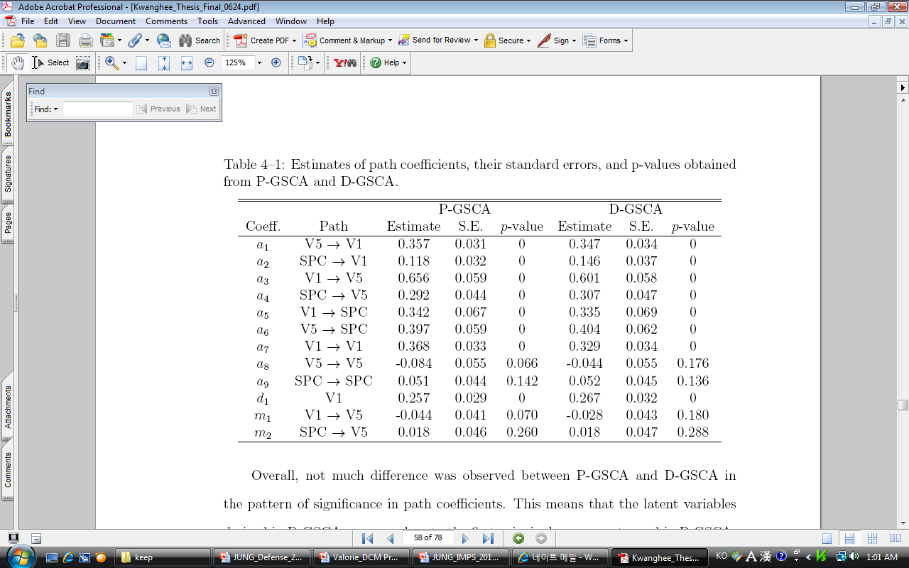
Result 1 : Attention to Visual Motion Data
Estimates, SE, p-values
Notes:
Next, let’s see the result of the attention to visual motion data anaysis. All contemporaneous effects were significant at the alpha level of .05.; only one autoregressive effect turned out be significant; the direct effect of u1 on V1 was signficant. However, neither of the two modulating effects of stimulus inputs were significant.

Slide 18
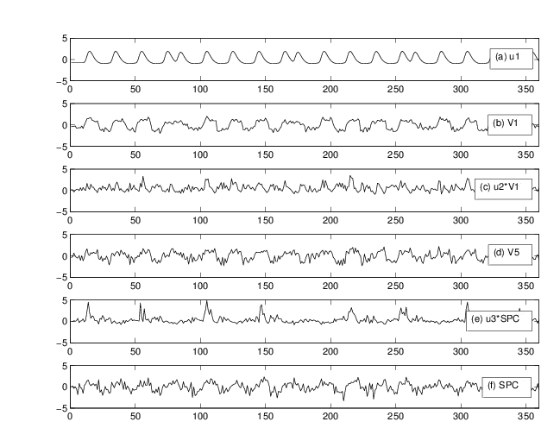
Result 1: Attention to Visual Motion Data
Notes:
In this figure, the time series of u1 and extracted components are presented. As can be seen, the significant direct effect of u1 on V1 is sensible because they covary quite clearly. ここに日本語の

Slide 19
Extensions of Dynamic GSCA
Simultaneous analysis of multi-subject data
Multi-sample (multi-group) comparison
Multilevel analysis (Jung et al., in press)
Dynamic GCANO
Notes:
Furthermore, the Dynamic GSCA model may be extended by in a variety of ways to enhance its capabilities. The possible enhancements include higher order latent variables, simultaneous analysis of multi-sample data, and incorporating interactions among latent variables.

Slide 20
Dynamic GCANO
Measurement model:
-- Multiple-set canonical correlation analysis (instead of PCA-like model as in Dynamic GSCA)
-- Homogeneity across subjects (but not across ROIs)
Structural model remains essentially the same as before (except that it includes latent interactions)

Slide 21
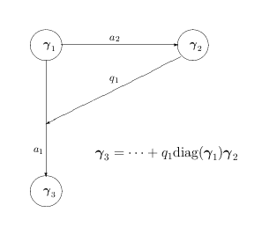
Latent Interaction

Slide 22
Model Equations: A Generic Form

Slide 23
An Example
Fu et al. (2013)
14 subjects viewed flickering checkerboard
3 replications of 20s fixation and 20s viewing
T = 225
4 ROIs, 81 voxels in each
FuG_L (left fugiform gyrus)
FuG_R
MOG_L (left middle occipital gyrus)
MOG_R

Slide 24
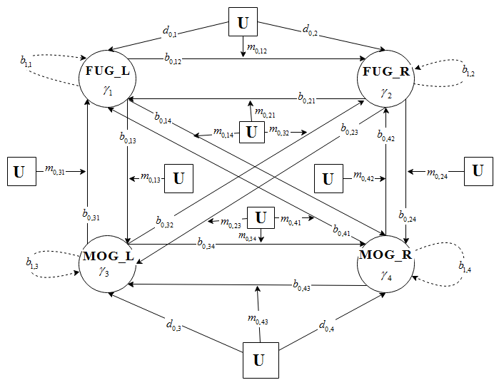
Structural Model

Slide 25
One stimulus input

Slide 26
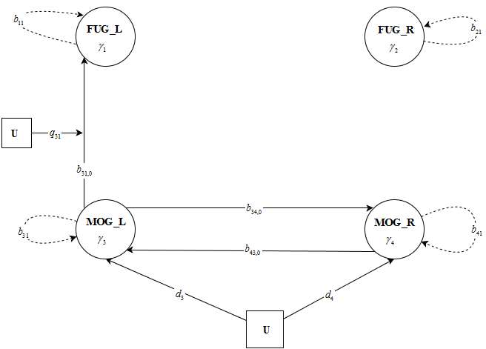
Significant Connections

Slide 27
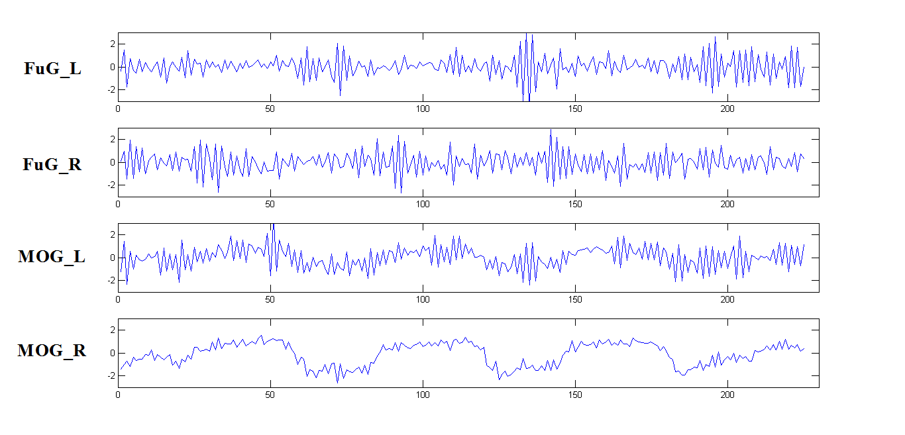
ROIs Activation Time Series

Slide 28
Multiple –Group Analysis
Normals, schizophrenic groups
Additional index g indicating a group

Slide 29

Equality Constraints
We may constrain $γ_{gj}$ (ROI j’s activations) across groups
We may also constrain other structural parameters equal across groups

Slide 30
Future Prospects
User friendly program
More flexible constraints
Groups created by repeated measurements
Time varying regression coefficients in structural models
Nonlinear models(?); Differential equations

Slide 31
Contributions by
Kwanghee Jung (McGill → Univ. of Texas at Houston)
Lixing Zhou (McGill)
Heungsun Hwang (McGill)
Todd Woodward (University of British Columbia)

Slide 32
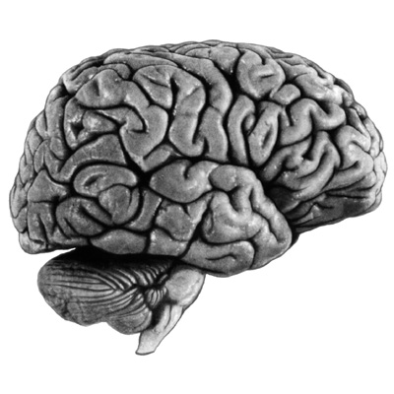
Thank you

Slide 33
Historical 1
Dynamic causal model (Stephan, 2008) – pioneering work in brain connectivity studies
Unified SEM (Kim et al., 2007) – autoregressive effects
Extended unified SEM (Gates et al., 2010) – stimulus effects
GSCA (Hwang & Takane, 2004) – PCA-SEM
Dynamic GSCA (Jung et al., 2012)

Slide 34
Historical 2
Regularized GCANO (Takane et al., 2008)
Functional GCANO (Hwang et al., 2012)
GCANO–PCA (Hwang et al., 2013)
Dynamic GCANO – GCANO-SEM

Slide 35
The Bootstrap Method
Sample from subjects (equivalent to sampling blocks of length equal to T).
May also bootstrap any contrasts between parameters (e.g., directionality of influence).

