Slide 1
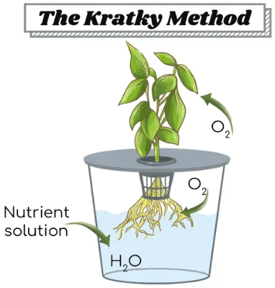
Hydroponic Lettuce Coming Soon!
https://whyfarmit.com/about/
But first, we have to measure the temperature of water our plants will be growing in!
(and find a thermometer…)
This is a student-run experiment. Please do not disturb the jars!
All water and nutrients are provided up front to the plant in the container.
The plant absorbs nutrients for growth, and the water level subsides.
The plant grows larger and oxygen fills the gap left by the water.
Plants only take up CO₂ through their leaves! Oxygen is used by the roots to perform cellular respiration.
Public Safety: 314-246-6911 or Ext. 6911 from any campus phone
For questions, please contact grahamscanlon@webster.edu

