Slide 1
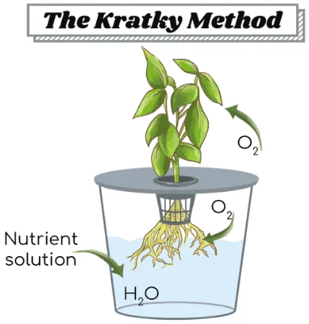
Hydroponic Basil & Lettuce are Growing!
https://whyfarmit.com/about/
This is a student-run experiment. Food safety is paramount!
Please do not disturb the plants!
They are being looked after.
All water and nutrients are provided up front to the plant in the container.
The plant absorbs nutrients for growth, and the water level subsides.
The plant grows larger and oxygen fills the gap left by the water.
Plants only take up CO₂ through their leaves! Oxygen is used by the roots to perform cellular respiration.
Public Safety: 314-246-6911 or Ext. 6911 from any campus phone
For questions, please contact grahamscanlon@webster.edu

