Slide 1
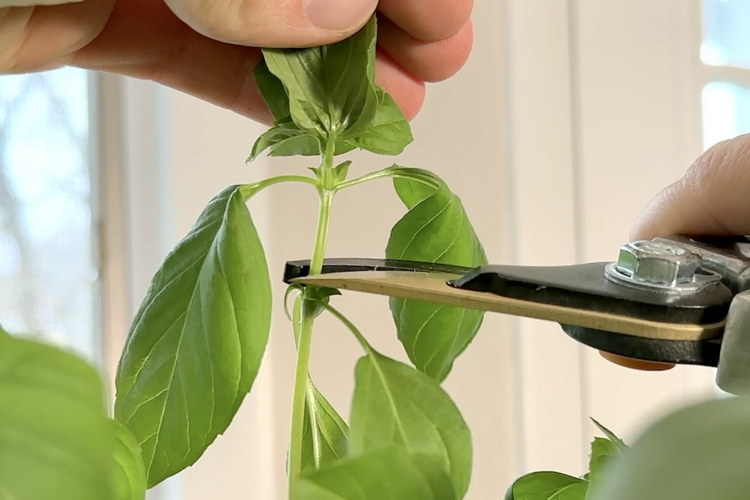
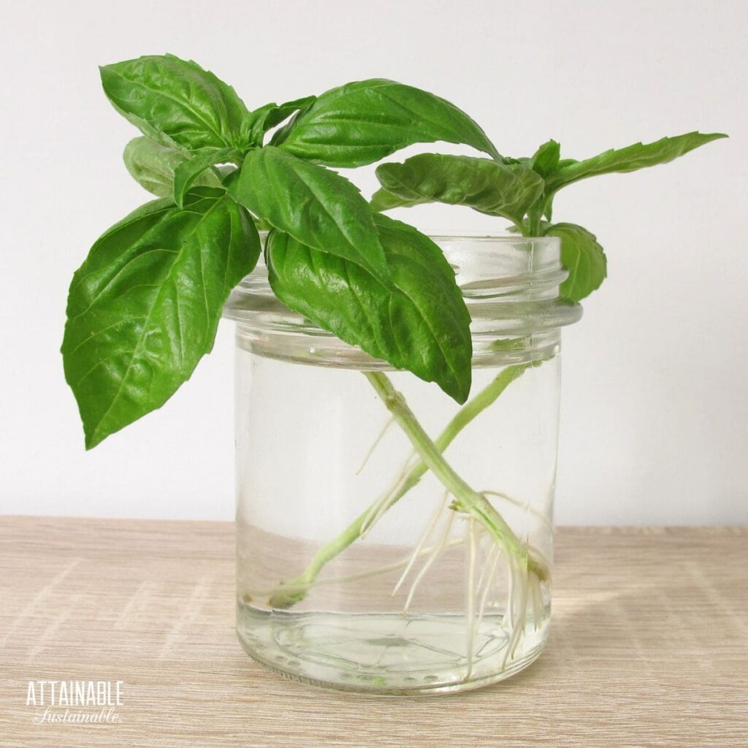
Harvest Your Own
Free Basil
Public Safety: 314-246-6911 or Ext. 6911 from any campus phone
For questions, please contact grahamscanlon@webster.edu
Identify the tallest stem [at least 4-6 sets of mature (large) leaves]
Identify the top 1-2 sets of mature (large leaves).
Gently pinch under the lower set of leaves you wish to harvest.
Cut 1/4 –inch above the set of leaves under the one you want to cut.

