Slide 1
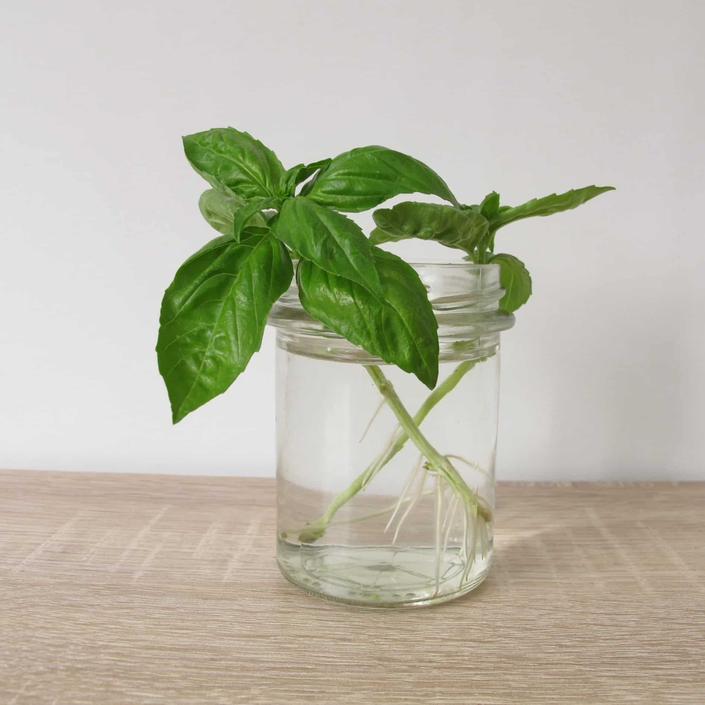
Free Basil Cuttings
Public Safety: 314-246-6911 or Ext. 6911 from any campus phone
For questions, please contact grahamscanlon@webster.edu
Fresh
Take the cup and the cutting!
Storing
Basil is sensitive to cold and does not store well in the refrigerator. Basil will keep for several days on the counter in a small jar of water like cut flowers.
Freezing
Blanch the leaves in boiling water for 1 minute, shock in ice water, drain well, package, and freeze. Use frozen basil in soups, stews, and sauces.
Washing – basil cuttings are not pre-washed!
Wash the stems and leaves in cold running water. Drain thoroughly on paper towels until completely dry.
Serving
Basil goes well with tomato and egg dishes.
Fresh basil is delicious in pizzas, pastas, and omelets.
Preserving
Or, you can dehydrate basil for long-term use. After the basil is completely dry, store it in airtight jars in a cool, dry location. Keep containers away from light, heat, and moisture.

