Slide 1
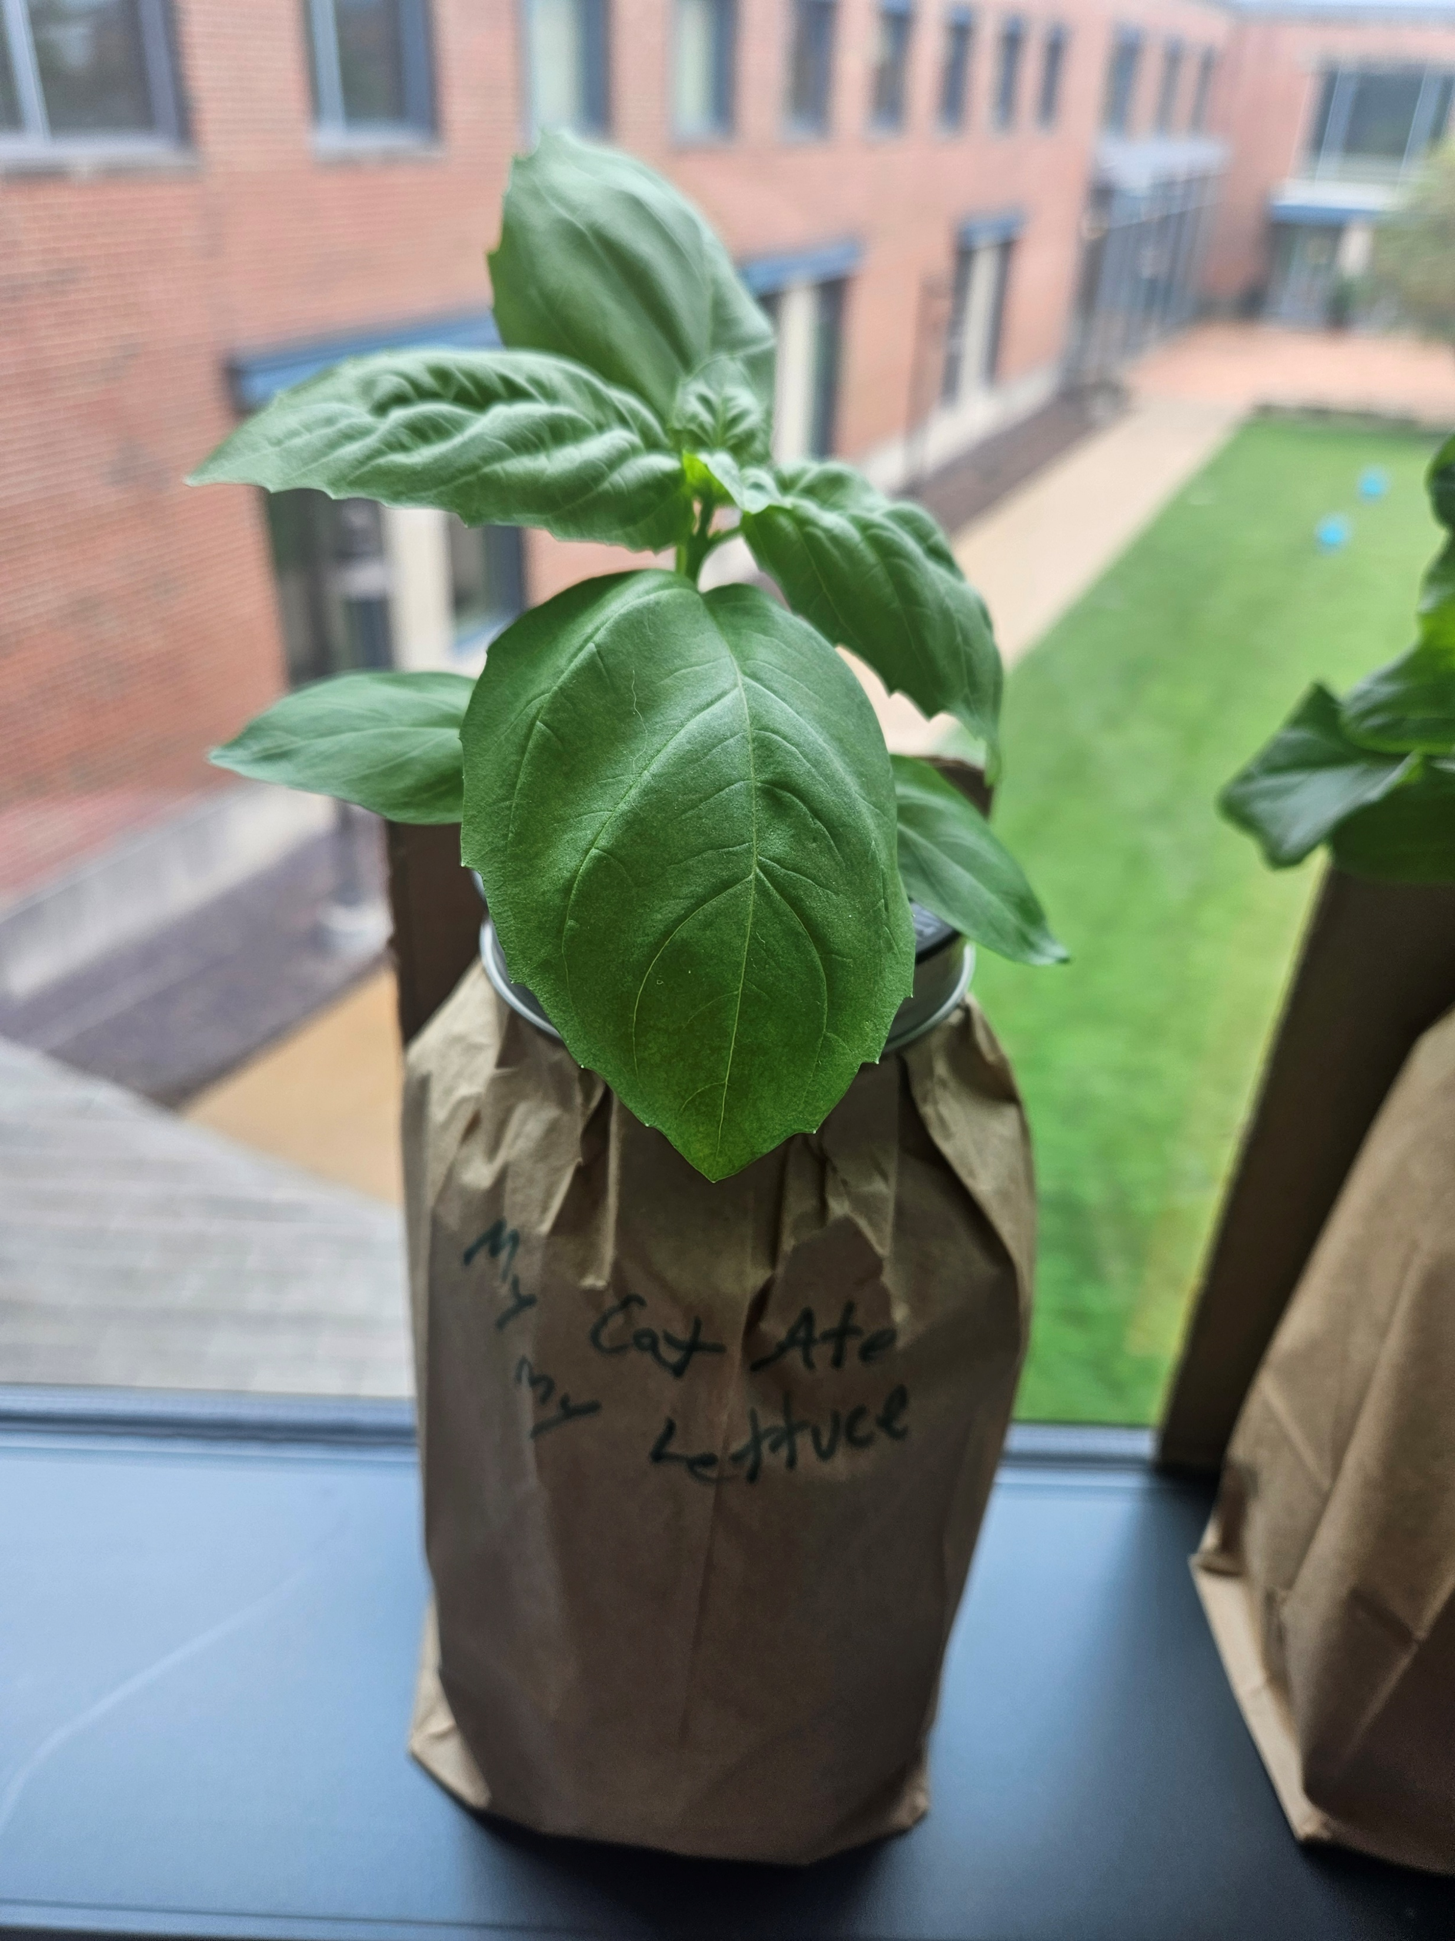

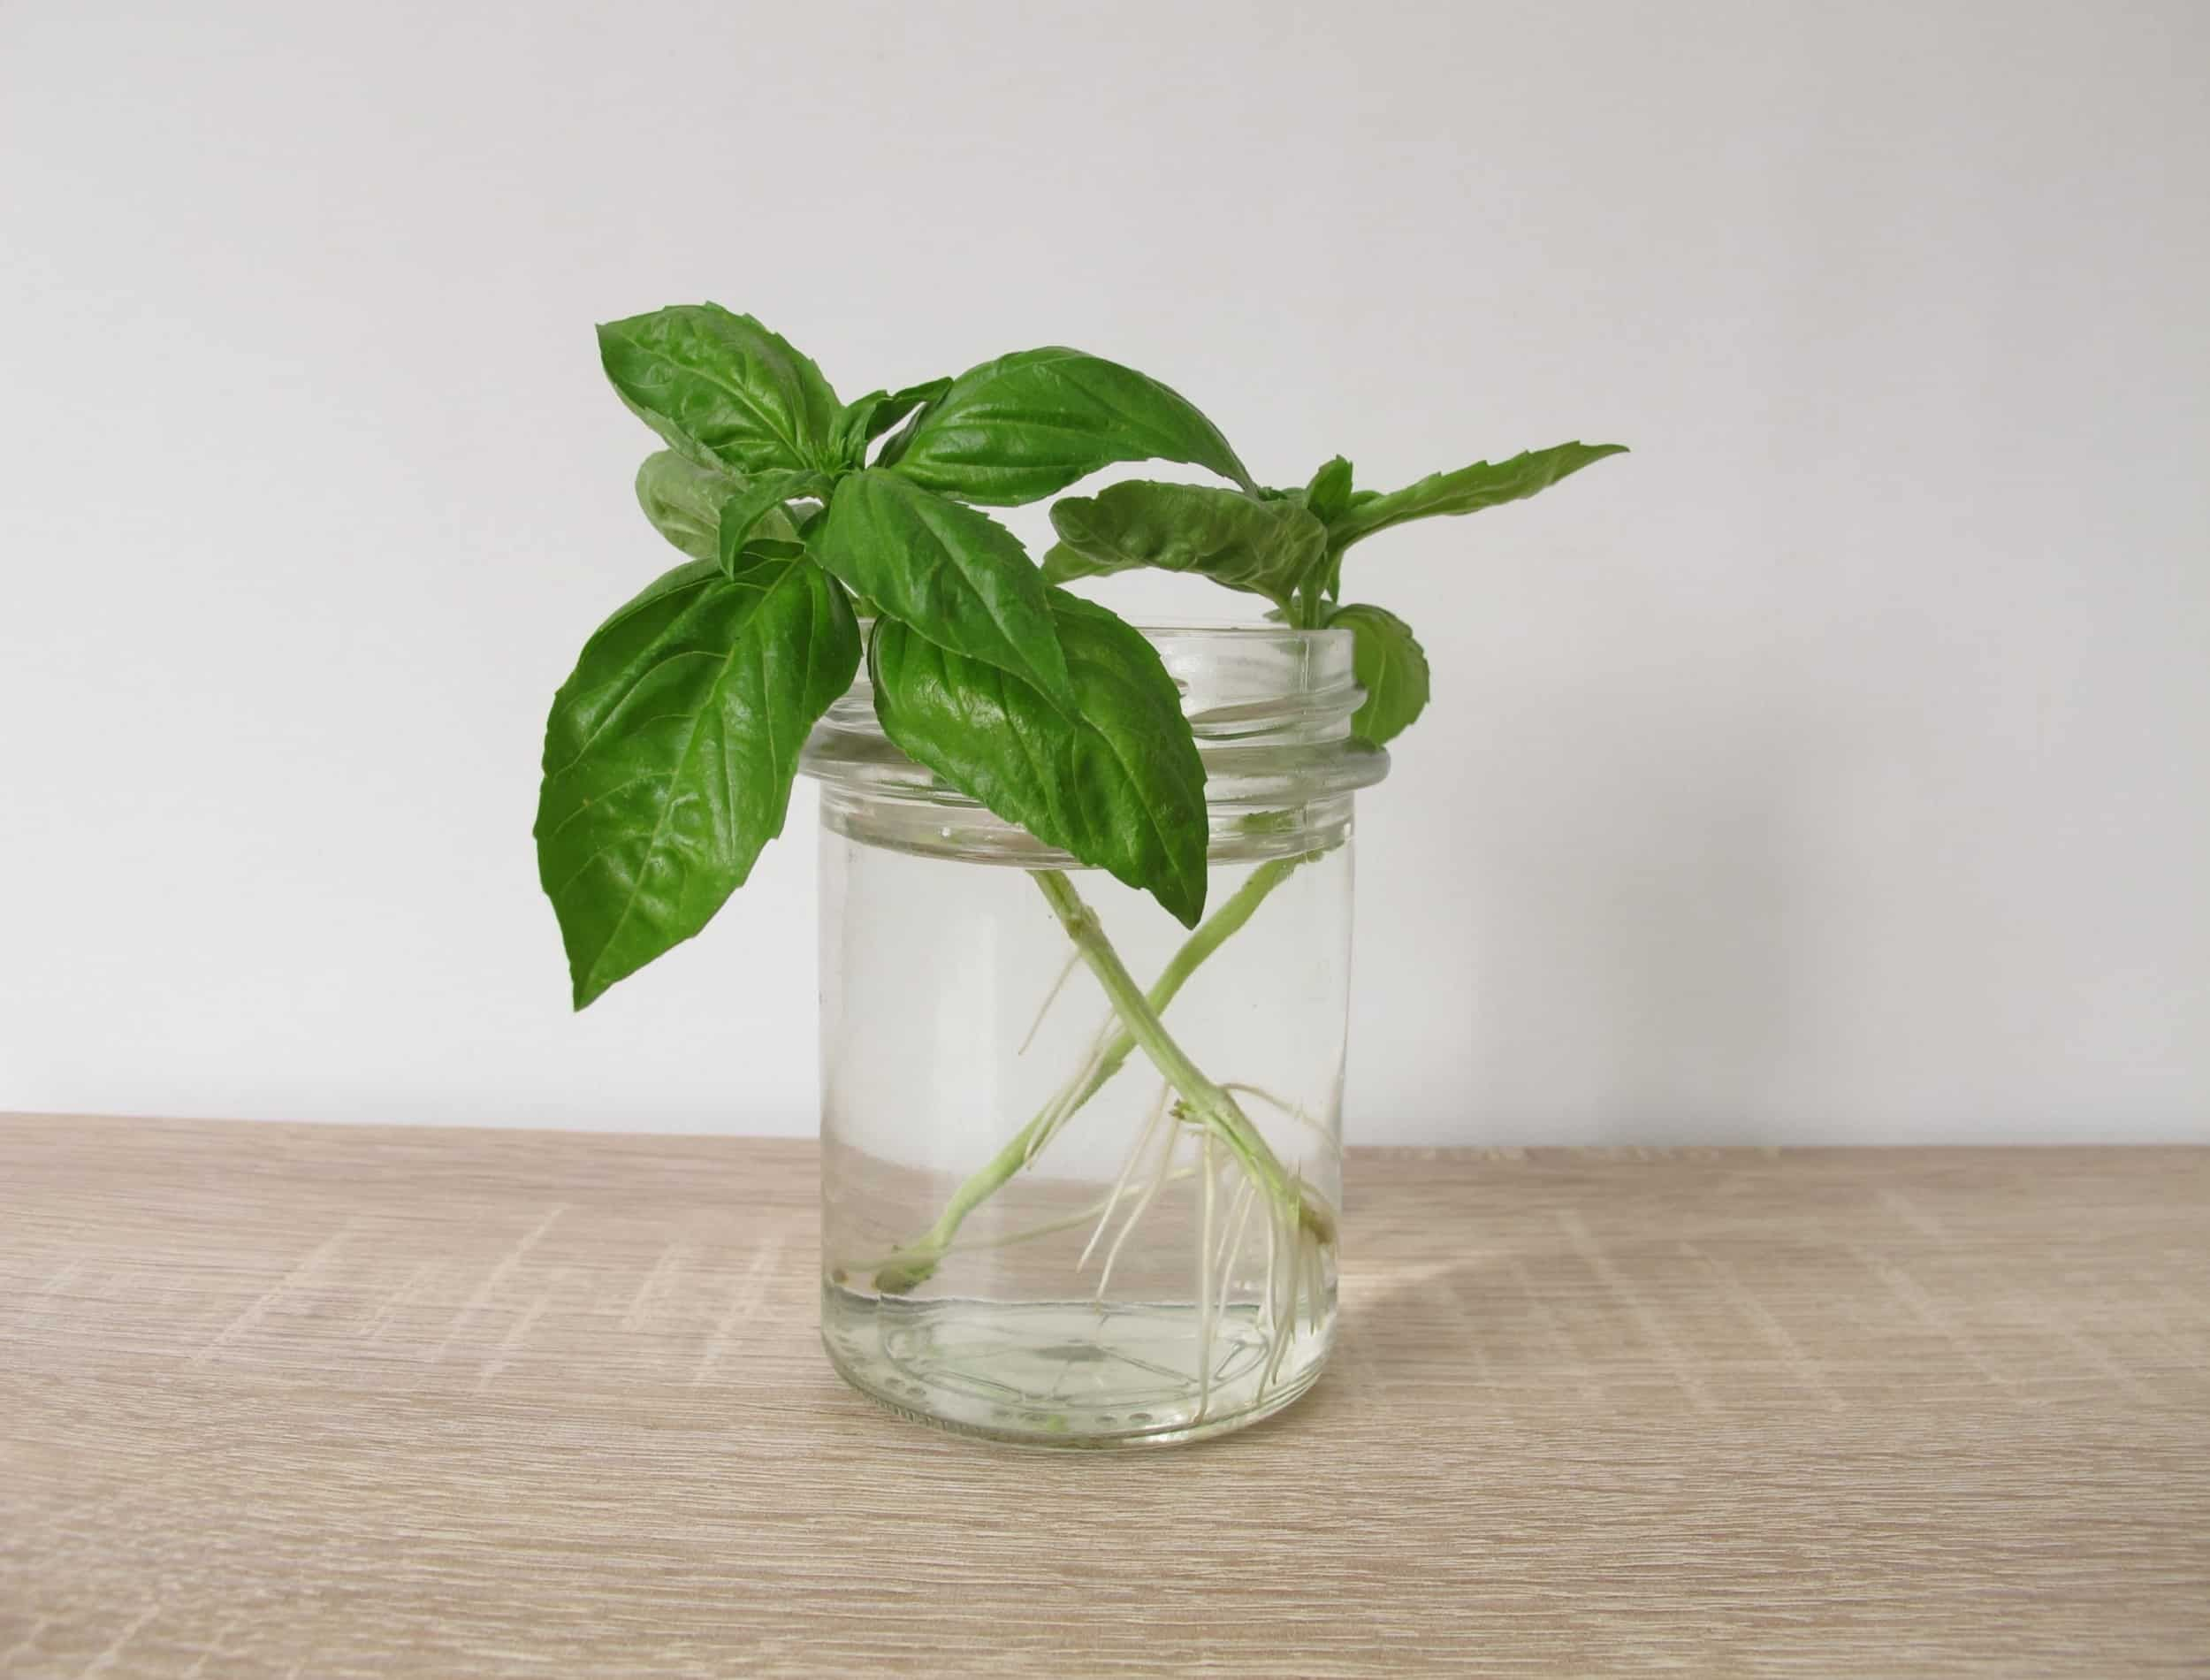
Help Harvest
Community
Basil!
Love Basil?
Enjoy fresh basil cuttings!
Interested in Hydroponics?
Lend a hand, Learn a skill
Hydroponic basil is growing on the windowsills of ISB
The basil is getting ready to harvest. I’m looking for somebody to take over the cutting and distribution of basil cuttings. It’s a great opportunity to support your community, learn about hydroponics, and you get to enjoy fresh basil!
If you are interested, please contact grahamscanlon@webster.edu

