Slide 1
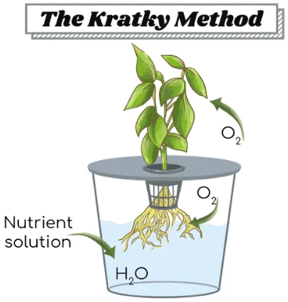
Hydroponic Lettuce is Growing!
https://whyfarmit.com/about/
This is a student-run experiment. Food safety is paramount!
Please do not disturb the plants!
The plants may beg you for water. Please resist! It’s a mirage. They have not been deserted.
All water and nutrients are provided up front to the plant in the container.
The plant absorbs nutrients for growth, and the water level subsides.
The plant grows larger and oxygen fills the gap left by the water.
Plants only take up CO₂ through their leaves! Oxygen is used by the roots to perform cellular respiration.
For questions, please contact grahamscanlon@webster.edu

