Slide 1


Probabilistic methods for nuclear data
Georg Schnabel
g.schnabel [at] iaea.org
Nuclear Data Section
Division of Physical and Chemical Sciences NAPC
Department for Nuclear Sciences and Applications
IAEA, Vienna
Workshop on Computational Nuclear Science and Engineering
13 July 2021

Slide 2

Short bio
Studied physics at TU Vienna
PhD in nuclear data evaluation 2015
Postdoc at CEA Saclay (2015-2018) and Uppsala University (2018-2019)
Since 2020 nuclear physicist in Nuclear Data Section at IAEA dealing with nuclear data library projects and code development

Slide 3

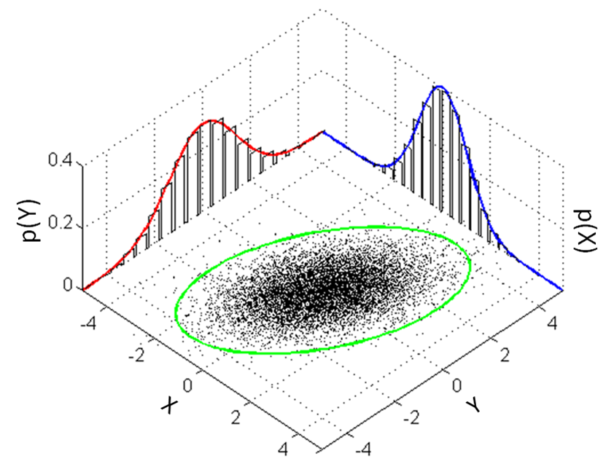
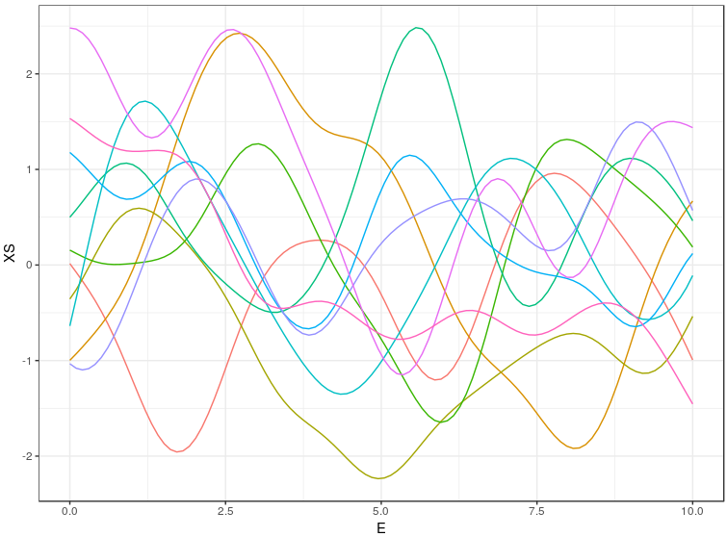
Outline
About nuclear data
Bayesian statistics
Multivariate normal distribution
Approaches to solve Bayes equation in nuclear data evaluation
Generalized Least Squares
Gaussian processes

Slide 4
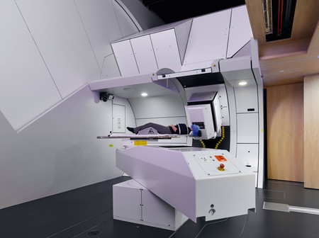
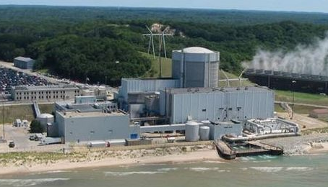



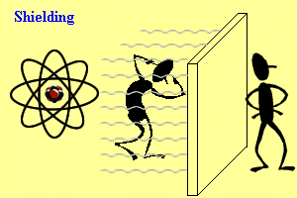
Nuclear data
Probabilities of various nuclear interactions involving the atomic nuclei, e.g., cross sections.
Relevant for:
Reactor physics
Radiation dosimetry
Radiation protection
Radioactive waste management
Astrophysics
Nuclear medicine
Fusion research
...
Target isotope
Palisades Nuclear Generating Stations
PSI Gantry 2 facility
n
non-elastic
elastic
Joint European Torus

Slide 5

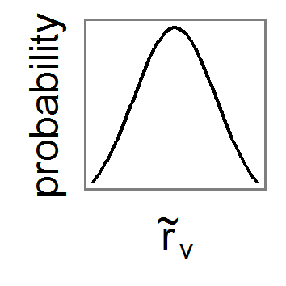
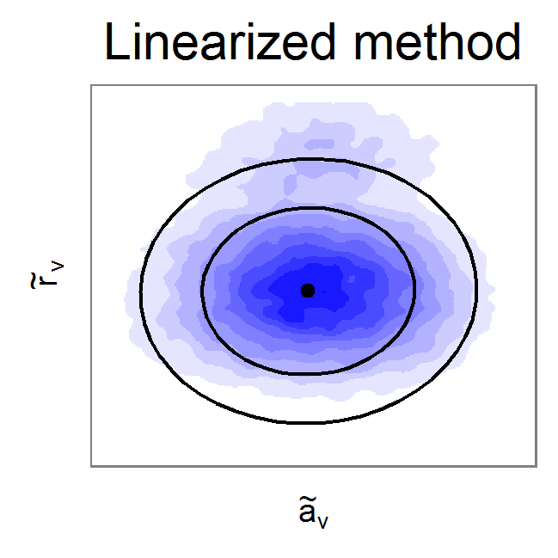
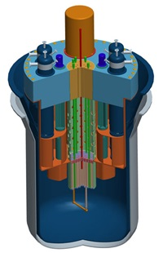
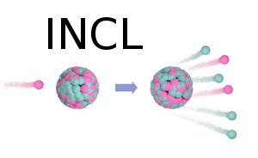


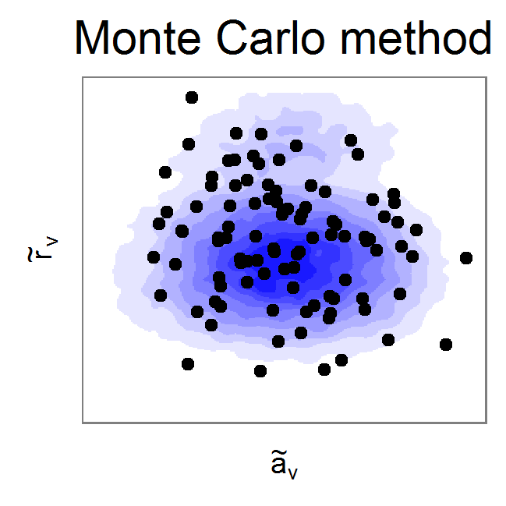


Nuclear data evaluation
Models
Evaluation method
Simulation
ENDF
+
Cov
Perturbation Theory
Experiments
ENDF #1
ENDF #2
Total Monte Carlo
...
MCNP, OpenMC, Geant4, etc.
EXFOR
El. Prod. #1
Element
Production
+
Cov
El. Prod. #2
...

Slide 6
Nuclear data evaluation
Models
Evaluation method
Simulation
ENDF
+
Cov
Perturbation Theory
Experiments
ENDF #1
ENDF #2
Total Monte Carlo
...
MCNP, OpenMC, Geant4, etc.
EXFOR
El. Prod. #1
Element
Production
+
Cov
El. Prod. #2
...

Slide 7
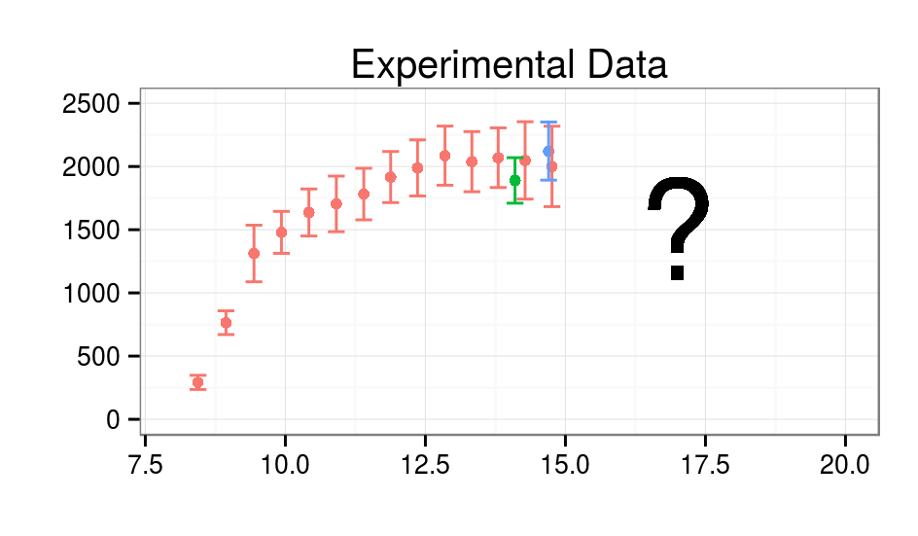
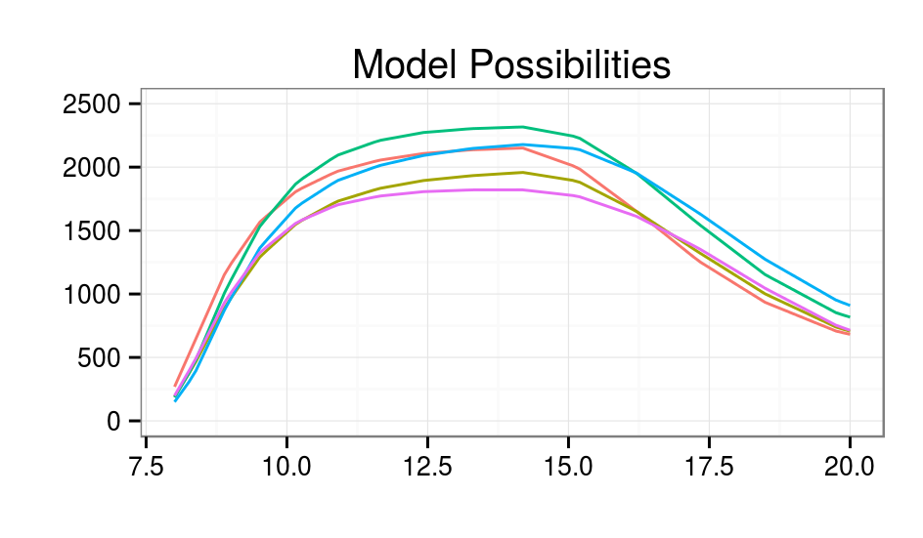
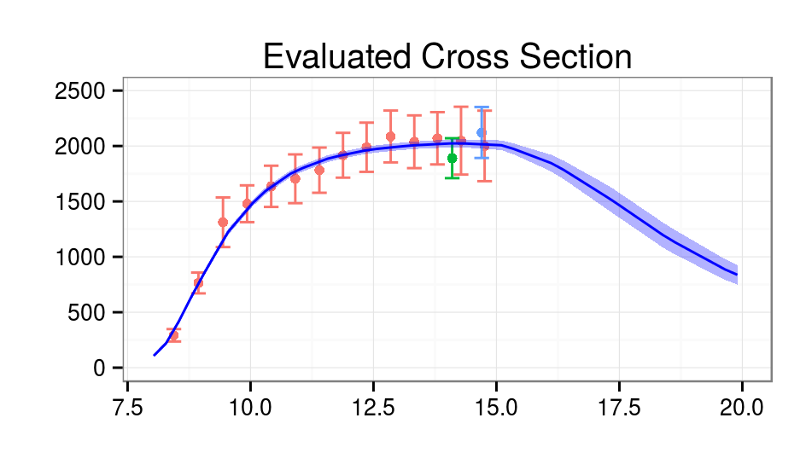
General task setting

Slide 8
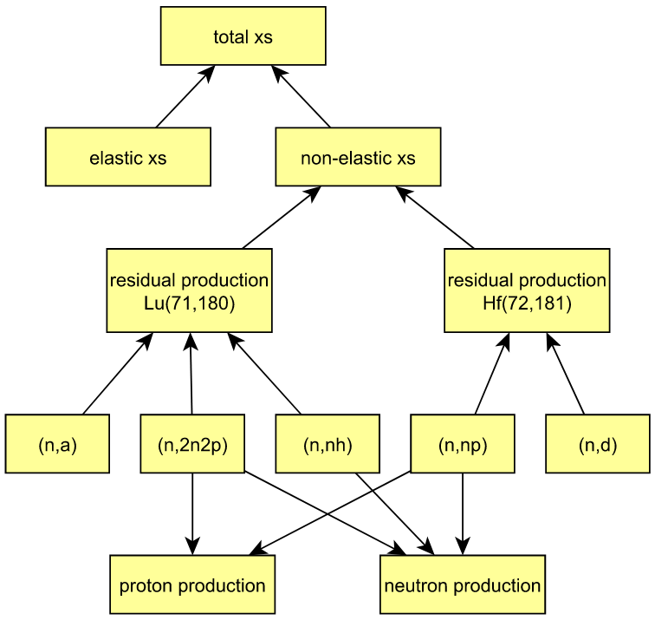
System of reactions

Slide 9
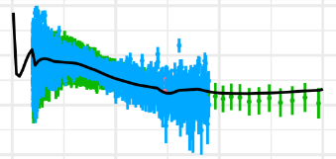
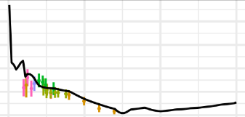
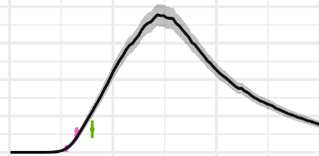
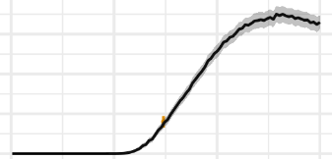
System of reactions

Slide 10
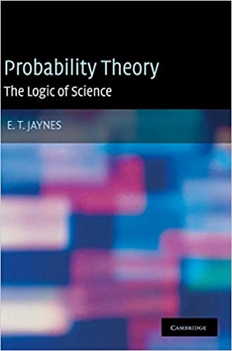
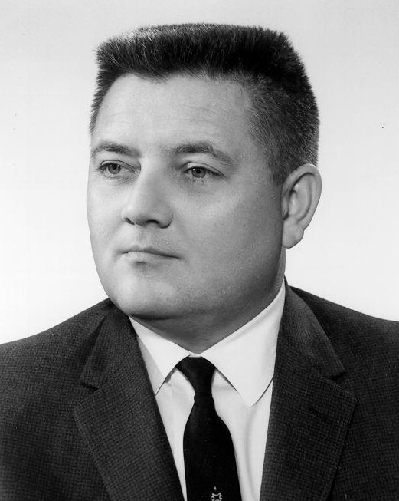
Jaynes Robot
Hypotheses
H1: It rained
H2: It did not rain
Observations
O1: The ground is wet
O2: The ground is dry
Which hypothesis is true?
Edwin Thompson Jaynes
1922-1998

Slide 11





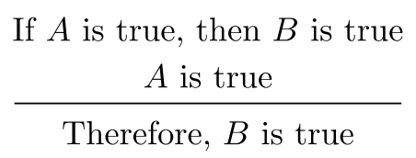
Consistency with Aristotelian logic
Hypothesis
Observation
True
True

Slide 12
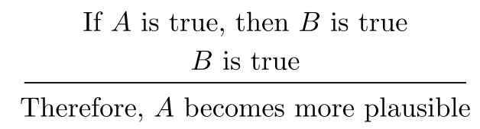
Consistency with common sense
Hypothesis
Observation
More plausible
True

Slide 13
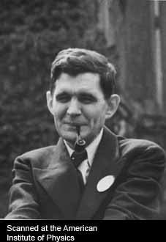
Desiderata
(I) Degrees of Plausibility are represented by real numbers
(II) Qualitative Correspondence with common sense
(IIIa) If a conclusion can be reasoned out in more than one way, then every possible way must lead to the same result.
(from E.T. Jaynes, Probability Theory: The Logic of Science)
Richard Threlkeld Cox
1898-1991

Slide 14
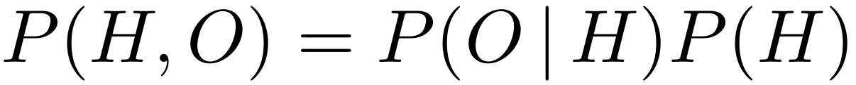
Desiderata / Cox theorem
(I) Degrees of Plausibility are represented by real numbers
(II) Qualitative Correspondence with common sense
(IIIa) If a conclusion can be reasoned out in more than one way, then every possible way must lead to the same result.
(from E.T. Jaynes, Probability Theory: The Logic of Science)
Computation rules of probability theory follow
Richard Threlkeld Cox
1898-1991
e.g., product rule

Slide 15
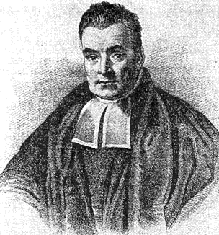
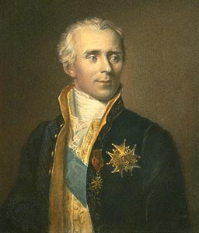
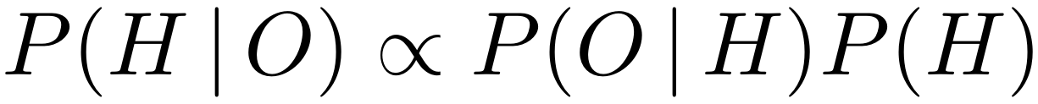
Bayesian update formula
Thomas Bayes
1701-1761
H hypothesis (“It rained”)
O observation (“Floor wet”)
P(H) probability of hypothesis to be true
P(O|H) probability to make observation O
given hypothesis H is true
P(H|O) probability of hypothesis H
given we observed O
Pierre Simon Laplace
1749-1827

Slide 16
Bayesian update formula
Thomas Bayes
1701-1761
H hypothesis (“It rained”)
O observation (“Floor wet”)
P(H) probability of hypothesis to be true
P(O|H) probability to make observation O
given hypothesis H is true
P(H|O) probability of hypothesis H
given we observed O
Pierre Simon Laplace
1749-1827
“Prior”
“Likelihood”
“Posterior”

Slide 17
Bayesian update formula
Thomas Bayes
1701-1761
H hypothesis
O observation
e.g., H(x) := “The cross section at 5 MeV is x mBarn”
P(H(x)) → P(x)
Which probability distributions for P(O|H) and P(H)?
Pierre Simon Laplace
1749-1827

Slide 18
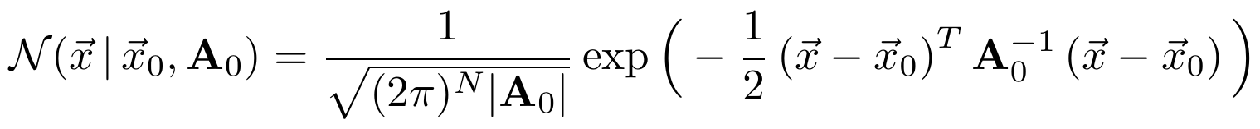
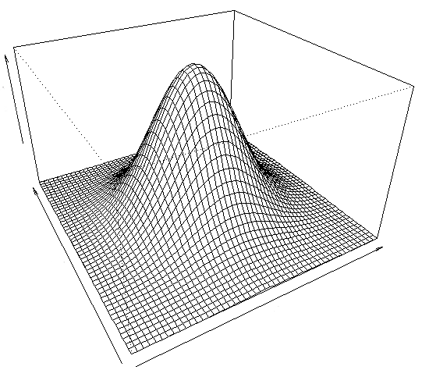
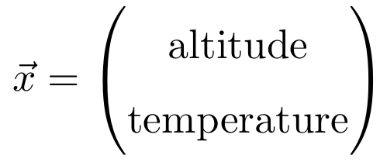
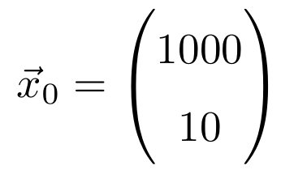
Multivariate normal distribution
y
x

Slide 19
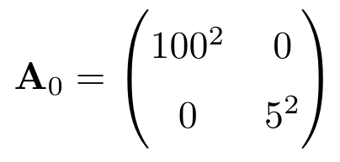
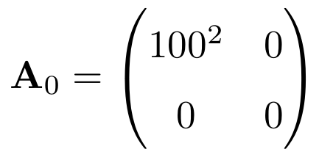
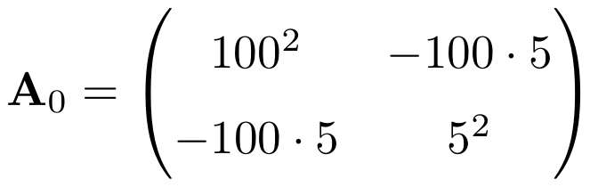
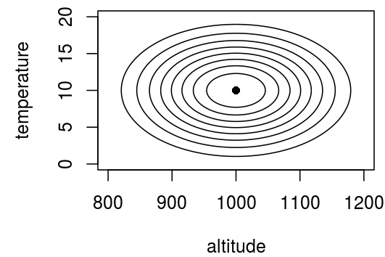
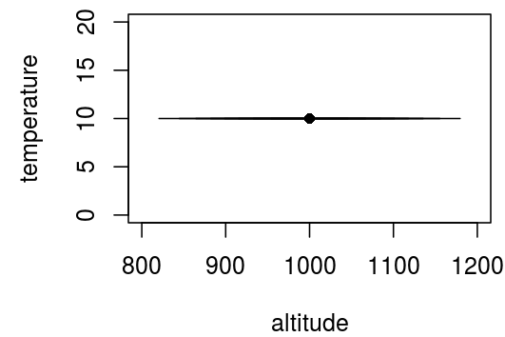
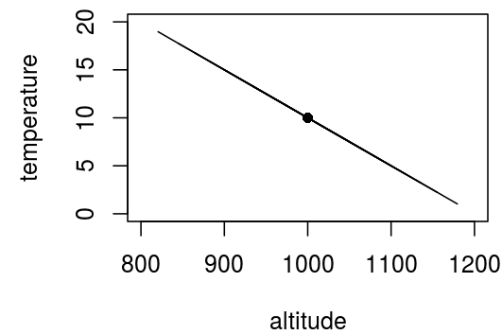
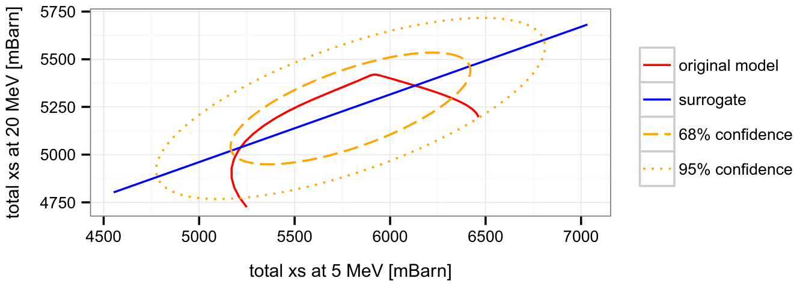
Covariance matrix
Variance / uncertainty squared
covariance
A covariance matrix captures linear relationships and uncertainties

Slide 20
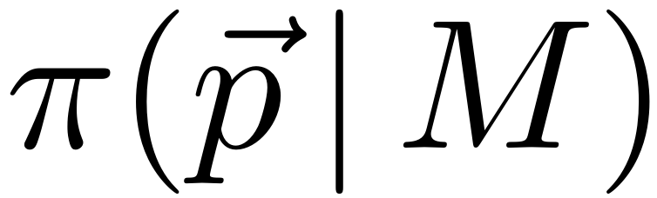
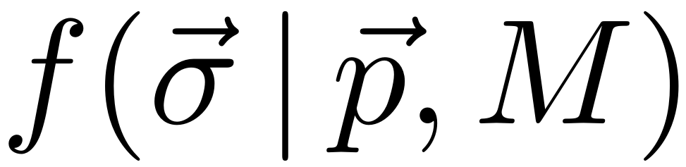
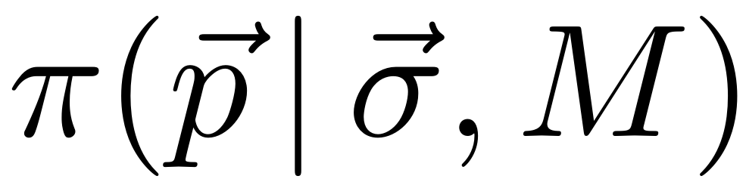
Bayesian Inference in Nuclear Data
Basic assumption
Observables can be
predicted by nuclear model M
based on parameter set p
cross section [mBarn]
incident energy [MeV]
prior distribution on model parameters
likelihood: probability to measure cross sections σ
if model parameter set p is true
posterior: refined probability distribution
for parameters taking into account observations σ

Slide 21
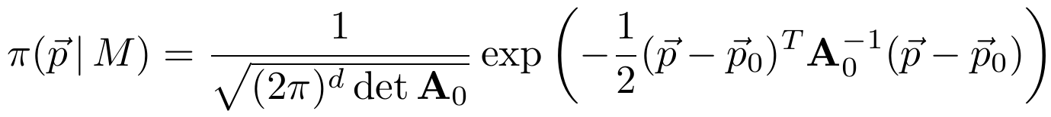
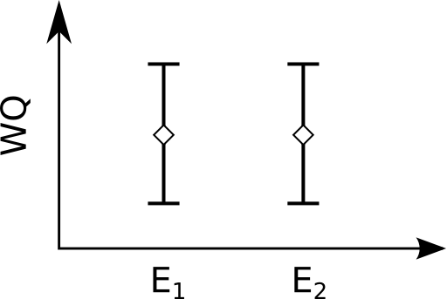
Which probability distributions?
Prior distribution (model parameters)
supported by
- principle of maximum entropy
- easy to work with!
Likelihood (experimental data)
supported by
- principle of maximum entropy,
- limiting distribution,
- central limit theorem
- easy to work with!

Slide 22
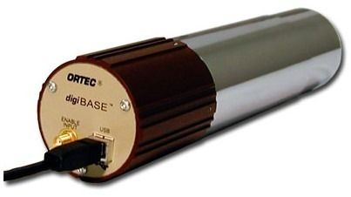

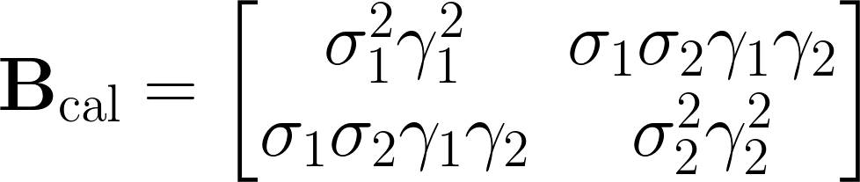
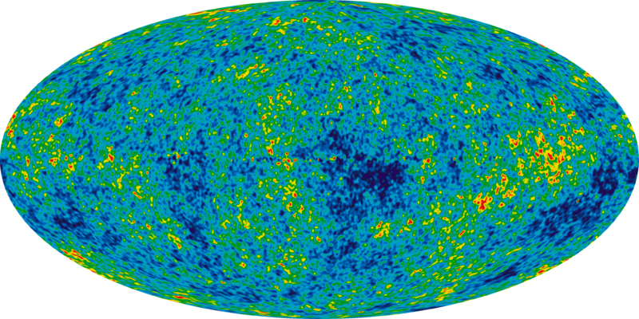
Cooking a covariance matrix
“statistical” (counting) uncertainty
detector
detector calibration uncertainty
sample thickness*
uncertainty about sample thickness
uncertainty about background noise
...
background noise
*) Rights: Eckhard Pecher, http://creativecommons.org/licenses/by/2.5/

Slide 23
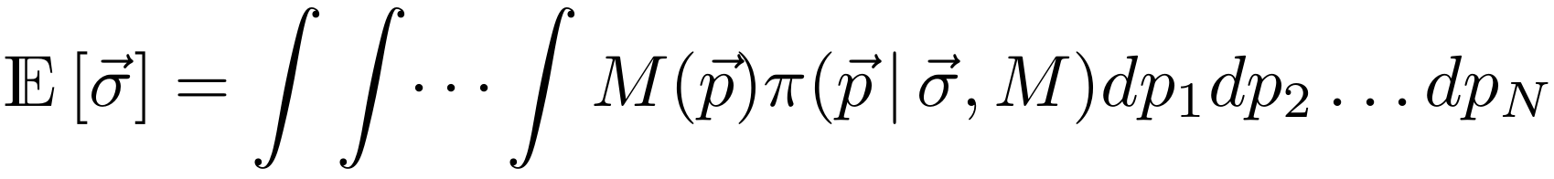
Quantities of interest
Expectation of parameters according to posterior distribution
Mode (maximum) of posterior distribution
Standard deviation parameters according to posterior distribution
Correlations of distribution

Slide 24
Nuclear data challenges
Regarding nuclear models
Non-linear (nuclear physics is complicated)
Not analytic (differential equations, simulation)
Computationally expensive (minutes to hours)
Regarding linear algebra
Computing with large covariance matrices
Regarding statistical models
Imperfect physics model
Multivariate normal distribution may be not always appropriate
Uncertainties wrong or unknown

Slide 25
Nuclear data challenges
Regarding nuclear models
Non-linear (nuclear physics is complicated)
Not analytic (differential equations, simulation)
Computationally expensive (minutes to hours)
Regarding linear algebra
Computing with large covariance matrices
Regarding statistical models
Imperfect physics model
Multivariate normal distribution may be not always appropriate
Uncertainties wrong or unknown

Slide 26

How to evaluate?
Three possibilities
a) Linearization
b) Surrogate approach
c) Monte Carlo procedure
simplified models
exact model

Slide 27


Monte Carlo approach
1) generate ensemble from prior
2) calculate
3) Calculate statistics from posterior distribution, e.g., best estimates, correlations, uncertainties, etc. by likelihood weighting

Slide 28

Linearization
Analytical update formulas

Slide 29
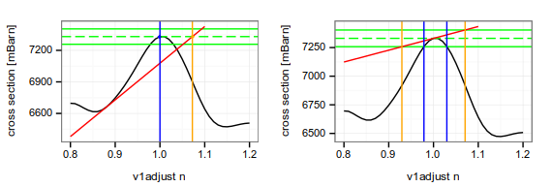
Linearization: Possible issues
Bad expansion point
Strong non-linearity

Slide 30
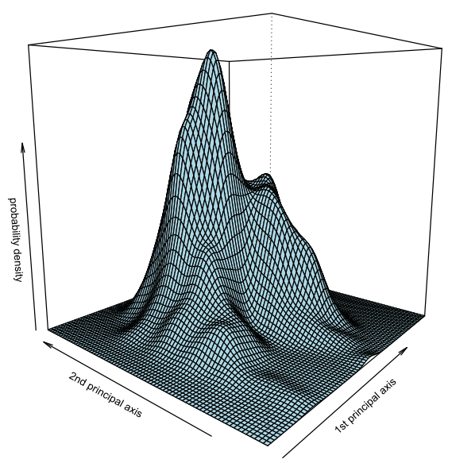
Surrogate approach basic idea
is linked to
v1
aV
replaced by
ϭ₁
ϭ₂

Slide 31



Surrogate approach construction of M_{sur}
1) draw ensemble from prior distribution
2) use nuclear model to calculate
3) estimate multivariate normal distribution in observation space
Analytic update formulas

Slide 32
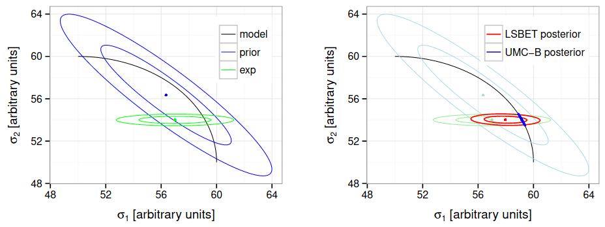
Surrogate approach: Behavior

Slide 33

Visualization of non-linearity

Slide 34



Generalized Least Squares (GLS) in a nutshell
Prior
Likelihood
Bayesian update
Posterior
“GLS formulas”

Slide 35











Simple example: straight line model
Prior
Likelihood

Slide 36

Straight line model

Slide 37



Straight line model
(garbage in, garbage out)

Slide 38




Important insight about models
“All models are wrong but some are useful”
- George E. P. Box
Reality
Ice cream or pizza?

Slide 39


More realistic modeling
Experimental Observation = | Model Prediction +
 | Measurement Error
Experimental Observation = | Model Prediction +
 | Model Error +
 | Measurement Error

Slide 40


Stochastic process e.g., stock price evolution
1 jump/second
jumps: +1 / -1
stochastic process
is associated with a
random function
How can we mathematically define a process?

Slide 41

Stochastic process with observation
observation
rules out
a lot of paths
How can we constrain a process with observations?

Slide 42
Characterization of a Gaussian process
All finite sets of function values at different locations are distributed according to a multivariate normal distribution
→ Gaussian process

Slide 43


Specification of a Gaussian process
Specify a function that yields the covariance between function values f(x₁) and f(x₂) for any possible pair x₁ and x₂. This function is called a covariance function.
Specify another function μ(x) that yields the center value of the process at location x. This function is called a mean function.

Slide 44



Sampling from a Gaussian process
X₁
X₂
X₃
...

Slide 45



Examples of Gaussian processes
Play video

Slide 46







Constraining with observations /
Model training
Use GLS formulas:
Introduce computational mesh U and experimental mesh V
and identify:
Resulting vector p1 contains posterior predictions on mesh U and A1 is the associated covariance matrix
(Other terms: Gaussian process regression, Kriging)

Slide 47
GPs constrained with observations
Play video

Slide 48

GPs constrained with observations
The posterior covariance matrix encodes more than just uncertainties!

Slide 49

Machine learning view on GPs
Gaussian process regression is a method to learn a non-linear function f(x) from observations {(xi, yi)}i=1..N
It can be used for regression and classification problems
It is an alternative to other ML techniques, e.g., random forests and neural networks with its own pros & cons

Slide 50

Comparison to neural networks
GP processes
artificial neural networks
Both approaches …
… are methods for classification and regression
… are universal function approximators
Neural networks …
… scale better to large data sets
… are able to capture non-local features
… are difficult to interpret
GP processes …
… are statistical methods from the ground up (uncertainties)
… facilitate the incorporation of prior assumptions
… interface well with existing nuclear data evaluation methods

Slide 51
Why we started talking about GPs

Slide 52



Linear model as Gaussian process

Slide 53
Relationship: linear models and GPs
All linear models (splines, Fourier series, other polynomials, …) can be represented as a Gaussian process if one assigns a prior covariance matrix to the model parameters/coefficients
Some Gaussian processes can be represented as a linear model with a finite number of parameters and a multivariate normal prior on the parameters
All Gaussian processes can be represented as a linear model with an infinite number of parameters
Clarification: e.g., y(x) = ax² + bx is a linear model in our context because the predictions at all x are a linear function of the parameters a and b

Slide 54

Combination of Gaussian processes

Slide 55
Behavior of combined GPs
Play video
Sum of random functions f1(x) + f2(x)
Some kind of modulation

Slide 56



Disentangling Gaussian processes
computational mesh U and experimental mesh V
Compound prediction on computational mesh U and associated covariance matrix:

Slide 57

Disentangling Gaussian processes
computational mesh U and experimental mesh V
Model prediction on computational mesh U and associated covariance matrix:

Slide 58



Example of disentangled compound GP
More conservative model prediction uncertainties

Slide 59
Recap
Introduction to Bayesian statistics with multivariate normal model
Common approaches in Nuclear Data to (approximately) evaluate the Bayesian update equation (GLS method)
Gaussian processes as flexible modeling framework to fit functions which is mathematically compatible with the GLS method (Gaussian process regression = GLS with linear models with possibly infinitely many parameters)
Bayesian inference is a large research field and it is applied in many domains, e.g., natural language processing, image analysis, time series prediction, etc. and there is a vast world of possibilities beyond the GLS method, also for nuclear data!

Slide 60
Nuclear data challenges & perspectives
Regarding nuclear models
Non-linear (nuclear physics is complicated)
Not analytic (differential equations, simulation)
Computationally expensive (minutes to hours)
Regarding linear algebra
Computing with large covariance matrices
Regarding statistical models
Imperfect physics model
Multivariate normal distribution may be not always appropriate
Uncertainties wrong or unknown
Machine Learning techniques
Robust outlier detection
Global approaches to cross section predictions over the nuclide chart
Enhance traditional Bayesian evaluation techniques with ML methods

Slide 61


Nuclear data challenges & perspectives
Regarding nuclear models
Non-linear (nuclear physics is complicated)
Not analytic (differential equations, simulation)
Computationally expensive (minutes to hours)
Regarding linear algebra
Computing with large covariance matrices
Regarding statistical models
Imperfect physics model
Multivariate normal distribution may be not always appropriate
Uncertainties wrong or unknown
Machine Learning techniques
Robust outlier detection
Global approaches to cross section predictions over the nuclide chart
Enhance traditional Bayesian evaluation techniques with ML methods
Andes picture: Carlos Valera, https://www.flickr.com/photos/c32/8025427795, https://creativecommons.org/licenses/by/2.0/

Slide 62
References
E. T. Jaynes “Probability Theory: The Logic of Science” (first chapters available online for free)
C. E. Rasmussen & C. K. I Williams, “Gaussian processes for Machine Learning”, http://www.gaussianprocess.org/gpml/
Presentation, videos and code at github.com/gschnabel/compnuc-workshop-2021

