Slide 1


Probabilistic methods for nuclear data
Georg Schnabel
g.schnabel [at] iaea.org
Nuclear Data Section
Division of Physical and Chemical Sciences NAPC
Department for Nuclear Sciences and Applications
IAEA, Vienna
Workshop on Computational Nuclear Science and Engineering
23 May 2022

Slide 2
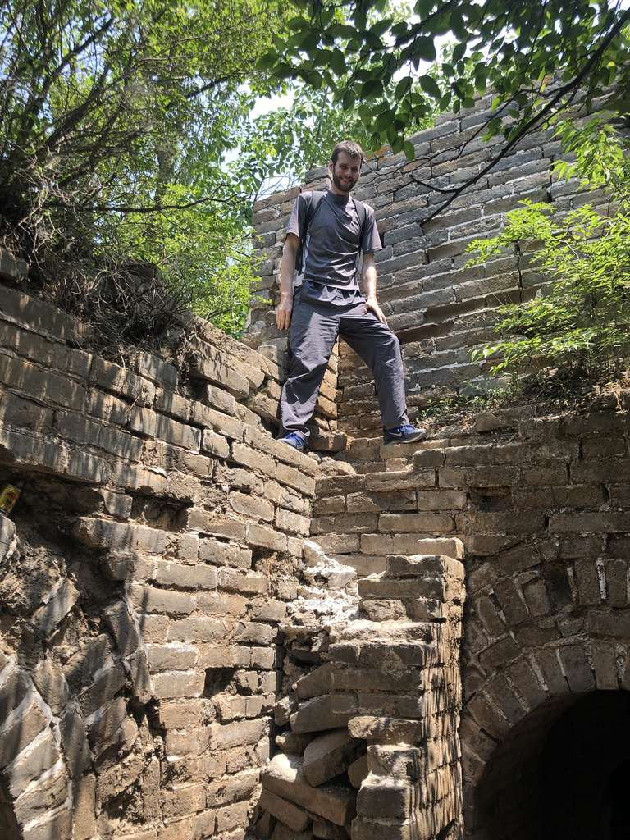
Short bio
Studied physics at TU Vienna
PhD in nuclear data evaluation 2015
Postdoc at CEA Saclay (2015-2018) and Uppsala University (2018-2019)
Since 2020 nuclear physicist at Nuclear Data Section of the IAEA dealing with nuclear data library projects, method and code development

Slide 3

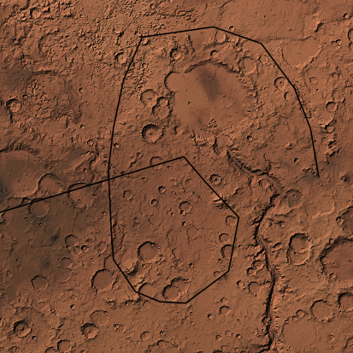

Challenge #1: Mars rover
A self-driving vehicle should follow a predefined path on Mars
Assumptions:
Vehicle approximately aware of initial position and knows approximately speed and direction of movement at any point in time afterwards.
Task:
Determine current position by x₀ = x_{old} + v*Δt and adjust speed and direction to stay on desired trajectory
Problem:
Uncertainty about position puts the rover at risk to fall into a deep crater and get damaged
ghost car

Slide 4
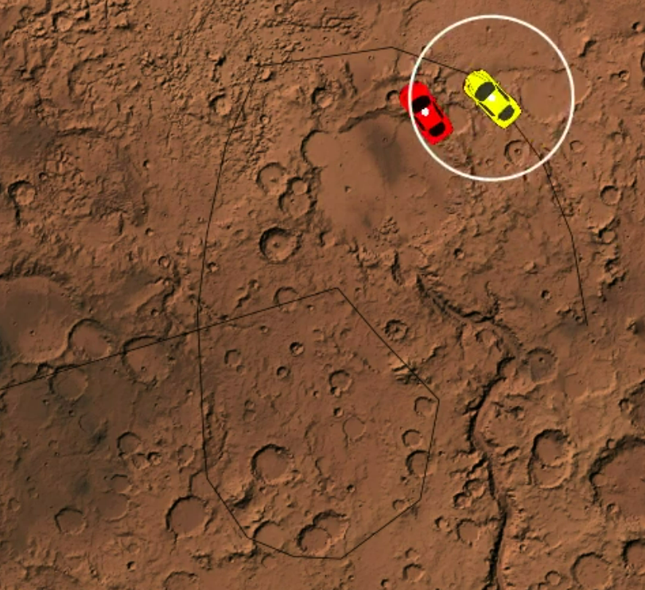
Truth-Estimate divergence
Link to movie

Slide 5
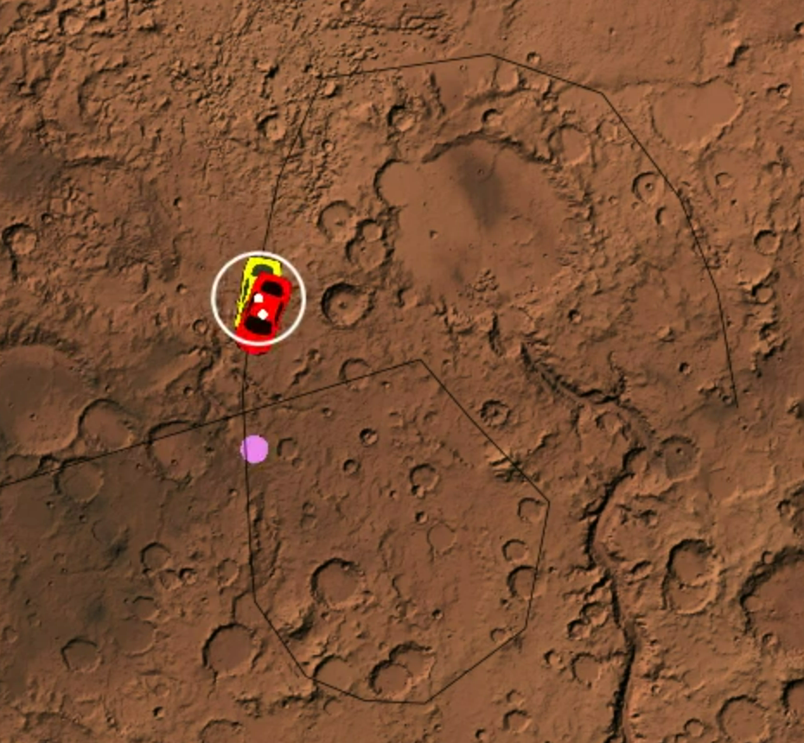
Make use of GPS
Link to movie

Slide 6
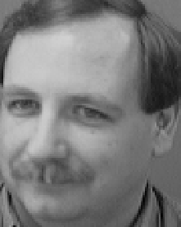
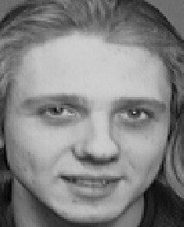
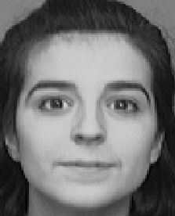
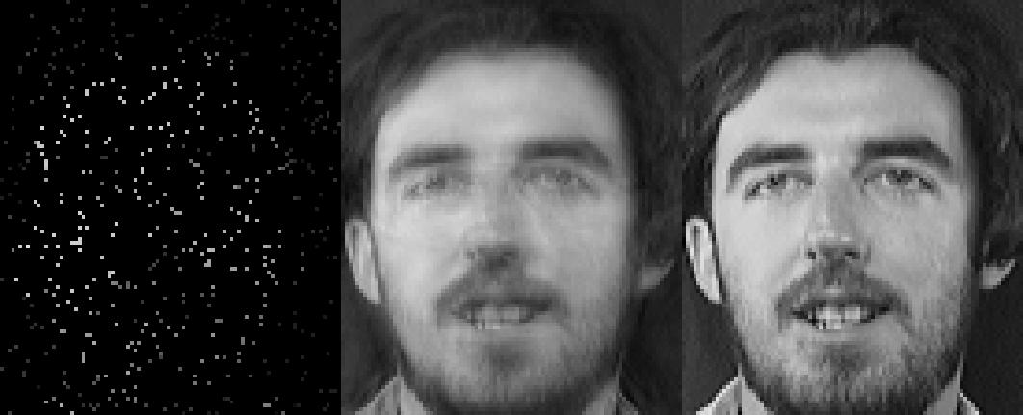
Challenge #2: Face reconstruction
Taken from the A&T face dataset

Slide 7
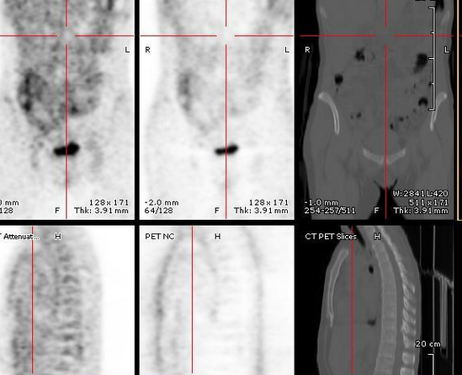
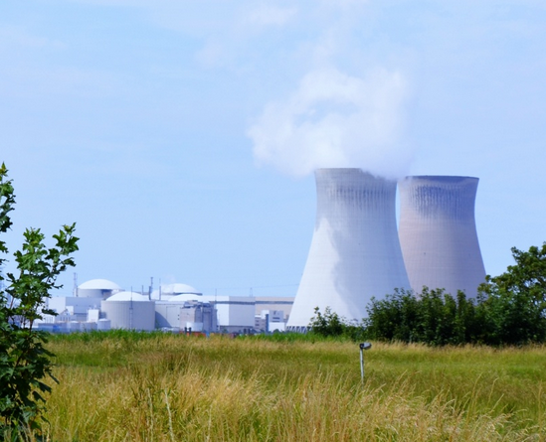

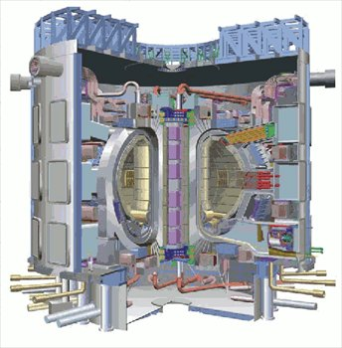
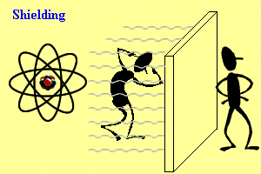
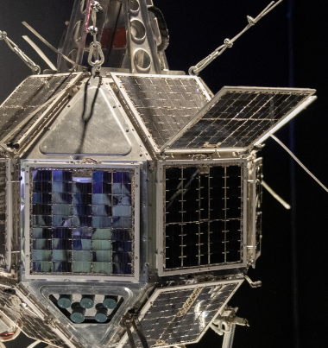
Nuclear data
Probabilities of various nuclear interactions involving the atomic nuclei, e.g., cross sections.
Relevant for:
Reactor physics
Radiation dosimetry
Radiation protection
Radioactive waste management
Astrophysics
Nuclear medicine
Fusion research
...
Target isotope
n
non-elastic
elastic

Slide 8
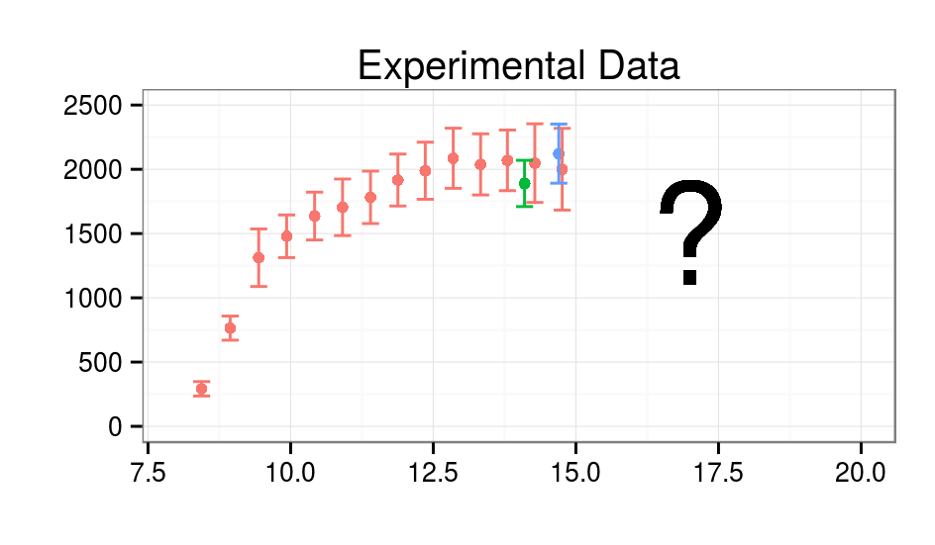
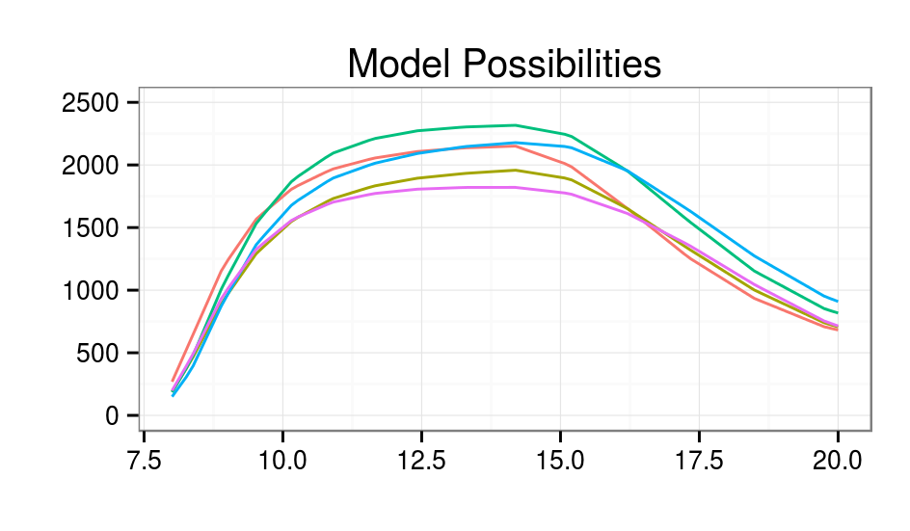
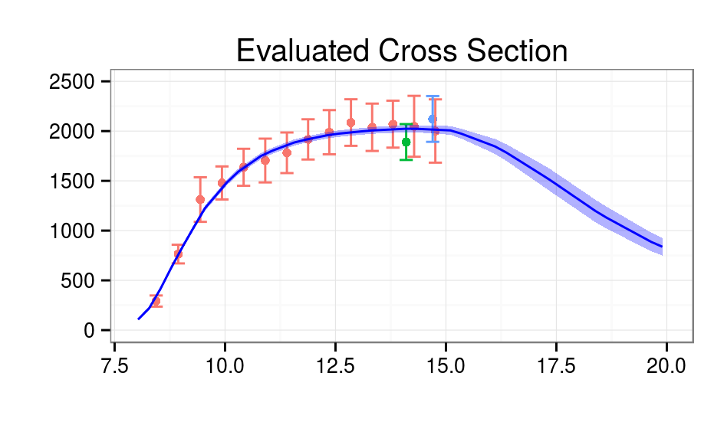
Challenge #3: Nuclear data evaluation

Slide 9
Two formulas for (at least) three applications

Slide 10

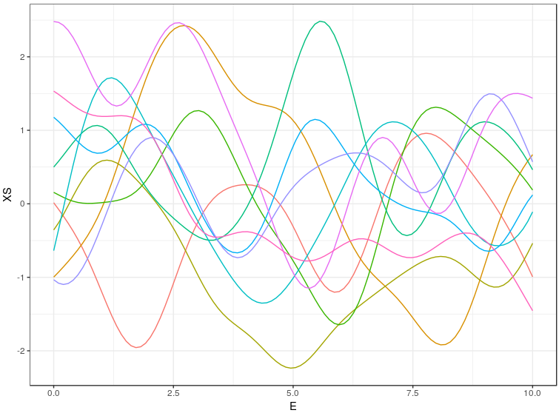
Outline
Why those equations? Where do they come from?
Application of these formulas to different inference problems
On the way, we will encounter two data science methods

Slide 11
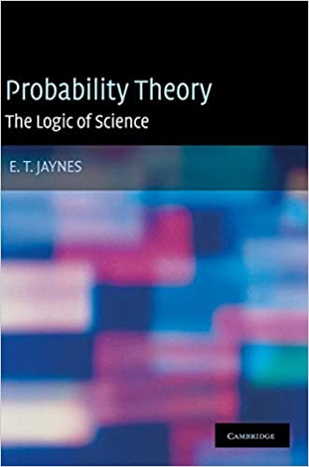
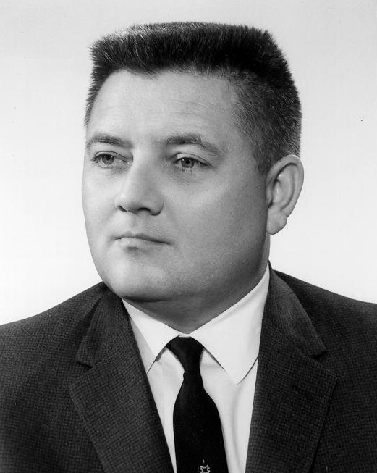
Jaynes Robot
Hypotheses
H1: It rained
H2: It did not rain
Observations
O1: The ground is wet
O2: The ground is dry
Which hypothesis is true?
Edwin Thompson Jaynes
1922-1998

Slide 12




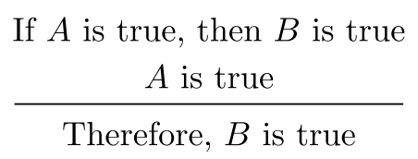
Consistency with Aristotelian logic
Hypothesis
Observation
True
True

Slide 13
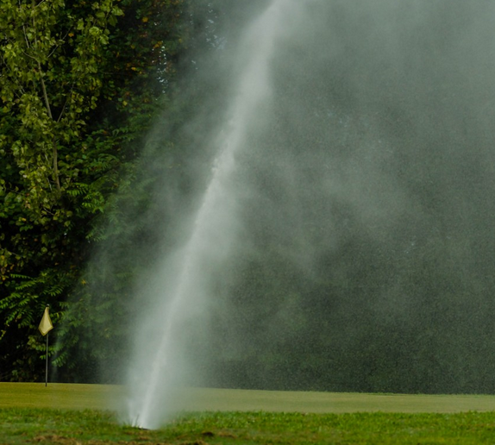
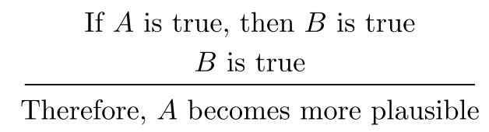
Consistency with common sense
Hypothesis
Observation
More plausible
True

Slide 14
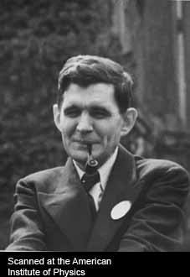
Desiderata
(I) Degrees of Plausibility are represented by real numbers
(II) Qualitative Correspondence with common sense
(IIIa) If a conclusion can be reasoned out in more than one way, then every possible way must lead to the same result.
(from E.T. Jaynes, Probability Theory: The Logic of Science)
Richard Threlkeld Cox
1898-1991

Slide 15
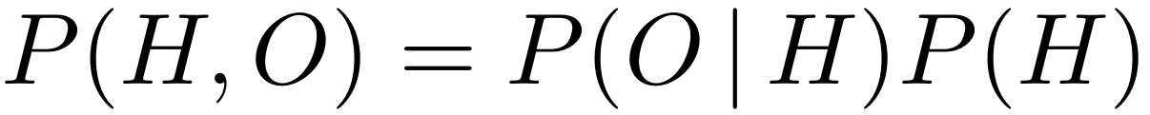
Desiderata / Cox theorem
(I) Degrees of Plausibility are represented by real numbers
(II) Qualitative Correspondence with common sense
(IIIa) If a conclusion can be reasoned out in more than one way, then every possible way must lead to the same result.
(from E.T. Jaynes, Probability Theory: The Logic of Science)
Computation rules of probability theory follow
Richard Threlkeld Cox
1898-1991
e.g., product rule

Slide 16
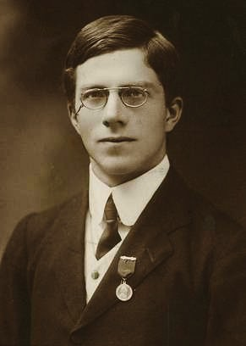
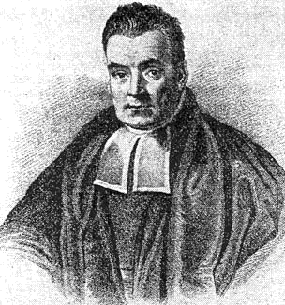
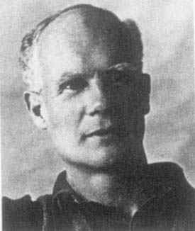
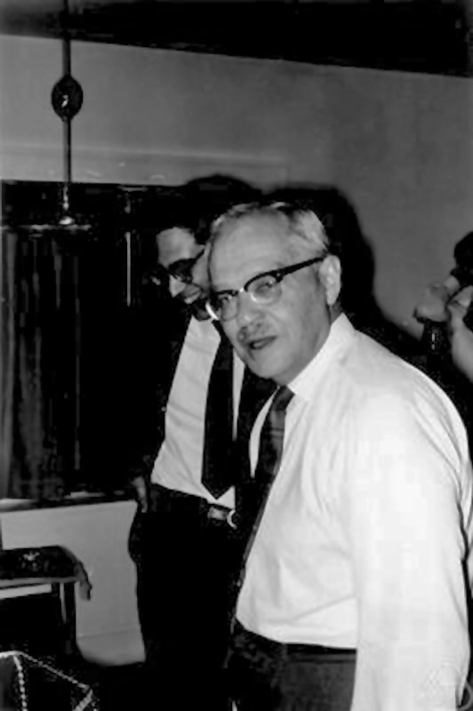
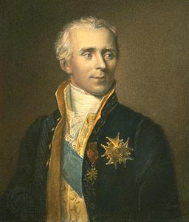
The statistical split
Frequentist statistics
Bayesian statistics
Ronald Fisher
Thomas Bayes
Egon Pearson
Pierre-Simon Laplace
Jerzy Neyman *
*) MFO - Mathematisches Forschungsinstitut Oberwolfach
https://opc.mfo.de/detail?photo_id=3044
CC-BY-SA 2.0 de

Slide 17
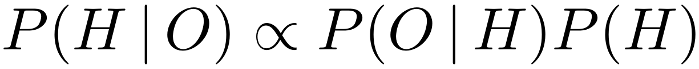
Bayesian update formula
Thomas Bayes
1701-1761
H hypothesis (e.g., “It rained”)
O observation (e.g., “Floor wet”)
P(H) probability of hypothesis to be true
P(O|H) probability to make observation O
given hypothesis H is true
P(H|O) probability of hypothesis H
given we observed O
Pierre Simon Laplace
1749-1827

Slide 18
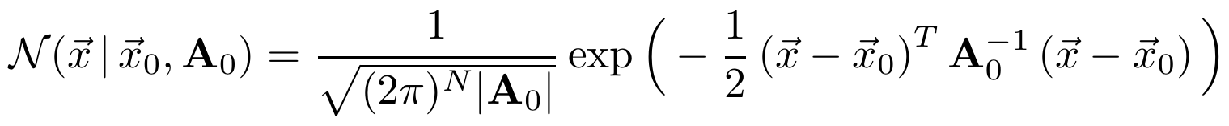
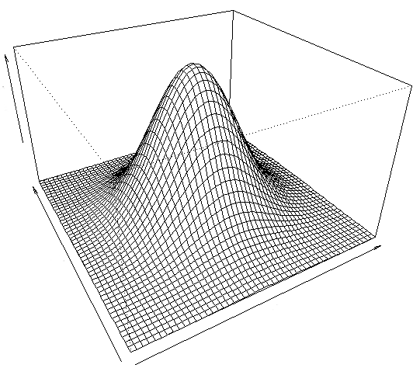
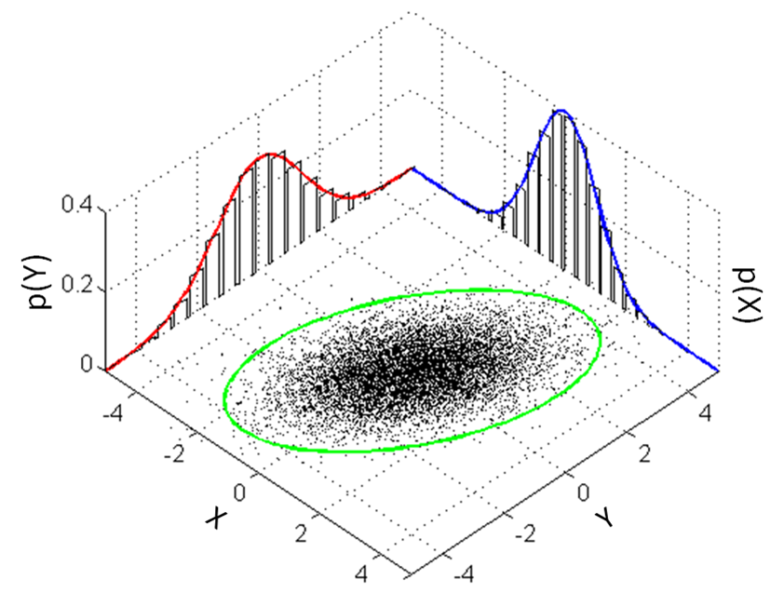
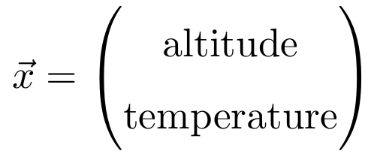
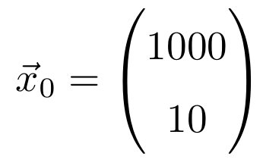
Multivariate normal distribution
y
x

Slide 19
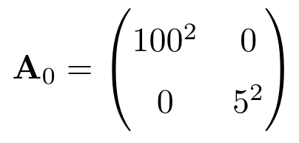
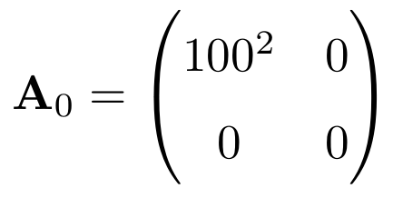
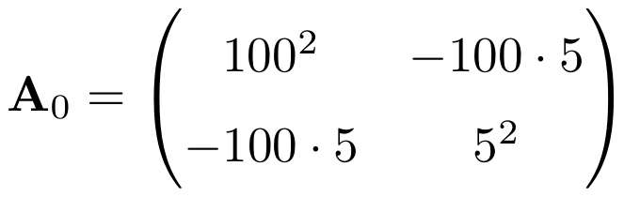
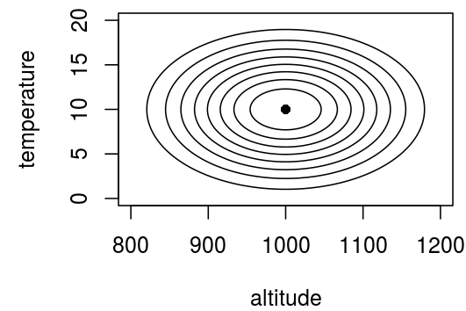
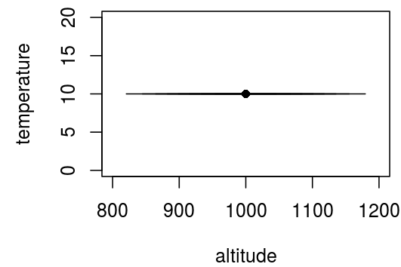
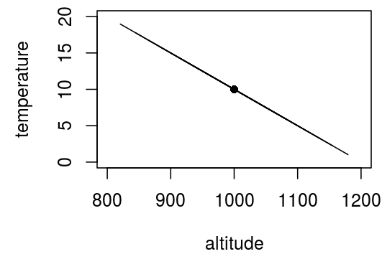
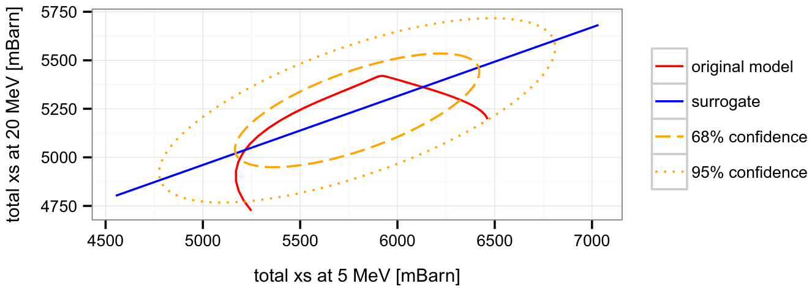
Covariance matrix
Variance / uncertainty squared
covariance
A covariance matrix captures linear relationships and uncertainties

Slide 20
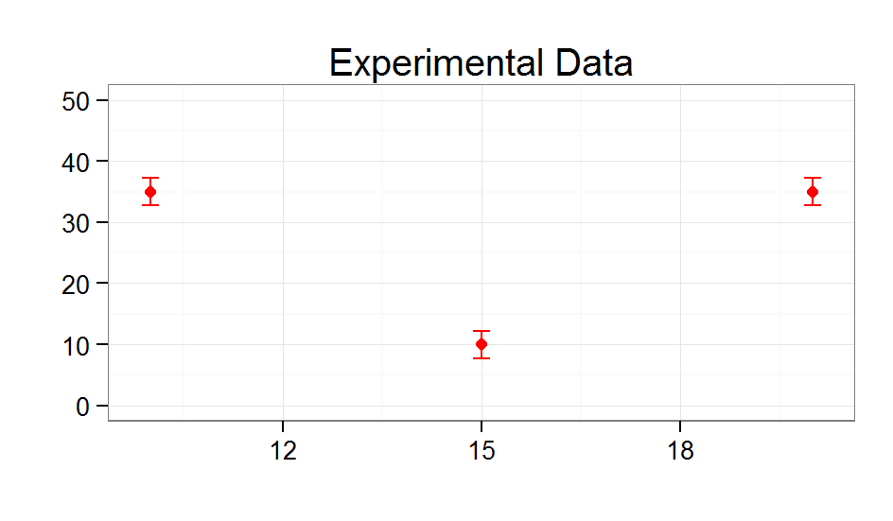
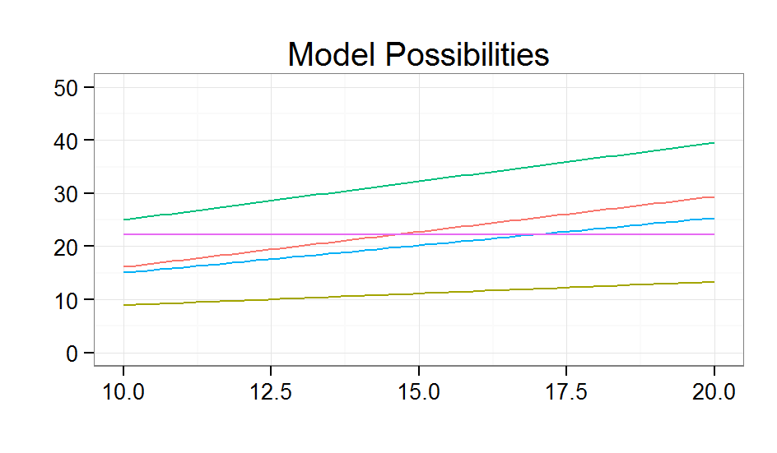
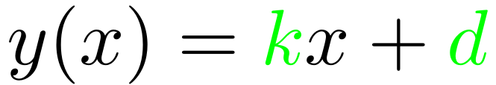
Putting everything together
(at the example of linear regression)

Slide 21
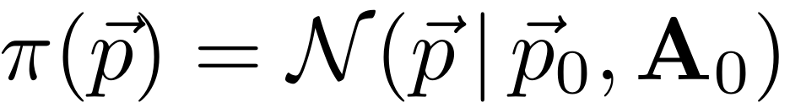
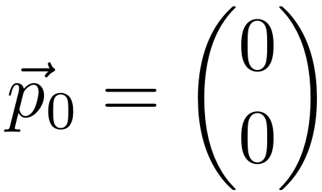
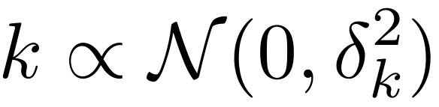
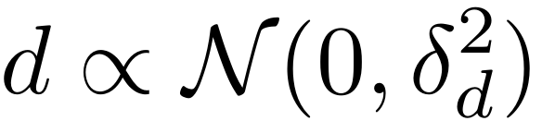
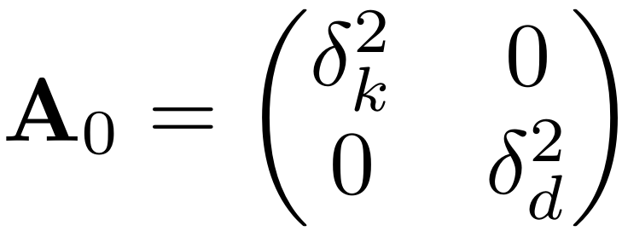
Putting everything together
(prior knowledge “P(H)”)

Slide 22


Putting everything together
(likelihood “P(O|H)”)

Slide 23


Putting everything together
(likelihood “P(O|H)”)
Counting statistics
→ Poisson distribution

Slide 24


Putting everything together
(likelihood “P(O|H)”)

Slide 25



Generalized Least Squares (GLS) in a nutshell
Prior
Likelihood
Bayesian update
Posterior
“GLS formulas”

Slide 26

And the result?

Slide 27




Important insight about models
“All models are wrong but some are useful”
- George E. P. Box
Image credit:
DavidMCEddy at en.wikipedia
CC BY-SA 3.0
Reality
Ice cream or pizza?

Slide 28




How to deal with a deficient model (or to come up with a good one)?
But what if it is too difficult to find a good analytic function?

Slide 29

Surrogate approach
Assumptions:
Access to a good physics model
Ability to perform hundreds to thousands of model calculations using different parameter values in good time
Each model calculation yields predictions on a dense mesh and we can use linear interpolation between mesh points
E₁
E₂
E₃
...

Slide 30


Surrogate approach basic idea
is linked to
v1
aV
replaced by
ϭ₁
ϭ₂

Slide 31


Surrogate approach construction of M_{sur}
1) draw ensemble from prior distribution
2) use nuclear model to calculate
3) estimate multivariate normal distribution in observation space
Generalized Least Squares formulas

Slide 32

Application to nuclear data evaluation face reconstruction
We have a sample of model predictions faces

Slide 33



Representation of faces

Slide 34








All the matrices in their glory details
Prior belief
Observation
Improved estimate

Slide 35

Example result
Observation (5%)
Prediction
Original

Slide 36
Ok, let’s do also nuclear data evaluation with this approach
Here is the sample of faces model predictions
(measured xs = intensities of available pixels)

Slide 37

But what if...
E₁
E₂
E₃
...
… we don’t have a good physics model nor a comprehensive database
… we don’t know a good analytic function to be used as model

Slide 38



Idea: Use a function to construct covariance matrices
X₁
X₂
X₃
...

Slide 39


Covariance function
Specify a function that yields the covariance between function values f(x₁) and f(x₂) for any possible pair x₁ and x₂. This function is called a covariance function.
Specify another function μ(x) that yields the center value of the process at location x. This function is called a mean function.

Slide 40




Different covariance functions and the prior knowledge they induce
Play video

Slide 41


Gaussian process regression
Powerful concept
Directly parametrize covariance matrix and work implicitly with an infinite number of parameters/basis functions!
Sample from prior (δ=λ=1)
Posterior uncertainty

Slide 42

Computational mesh and experimental mesh
Introduce computational mesh U and experimental mesh V

Slide 43



A few covariance matrices

Slide 44





Applying the GLS formulas
Use GLS formulas:
Make the following assignments:

Slide 45

GPs constrained with observations
The posterior covariance matrix encodes more than just uncertainties!

Slide 46

GPs constrained with observations
Play video

Slide 47

Comparison to neural networks
GP processes
artificial neural networks
Both approaches …
… are methods for classification and regression
… are universal function approximators
Neural networks …
… scale better to large data sets
… are able to capture non-local features
… are difficult to interpret
GP processes …
… are statistical methods from the ground up (uncertainties)
… facilitate the incorporation of prior assumptions
… interface well with existing nuclear data evaluation methods

Slide 48
Summary
Two formulas for inference for at least three applications (GLS)
Presented an argument to motivate the use of Bayesian statistics
Employed the multivariate normal distribution
Generalized Least Squares method applied in different ways
Finally, we talked about Gaussian process regression which can be regarded as special case of Bayesian GLS if we discretize the function (or vice-versa)

Slide 49


Bonus: Mars rover
Task: An automated vehicle should follow a predefined path on Mars
Hypothetical approach:
a) Vehicle is aware of initial position and its speed and direction of movement at any point in time afterwards.
b) Determine current position by x₀ = x_{old} + v*Δt
c) Adjust speed and direction to stay on desired trajectory
Problems:
Neither initial position nor speed nor direction are perfectly known. This introduces uncertainty about the current position.
State and error propagation:
ghost car

Slide 50



Update equations
Prior belief
Observation
Improved estimate

Slide 51



Using a laser guidance system
Prior belief
Observation
Improved estimate

Slide 52

Using a laser guidance system
Link to movie

Slide 53
References
E. T. Jaynes “Probability Theory: The Logic of Science” (first chapters available online for free)
C. E. Rasmussen & C. K. I Williams, “Gaussian processes for Machine Learning”, http://www.gaussianprocess.org/gpml/
GitHub repository with the scripts and videos of this presentation: https://github.com/gschnabel/compnuc-workshop-2022

