Slide 1
Probabilistic methods for nuclear data
(An introduction to Gaussian process regression)
Georg Schnabel
Nuclear Data Section
NAPC/IAEA
Joint ICTP/IAEA School on AI for Nuclear, Plasma and Fusion Science
Trieste, 2023

Slide 2
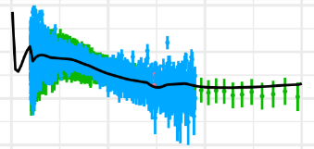
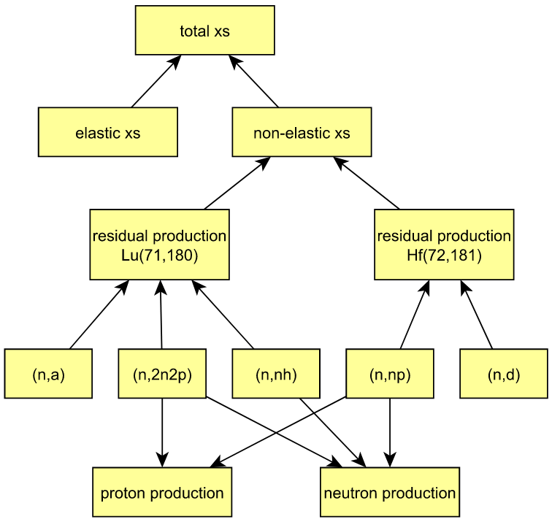
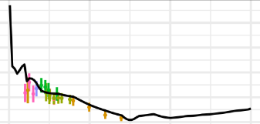
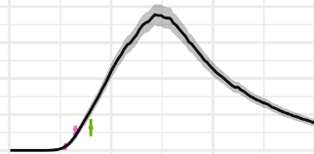
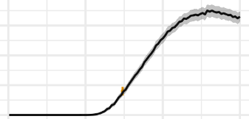
System of excitation functions

Slide 3
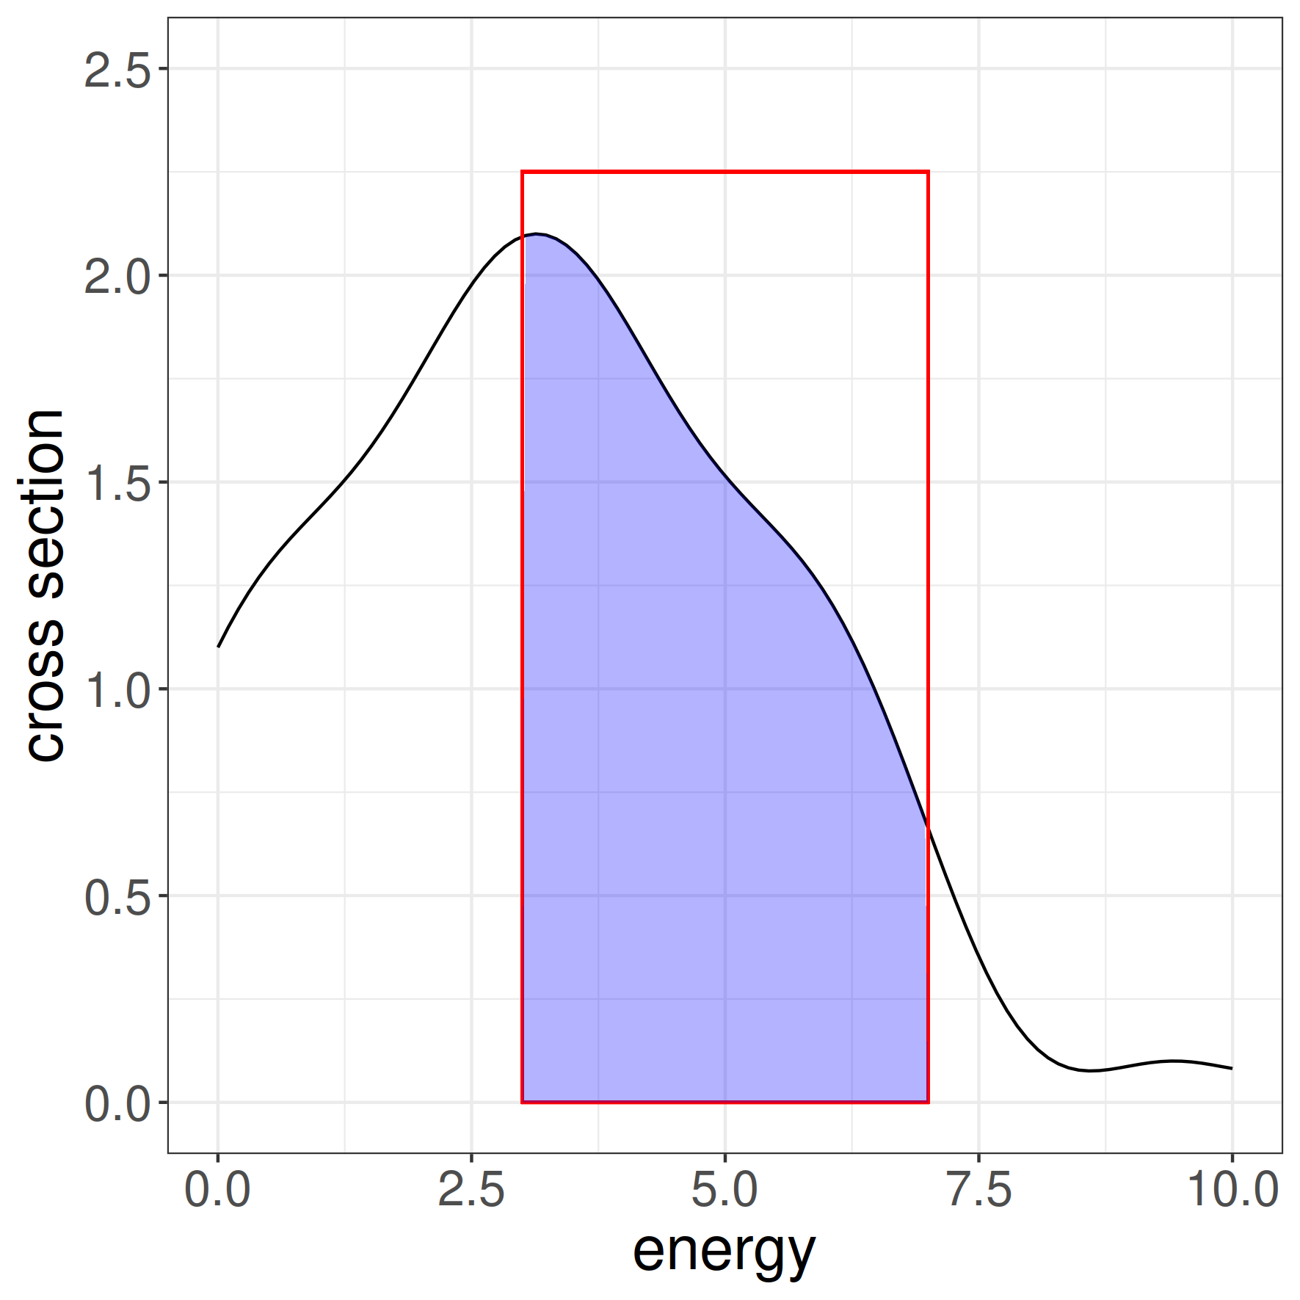
Measurement with finite resolution

Slide 4
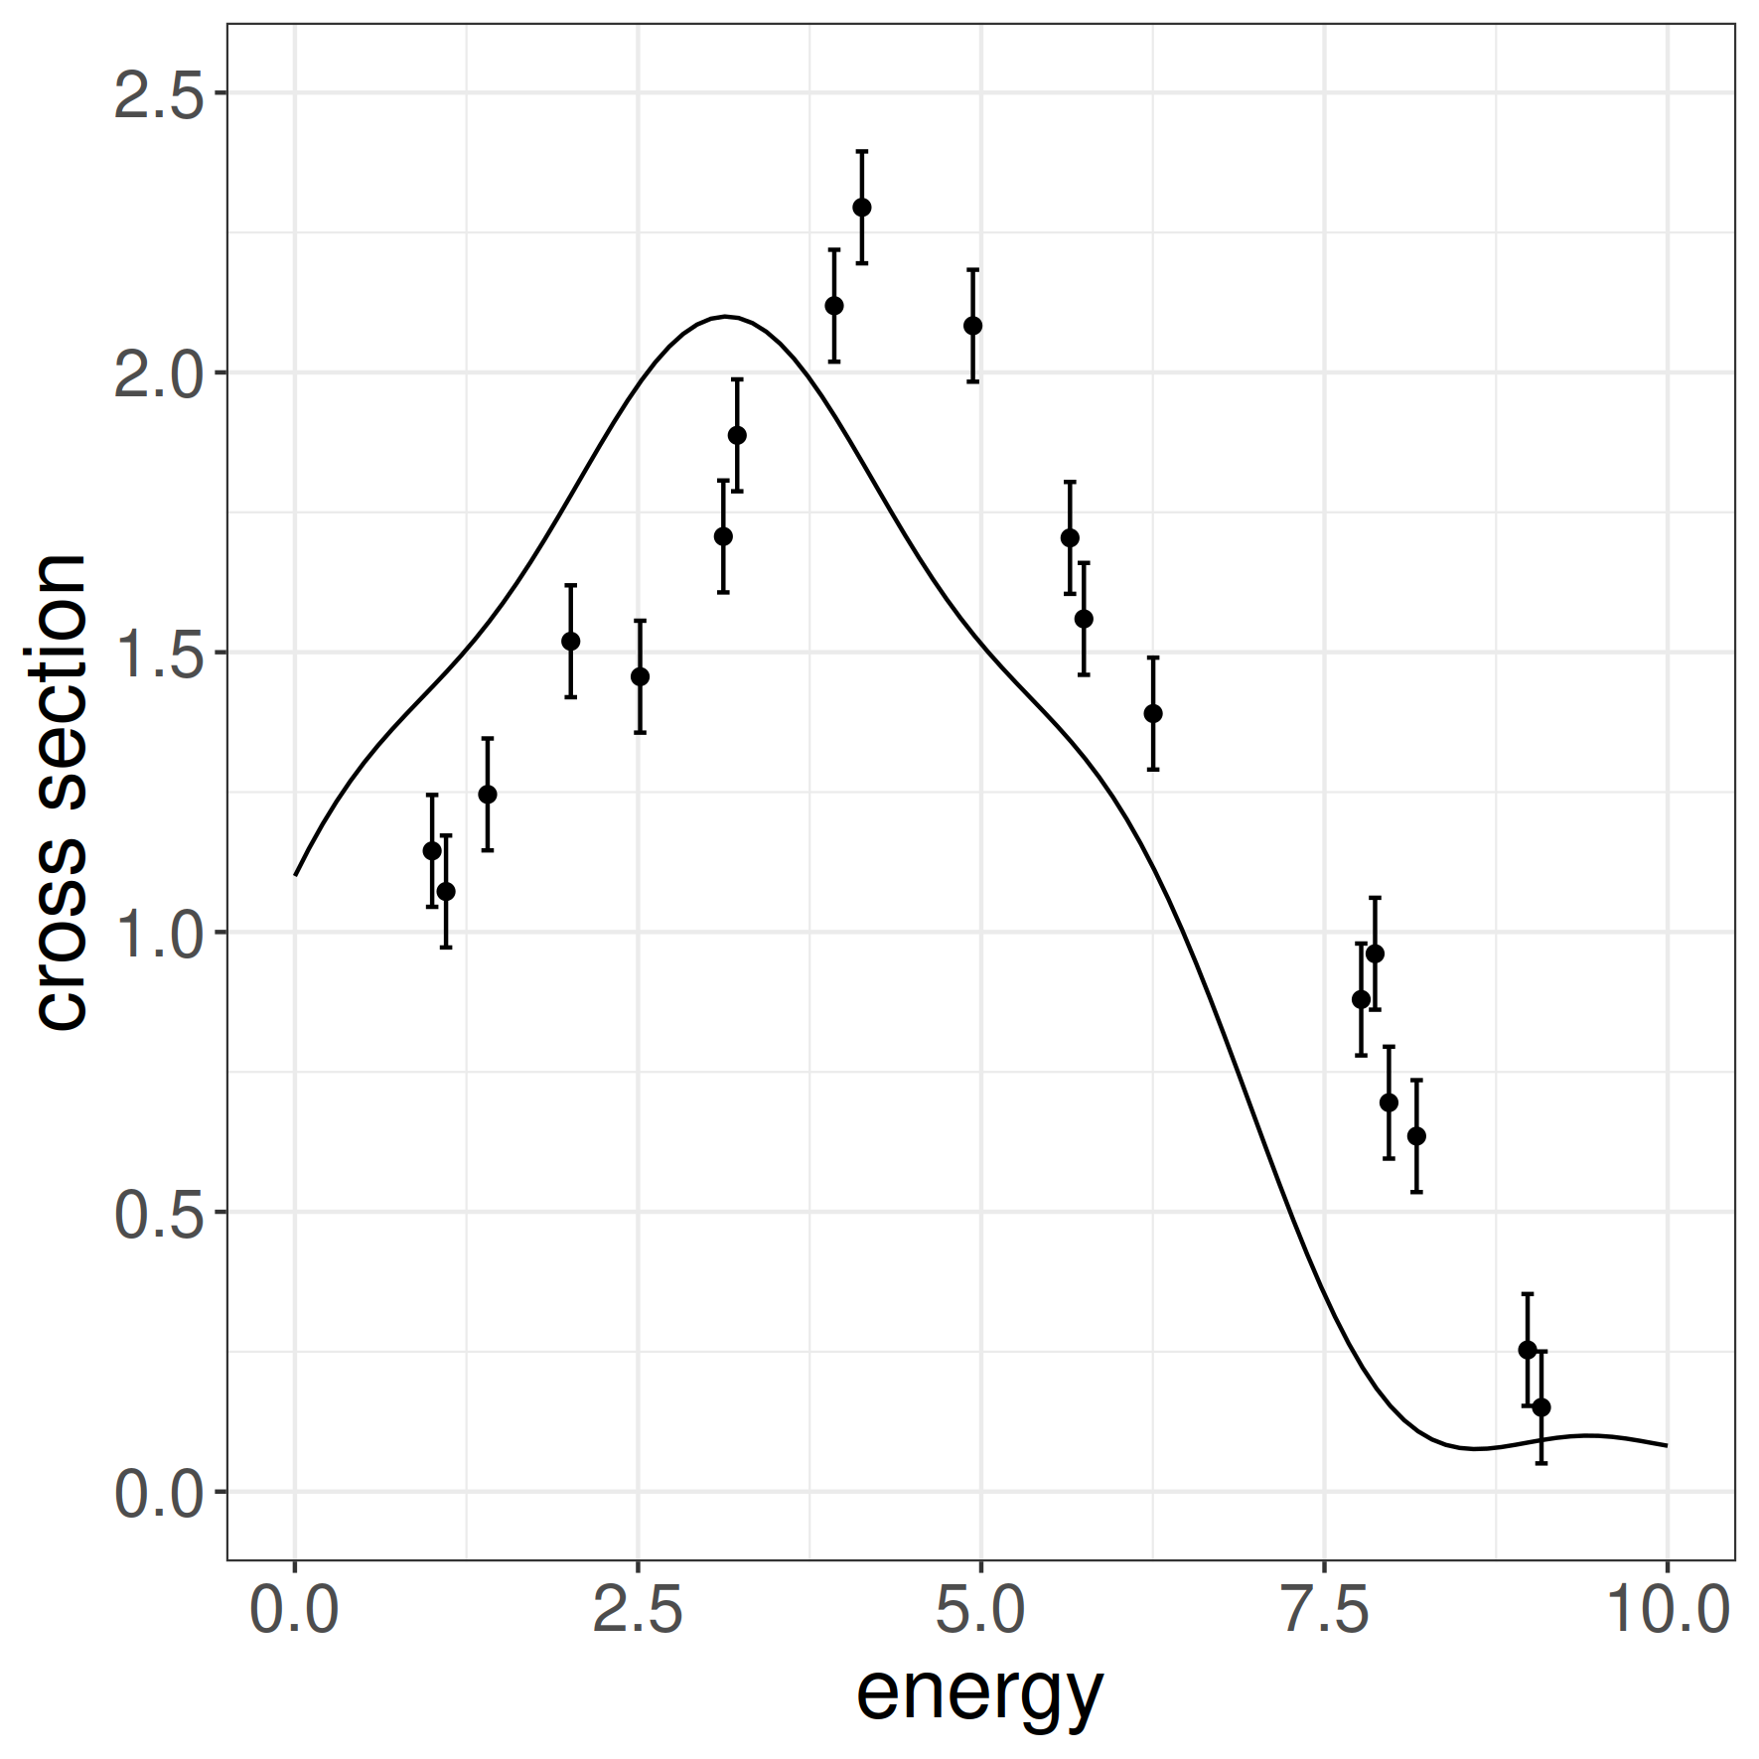
Measurement with uncertain energy calibration

Slide 5
General setting
System of unknown functions, values, parameters linked together by some relationships (e.g., sum of some functions should yield another function)
Partial observations (noisy, finite resolution, not precisely known x-value)

Slide 6
Specific focus of this lecture
System of unknown functions, values, parameters linked together by some relationships (e.g., sum of some functions should yield another function)
Partial observations (noisy, finite resolution, not precisely known x-value)

Slide 7
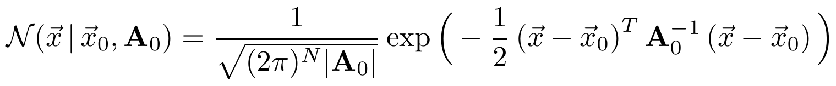
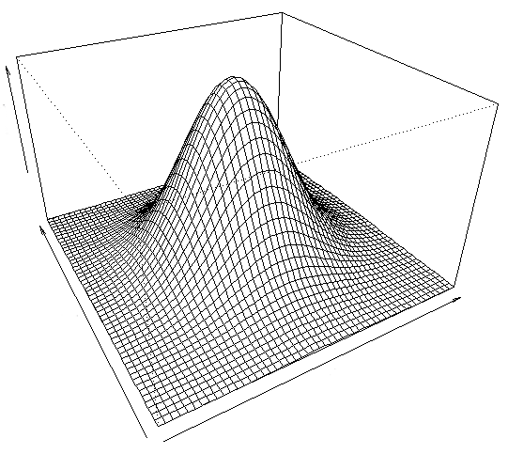
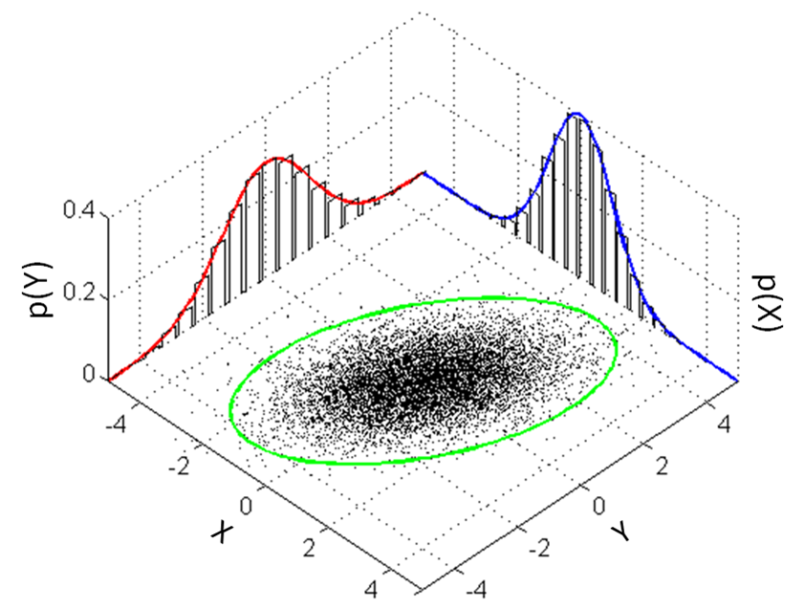
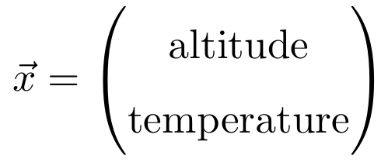
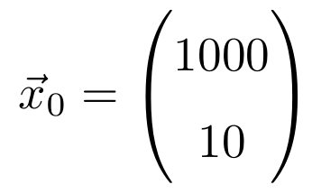
Multivariate normal distribution
y
x

Slide 8
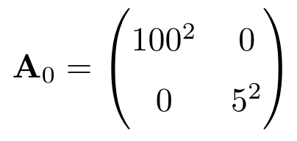
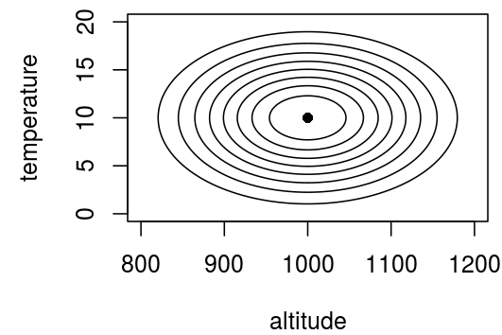

Covariance matrix
Variance / uncertainty squared

Slide 9
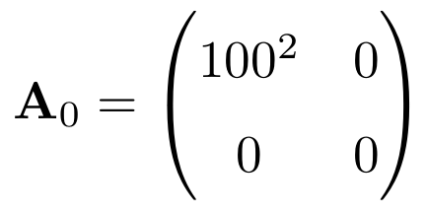
Covariance matrix
?

Slide 10
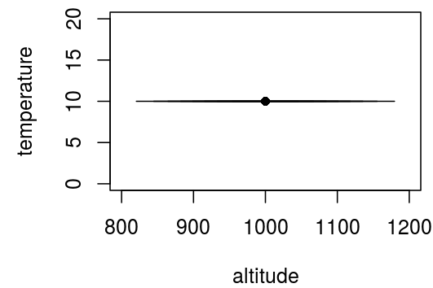
Covariance matrix
Variance / uncertainty squared

Slide 11
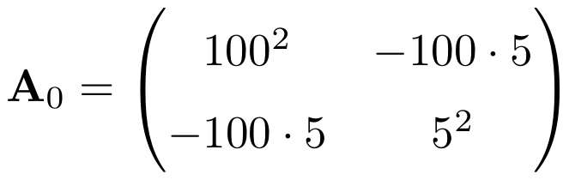
Off-diagonal elements
?

Slide 12
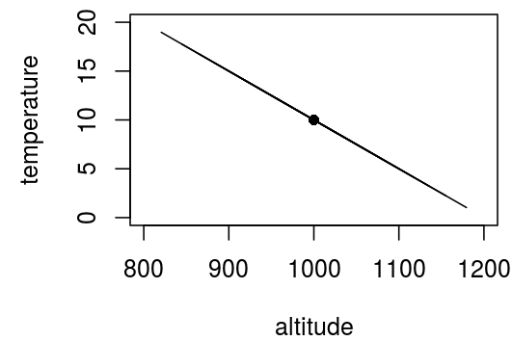
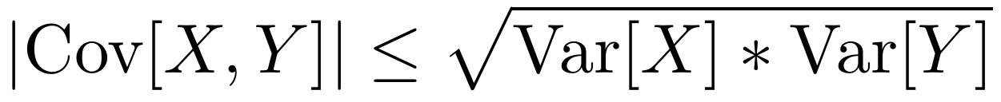
Off-diagonal elements

Slide 13
Conditional probability density function

Slide 14
Conditional probability density function

Slide 15
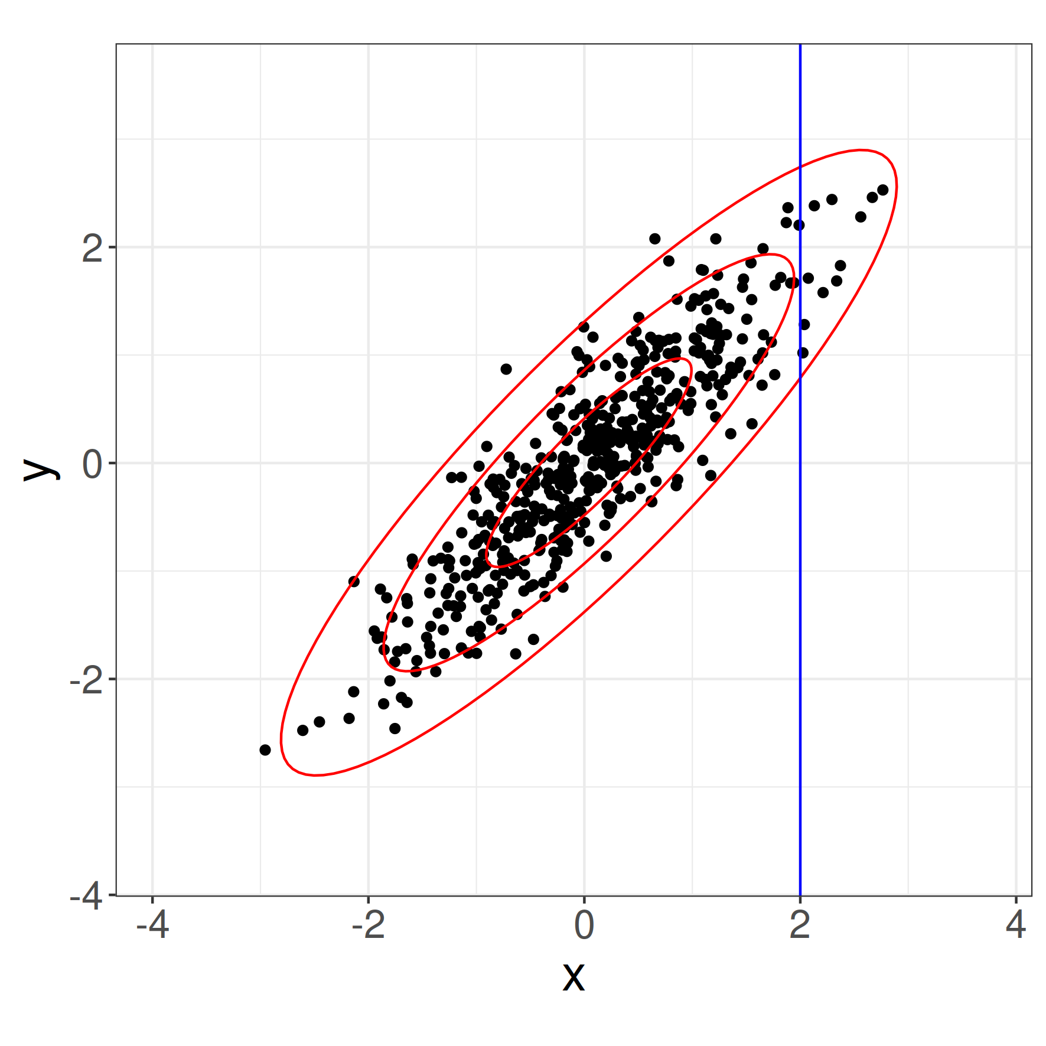
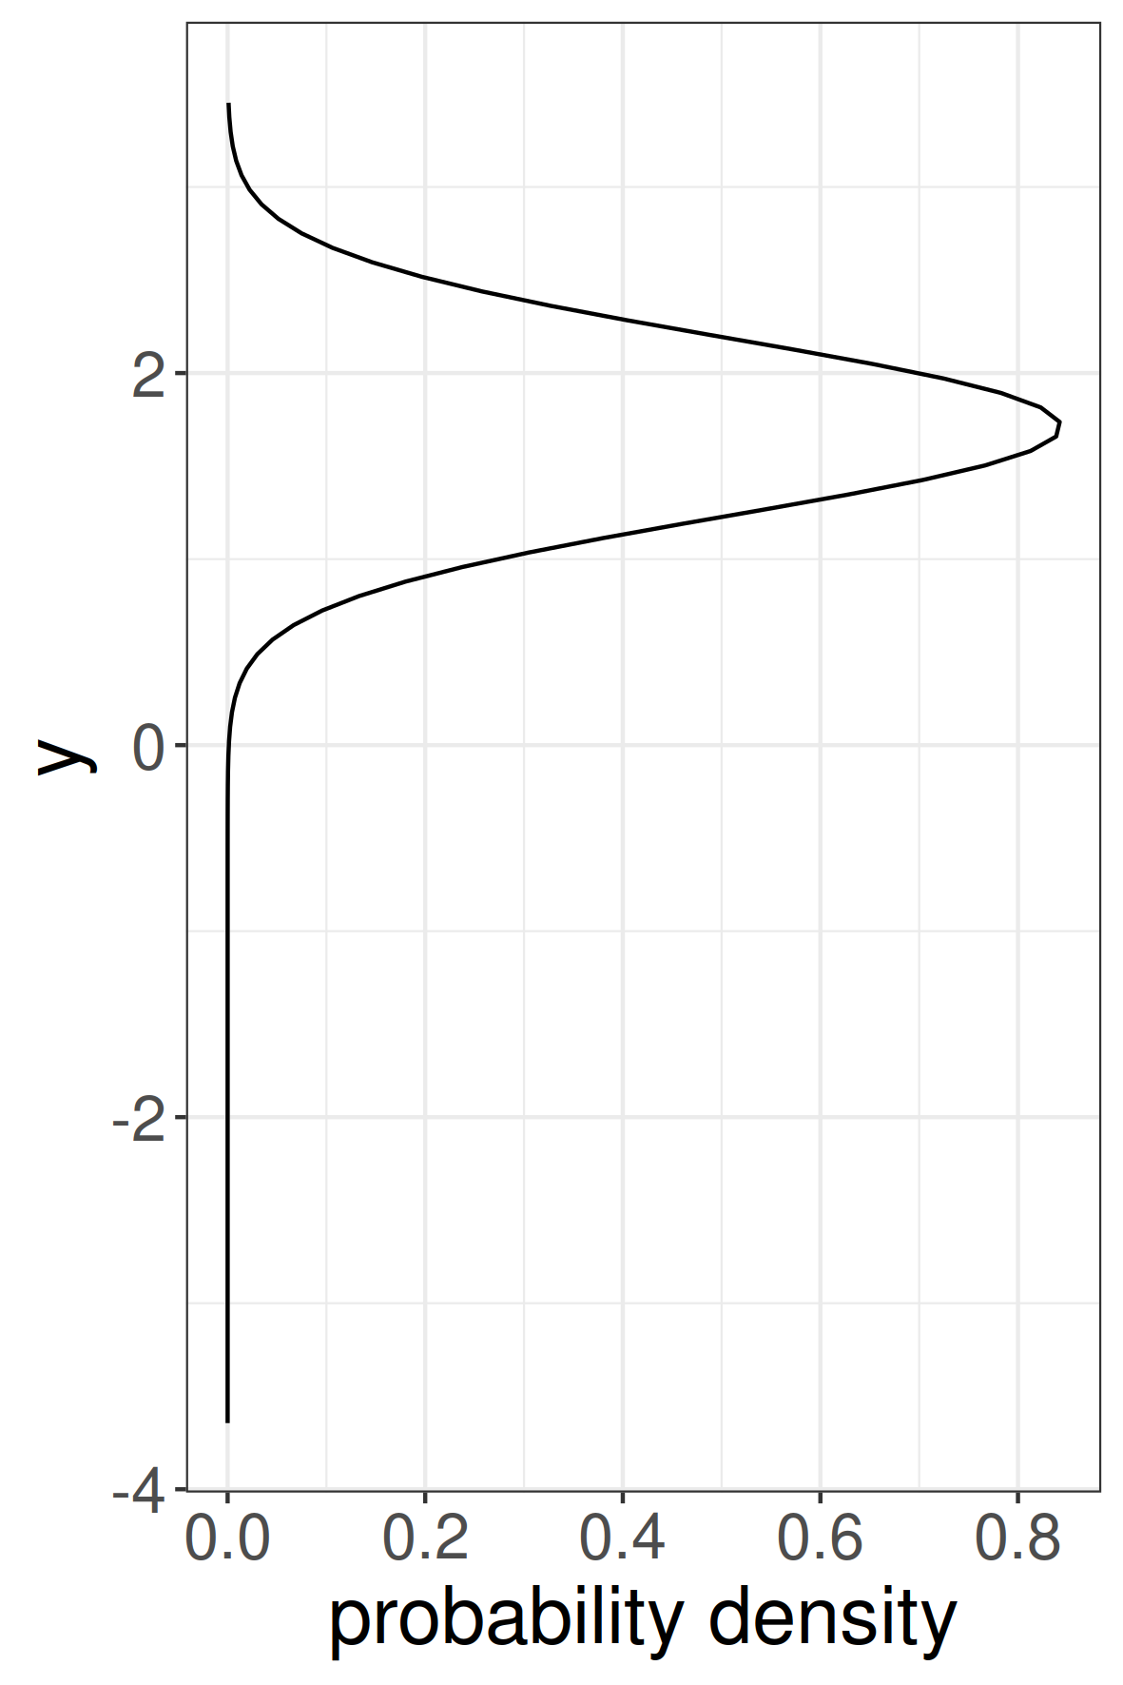
Correlated non-degenerate case
b

Slide 16





Conditional pdf of multivariate normal distribution
Distribution parameters for x1 if we know x2=a

Slide 17
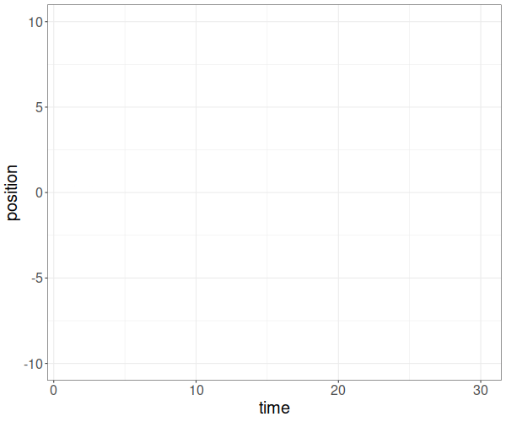
Stochastic process e.g. Brownian motion
one jump/second
jumps: +1 / -1
stochastic process
is associated with a
random function

Slide 18

Stochastic process e.g. Brownian motion
one jump/second
jumps: +1 / -1
stochastic process
is associated with a
random function

Slide 19
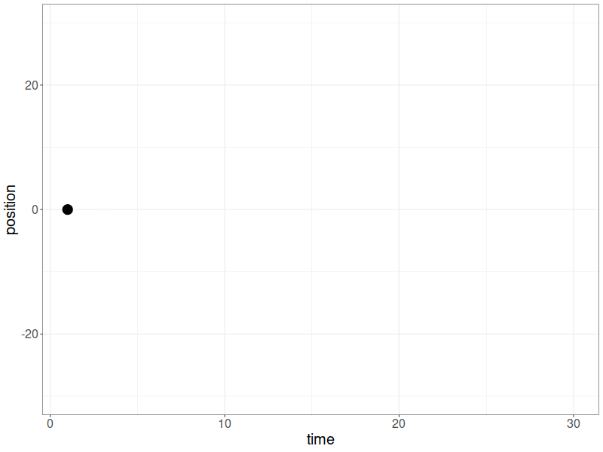
Brownian motion

Slide 20
Spatial distribution after some time
At time t, we had a number of t jumps (+1 or -1)
Np is number of +1 steps
Nm is number of -1 steps
x(t) = Np - Nm = 2*Np - t
+1 and -1 jumps are equally likely

Slide 21

Spatial distribution after some time
At time t, we had a number of t jumps (+1 or -1)
Np number of +1 steps
Nm number of -1 steps
x(t) = Np - Nm = 2*Np - t
+1 and -1 jumps are equally likely
n = t
k = (x + t) / 2
p = 0.5

Slide 22


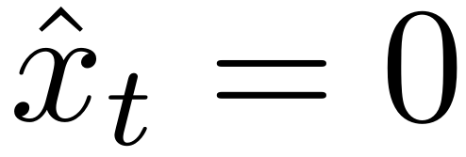
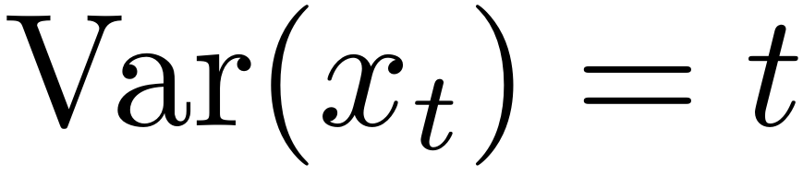
Normal approximation (N>>k, k>>0
n = t
k = (x + t) / 2
p = 0.5

Slide 23
What about observations?
one jump/second
jumps: +1 / -1
stochastic process
is associated with a
random function

Slide 24

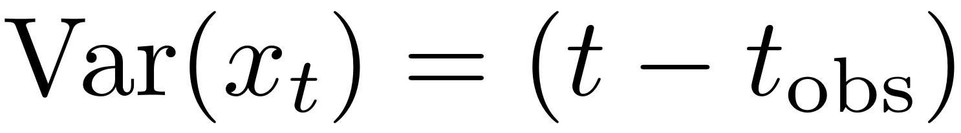
Conditional distribution
Starting with x0 = 0
Evolution after we observed position xobs at tobs

Slide 25


Conditional distribution
Starting at x0 = 0
Evolution after we observed position xobs at tobs

Slide 26

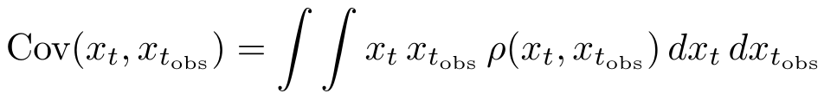
Covariance between xt and xt_obs

Slide 27
Covariance between xt and xt_obs

Slide 28
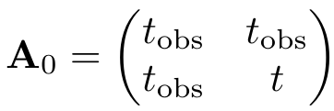
Covariance matrix for our process

Slide 29
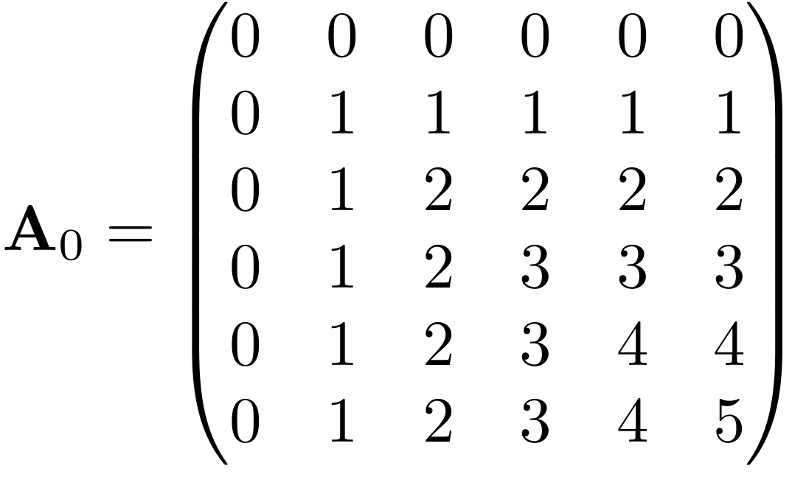
Full covariance matrix up to t=5

Slide 30
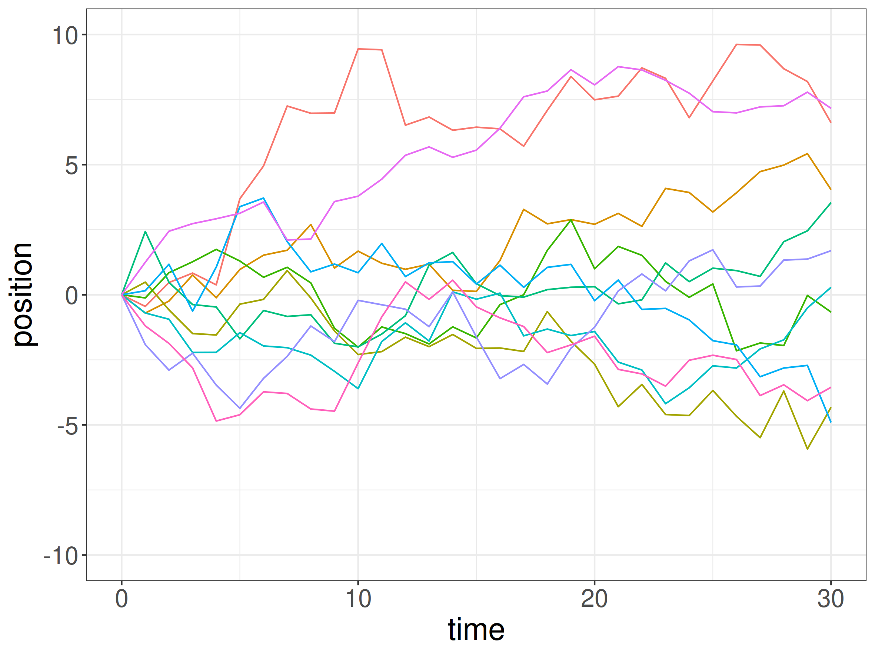
Sampling from the multivariate normal distribution

Slide 31
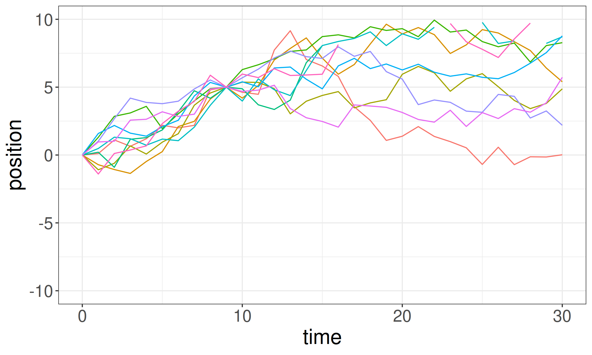
Constraining with observation

Slide 32
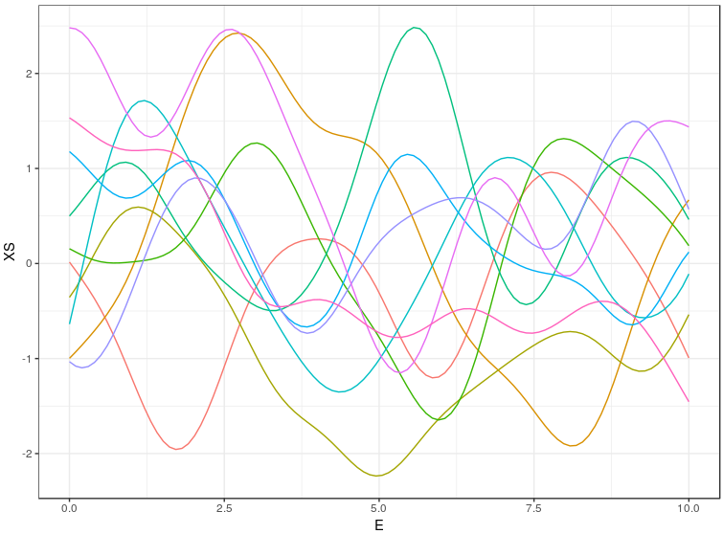
Characterisation of Gaussian process
All finite sets of function values at different locations are distributed according to a multivariate normal distribution
→ Gaussian process

Slide 33
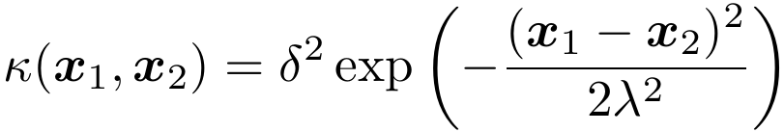
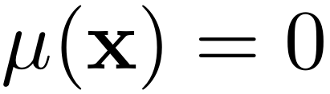
Specification of a Gaussian process
Specify a function that yields the covariance between function values f(x₁) and f(x₂) for any possible pair x₁ and x₂. This function is called a covariance function.
Specify another function μ(x) that yields the center value of the process at location x. This function is called a mean function.

Slide 34
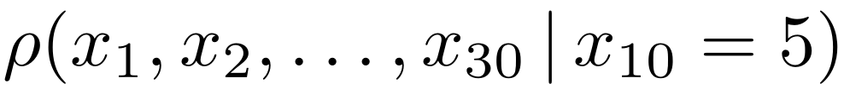
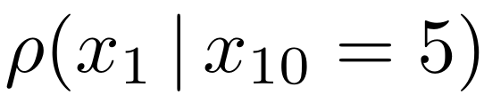
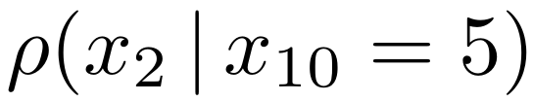
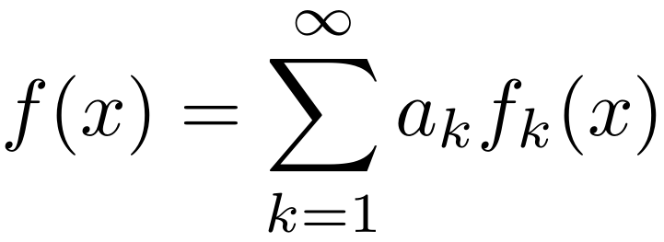
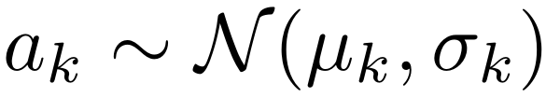
Some features of Gaussian process regression
Predictions can be calculated one at a time
Usually (depending) on covariance matrix, GP regression amounts to fitting infinitely many coefficients

Slide 35
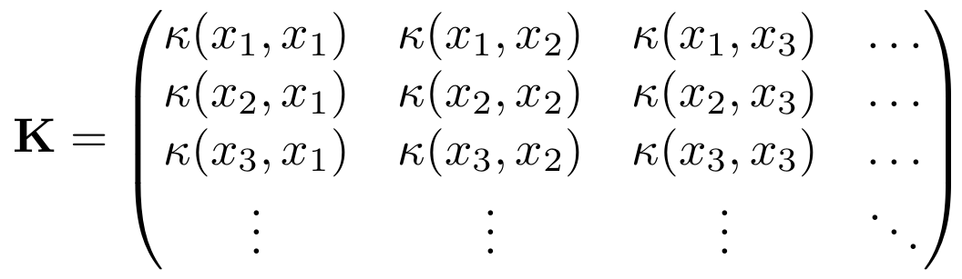
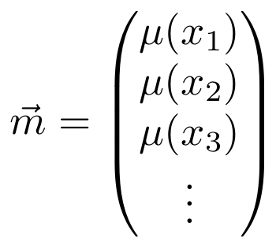

Sampling from a Gaussian process
X₁
X₂
X₃
...

Slide 36
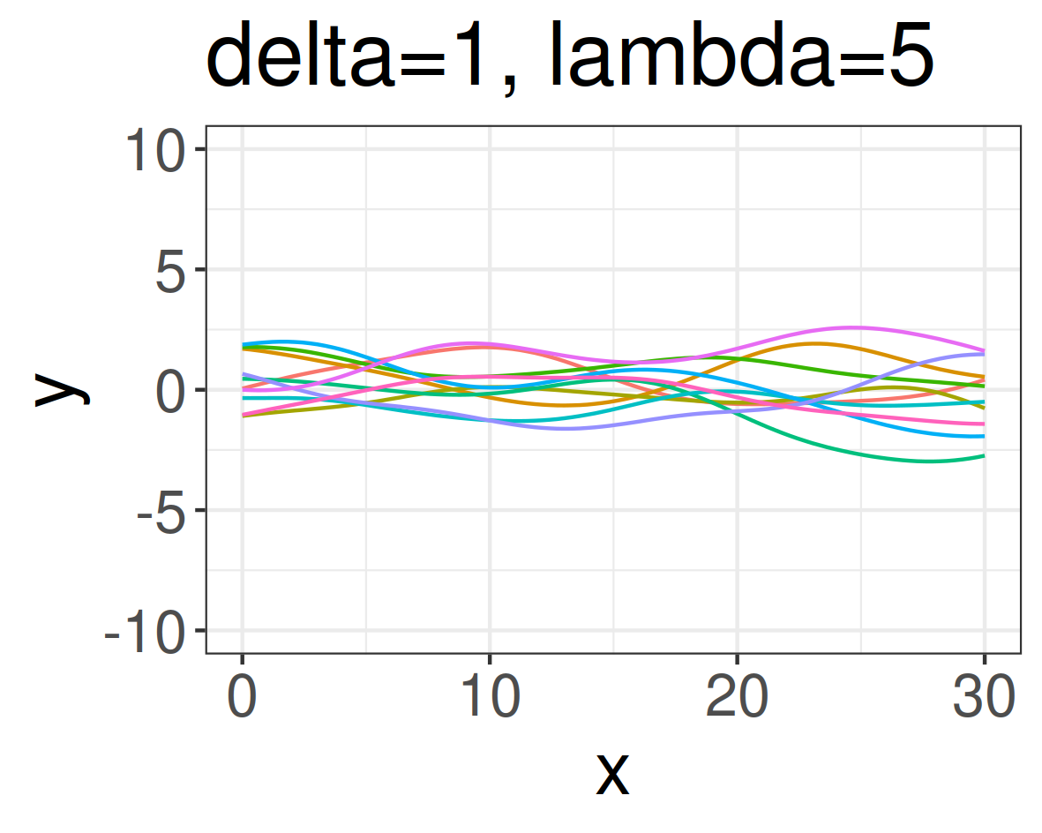
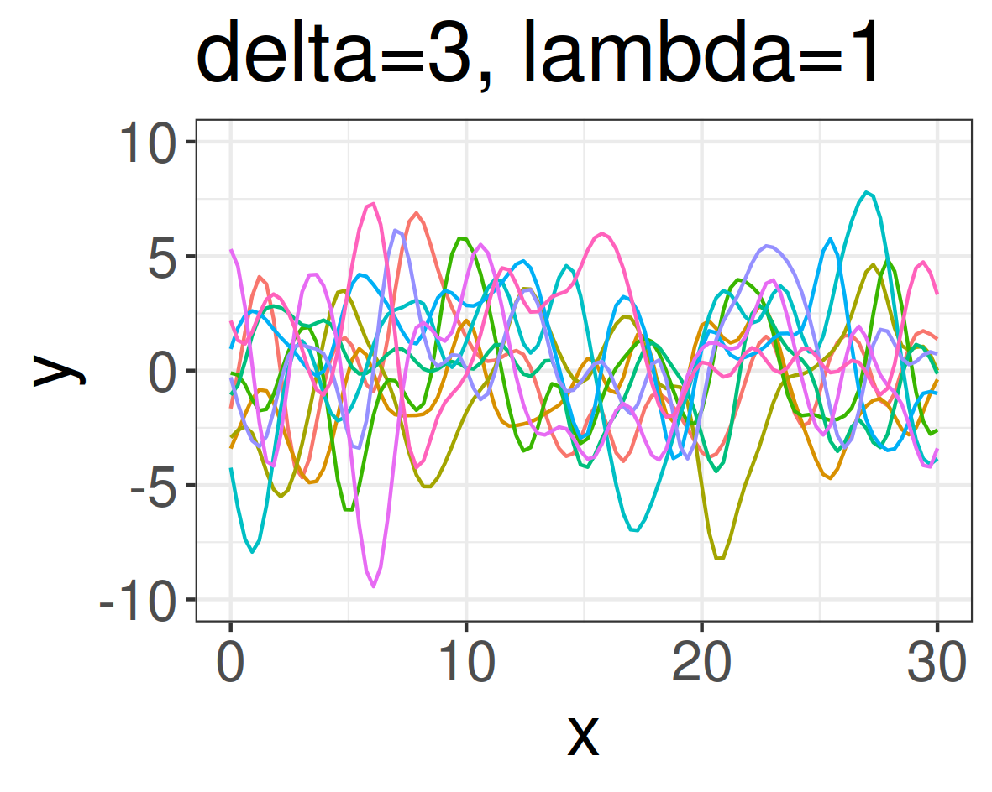
Hyperparameters
amplitude
length scale

Slide 37
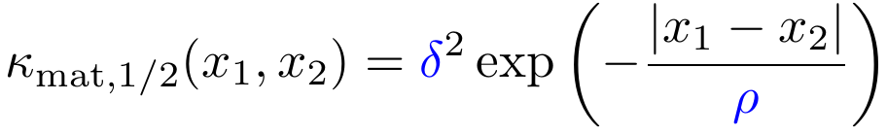
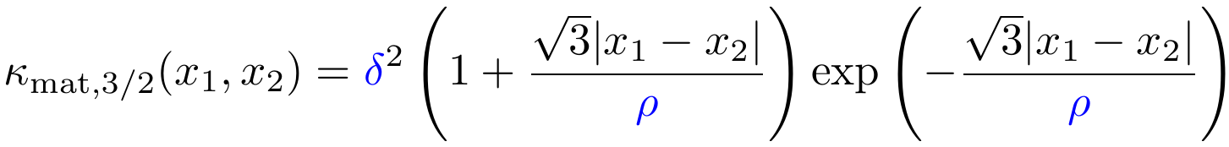
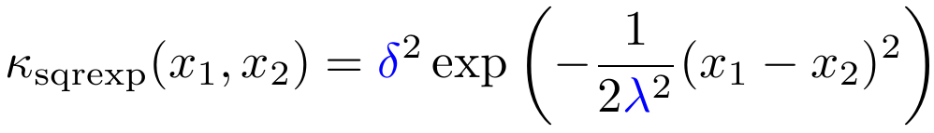
Examples of Gaussian processes

Slide 38
Conditioning on observations

Slide 39
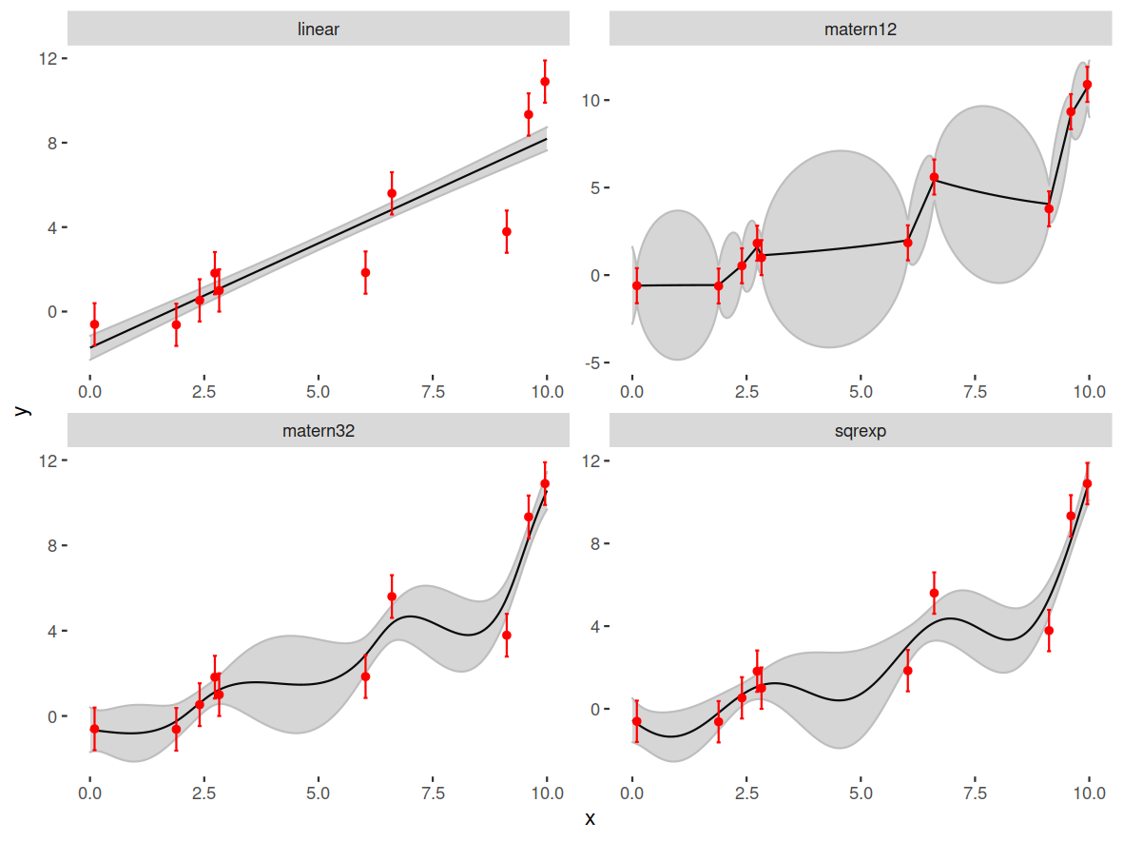
Conditioning on observations

Slide 40




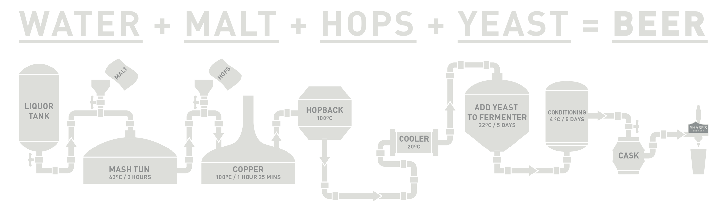

Covariance brewing
Combination rules for covariance functions
Squared exponential covariance functions
Transition kernel

Slide 41
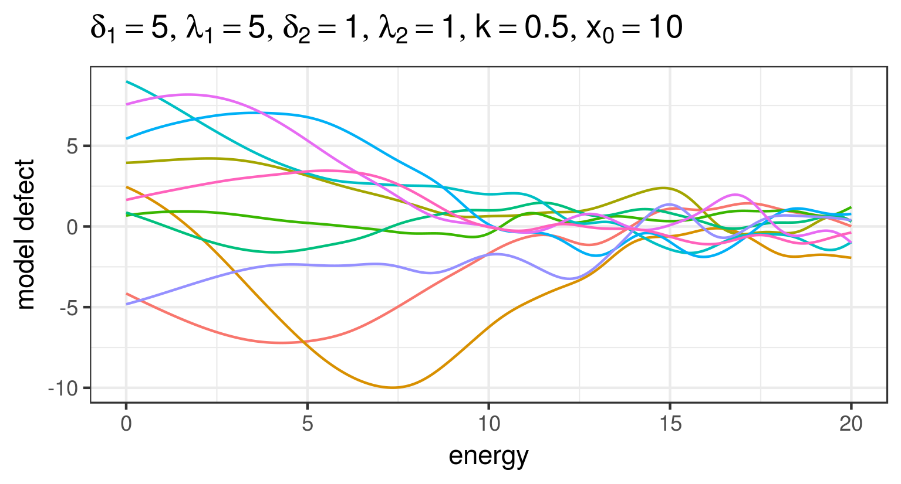
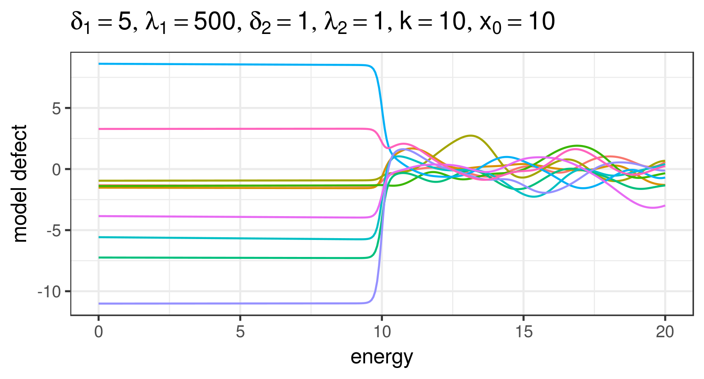
Example of compound covariance function

Slide 42

ML view on GPR
Gaussian process regression is a method to learn a non-linear function f(x) from observations {(xi, yi)}i=1..N
It can be used for regression and classification problems
It is an alternative to other ML techniques, e.g., random forests and neural networks with its own pros & cons

Slide 43

Comparison to neural networks
GP processes
artificial neural networks
Both approaches …
… are methods for classification and regression
… are universal function approximators
Neural networks …
… scale better to large data sets
… are able to capture non-local features
… are difficult to interpret
GP processes …
… are statistical methods from the ground up (uncertainties)
… facilitate the incorporation of prior assumptions
… interface well with existing nuclear data evaluation methods

Slide 44
Useful resources
C.E. Rasmussen, C. K. I. Williams, “Gaussian processes for machine learning”
D. Duvenaud, “The Kernel Cookbook”, https://www.cs.toronto.edu/~duvenaud/cookbook/

