Slide 1
Introduction to nuclear data and applications
Georg Schnabel
Nuclear Data Section
NAPC/IAEA
Joint ICTP/IAEA School on AI for Nuclear, Plasma and Fusion Science
Trieste, 2023

Slide 2
Outline
What are nuclear data?
Where is nuclear data needed?
How are nuclear data produced?
Where are nuclear data maintained and stored?

Slide 3
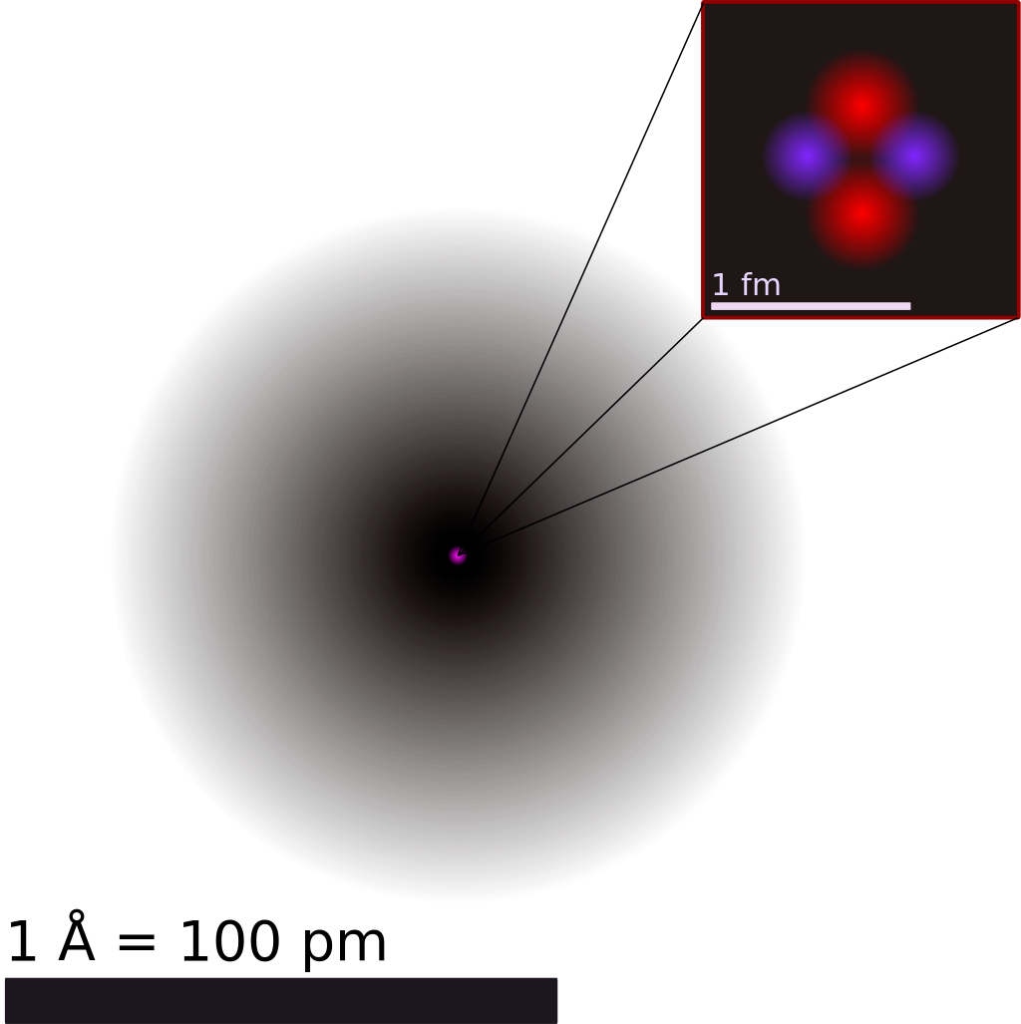
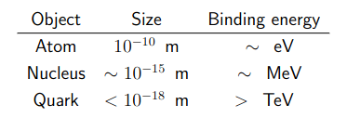
Simple definition of Nuclear Data
Nuclear data represents a collection of information and properties related to the atomic nuclei and their interactions.
1 MeV ≈ 1.602*10⁻¹³ Joules
Wikipedia, User Yzmo (CC BY-SA 3.0)

Slide 4
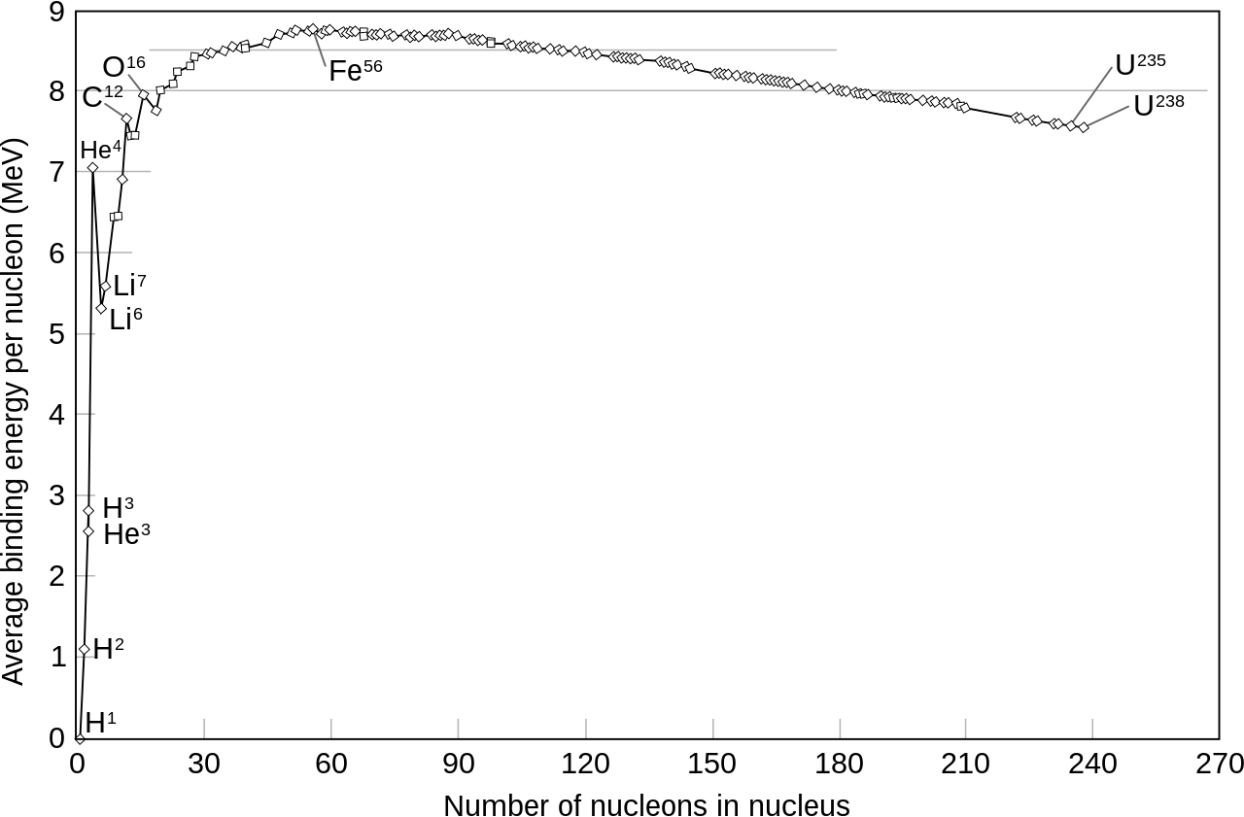
Some properties of the nucleus
Atomic number (Z): number of protons
Mass number (A): number of nucleons
Binding energy
Spin and parity
Example specification: ¹⁹⁷Au

Slide 5
Nuclear reaction
B
A
a
residual
projectile
target
b
ejectile
a + A → b + B
A(a,b)B
Q-value: amount of energy released in reaction
Q = masses (before) – masses (after)
= Ma + MA – MB - Mb

Slide 6

Total cross section
interaction
no interaction

Slide 7
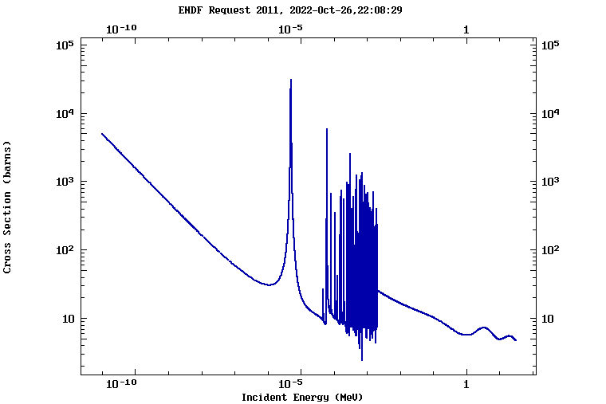
Energy dependence of total cross section
Total neutron-induced cross section of Au-197
1 barn = 10⁻²⁸ m²

Slide 8
Other essential cross sections
interaction

Slide 9
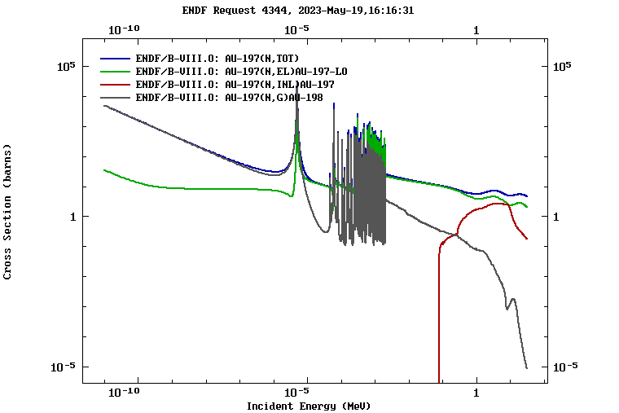
Competition of reaction channels

Slide 10
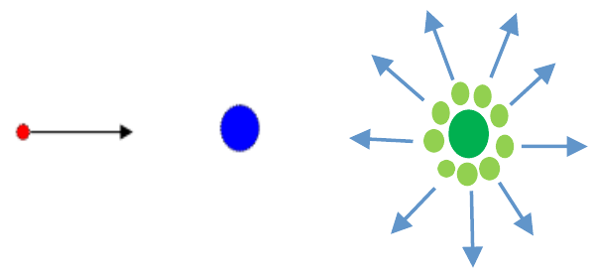
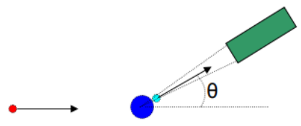
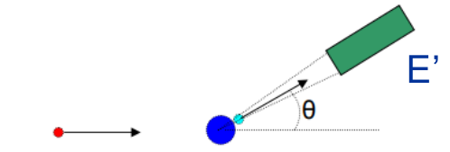
Different types of cross sections
Angle-integrated cross sections
Angular distribution dσ/dΩ
Double-differential cross section d²σ/dEdΩ

Slide 11
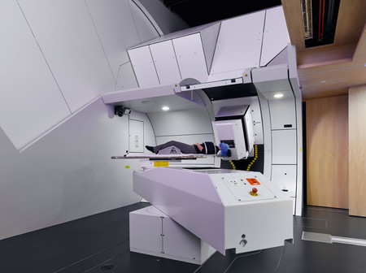
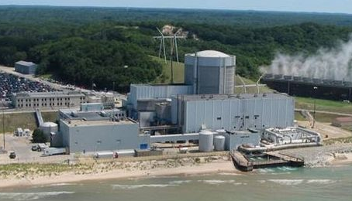
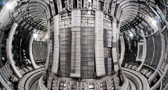
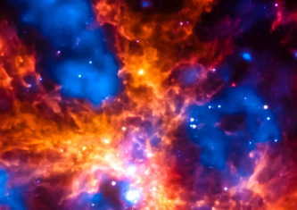

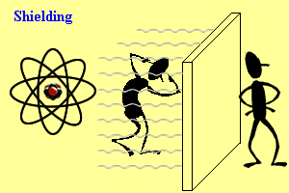
Where are cross section data needed?
Design of nuclear reactors and accelerators
Nuclear medicine and radiation therapy
Nuclear astrophysics
Radiation protection
Fusion research
Space applications
Radioactive waste management
Palisades Nuclear Generating Stations
PSI Gantry 2 facility
Joint European Torus

Slide 12
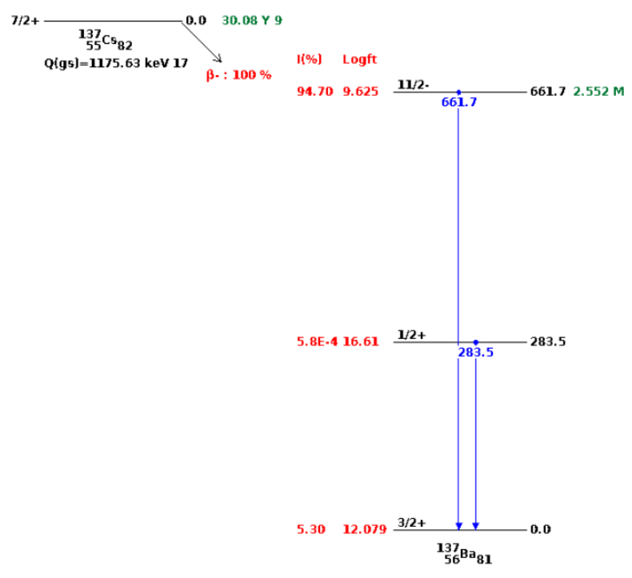
Nuclear structure data
Half-lives
Decay modes: alpha, beta, gamma, etc.
Decay radiation: alphas, electrons, positrons, gammas, etc.
Branching ratios
Levels, spins, parities
Other: multipolarities, conversion coefficients, magnetic moments, Q-values, transition strengths

Slide 13
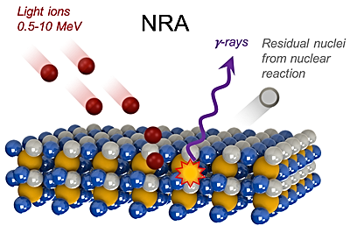

Ion beam analysis
Example: Nuclear Reaction Analysis (NRA)
Image credit: Helmholtz-Zentrum Dresden Rossendorf (HZDR)
https://www.hzdr.de/db/Cms?pOid=10633&pNid=597

Slide 14






Fission process & fisison yields
Prompt decay
Neutron and gamma emission until metastable or ground state
β decay
β⁻ decay until stable (long-lived) nuclides
n
²³⁵U
²³⁶U
⁹⁴Rb
n
β–
Fission fragment yield
¹⁴²Cs
γ
β–
n
n
β–
⁹³Rb
γ
β–
n
γ
n
β–
n
n
¹⁴¹Cs
β–
n
β–
β
β–
β
β–
n
β–
n
β–
β–
Independent yield
Independent yield
Cumulative yield
Cumulative yield
A=141 β⁻ decay chain
Mass chain yield
A=93 β⁻ decay chain
Mass chain yield

Slide 15
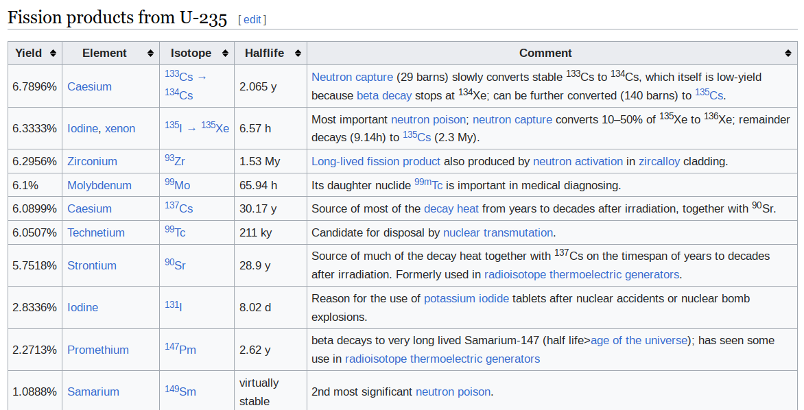
Example of fission product yields
From https://en.wikipedia.org/wiki/Fission_product_yield

Slide 16
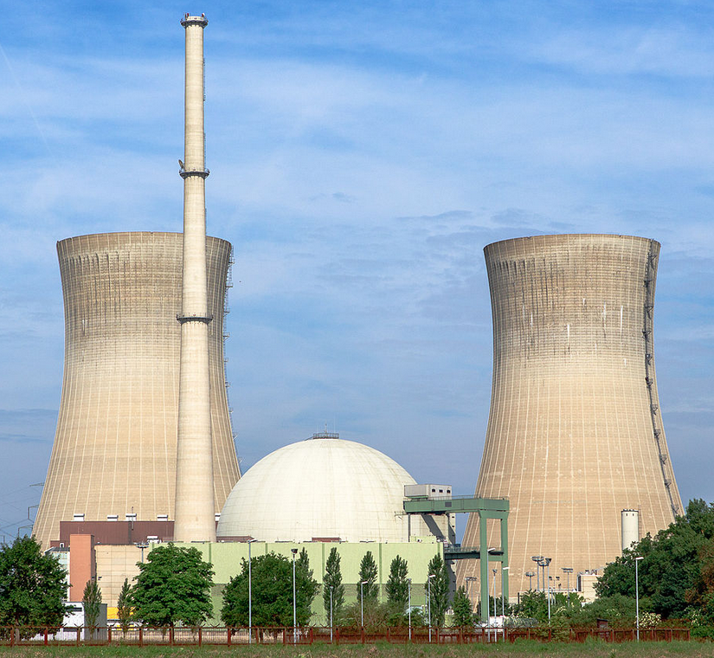
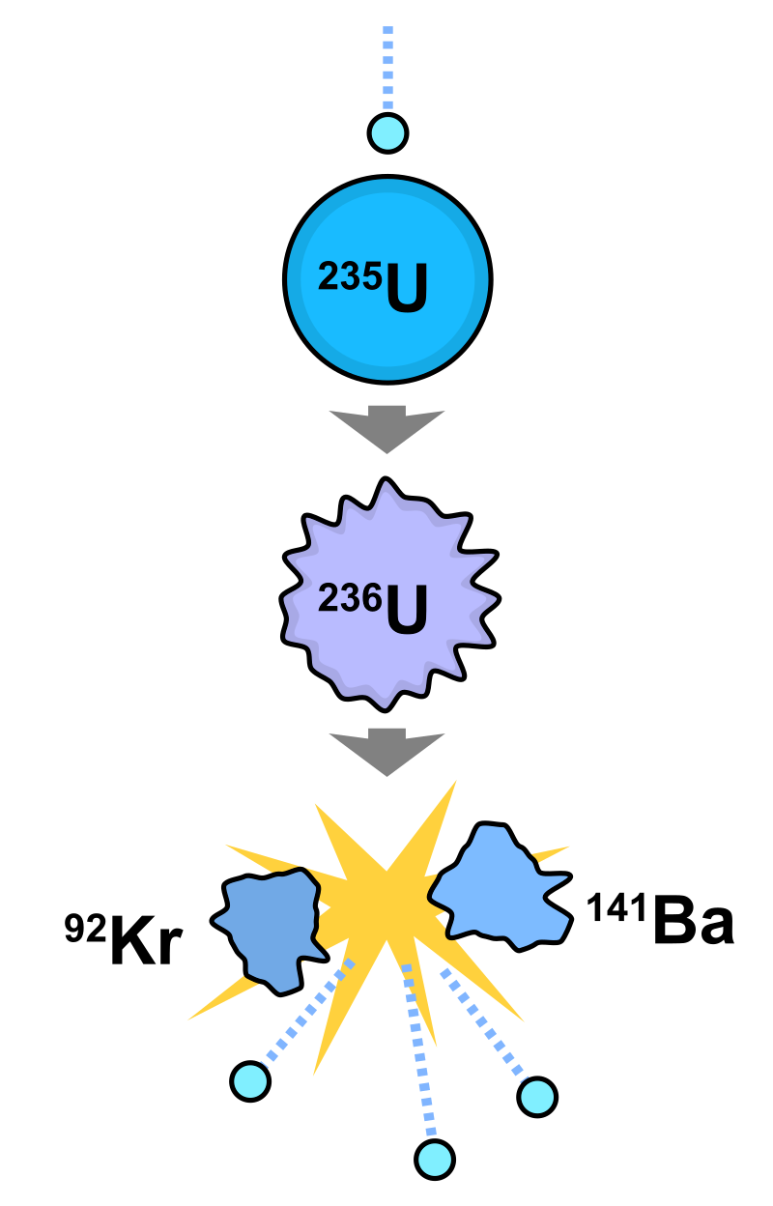
Need for fission yield data
Fuel burnup
Fuel design optimization
Radioactive waste management
Transmutation
Nuclear forensics
...
Wikipedia, User Avda (CC BY-SA 3.0)

Slide 17
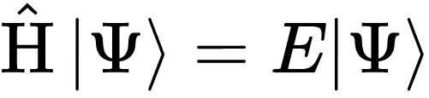

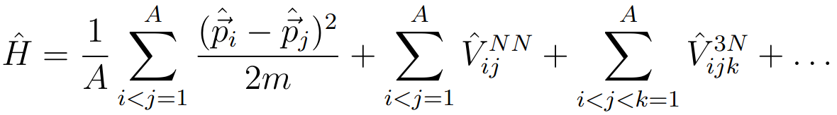
Generation of nuclear data
(ideal world)
“The high-level strategy is to solve the non-relativistic many-nucleon Schrödiner equation with the inter-nucleon interactions as the only input”
From P. Navratil et al, “Unified ab initio approaches to nuclear structure and reaction” (arXiv:1601.03765)

Slide 18
Generation of nuclear data (reality)
Compilation
  Collecting experimental data and ingesting them into databases
Evaluation
  Combining models and experimental data by statistical techniques (Bayesian inference)
Validation
  Assessing the performance of evaluated nuclear data by using them in simulations of benchmark experiments (criticality, shielding, etc.)

Slide 19


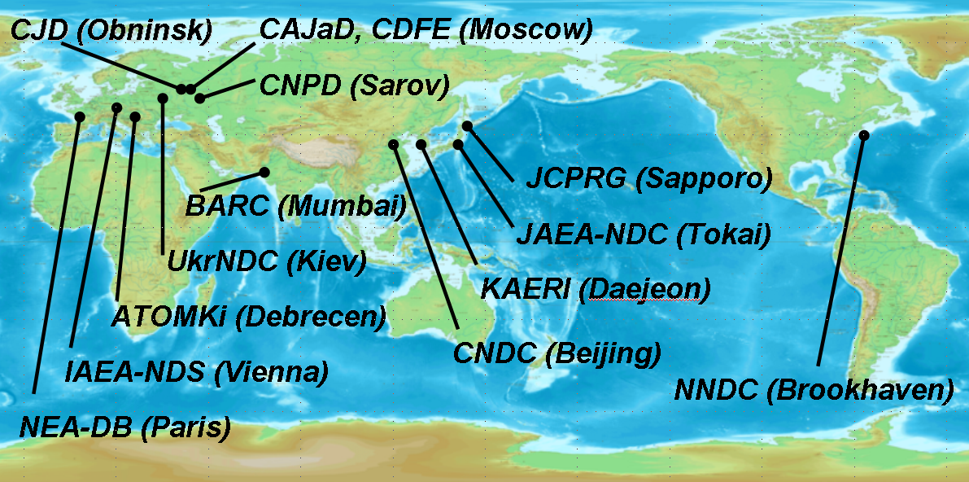
Nuclear Reaction Data Centre Network (NRDC)
NNDC
OECD NEA Data Bank
IAEA NDS
CJD, CDFE, CNPD
ATOMKI
UkrNDC
JCPRG
CNDC
NDPCI
KAERI
Coordinated by IAEA-NDS
(Nuclear Data Section)
Each centre compiles data measured
in its geographical area
(e.g., Data measured in Spain are
compiled by NEA Data Bank in Paris)

Slide 20
EXFOR – Library of exp. cross sections
Collection of numerical experimental data and other quantities
Not only neutrons but also photons, protons, and other charged particles
SUBENT 22006049 20081028
BIB 4 8
REACTION (92-U-238(N,G)92-U-239,,SIG)
SAMPLE Metallic disk 29.872 gram, 50 mm diameter,
0.9 mm thick
STATUS (TABLE) Data submitted by Dr. J.Voignier .
Table V of main reference.
HISTORY (19910125C) S.W.
(19910205E)
(20050716A) Sample data added .
ENDBIB 8
NOCOMMON 0 0
DATA 3 4
EN DATA ERR-T
MEV MB MB
5.0000E-01 1.2200E+02 9.0000E+00
7.2000E-01 1.2770E+02 9.0000E+00
9.0000E-01 1.3160E+02 9.0000E+00
1.1000E+00 1.1440E+02 8.0000E+00
ENDDATA 6
ENDSUBENT 19
²³⁸U(n,γ)²³⁹U cross section measured
in France in 1980s in EXFOR

Slide 21

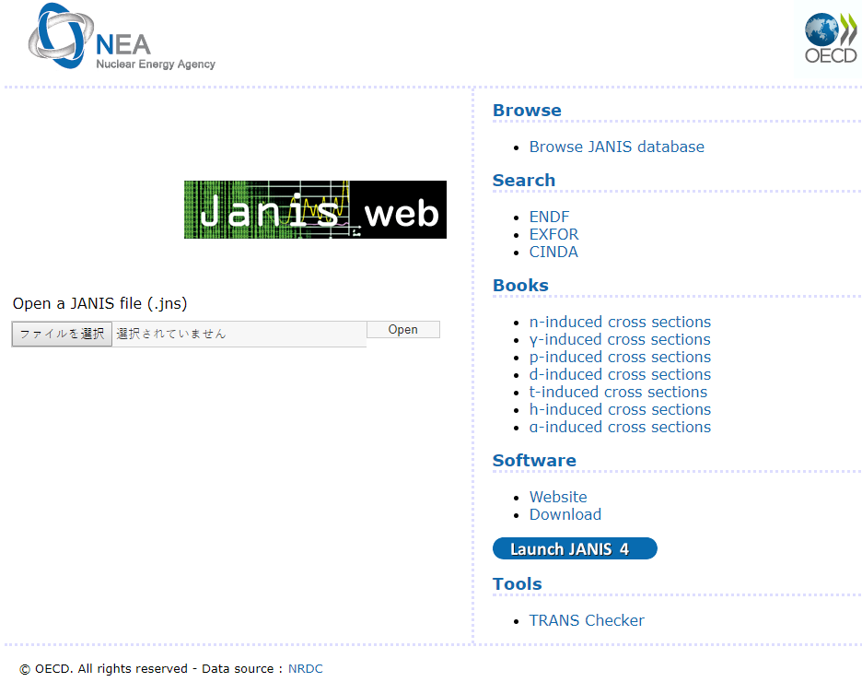
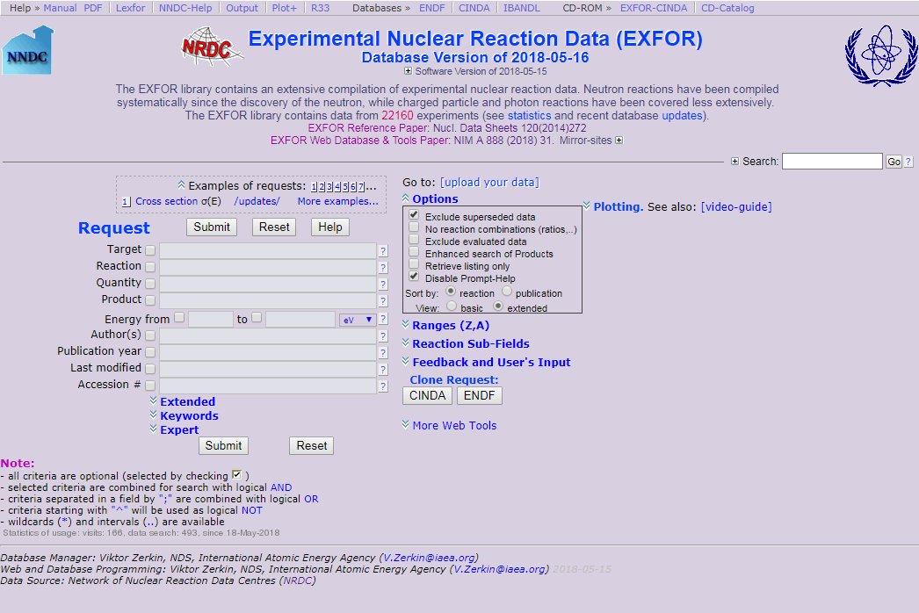

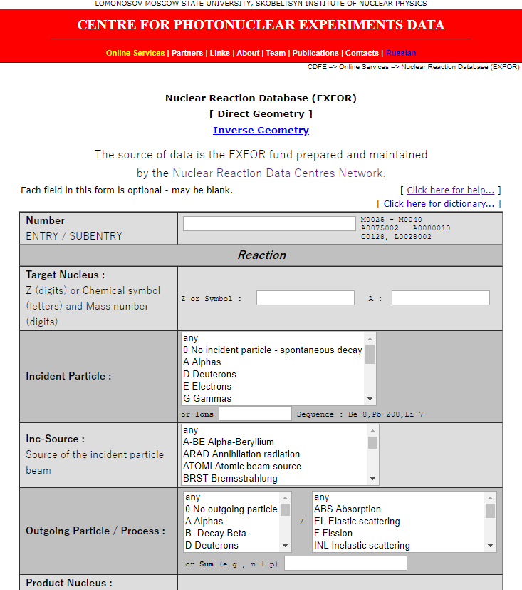
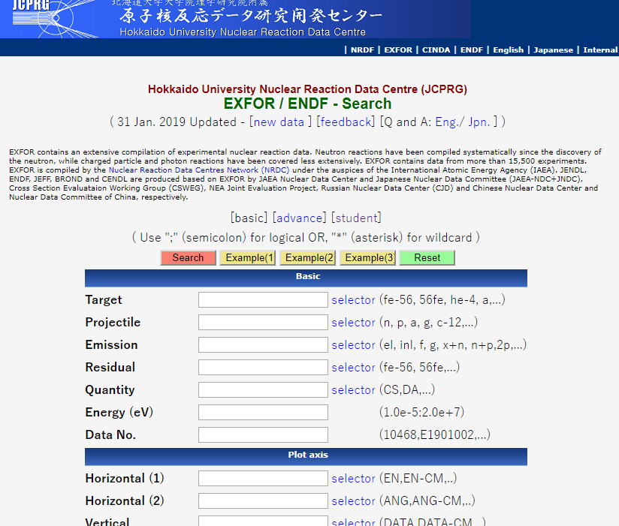
Various access options to EXFOR
EXFOR
Master
http://www.oecd-nea.org/janis/
http://www-nds.iaea.org/exfor/
http://www.jcprg.org/exfor/
http://cdfe.sinp.msu.ru/exfor/

Slide 22
Evolution of EXFOR over time
~22,000 experiments
total
neutron
charged-particle
photon

Slide 23
Nuclear data evaluation
Different approaches depending on energy range and objective of evaluation, e.g.,
  R-matrix fits in the resonance range
  Fits of nuclear models in the fast energy range
  “No-model” fits if lots of data available and accuracy is essential (e.g., neutron data standards)
resonance
range
fast
range

Slide 24
Nuclear reaction codes
R-matrix analysis codes:
  AZURE2, SAMMY (ORNL), EDA (LANL), CONRAD (CEA Cadarache), AMUR (JAEA), FRESCO (LLNL), RAC (Tsinghua), REFIT (GEEL), ...
Nuclear Reaction Codes
  Empire: https://nds.iaea.org/empire/
  TALYS: https://www-nds.iaea.org/talys
  CCONE
  CoH3
  ...
“Compound Nuclear Reactions,”, Proceedings of the 6th International Workshop on Compound-Nuclear Reactions and Related Topics, CNR*18
https://link.springer.com/book/10.1007/978-3-030-58082-7

Slide 25
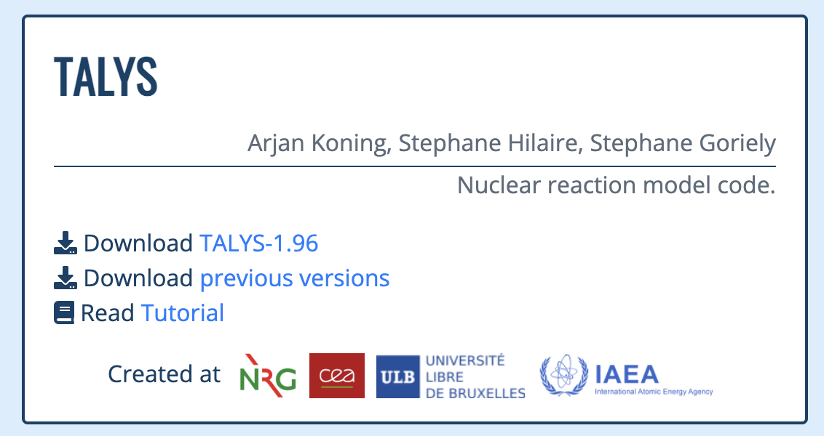
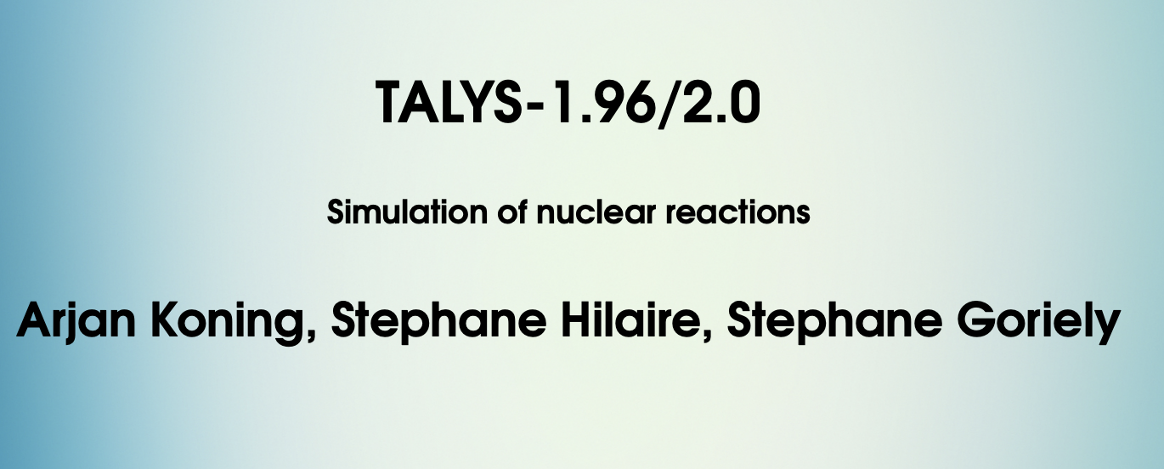
Components in TALYS
Input
Physical parameters
Reaction
models
Multiple
emission
Output
projectile n
element Fe
mass 56
energy 14.0
Nuclear Structure (RIPL-3)
Masses
Discrete levels
Level densities
Resonance parameters
Photon strength functions
Optical model parameters
Fission barrier parameters
Optical model (ECIS)
Local/global OMP
Phenomenological
Semi-microscopic (JLM)
Multiple emission
Hauser-Feshbach
Multiple preeq. exciton
Fission competition
γ-ray cascade
Exclusive channels
Recoils
Fission fragment de-excitation
Output files per reaction channel
Cross sections
Total
Exclusive: (n,γ), (n,f), (n,n’), (n,2n), (n,p) etc.
Per level
Residual production
Particle production
γ-ray production
Emission spectra
Single-differential
Double differential
Recoils
Angular distributions
Elastic
Per level
Particle multiplicities
Fission yields, neutron observables
Astrophysical reaction rates, MACS
…
+ some 400 keywords
Direct reaction
Spherical OMP
DWBA
Coupled-channels
Rotational
Vibrational
Giant resonances
Weak-coupling
Other
Fission fragment distributions
‘Best’ nuclear model parameters optimised to experimental reaction data
Compound reactions
Hauser-Feshbach
Width fluctuations
Blatt-Biedenharn ang. dis.
Particle, photon and fission transmission coeff.
γ-ray emission
Pre-equilibrium reactions
Exciton model
Particle hole level density
Kalbach systematics
Angular distribution
Cluster emission
γ-ray emission
Phenomenological parameters
Microscopic tables

Slide 26

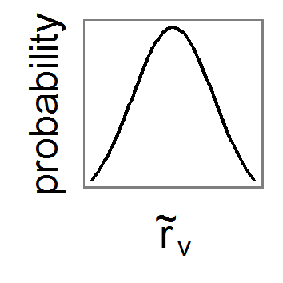
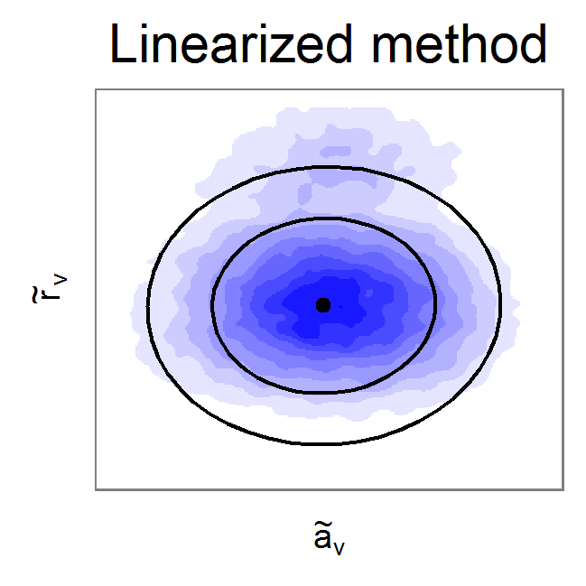
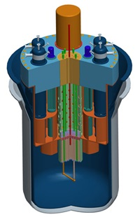


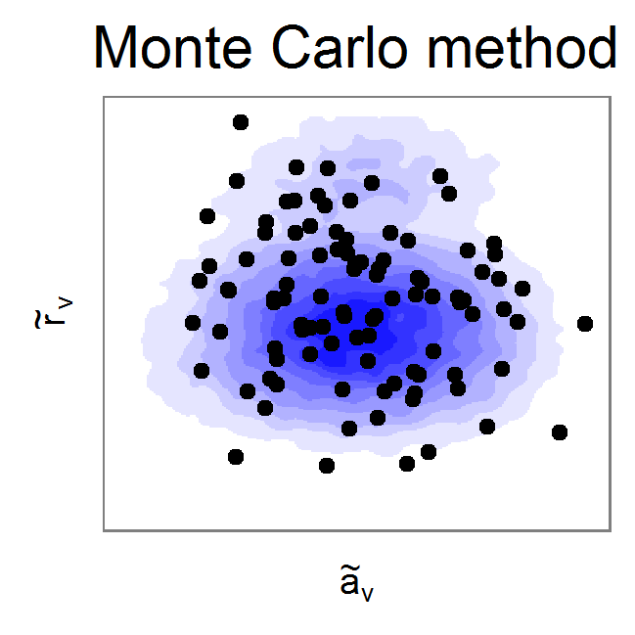
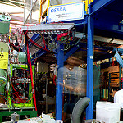

Model-based evaluation
Models
Simulation/
Validation
Evaluation method
ENDF
+
Cov
Perturbation Theory
Processing
Experiments
ENDF #1
ENDF #2
Total Monte Carlo
...
MCNP, OpenMC, Geant4, etc.
EXFOR

Slide 27
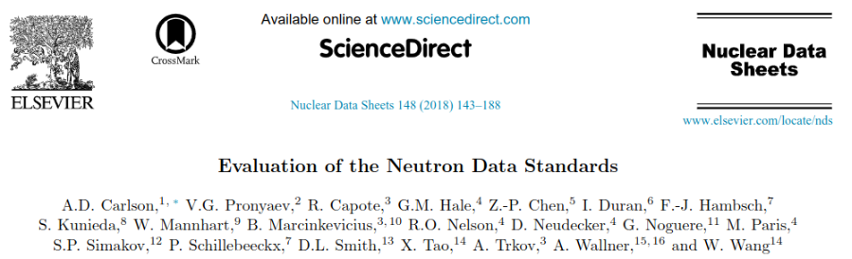
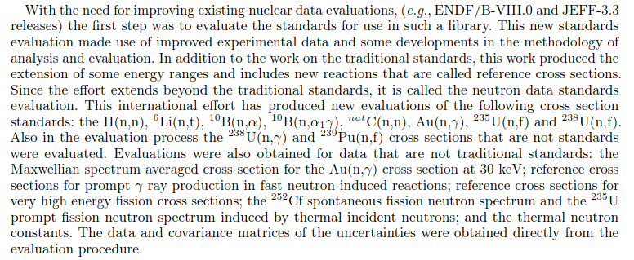
Evaluation example without nuclear models

Slide 28
Consistent evaluation of multiple reaction channels (without nuclear model)
SG-Pu9 / Pu9(n,f)
abs
Pu9(n,f) / U8(n,f)
abs
Pu9(n,f) SACS
abs
Pu9(n,f) / U5(n,f)
abs
Pu9(n,f) /
[10B(n,a0) + 10B(n,a1)]
shape
Pu9(n,f)
abs
U8(n,g) / Pu9(n,f)
shape
Pu9(n,f) / U5(n,f)
shape
Pu9(n,f) / 6Li(n,a)
shape
Pu9(n,f) / U8(n,f)
shape
Pu9(n,f)
shape

Slide 29
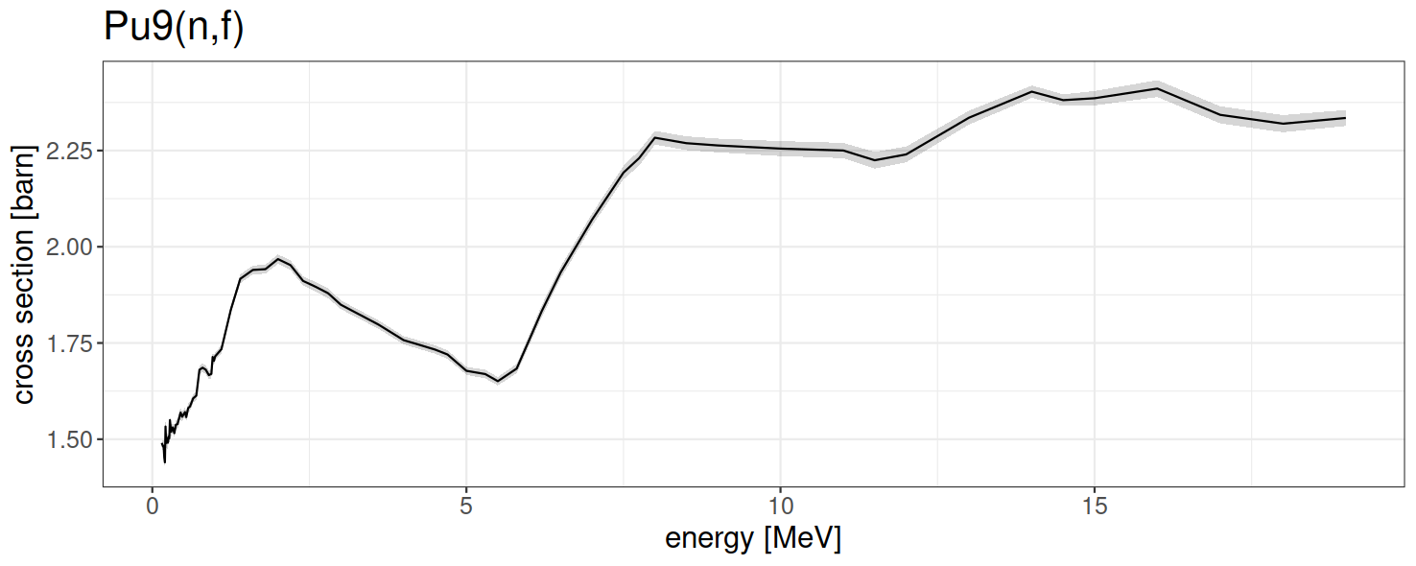
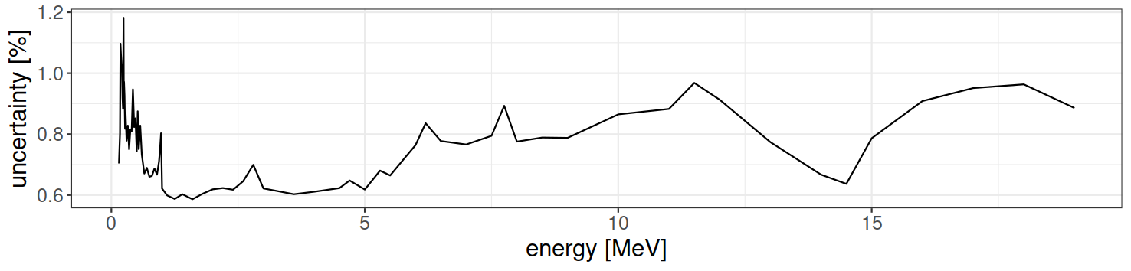
Evaluation: Estimated excitation function with uncertainty band

Slide 30
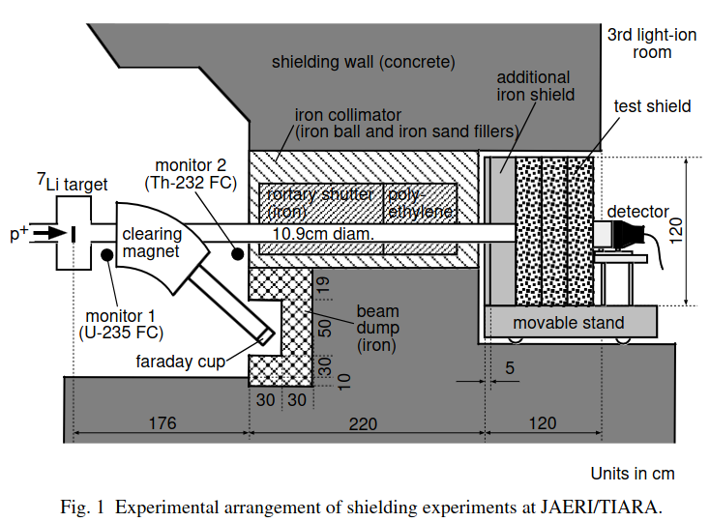
Validation with Integral benchmarks
From: C. Konno, Y. Ikeda, K. Kosako, “DORT Analysis of Iron and Concrete Shielding Experiments at JAERI/TIARA with P7 and P9 Approximated LA150 Multigroup Libraries” (2000)

Slide 31
Nuclear Data Libraries
Storage and dissemination of nuclear data
Libraries associated with regions/countries:
ENDF/B (USA), JEFF (Europe), JENDL (Japan), CENDL (China), BROND (Russia)
Other/Project based libraries:
FENDL, IRDFF-II, Neutron Data Standards, Photonuclear (IAEA), TENDL (TALYS), ...
Graphical interface to content of libraries: https://nds.iaea.org/exfor/endf.htm

Slide 32
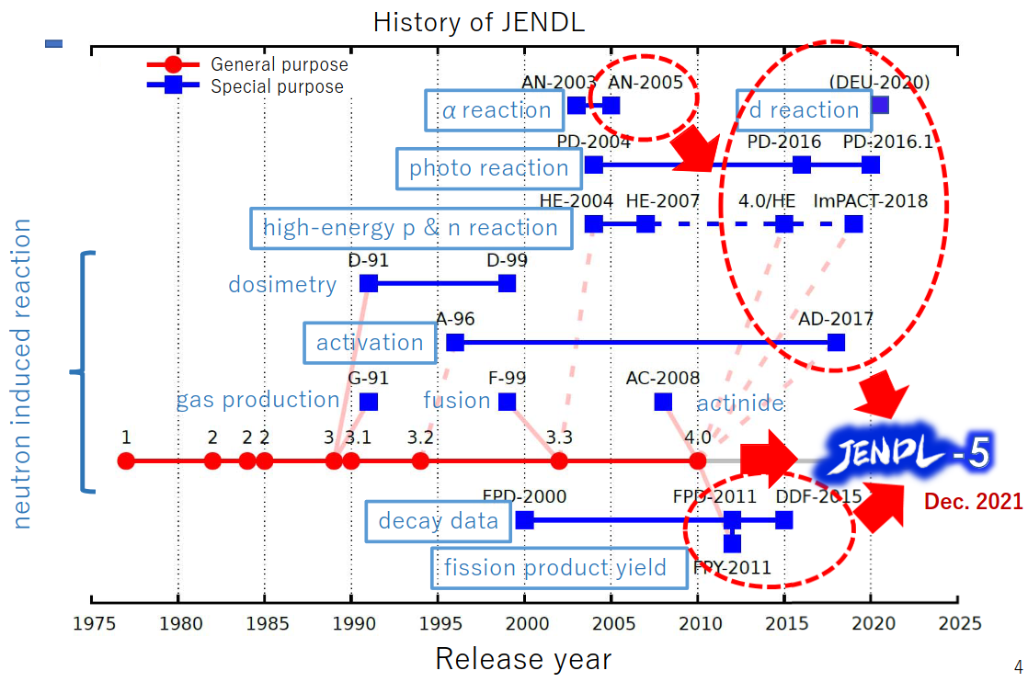
Example JENDL
Slide: Courtesy of Osamu Iwamoto

Slide 33
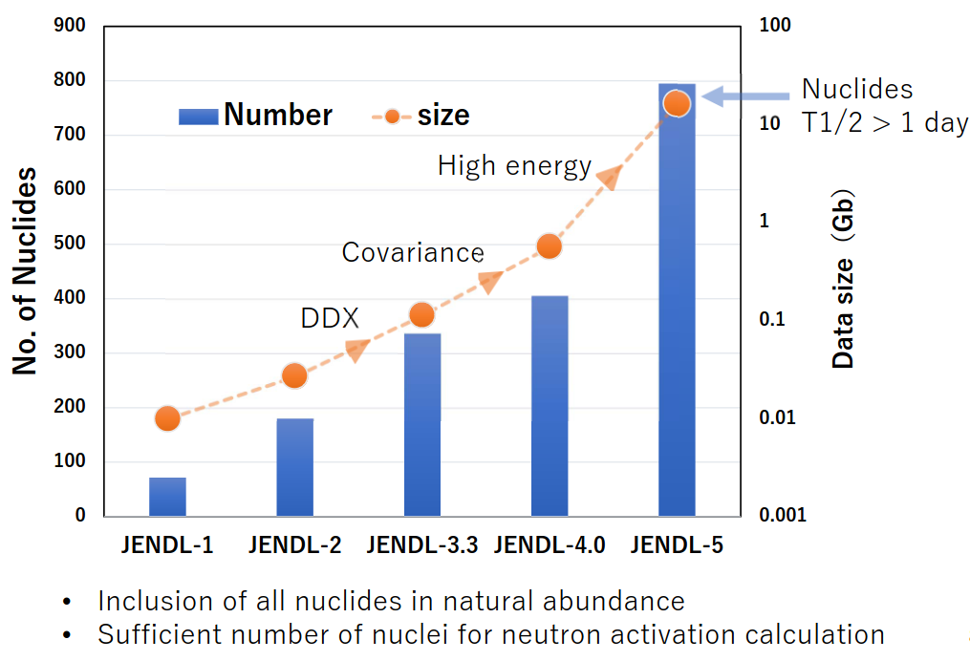
Example JENDL
Slide: Courtesy of Osamu Iwamoto

Slide 34
Summary
Nuclear data: quantities associated with nuclear reactions (cross sections, Q-values, etc.) and nuclear structure (level energies, spin, parity, etc.)
Wide range of applications (e.g., nuclear medicine, reactor design, fusion research)
Ab-initio calculations challenging, therefore production of nuclear data relies on experimental data and nuclear models
Statistical methods are used for an evaluation to combine various sources of data (models and measurements)

Slide 35
Acknowledgments
Thanks to my colleagues Daniel Lopez Aldama, Vivian (Paraskevi) Dimitriou, Osamu Iwamoto, Arjan Koning, Shin Okumura, Naohiko Otsuka and Jean-Christophe Sublet for sharing parts and visuals of some of their presentations

