Slide 1

Aircraft_dynamics.jl
Open Source Aircraft Design Software
Contact: George Schreck
Email: george.schreck@gmail.com
Phone: 919-418-0542

Slide 2
Problems
Open source or inexpensive software does not exist to do the end to end calculations of a sub-sonic, fixed wing aircraft
Much of the software that is available requires extensive training to use effectively
Multiple software packages exist that perform part of the solution, e.g. XFLR
A significant number of designs have been produced that are inefficient, unstable or just plain unsafe.

Slide 3
Goals
Produce a single, extensible library of software routines that can perform many of the calculations in basic aircraft design
Provide a wrapper program that executes the library to analyze a basic aircraft design
Flag potential design problems that violate best known design practices
Code the software using a modern scientific, open source language
Provide the source and examples that can be used to help understand the tool
Write the software as a collaborative learning exercise

Slide 4
High Level Initial Architecture
Aircraft Model Generated in CAD
Excel Intermediate Data File
Julia Control Program
Julia Design Rule Checker
Report Writer
Julia programming language was chosen because, since its inception at MIT, it has gained a great deal of support worldwide by universities as well as industry
It has many of the same features as Matlab and Python
The software is deliberately written as a library of subroutines that can be independently modified, tested or added to as necessary to improve operation or enhance capabilities

Slide 5
Software Status
Experiments have been run to use named variables in Solidworks to generate the required data for the Intermediate Data file. This work is still in its infancy. Note, that any CAD system could be used. There is no attempt to use a particular tool.
Excel Intermediate Data File contains formatted data with preset variable names. It does not require particular data ordering or units. It converts all units to metric and stores the data within the program. This file can be generated by a CAD system with scripting or “by hand”. The software ignores additional variables it doesn’t require.
The Julia control program and software libraries are in work with some features demonstratable. There are about 24 discrete calculations that are being reported. Additional support subroutines are included in the library. The code base is approximately 800 lines and growing. Some of the code is ‘demonstration code” that can be rewritten to execute more efficiently.
The design rule checker and report writer are not started.

Slide 6
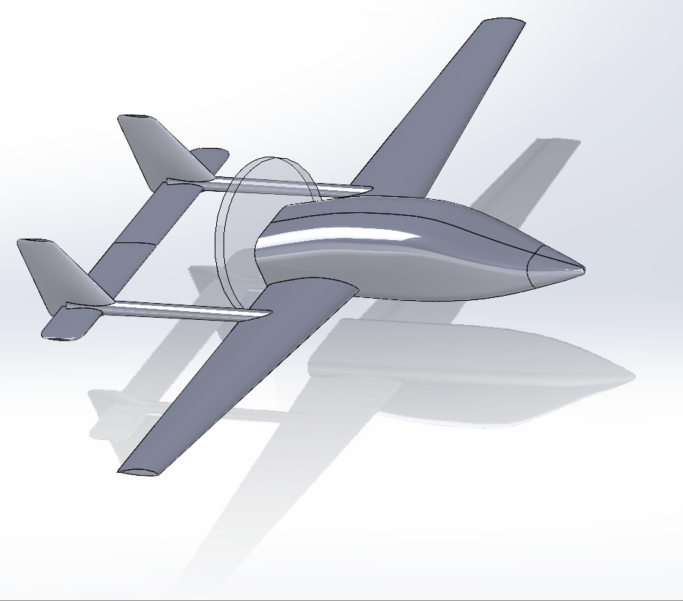
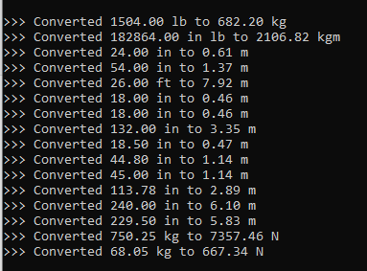
Example Input File
The model above was generated in Solidworks and serves as the basis for the test design
The spreadsheet at the right was hand generated from the CAD data.
The black box at the right contains the Julia processor adjusting the units to be appropriate for each calculation performed

Slide 7
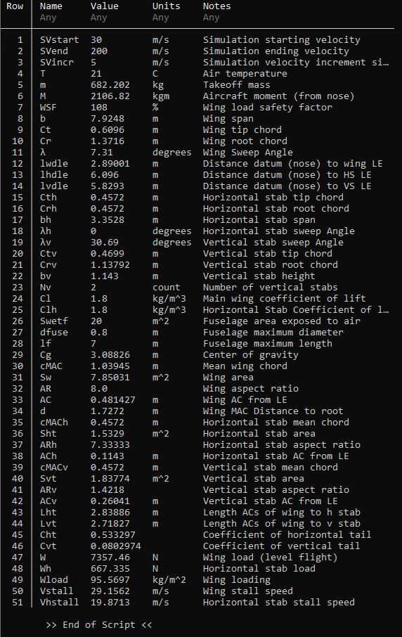
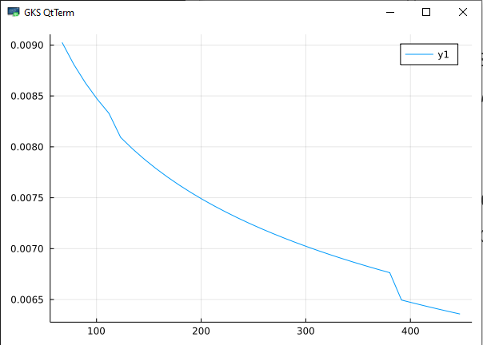
Current Output Data
The output at the left is the internal data matrix that is used for storing the aircraft data. Rows 1 – 28 match the data being read in. The balance are calculated values.
The software adjusts the units to remain consistent for each calculation type. Ultimately, the report generator will determine the output units
The graph at the bottom represents the first unformatted drag plot generated from the calculated Reynolds number using the velocity and fuselage dimensions. Note that it is currently not interpolating the skin friction drag curves, hence the steps in the graph

Slide 8
Next Steps
The potential for development of the product is limited to the size of the team’s imagination.
Near term goals:
Completing the calculations for static analysis of the aircraft design: additional drag components, basic performance, stability, etcetera
Update all coordinate calculations to 3D
Improve some of the calculation accuracies
More tightly integrate airfoil shapes into the calculations
Start building the framework for design rule checking the aircraft design
Add control surface forces to enable control system design
Longer term goals:
Add a detailed report generator, with graphs and information on design margins against design rules
Add dynamic modeling/predictions

Slide 9
Closing Thoughts
The intent is to move the software to an open source repository for further development.
It will be provided under one of the standard open source licenses.
Hopefully, it will be embraced by multiple people to carry the torch of learning, improvement and enhancement while providing a tool to improve safety and design consistency

